Slide 1
IUGG
Update
TT TWO - TT DMP JOINT, 22 Feb 2022
Item J8
Laura Kong, ITIC

Slide 2
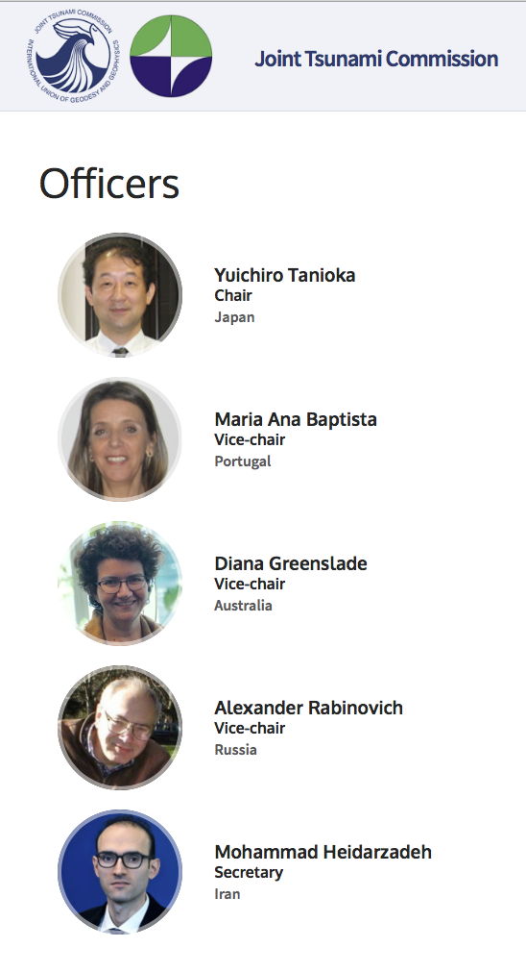
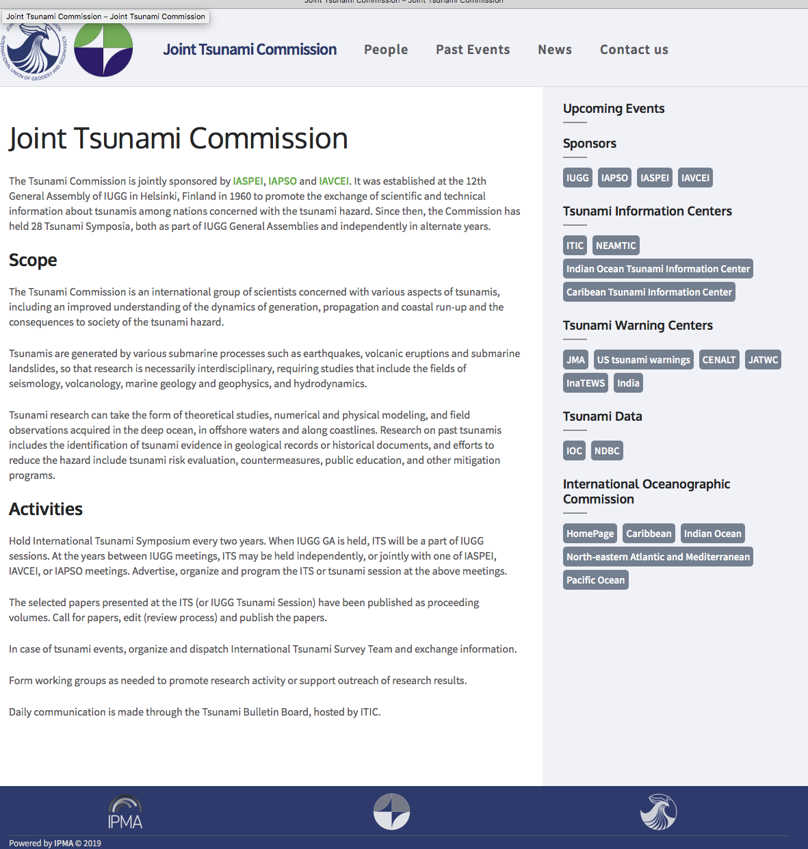
IUGG Joint Tsunami Commission
Est 12th General Assembly of IUGG, 1960
Promote the exchange of scientific and technical information about tsunamis among nations concerned with the tsunami hazard
Last Business Meeting: 2 July 2022
Working Groups
Tsunami Terminology – William Power, NZ
Science-based Tsunami Warning - Laura Kong, USA
Tsunami Magnitude - Vasily Titov, USA
GNSS Data for Tsunami Warning - Tony Song, USA
Meteotsunami - Ivica Vilibic, Croatia
Tsunami Data – Slava Gusiakov, Russia
Elected 2019
https://tsunamicommission.ipma.pt/home/

Slide 3
Meetings and Publications – 2019-2021
Since 1960, 28 Tsunami Symposia, both as part of IUGG General Assemblies and independently in alternate years.
International Tsunami Symposium, during the 27th IUGG General Assembly (Montreal, Canada, July 8-July 18, 2019). JP05 Tsunamis.
The 30th International Tsunami Symposium (on-site and online) (Sendai, Japan, July 1- July 3, 2021). The best poster awards (for young researchers) were presented to Dr. Makinoshima (Japan), Ms. Shinka (Japan), Dr. Salmaidou (UK).
Publications
Twenty five years of modern tsunami science following the 1992 Nicaragua and Flores Island tsunamis, Volume I, 22 papers, Pure and Applied Geophysics, 2019, Editors: U. Kanogle, Y. Tanioka, E.A. Okal, M.A. Baptista and, A.B. Rabinovich.
Twenty five years of modern tsunami science following the 1992 Nicaragua and Flores Island tsunamis, Volume II, 25 papers, Pure and Applied Geophysics, 2020, Editors: U. Kanogle, Y. Tanioka, E.A. Okal, M.A. Baptista and, A.B. Rabinovich.
Illapel, Chile, earthquake on September 16th, 2015, Topical collection in Pure and Applied Geophysics, 22 papers published online.
The 2016 Kaikoura, New Zealand, tsunamis. Topical collection in Pure and Applied Geophysics, 7 papers publ online.
Sea Level 2017. Topical collection in Pure and Applied Geophysics, 7 papers published online.
The Central Italy earthquake crisis with onset August 24, 2016. Topical collection in Pure and Applied Geophysics, 7 papers published online.
The September 2017 Chiapas and Central Mexico earthquakes and tsunamis. Topical collection in Pure and Applied Geophysics, 6 papers published online.

