Slide 1
DECADE TSUNAMI PROGRAMME AND IOC UNESCO TSUNAMI READY RECOGNITION PROGRAMME
FROM MEETING OF THE INTER-ICG TASK TEAM ON DISASTER MANAGEMENT AND PREPAREDNESS
INTERGOVERNMENTAL OCEANOGRAPHIC COMMISSION UNESCO
21 - 22 February 2022 - On-line
TOWS Task Team on Disaster Management and Preparedness (TT-DMP) Members
and Observers
Cecilia Valbonesi- WG4 CHAIR

Slide 2
5. TSUNAMI READY PROGRAMME – PROPOSAL FOR ENDORSEMENT BY IOC
Dr Laura Kong, Director of International Tsunami Information Centre (ITIC) introduced a document on Tsunami Ready Programme for TT-DMP discussion and approval for recommendation to the TOWS-WG-XV, and eventual endorsement by IOC at its next Governing meeting in June 2022.
The intent is to transition from a Pilot to a Programme.
This document presents the main features of a Programme (i.e., aim, planning, promotion, scientific and technical guidance, standard-setting, among others).
The document highlights that the Tsunami Ready Recognition Programme is an international community-based recognition programme developed by UNESCO/IOC. It aims to build resilient communities through awareness and preparedness strategies that will protect life, livelihoods, and property from tsunamis in different regions.
In June 2021, the IOC Assembly through IOC Decision A-31/3.4.1 - Warning Mitigation Systems for Ocean Hazards. approved the establishment of the IOC Ocean Decade Tsunami Programme, with the aim of making 100% of communities at risk of tsunami prepared for and resilient to tsunamis by 2030 through the implementation of the UNESCO/IOC Tsunami Ready Recognition Programme and other initiatives.
The implementation of the Tsunami Ready Recognition Programme will be a key contribution to achieving the societal outcome ‘A Safe Ocean’ of the Ocean Decade.
The proposal is attached to this Report as Annex A.

Slide 3
5. TSUNAMI READY PROGRAMME – PROPOSAL FOR ENDORSEMENT BY IOC
Recommendations to TOWS-WG:
Recommends to include both “UNESCO” and “IOC” in the name of the Programme, i.e. “UNESCO/IOC Tsunami Ready Recognition Programme”,
Recommends the establishment of an UNESCO/IOC Tsunami Ready Recognition Programme, as described by the TT-DMP Working document on the UNESCO/IOC Tsunami Ready Recognition Programme (Annex A of this Report),
Recommends further the addition of the task to facilitate the UNESCO/IOC Tsunami Ready Recognition Programme to the Terms of Reference of each ICG Tsunami Information Centre (TIC).

Slide 4
6. NEW PROJECTS, INCLUDING OCEAN DECADE ACTIONS
NEAM
Mr. Denis Chang Seng, ICG/NEAMTWS Technical Secretary reported on the new UNESCO/IOC and European Union (EU) Directorate-General for European Civil Protection and Humanitarian Aid Operations (DG-ECHO) CoastWAVE project “Strengthening the Resilience of Coastal Communities in the North-East Atlantic and Mediterranean Region to the Impact of Tsunamis and Other Sea Level Related Coastal Hazard”.
The CoastWAVE project is currently being implemented in seven countries: Cyprus, Egypt, Morocco, Greece, Malta, Turkey, and Spain; and it will also involve the technical expertise and advice of Member States such as Italy and France who are already implementing Tsunami Ready communities. The project aims to improve understanding of tsunami and sea-level related risks perceptions (tsunami, storm surge and sea-level rise), develop better communication strategies, enhance real-time detection and monitoring capacities, improve alert and warning capacity and eventually implement at least seven Tsunami Ready recognized communities by 2023 in the seven selected countries. The project will build upon the JRC Last Mile Projects implemented in Greece, Malta, and Turkey.
A Project Assistance (Finance and Administration) and Associate Project Officer have recently been recruited. They will report to the TT-DMP in 2023. Project implementation is based on a flexible and adaptable time frame within the project lifetime of 2.5 years due to COVID-19.

Slide 5
6. NEW PROJECTS, INCLUDING OCEAN DECADE ACTIONS
Indian Ocean
Mr. Ardito Kodijat presented a report on new projects in the IOTWMS. The UNESCAP TTF-29 - Phase 2 project, “Strengthening tsunami early warning in the North West Indian Ocean region through regional cooperation”, was launched in December 2021. The participating Member States of the project include India, Iran, Pakistan, Oman and the United Arab Emirates. The two objectives of the second phase of the project are to complete the finalization of Phase-1 remaining activities in tsunami risk knowledge and strengthening of national tsunami warning chains and to gap analysis and development of guidance on tsunami inundation mapping and evacuation planning in the NWIO region.
The IOTIC BMKG Programme has requested funding to support the following activities: 1. Indian Ocean Regional Workshop (proposed); 2. Development of Tsunami Ready Tools (proposed); 3. OTIC and IOWave Website (proposed).
In addition, the IOTIC BMKG Programme plans to develop a UNESCO-IOC Tsunami Ready Recognition online application. The online application will allow the National Tsunami Ready Board to select the region of the nominated village, complete indicators checklist and document attachments, as well as workflow to the IOC Secretariat, TIC, and ICG of the region to access the files. Presently, the Tsunami Ready Recognition online application platform is in an early discussion phase.

Slide 6
6. NEW PROJECTS, INCLUDING OCEAN DECADE ACTIONS
Pacific
The ITIC has received funding from US to implement Tsunami Ready in the Republic of Marshall Islands, Federated States of Micronesia, and Palau, as well to assist in Fiji.
Caribbean
Nine (9) new Tsunami Ready Communities are scheduled to be recognized (1 each in Dominica, Dominican Republic, Grenada, Jamaica, Saint Lucia, St. Vincent and the Grenadines, and Trinidad and Tobago, and 2 communities in Barbados) in 2022. Additionally, Anguilla (territory-wide) and the communities of St. Patrick, Grenada and Fort Liberte, Haiti are up for renewal.
The IOCARIBE-led UN Decade Actions for CARIBE EWS include two new projects:
1. Integrating Coastal Hazard Early Warning Systems and Services for the Tropical Americas and Caribbean (iCHEWS TAC)
2. TAC Ocean Observing and Forecasting System (TAC-OOS)
A total of 34 Member States and Territories in the region will benefit from the iCHEWS TAC Project. Key objectives of the project include prioritizing the integration of existing and new coastal hazards early warning systems and services considering four components: Monitoring and Warning, Risk Knowledge, Warning Dissemination and Communication, and Response Capabilities, supported by capacity development. In addition, other ocean-related hazards and their impacts will be considered including tropical cyclones, climate change, tsunami, sargassum, wastewater, oil spills, and coral bleaching.
CARIBE EWS also reported that it will participate in the Ocean Decade: Safe Ocean Laboratory which will take place from 5-7 April 2022. Themes to be addressed include blue line modeling and GIS to identify tsunami and other coastal inundation limits, warning and responding to atypical tsunamis and SMART Subsea Cables.

Slide 7
J9. PLANNING FOR OCEAN DECADE
Science Committee progress and plans:
Dr Srinivas Kumar, Chair of the Ocean Decade Tsunami Programme (ODTP) Scientific Committee (SC), reported on the progress and plans following their initial meeting on 17th February 2022.
He underlined that the UN Ocean Decade (2021-30) is a once-in-a-generation opportunity to address gaps in tsunami warning, enhance community preparedness and contribute to “A Safe Ocean”. The IOC Assembly 31 (Dec. A-31/3.4.1) established the Ocean Decade Tsunami Programme Scientific Committee to Develop Research, Development & Implementation Plan to focus on Technological and Observational Advances to reduce uncertainties with the aim to have 100 % at-risk communities prepared and resilient to tsunamis by 2030 (Tsunami Ready, etc.).
The figure below shows the structure of the ODTP -SC in relation to other IOC governing structures, including TOWS-WG, TT-DMP, TT-TWO etc.

Slide 8
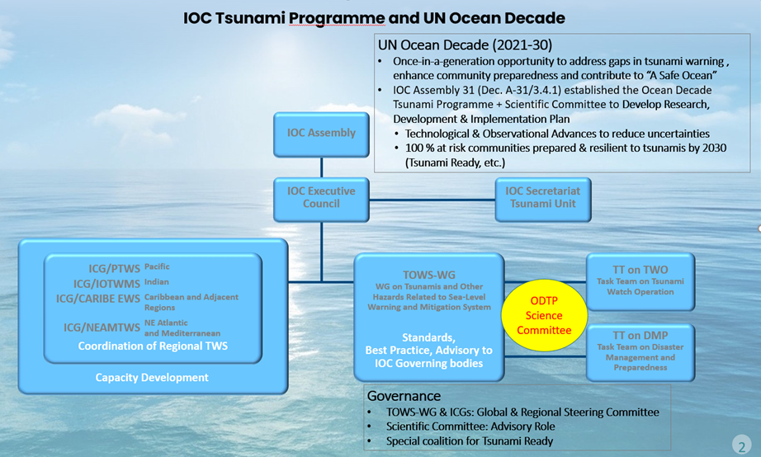
J9. PLANNING FOR OCEAN DECADE

Slide 9
Tsunami Ready Coalition
Mr. David Coetzee, (former) Chair of TT-DMP summarized the report of a meeting of the TT-DMP in October 2021, at the request of the Chair of the TOWS-WG, to advise on the composition and mandate of the special Tsunami Ready Coalition. The report is available on the meeting website.
It covered:1) the proposed Coalition mandate, goals and objectives; 2) Composition, and 3) Challenges in the functioning of the Coalition.
Recommendations to TOWS-WG:
Notes the report and proposals of the TT-DMP with regards to the special Tsunami Ready Coalition
Agrees to incorporate the proposed goal, objectives, scope and composition in the terms of reference for the tsunami Ready Coalition.

Slide 10
TSUNAMIS NEXUS WITH OTHER COASTAL HAZARDS (MULTI-HAZARD EARLY WARNING SYSTEMS)
Recommendations to TOWS-WG:
Notes with appreciation the efforts of the CARIBE-EWS and the Secretariat to coordinate and contribute to global initiatives related to MHEWS.
Encourages Member States, ICGs, IOC Tsunami Unit, Tsunami Information Centers and the UN Decade Tsunami Programme to purposely support, contribute to, and manage the integration of tsunami warning system capabilities with other coastal hazard early warning systems and services

Slide 11
TSUNAMI RISK REDUCTION IN URBAN PLANNING
Dr Harkunti P. Rahayu, the new Chair of TT-DMP, proposed that the UN Ocean Decade Tsunami Programme Framework for Action include:
mainstreaming Tsunami Disaster Risk Reduction in urban planning for city/municipality level by linking Ocean Decade actions with SDG’s Goal 11 to make cities inclusive, safe, resilient and sustainable; as well as with Target 5 of the Sendai Framework by increasing the number of local DRR strategies;
built back better pre-disaster recovery planning for tsunami by linking to priority 4 of Sendai Framework.

Slide 12
REDUCING THE UNCERTAINTY IN TSUNAMI FORECASTS
AGAINST ELAPSED TIME.
Through the UN Ocean Decade Tsunami Programme its proposed to enable more timely and accurate tsunami warnings by:
Expansion of existing and deployment of new technologies addressing observational gaps;
Wide expansion of real and near-real time data access and availability;
Access to data, tools and communication platforms, protocols and training to timely and effectively warn coastal and maritime communities.

Slide 13
ANNEX A: UNESCO/IOC TSUNAMI READY RECOGNITION PROGRAMME(UNESCO TSUNAMI READY)
In June 2021, the IOC Assembly approved the establishment of the IOC Ocean Decade Tsunami Programme, with the aim of making 100% of communities at risk of tsunami prepared for and resilient to tsunamis by 2030 through the implementation of the UNESCO/IOC Tsunami Ready Recognition Programme and other initiatives. The implementation of the Tsunami Ready Recognition Programme will be a key contribution to achieving the societal outcome ‘A Safe Ocean’ of the Ocean Decade.

