Slide 1
11. Next TSUNAMI SYMPOSSIUM and
other relevant meetings
Marinos Charalampakis (Greece)
TT-DMP ➔ TOWS-WG
ICG/NEAMTWS Steering Committee (online) 8 & 11 April 2022

Slide 2
1st UNESCO Tsunami Symposium 2018
The Assembly of the Intergovernmental Oceano-graphic Commission (UNESCO/IOC) decided in 2017 to conduct a symposium on enhancing existing operational tsunami forecasting to further develop warning products and enhance timely , accurate, reliable and effective decision-making and community response.
The Symposium on Advances in Tsunami Warning to Enhance Community Responses was organized on 12-14 February 2018 at UNESCO, Paris.
Participants : 6 international organizations
25 countries
105 participants
One of recommendation in the STATEMENT was to Encourage a repeat of this type of symposium.
Consideration of a venue that can accommodate a hybrid meeting

Slide 3
TOWS XIV report (2021)
NEXT TSUNAMI SYMPOSSIA
During the 2021–2030 Decade of Ocean Science:
2022 (first)
2026 (mid-term)
2030 (end of the decade).
The goal would be to examine lessons learnt from past events and recent efforts in further developing tsunami warning and mitigation systems to enable enhanced community responses. Future needs and suggested developments will contribute to the following areas:
(i) Detection and Warning;
(ii) Emergency Management;
(iii) Community Awareness and Preparedness;
(iv) National Initiatives;
(v) International Initiatives.

Slide 4
TOWS XV report (2022)
Recommendation 6 - TOWS XIV report (2021): In regard to the next Tsunami Symposium, incorporate more diversity in the organizing committee by inclusion of all regions; consider a venue that can accommodate a hybrid meeting that would enable the most people to successfully participate and engage; and explore funding opportunities. ORGANIZING COMMITTEE
CO-CHAIRS : TT TWO (or Scientific Committee) TT DMP IUGG – JTC UNESCO-IOC – Tsunami Unit (potentially) Other UN organization (potentially)
Dates and place ?
Funding ?
The TT-DMP nominated Dr Harkunti Rahayu as a co-chair of the Tsunami Symposium Organizing Committee. It also recommended that the Symposium Organizing Committee include representatives of the International Scientific Organizations, e.g. The Joint Research Centre of the European Commission, and other relevant bodies such as WMO and UNDRR.

Slide 5
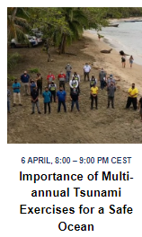
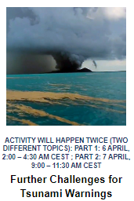
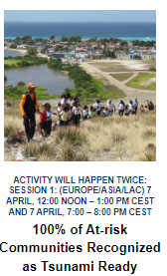
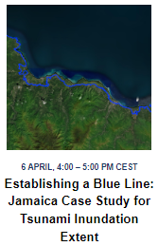
Other relevant meetings
United Nations Ocean Decade Safe Ocean Laboratory
(5-7 April 2022)
https://www.oceandecade-conference.com/en/satellite-activities-a-safe-ocean.html

Slide 6
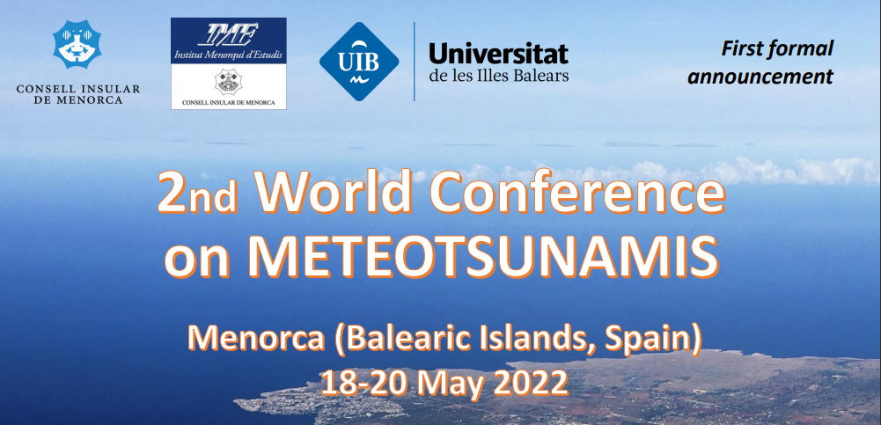
Other relevant meetings
2nd World Conference on Meteotsunamis
Menorca (Balearic Islands, Spain), 18 - 20 May 2022
Aims to deepen, extend and share the knowledge on scientific, technical and societal aspects of METEOTSUNAMIS.
http://2cm-menorca.ime.cat/Contingut.aspx?IdPub=2357

Slide 7
t h a n k y o u
ICG/NEAMTWS Steering Committee (online) 8 & 11 April 2022

