Slide 1
CAT-INGV
Italian NTWC and Tsunami Service Provider @NEAMTWS
NEAM Steering Committee
April 8-11, 2022

Slide 2
Update on activities of the intersessional period 2021- 2022 (in red)
Warning
Events 2021-2022 (update)
New methodology under testing/review (Probabilistic Tsunami Forecasting)
Ongoing technological efforts + PNRR Proposal for DARTs etc. (see also report for last ICG meeting)
Hazard
MPTS18: New Italian S-PTHA model (ongoing) - Delivery to DPC expected April 2022
Advancement of coastal areas inundation mapping (ISPRA website)
Methods for local hazard assessment (uncertainty estimate)
Community, Outreach and Mitigation
Activities in the EPOS cTCS-TSU
EU Proposal Funded, Submitted
Tsunami Risk perception studies on target groups (see also report for WG4)
Tsunami Ready (see report for WG4)
IT-ALERT (being tested during the volcanic drill in Vulcano island, 7-8-9 April 2022)

Slide 3
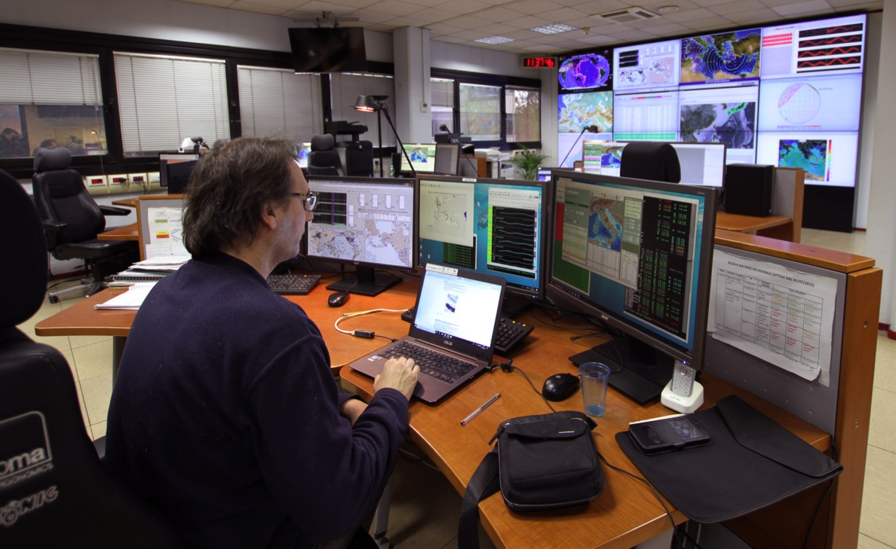
WARNING / CAT-INGV in the monitoring room @ INGV
26 alert messages since 2017
4 Watch
6 Advisory
16 Information
2 messages in Dec. 2021 (2 I)
2 messages in 2022 (1 A + 1 I)

Slide 4
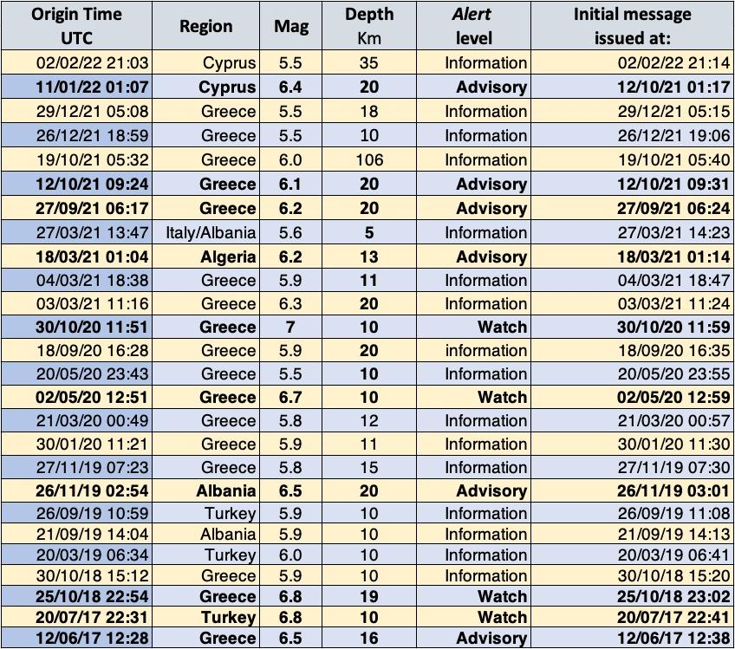
WARNING - Mediterranean events that triggered CAT-INGV

Slide 5
WARNING - Earthquakes and tsunami alerts 2017-2022 (March)
26 CAT-INGV Activations 2017-2022/March – 4 in December 2021-2022 (3 Info + 1 Advisory)
Mw 5.6 - 7.0 - Messages between 7-11 minutes
Notes:
NEAMTWS Activations

Slide 6
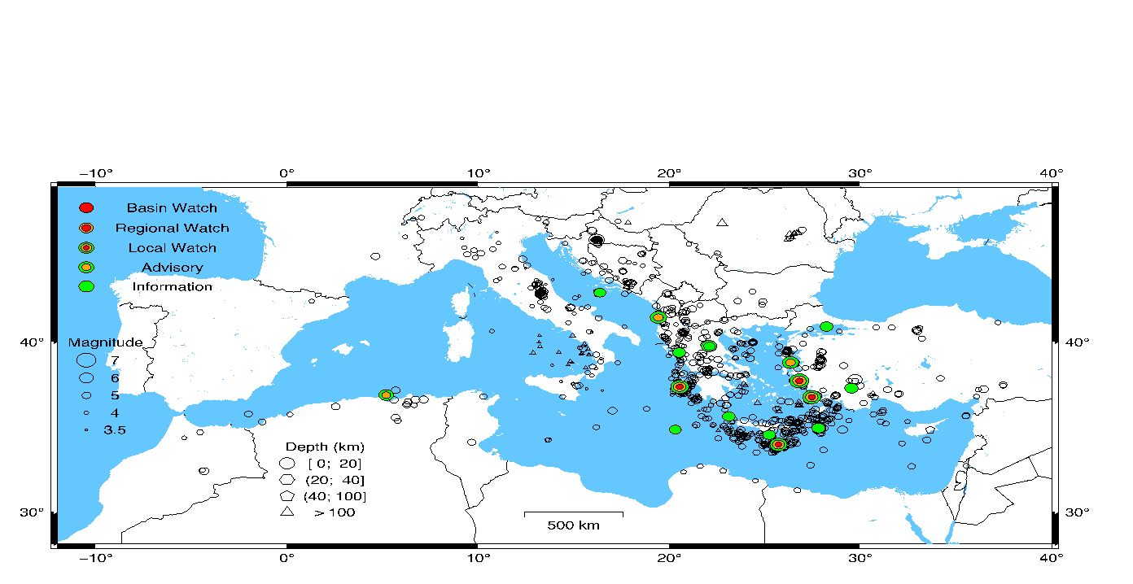
Main results: - Use Mwp (instead of Mb) even at low magnitude (5.0-5.8) → implemented in 2022 - Feasibility of using Early-Est solution n. 002 instead of 005 (3 minutes in advance)
Ongoing - New SOPs were approved by INGV CdA in December 2021 - Times of alert delivery (2017-2022): 7-10 minutes
(Amato et al., Seismol. Res. Letters, 2021)
WARNING - Earthquakes and tsunami alerts 2017-2021 (November)
Notes:
NEAMTWS Activations

Slide 7
INFRASTRUCTURES
Proposal submitted for
2+2 DART Buoys
Further OBPs linked to intermediate depth wave buoys (ISPRA)
10 new generation Tide-Gauges (ISPRA)
Numerous seismic and GNSS stations
Cabled Observatories - Smart Cables
USV for shallow water bathymetric surveys
Tier-1 and Tier-2 HPC Centers
New research Vessels (ISPRA)
…

Slide 8
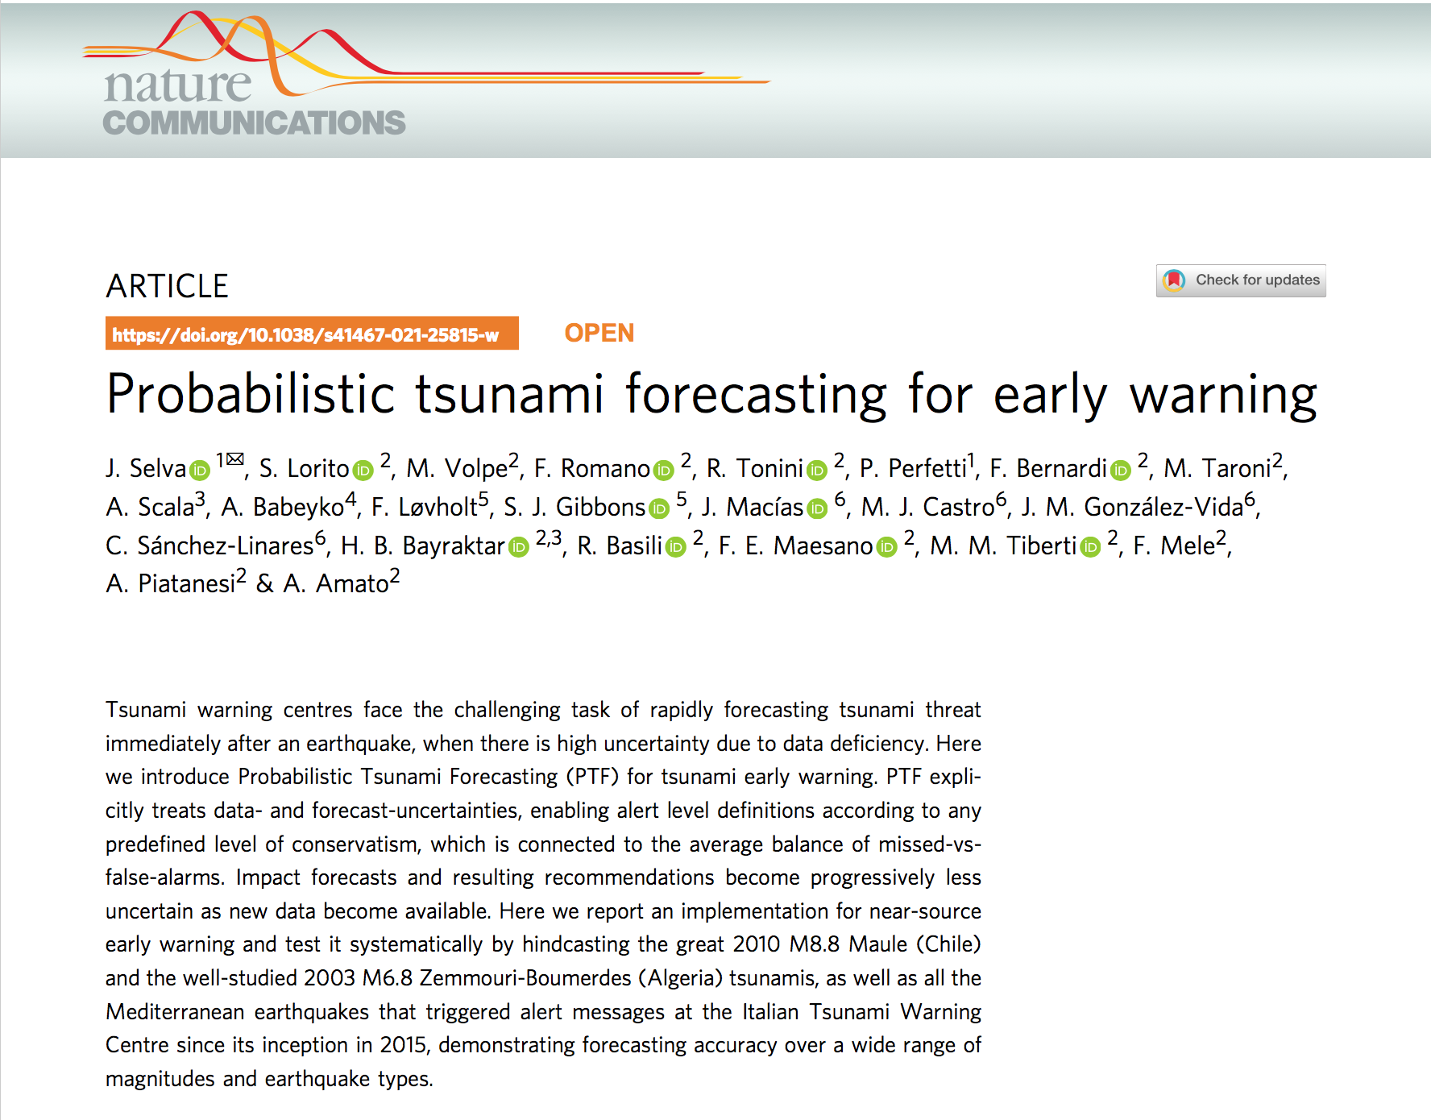
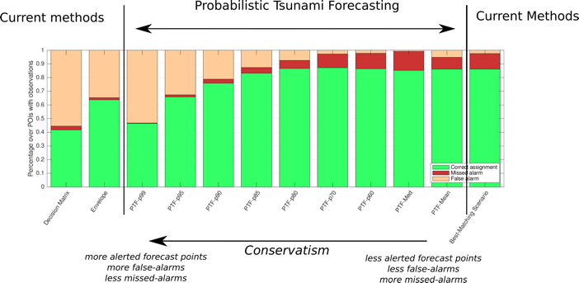
WARNING - Probabilistic Tsunami Forecast
PTF: MAIN STEPS BEFORE OPERATIVITY
Procedure is currently under continuous test in parallel with the DM - at least 6 months
Computing times reduced
Different versions publicly available via zenodo/github
Review ongoing by INGV Scientific Committee through a selected panel of international reviewers (3)
Evaluation by the Italian CP Department - Decision on thresholds
Review by other TSPs including operational aspects
Accreditation update / Evaluation by NEAM?

Slide 9
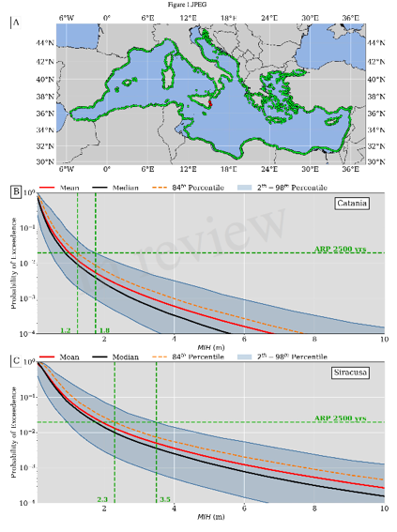
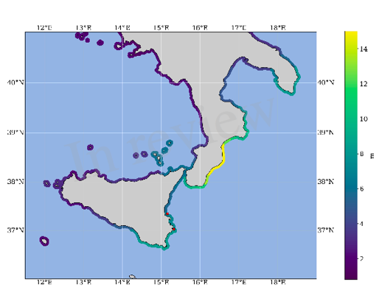
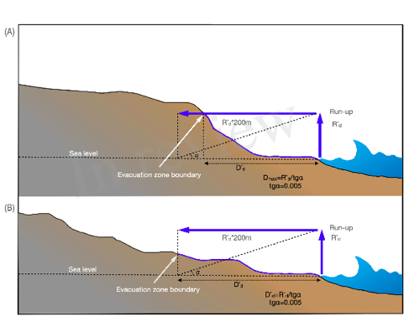
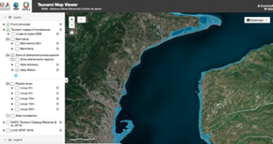
Inundation maps for Coastal Planning (including evacuation)
DirPC SiAM; DPC, 2018
Regional Hazard (NEAMTHM18)
2500 yr ARP + 84th percentile
Safety factors
Coastal dissipation
Notes:
Dealing with / Communicating uncertainty

Slide 10
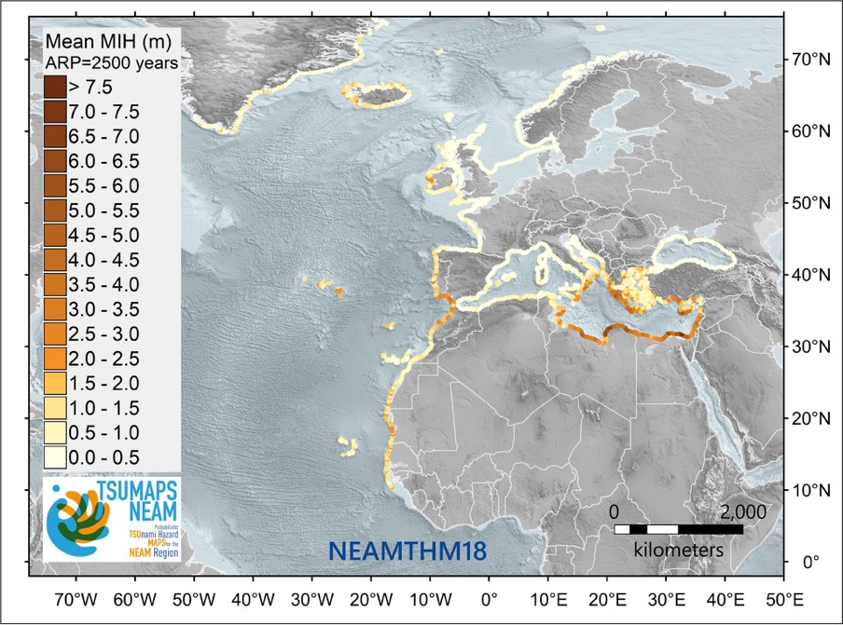
HAZARD modelling and mapping across scales
Basili et al., 2021 – TSUMAPS-NEAM - http://www.tsumaps-neam.eu
Funded by DG-ECHO; NEAMTWS Reference, being used as a basis for homogenous planning and as a driver for the prioritization of local assessments
Notes:
NEAM - Regional scale

Slide 11
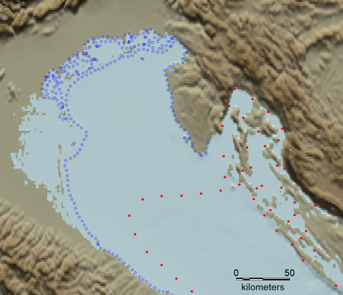
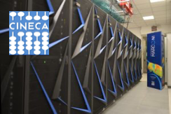
New Tsunami Hazard assessment for Italy
Tsunami Hazard assessment for Italy
1) New regional seismic catalogues
2) New regionalization
3) Improved spatial definition of crustal sources
4) Improved exploration of source parameters (strike, rake) for crustal sources
5) More slip distributions for subductions
6) Simulation for every source (not linear combinations) up to 10m depth (no longer 50m) on a denser grid (thanks to HPC), includes local coastal coseismic displacement for each scenario
7) New amplification factors on denser profiles
Tsunami-HySEA
HPC5@ENI
MARCONI100@CINECA

Slide 12
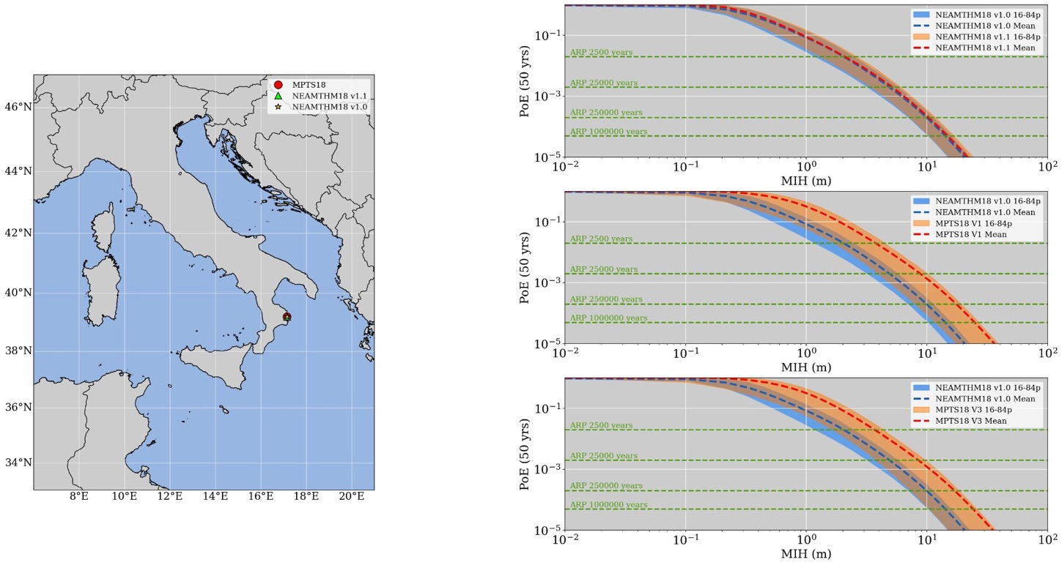
New Tsunami Hazard assessment for Italy
MPTS deliv. April 2022
Comparison with NEAMTH18
Discussion starting with DPC toward implementation

Slide 13
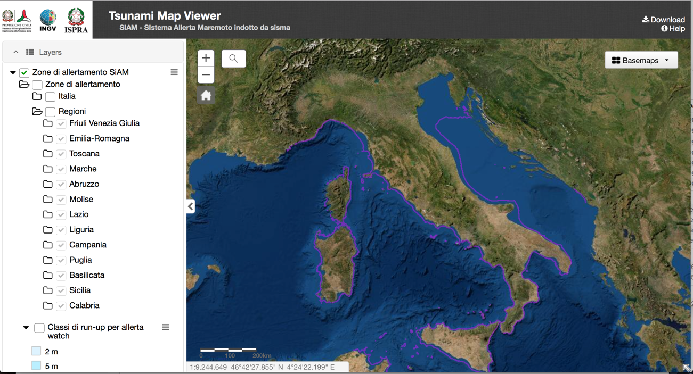
Tsunami Hazard and inundation zones
ISPRA has completed the revision of 13/15 Regions. Veneto finished, Sardinia ongoing

Slide 14
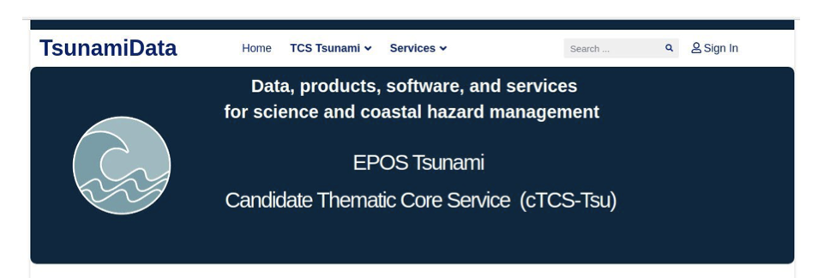
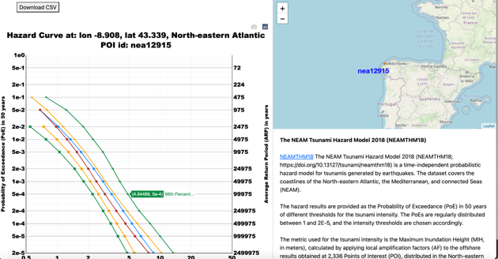
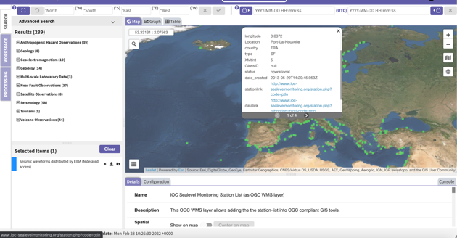
cTCS-TSU in EPOS
Building of the TCS Tsunami Service delivery framework: website and first OGC services on the EPOS portal completed

Slide 15
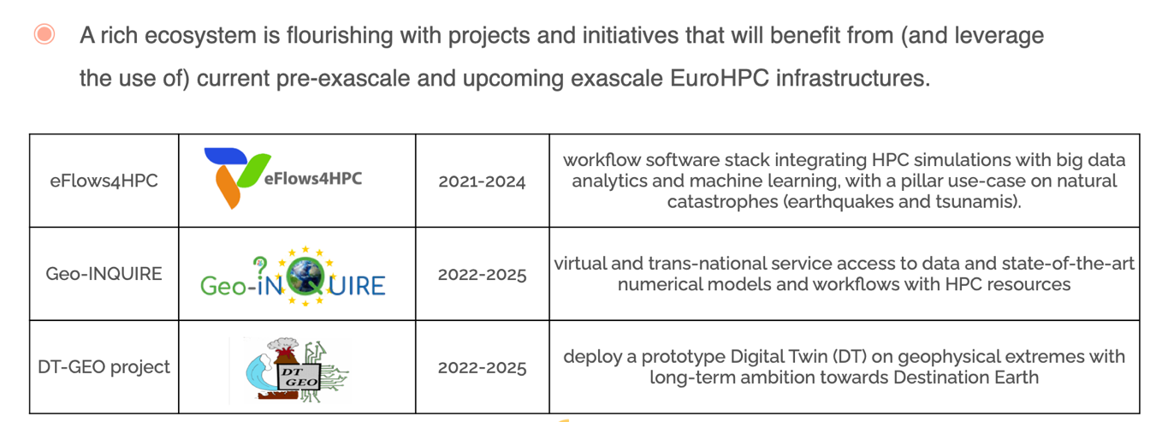
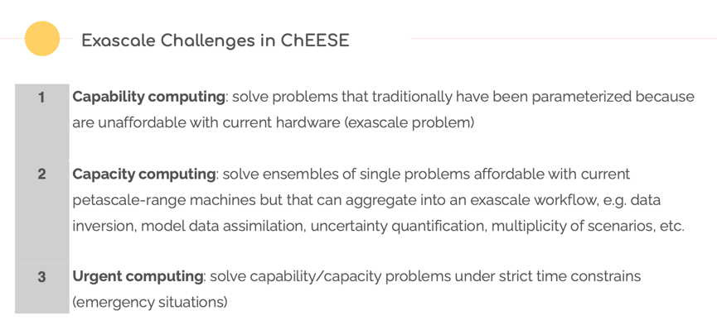
Horizon EU + EuroHPC Projects
ChEESE 2 submitted to EuroHPC

Slide 16
Mitigation and last mile activities
Tsunami Risk perception studies
Analysis of the national data in progress
2022: Survey in two schools and one with CP volunteers
Tsunami Ready
Some advancements in Minturno and Palmi
IT-ALERT
In test at Vulcano island for a drill on April 9, 2022
Updates of the CAT website

Slide 17
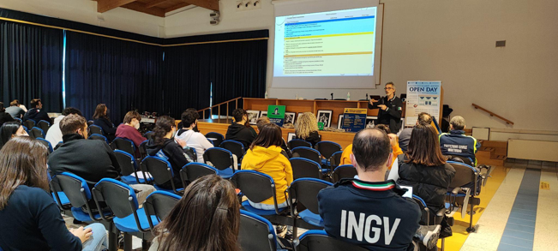
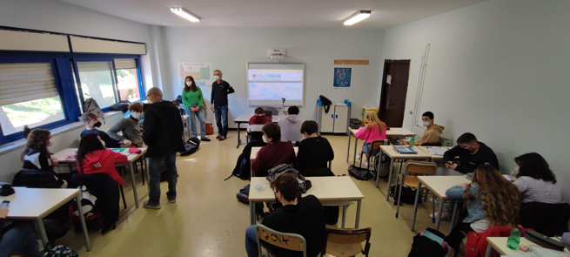
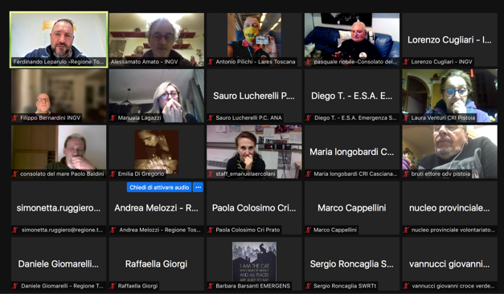
Risk perception assessment in specific targets:
schools and CP volunteers (Regione Toscana)
Minturno (TR candidate)
Questionnaires (with some changes) were administered in person (schools) or online before lessons on tsunamis.
We will repeat the survey in the next two months.
Tivoli (Rome)
Tuscany CP volunteers (Io Non Rischio campaign)

Slide 18
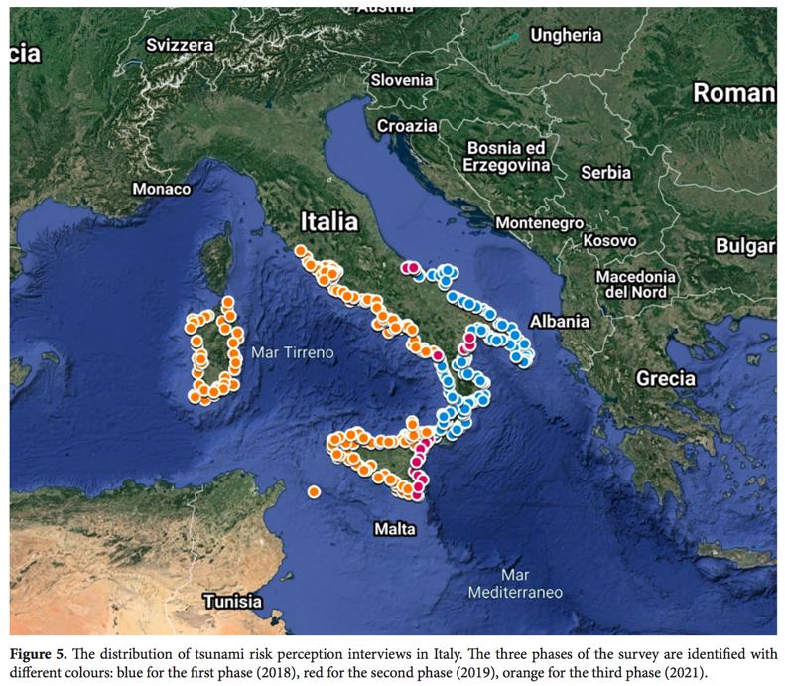
Mitigation and last mile activities: 2. Risk perception study
Total survey coverage in coastal municipalities (CATI) 2018 | 2020 | 2021
Surveyed coastal regions | 53% (8/15)
Surveyed coastal municipalities | 70% – (450/645)
Total respondents | 5.842 representative of about 12mln people (7.342 with Telepanel)
Km of surveyed coastline | 77,9% (6.166km/7.915km)
2021 – Telepanel (General public)
1500 total respondents | Nationwide distributed according to: age, gender, geographic area, educational qualification variables.
CUGLIARI ET AL. (2021), in progress
In 2022-2023 we will complete the coverage of coastal areas (7 Regions) + in-depth analysis at local level (focus groups etc.)

Slide 19
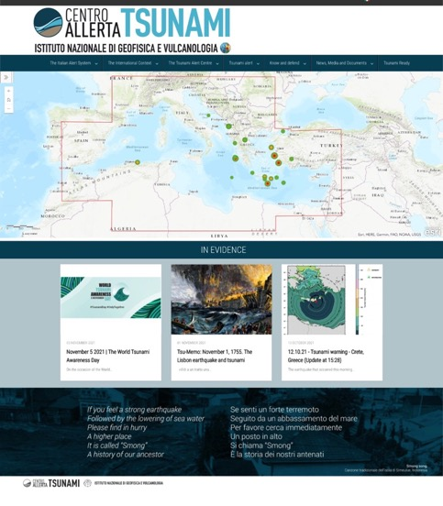
CAT-INGV Website
11 News since December 2021:
Tsu-Memo: March 27, 1964, the Alaska earthquake
Japan - Local tsunami warning 16.03.2022
Tsu-Memo: 11.03.11 Japan Tsunami
Tsu-Memo: Twelve years ago, the Maule tsunami in Chile.
02.02.22 - INFORMATION message for earthquake offshore, Cyprus island
11.01.22 - Tsunami Advisory alert - Cyprus Island
29.12.21-INFORMATION message for earthquake offshore, Greece area
Tsu-Memo: December 28, 1908, Reggio Calabria and Messina tsunami in Mario Baratta's plates
INFORMATION message for earthquake offshore, Greece area
Tsu-Memo: december 26, 2004, the Indian Ocean Tsunami
The relevance of the D.A.R.T. network for reconstructing a tsunami's source and quickly issuing warnings. The example of the March 4, 2021 Raoul Island earthquake
Notes:
The last-mile

Slide 20
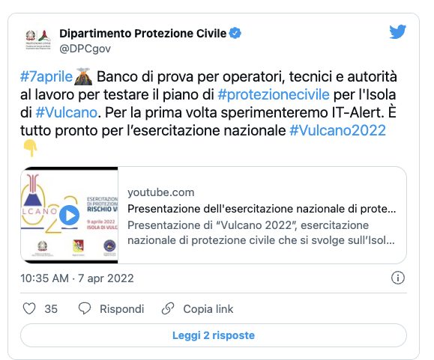
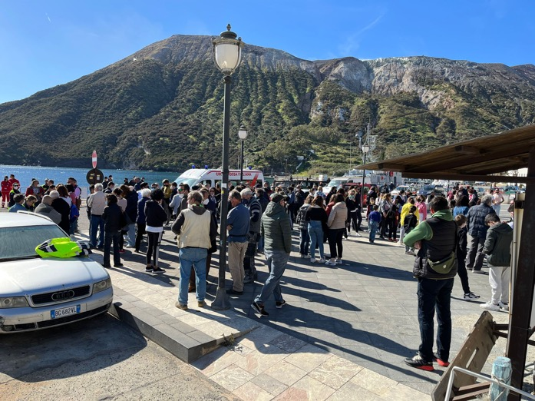
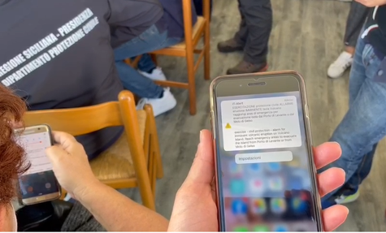
IT-ALERT (DPC Cell-Broadcasting)
Testing during the Vulcano Island drill / April 9, 2022 - Not a tsunami drill!
https://twitter.com/i/status/1512481459612753923
Notes:
The last-mile

Slide 21
IT-ALERT (DPC Cell-Broadcasting)
Some open issues…
From DPC IT-ALERT web site - 3 macro-criticalities
Con l'adozione del decreto legislativo 207/2021 è stato, dunque, affrontato e risolto il problema di coerenza dell'impianto del sistema italiano con le indicazioni europee e ora, alla fine del percorso, sarà necessario adeguare il Regolamento e la Direttiva del 2020.
Restano, inoltre, da superare ancora tre macro-criticità ereditate dalla precedente impostazione, che sono strettamente connesse l'una alle altre e che impediscono oggi l'utilizzo sicuro, chiaro e responsabile del sistema che si era immaginato di rendere operativo: la sicurezza dell'infrastruttura tecnologica, l'ambito di operatività del sistema pubblico di allarme e la definizione della governance del sistema.
BoR (20) 115
preparedness
Notes:
The last-mile

Slide 22
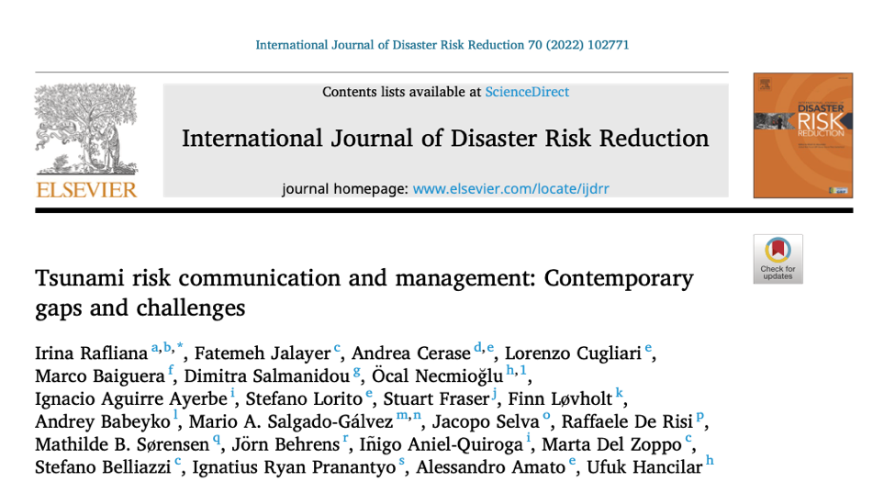
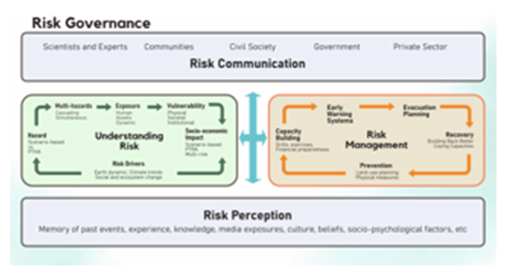
Papers published in 2022 with CAT-INGV personnel as co-authors

Slide 23
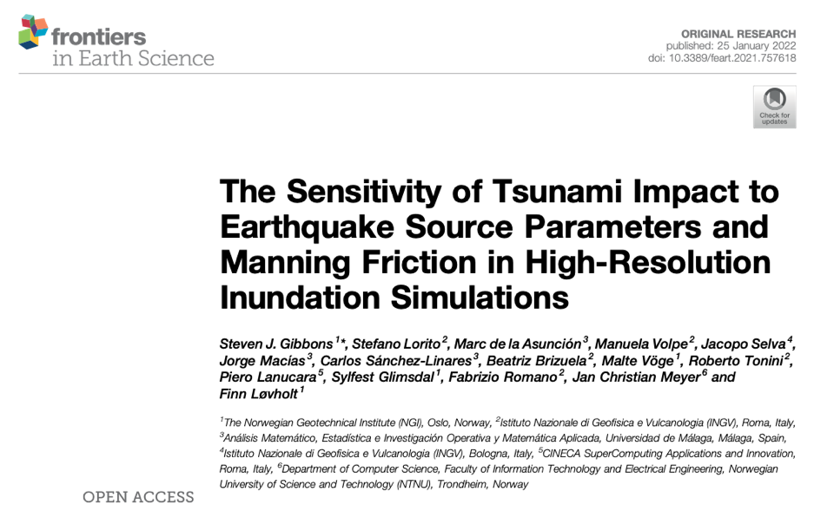
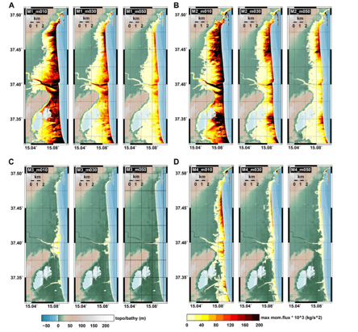
Papers published in 2022 with CAT-INGV personnel as co-authors

Slide 24
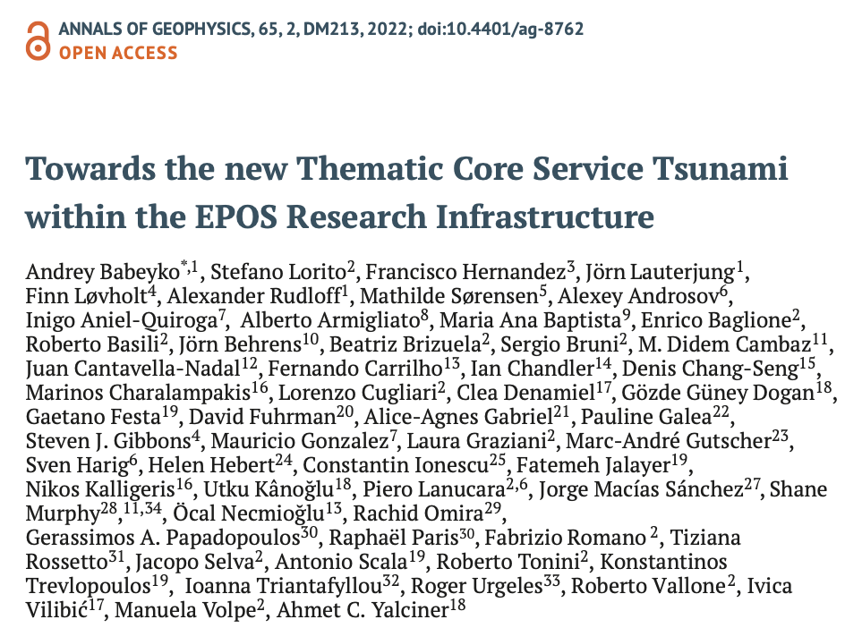
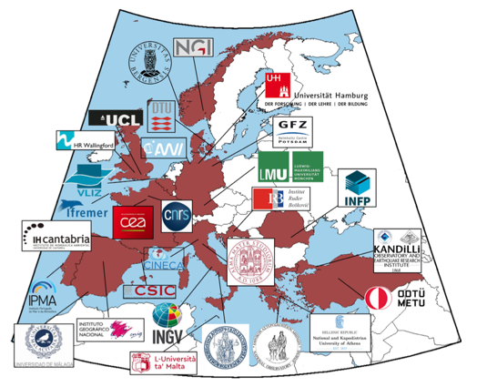
Papers published in 2022 with CAT-INGV personnel as co-authors

Slide 25
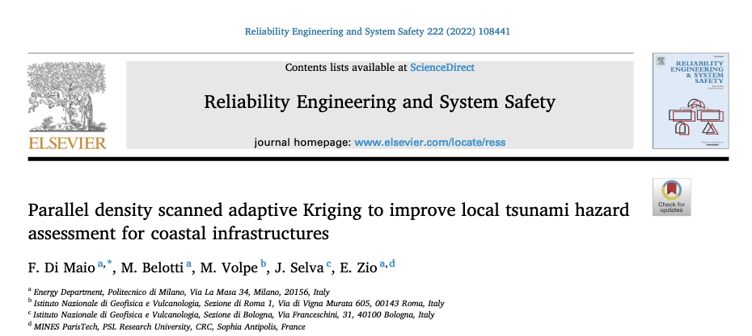
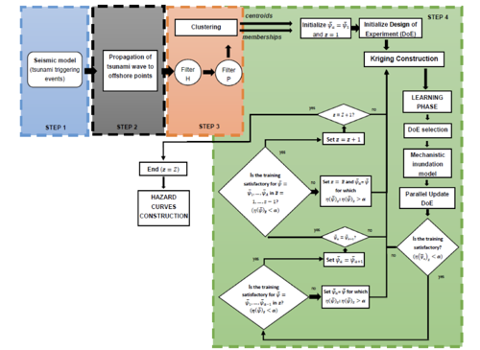
Papers published in 2022 with CAT-INGV personnel as co-authors

Slide 26
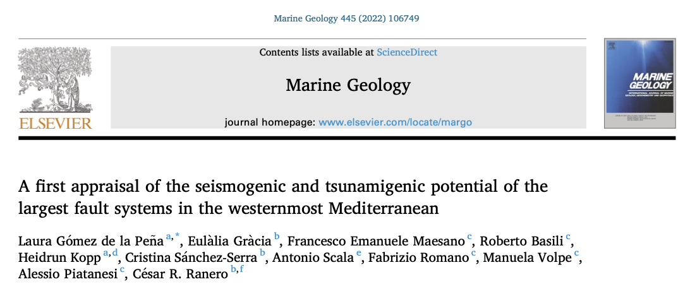
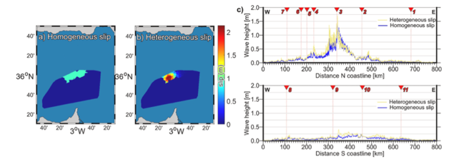
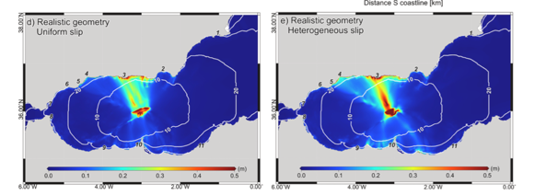
Papers published in 2022 with CAT-INGV personnel as co-authors

Slide 27
Useful Links
www.ingv.it/cat/en
http://www.tsumaps-neam.eu
https://tsunamiarchive.ingv.it/emtc.2.0/
https://storymaps.arcgis.com/stories/32091c82e42a4d30a2f24b1e7b5955b6
http://sgi2.isprambiente.it/tsunamimap/
https://rischi.protezionecivile.it/it/maremoto-0
WTAD 2021 / 8 November 2021 – NIOF-EGYPT

Slide 28
Thank you for your attention!
WTAD 2021 / 8 November 2021 – NIOF-EGYPT
Notes:
As testified by this Factsheet, for about 15 years we have been building the NEAMTWS

