Slide 1

4. Update of work plans and activities by WGs and TTs co-chairs
Task Team on Tsunami Exercise
co-chairs:
Ceren Ozer Sozdinler (Turkey) - Marinos Charalampakis (Greece)
ICG/NEAMTWS Steering Committee (online)
8 & 11 April 2022

Slide 2


Timeline of NEAMWave21

Slide 3
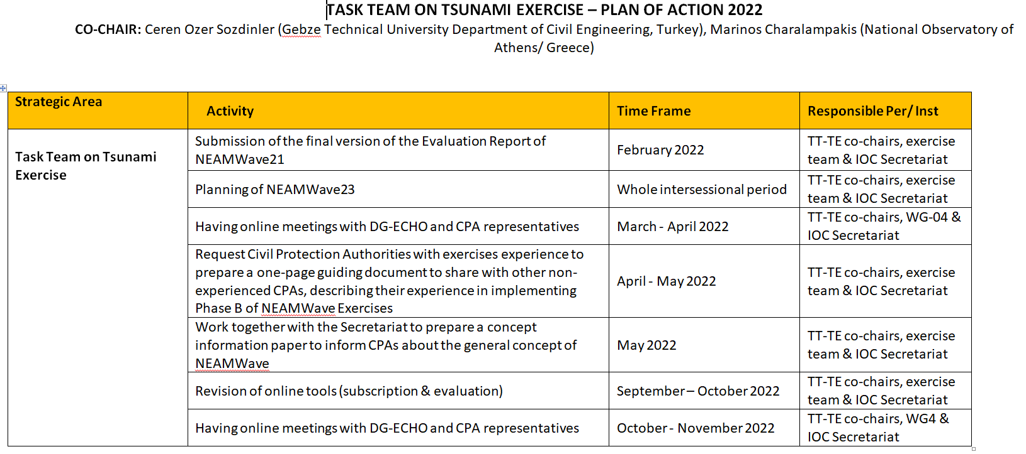
Plan of Actions 2022

Slide 4
NEAMWAVE23
Suggestions for the next NEAMWave exercise:
To be held in November 2023.
To have a close collaboration with the DG-ECHO, in order to engage as many CPAs from MSs as possible.
To seek the possibility to have a triple joint scenario by 3 TSPs, simulating real cases
To seek if it is feasible to intergrade the exercise with the Tsunami Ready activities related to the task “Organize and execute a community tsunami exercise”.

Slide 5
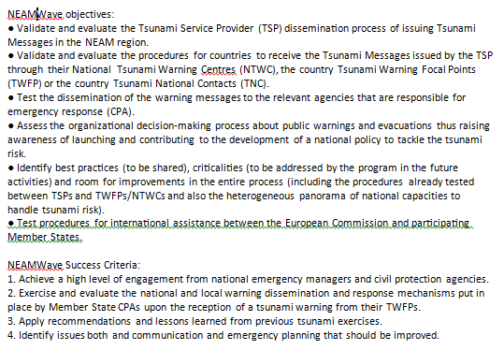
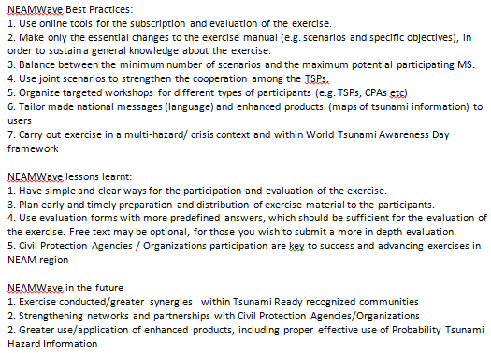
WAVE exercise
@ the INTER-ICG TT-DMP of the TOWS-WG
Chair TT-TWO invited chairs and/or representatives of Tsunami Wave Exercises from each ICG to provide a short summary of recent exercises, share outcomes and lessons learnt.

Slide 6
WAVE exercise
@ the INTER-ICG TT-DMP of the TOWS-WG
Recommendations:
Request that the TT-DMP continue to work on coordination of the conduct and reporting of exercises with the aim of having standard practices among the ICGs.
Requests the Secretariat to share reports and presentations regarding recent Wave exercises, outcomes, best practices and lessons learnt when received from ICGs.

Slide 7
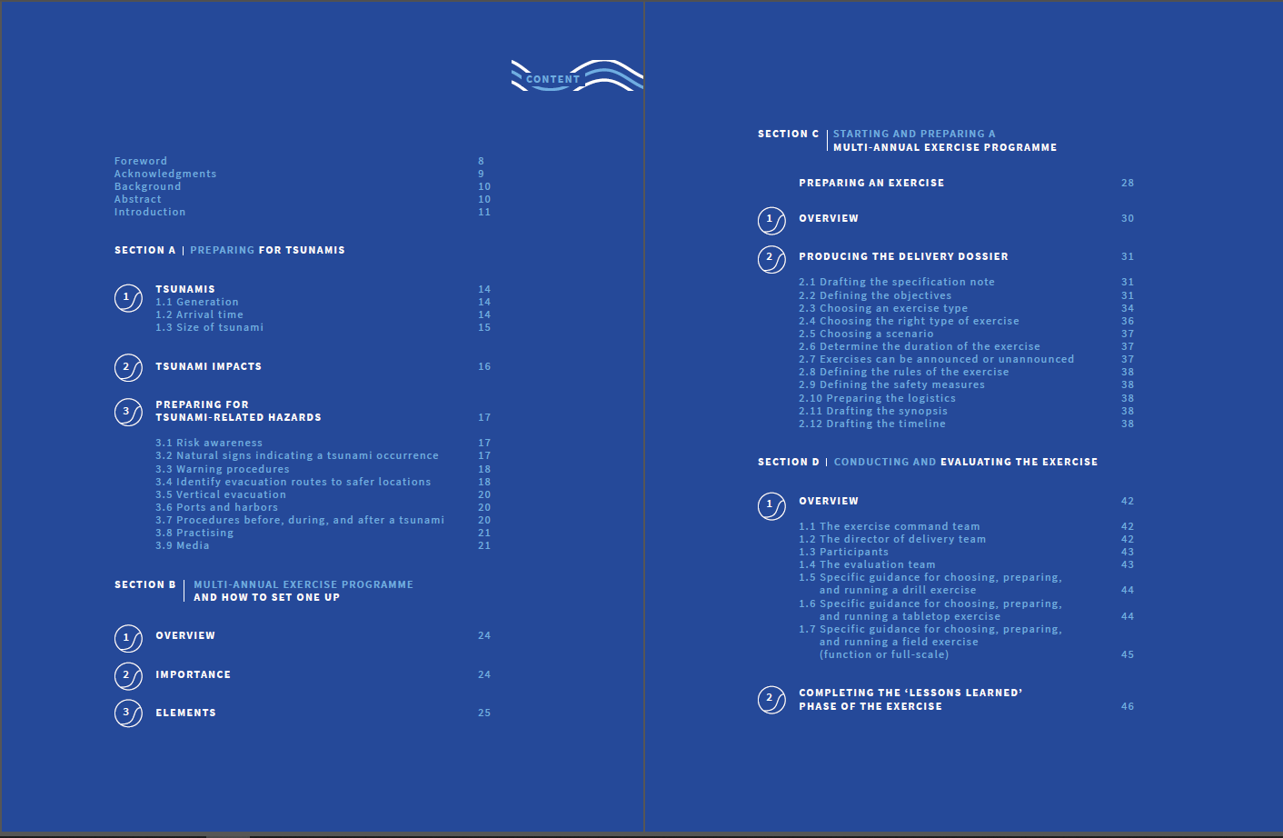
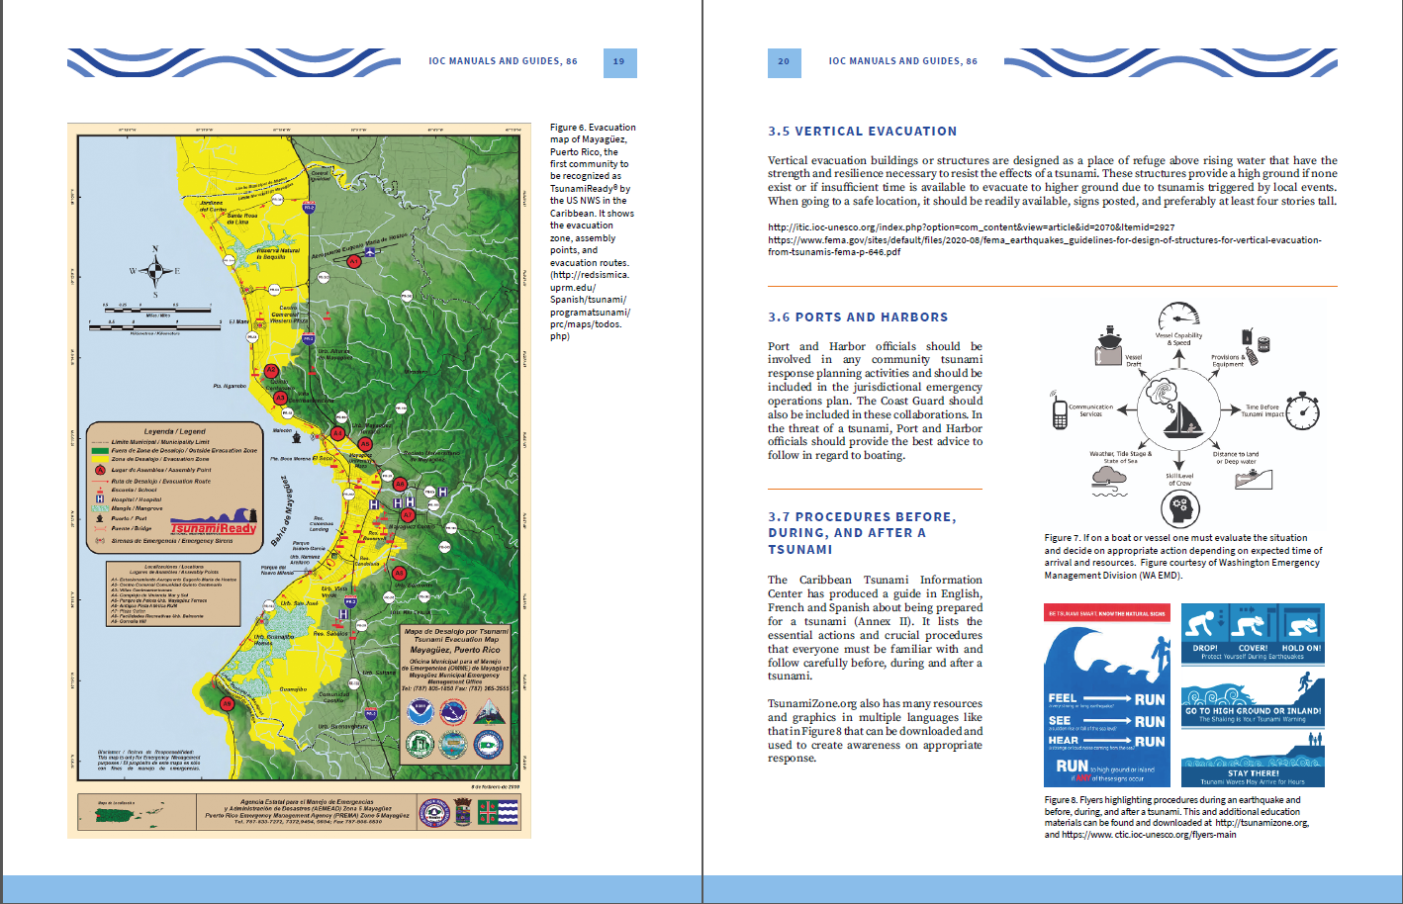
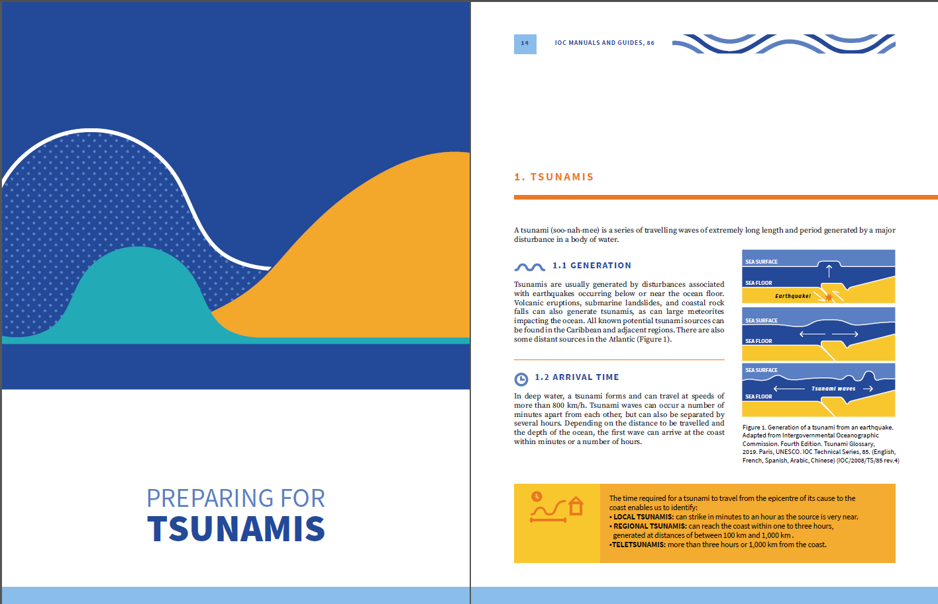

WAVE exercise
@ the INTER-ICG TT-DMP of the TOWS-WG
Appreciates the finalization and publication IOC Manual Guide 86 Multi-Annual Community Tsunami Exercise Programme: Guidelines for the Tsunami and other Coastal Hazards Warning System for the Caribbean and Adjacent Regions in English

Slide 8
t h a n k y o u
ICG/NEAMTWS Steering Committee (online)
8 & 11 April 2022

