Slide 1
UPDATE OF WORK PLANS AND ACTVITIES BY WORKING GROUPS AND TASK TEAMS CO-CHAIRS
Task Team on Tsunami Ready
co-chairs:
Ignacio Aguirre Ayerbe (Spain) & Elena Daskalaki (Greece)
ICG/NEAMTWS Steering Committee Teleconference, 8-11 April 2022

Slide 2
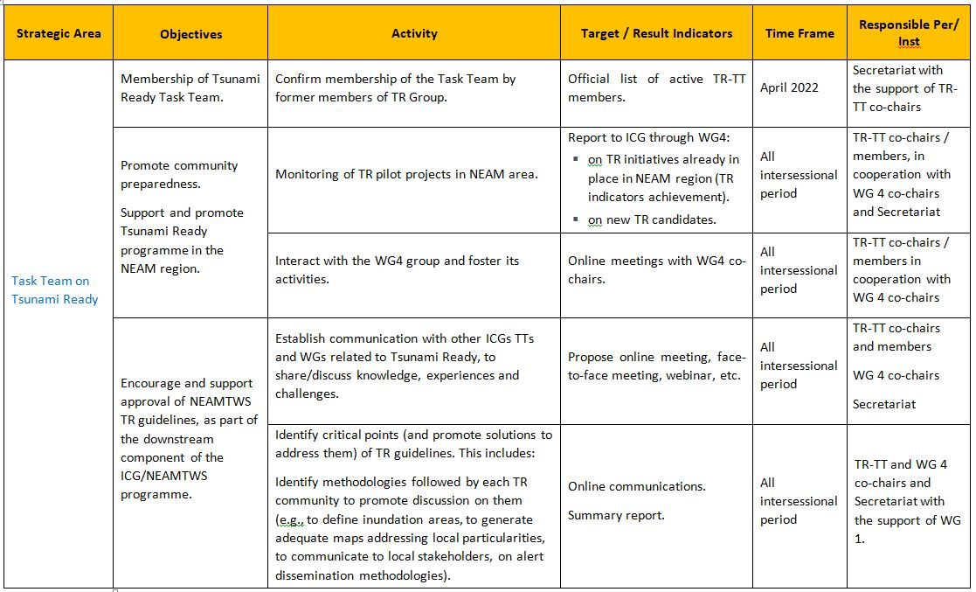
Plan of Action 2022
Task Team on Tsunami Ready: Plan of Action for 2022
Co-chairs: Ignacio Aguirre Ayerbe (Instituto de Hidráulica Ambiental de Cantabria, Spain) & Elena Daskalaki (National Observatory of Athens, Greece)

Slide 3
Plan of Action 2022
Task Team on Tsunami Ready: Plan of Action for 2022
Co-chairs: Ignacio Aguirre Ayerbe (Instituto de Hidráulica Ambiental de Cantabria, Spain) & Elena Daskalaki (National Observatory of Athens, Greece)

Slide 4
Task Team on Tsunami Ready Activities
Workshop of Task Team on Tsunami Ready and Working Group 4 on Multi Hazard Risk Perception Survey – April 2022
Development of a Coastal Multi-Risk Perception, Preparedness, Resilience Study and Survey Questionnaire for Tsunami, Storm Surge and Sea Level Rise
Forum on Safe Ocean Satellite Activity on making "100% of at-risk communities recognized as Tsunami Ready" – April 2022

Slide 5
Task Team on Tsunami Ready Activities
Contribution to UNESCO/IOC Tsunami Ready Innovation Platform (https://globalplatform.undrr.org/) providing photos and videos for NEAM region for communities that TR Program is ongoing or to be implemented – March 2022

Slide 6
Thank you
ICG/NEAMTWS Steering Committee Teleconference, 8-11 April 2022

