Slide 1
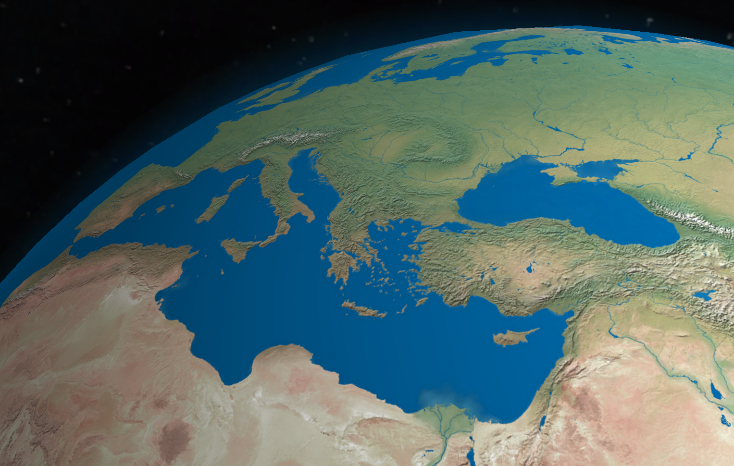
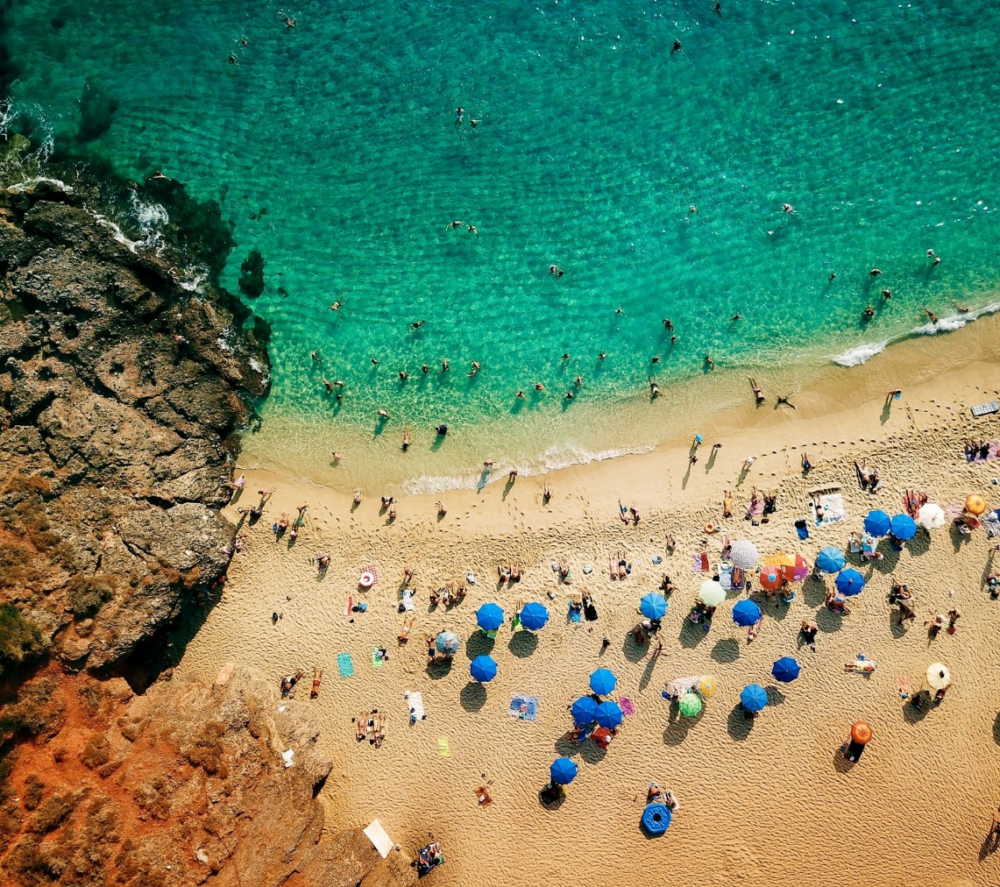
ICG/NEAMTWS Steering Committee 8-11 April 2022
Report by the IOC Secretariat
Denis CHANG SENG, PhD
Programme Specialist
Tsunami Unit, Technical Secretary (ICG-NEAMTWS) Global Ocean Observing System (GOOS) & IOC Focal point for MHEWS/ IN-MHEWS
Intergovernmental Oceanographic Commission of UNESCO

Slide 2
Outline
Documentation / publications
Communication and outreach
Meetings/Events
Project

Slide 3
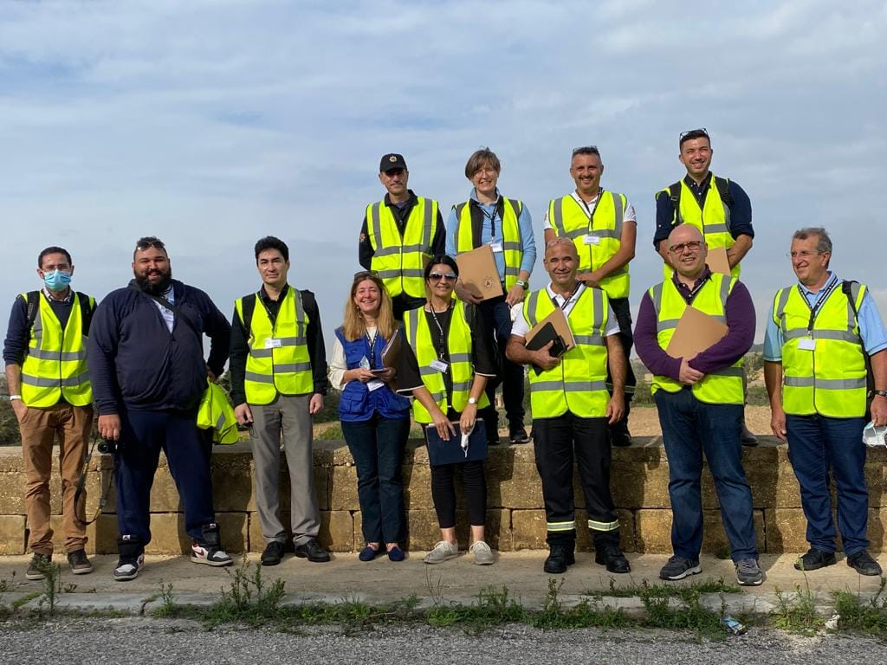
DOCUMENTATION & PUBLICATION
Ongoing
ICG/NEAMTWS NEAMWave21 Evaluation (Final Draft Submitted)
Review of Tsunami Last Mile MALTA21 exercise Evaluation Report, Marsaxlokk (Malta), 5 November 2021
Complet(ed)
ICG/NEAMTWS 2021-2030 Strategy
ICG/NEAMTWS –XVII Summary Report
ICG/NEAMTWS Status on Tsunami Education Awareness and Preparedness in NEAM region

Slide 4
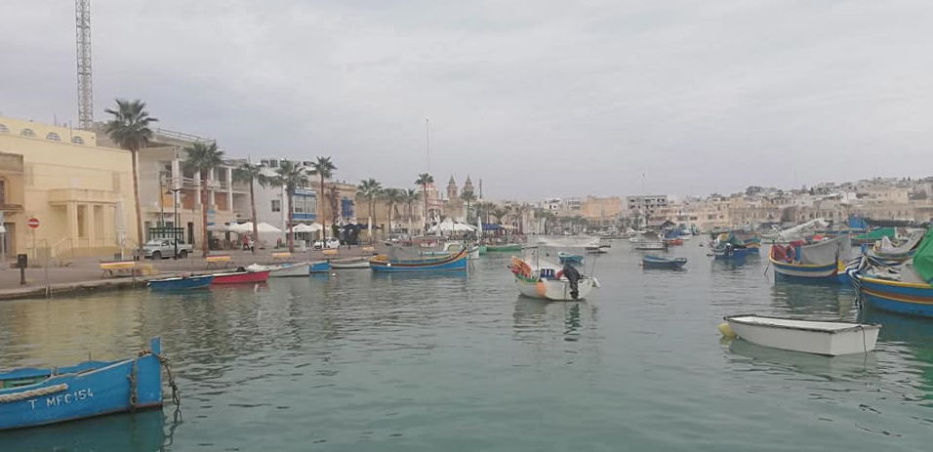
COMMUNICATION, OUTREACH IMPACT
2 Articles Published 2022 [10 in 2021]
Seventeenth Session of the ICGNEAMTWS : Ten Tsunami Ready Recognized Communities by 2023 [597 Hits on NEAMTIC]
CoastWAVE Project Kick Off Workshop [600 Hits on NEAMTIC]

Slide 5
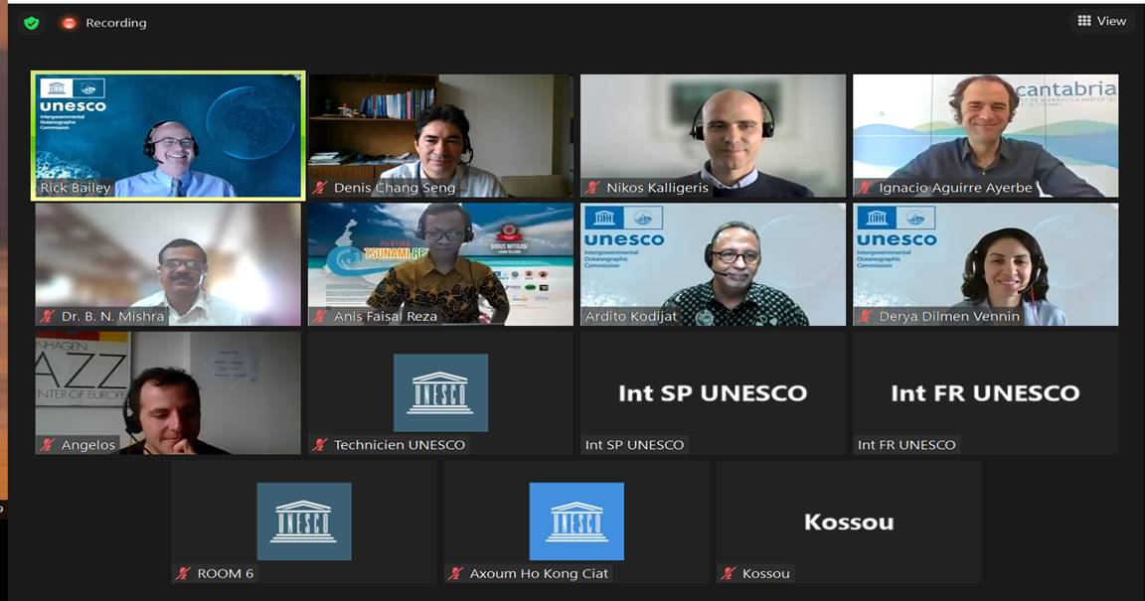
2022 MEETINGS/ EVENTS
21 Feb - 22 Feb
TOWS-TT- DMP : TOWS-WG- Inter-ICG Task Team on Disaster Management Preparedness (TT-DMP)
21 Feb - 22 Feb
TT-TWO : TOWS-WG Task Team on Tsunami Watch Operations [online]
24 Feb - 25 Feb
TOWS-WG-XV : Fifteen Meeting of the Working Group on Tsunamis and Other Hazards related to Sea Level Warning and Mitigation Systems (TOWS-WG-XV)
5 Apr - 05 Apr
Evaluation and Review of NEAMTIC Multi Hazard Risk Perception Survey
08 Apr - 11 Apr
ICG/NEAMTWS SC : ICGNEAMTWS Steering Committee
7 Apr
Safe Ocean Satellite Activity

Slide 6
PROJECT
Tsunami Ready Recognized Communities
Alert Systems
Detection & Monitoring
Risk Perception & Communication Strategies
Project “Strengthening the Resilience of Coastal Communities in the North-East Atlantic and Mediterranean Region to the Impact of Tsunamis and Other Sea Level-Related Coastal Hazard”
Approved by the European Union (EU) Directorate-General for European Civil Protection and Humanitarian Aid Operations (DG ECHO)
Geographical scope/benefitting countries | North Eastern Atlantic and Mediterranean Sea: Cyprus, Egypt, Greece, Malta, Morocco, Spain, and Turkey
Technical Advise | Italy and France
Area of influence | 40 NEAMTWS Member States
Period | 01/09/2021 --- 30/03/2024

Slide 7
Overall Progress
Recruitment of two project staff
Project Assistant (Administration, Finance and Budget)
Associate Project Officer (Project Coordinator)
Organized Kick-off project workshop,17 & 20 Dec 2021
Others
Technical and Financial Proposals [~80 %]
Implementation Partnership Agreement(IPA) [~50 % ]
Other contracting modalities [Ongoing Preparations, comp 2 & 3]
Workshop /meeting on Sea Level Hazard, Risk, Preparedness and Resilience Survey

Slide 8
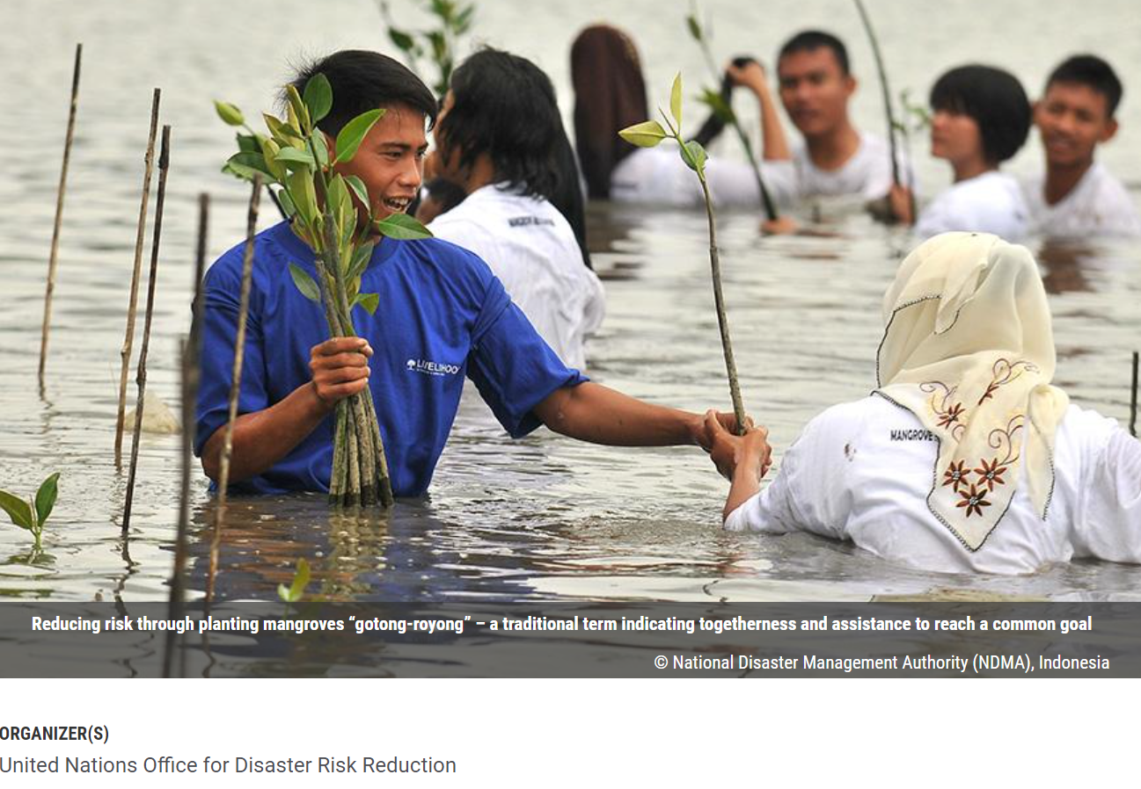
UPCOMING MEETINGS/EVENTS
23 - 28 May 2022 Seventh Session of the Global Platform for Disaster Risk reduction ( GP2022)
Coordinating IOC UNESCO Input
Thematic Session 3 Organizing Team Member : Multi-hazard and Multi Sector
Thematic Session 15 Organizing Team Member on EWEA
Member of IN-MHEWS Planning and Organization of IN-MHEWS Side Event at GP2022

Slide 9
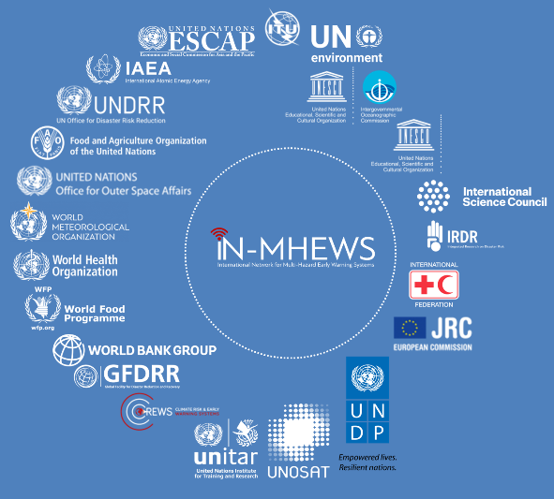
Multi-Hazard Early Warning Systems
IN-MHEWS
Third Multi-Hazard Early Warning Conference (MHEWC-III)
Words into Action Guide Multi-hazard Early Warning Systems

Slide 10
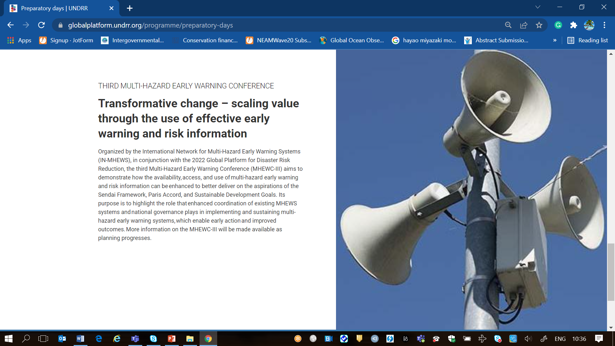
Third Multi-Hazard Early Warning Conference (MHEWC-III)
Call for posters
Side events planned
360-400 max in person
1000 already registered
Aims
Take stocks of progress in the implementation of Target G of Sendai Framework & report latest trends in MHEWS design and results
Identify gaps and challenges in practice, policy and science to be addressed
Share knowledge , lessons learned, and emerging good practices
Initiate commitments for scaling-up actions on early warnings and promote synergies and partnership
8 Themes Multi-sector governance of EWS - Enablers of transformative change Inclusive EWS Impact-based forecasting Anticipatory action Risk Communication Monitoring, evaluation and learning Advocacy, communication and advancing global policy agendas Science, Technology and Innovation

Slide 11
WiA Guide Objective
2017
2018
Today
Objective: Provide advice for governments, stakeholders & partners on how to institutionalize, operate, monitor and strengthen people-centred inclusive approaches for multi-hazard and comprehensive end-to-end EWS that enables early action to protect livelihoods, people and assets.

Slide 12
Membership and Composition
CEMADEM / IFRC / JRC
FAO
IFRC
ITU
UNDP
UNDRR
UNESCAP
UNESCO
UNESCO / UNESCO-IOC
UNICEF
UNITAR
UNOOSA/UN-SPIDER
WFP
WHO
WMO

Slide 13
Timeline & Roles Reference Group
Nov - Jan
Jan-March 22
3rd Reference Group meeting (Feedback WiA draft)
1st Reference Group meeting (Inception)
2nd Reference Group meeting (Review content)
Call for Good Practices
Reach out to partners requesting contributions to specific chapters
Follow-up on gaps
Drafting WiA guide
Preparation Public Consultation
Oct
Jan
April
Consultation with Reference Group on:
Composition RG
WiA Outline
Partners that should contribute to chapters
Categories for call for Good Practices
Reference Group supports:
Good practices selection (RG members support specific categories)
Identify gaps & agree on way forward
Reference Group supports:
Development of working session planned during the MHEWC
Promote good practices during WMD
Consultation with Reference Group on:
Revise draft
Provide feedback (inputs as required) in writing & during RG meeting

Slide 14
Timeline & Roles Reference Group
Public Review including sessions during MHEWC
June
4th Reference Group meeting (Review final draft)
Aug/ Sept
International Day for Disaster Risk Reduction 2022
Update WiA guide based on comments revised during public review
Develop draft dissemination Strategy
Copy-editing, design including infographic
Coordinate launch of WiA guide
May
July
Oct
Reference Group supports:
Thematic consultation sessions during MHEWC
Share outcomes & feedback with consultant
Consultation with Reference Group on:
Final draft
Feedback on dissemination strategy
Reference Group supports:
Launch preparation as agreed
Reference Group supports:
Launch event
Promotion of WiA guide through networks

Slide 15
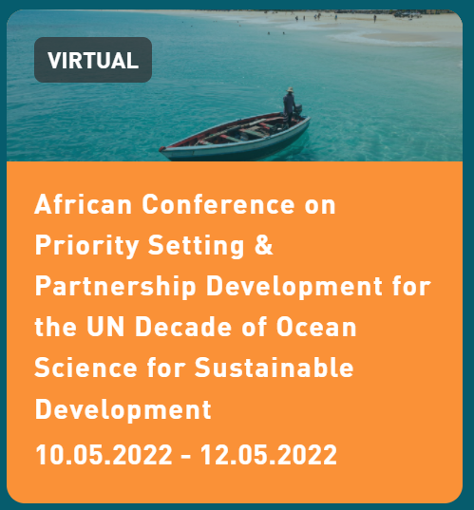
Relevant Ocean Decade Meetings
Side Event
Safe Ocean ( WTAD &Tsunami Ready)
To be submitted by UNDRR
Side Event
Resilient and Safer Coast
CoastWAVE Project
Side Events
1. Further Challenges for Warnings of Tsunamis
2. Tsunami Ready (Spain, Greece Turkey Interviews )

Slide 16
ICG/NEAMTWS Secretariat Team

Slide 17
END

