Slide 1
Reports from GOOS components
Ocean Best Practices System (OBPS)
Presenters : SG-OBPS Co-Chairs
Jay Pearlman, Johannes Karstensen
[IEEE, GEOMAR]
Contributors: Pauline Simpson and Steering Group for OBPS
GOOS 11th Steering Committee meeting [online], April 2022

Slide 2
Ocean Best Practices System - Introduction
OBPS provides services to the ocean observation, research, data management and applications communities.
OBPS Mission: To develop and sustain an evolving system which fosters collaboration, consensus building, and innovation by providing coordinated and global access to best practices and standards across ocean sciences and applications
OBPS facilitates the evolution of methods into best practices through convergence and endorsement.
With GOOS, OBPS supports the evolution, convergence, and endorsement of best practices for EOVs
OBPS is co-sponsored by GOOS and IODE as an IOC Project
The advanced OBPS was developed from a collaboration of IODE OceanDataPractices, AtlantOS, ODIP, EuroSea and Ocean Obs RCN, the OBPS team, IODE and GOOS with guidance from the 'community of users'
Notes:
GOOS was a member of JCOMM which was a partner in Joint JCOMM-IODE Ocean Data Standards and Practices Project (2012) . Ocean Data Practices Repository was a deliverable of the ODSPP and the JCOMM Catalogue of Practices (163 records) was migrated (2014) to form the foundation collection which is now known from 2018 with a broader all-ocean related remit, as OBPS

Slide 3
Why Best Practices (1)
Agreeing on best practices enables harmonized collection, analysis, and distribution of marine (meta)data, products
• Best practices are fundamental to overcome fragmentation and enable global system interoperability
• Best practices are present across communities – but require a coordination framework to scale

Slide 4
Why Best Practices (2)
Quality and consistency of observations
Efficiency (don’t re-invent the wheel)
Transparency - Data traceability, reproducibility and FAIR
Historical data - improved recovery
Seamless linkages between design, data, models and applications
Trusted resource for training and capacity development

Slide 5
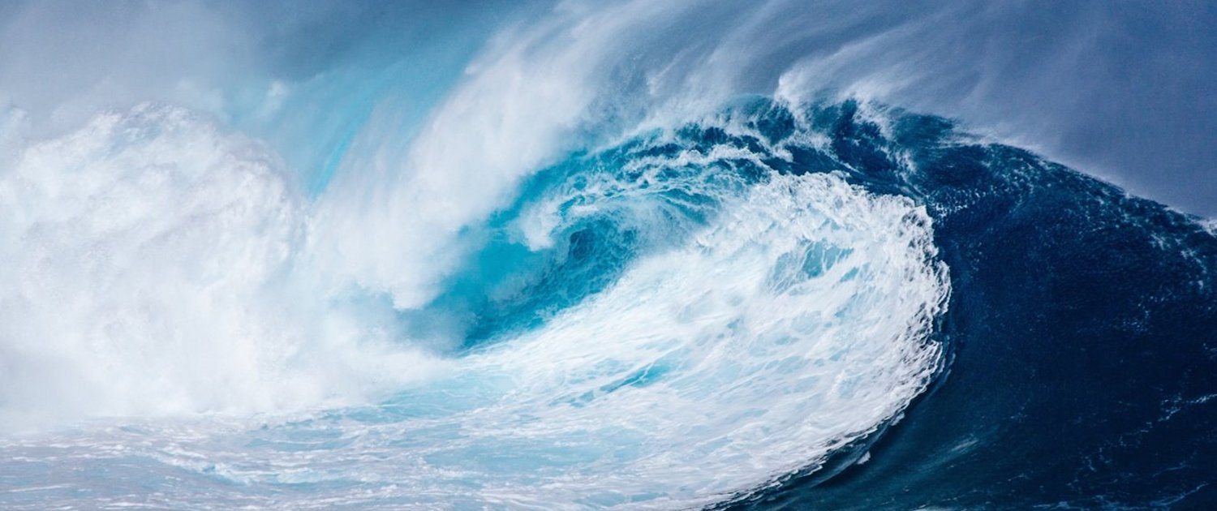
Achievements so far...
Summary 2021-22
Image credit: GEO Blue Planet

Slide 6
OBPS – a perspective repository, journal, capacity development, community engagement
Expanding number of records in the repository
(now 1580, an increase of 25% in 2021)
Increased use and growth of community collections
(51: Arctic, eDNA, SeaDataNet, MEDIN, SOCIB, etc)
Growing access to the OBPS
(e.g. 11300 visits from 164 countries in Dec 2021)
Global participation in annual BP Workshops
(>400 active participants)
Broader involvement through task teams and new volunteers – motivating a generational change

Slide 7
OBPS Roadmap
A global, sustained and trusted hub of ocean know-how
Supporting GOOS in globalizing and socializing methods across communities and organizations
Motivating and focusing a global conversation around best practices
Encouraging experts and organisations to endorse what “is best”
Harmonizing metadata and structures (FAIR BP)
Synergizing best practices and standards

Slide 8
OBPS 2021
Endorsement of Ocean Decade “OceanPractices”
Multilingual content and growing internationalization
Community support to develop BP
Creation of Stakeholder Community Forum
Task Teams*
Peer-reviewed Frontiers in Marine Science
Synergy with Ocean Info Hub (IODE Program)
*Diversity, eDNA, BP adaptation for DC, Decision trees (tbc), KPIs

Slide 9
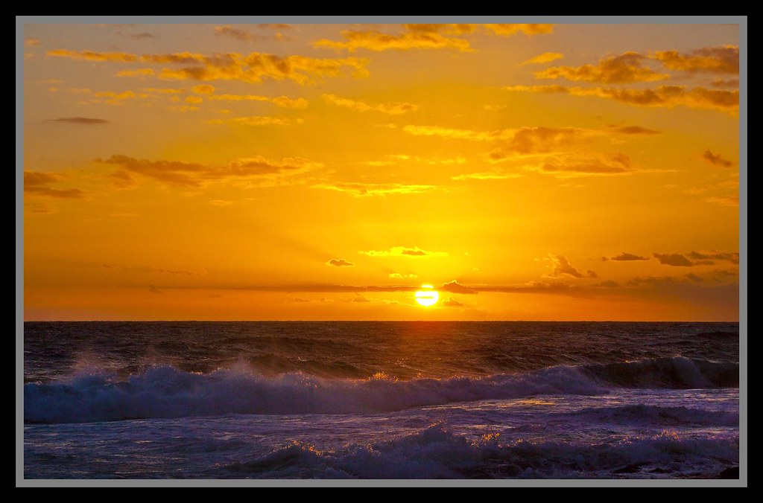
Future plans
Each day begins with a plan

Slide 10
OBPS 2022-23 – continuing our core work
OceanPractices broadly supports Ocean Decade
Expanding work with developing nations, remote regions and Indigenous Peoples
Africa, Arctic, South Pacific
Building out the value chain – modeling, applications
Broader inclusion of ECOP
In OBPS leadership roles, as ambassadors for BP
Federated Network of methodological management systems

Slide 11
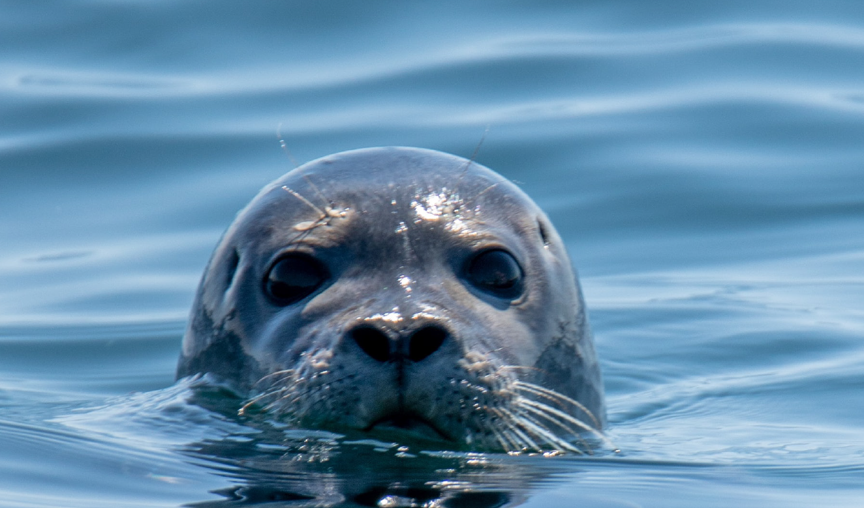
Opportunities – How can we work more Together
Expand endorsement of Best Practices
Coordination with GOOS in outreach
Co-creation and production of capacity development opportunities
Leverage GRAs in OBPS global actions
Image credit: GOOS Implementation Plan
Thank you for continuing OBPS Support

Slide 12
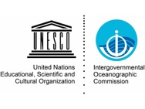
OBPS Steering Group - 2021
Sergey Belov
Mark Bushnell
Pier Luigi Buttigieg
Claudia Delgado
Juliet Hermes
Emma Heslop
Cora Horstmann Kirsten Isensee
Johannes Karstensen
Arno Lambert
Ana Lara Lopez
Adam Leadbetter
Frank Muller-Karger
Cristian Muñoz
Francoise Pearlman
Jay Pearlman
Peter Pissierssens
Rachel Przeslawski
Nick Roden Pauline Simpson
Jordan van Stavel

Slide 13
Thank you
goosocean.org
Photo credit: Tommy Bornmnan

