Slide 1
IPMA National Tsunami Warning Center - Status
Fernando Carrilho
ICG/NEAMTWS SC meeting
08-11 April 2022

Slide 2
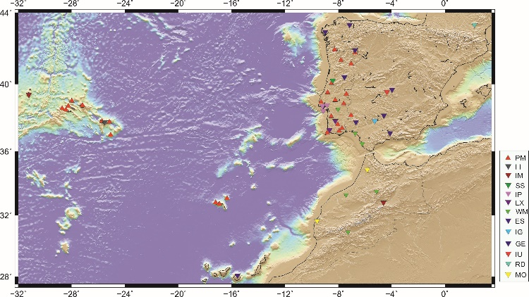
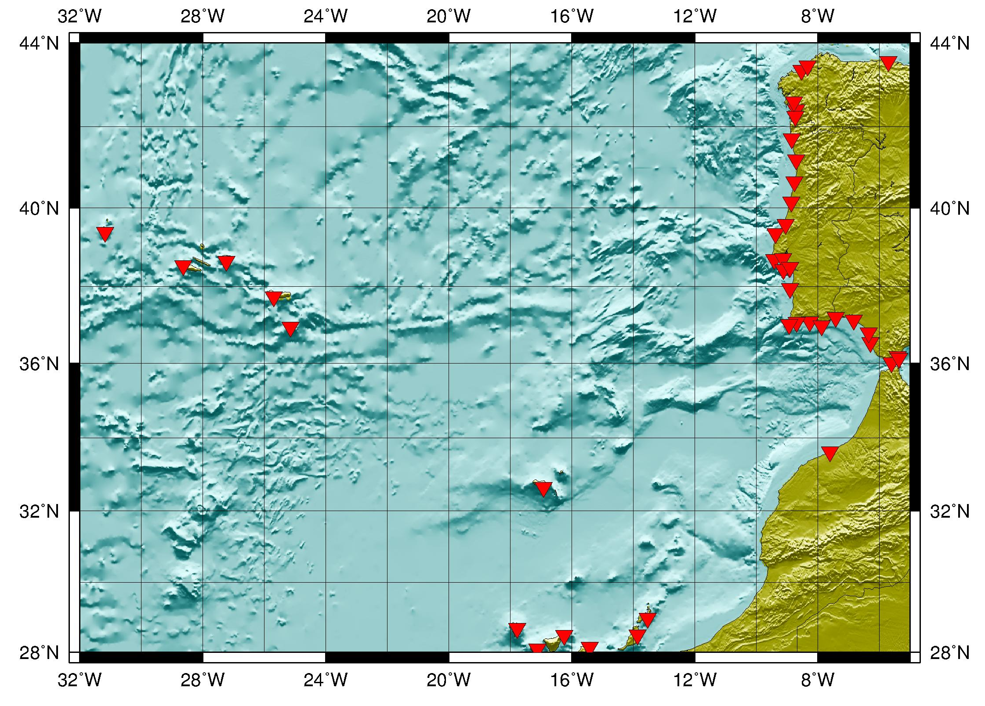
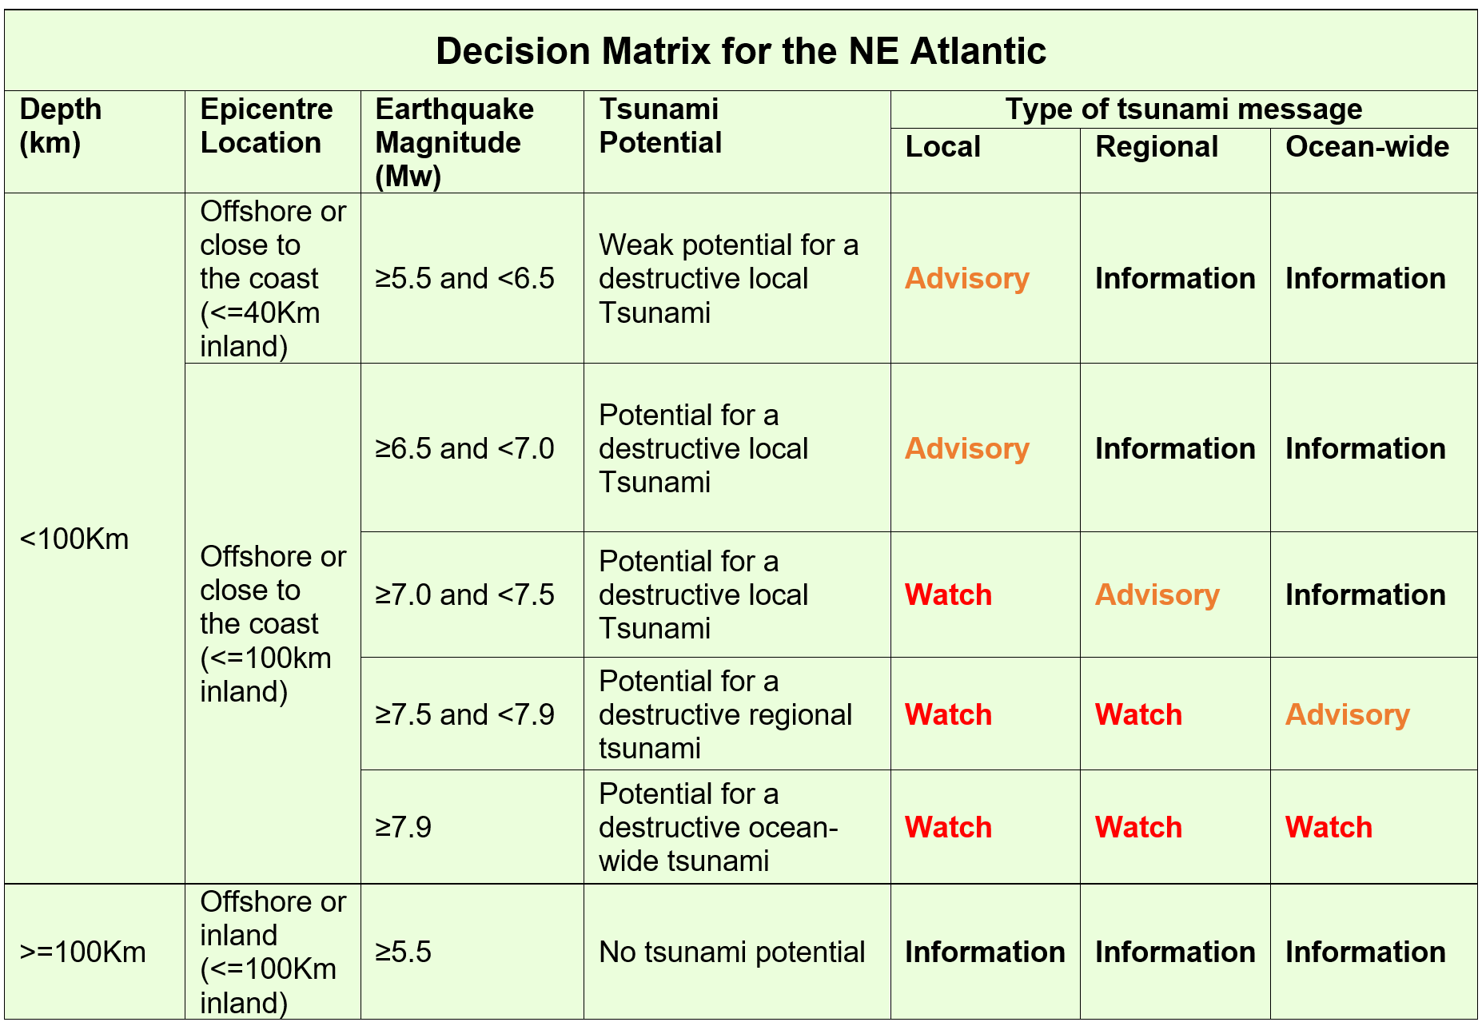
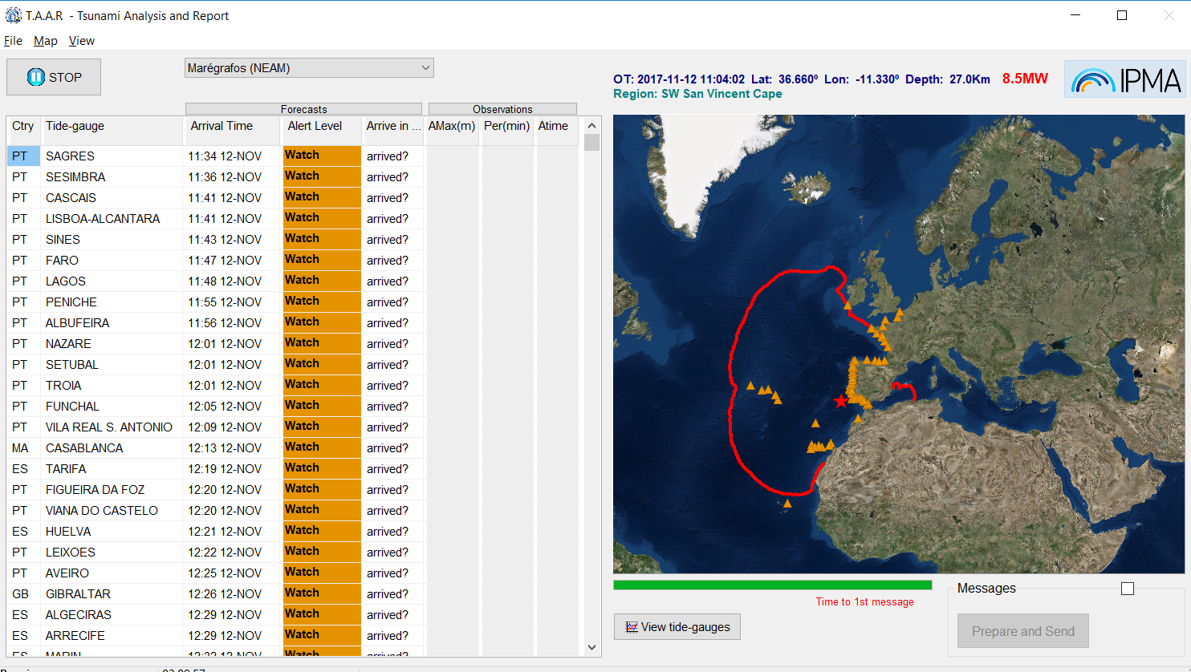
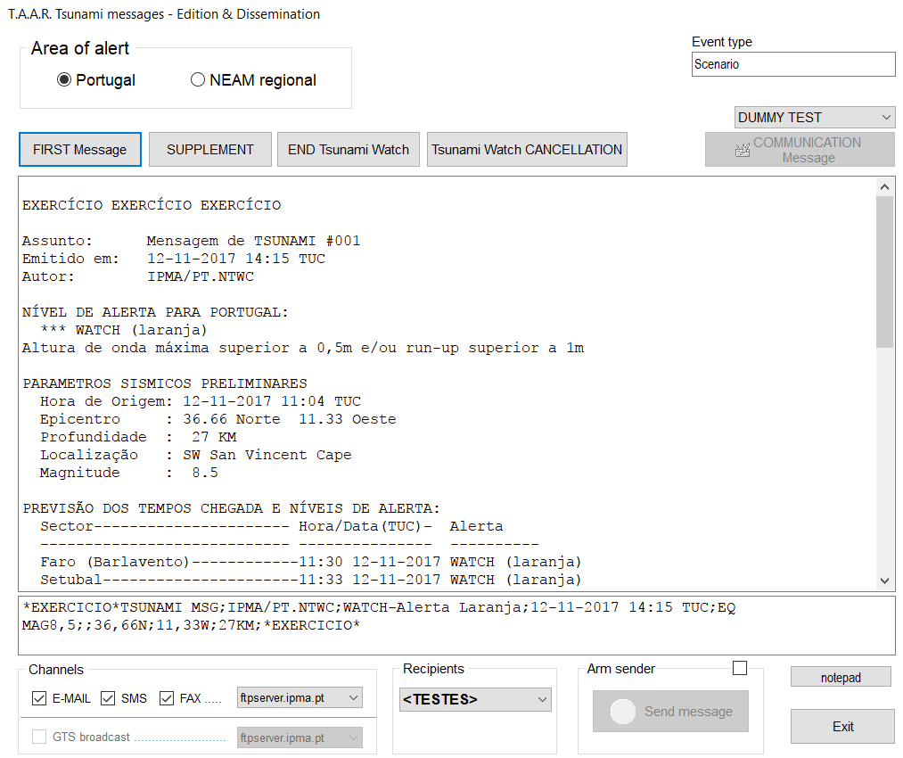
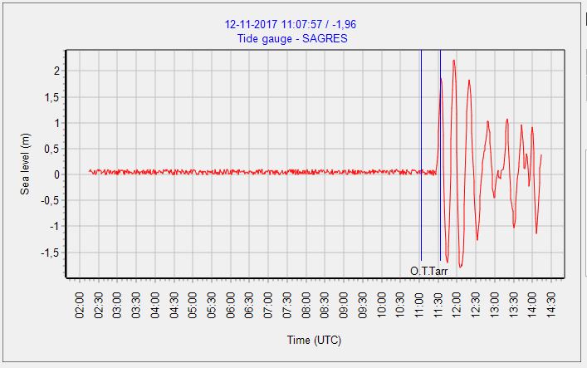
Schematic View
Seismic network
Sea level network
Decision Matrix
Tsunami Analysis and Report
ALERT!
Civil Protection System

Slide 3
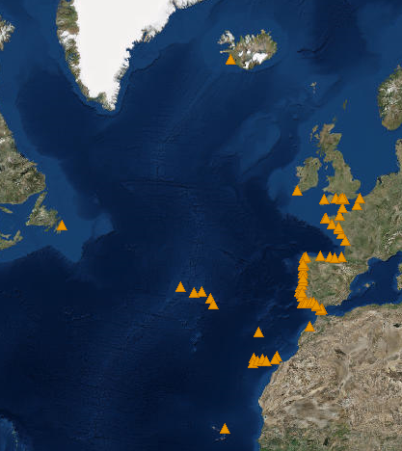
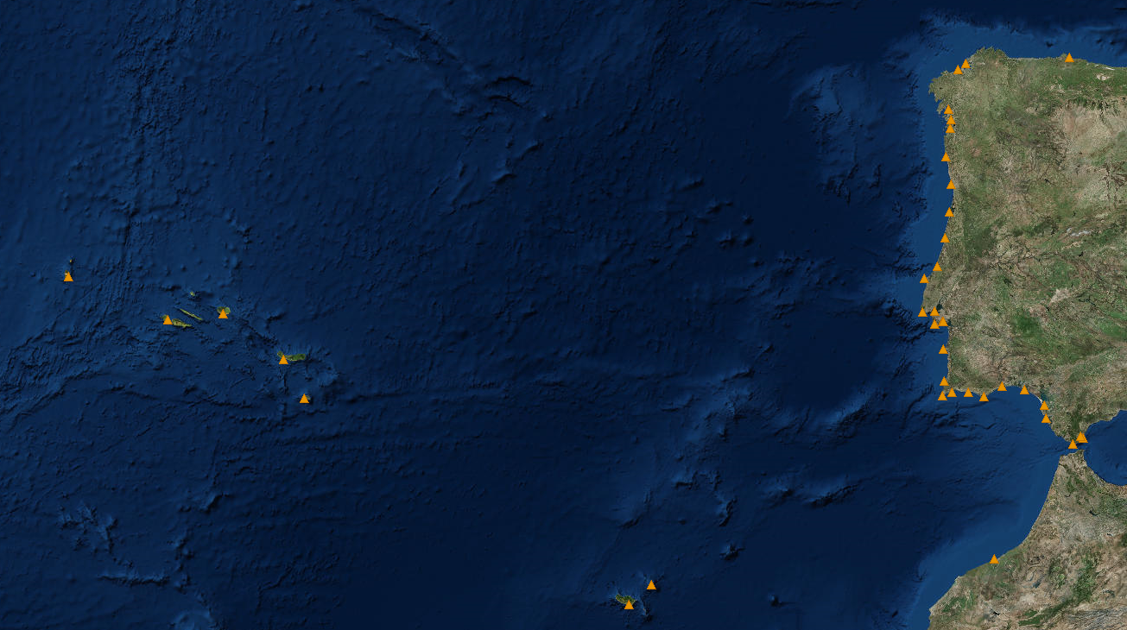
Sea level network
Internet
GTS
MPLS
Internet
GTS
MPLS
Langosteira
Ferrol
Gijon
Vilagarcia
Marin
Vigo
Viana
Leixões
Flores
Aveiro
Figueira da Foz
Lisboa
Nazaré
Troia(
Angra
Peniche
Horta
Cascais
Setúbal
Sesimbra
Huelva
Sines
Bonanza
Ponta Delgada
Arrifana
Algeciras
Santa Maria
Sagres
Lagos
V.R.S. António
Albufeira
Cádiz
Faro
Tarifa
X
Gibraltar
64 stations
Porto Santo
Casablanca
Funchal
Sources:
CENALT, seiscomp/MPLS (SHAUM stations)
IH, webservice/internet (Instituto Hidrográfico)
JRC, webservice/internet
GTS (IH & Cape Verde)
DGT sites, webservice/internet (Direção geral do Território)
IGN seiscomp/internet (Puertos del Estado stations)
Instituto Hidrográfico
Puertos Del Estado (via IOC & IGN)
Direção Geral do Território
CNRST (via CNRST & JRC)
JRC (ipma & ign support)
IOC

Slide 4
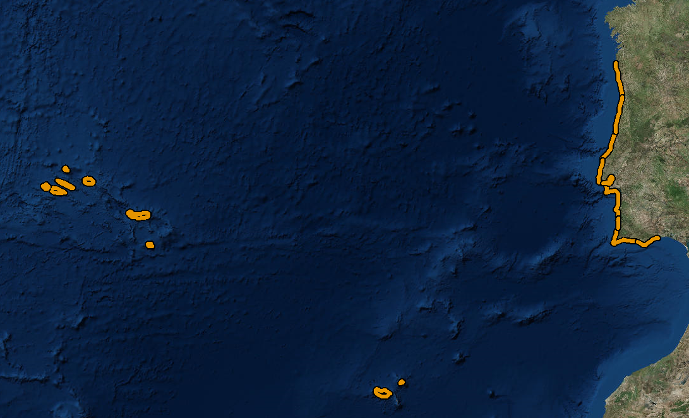
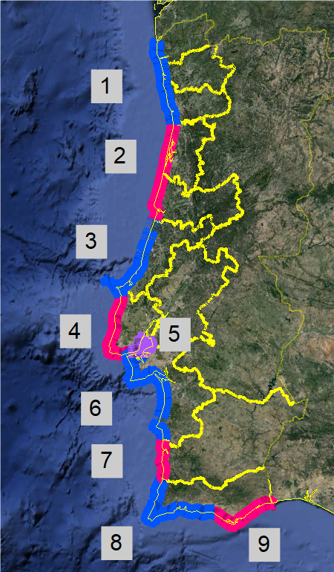
Forecast coastal segments
Mainland
1. Viana-Braga-Porto
2. Aveiro-Coimbra
3. Leiria
4. Lisboa Atlântico
5. Estuário Tejo
6. Setúbal
7. Beja
8. Faro Barlavento
9. Faro Sotavento
Islands
10-11. Madeira & Porto Santo
12-20. Azores islands
Islands
10-11. Madeira & Porto Santo
12-20. Azores islands
For each segment:
Early tsunami arrival time
Maximum alert level

Slide 5
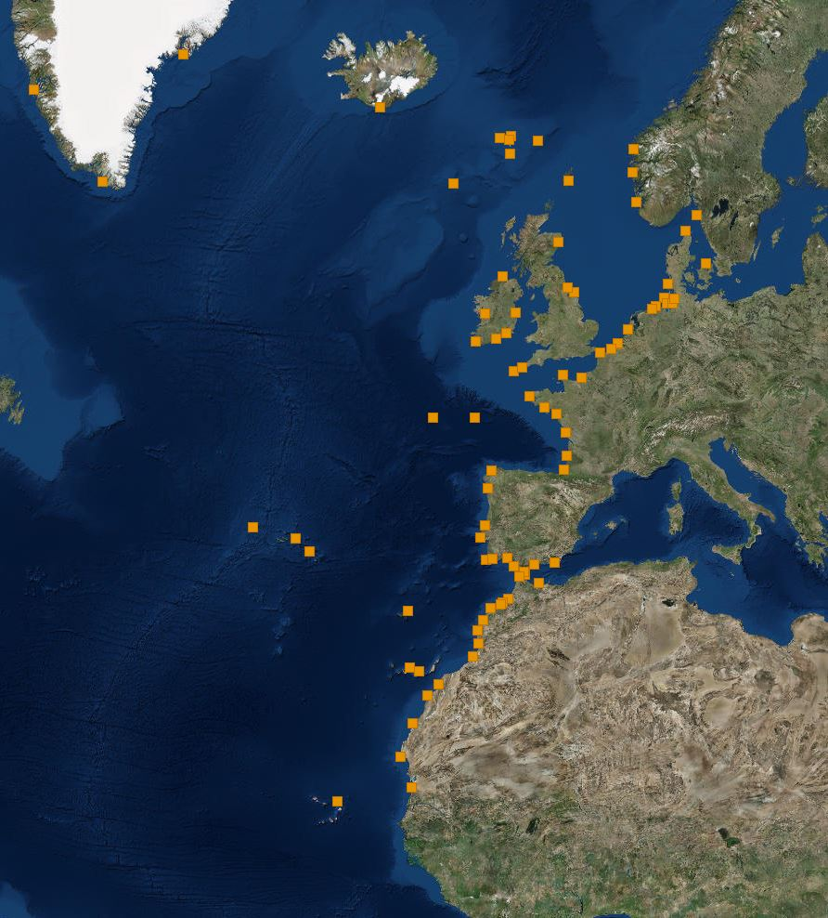
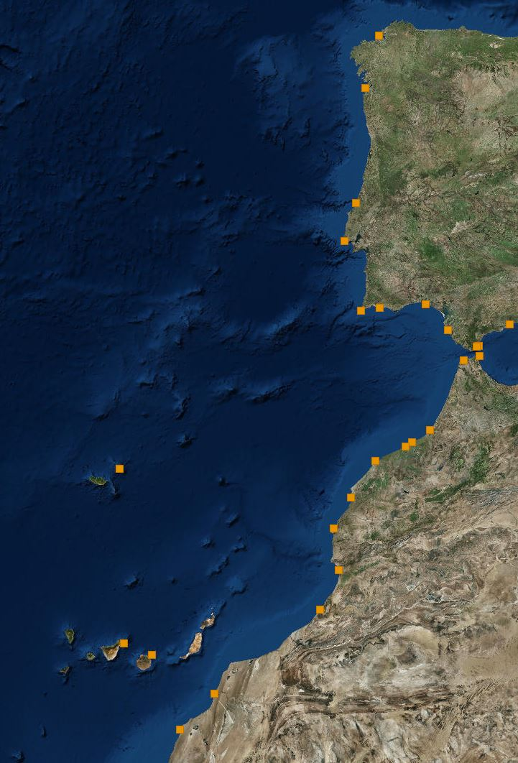
Forecast points – Regional TSP

Slide 6
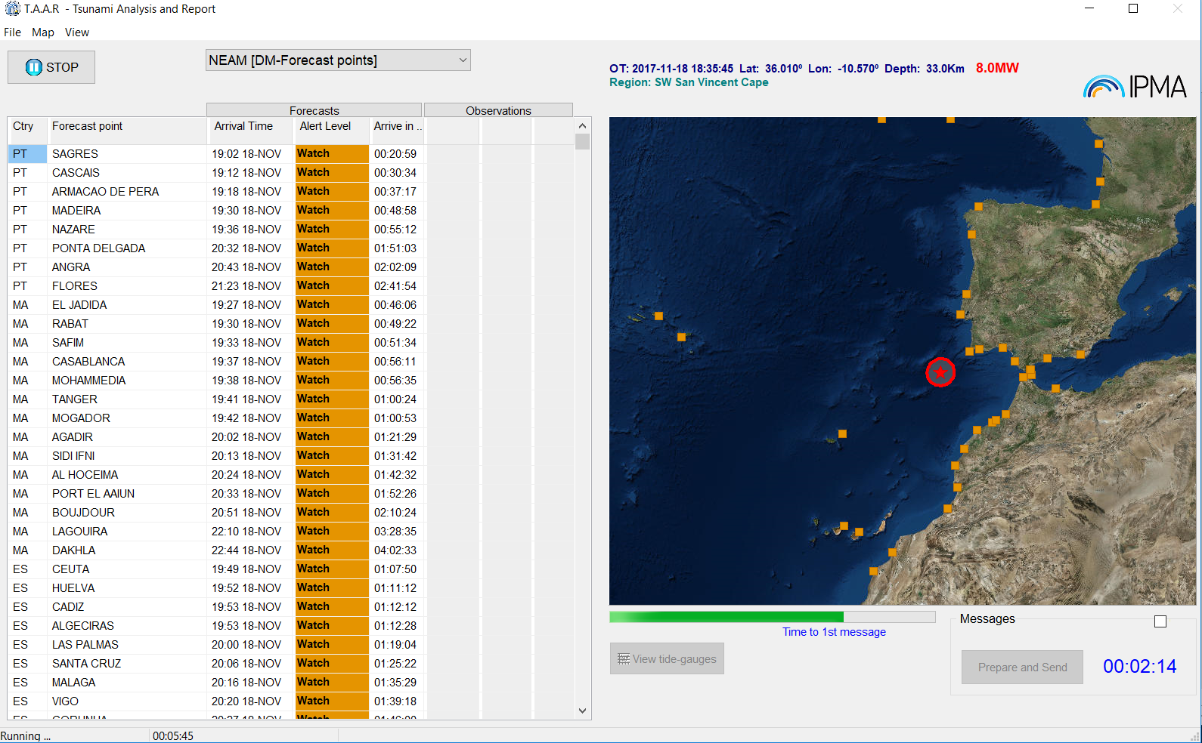
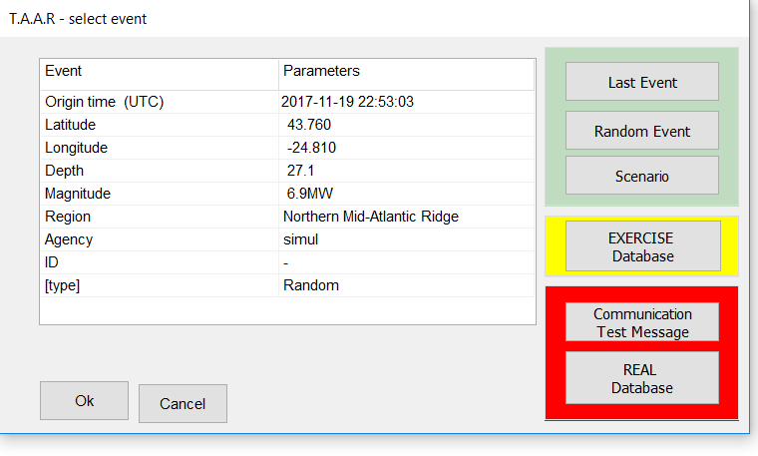
TAAR – Tsunami Analysis And Report
Testing purposes
(include random full scenarios)
Exercise Mode
(Neamwave21, others)
Real events and
Communication tests

Slide 7
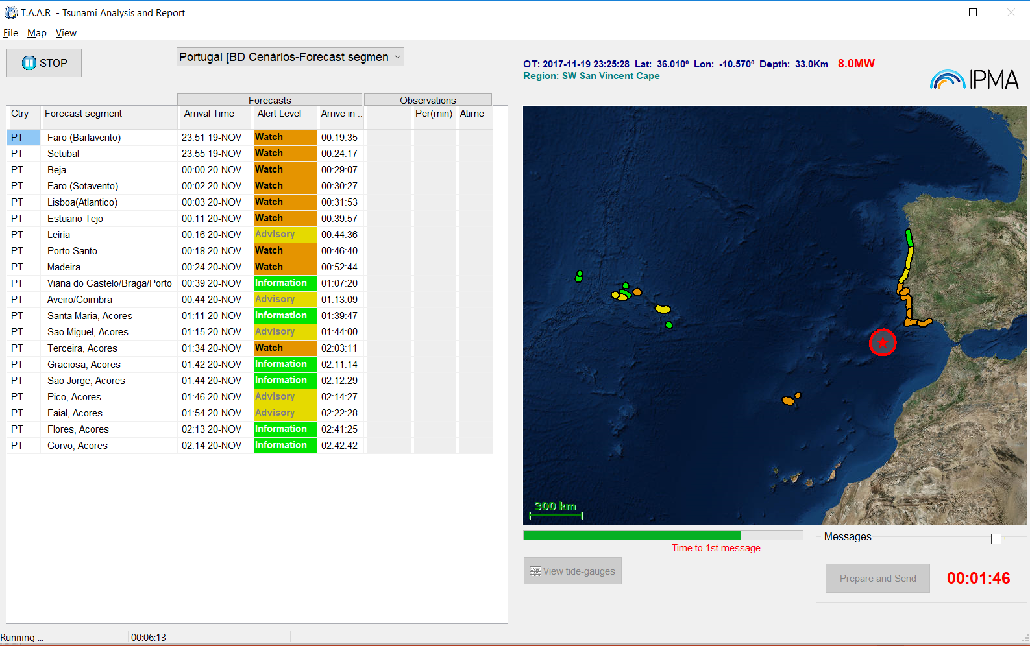
TAAR – Tsunami Analysis And Report
NEAM forecast points
Run TTT and apply decision matrix
OR
Scenario database
National coastal segments forecast
Expected
TsuArrTime
Time to tsunami arrive
Alert
Level
Expected
TsuArrTime
Time to tsunami arrive
National coastal segments
Alert
Level
Countdown Time to issue 1st message

Slide 8
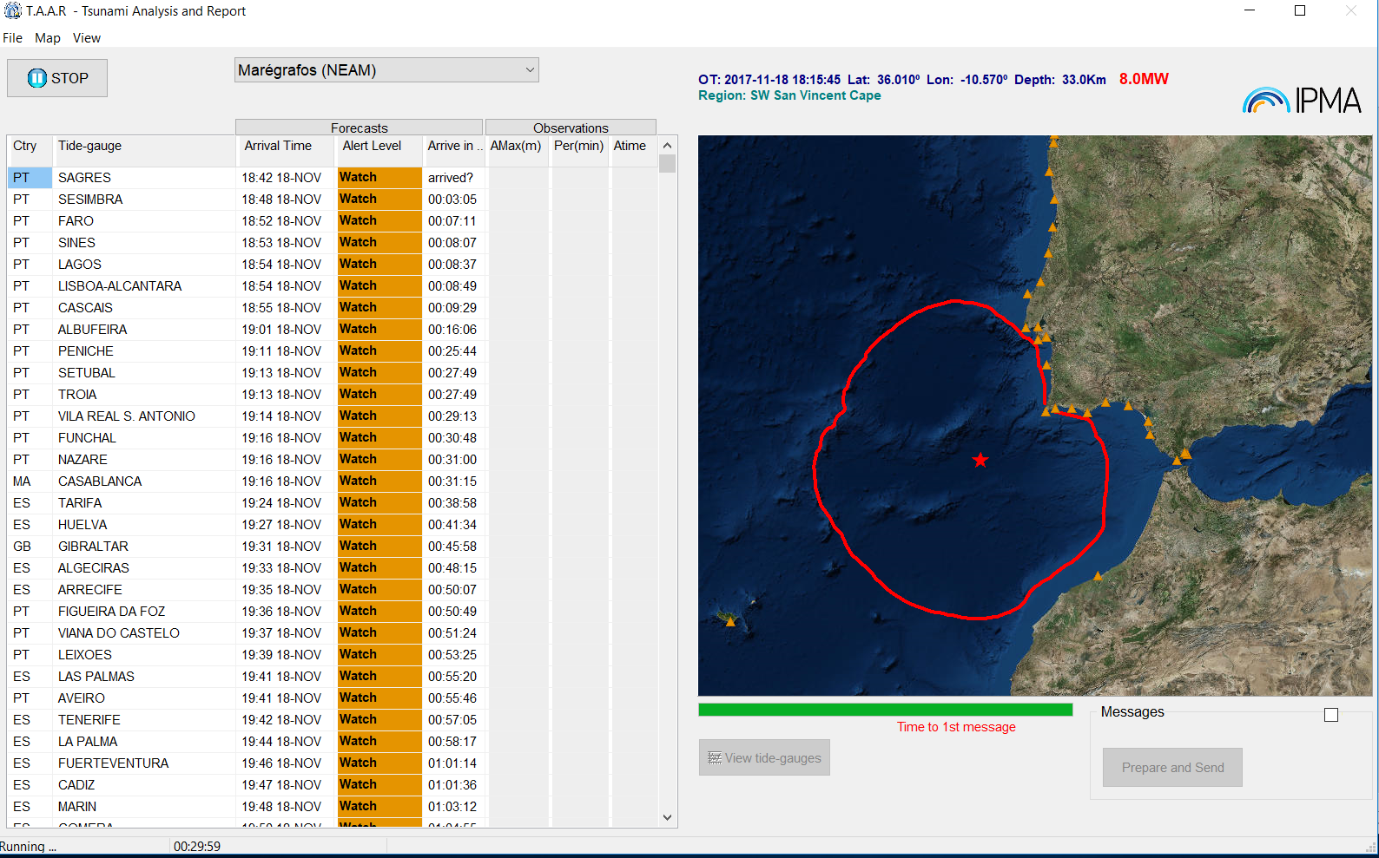
TAAR – Tsunami Analysis And Report

Slide 9
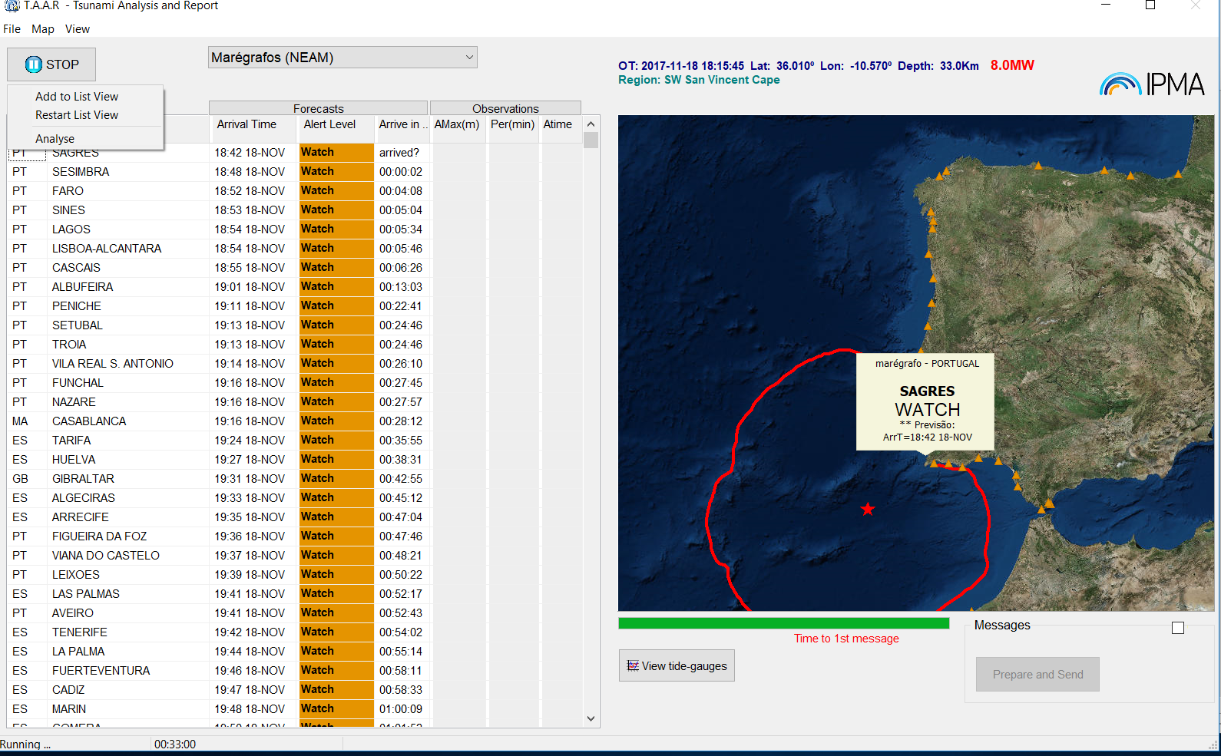
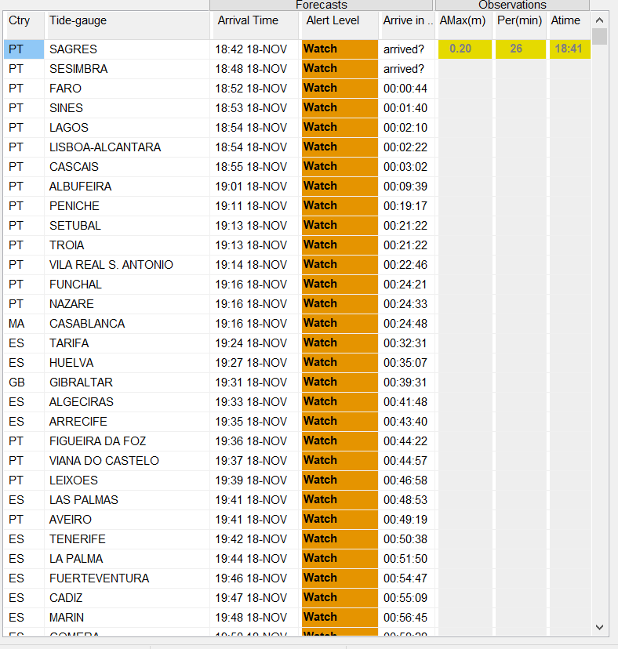
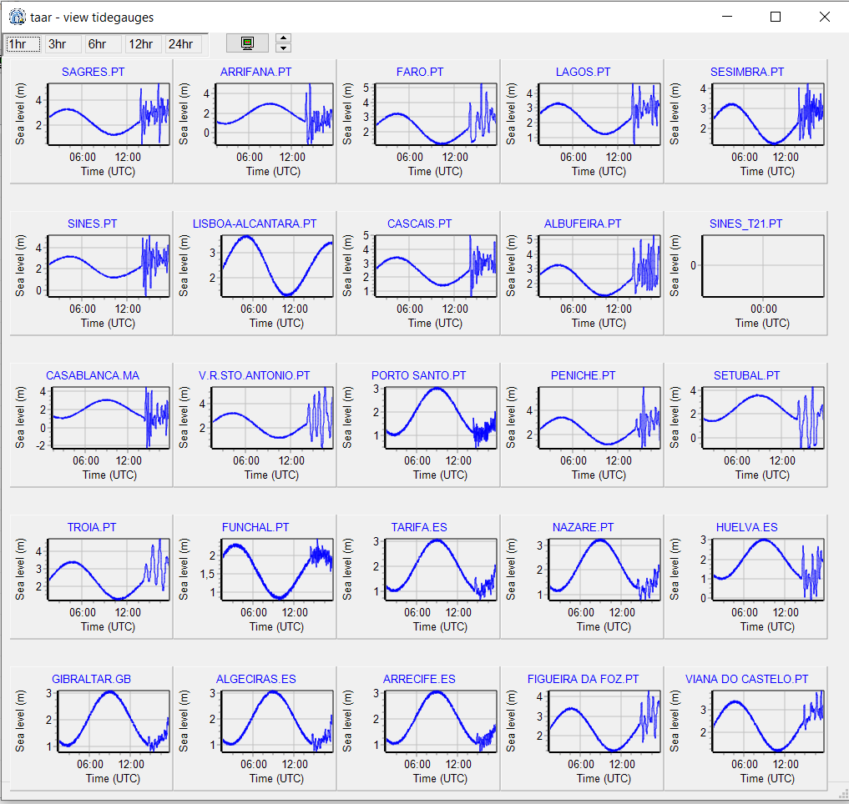
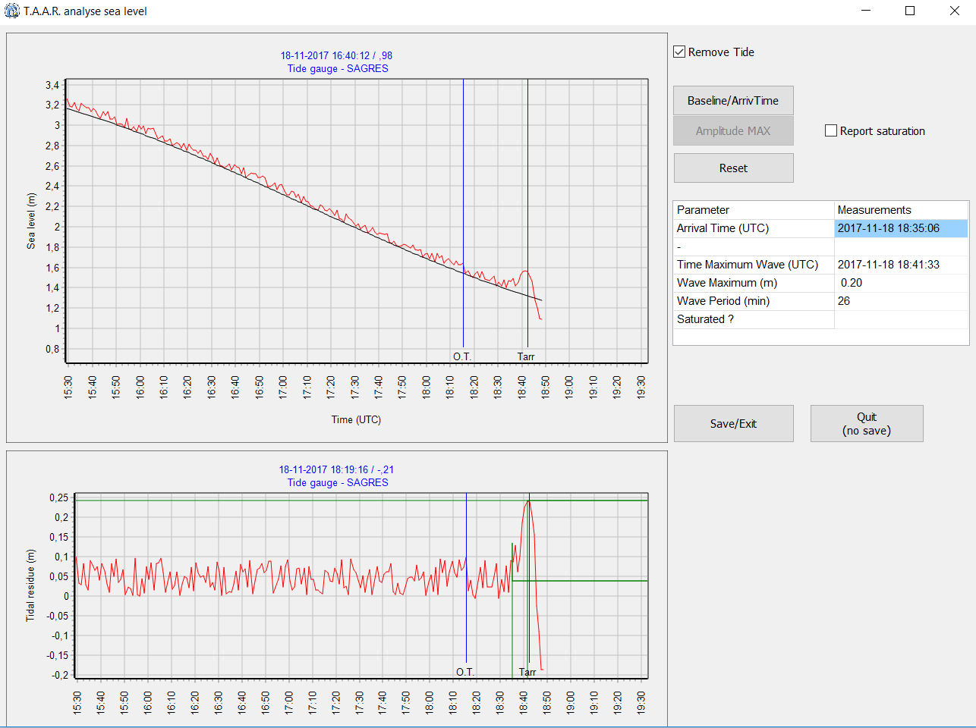
TAAR – Tsunami Analysis And Report
Upgrade
on real-time sealevel monitoring

Slide 10
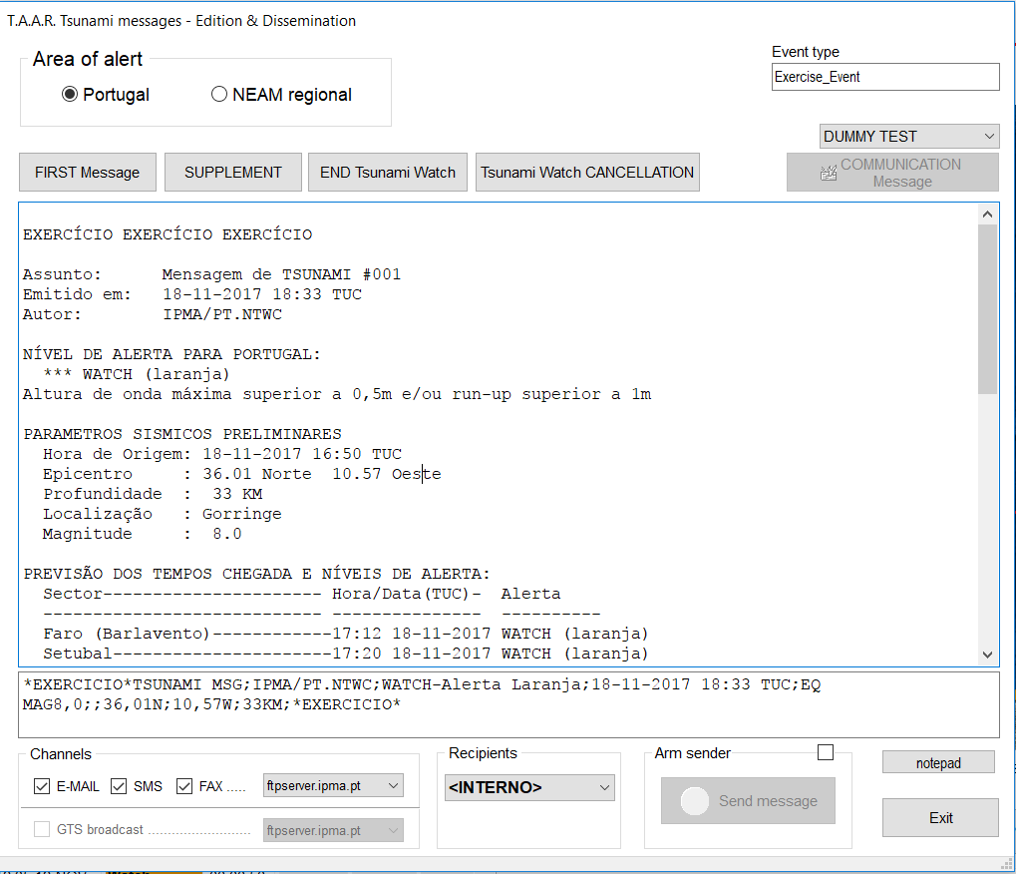
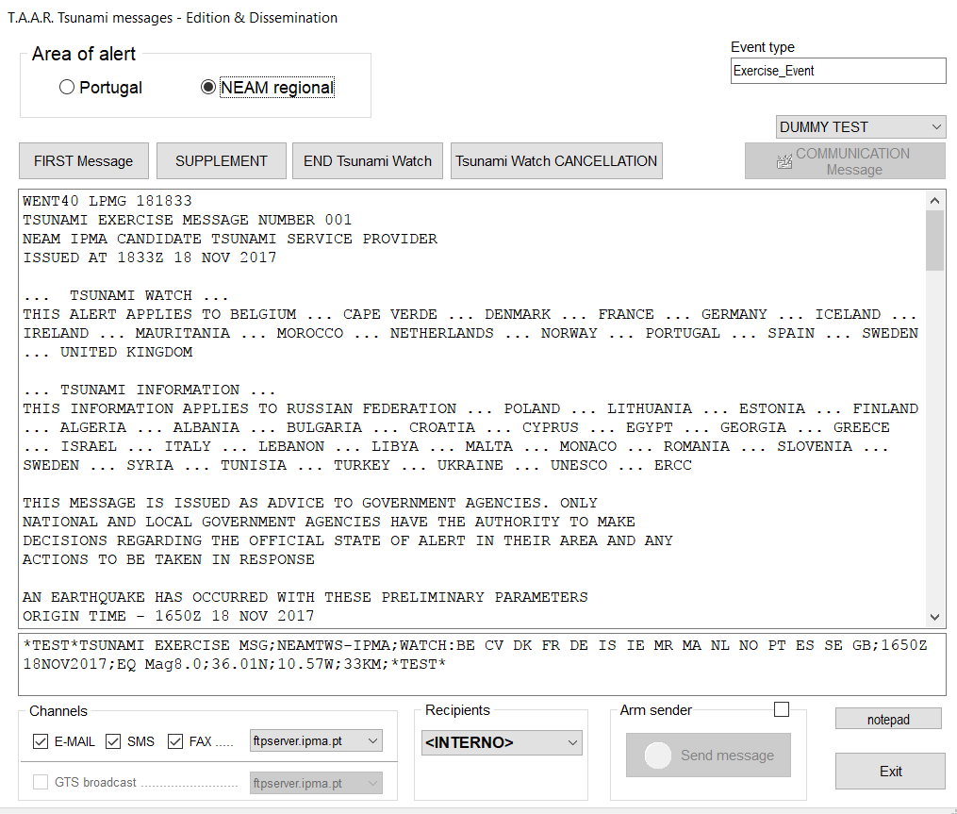
TAAR – Tsunami Analysis And Report
EMAIL
FAX
GTS
EMAIL
FAX
SMS
To be improved
(SMS)

Slide 11
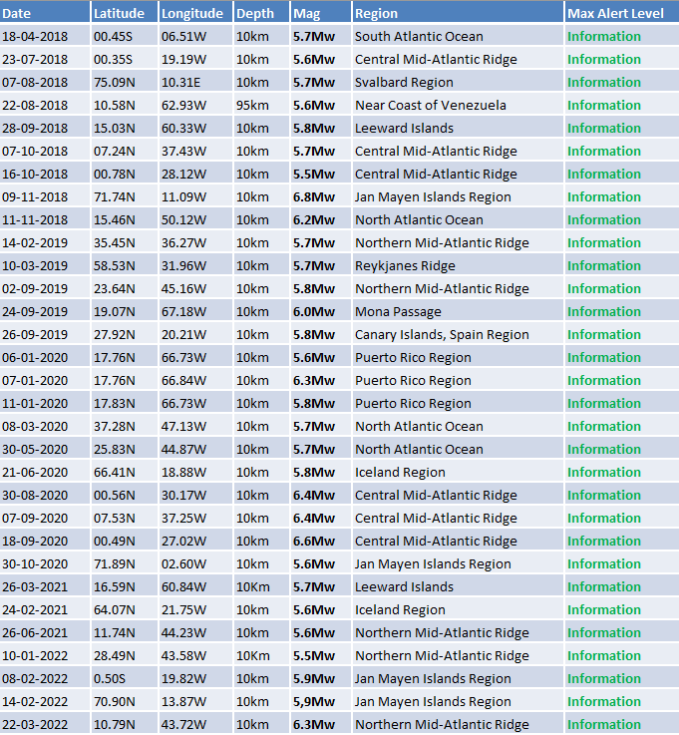
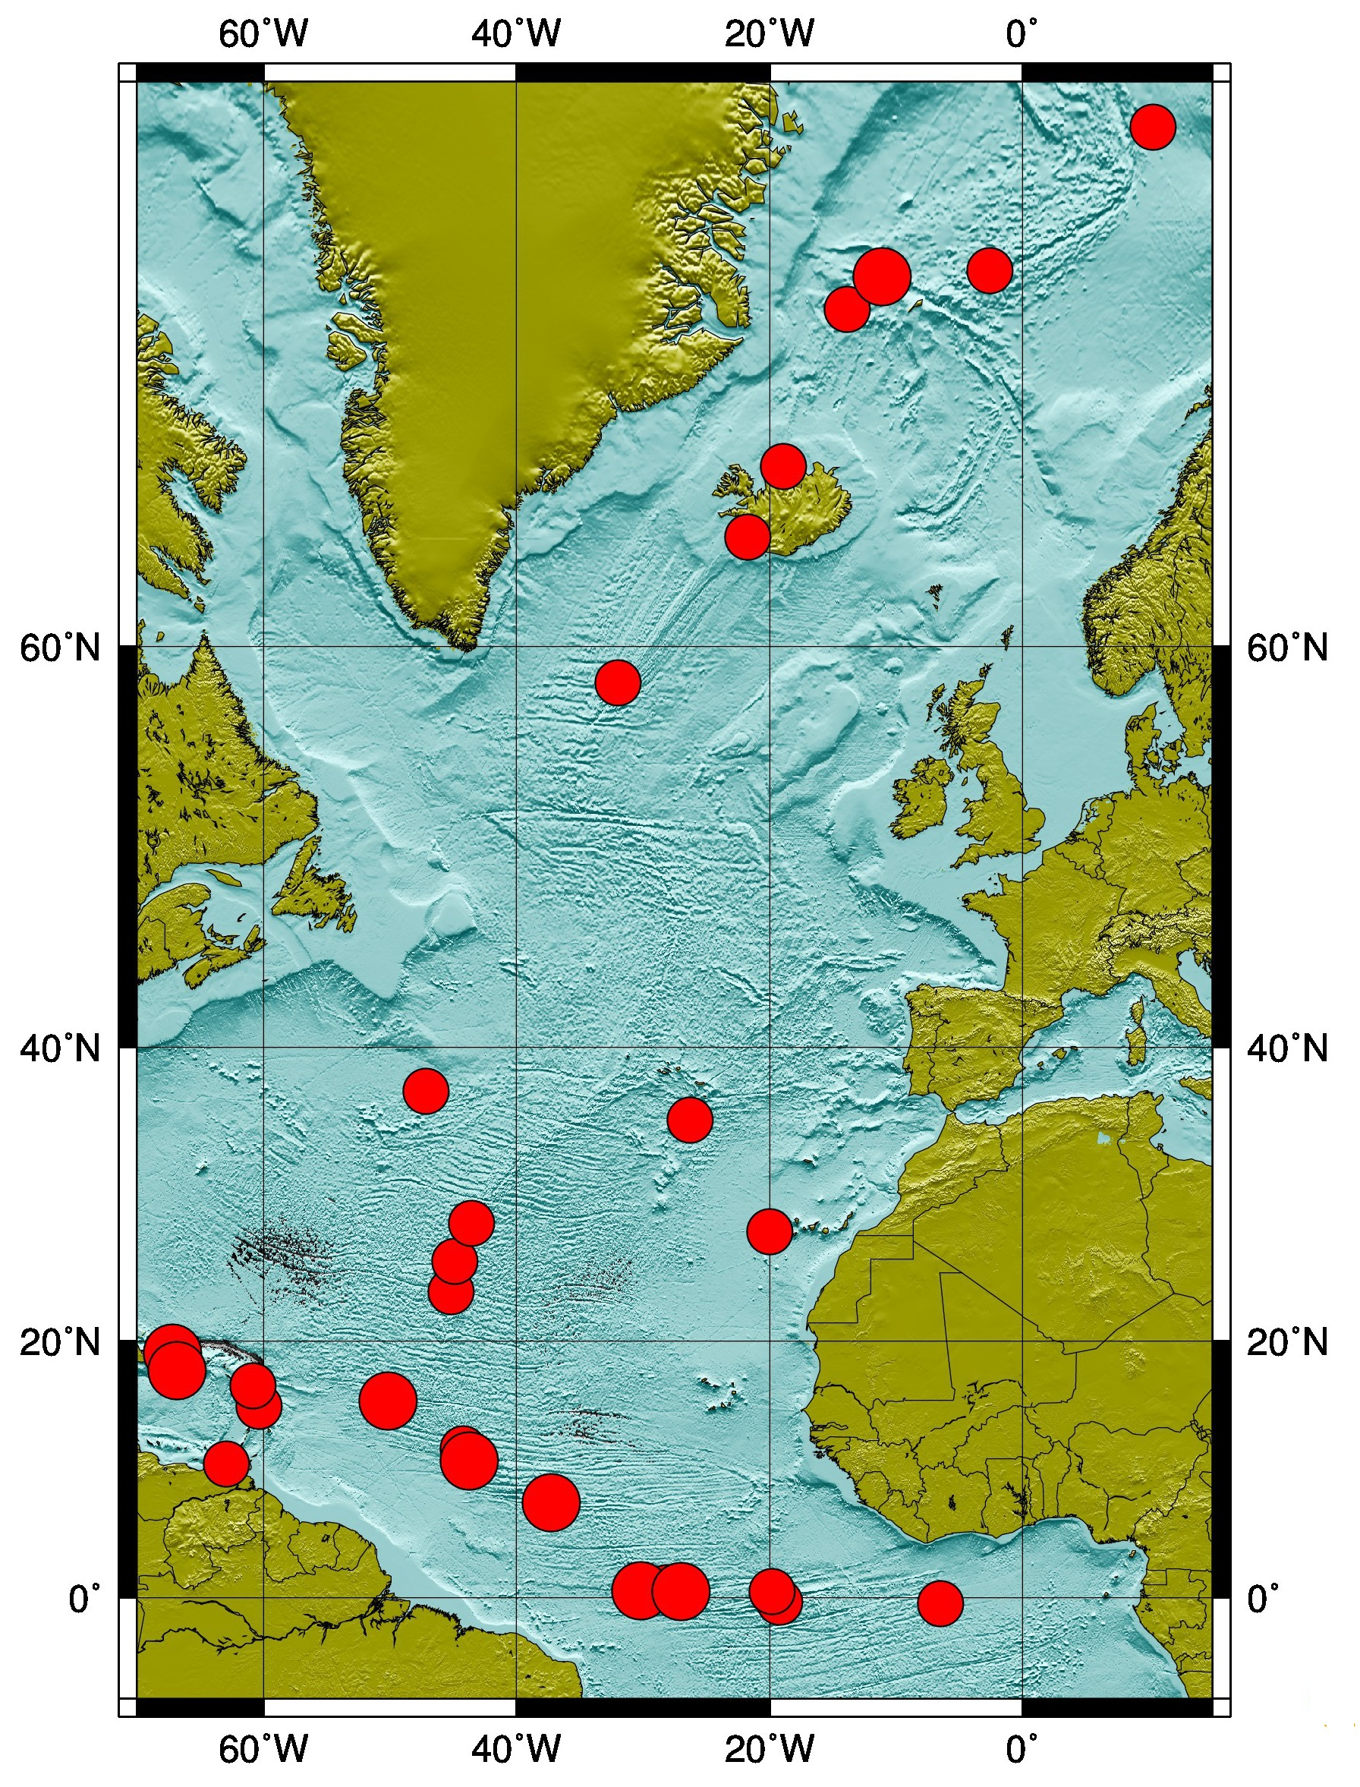
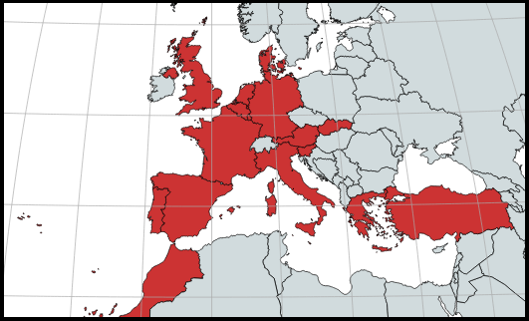
Regional level – TSP for NE Atlantic
Operation started on january 2018
Accreditation on 2019
31 Tsunami messages issued:
Subscribers:
Portugal
Spain
Morocco
Denmark
France
Germany
UK
Turkey
Greece
Italy
IOC, ERCC and JRC
31 events

Slide 12
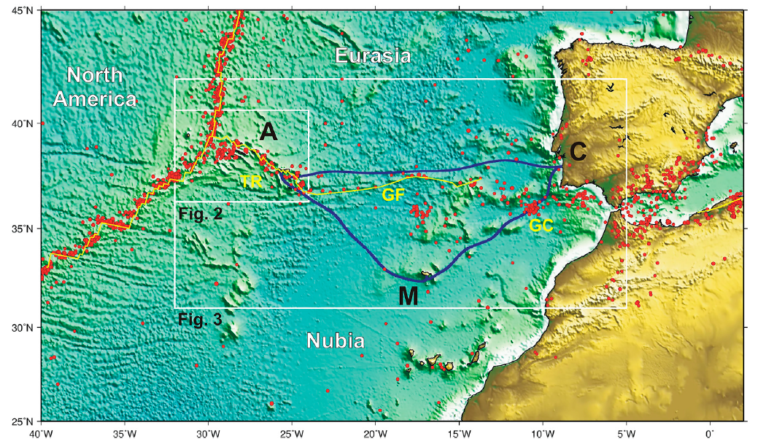
Future perspectives #1
New Submarine Cable Ring connecting PT Mainland-Azores-Madeira –
opportunity for a SMART system (SMART CAM)
December 2019
Working group nominated by the Government recommended the implementation of “....Seismic and Environmental Detection”
September 2020
Government published the decision of Renew the CAM ring including “Seismic and Environement Detection”
Public company, IP TELECOM, designated to implement the project
October 2021
Project included in the general budget of the state for 2022 (~57M€)
SMART funcionalities included
from Matias et al., 2021

Slide 13
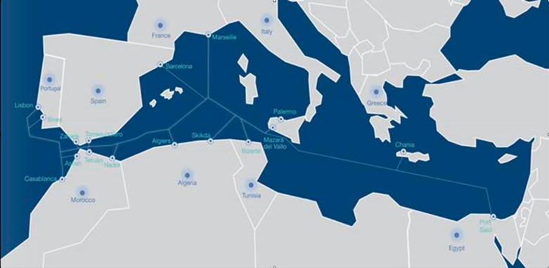
Future perspectives #2
A new submarine cable – MEDUSA
another opportunity for a SMART system
Connects Lisbon-Gibraltar-Barcelona-Marseille-Sicily-Crete with branches to North Africa (9 countries; possible +2, Turkey and Lybia)
On service in 2025
Private promotor (Afr-IX)
Telecom portion already funded (~326M€)
Extra 26M€ required to become SMART:
Sponsors for CAPEX ...?
Ministries/agencies concerned with early warning, climate and ocean, telecom and finance...
aprx 2,1M€/y during 15years
58 repeaters (accelerometers, temperature, pressure)

Slide 14
Thank you !

