Slide 1
TSUNAMI READY TOOLS
ICG/NEAMTWS SC Meeting
8-11 April 2022
Task Team on Disaster Management and Preparedness,
Key Discussions and Recommendations, 22-22 Feb 2022
Denis Chang Seng, PhD
Programme Specialist Tsunami Unit, Technical Secretary (ICG-NEAMTWS) Global Ocean Observing System (GOOS) & IOC Focal point for MHEWS/ IN-MHEWS Intergovernmental Oceanographic Commission of UNESCO

Slide 2
TOWS Task Team on Disaster Management
and Preparedness
Key Discussions and Recommendations to TOWS-WG
21-22 Feb 2022

Slide 3
IOC Tsunami Ready Guidelines and Tsunami Ready Logo
Key Discussions
The MG 74 on Standard Guidelines for the Tsunami Ready Recognition Programme and Tsunami Ready Logo have gone through a series of revisions and updates.
Municipalities/communities that started the accreditation procedure using the previous scheme of indicators should update it to the new one if they apply for accreditation after the approval of the new guidelines.
Importance of standardizing Tsunami Ready signs in order not to confuse for example visitors

Slide 4
Recommendations to TOWS
Tsunami Ready Logo
Requested that only communities that have received recognition of TR receive automatic approval for the usage of the TR logo for the duration of their TR status in its official products and documents,
Requested that any other entities (including National TR Boards) must request approval from UNESCO/IOC Secretariat to use the Tsunami Ready logo.
Further requested that the automatic approval for the usage of the logo by Tsunami Ready communities be informed by the IOC Secretariat in the Tsunami Ready designation letter with regards to MG 74.
NEAMTWS
NEAMTWS

Slide 5
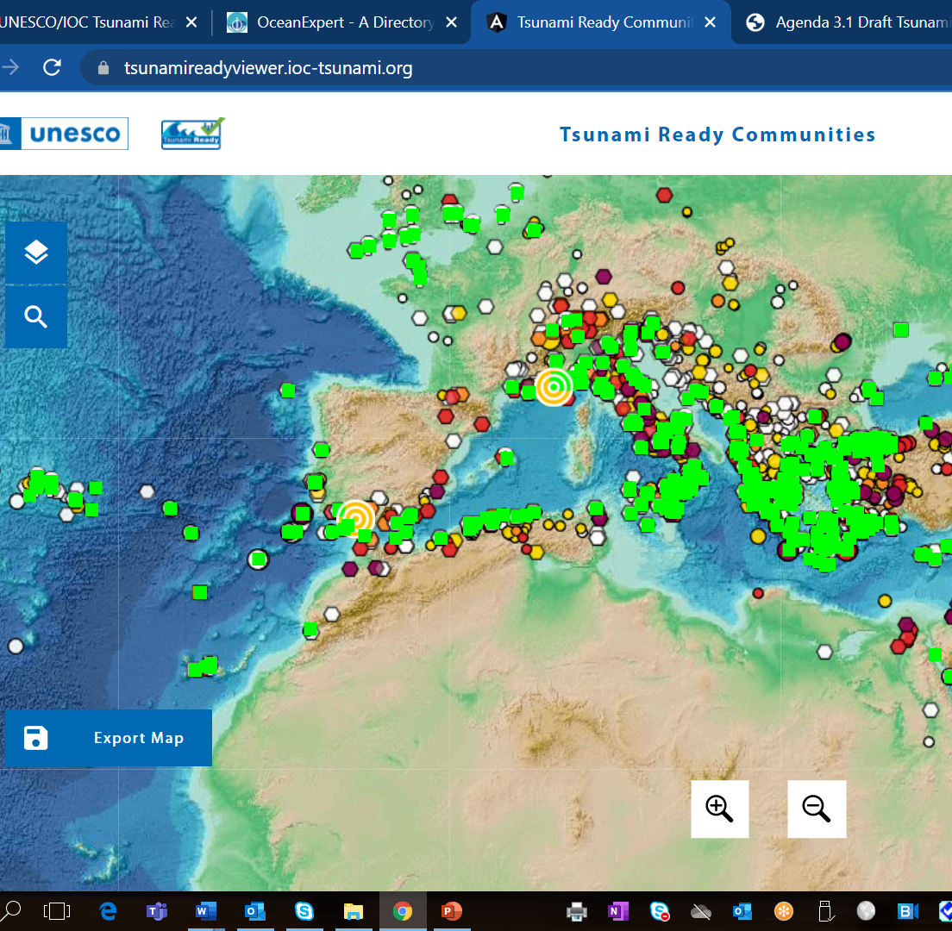
Tsunami Ready Interactive Map Viewer
Key Discussions
Currently 30 TR recognized communities.
The interactive map is driven by an Excel data spreadsheet which will be populated
The TR Map Viewer is completed in accordance with the UN political border requirements, disclaimer and use rights.
The TR website hosted* by ITIC:
contains information about the Programme,
Easy links to the TR Map Viewer
Information page on each community that has been recognized as UNESCO IOC Tsunami Ready.
Secretariat developing internal procedures and workflows between the TR Boards, TICs and the Secretariat to manage the TR recognition process.

Slide 6
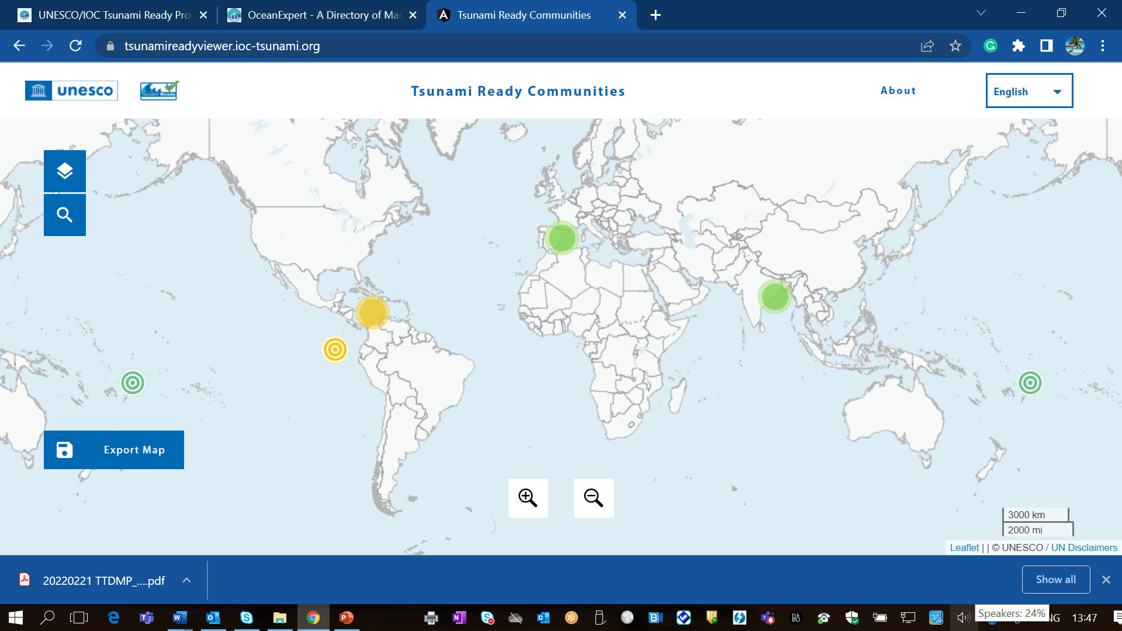
Tsunami Ready Interactive Map Viewer

Slide 7
Tsunami Ready Resource Documents & Tools
Recommendations to TOWS
Noted with appreciation the hosting of the TR web site by ITIC,
Further noted the importance to have TR resource documents available in local languages, Requested ICGs and the IOC Tsunami Programme Secretariat to advise countries that are currently in the process of implementing TR , to now follow the MG74 when submitting/applying for Tsunami Recognition, and that MG74 will apply for all future applications.
Noted that there are Member States that have their own tsunami preparedness programmes that align closely with the UNESCO/IOC Programme, and
Requested the TT-DMP to consider a mechanism to equate those programmes to Tsunami Ready.

Slide 8
Tsunami Ready Communication Tools
Key Discussions
New TR Board Game and Animation Video Series as part of the Tsunami Ready Communication Tools.
Printing the board game costs 60 USD. IOTIC has delivered 200 board games in Indonesian and English.
In future, the board game can be translated into different languages, however, the shipping cost is high compared to the actual cost of production.
IOTIC is happy to share all files with respective ICGs for their own production.
Additional funding is needed to continue the development of communication tools.
The meeting was interested in possible marketing strategies to make the game more available to the public.
Source: IOTIC

Slide 9
Tsunami Ready Board Game
Source: IOTIC
IOTIC sent 6 TR Board Game to Paris
Vladimir
Bernardo
Denis
Soichiro Yasukawa
Vinny
And one for the UNDOS Secretariat.

Slide 10
To Paris I sent 6 boxes with attention to Bernardo, the 6 boxes are for:
Vladimir
Bernardo
Denis
Soichiro Yasukawa
Vinny
And one for the UNDOS Secretariat.
How to share our six?

Slide 11
Tsunami Ready Video Series
Recommendations to TOWS-WG
Noted with appreciation the development and production of a new TR Board Game and supporting animation video series prepared by IOTIC,
Noted that additional resources will be required for the production and translation of TR Board Game into several languages.
Source: IOTIC

