Slide 1
Global Ocean Observing System
Chris Redgate &
Pete Lasher
Steering Committee
28 April 2022

Slide 2
Who We Are
60
3,000+
30+ / 7
Years of Service to Non-profits Worldwide
Consulting & Support Services Provided to More than 3,000 Non-profits & NGOs
Our Client Work has Reached Across Over 30 Countries &
7 Continents
100+
100+
$60B+
Fundraising Campaigns of $1 Billion or More Supported
Consulting Partnerships in Academic Medicine and Research Institutes
Aggregate Current Client Fundraising Goals
Grenzebach Glier and Associates | Confidential – Not for Duplication
www.grenzebachglier.com

Slide 3
The Purpose of Our Project
Assist GOOS in developing a philanthropic messaging strategy:
A focused set of ideas that that emanate from GOOS mission, vision, and brand
An articulation of the opportunity to create a solution to a significant challenge
An argument for why philanthropic support is essential to success
An expression of the positive impact that this support would generate
Philanthropic messaging shows prospective donors how your work serves their goals for creating positive change.
Grenzebach Glier and Associates | Confidential – Not for Duplication
www.grenzebachglier.com

Slide 4
Our Approach
Introductory and Concluding Meetings
8 interviews with a range of experts
Ideas Workshop with Co-Chairs
GOOS 2030 Strategy
Framework for Implementation
Independent Research
Grenzebach Glier and Associates | Confidential – Not for Duplication
www.grenzebachglier.com

Slide 5
Our Approach
Philanthropy seeks to deliver a solution to a societal challenge. Acting according to their own values, donors invest in organizations whose mission it is to create that solution. To attract support, we must rigorously discern and convey our distinct ability to deliver this.
1. Frame the Challenge
Why is ocean observing important?
What needs are not fulfilled?
What are the barriers to and opportunities for improving things?
Who or what is harmed or endangered by the unfulfilled need?
Grenzebach Glier and Associates | Confidential – Not for Duplication
www.grenzebachglier.com

Slide 6
Our Approach
2. Identify the Strengths
What is our organization’s uniquely position and strength?
In what way is this vital to a positive outcome?
3. Establish the Vision
What is the solution that this organization can provide?
What investments need to be made to deliver that solution?
4. Convey the Impact
What positive change is brought about by fulfilling this vision?
Who or what benefits from the fulfillment of this vision?
Grenzebach Glier and Associates | Confidential – Not for Duplication
www.grenzebachglier.com

Slide 7
Findings: Framing the Challenge
Ocean is important to all life on earth
Ocean will create and can predict the future state of planet
Ocean affects all air, water, land, atmosphere, weather, disasters
Ocean affect life, food, livelihoods, economy, safety, security
Ocean is known to be changing but is critically under-observed
Heat and carbon are both grave concerns and big uncertainties
There are gaps in observing and inconsistencies in tech and standards
All current decisions and policies are based on insufficient info
Vast majority of the ocean is international waters
Government funding is directed toward national interests
Big disparity between what wealthy and poor nations can do
Poor are disproportionately affected and vulnerable
Scope +
Magnitude
Need + Urgency
Context
Grenzebach Glier and Associates | Confidential – Not for Duplication
www.grenzebachglier.com

Slide 8
Findings: Identifying the Strengths
GOOS sees across the whole observing system
GOOS is the entity that connects all the parties
GOOS has a sound strategy for the future
GOOS has a framework for implementation that strategy
GOOS has an international mandate and the ability to speak to nations
The observing community is mature -- ready to act and to be scaled
Grenzebach Glier and Associates | Confidential – Not for Duplication
www.grenzebachglier.com

Slide 9
Findings
GOOS has three key philanthropic impact areas:
Mitigating Climate Change
Ensuring Ocean Health
Advancing Social Justice (equity in wellbeing, security, and prosperity)
GOOS possesses a big idea to attract philanthropy:
Creating an international ocean station
Grenzebach Glier and Associates | Confidential – Not for Duplication
www.grenzebachglier.com

Slide 10
Key Philanthropic Messages

Slide 11
Overarching Message
Our vision will empower humanity to see, understand, and prepare for our future on this planet.
Expanded message:
“The future of all life on our planet is being shaped right now in the ocean.
But we cannot see it.
Much of the ocean remains a dark mystery – unmapped, unobserved, and unexplored. In this darkness lies the future of our climate, our weather, our food, our health, our livelihoods, our lands, and the very stability of our society. Right now, we are driving into our future in darkness. We want to turn on the headlights. Our vision is to create the international ocean station that will empower humanity to see, understand, and prepare for our future on this planet.
This is essential to mitigating climate change. It’s vital to protecting ocean health. And it’s a matter of social justice for the most vulnerable in society worldwide.”
Grenzebach Glier and Associates | Confidential – Not for Duplication
www.grenzebachglier.com

Slide 12
Climate Change
Creating an international ocean station is a bold, urgent, and achievable step that we can take to mitigate climate change.
Expanded message:
“Creating an international ocean station is a bold, urgent, and achievable step that we can take to mitigating climate change – one that will have immediate impact. This is the only way for us to truly understand whether and for how long the ocean will be able to absorb carbon, and thus protect humanity and the planet from the disastrous effects of climate change.”
Grenzebach Glier and Associates | Confidential – Not for Duplication
www.grenzebachglier.com

Slide 13
Ocean Health
Creating an international ocean station will help to ensure the healthy ocean we need for the future of life on Earth.
Expanded message:
“The ocean is essential for the existence of life on Earth. It gives us the oxygen we breathe and the food we eat. It hosts 90 per cent of all trade, a $3 trillion economy, and hundreds of millions of species. We know that heat and carbon are changing the ocean dramatically, and yet the ocean remains critically under-observed. Our vision of creating an international ocean station is an important step that we can take to ensuring the ocean we need for the future of life on Earth.”
Grenzebach Glier and Associates | Confidential – Not for Duplication
www.grenzebachglier.com

Slide 14
Social Justice
Our vision is a linchpin for social justice worldwide. The promise of wellbeing, safety, security, and prosperity for hundreds of millions of poor and vulnerable people depends on an ocean that is healthy, vibrant, and observed.
Expanded message:
“Our vision for an international ocean station can be a linchpin for social justice worldwide. That’s because a stable, livable planet sustained by a healthy ocean undergirds progress on all forms of social justice and humanitarian aid, and a warming climate with severe weather threatens them all. The alleviation poverty and hunger. The availability of nutritious food. The provision of clean water. The promotion of health. The transport of essential goods. The safety of refugees and migrants. The warnings of natural disasters. The livelihoods of millions of poor and marginalized people in the developing world. The stability of nations. The progress of human rights. All of these hinge upon an ocean that is healthy, vibrant, and observed.”
Grenzebach Glier and Associates | Confidential – Not for Duplication
www.grenzebachglier.com

Slide 15
Adapting the Messages
With your support, we will…
…empower humanity to see, understand, and prepare for our future on this planet.
…take a bold, urgent, and achievable step toward mitigating climate change.
…will help to ensure the healthy ocean we need for the future of life on Earth.
…help to advance social justice worldwide. Because the promise of wellbeing, safety, security, and prosperity for the poor and vulnerable depends on an ocean that is healthy, vibrant, and observed.
…create the international ocean station, the first step toward establishing a truly global ocean observing system that works for the future of humanity.
Grenzebach Glier and Associates | Confidential – Not for Duplication
www.grenzebachglier.com

Slide 16
Supporting Messages
What is GOOS?
GOOS is the heart of our understanding of the ocean – an engine that powers the flow of vital ocean data to all corners of the world.
What is an international ocean station?
An international ocean station is the ultimate expression of our goal – to create a truly global, linked, and sustainable ocean observing system that works for humanity and all life of Earth.
Why should GOOS take on this challenge?
Global challenges require international solutions. GOOS is the only entity that has the ability to see across the ocean observing systems and to speak to nations.
Why should the solution be found in philanthropy?
Philanthropy has the freedom to pursue a bold, long-range vision, beyond the short-term time frames of government grants and election cycles. Furthermore, the climate emergency, if left unaddressed, will hinder all of philanthropy’s other efforts to improve the human condition.
Grenzebach Glier and Associates | Confidential – Not for Duplication
www.grenzebachglier.com

Slide 17
Next Steps

Slide 18
Next Steps
1. Develop a fundraising operation plan:
Design a fundraising program
Develop of short-term and long-term fundraising strategies
Define the roles of key stakeholders in the fundraising process
Identify the staffing and resources necessary to implement the plan
2. Prepare to adapt this message platform for a range of vehicle and audiences:
Mass communication to attract lower-level donor support
Problem-solving narratives for foundation grants and major gifts
Targeted proposals for philanthropic funding of significant ideas
Speeches, presentations, and talking points
Grenzebach Glier and Associates | Confidential – Not for Duplication
www.grenzebachglier.com

Slide 19
Supplemental Material

Slide 20
Who We Are: Chris Redgate
Chris Redgate is Vice President for Strategic Communications at GG+A. For nearly 25 years, Chris has helped to strengthen and grow mission-driven institutions in the fields of art, culture, education, medicine, environment.
His clients include:
The Smithsonian Institution
The University of Melbourne
Vanderbilt University
Philadelphia Ballet
Lyric Opera of Chicago
Fred Hutchinson Cancer Center
Pomona College
The Doherty Institute
Prior to joining GG+A, Chris created strategies and communications to help institutions attract more than $7 billion in sponsorship and philanthropy. He developed messaging and collateral for $1 billion in nonprofit fundraising campaigns and directly raised more than $100 million as a frontline fundraiser for cultural institutions. Previous work includes strategic communications and revenue generation for the International Olympic Committee, the Chicago Symphony Orchestra, and others.
Grenzebach Glier and Associates | Confidential – Not for Duplication
www.grenzebachglier.com

Slide 21
Who We Are: Pete Lasher
Pete Lasher is Senior Vice President at GG+A and the firm’s Practice Area Leader in the field of Higher Education. Pete brings more than 30 years of successful fundraising experience to clients, including leadership of five separate billion-dollar capital campaigns at private and public institutions in the US.
As GG+A’s higher education practice senior leader, he currently advises universities in North America and the UK that are in or have successfully completed campaigns ranging from $300 million to $2.5 billion.
Throughout his career, Pete has specialized in driving fundraising performance by utilizing philanthropic analytics and performance metrics to achieve campaign goals. As part of that experience, Pete has developed expertise in board and volunteer management, campaign operations, major and principal gift program management, performance analytics, and fundraising coaching and training of development staff and academic and volunteer leadership.
Grenzebach Glier and Associates | Confidential – Not for Duplication
www.grenzebachglier.com

Slide 22
Our Approach
Study key documents:
The Global Ocean Observing System 2030 Strategy
A Roadmap for the Implementation of the GOOS 2030 Strategy
Review key content:
The GOOS website
GOOS Ocean-Climate Priorities Presentation at COP26
GOOS Videos
Related Resources
External articles
Firm research:
Philanthropic funding for UN agencies
Grenzebach Glier and Associates | Confidential – Not for Duplication
www.grenzebachglier.com

Slide 23
Our Approach
Introductory Meeting:
Emma Heslop, Albert Fischer, Anya Waite, Toste Tanhua
Individual Interviews:
Toste Tanhua
Anya Waite
John Gunn
Joaquin Tintore
Maciej Telszewski
Michelle Huepel
Joana Akrofi
Concluding Sessions:
Emma Heslop, Anya Waite, Toste Tanhua
Grenzebach Glier and Associates | Confidential – Not for Duplication
www.grenzebachglier.com

Slide 24
Our Approach
Philanthropy seeks to deliver a solution to a societal challenge. Acting according to their own values, donors invest in organizations whose mission it is to create that solution. To attract support, we must rigorously discern and convey our distinct ability to deliver this.
1. Frame the Challenge
Why is ocean observing important?
What needs are not fulfilled?
What are the barriers to and opportunities for improving things?
Who or what is harmed or endangered by the unfulfilled need?
Grenzebach Glier and Associates | Confidential – Not for Duplication
www.grenzebachglier.com

Slide 25
Our Approach
2. Identify the Strengths
What is our organization’s uniquely position and strength?
In what way is this vital to a positive outcome?
3. Establish the Vision
What is the solution that this organization can provide?
What investments need to be made to deliver that solution?
4. Convey the Impact
What positive change is brought about by fulfilling this vision?
Who or what benefits from the fulfillment of this vision?
Grenzebach Glier and Associates | Confidential – Not for Duplication
www.grenzebachglier.com

Slide 26
Findings: Framing the Challenge
Ocean is important to all life on earth
Ocean will create and can predict the future state of planet
Ocean affects all air, water, land, atmosphere, weather, disasters
Ocean affect life, food, livelihoods, economy, safety, security
Ocean is known to be changing but is critically under-observed
Heat and carbon are both grave concerns and big uncertainties
There are gaps in observing and inconsistencies in tech and standards
All current decisions and policies are based on insufficient info
Vast majority of the ocean is international waters
Government funding is directed toward national interests
Big disparity between what wealthy and poor nations can do
Poor are disproportionately affected and vulnerable
Scope +
Magnitude
Need + Urgency
Context
Grenzebach Glier and Associates | Confidential – Not for Duplication
www.grenzebachglier.com

Slide 27
Findings: Identifying the Strengths
GOOS sees across the whole observing system
GOOS is the entity that connects all the parties
GOOS has a sound strategy for the future
GOOS has a framework for implementation that strategy
GOOS has an international mandate and the ability to speak to nations
The observing community is mature -- ready to act and to be scaled
Grenzebach Glier and Associates | Confidential – Not for Duplication
www.grenzebachglier.com

Slide 28
Findings: Establishing the Vision
The Vision for GOOS is to implement the 2030 Strategy.
For philanthropy to play a role in supporting that strategy, the strategy must be articulated in a way that demonstrates to donors that GOOS has a clear plan to invest in people, technology, coordination, and continuity, and that this investment will allow us to move the necessary levers to reach an achievable goal. It is important to present to donors an image of what the realized goal looks like and what change it creates in the world.
Grenzebach Glier and Associates | Confidential – Not for Duplication
www.grenzebachglier.com

Slide 29
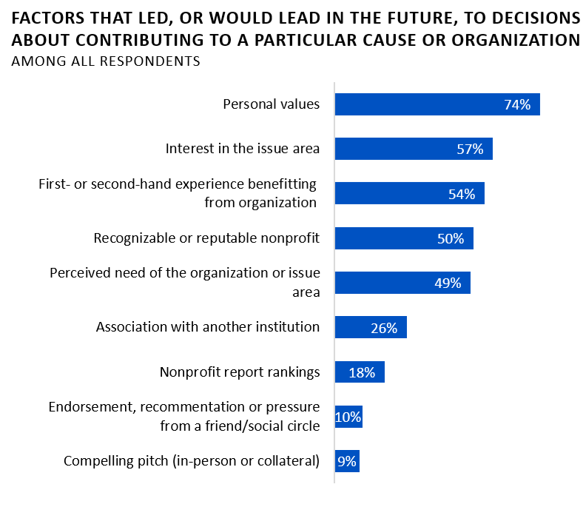
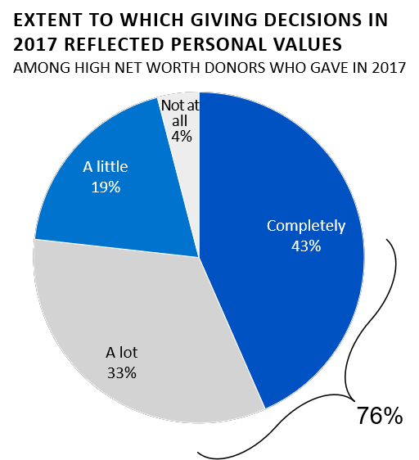
Insights: Donor Motivations
A messaging platform is grounded on research into the motivations of high-net-worth donors.
These charts are from the 2018 U.S. Trust® Study of High Net Worth Philanthropy.
They are presented here only for the purpose of discussion.

Slide 30
Longer Messages: Overarching
The ocean is essential for all life on Earth. It gives us the oxygen we breathe and the food we eat. It covers 70 per cent of the Earth’s surface, represents 99 per cent of all habitable space on the planet, and it is home to millions of species. It hosts 90 per cent of all trade. It supports a $3 trillion economy. We know that the ocean is changing dramatically. Ocean temperatures are rising, with significant ramification for all of nature and humanity. Since the dawn of the Industrial Revolution, the has absorbed 40 per cent of all carbon generated by human activity. The ocean currently absorbs more carbon than all the rainforests combined, and it contains 50 times more carbon than the atmosphere. Whether and for how long it will continue is one of the greatest uncertainties in the world today.
The future of all life on the planet is being shaped right now in the ocean. But we cannot see it. More than 80 per cent of the ocean is unmapped, unobserved, and unexplored. In this darkness lies the future of our climate, our weather, our food, our health, our livelihoods, the very stability of our society.
Right now, we are driving into our future in darkness.
Our mission is to turn on the headlights.
The international ocean station will empower us see, understand, and prepare for our future. It represents a bold, urgent, and achievable step that we can make toward understanding our future on this planet. At this critical time, the international ocean station will enable us to assess the state of carbon in the ocean, to build toward comprehensive capability and global coverage in ocean observing, and to standardize and improve the flow of ocean data worldwide. This is essential to mitigating climate change. It’s vital to protecting ocean health. And it’s a matter of social justice for the most vulnerable in society worldwide.
Grenzebach Glier and Associates | Confidential – Not for Duplication
www.grenzebachglier.com

Slide 31
Longer Messages: Climate Change
Creating the international ocean station is a bold, urgent, and achievable step we can take to mitigating climate change – one that will have immediate impact. It is the only way for us to truly understand whether and for how long the ocean will be able to absorb carbon, and thus protect humanity and the planet from the disastrous effects of climate change. Carbon dioxide is a driver of climate change and the warming of our planet. The ocean absorbs more carbon than all the rainforests combined, and it has absorbed 40 per cent of all carbon generated by human activity since the dawn of the Industrial Revolution. It contains 50 times more carbon than the atmosphere. Right now, the ocean is protecting humanity and all life on the planet from the disastrous effects of climate change. Whether and for how long this will remain true is uncertain. Evidence suggests that the ocean’s ability to absorb carbon may be waning, and that the carbon sinks may fail. If so, the ocean would then be emitting carbon into the atmosphere, speeding the rise in global temperatures and effecting every living thing on earth. But if you cannot see a problem, you cannot design its solution.
Supporting Facts:
93 per cent of the excess heat energy stored by the Earth over the last 50 years is found in the ocean.
Almost two-thirds of the world's cities with populations of over five million are located in areas at risk of sea level rise.
More than 600 million people (around 10 per cent of the world’s population) live in coastal areas that are less than 10 meters above sea level.
Nearly 2.4 billion people (about 40 per cent of the world’s population) live within 100 km (60 miles) of the coast.
Oceans, coastal, and marine resources are essential to the lives of people living in coastal communities (about 37 per cent of the world’s population).
Increasing ocean and air temperatures are already harming human health, due to the enhanced survival and spread of tropical diseases.
Without understanding ocean carbon, all land- and atmosphere-based predictions about climate change may be inaccurate or meaningless.
Grenzebach Glier and Associates | Confidential – Not for Duplication
www.grenzebachglier.com

Slide 32
Longer Messages: Ocean Health
The ocean is essential for the existence of life on Earth. It gives us the oxygen we breathe and the food we eat. It hosts 90 per cent of all trade. It supports a $3 trillion economy. It covers 70% of the Earth’s surface. It represents 99% of all habitable space on the planet, and it is home to millions of species. We know that the ocean is changing dramatically. Rising concentrations of carbon in the atmosphere drive up ocean surface temperatures and causing ocean acidification. To our benefit on land, the ocean absorbs 90 per cent of the excess heat added to the atmosphere by burning fossil fuels and other human activities. Warming and acidification interact to the detriment of marine ecosystems – and ultimately to the detriment of all aspects of human life. But we fail to fully understand this challenge because the ocean remains critically under-observed. The creation of an international ocean station is a profound opportunity to see and understand our future. It will give us the ability to observe and understand the state of the world’s largest carbon sink, and thus to develop accurate predictions about and design potential solutions for the future of our planet. A key element of the project will be to analyze the gaps in worldwide ocean observing systems, and to chart a path toward a global, sustained, real-time picture of the ocean. This will arm us with insight and empower us to preserve the air we breathe, the food we eat, and the livelihoods of hundreds of millions of people worldwide.
Supporting Facts:
99 per cent of the habitable space on Earth is in the ocean
97 per cent of all the water on Earth is in the ocean
20 per cent of the world’s coral reefs have been destroyed and show no immediate prospects for recovery
60 per cent of coral reefs are currently threatened by a combination of ocean warming, acidification, and other anthropogenic impacts, a number that will rise to 90 per cent by 2030 and about 100 per cent by 2050.
Grenzebach Glier and Associates | Confidential – Not for Duplication
www.grenzebachglier.com

Slide 33
Longer Messages: Social Justice
Our vision for an international ocean station can be a linchpin for social justice worldwide. That’s because a stable, livable planet sustained by a healthy ocean undergirds progress on all forms of social justice and humanitarian aid, and a warming climate with severe weather threatens them all. At this critical time for our planet, the international ocean station represents a bold, urgent, and achievable step that we can make toward mitigating climate change, and thus advancing social justice. Access and equity in health, wellbeing, safety, nutrition, and prosperity hinge upon an ocean that is healthy, vibrant, and observed. The international ocean station will bring us two significant steps forward: First, we will understand the state of ocean carbon – a crucial step that science must take to see and mitigate the future of climate change. Second, we will chart a plan to fill gaps in ocean observing, to ensure that we have a comprehensive view of the ocean and thus our future on the planet. These are crucial to justice and equity worldwide. Right now, the damaging effects of climate change disproportionately impact the poor and vulnerable. Right now, gaps in ocean observing are most prevalent in developing regions on the world. The vast majority of those who rely on the ocean for both their livelihood and their food are in developing countries. Those who are most vulnerable to the damage of a warming ocean, a warming planet, natural disasters, or food shortages are those least equipped to recover from such threats. At a time when wealthy nations and organizations are working to advance social justice in so many ways, climate change threatens to undo that progress. The promise of wellbeing, safety, sustainability, and prosperity for hundreds of millions of poor and vulnerable people around the world depends on our ability to understand the ocean and its future. Our vision for international ocean station is a bold yet realistic step that we can take to achieve that.
Supporting Facts:
Natural disasters—90 per cent of which are classed as climate related and all of which could be mitigated through improved ocean observing—cost the world economy US$520 billion per year and push 26 million people into poverty every year
97 per cent of the world’s fishermen live in developing countries, and fishing is their major source for food and income. The vast majority of the workers in secondary marine-related activities, such as fish processing and marketing, are women in developing countries
Grenzebach Glier and Associates | Confidential – Not for Duplication
www.grenzebachglier.com

Slide 34
Fundamental Messages
What is an international ocean station?
Our vision for an international ocean station represents the ultimate expression of our goal: to create a truly global, linked, and sustainable ocean observing system that works for humanity and all life of Earth.
In the world of science, it is an idea of the magnitude of the International Space Station, but for our most important yet least explored resource – the ocean.
It is a goal that is critical to our mitigation of climate change. It is vital to ensuring ocean health. And, ultimately, it is essential to the promise of social justice for the most poor and vulnerable in society, worldwide.
Grenzebach Glier and Associates | Confidential – Not for Duplication
www.grenzebachglier.com

Slide 35
Distinguishing Messages
Why should GOOS take on this challenge?
This is a global challenge that requires an international solution. GOOS is the only entity with the ability to see across the ocean observing systems, with an international mandate and with a platform to speak to nations.
Why should this be undertaken now?
We have the expertise and the framework ready to address the most urgent uncertainty in climate science.
The ocean observing community is mature and effective, with a strategy and framework that is ready to be implemented.
Without an accurate assessment of the carbon sink, all other individual steps toward mitigating the climate crisis might be mistaken, ineffective, or in fact detrimental to the cause.
If the climate crisis is not addressed urgently and effectively, progress in all other efforts to improve the human condition will be more difficult, if not impossible.
Grenzebach Glier and Associates | Confidential – Not for Duplication
www.grenzebachglier.com

Slide 36
Distinguishing Messages
Why should the solution be found in philanthropy?
Philanthropy offers the freedom to pursue a bold, long-range vision that will positively contribute to all other humanitarian goals.
Philanthropy has the freedom to make visionary investments beyond the short-term time frames of government grants and election cycles.
The philanthropic sector has an immediate and critically important opportunity and responsibility to bring its engagement, expertise, and resources to address the climate crisis.
Philanthropy is experienced at partnering across sectors, de-risking innovation, and using its resources in flexible and versatile ways.
If left unaddressed, the climate emergency will directly or indirectly thwart the achievement of philanthropy’s other goals for improving the human condition.
Grenzebach Glier and Associates | Confidential – Not for Duplication
www.grenzebachglier.com

Slide 37
Thank You

