Slide 1
CLIVAR-GOOS Workshop From Global to Local – Cultivating new solutions and partnerships for an enhanced ocean observing System in a decade of accelerating change
Venue:
The Abdus Salam International Centre for Theoretical Physics (ICTP), Trieste, Italy
2. Date:
3-day workshop during 15-19 Aug. 2022
(or 22-26 Aug)
Weidong Yu
on behalf of Workshop Organizing Committee

Slide 2
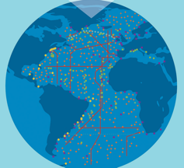
Background: recent decadal review over three basins
Observing System Review in response to new scientific and social demands
Notes:
2

Slide 3
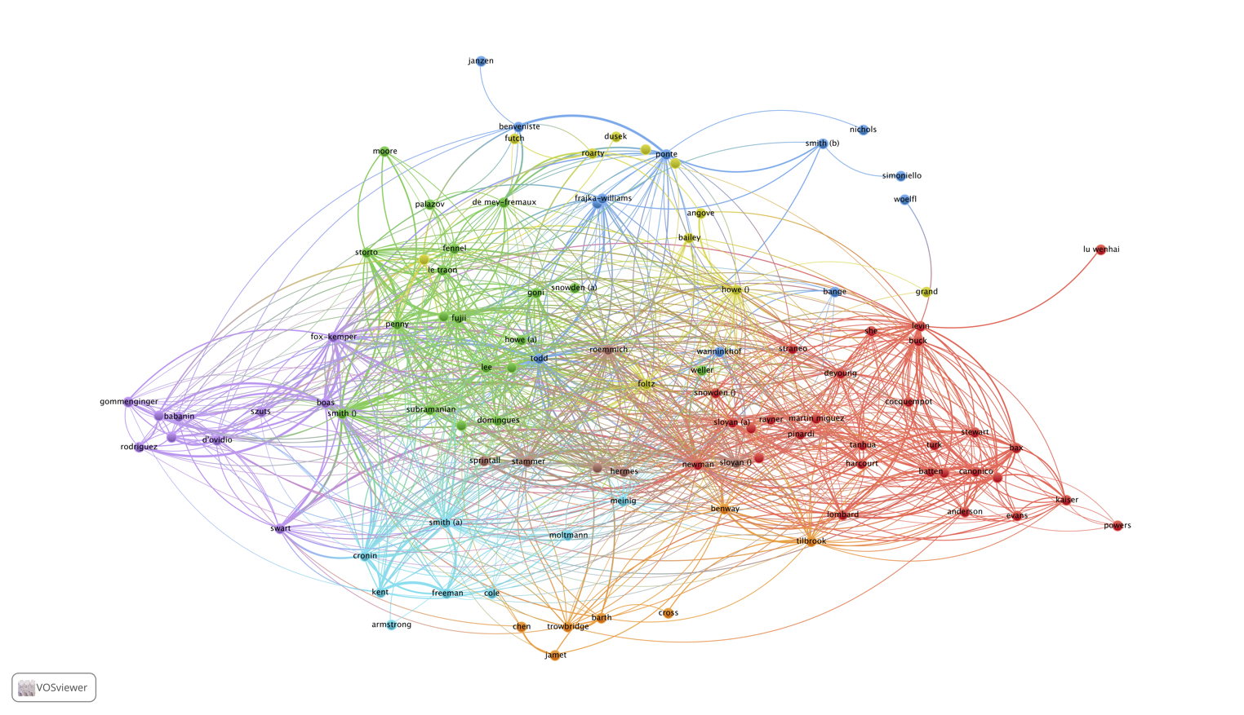
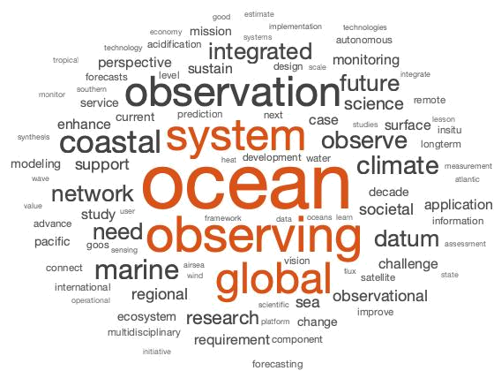
Community White Papers: The ocean is one and a whole. Ocean observations, information, uses are all connected
Bibliographic coupling analysis
Resilience, adaptation
Citizen science
Marine security
Modelling forecasts/operational oceanography
Deep ocean
Regional integrated observing systems
Data integration
Best practices
Remote sensing
Climate
Observing innovation
Marine biodiversity
Governance
Acidification
World Cloud on White Papers Titles
Air-sea fluxes
Regional/Ocean observatories
Courtesy of F. Lombard

Slide 4
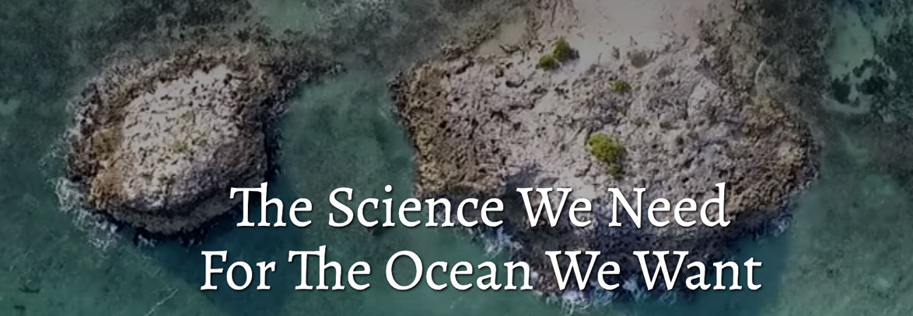
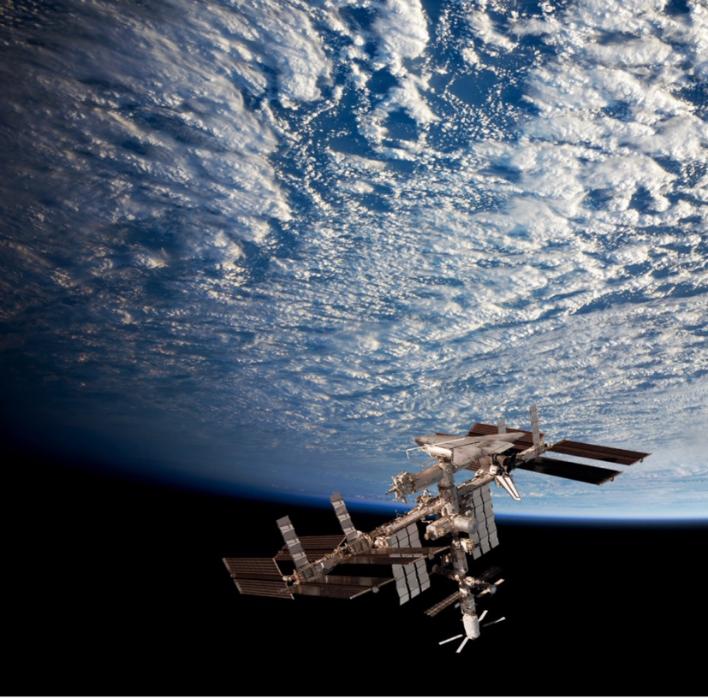
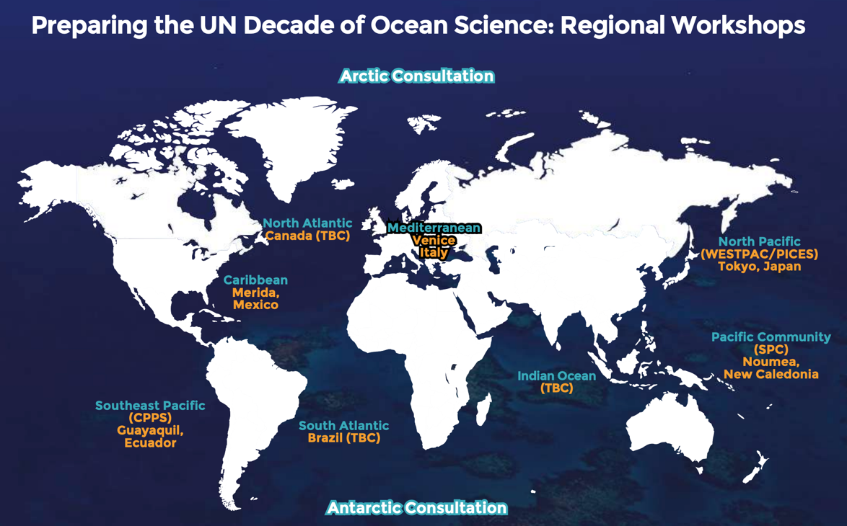

Slide 5
Planning process of CLIVAR-GOOS Coastal Observation Workshop
First postpone
Second postpone
Jan. 2020
Initial proposal to sponsors
Committee buildup
Sep. 28, 2020
Committee Meeting
May 3-5, 2021
Venue: ICTP, Italy
Aug. 15-29 (or. 22-26), 2022
Venue: ICTP, Italy
Aims and objectives:
The need for expansion of long-term observations into the coastal zone is recently identified, where humans interact with the ocean, and for multi-disciplinary observing systems that better track oxygen minimum zones, the carbon cycle, and productivity. The challenges — identifying drivers, optimizing design, funding expansion, developing new resources, testing new platforms and sensors, building partnerships with rim nations, capacity building, data sharing etc. are urgently to be addressed.
Another major objective of this workshop is to discuss and develop opportunities for developing rim countries to increase their oceanographic capabilities and improve regional forecasting in partnership with the various regional ocean observing systems.
Finally, the workshop will provide an opportunity to discuss how the efforts and priorities of regional and national observing systems combine and how the panels can prepare together for the UN’s International Decade of Ocean Science for Sustainable Development, 2021-2030

Slide 6
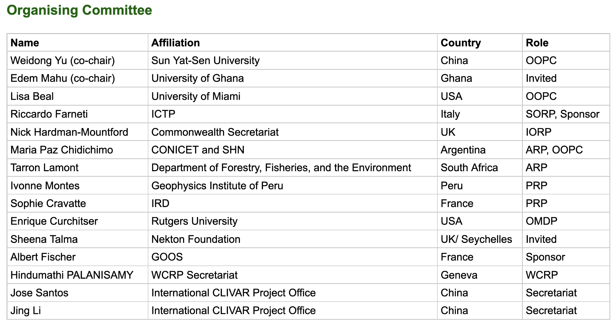
CLIVAR-GOOS Workshop
From global to coastal: Cultivating new solutions and partnerships for an enhanced Ocean Observing System in a decade of accelerating change
Proposed attendees
The workshop is by invitation and we anticipate approximately 100 participants, with priority to CLIVAR region panels (ARP, PRP, IORP, NORP and SORP) and GSOP, as well as scientists from the developing and coastal countries, representatives from partner programs working on global ocean observations, such as IOC-UNESCO, SOOS and GOOS.

Slide 7
CLIVAR-GOOS Coastal Observation Workshop
Day One
Theme: Societal and scientific drivers of regional ocean observing systems
9:00 - 9:20 Opening session
Peter Thomson
Vladimir Ryabinin (IOC-UNESCO)
Plenary session (75 mins)
Global perspective talks （ 9:20 - 10:05 ）
UN Ocean Decade - Someone from GOOS Community to be identified - 15 mins
A joint presentation – by representatives from IndOOS + TPOS-2020 +TAOS - 10 min *3 = 30 mins
2. Flash talks from developing countries (5 mins * 6 ):
Western Indian Ocean
Eastern Indian Ocean
Western Pacific Ocean
Eastern Pacific Ocean
Eastern Atlantic Ocean
Southwestern Atlantic Ocean
PM – Breakout Sessions
Session-1: Pacific Ocean basin
Session-2: Indian Ocean basin
Session-3: Atlantic Ocean basin
Session of opportunity: Gathering on challenges, needs, opportunities from Plenary talks & discussion
Poster session
Breakout wrap-up

Slide 8
CLIVAR-GOOS Coastal Observation Workshop
Day 2
Theme: Connect observation-modeling-prediction
AM - Plenary Session (15 mins * 6 = 90 mins)
CoastPredict: Nadia Pinardi (Italy)
ObservingTogether: Molly Powers (The Pacific Community)
INCOIS modeling and service: Kunal Chakraborty
ROMS/CROCO modeling: Pierrick Penven (IRD)
Google Ocean
Vulcan
PM - Breakout Session
Session-1: Coastal disaster reduction (climate risks, Tsunami warning system, Tonga volcano eruption – a recent example)
Session-2: Coastal ecosystem conservation and protection
Session-3: Stakeholder engagement
Session-4: Fisheries and aquaculture
Session of opportunity
Poster session
Breakout wrap-up
Note: the speakers are yet to be officially confirmed.

Slide 9
CLIVAR-GOOS Coastal Observation Workshop
Day 3
Theme: Multi-disciplinary and innovative observing system and expansion into coastal zones
AM - Plenary session (15 mins * 6 = 90 mins)
Autonomous vehicle (such as Saildrone, wave-glider...)
Animal-borne sensors
Satellite observation
Coral reef with the environmental stresses and fisheries
Low-cost sensors and citizen science
New Players such as Schmidt Institute of Oceanography | OceanX | Rev-ocean | Minderoo Foundation | OceanVisions.
PM - Breakout Session
Session-1: Capacity building and pilot projects
Session-2: Indigenous and local knowledge systems
Session-3: Public awareness and citizen science
Session-4: Demo-applications
Poster session
Breakout wrap-up

Slide 10
Workshop Deliverables:
A CLIVAR/GOOS report will be prepared to communicate the outcomes of the workshop. These will include (1) Identification of cross-cutting challenges and strategies for the continuation and enhancement of the regional observing systems. (2) Identification of “low hanging fruits” in terms of new partnerships and observing system elements that have high priority and near-term opportunity for development. (3) Identification of observing system goals that align with the UN Decade of Ocean Science for Sustainable Development (2021-2030).
An article summarizing the outcomes of the workshop will be prepared and submitted to an international scientific journal.
A special edition of “CLIVAR Exchanges” providing a conference summary and showcasing selected research presented at the workshop (this could be a joint publication with USCLIVAR-VARIATIONS).

