Slide 1
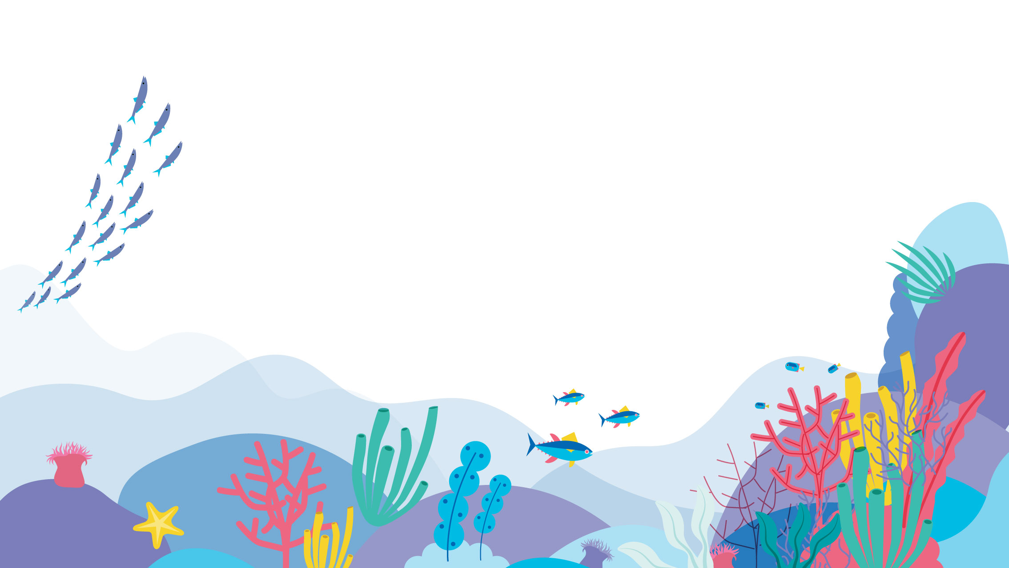

and genetic data

Slide 2
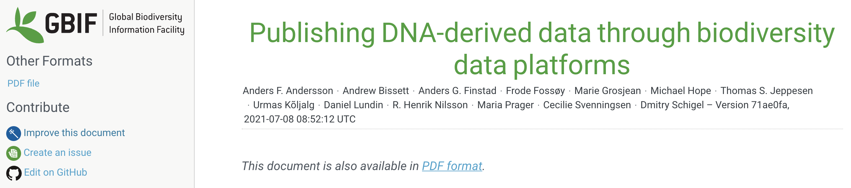
DNA-derived data extension
  Enables the addition of sequences and key metadata to OBIS
Occurrence
core
DNA-derived
data
extension
Notes:
The core of OBIS are the PRESENCE and ABSENCE DATA. These records can represent point locations, but can also be part of line transects from trawling, or polygons, or even a point in a grid for cases were the exact location cannot be disclosed.

Slide 3
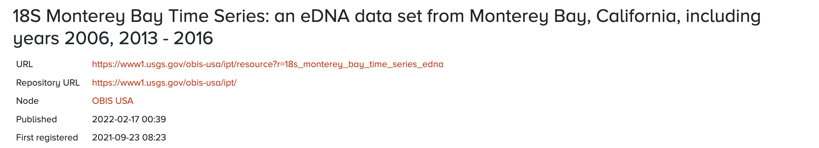
First OBIS genetic dataset
64,841 records based on metabarcoding of the 18S gene
Francisco Chavez - Principle Investigator (chfr@mbari.org)
Kathleen Pitz - Research Associate (kpitz@mbari.org)
Diana LaScala-Gruenewald - Point of Contact (dianalg@mbari.org)
All code used for formatting available on github as an OBIS use case for genetic data
https://github.com/iobis/dataset-edna

Slide 4
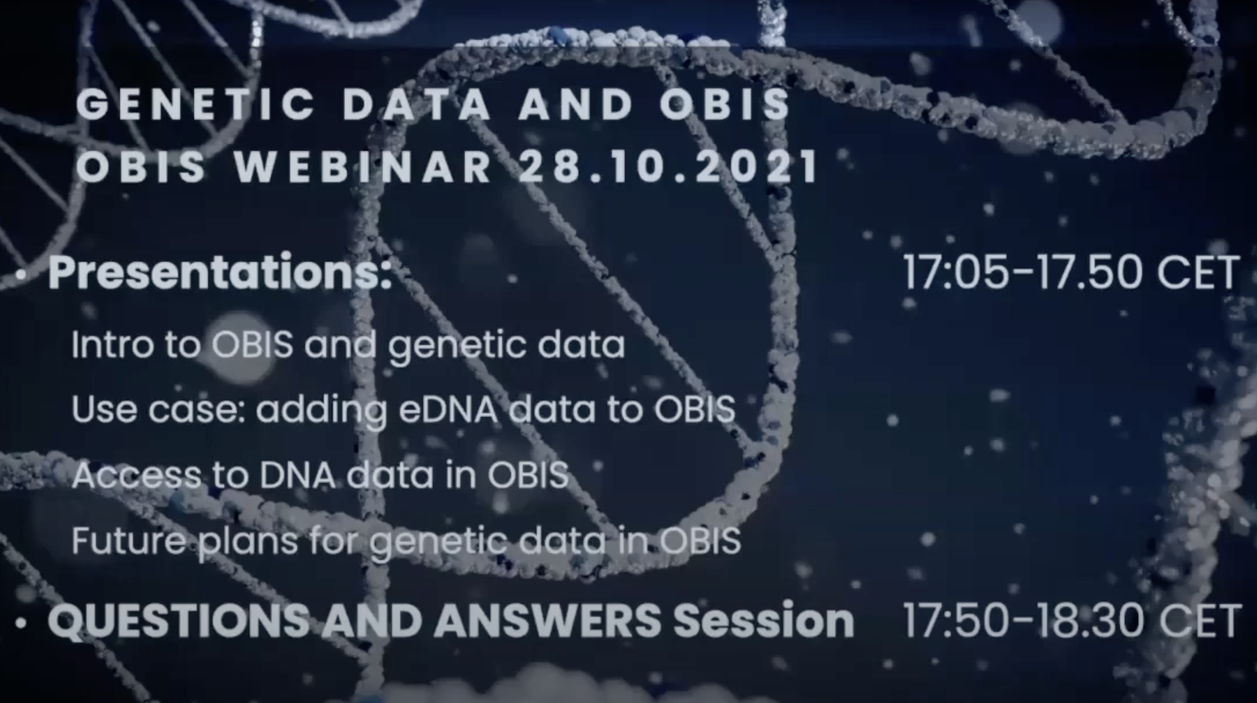
OBIS webinar on genetic data
https://www.youtube.com/watch?v=KKh_Hd8zybs
Over 100
participants

Slide 5
OBIS special cases
Taxonomic backbone: World Register of Marine Species
Unknown sequences recorded as the highest rank available: Biota
Environmental information: Extended measurement or Fact
Notes:
A lot of data already exist, but the challenge lies in finding, accessing and making sense of the myriad of existing, but dispersed pieces of data.

Slide 6
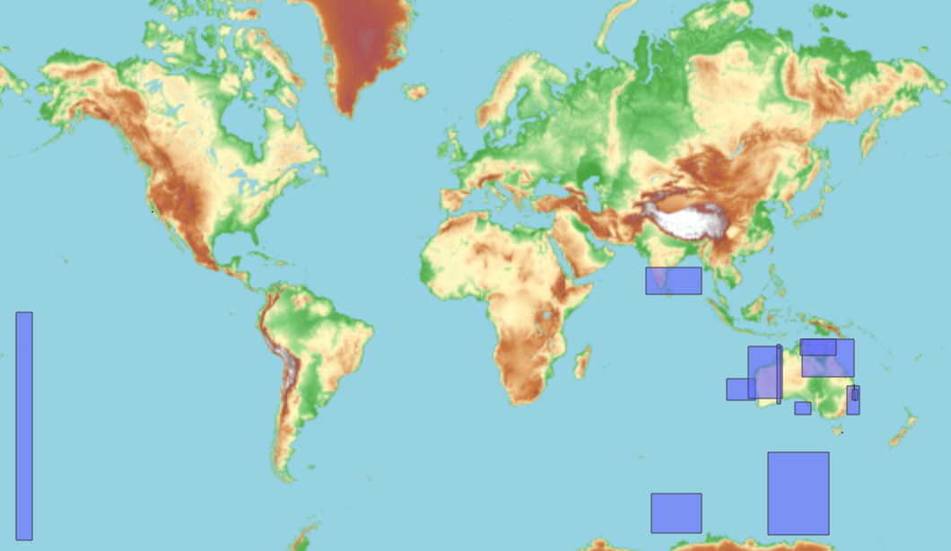
OBIS current genetic datasets
24 datasets
16,834,825 records
Majority of the data so far is microbial

Slide 7
Future plans
Further development of the PacMAN bioinformatics pipeline
  Needs from the community?
Discussions on how to deal with the taxonomic backbone for microbes with WoRMS
Quality control FastQC
Adapter and primer trimming
Trimmmomatic cutadapt
ASV inference
dada2
Taxonomic assignment
Bayesian least common ancestor
Formatting to DwC-A
Custom script
Sequence alignment with reference database
Bowtie2

Slide 8
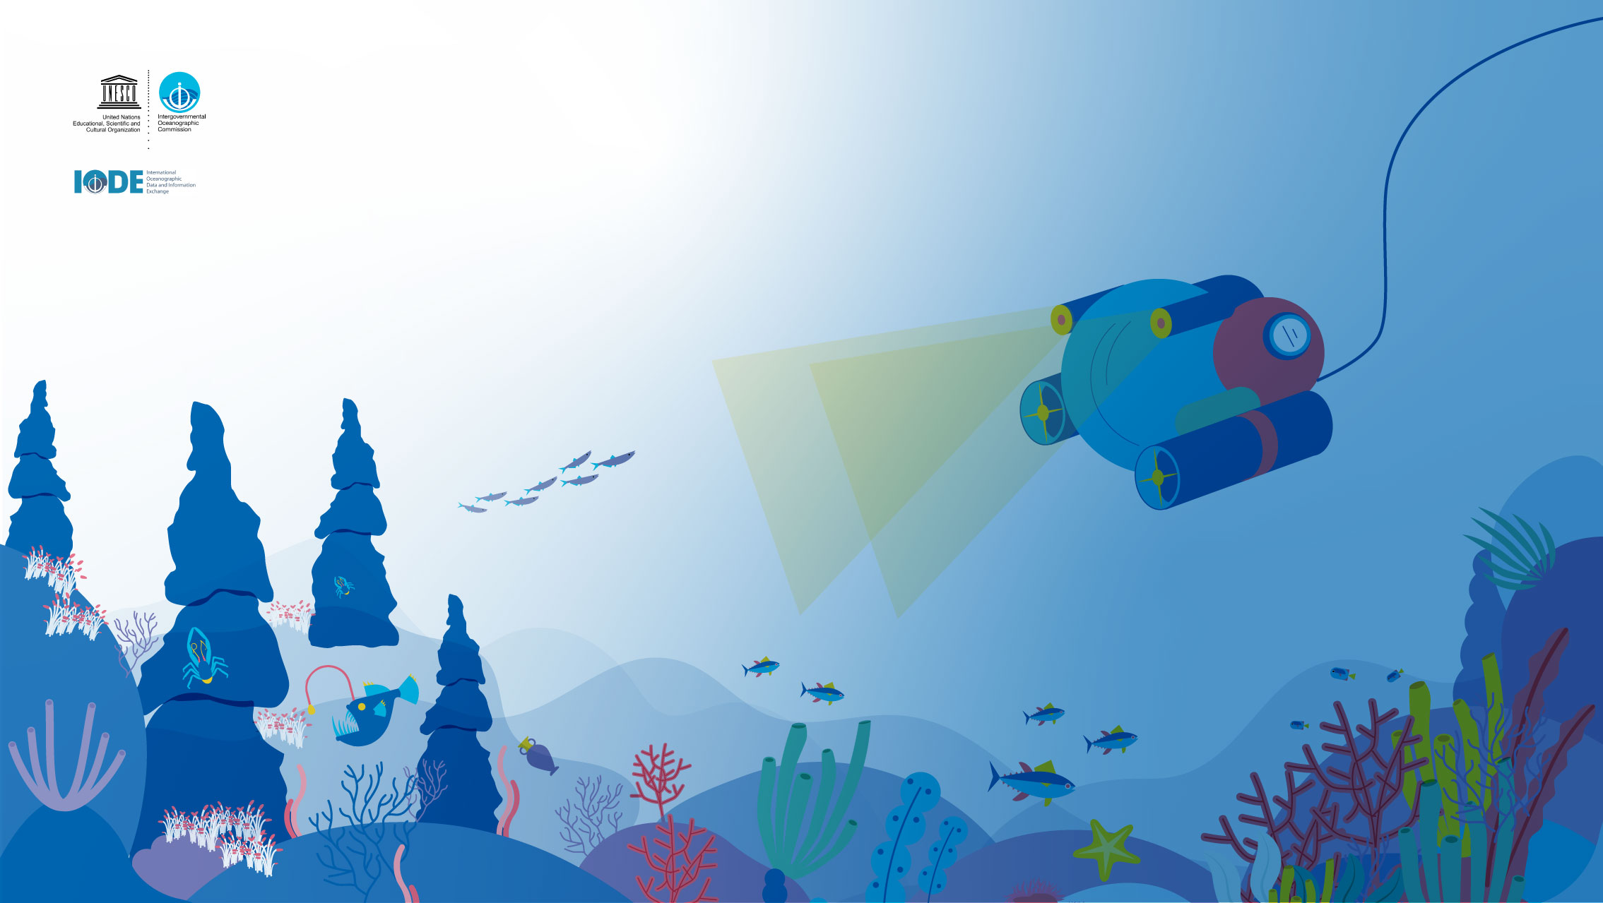
Thanks
Notes:
I wish to thank to all the supporters, donors and the thousands of scientists and the hundreds data managers who have been involved and contributed to OBIS. Without their efforts we would not have this fantastic resource to use today and in the future by our children.

