Slide 1
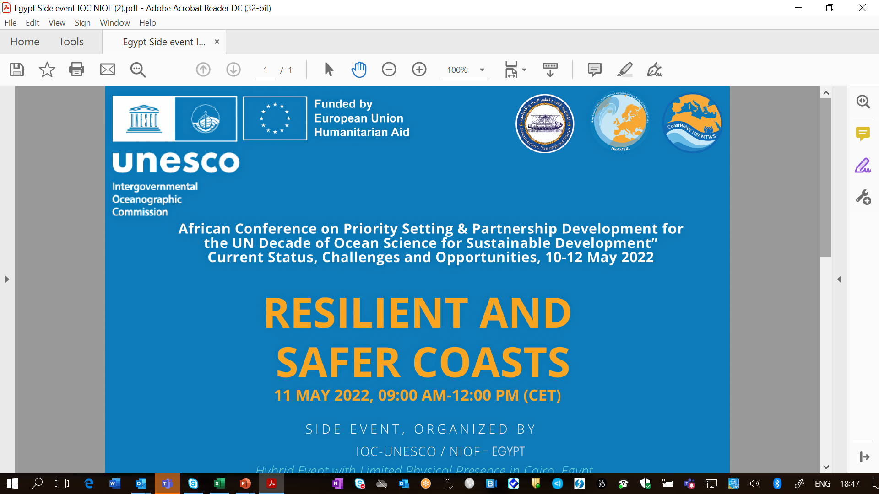

Slide 2
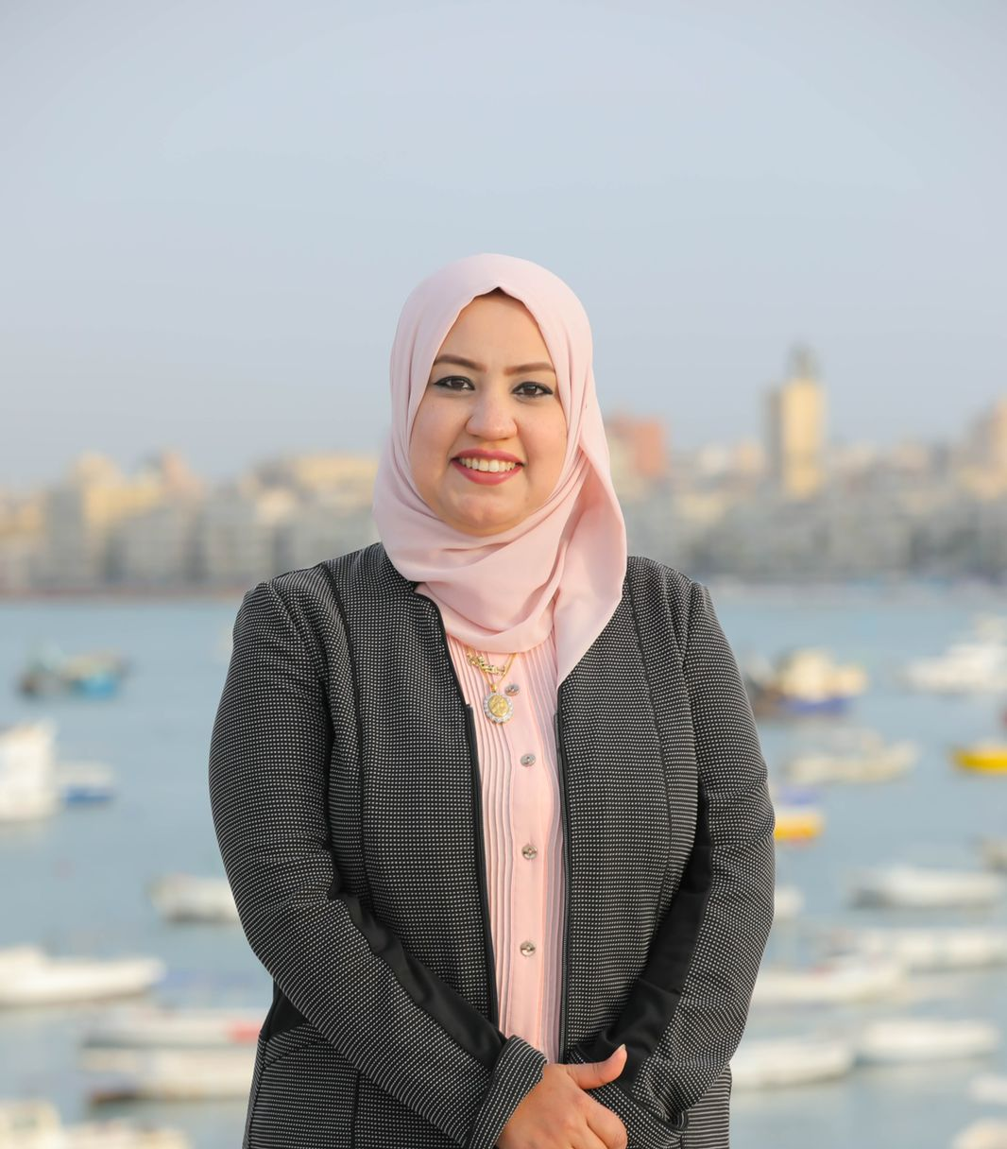
Dr. SUZAN M. ELGHARABAWY EGYPT
Prof. at National Institute of Oceanography and Fisheries (NIOF)
Division of Marine Environment
Vice-chair of IOC-Africa

Slide 3
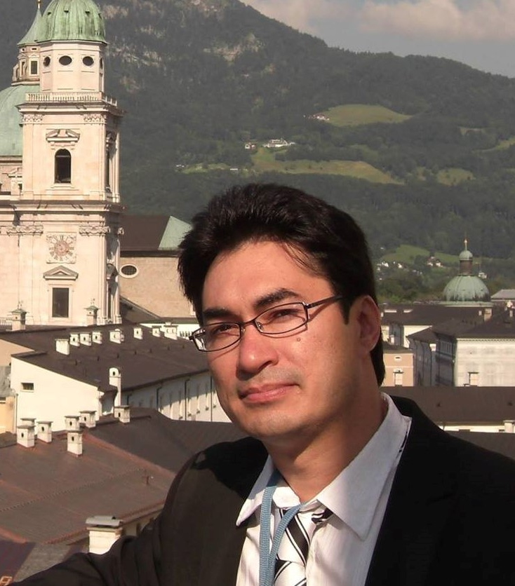
Dr. DENIS CHANG SENG IOC-UNESCO
Programme Specialist
Tsunami Unit (Technical Secretary ICG/NEAMTWS)
Global Ocean Observation System (GOOS)
IOC Focal Point UNFCCC NWP on Ocean, Biodiversity and the International Network for Multi-Hazard Early Warning Systems

Slide 4
SESSION 1
Timing | SESSION / CONTENT | Key Topics/ Themes and Speakers/Presenters/Panelists Moderator: Suzan M. El-Gharabawy, NIOF, Vice-chair of IOC-Africa
09:00am-09:20am | SESSION 1 HIGH LEVEL REMARKS | Maria Ana Baptista, Chair of ICG/NEAMTWS Peter Billing, Unit Head of EU DG ECHO Vladimir Ryabinin, IOC-UNESCO Executive Secretary Amr Hamouda, President of NIOF, Egypt Mohamed Taher Elsherief, Governor of Alexandria, Egypt

Slide 5
SESSION 2
09:20am-10:15am | SESSION 2 KEY OPENING PRESENTATIONS SETTING THE CONTEXT & CHALLENGES INTO PERSPECTIVE | o Ocean Sea Level Related Risk: The Challenges [Denis Chang Seng]
 | STRATEGIES | Decade Tsunami Programme [Bernardo Aliaga] ICG/NEAMTWS 2021-2030 Strategy [Alessandro Amato, INGV, Italy] Governance, Partnerships and Collaboration Enhancing and Scaling-up Actions including CoastWAVE Project [ Denis Chang Seng] Video 1 - CoastWAVE Project Technological (Detection, Forecasting and Alert Systems- CoastWAVE Project) [ Derya Vennin]

Slide 6
SESSIONS 3, 4 & 5
10:15am-11:15am | SESSION 3 PANEL DISCUSSION SOLUTIONS & TOOLS | Moderators: Denis Chang Seng and Derya Venin Indonesia-Dr Andi Eka Sakya, National Agency for Research and Innovation Egypt- Dr Amr Hamouda- President of NIOF, Egypt Greece- Dr Elena Daskalaki-Seismologist at NOA Morocco-Dr Khalid El Khalidi-Prof at Chouaïb Doukkali University Spain- Ignacio Aguirre Ayerbe, Technologist at IHCantabria Turkey- Prof Ahmet Cevdet Yalçıner, Prof. at METU Video 2 Young Professionals (4) Egypt- Mohamed Salah Hassan, PhD Student France- Claire Jaffrezic, MsC Student Morocco- Imane Joudar, PhD Student Turkey- Gozde Guney Dogan, PhD Student
11:15am-11:35am | SESSION 4 | o Q & A
11:35am-11:45am | SESSION 5 | o Moderator and all
 | WRAP UP / FINAL ROUND AND
 | CLOSING
 | KEY TAKE AWAY MESSAGE

Slide 7
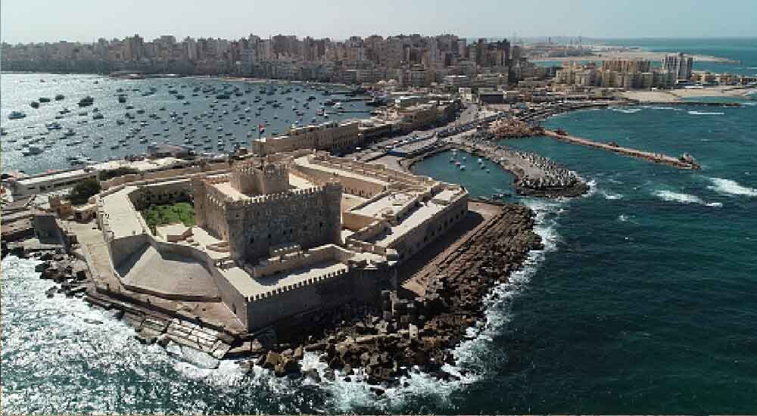
SESSION 1

Slide 8
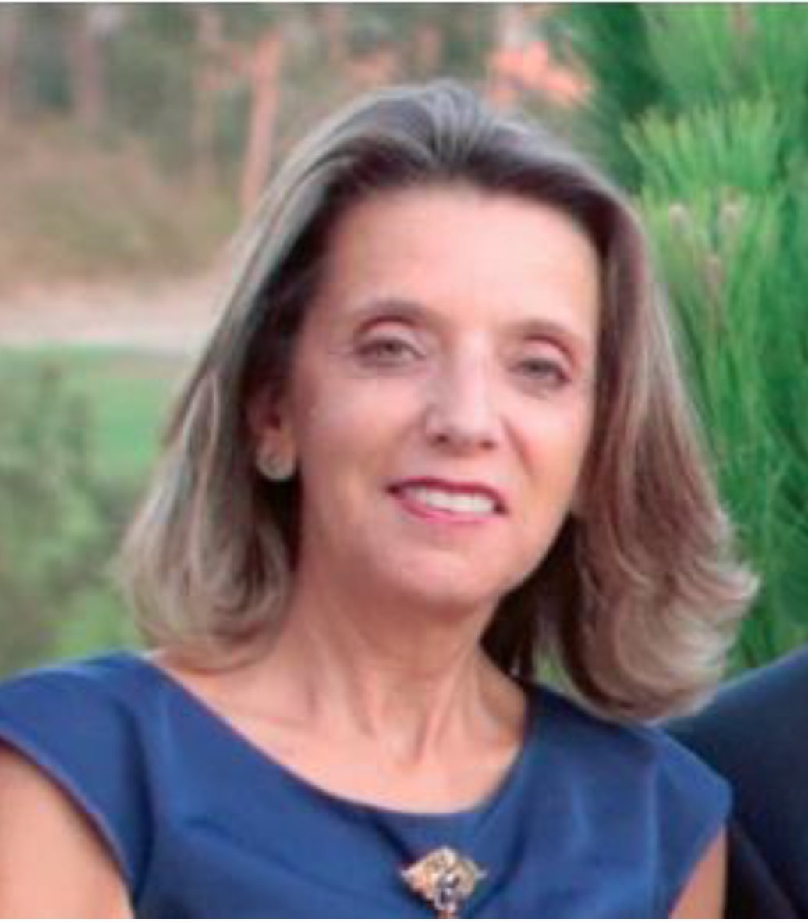
Prof. MARIA ANA BAPTISTA PORTUGAL
Chair of Intergovernmental Coordination Group for North-Eastern Atlantic, the Mediterranean and Connected Seas Tsunami Warning and Mitigation System (ICG/NEAMTWS)
Professor at the Higher Institute of Engineering of Lisbon, Polytechnic Institute of Lisbon, Portugal)
Research Fields: Earthquake, natural hazards, Tsunami

Slide 9
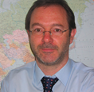
PETER BILLING DG ECHO
Deputy Director for Emergency Management and Head of Unit “Security and Situational Awareness” at the Directorate-General, “European Civil Protection and Humanitarian Aid Operations – ECHO” of the European Commission, Brussels

Slide 10
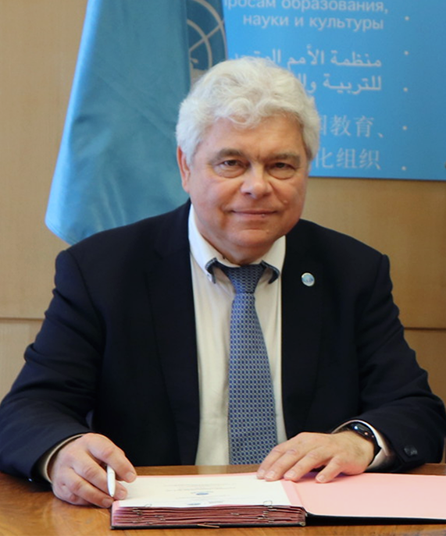
Dr. VLADIMIR RYABININ IOC-UNESCO
Executive Secretary and ADG at Intergovernmental Oceanographic Commission of UNESCO
Oceanographer, Climatologist, meteorologist
Research areas: Ocean circulation and thermodynamics, numerical weather prediction, marine meteorology, wind wave modeling

Slide 11
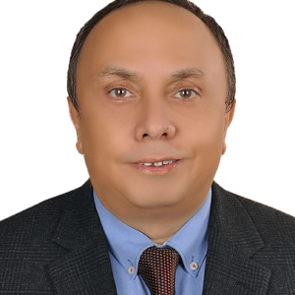
Prof. AMR HAMOUDA EGYPT
President of National Institute of Oceanography and Fisheries (NIOF) Ministry of Higher Education & Scientific Research
Subject Area: Marine Geology, Geophysics

Slide 12
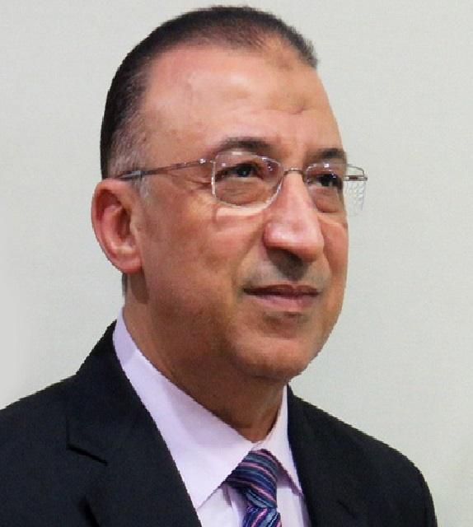
MOHAMED TAHER ELSHERIEF EGYPT
Governor of Alexandria

Slide 13
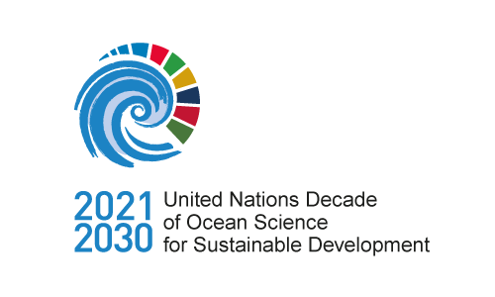
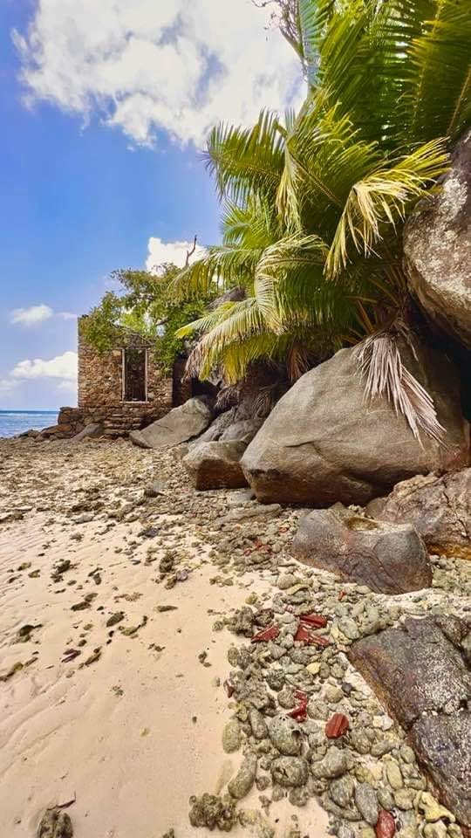
SESSION 2

Slide 14
Dr. DENIS CHANG SENG IOC-UNESCO
Programme Specialist
Tsunami Unit (Technical Secretary ICG/NEAMTWS)
Global Ocean Observation System (GOOS)
IOC Focal Point UNFCCC NWP on Ocean, and Biodiversity and the International Network for Multi-Hazard Early Warning Systems

Slide 15
Ocean Sea Level Related Risk: The Challenges

Slide 16
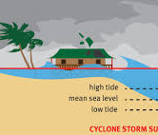
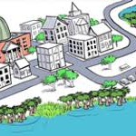
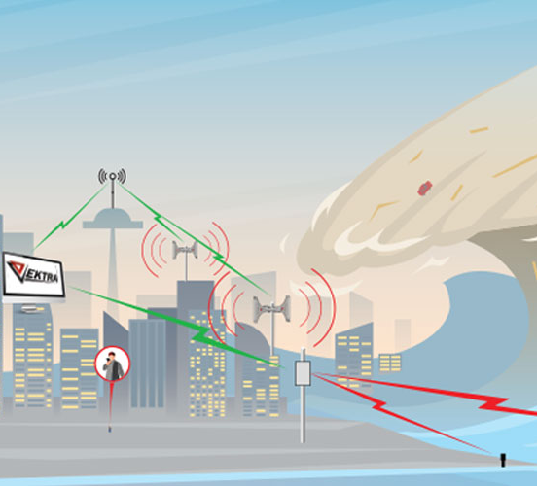
Sea Level Related Hazards and Risks
Coastal zones are naturally exposed and impacted to different ocean hazards.
Tsunamis, Storm Surge and Sea Level Rise
Human induced climate change favors the increase in frequency and intensity of storm surges and cause sea level rise.
Tsunami is a low frequency, but high consequence and impact coastal hazard.

Slide 17
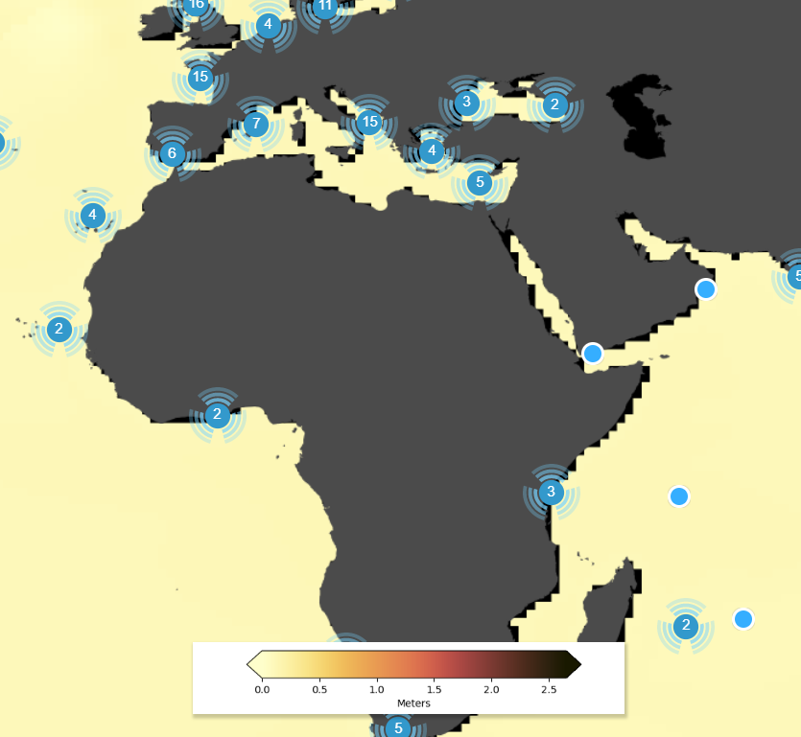
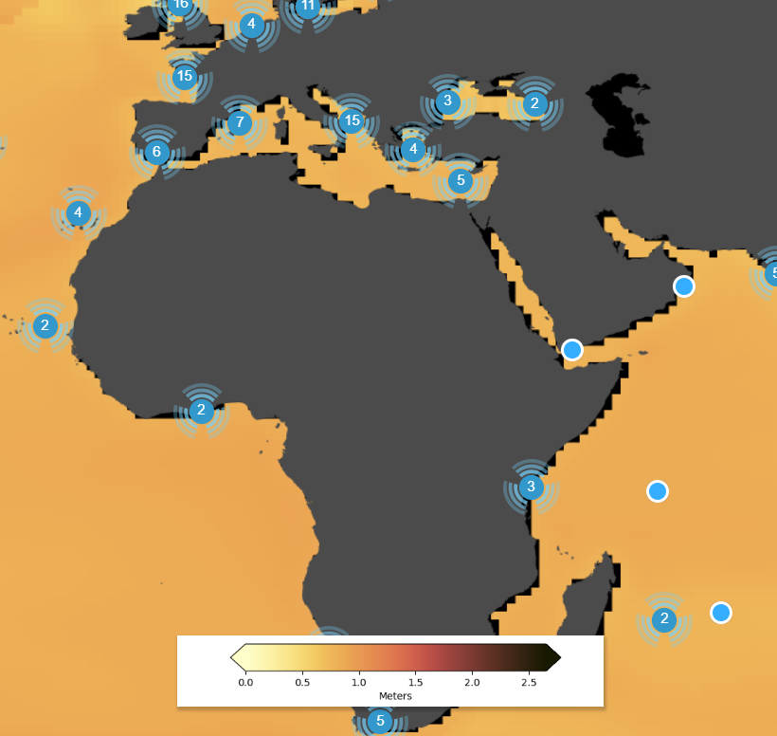
Sea Level Rise
SSP1-1.9: very ambitious scenario to represent the 1.5°C goal of the Paris Agreement
SSP1-2.6: sustainable development scenario
SSP2-4.5: intermediate scenario
SSP3-7.0: regional rivalry scenario
SSP5-8.5: fossil-fuel based development
The NASA Sea Level Projection Tool
Med is turning into the fastest warming sea with irreversible changes for marine and human life.
Source : NASA
Tool allows users to visualize and download the sea level projection data from the IPCC 6th Assessment Report (AR6).
2030
2030
2100
SSP5-8.5
SSP5-8.5

Slide 18
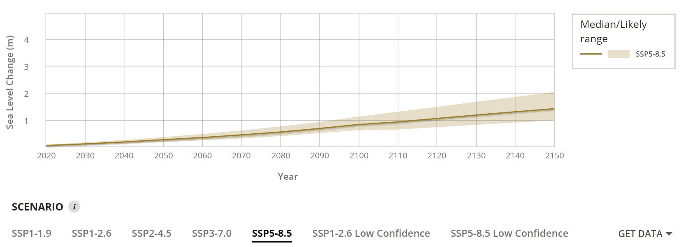
ALEXANDRIA

Slide 19
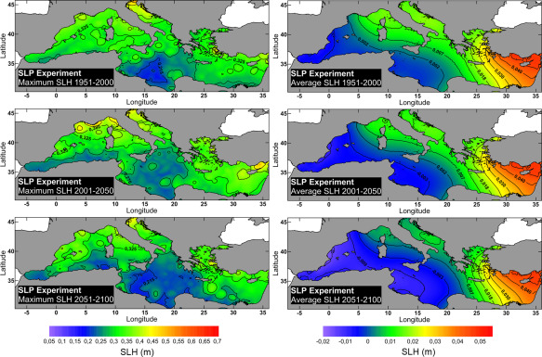
Storm Surges Variability and Trends Under Future Climatic Conditions in the Mediterranean Sea
West to East gradient
Alexandria, Egypt and others in the east more exposed to future storm surge?
Source: Yannis S.Androulidakis et al

Slide 20
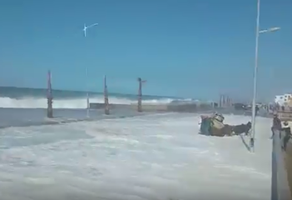
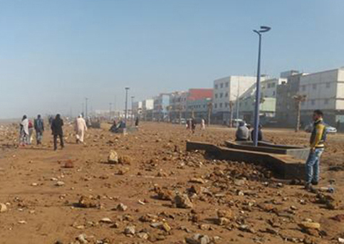
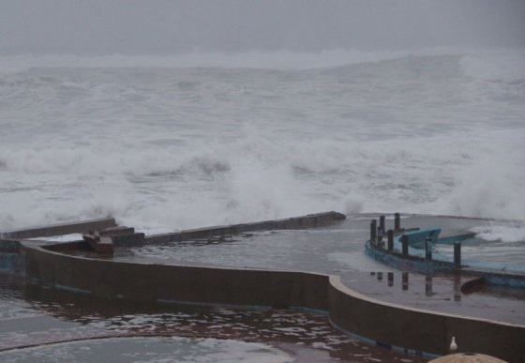
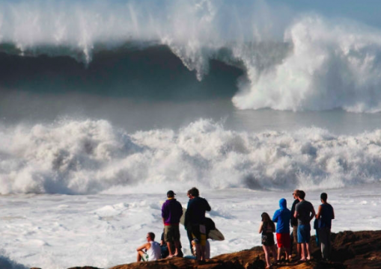
Ocean Swells / Storm Surge/ Meteo-Tsunami?
Morocco, Jeudi 2 février 2017
Source: UNESCO, Rabat Office

Slide 21
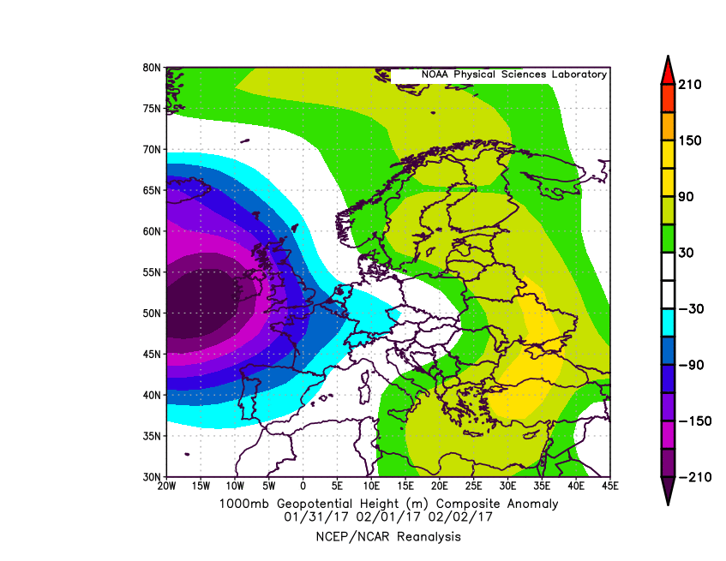
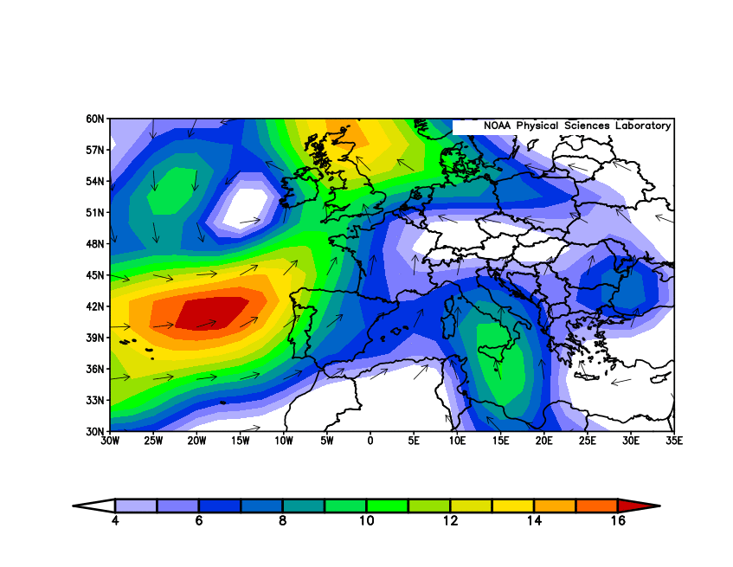
Associate Atmospheric Anomaly
Geopotential Height Anomaly (1000 mb)
Vector Wind Anomaly (1000 mb)

Slide 22
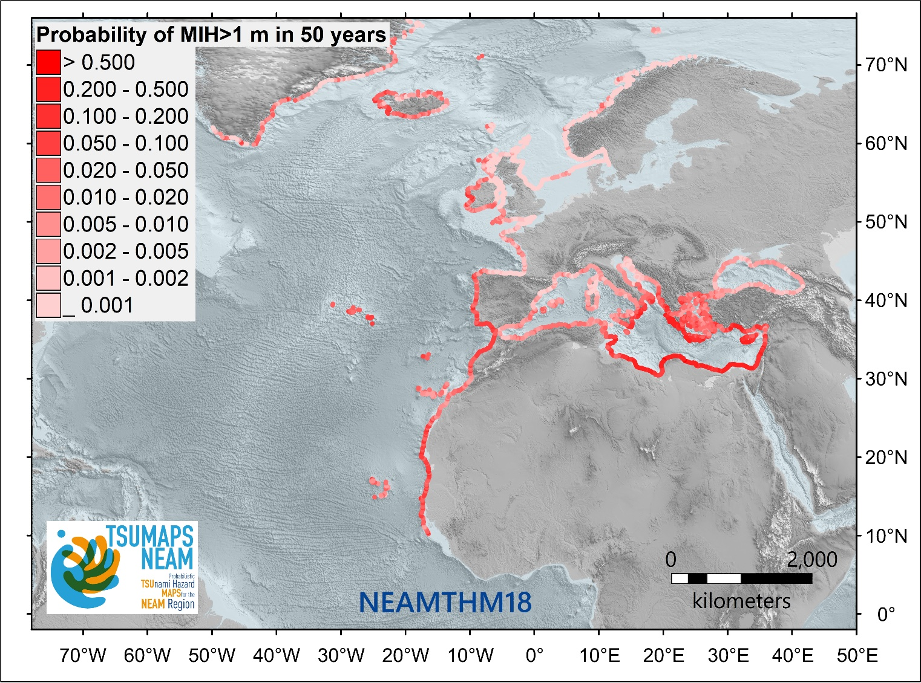
Probability of Tsunami in NEAM Region
In the NEAM region, the probability/likelihood of an earthquake-generated tsunami exceeding a Maximum Inundation Height (MIH) of 1 m in 50 years is illustrated in the Fig.
Note:- MIHs greater than 1 meter tsunamis have been observed recently (Samos and Izmir region 2020, Kos-Bodrum in 2017)
Significant damages reported
Probabilistic tsunami hazard assessment of the NEAM region^{[1]}
^{[1]} Probability of an earthquake-generated tsunami exceeding a maximum inundation height (MIH) of 1 m in 50 years evaluated every ~20 km on the NEAM region coastlines. The map was derived from the NEAM Tsunami Hazard Model 2018 (NEAMTHM18; Basili et al., 2021), which is a product of the TSUMAPS-NEAM project funded by the European Civil Protection and Humanitarian Aid Operations (DG-ECHO). For more details of the model, see http://www.tsumaps-neam.eu. The map presented here was produced with the best information available at the time of modelling. The accuracy of these maps is subject to limitations in the accuracy and completeness of available bathymetry and topographic information, and in the current knowledge of the tsunami sources and characteristics. In the last few years, MIHs greater than 1 meter have been observed during at least three earthquake-generated tsunamis (Samos and Izmir region 2020, Kos-Bodrum in 2017), which caused damage.
Source : TSUMAPS-NEAM project

Slide 23
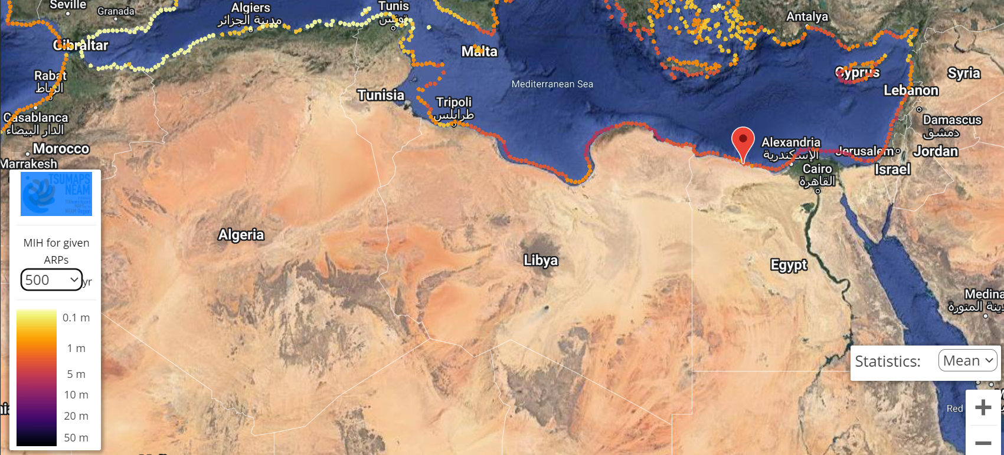
Recurrence of Tsunami in N-Africa
For more details of the model, see http://www.tsumaps-neam.eu.

Slide 24
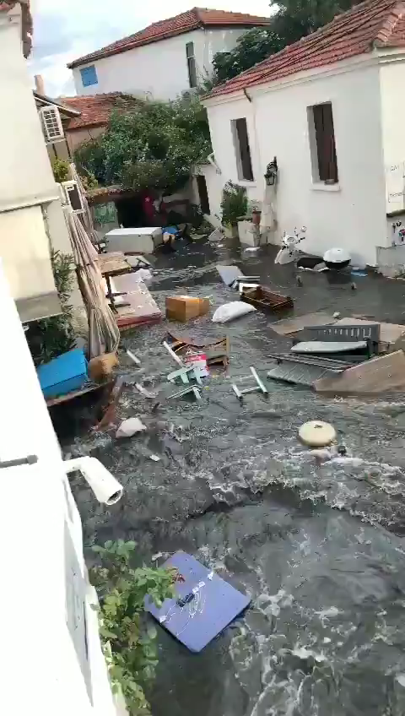
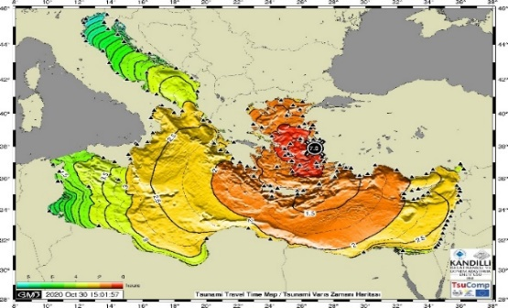
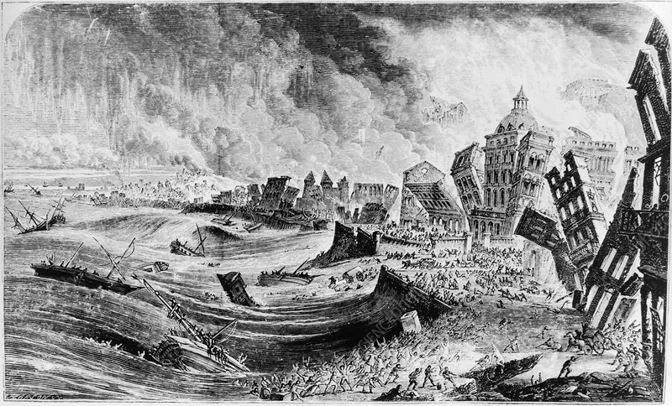
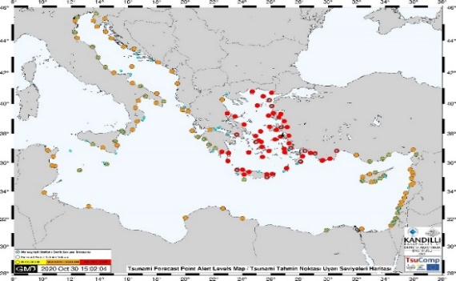
Tsunami Historical and Recent Tsunami Events
TSP Alerts: 8-11 min
Tsunami waves: 15-20 min
Official Response/ public: >20 min
Reports of some kind kind of ‘self-organized’ evacuation
THE 1755 EARTHQUAKE & TSUNAMI
-Lisbon was flooded with tsunami waves of 6 m height.
-estimated 60,000 deaths.
-10,000 may have lost their lives in Morocco.
OCT 2020 SAMOS-IZMIR TSUNAMI
source KOERI, Turkey
Tsunami travel time
https://media.sciencephoto.com/image/e3700073/800wm
Forecast point alert (Watch, Advisory and Information) map,
Notes:
NOA (Greece), KOERI (Turkey) and INGV (Italy) TSPs issued earthquake-tsunami bulletins to Member States within 8-11 minutes following the detection of the earthquake.
Greece and Turkey were on Tsunami Watch (highest level of alert), while other countries either on Tsunami Advisory and or Tsunami Information levels.
Eyewitnesses claim the drawback started within 2-5 minutes followed by runup within 15-20 minutes after the Earthquake.
The Civil Protection in Greece activated the emergency to send messages 24 minutes after the earthquake to cellphones.
The event once again highlighted the difficulties of warning with regard to locally generated, rapid onset of tsunami and challenged the ability of local authorities and the communities at risk to take early action.

Slide 25
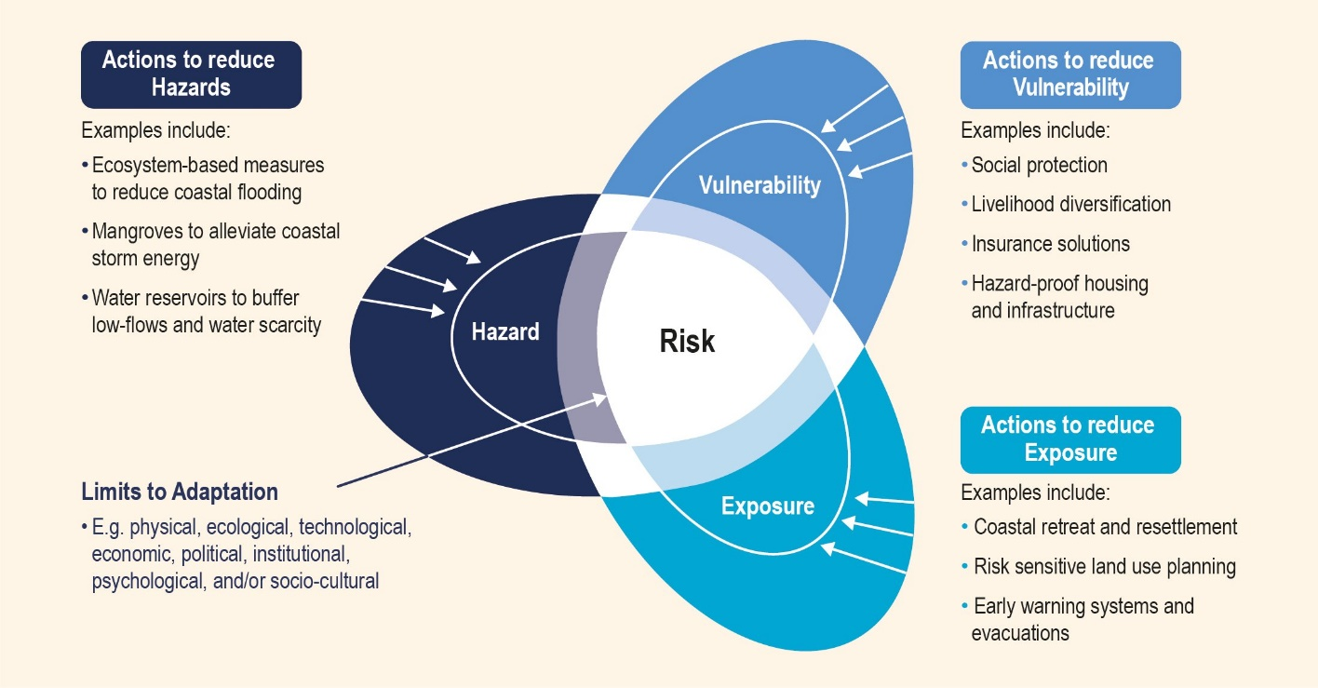
Challenges
Hazards
Climate change, multi-source and complex mechanisms of tsunami generation (including non-seismic)
Exposure, Vulnerability and Risks
Increasing coastal population, coastal tourism activities, blue economy etc
Low awareness and preparedness. The risks posed by all the three ocean related hazards are largely underestimated in the South-Mediterranean countries ( Schmid and Chang Seng 2021)
Effectiveness and inclusive, people centered End–to-End EWS. Early Warning and Early Action Challenges (EWEA).
Governance e.g., regulations, policies, standard operating procedures are usually lacking, especially in connecting national to the community level.
Coastal urban planning and management
Below 10 meters:
116 million & increasing
Excluding dynamic exposure / vulnerability: Seasonal variability in population associated with tourism activities

Slide 26
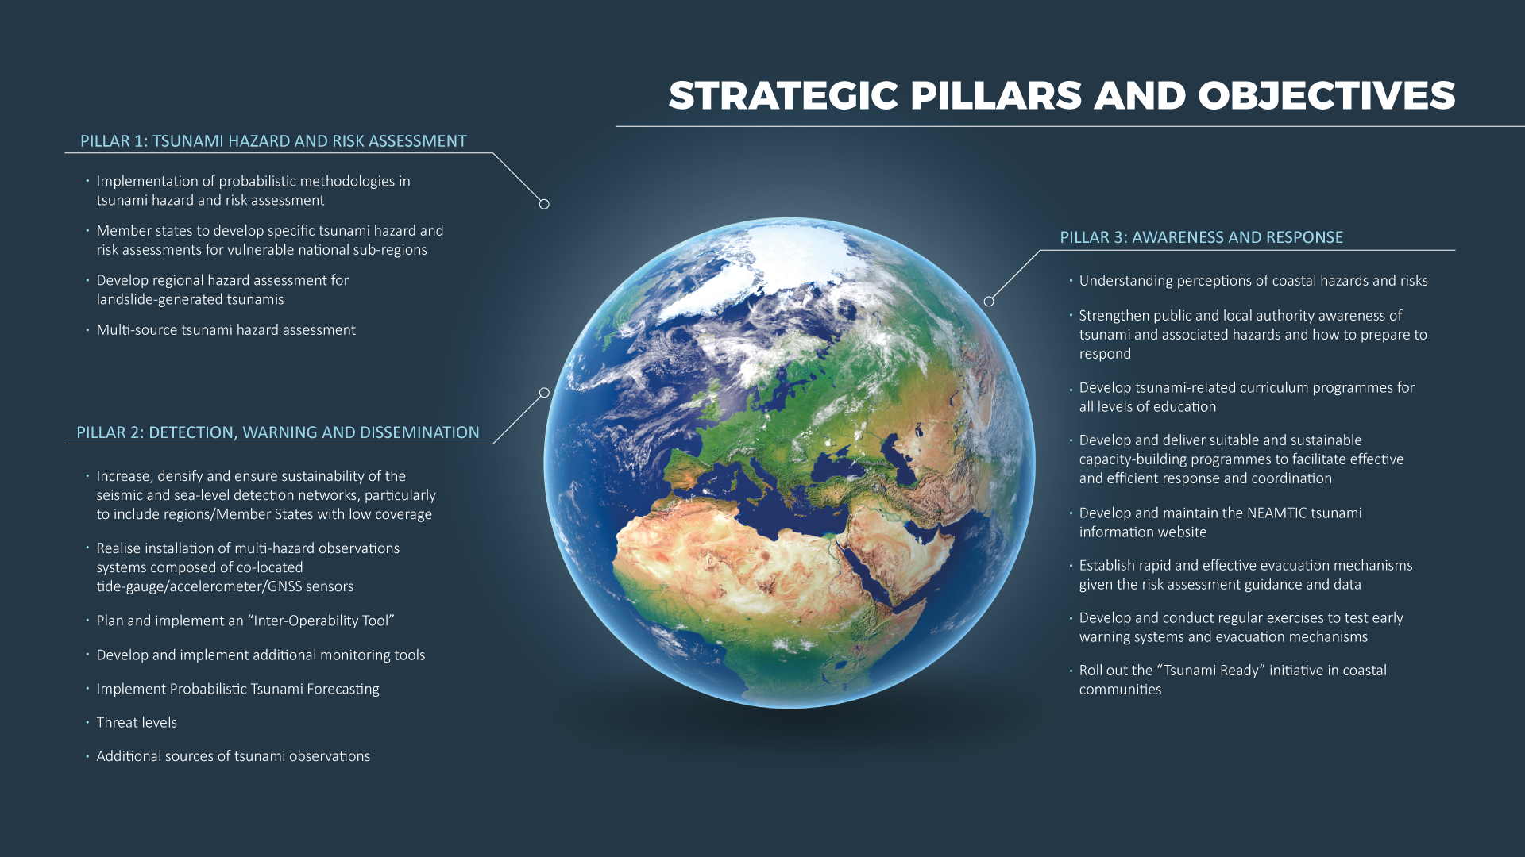
ICG/NEAMTWS 2030 Strategy

Slide 27
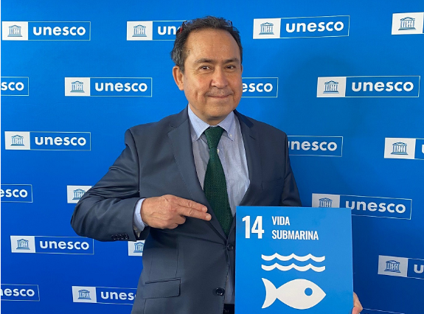
Mr. BERNARDO ALIAGA UNESCO IOC
Programme Specialist
Head of Tsunami Unit (a.i)
Technical Secretary for the Caribbean (ICG CARIBE EWS)and the Pacific Tsunami Warning and Mitigation System (ICG PTWS)

Slide 28
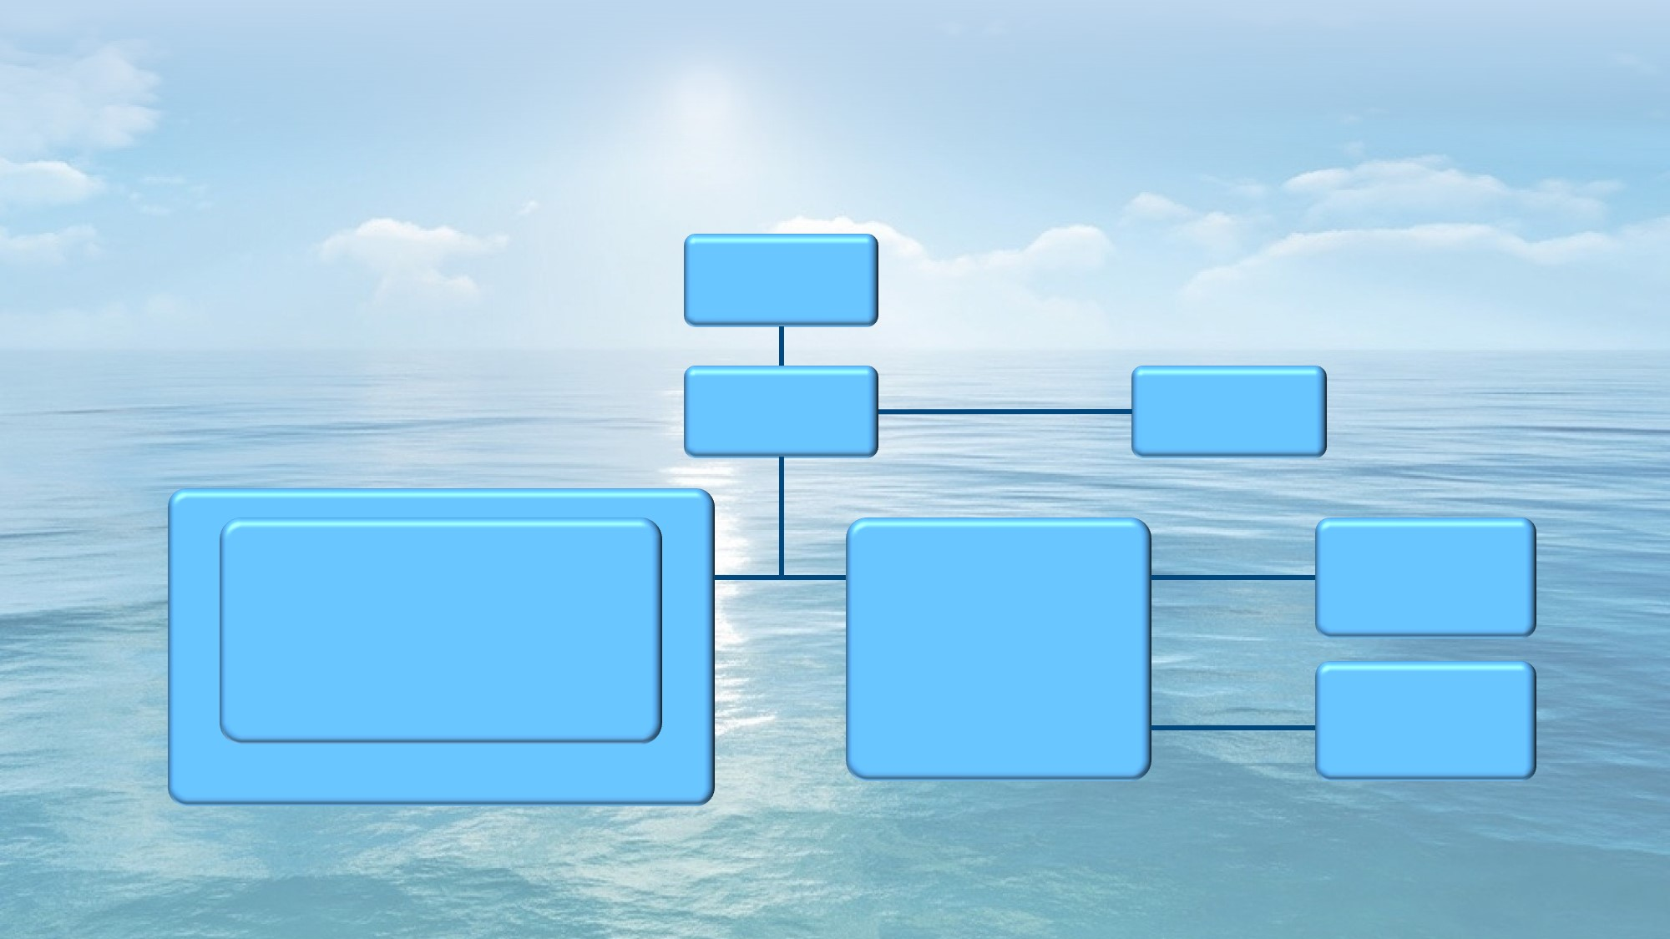
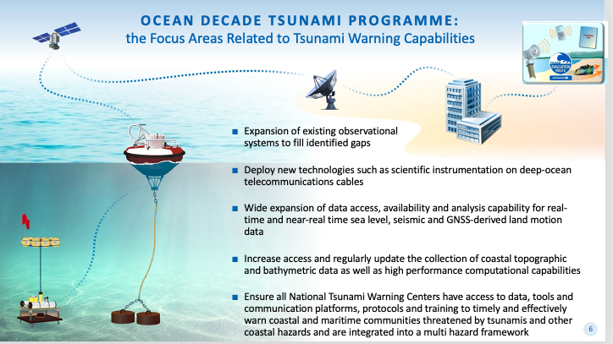
IOC Tsunami Programme and UN Ocean Decade
UN Ocean Decade (2021-30)
Once-in-a-generation opportunity to address gaps in tsunami warning , enhance community preparedness and contribute to “A Safe Ocean”
IOC Assembly 31 (Dec. A-31/3.4.1) established the Ocean Decade Tsunami Programme + Scientific Committee to Develop Research, Development & Implementation Plan
Technological & Observational Advances to reduce uncertainties
100 % at risk communities prepared & resilient to tsunamis by 2030 (Tsunami Ready, etc.)
IOC Assembly
IOC Executive Council
IOC Secretariat
Tsunami Unit
ICG/PTWS
ICG/IOTWMS
ICG/CARIBE EWS
ICG/NEAMTWS
Pacific
Indian
Caribbean and Adjacent Regions
NE Atlantic and Mediterranean
TOWS-WG
WG on Tsunamis and Other Hazards Related to Sea-Level Warning and Mitigation System
TT on TWO
Task Team on Tsunami Watch Operation
ODTP Science Committee
Standards, Best Practice, Advisory to IOC Governing bodies
TT on DMP
Task Team on Disaster Management and Preparedness
Coordination of Regional TWS
Capacity Development
Governance
TOWS-WG & ICGs: Global & Regional Steering Committee
Scientific Committee: Advisory Role
Special coalition for Tsunami Ready
Notes:
Services associated with the Global Tsunami Warning System are governed by the 4 ICGs, and advocated for by the Inter-ICG Working Group on Tsunamis and Other Hazards Related to Sea-Level Warning and Mitigation System (TOWS WG). TOWS-WG is informed by two standing task teams made up of ICG representatives on Tsunami Warning Operation and Disaster Management and Preparedness. The Chair of the TOWS WG ensures development and delivery of recommendations to the IOC Executive Council and General Assembly.
TOWS-WG is composed with Chairs of the 4 ICGs, GOOS, IODE and JCOM, plus High-level representatives invited from the key TOWS-WG stakeholders (CTBTO, FSDN, UNDRR, WMO and now IUGG TC!).

Slide 29
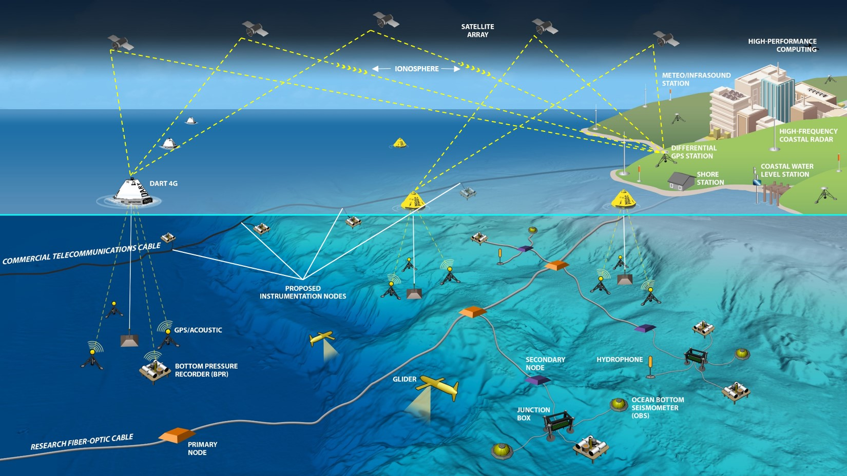
Rethinking Ocean Observations:
Reducing Uncertainty in Global Tsunami Forecasts
Source: National Oceanic and Atmospheric Administration
Notes:
To achieve the Vision of the Decade, we cannot continue to rely to base our capability on seismic waveform analysis alone. Tsunamis must be detected and measured *in the ocean* in order for reliable forecasts to be produced. Many sensors will need to contribute (GPS ground stations, in-situ seismometers, hydrophones, BPRs, gliders, coastal radars, water level stations, dedicated cabled observatories, instrumented industry cable and of course stand-alone precisely located BPR/Buoy systems). Many are low or *no cost*…and *every coastal country in world can and should contribute at some level.

Slide 30
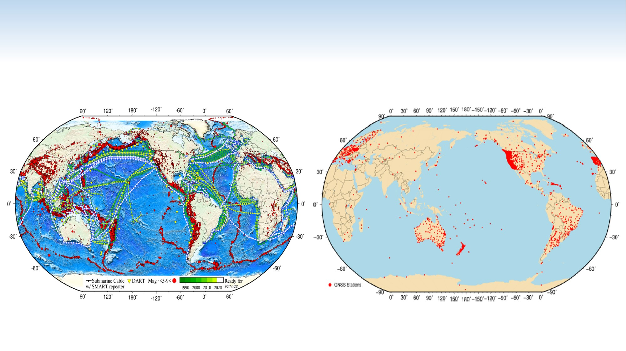
NEW POTENTIAL SOURCES OF SEISMIC OBSERVATIONS FOR TSUNAMI WARNING SYSTEMS
Locations and magnitudes of historical seismic events (red),
DART tsunami buoys (yellow triangles) and current (green)
and planned (white) submarine cables,.
SMART repeaters shown every 300 km
The location of 2,260 real-time GNSS stations from public networks around the world
Angove, M . et. al, 2019
Pacific Northwest Geodetic Array/Central Washington University

Slide 31
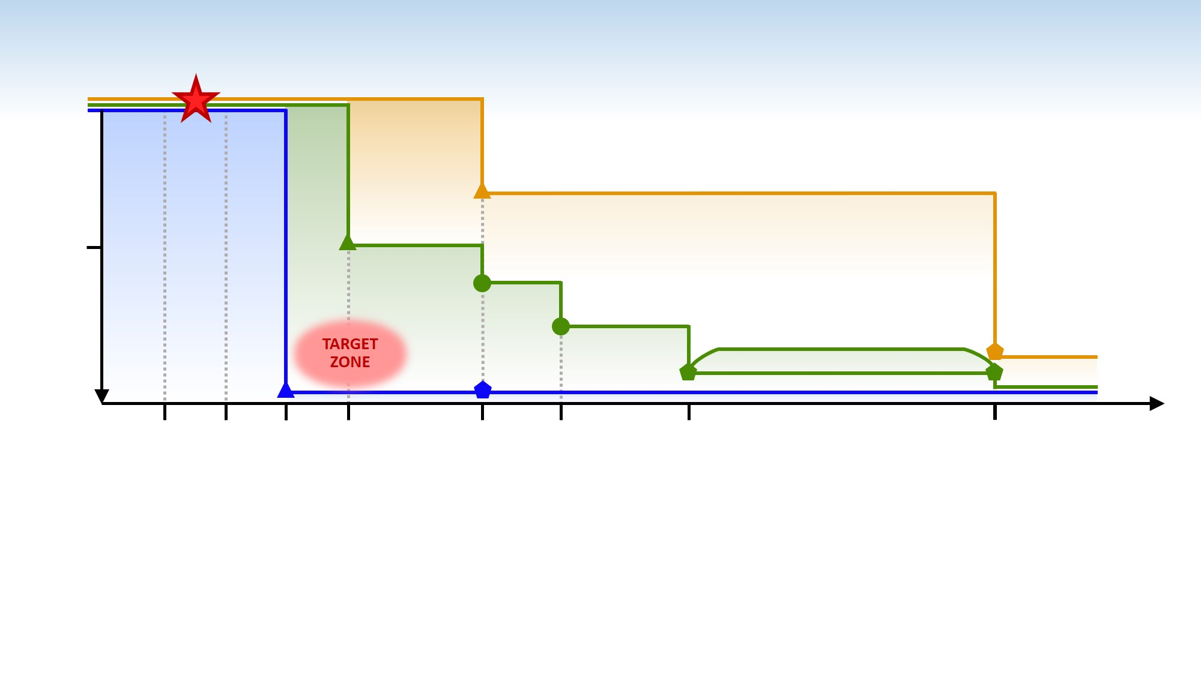
STRATEGY
WARN!
1
Forecast
Problem we don’t understand
Problem we do understand
2004
Refine Forecast
TSUNAMI WAVEFIELD UNCERTAINTY
Cancel
.5
2019
2030
between
0
1 min
5 min
10 min
15 min
45 min
1 hr
2 hr
up to
1 day
TIME
LOCATION AND MAGNITUDE (initial)
CENTROID MOMENT TENSOR (seismic)
COASTAL SEA LEVEL
DART II
FINITE FAULT MODEL (seismic)
FINAL ANALYSIS
Centroid Moment Tensor (GNSS)/Finite Fault Model (GNSS)
Full Bottom Pressure (Tsunameters and Cables)
In-situ Accelerometers
More…
Data Availability 2004—2030
Angove et. all, 2019

Slide 32
“Protecting Communities from the World's Most Dangerous Waves: A Framework for Action under the UN Decade of Ocean Science for Sustainable Development”
1. Risk Knowledge.
● Improve our understanding of the tsunami hazard by expanding our knowledge of past or potential tsunami sources,
● Fully understand the impacts to critical infrastructure and marine assets and how to minimize them.
2. Monitoring and Warning.
● More quickly detect and measure tsunamis directly, through ocean observations to include instrumentation of undersea cables
● Ensure critical tsunami generation parameters are identified through the optimal use and real-time sharing of new and existing sensors and data
● Leverage the Seabed 2030 hydrographic survey initiative to ensure nearshore coastal zones have complete bathymetric/topographic data coverage at the required resolution
3. Warning Dissemination and Communication.
● Ensure full integration of tsunami services within a Multi-Hazard Early Warning Framework
● Facilitate development of warning dissemination and communication options that are appropriate to geographic, demographic, and infrastructure conditions for the timely dissemination of warnings

Slide 33
Protecting Communities from the World's Most Dangerous Waves: A Framework for Action under the UN Decade of Ocean Science for Sustainable Development”
4. Response Capability
● Tsunami evacuation maps must be available for all coastal communities
● Ensure 100% of tsunami-vulnerable communities around the world meet the indicators outlined in the UNESCO/IOC Tsunami Ready program
● Ensure plans to minimize impacts to critical infrastructure and marine assets are in place to enable quicker post-tsunami restoration of services
5. Capacity Development and attention to SIDS and LDCs
● Enhanced capacity development is necessary for the understanding of the tsunami hazard, timely warning and response and resilience.
● Ensure that SIDS and LDCs are fully integrated into all phases of the global Tsunami Warning and Mitigation System.

Slide 34
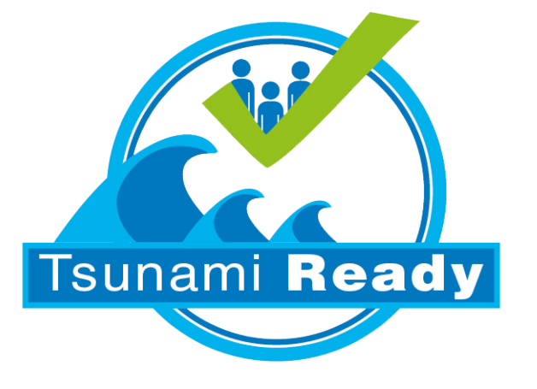
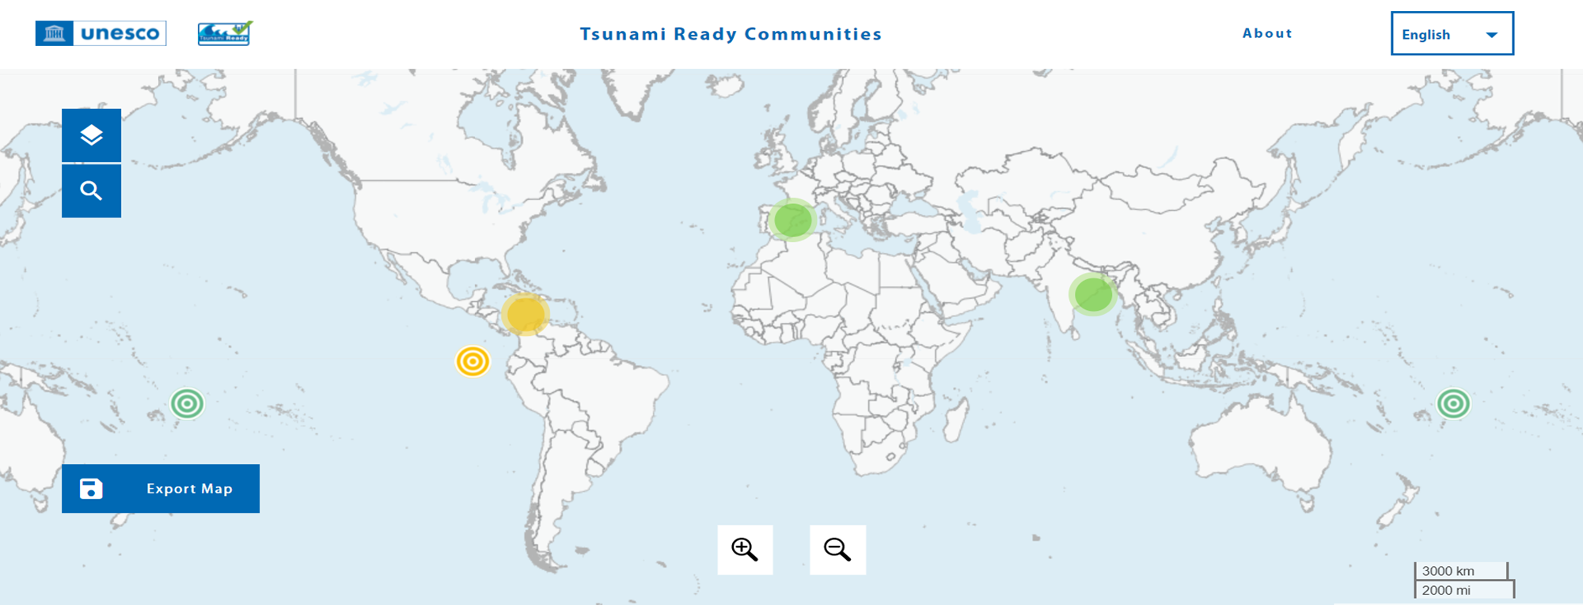
100% of communities at risk of tsunami prepared for and resilient to tsunamis by 2030 through the implementation of the UNESCO/IOC Tsunami Ready Recognition Programme and other initiatives.
The implementation of the Tsunami Ready Recognition Programme will be a key contribution to achieving the societal outcome ‘A Safe Ocean’ of the Ocean Decade.
Currently 30 TR recognized communities

Slide 35
Scientific Committee for the UN Ocean Decade Tsunami Programme (SC-ODTP)
Goal=Draft a 10-Year Research, Development and Implementation Plan for the Ocean Decade Tsunami Programme
Timeline
Consultations with TSU community (TTs/ICGS)
Draft chapters
Consult/contributions Member States (CL)
17 Feb 2022
24-25 Feb 2022
7-8 April 2022
13-17 June 2022
December 2022
23-24 Feb 2023
IOC -EC 55
SC 1st meeting
(online)
TOWS-WG-XV
Safe Oceans
Lab
3rd SC meeting (in person)
IOC Governing body
Tsunami Ready Programme
TOWS WG XVI
Laboratories are innovative formats that function as self-sustaining events. They act as a creative platform to link diverse stakeholders and topics to trigger collaborative efforts regarding the UN Ocean Decade.
The meeting broadly discuss the terms of reference and agreed on a timeline for delivering the 10-year plan
TOWS-WG is a standard setting and advisory body to the IOC on tsunami and other coastal hazards. This session discussed SMART Cable, Tsunami Ready & UN Decade
Final version of the Draft 10-Year Research, Development and Implementation Plan for the Ocean Decade Tsunami Programme.
Endorsement of the 10-Year Research, Development and Implementation Plan for the Ocean Decade Tsunami Programme
2nd SC meeting
(in person)
Opportunity for an in-person SC meeting – 1st Draft of the 10-Year Plan

Slide 36
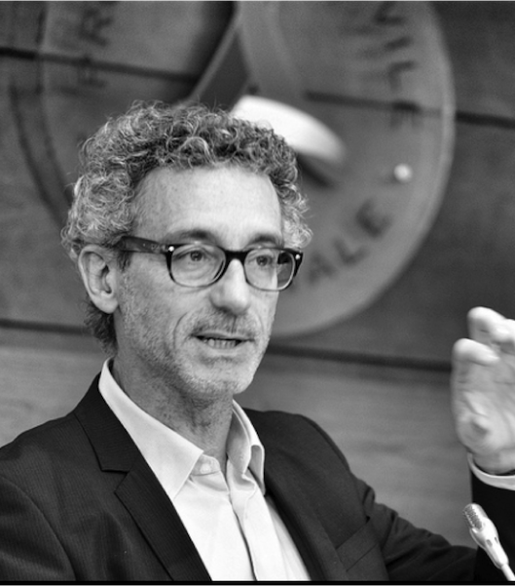
Dr. ALESSANDRO AMATO ITALY
Research Director at the National Institute of Geophysics and Volcanology (INGV)
(Former) Director of the National Earthquake Center and a member of the Major Risks Commission
Head of the Tsunami Alert Center at INGV
ICG/NEAMTWS Former Co-Chair Task Team on Documents
Geologist and seismologist

Slide 37
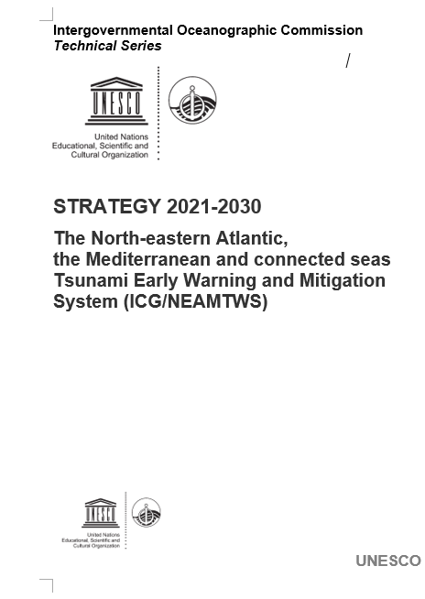
ICG/NEAMTWS 2021-2030 Strategy
The new ICG/NEAMTWS 2021-2030 Strategy outlines key objectives for a continuously improving NEAMTWS to meet stakeholder requirements during the period 2021–2030.
It will also contribute to the UN Decade of Ocean Science for Sustainable Development 2021-2030, in particular by responding to the needs of society for a “safe ocean” where people are protected from ocean hazards.
Strategy seeks to capitalise on the Ocean Decade societal benefits in order to further improve monitoring, detection and data-sharing among Member States and partners.

Slide 38
The vision
Coastal communities around the North-eastern Atlantic, Mediterranean and connected seas are resilient to tsunamis and other sea-level related hazards, with an effective tsunami warning and mitigation system that is based on Member State participation.

Slide 39
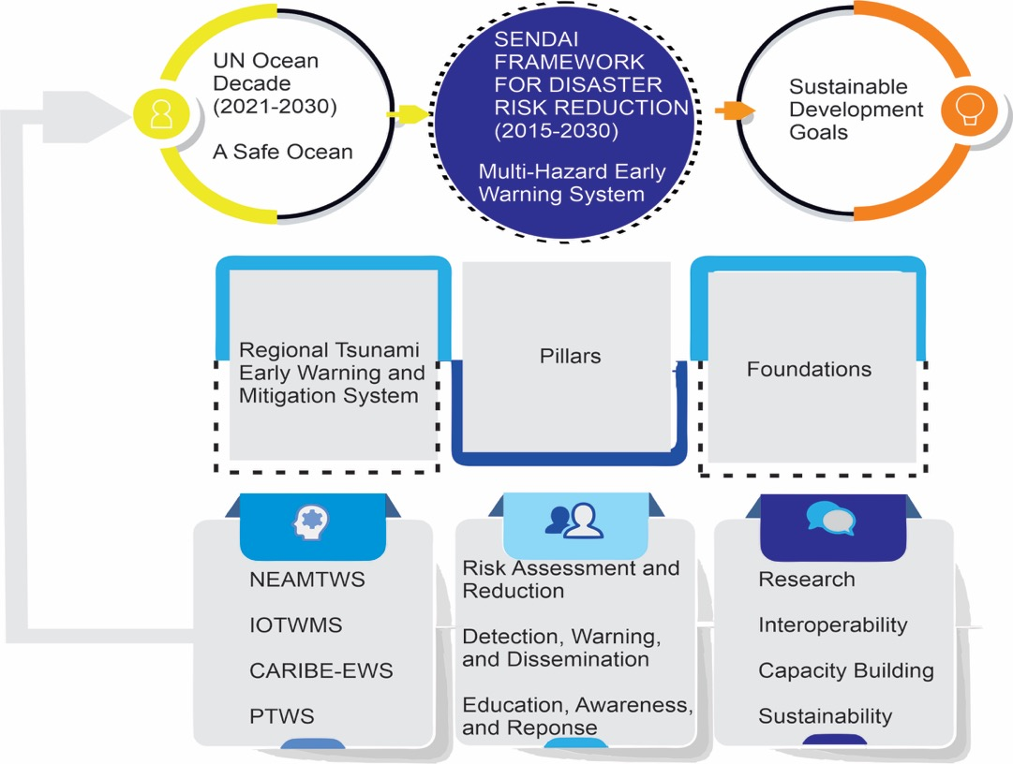
The general framework

Slide 40
The Three Pillars
The Strategy of the North-eastern Atlantic, Mediterranean and connected seas Tsunami Warning and Mitigation System is founded on three pillars:
1. Tsunami Hazard and Risk Assessment
2. Detection, Warning and Dissemination
3. Awareness and Response
These pillars require a foundation of interoperability and sustainability and the enabling activities of research and capacity-building

Slide 41
PILLAR 1: Tsunami Hazard and Risk Assessment
Objective 1.1: Implementation of probabilistic methodologies in tsunami hazard and risk assessment
Objective 1.2: Member states to develop specific tsunami hazard and risk assessments for vulnerable national sub-regions
Objective 1.3: Develop regional hazard assessment for landslide-generated tsunamis
Objective 1.4: Multi-source tsunami hazard assessment

Slide 42

Probabilistic Tsunami Hazard Assessment of the NEAM Region: the NEAMTHM18 (Basili et al. 2021)
Probability of an earthquake-generated tsunami exceeding a maximum inundation height (MIH) of 1 m in 50 years evaluated every ~20 km on the NEAM region coastlines. The map was derived from the NEAM Tsunami Hazard Model 2018 (NEAMTHM18; Basili et al., 2021), which is a product of the TSUMAPS-NEAM project funded by the European Civil Protection and Humanitarian Aid Operations (DG-ECHO). For more details of the model, see http://www.tsumaps-neam.eu. The map presented here was produced with the best information available at the time of modelling. The accuracy of these maps is subject to limitations in the accuracy and completeness of available bathymetry and topographic information, and in the current knowledge of the tsunami sources and characteristics. In the last few years, MIHs greater than 1 meter have been observed during at least three earthquake-generated tsunamis (Samos and Izmir region 2020, Kos-Bodrum in 2017 and Samos in 2020), which caused damage.

Slide 43
PILLAR 2: Detection, Warning and Dissemination
Objective 2.1: Increase, densify and ensure sustainability of the seismic and sea-level detection networks, particularly to include regions/Member States with low coverage
Objective 2.2: Realise installation of multi-hazard observations systems composed of co-located tide-gauge/accelerometer/GNSS sensors
Objective 2.3: Plan and implement an “Inter-Operability Tool”
Objective 2.4: Develop and implement additional monitoring tools
Objective 2.5: Implement Probabilistic Tsunami Forecasting
Objective 2.6: Threat levels
Objective 2.7: Additional sources of tsunami observations

Slide 44
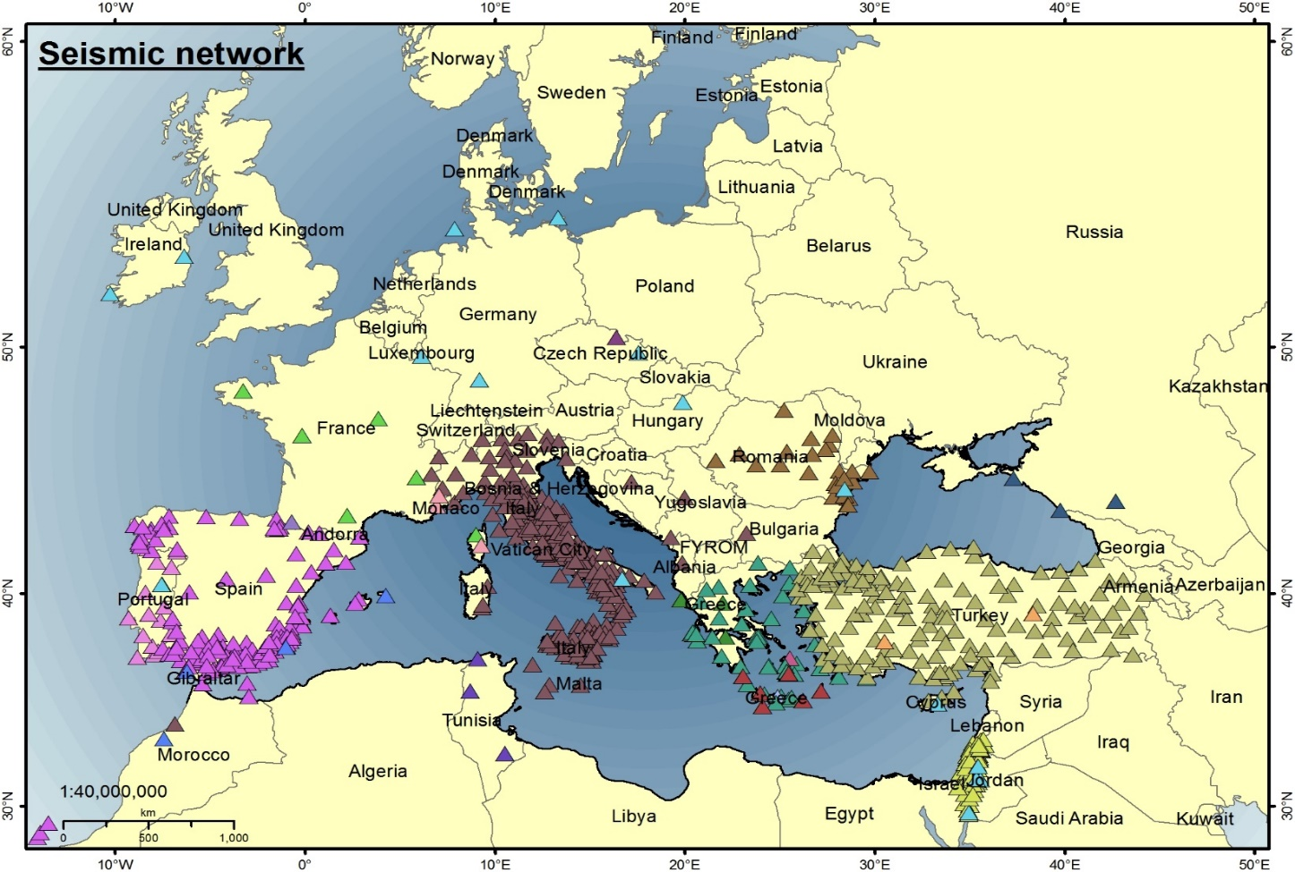
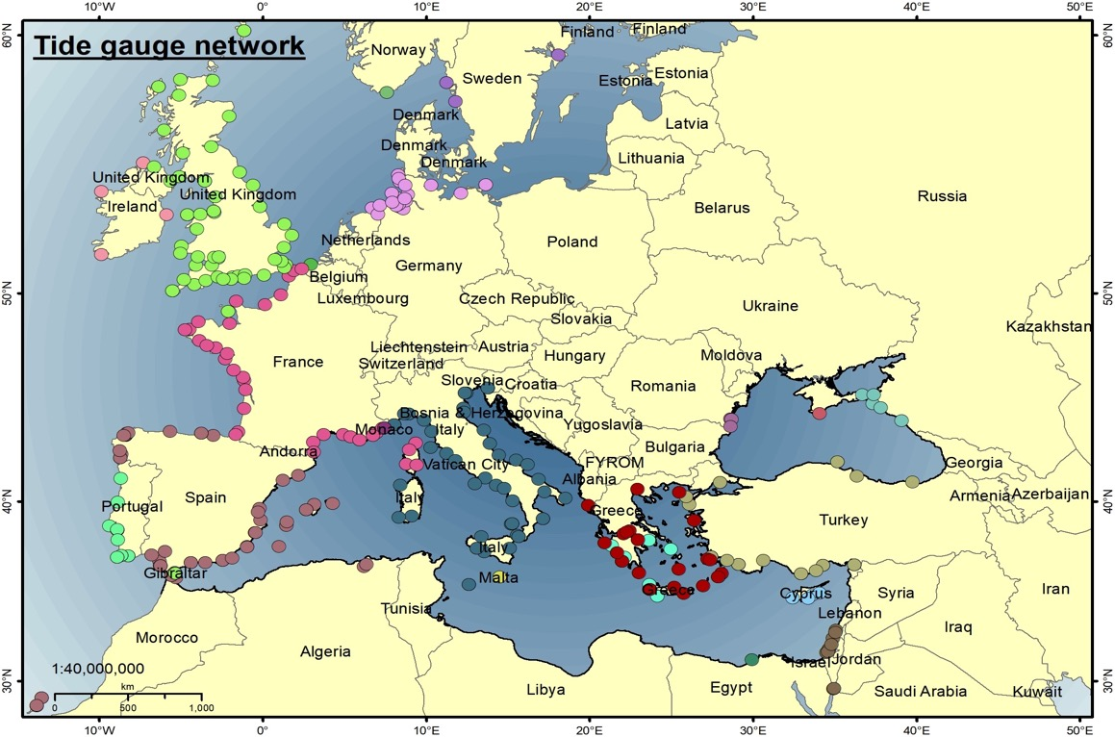
Improving Seismic and Sea Level Networks

Slide 45
PILLAR 3: Awareness and Response
Objective 3.1: Understanding perceptions of coastal hazards and risks
Objective 3.2: Strengthen public and local authority awareness of tsunami and associated hazards and how to prepare to respond
Objective 3.3: Develop tsunami-related curriculum programmes for all levels of education
Objective 3.4: Develop and deliver suitable and sustainable capacity-building programmes to facilitate effective and efficient response and coordination
Objective 3.5: Develop and maintain the NEAMTIC tsunami information website
Objective 3.6: Establish rapid and effective evacuation mechanisms given the risk assessment guidance and data
Objective 3.7: Develop and conduct regular exercises to test early warning systems and evacuation mechanisms
Objective 3.8: Roll out the “Tsunami Ready” initiative in coastal communities

Slide 46
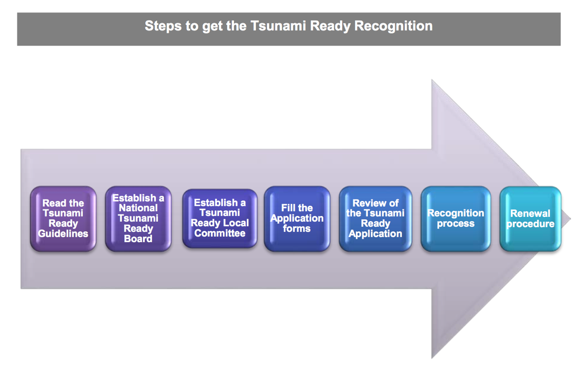
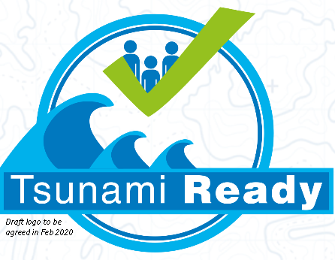



NEAMTWS Towards being Tsunami Ready
 | TSUNAMI READY INDICATORS | Date of evaluation:
 | Stage of achievement | Initial stage | Medium stage | Final stage
I | MITIGATION (MIT)
1 | MIT-1. Tsunami hazard zones are mapped and designated
2 | MIT-2. The number of people at risk in the tsunami hazard zone is estimated
3 | MIT-3. Available economic, infrastructural, political, and social resources are identified
4 | MIT‑4. Tsunami information is publicly displayed.
II | PREPAREDNESS (PREP)
5 | PREP‑1. Easily understood tsunami evacuation maps are developed.
6 | PREP‑2. Outreach and public awareness and education resources are available and distributed.
7 | PREP‑3. Outreach or educational activities are held at least 3 times a year.
8 | PREP‑4: A Tsunami community exercise is conducted at least every two years
III | RESPONSE (RESP)
9 | RESP-1. A community tsunami emergency operations plan (EOP) has been prepared
10 | RESP-2. The capacity to manage emergency response operations during a tsunami has been established.
11 | RESP-3. Redundant and reliable means to timely receive 24-hour official tsunami alerts have been identified.
12 | RESP-4. Redundant and reliable means to timely disseminate 24-hour official tsunami alerts to the public have been identified.
Several pilot communities in Italy, France, Spain, Greece, Turkey, Portugal…

Slide 47
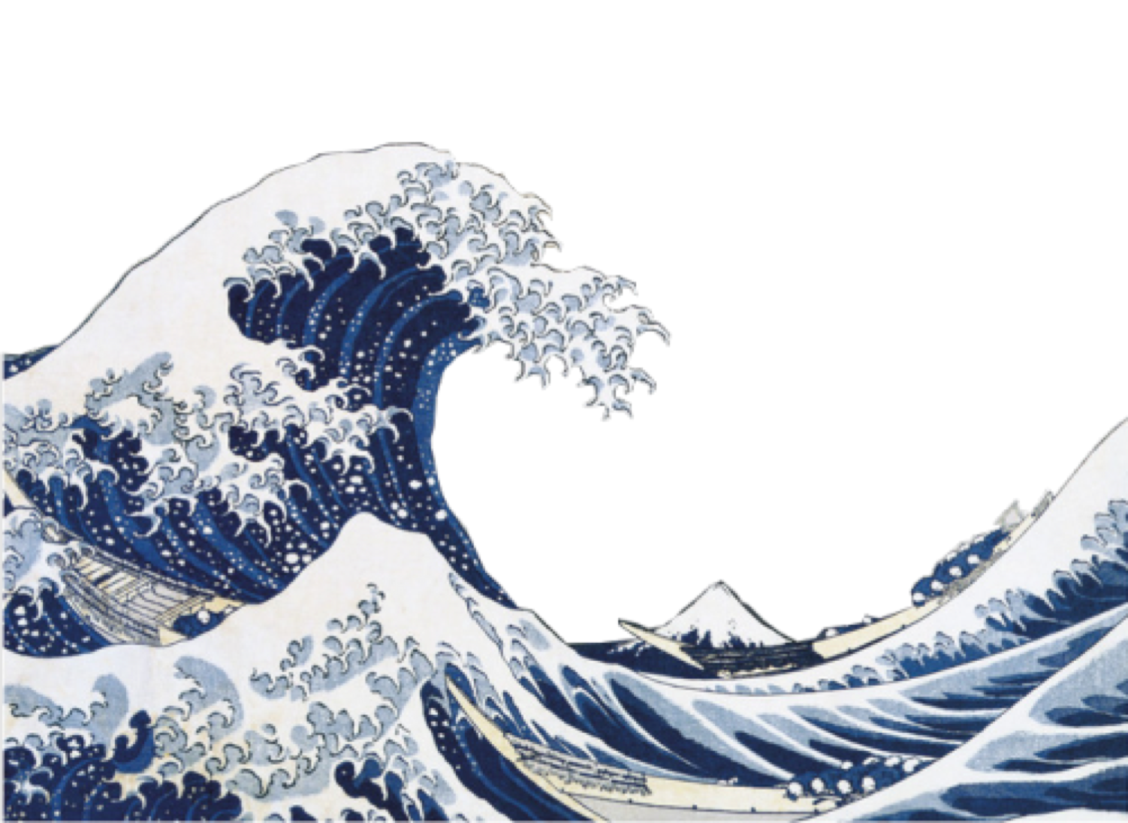
Thank you
Grazie
Merci
Gracias
Obrigado
Ευχαριστώ
Teşekkürler
شكرًا لك
ありがとうございました
多謝

Slide 48
Dr. DENIS CHANG SENG IOC-UNESCO
Programme Specialist
Tsunami Unit (Technical Secretary ICG/NEAMTWS)
Global Ocean Observation System (GOOS)
IOC Focal Point UNFCCC NWP on Ocean & Biodiversity and the International Network for Multi-Hazard Early Warning Systems

Slide 49
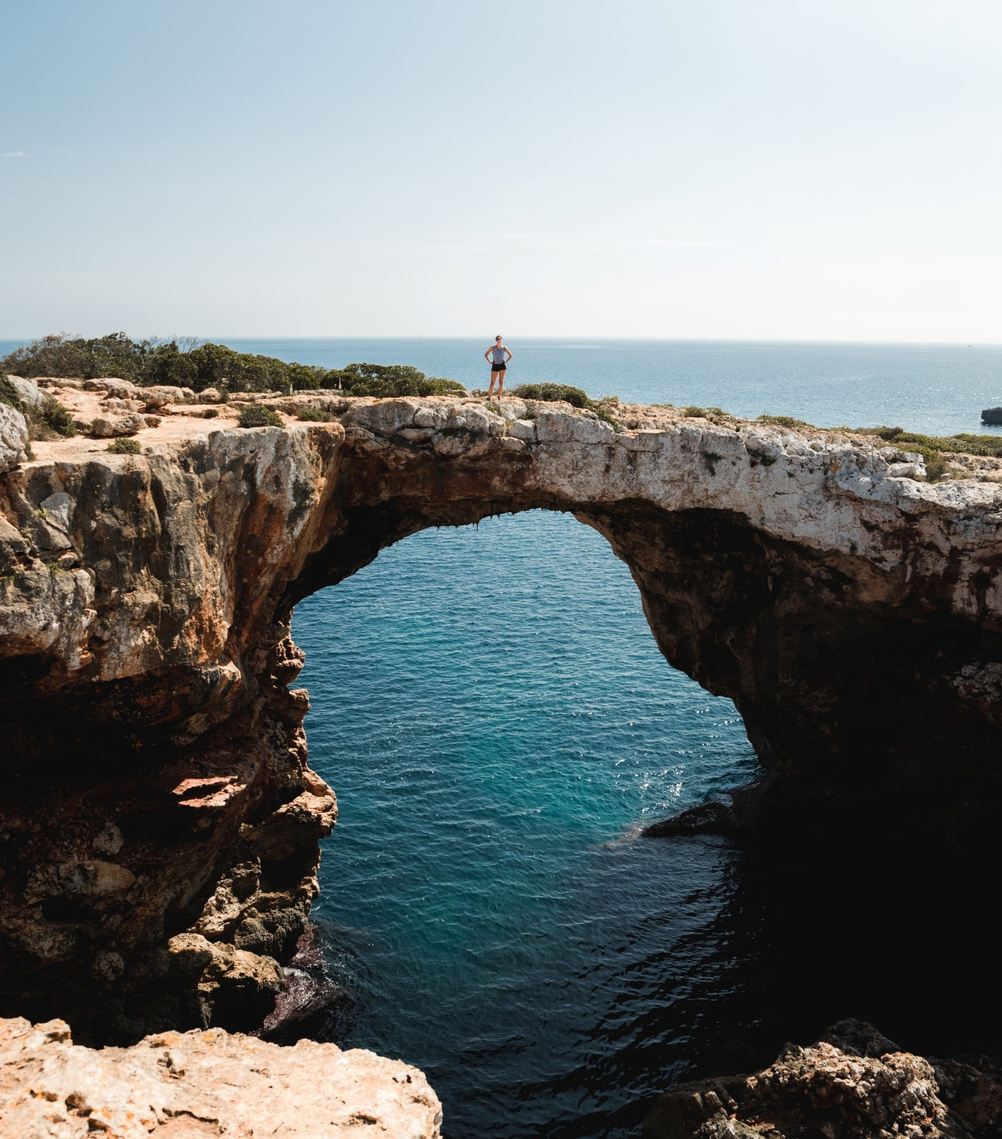
Building on Current Achievements
Governance, Partnerships and Collaboration:
Enhancing and Scaling-Up Actions though CoastWAVE Project

Slide 50
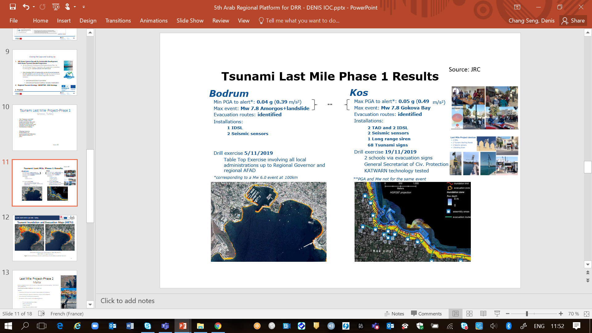
Tsunami Last Mile Project-Phase 1 Greece & Turkey
The 'Tsunami Last Mile' Phase 1 project (2018-2021) was implemented by the JRC and partners in Kos (Greece) and Bodrum (Turkey)
The TLM project has shaped tsunami preparedness at community level following the tsunami events in 2017
Source: JRC

Slide 51




JRC Last Mile Project Phase 2 Malta
Project Implementation Study Area: Marsaxlokk town (Floating Population of 7000)
Malta first end-to-end exercise, 5 Nov 2021
Source Malta CPD /JRC / M. Santini 2021

Slide 52



IOC DG ECHO NEAMTWS PROJECT
CoastWAVE Project “Strengthening the Resilience of Coastal Communities in the North-East Atlantic and Mediterranean Region to the Impact of Tsunamis and Other Sea Level-Related Coastal Hazard”
Funded by the European Union (EU) Directorate-General for European Civil Protection and Humanitarian Aid Operations (DG ECHO)
Geographical scope/benefitting countries | North Eastern Atlantic and Mediterranean Sea: Cyprus, Egypt, Greece, Malta, Morocco, Spain, and Turkey
Technical Advise | France and Italy
Area of influence | 40 NEAMTWS Member States
Period | 01/09/2021 --- 30/03/2024

Slide 53

PROJECT GOALS
Project Management, Monitoring etc.
Tsunami Ready Recognized Communities
Alert Systems
Detection & Monitoring
Risk Perception & Communication Strategies
Improved understanding of tsunami and sea-level related risks.
Better communication strategies to govern sea-level related risk
Enhanced real time detection and monitoring capacities
Improved framework for the sustainability of the existing Inexpensive Device for Sea Level (IDSL) Network
Improved alert/warning capacity
At least seven Tsunami Ready recognized communities by 2023

Slide 54
PROJECT IMPLEMENTING PARTNERS & STAKEHOLDERS
TSPs
Sea Level Monitoring & Tsunami Detection Organizations
Local Government
Community Leaders & members
Ministry of Education (schools)
Scientific organizations , Universities
NGOs
Media
JRC
UNDRR
UNESCO Field Offices
Ministry of Tourism (Hotels)
Community Emergency Organizations & Response Teams
NTWCs

Slide 55
CoastWAVE Project submitted as an IOC Ocean Decade Project

Slide 56
Video 1
EU ECHO Project

Slide 57

Dr. DERYA I. VENNIN IOC-UNESCO
Associate Project Officer at IOC-UNESCO
Subject area: Marine and Coastal engineering, Physical Oceanography
Activities: Management of "Strengthening the Resilience of Coastal Communities in the North-East Atlantic, Mediterranean Region to the Impact of Tsunamis and Other Sea Level-Related Coastal Hazards (CoastWAVE)" Project

Slide 58
Detection, Monitoring and Alerting Systems
Tsunami Ready Recognized Communities
Alert Systems
Detection & Monitoring
Risk Perception & Communication Strategies
Project Countries:
Cyprus, Morocco, Egypt, Malta, Turkey, Spain and Greece

Slide 59

Detection & Monitoring
Why Monitor Water level?
Water Level Data is used for:
Source: GOOS / IOC-UNESCO
Applications of water level data range from making nautical charts to global sea level monitoring
Real time monitoring is essential for tsunami detection, storm surge and warning, sea level rise, oceanographic and climate research
Notes:
Sea level observations provide information on a wide spectrum of oceanographic processes, ranging from surface and internal tides to surface currents and ocean eddies.
In situ observations of sea level are also needed to monitor and understand global sea level rise, as well as interannual to decadal sea level variations, which provide insight into ocean circulation changes on climate time scales.
sea level data are being used for oceanographic and climate research, as well as for practical applications associated with storm surges and tsunami monitoring

Slide 60

Detection & Monitoring
Why we need water level data of tsunami ?
Detect the presence of a tsunami in deep-ocean
Measure tsunami arrival and wave height near and at the coast
Validate tsunami models
Photo Credit: Canva

Slide 61




Detection & Monitoring
How are tsunamis measured/observed?
On Coast:
Tide gauges that record a data on period of 1min
Photo Credit: NOAA
Near the Coast: GPS sensors on buoys
In Deep Ocean: sensors including
Tsunameters (DART Buoys)
Smart cables
DAS (Distributed Acoustic Sensing)
High-precision coastal real-time Global Navigation Satellite Systems
Photo Credit: NOAA
Notes:
Sea level observations provide information on a wide spectrum of oceanographic processes, ranging from surface and internal tides to surface currents and ocean eddies.
In situ observations of sea level are also needed to monitor and understand global sea level rise, as well as interannual to decadal sea level variations, which provide insight into ocean circulation changes on climate time scales.
sea level data are being used for oceanographic and climate research, as well as for practical applications associated with storm surges and tsunami monitoring
Water level data describe sea surface height. Applications
of water level data range from making nautical charts
to global sea level monitoring. Real-time monitoring of
water level data is also essential for tsunami detection and
warning. Tsunami waves disperse across the ocean at very
high speeds in deep water and essentially go unnoticed.
However, when the waves reach the shore, the waves
slow down and the height of the wave increases. Modern
instrumentation is capable of detecting deep-ocean sea
surface height changes and accurately capturing those
heights when the wave reaches the shore.

Slide 62

Detection & Monitoring
Current Coastal Sea Level Station Network-Tide Gauges at NEAMTWS
Total of 240 operational stations
Most stations provide values every minute and are updated each 5 minutes.
Map of sea level networks used by NEAMTWS Tsunami Service Providers (IOC-UNESCO)

Slide 63

Detection & Monitoring
NEAMTWS Current JRC Network of Inexpensive Device for Sea-Level Measurement (IDSL) Devices
Developed for Tsunami Hazard monitoring in NEAMTWS area of IOC-UNESCO
Cheap and effective
Long term reliability is being tested
Missing coverage of North Africa coasts
40 devices in NEAM

Slide 64

Detection & Monitoring
NEAMTWS Current Network of IDSLs
DG ECHO CoastWAVE Project Implementation
Install new IDSLs
Upgrade the existing IDSLs
Update the existing technology of IDSLs
IDSLs to be repaired in 7 project countries
4 IDSLs to be installed including Morocco and Egypt
Its reliability, duration and quality need to be determined.
in collaboration with IOC-UNESCO and DG ECHO.
Photo Credit: JRC
Notes:
Sea level observations provide information on a wide spectrum of oceanographic processes, ranging from surface and internal tides to surface currents and ocean eddies.
In situ observations of sea level are also needed to monitor and understand global sea level rise, as well as interannual to decadal sea level variations, which provide insight into ocean circulation changes on climate time scales.
sea level data are being used for oceanographic and climate research, as well as for practical applications associated with storm surges and tsunami monitoring
Water level data describe sea surface height. Applications
of water level data range from making nautical charts
to global sea level monitoring. Real-time monitoring of
water level data is also essential for tsunami detection and
warning. Tsunami waves disperse across the ocean at very
high speeds in deep water and essentially go unnoticed.
However, when the waves reach the shore, the waves
slow down and the height of the wave increases. Modern
instrumentation is capable of detecting deep-ocean sea
surface height changes and accurately capturing those
heights when the wave reaches the shore.

Slide 65

Detection & Monitoring
Ongoing Technological Efforts at Italy

Slide 66


Detection & Monitoring
.
Tsunami observations on Maritime Infrastructure provide:
New Technologies-UN Decade of Ocean Science for Sustainable Development (2021-2030)
More tsunami observations
Co-located environmental observations
Better monitoring and prediction capabilities
Efficient operations of maritime facilities and sustainable management practices.
Closer stakeholder collaboration
Extensive Coverage at Low Cost

Slide 67


Detection & Monitoring
New Technologies-UN Decade of Ocean Science for Sustainable Development (2021-2030)
TSUNAMI MONITORING by SHIPS:
GPS-equipped ships enable each vessel to act as an open-ocean tide gauge, supporting tsunami monitoring.
Photo Credit: Mario Tama / Getty Images file

Slide 68



Alert Systems
Tsunami Alerting Device (TAD) in NEAM Region
Developed by EU JRC
Delivers warning messages
Consists of a panel equipped with data receivers, a display, an alerting siren and a loudspeaker.
Can be automatically activated by the GDACS system or can be connected to local sea level system
Provides multi-usage for local authority: to interact with the population in normal times (greeting messages, touristic or public useful information)
TADs will be installed under COASTWAVE DG ECHO Project
Photo Credit: JRC

Slide 69
SESSION 3
PANEL DISCUSSION

Slide 70

Dr. ANDI EKA SAKYA (INDONESIA)
National Agency for Research and Innovation
Research Center for Geological Hazard
Former Chair of ICG/IOTWMS
Senior Engineer Agency for the Assessment and Application of Technology (BPPT)

Slide 71

MSc. IGNACIO AGUIRRE-AYERBE (SPAIN)
Technologist at IHCantabria
Participating in different international projects related to Vulnerability and Risk assessment to natural hazards.
Research lines: Vulnerability and risk assessment to natural hazards
Website for more info:
https://ihcantabria.com/en/directorio-personal/investigador/ignacio-aguirre-ayerbe/

Slide 72

Prof. AMR HAMOUDA (EGYPT)
President of National Institute of Oceanography and Fisheries (NIOF) Ministry of Higher Education & Scientific Research
Subject Area: Marine Geology, Geophysics
36 Publications, 261 citations

Slide 73

Prof. AHMET CEVDET YALCINER (TURKEY)
Professor at Middle East Technical University, Department of Civil Engineering
Research areas: Numerical modeling of tsunamis and storms, sediment transport, port and breakwater design, sediment transport
Over 50 articles and more than 90 papers published in international books or distinguished scientific journals; Total Citations (WOS): 1572
Website for more info:
https://avesis.metu.edu.tr/yalciner

Slide 74

MSc. ELENA DASKALAKI (GREECE)
Senior Seismologist in the Institute of Geodynamics, National Observatory of Athens (NOA)
25 publications and 357 citations
Co-chair of Task Team on Tsunami Ready of ICG/NEAMTWS

Slide 75

Dr. KHALID EL KHALIDI (MOROCCO)
Faculty of Sciences - Chouaïb Doukkali University · Professor of Department of Geology
Project: Impact of anthropogenic changes on sedimentary and geochemical processes in coastal areas
24 Publications and 57 Citations

Slide 76
Video 2
OceanGeneration

Slide 77
MOHAMED SALAH HASSAN (EGYPT)
Master degree in Marine geophysics
Member of the research team at national institute of oceanography and fishers (NIOF)
CLAIRE JAFFREZIC (FRANCE)
Intern at IOC-UNESCO
Master in Disaster and Natural Risk Management (GCRN) at Paul Valéry University
GOZDE GUNEY DOGAN (TURKEY)
Middle East Technical University | METU
IMANE JOUDAR (MOROCCO)
Université Chouaib Doukkali
Department of Civil Engineering ·PhD student
Department of Earth Sciences ·PhD student

Slide 78
SESSION 4
Q & A

Slide 79
SESSION 5
Key Outcomes and Messages

Slide 80
END
END THANK YOU FOR YOUR PARTICIPTION AND SUPPORT

