Slide 1


OOPC & RRR
Sabrina Speich, Weidong Yu, co-chairs
OGC 13th, May 2022

Slide 2
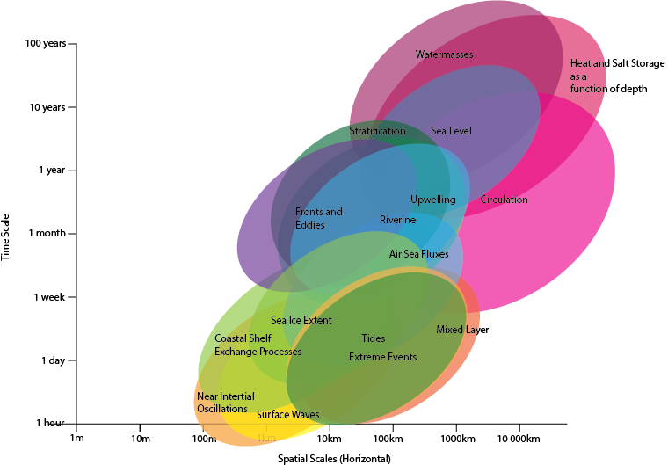
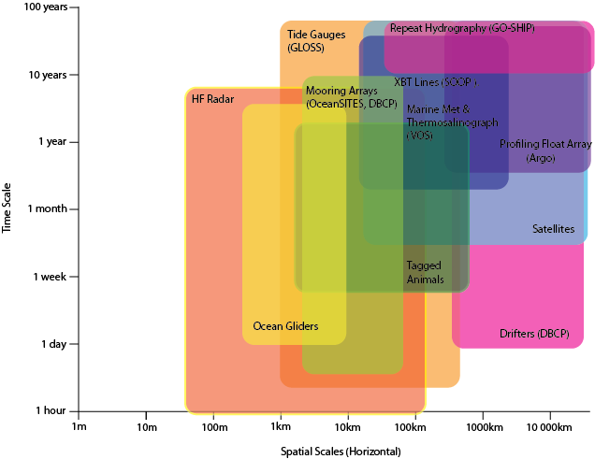
OOPC Review/Evaluation of observing systems
OOPC & CLIVAR associate to provide evaluations of regional/basin observing systems
GOAL:
Build the best observing system integrating different platform to monitor/measure various phenomena/societal requirements. Classically this has been developed for the physical variables (EOVs & ECVs)
PHENOMENA/SOCIETAL REQUIREMENTS
OBSERVING PLATFORMS
Time scale
Time scale
Spatial scale
Spatial scale

Slide 3




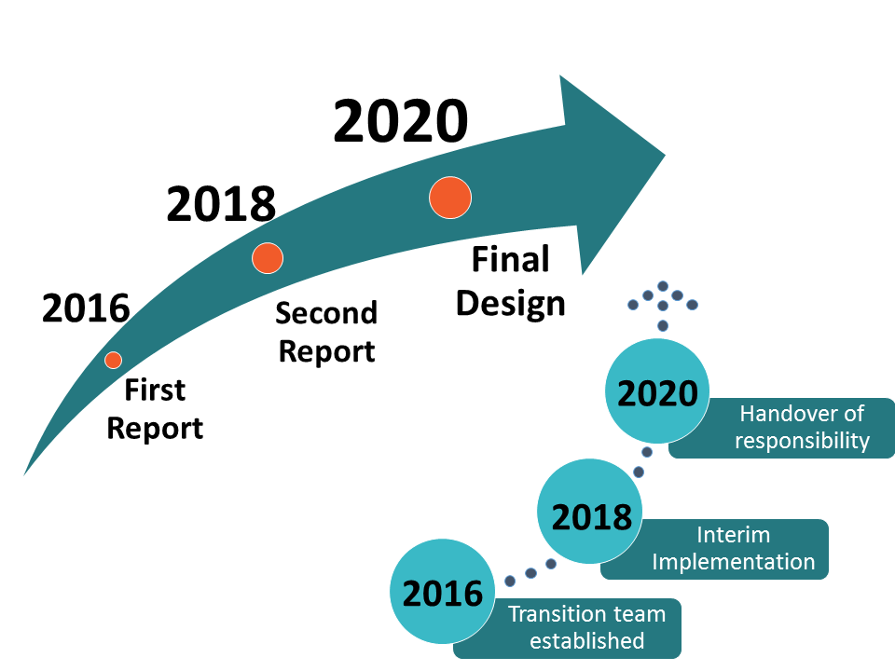
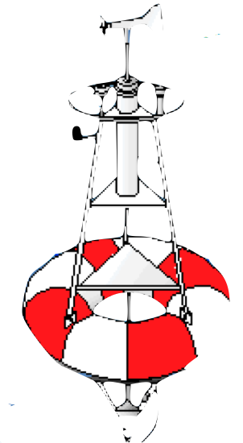
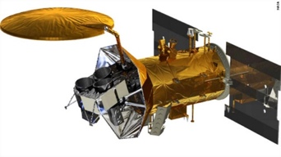
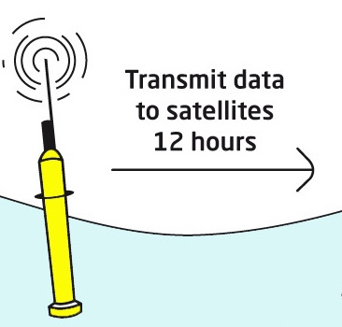
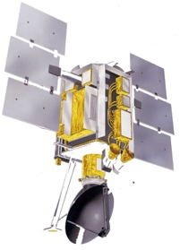









OOPC Review/Evaluation of Tropical Systems
Assessment of Ocean Observing System to meet user requirements
  Global integration of parts (i.e. Basin systems, and topical systems, platforms)

Slide 4
OOPC Review/Evaluation of Tropical Systems
To evaluate the adequacy and the most suitable set of platforms to be integrated in the observing system, each reviews of the Tropical Observing Systems provided requirements in terms of EOVs/ECVs
TPOS 2020
TAOS 2021

Slide 5



OOPC Observing system evaluation for other phenomena at global scale
  OASIS
Resolve air-sea fluxes to understand and predict ocean’s influence on weather and climate
Large multidisciplinary community mobilized: SCOR Working Group #162 + Endorsement by Ocean Decade + Consortium for Ocean Leadership support
  Boundary Systems
5 “dialogues” between the modelling and observing community in 5 boundary systems (one left).
Paper being prepared with recommendations
  Ocean Indicators Framework
Mutlidisciplinary group of experts mobilized (28 members)
Round of interviews undertaken
“Baseline” paper being drafted
Notes:
This is the most straightforward part, simply describing the activities that are on going, bearing in mind the very different timeframe of all of them (OASIS is 5-10 y, BSTT may end this year, the Ocean Indicators may span several years), and the level of support and ambition.

Slide 6

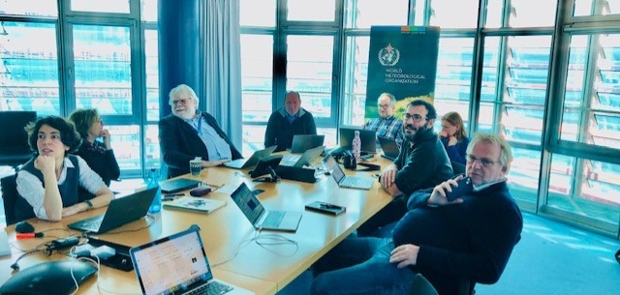

OOPC The ocean component of GCOS
Submit your abstract before 1st June!
  GCOS Status Report presented at COP26
SBSTA welcomed the Status Report:
GCOS SR acknowledges progress but also identifies gaps and needs, in particular to enhance and sustain observations.
  GCOS Implementation Plan drafted
GCOS IP recommends actions to improve the climate observing system.
GCOS IP also presents an update of ECV requirements.
  GCOS Climate Observation Conference
Sabrina Speich: chair of Scientific Committee.
In person meeting, 3 days, 6 sessions.
https://www.eventsforce.net/gcos-coc
Notes:
I would highlight here that OOPC leads this activities within GCOS, but this has been a clear example of cross-panel activity where BGC and BioEco panel have been involved and provided feedback. We think this has worked reasonably well, and it has improved (GCOS IP was better than GCOS Status Report in terms of how the other panels were involved), but we are working towards improving the mechanisms to channel that feedback in due time.
There are many other areas where there is a strong cross-panel component. The panels officers are working together in rationalising and clarifying the reporting on requirements for EOVs, there is a new EOV template and we are working on a document which will describe EOV framework.

Slide 7
OOPC The ocean component of GCOS
  GCOS Implementation Plan drafted
GCOS IP recommends actions to improve the climate observing system.
GCOS IP also presents an update of ECV requirements.
Evolution of the ocean ECVs: In phase with a set of EOVs, with “global scale climate” requirements
Biological ECVs/EOVs standardization just started
GCOS now to focus on extremes and adaptations (mandate from UNFCCC). This means that the observing system needs to be consistent seamlessly for all time scales (weather to decadal and beyond time scales).
The EuroSea EU H2020 project has started to develop indicators and therefore EOVs/ECVs requirements across these different time scales and also is looking to how the EOVs requirements at regional/local scale (for extremes and adaptation) can be tackled.
Notes:
I would highlight here that OOPC leads this activities within GCOS, but this has been a clear example of cross-panel activity where BGC and BioEco panel have been involved and provided feedback. We think this has worked reasonably well, and it has improved (GCOS IP was better than GCOS Status Report in terms of how the other panels were involved), but we are working towards improving the mechanisms to channel that feedback in due time.
There are many other areas where there is a strong cross-panel component. The panels officers are working together in rationalising and clarifying the reporting on requirements for EOVs, there is a new EOV template and we are working on a document which will describe EOV framework.

Slide 8
OOPC/CLIVAR & RRR
OOPC has started to run evaluations of observing systems with the RRR in mind to recommend the way forward for an integrated and fit-for-purpose observing system.
However:
We miss a more efficient tool to go from separate phenomena (and specific EOVs/ECVs requirements) to an integrated observing system
The ocean and atmosphere (and sea-ice, etc) operational communities (altogether) to work with ocean experts for building the needed observing system
The UN Decade of Ocean Science GOOS sponsored “Ocean Observing Co-Design” programme to develop more quantitative and agile tools for such co-design and regular evaluation of the observing system
Notes:
I would highlight here that OOPC leads this activities within GCOS, but this has been a clear example of cross-panel activity where BGC and BioEco panel have been involved and provided feedback. We think this has worked reasonably well, and it has improved (GCOS IP was better than GCOS Status Report in terms of how the other panels were involved), but we are working towards improving the mechanisms to channel that feedback in due time.
There are many other areas where there is a strong cross-panel component. The panels officers are working together in rationalising and clarifying the reporting on requirements for EOVs, there is a new EOV template and we are working on a document which will describe EOV framework.

Slide 9

Thank you
goosocean.org

Slide 10
Notes to the template
Using image placeholders
The picture slides are predefined with picture placeholders that help you to manage the image you add into the field.
Click the button in the middle of the field to select and import the picture you want to use. The picture field will automatically fill the field with the image.
You can edit the position of the image using the crop tool, which is in the ‘Picture Tools > Format menu. This menu appears when you click on an image.
The crop tool allows you to enlarge, adjust position or crop the image to fit.

Slide 11
The Request
    10 minute recorded report followed by 15 minute Q&A session
The format will be a 10 minute recorded report with 10-15 minutes of moderated questions
The webinars will be recorded and made available for those not able to attend live
we’d also appreciate having your presentation sent to Forest Collins (f.collins@unesco.org) after the webinar for posting
  Purpose
    Give the SC a chance to hear about:
      Achievements
      Future plans
      Opportunities & Issues

