Slide 1
Realizing the Benefits of Ocean Knowledge through Ocean Observing Co-Design
Supporting the Decade of Ocean Science for Sustainable Development by transforming our ocean observing system assessment and design process.
Sabrina Speich, IPSL, France
David Legler, NOAA; Emma Heslop, GOOS IOC/UNESCO;
Albert Fisher, GOOS, IOC/UNESCO; Ann-Christine Zinkann, NOAA
Notes:
5 take away messages

Slide 2
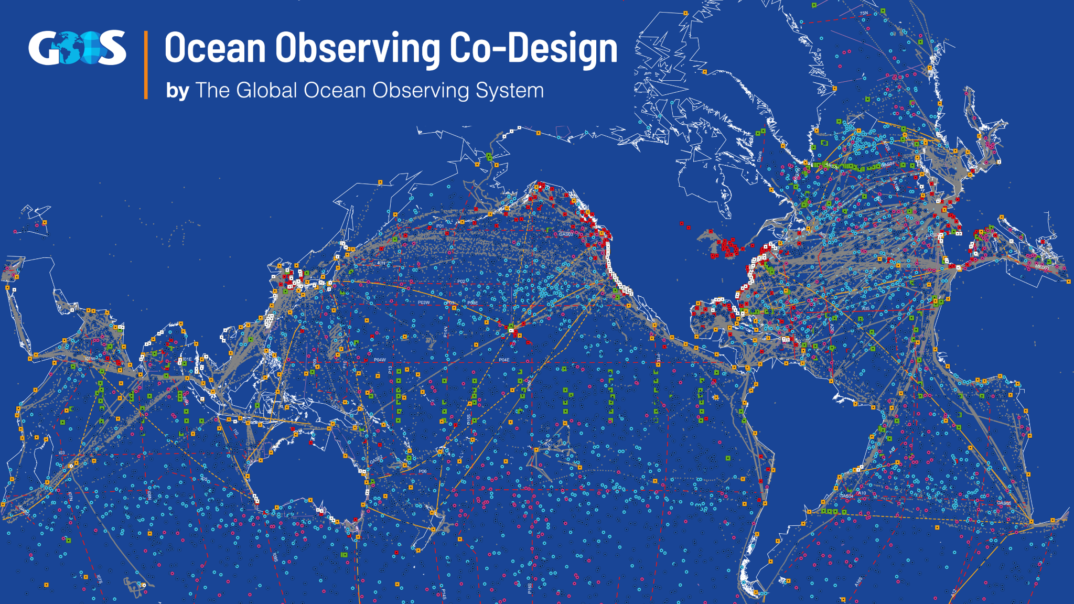
Thanks to over 100 countries and GOOS, the marine research community has demonstrated an initial global ocean observing capability
This GOOS system of 12 observing networks and 15 GRAs’s addresses some of the needs for operational services, climate and ocean health
While continually demonstrating benefit, this “system” is not yet fully integrated across disciplines, nor tightly integrated with downstream forecast systems, beneficiaries, and potential supporters.
The UN Decade is a once-in-a-lifetime opportunity to transform the current activities into an integrated, responsive, and valued ocean observing SYSTEM we need
Notes:
While continually demonstrating benefit, this “system” is not yet fully integrated across disciplines, nor tightly integrated with downstream forecast systems, beneficiaries, and potential supporters.

Slide 3
The challenge
We need new information on the ocean to meet major challenges across climate change adaptation and mitigation, coastal ocean and weather prediction, food security, human safety and the wellbeing of marine life.
For this we need to better integrate observations and models to produce useful ocean knowledge and establish clear priorities for investment in ocean observing for the future.
Notes:
Ocean Observing Co-Design will create a system co-designed with observing, modelling and key user stakeholders that will evolve ocean observing and give us the ocean we need for the future we want.

Slide 4
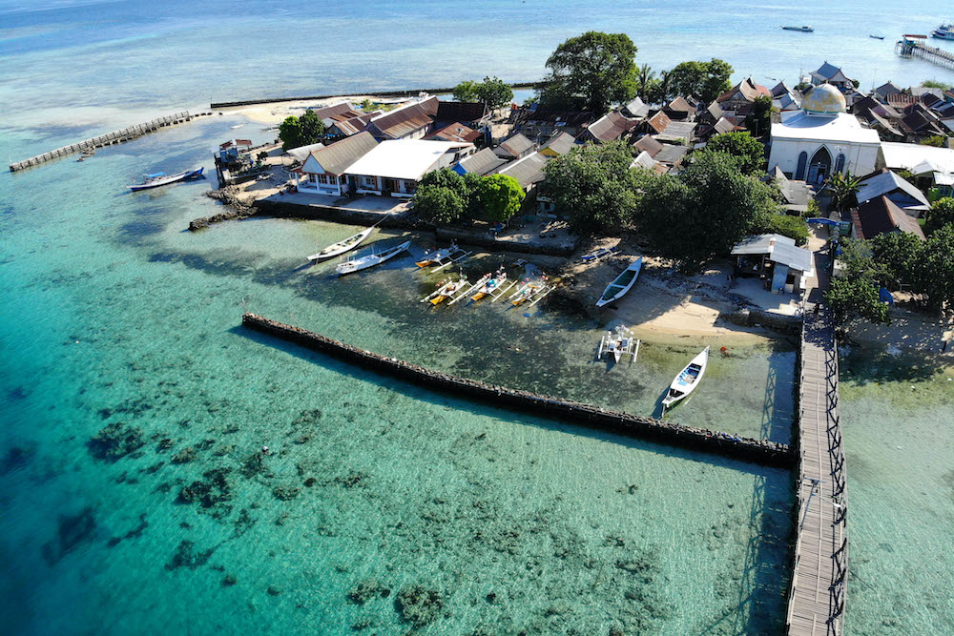
Ocean Observing Co-Design will support the Ocean Decade by transforming our ocean observing system assessment & design process.
By 2030, Ocean Observing Co-Design will:
develop a more user-focused co-design process to create a fit for purpose, integrated, and responsive observing system.
include the large range of ocean observing efforts in place, as well as actively involving new technologies, and the modelling, forecast, and services communities.
together build the process, infrastructure and tools, to inform investment and benefit society

Slide 5
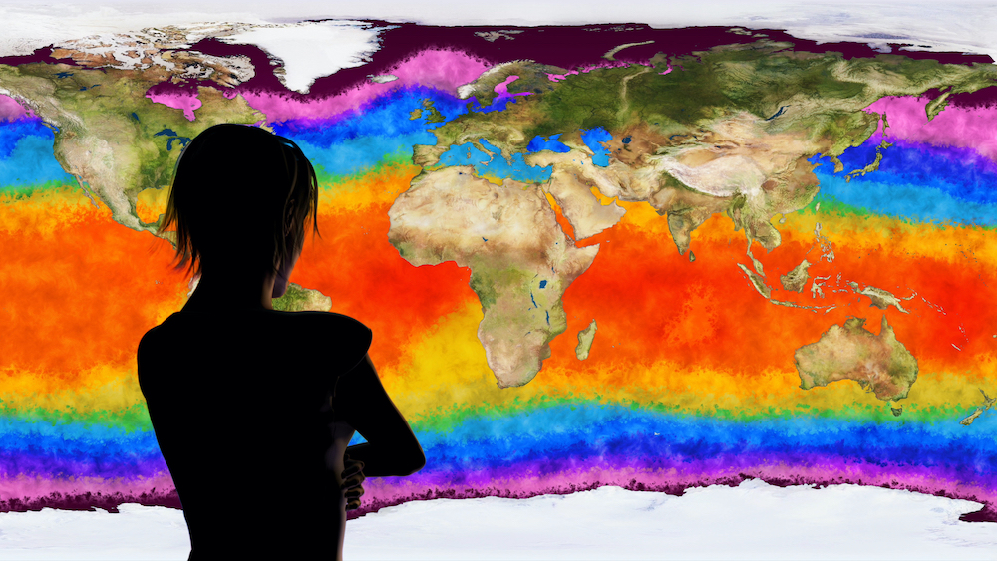
Objectives
Offer national government funders the information needed to target investment globally, regionally and locally and establish what implementation will have the greatest impact. Governments will be able to track implementation, show the benefits that justify costs and increase ROI.
Provide investors with the opportunity to help create a hub or center of excellence that analyses observing systems and results in sustainable management.
Make ocean observing and information appreciably more accessible and impactful through transformative co-design, working with the modelling community and key user stakeholders to achieve tangible integration and interoperability.

Slide 6
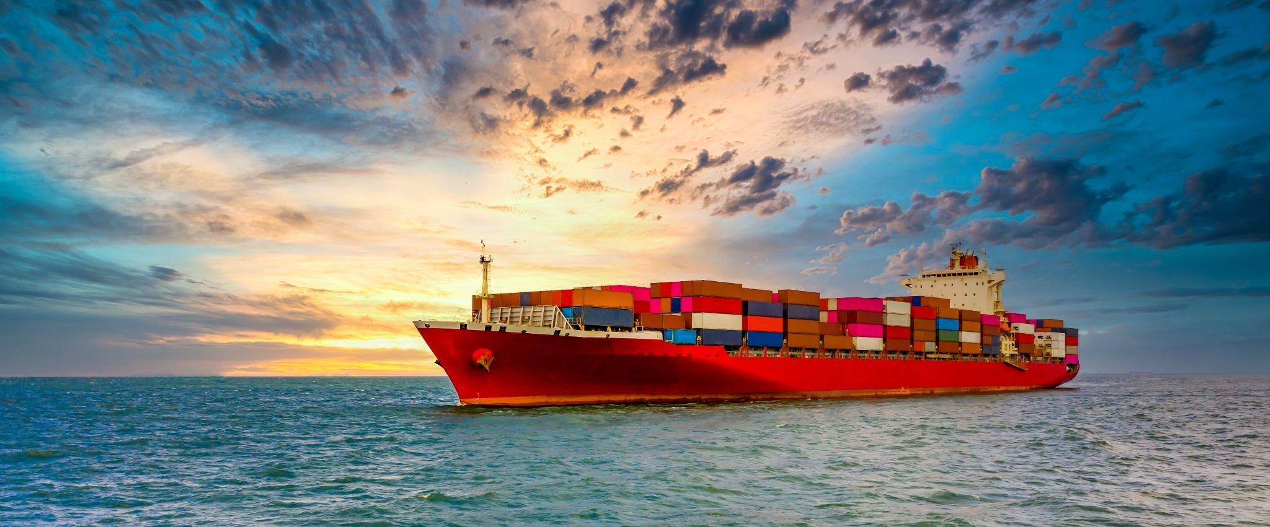
Objectives cont.
4. Develop system diagnostics, tools and reporting capability to better assess fitness-for-purpose across evolving requirements and use-inspired needs, including digital scenario tools that work backwards from intended impact to give us a priority plan for observing.
5. Establish the international capacity and modular infrastructure to co-design and regularly evaluate the observing system at different scales. For example, using a toolkit of software and user engagement/co-design methods that we can apply to global problems or local challenges.

Slide 7
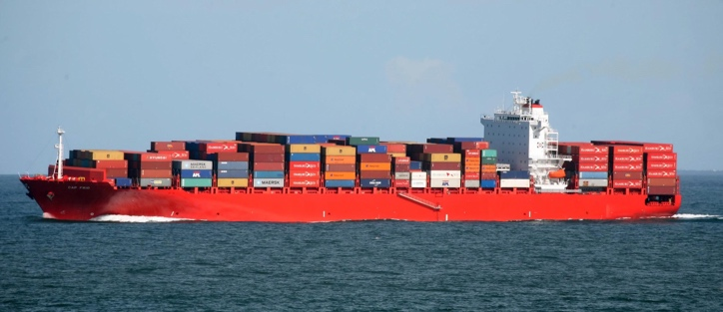
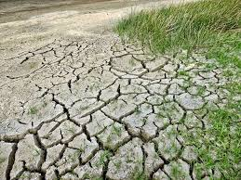
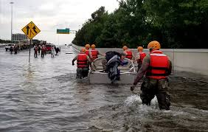
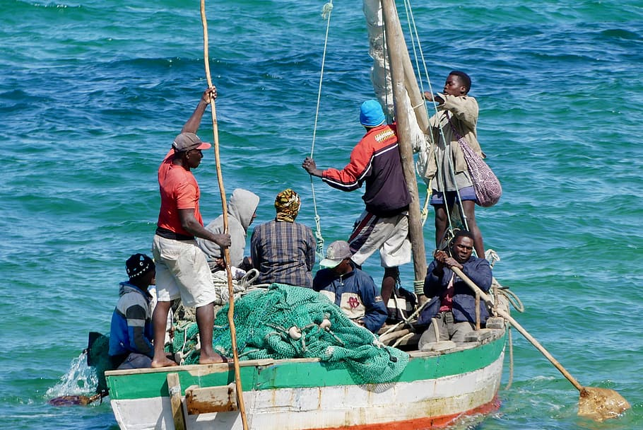
Co-design: foster connections, produce answers
Observations
Models and Obs Assessment Tools
Integrated and Impactful Observing System, Models, and Products
Products and Services
User Needs and Requirements
Notes:
CoDesign: the development and intentional planning of a system by a collection of stakeholders

Slide 8
WHO’S INVOLVED?
PARTNERS
WCRP
Copernicus Climate Change Service C3S
Mercator/Copernicus
Bio-Eco Panel
WMO
ECMWF
IODE
MOi
GCOS
MBON
SOCIB
UNEP-WCMC
IOC Marine Policy
IOOS
IMOS
OceanPredict
Argo
IOCCP
OCEAN DECADE PROGRAMMES
MarineLife 2030
ForeSea
DITTO
OASIS
OBON
CoastPredict
Observing Together
+++
ENDORSED PROJECT LEAD PARTNERS
1. GO-SHIP | Go Ship Evolve
2. OceanOPS | Odyssey
3. National Oceanographic and Maritime Institute (NOAMI) Bangladesh
4. Northeastern Regional Association of Coastal Ocean Observing Systems (NERACOOS)
5. COCAS | LOCEAN-IPSL
6. Consorcio de Investigación del Golfo de México (CIGOM)
7. Joint Task Force SMART Subsea Cables
8. Sydney Institute of Marine Science | AniBos
9. The Argo Steering Team
10. Integrated Carbon Observing System Ocean Thematic Centre (ICOS-OTC)
11. Geoazur | 300 MERMAIDS
GOOS components
GOOS Panels
ETOOFS
OCG
Notes:
This is overview of who’s involved in this programme. In the original programme proposal we had support from a significant number of partners listed here on the left. Noted in the centre panel are other endorsed Ocean Decade programmes that present key players for collaboration. The third panel here shows the 11 projects that have been allocated to this programme these include projects that are part of existing networks or looking to establish new networks and then also projects that focus on establishing or enhancing integrated observing systems regionally.

Slide 9
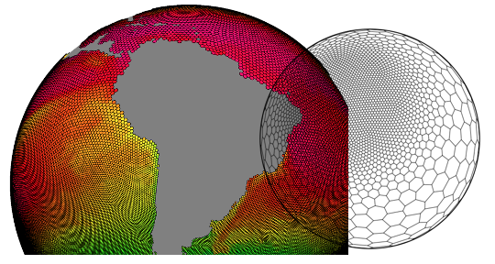
EXEMPLAR APPROACH
Exemplars: projects to develop and advance co-design principles and components around identifiable societally beneficial needs (e.g. products and services)
Orienting around benefit areas targeting use areas, accelerating payoff for stakeholders
Exemplars will come in a wide variety of sizes, scope, types of participants, and aims.
Some exemplar areas are likely more mature than others in terms of readiness/availability of observations, products, services, and identifying stakeholder needs
AIMS:
Develop consistent and transferable capabilities, tools, and methodologies as well as fit-for-purpose observations, models, and products/services
Embrace UN Decade outcomes/principles, including accessibility and equity/inclusion
Notes:
This is an example of the exemplar areas that we propose we can start to work on through projects. Different exemplar areas are more mature than others for service delivery, model and observing maturity - and these different levels of maturity need to be addressed so that processes and tools developed can be broadly applicable. It’s important to note that these are exemplars that we suggest as initial example areas. The tools and processes developed will be applicable to other areas.
The exemplars noted here are ones that have been discussed as being potential use areas that we could develop projects around. And importantly alongside each exemplar area we have noted the stakeholders who are the end-users who much be part of the co-design process.
There are many more exemplars that need to be considered: even basic ones such as how do we better integrate Argo, drifters, buoys, Oceansites, XBT, go-ship, gliders, animal borne sensor network (ANIBOS), and all the rest into a single integrated and cost effective observing system…not a collection of observing projects?

Slide 10
Exemplar Examples (and stakeholders)
Ocean Carbon Cycle: national policy makers, those assessing carbon storage
Marine heatwaves: aquaculture, fisheries
Forecasting tropical cyclones: coastal communities, local authorities, national governments
Coastal storm surge inundation: coastal managers, urban planners, coastal industries & communities
Ocean Boundary Currents (off east and west coasts): fisheries, coastal communities (resilience)
Marine Life 2030: fisheries, sanctuaries, and MPAs
Notes:
This is an example of the exemplar areas that we propose we can start to work on through projects. Different exemplar areas are more mature than others for service delivery, model and observing maturity - and these different levels of maturity need to be addressed so that processes and tools developed can be broadly applicable. It’s important to note that these are exemplars that we suggest as initial example areas. The tools and processes developed will be applicable to other areas.
The exemplars noted here are ones that have been discussed as being potential use areas that we could develop projects around. And importantly alongside each exemplar area we have noted the stakeholders who are the end-users who much be part of the co-design process.
There are many more exemplars that need to be considered: even basic ones such as how do we better integrate Argo, drifters, buoys, Oceansites, XBT, go-ship, gliders, animal borne sensor network (ANIBOS), and all the rest into a single integrated and cost effective observing system…not a collection of observing projects?

Slide 11
KEY EVENT | CO-DESIGN WORKSHOP
DATES: June 7, 8, 9 and Day 4 date in September tba
Use lessons learnt and previous experiences to define exemplars and develop Exemplar project outlines

Slide 12
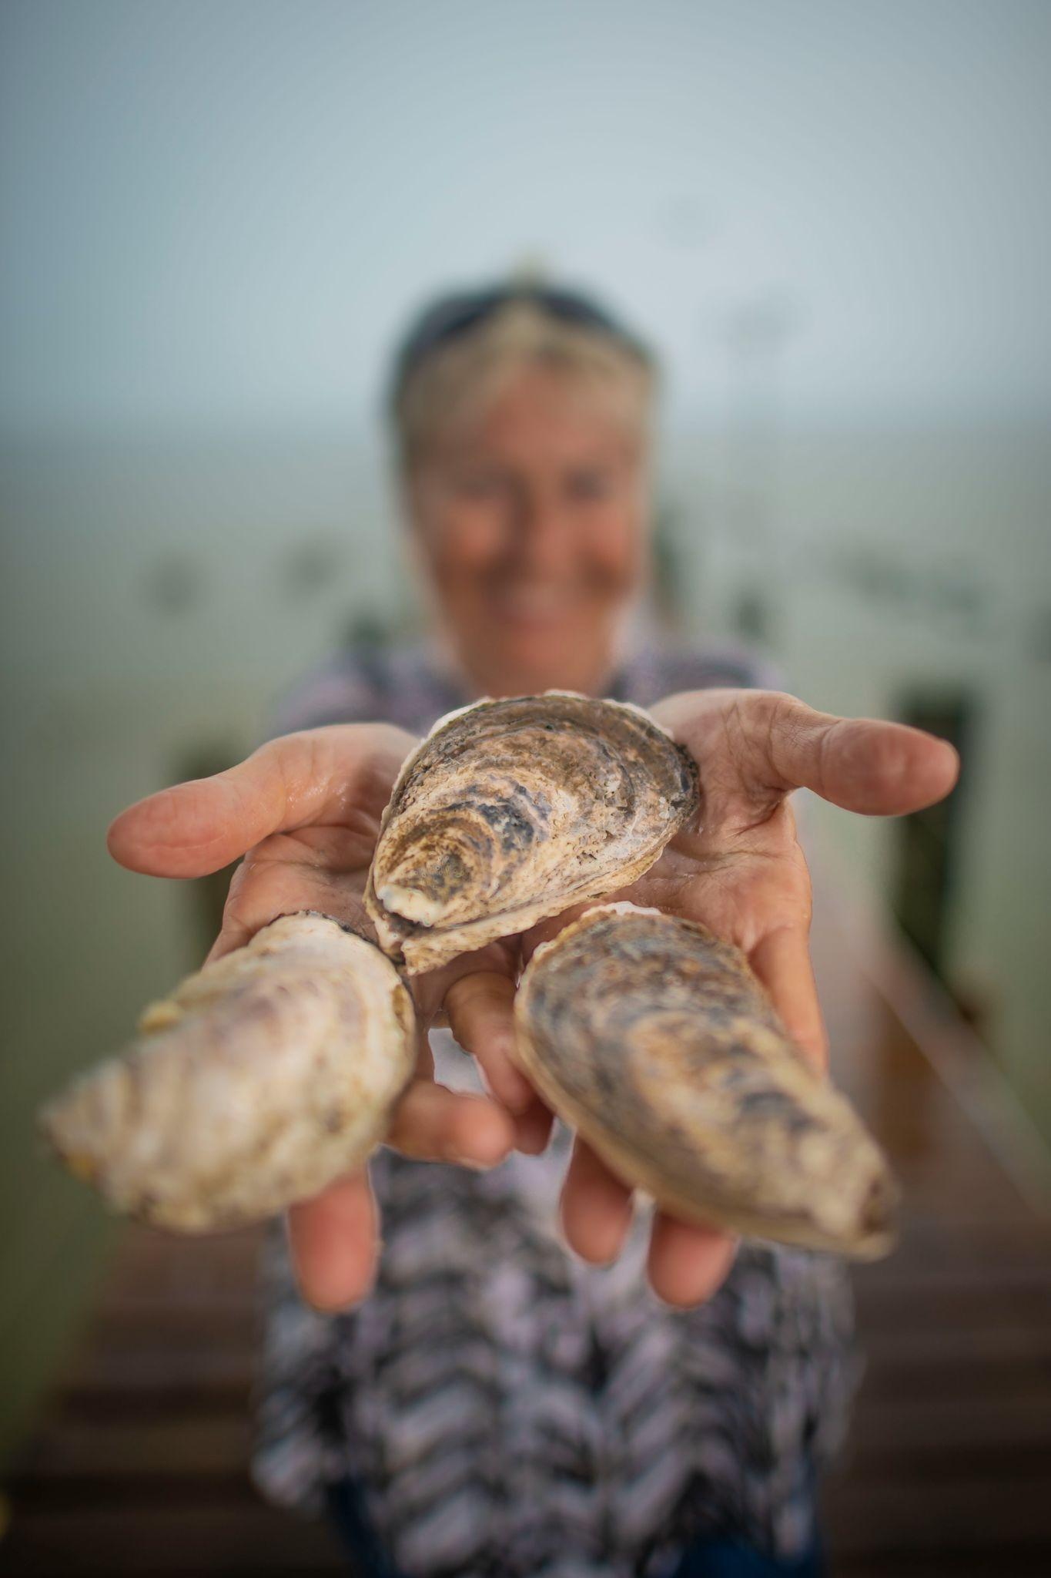
Ocean Observing Co-Design Programme will deliver to society
Advanced ocean observing system
Tools to ask key questions about observing cost and benefit
Improved data, products, and knowledge used by stakeholders
Demonstrated methodologies for continued future development of an integrated and responsive ocean observing system
And lead us to the ocean knowledge environment we need to
Predict future marine environments more skillfully
Manage ocean resources
Empower ocean-dependent communities to adapt to change.
Assess the impact of action towards a sustainable ocean.
Notes:
ROI

Slide 13
Thank you!
© SOCIB

Slide 14
extra slides

Slide 15
WHO’S INVOLVED?
PARTNERS
WCRP
Copernicus Climate Change Service C3S
Mercator/Copernicus
Bio-Eco Panel
WMO
ECMWF
IODE
MOi
GCOS
MBON
SOCIB
UNEP-WCMC
IOC Marine Policy
IOOS
IMOS
OceanPredict
Argo
IOCCP
OCEAN DECADE PROGRAMMES
MarineLife 2030
ForeSea
DITTO
OASIS
OBON
CoastPredict
Observing Together
+++
ENDORSED PROJECT LEAD PARTNERS
1. GO-SHIP | Go Ship Evolve
2. OceanOPS | Odyssey
3. National Oceanographic and Maritime Institute (NOAMI) Bangladesh
4. Northeastern Regional Association of Coastal Ocean Observing Systems (NERACOOS)
5. COCAS | LOCEAN-IPSL
6. Consorcio de Investigación del Golfo de México (CIGOM)
7. Joint Task Force SMART Subsea Cables
8. Sydney Institute of Marine Science | AniBos
9. The Argo Steering Team
10. Integrated Carbon Observing System Ocean Thematic Centre (ICOS-OTC)
11. Geoazur | 300 MERMAIDS
GOOS components
GOOS Panels
ETOOFS
OCG
Notes:
First an overview of who’s involved in this programme and who’s here today. In the original programme proposal we had support from a significant number of partners listed here on the left. Noted in the centre panel are other endorsed Ocean Decade programmes that present key players for collaboration. The third panel here shows the 11 projects that have been allocated to this programme these include projects that are part of existing networks or looking to establish new networks and then also projects that focus on establishing or enhancing integrated observing systems regionally.

Slide 16
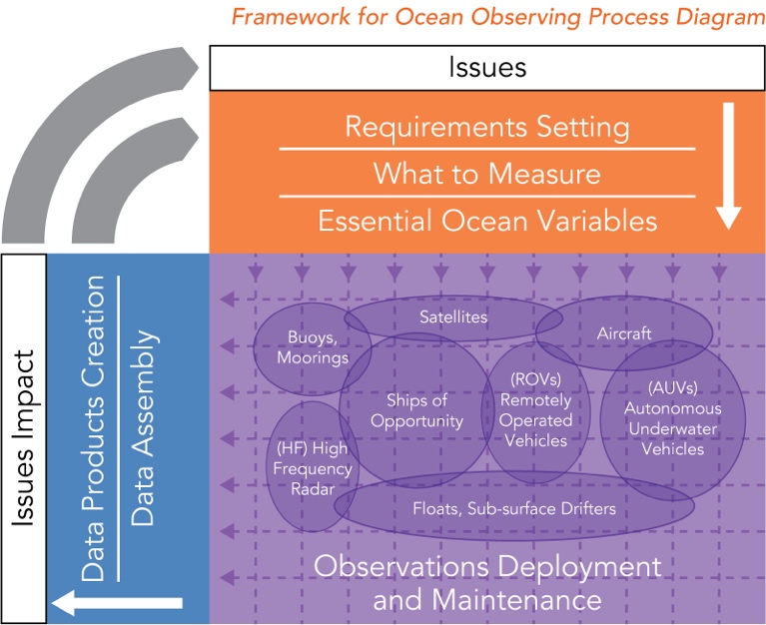
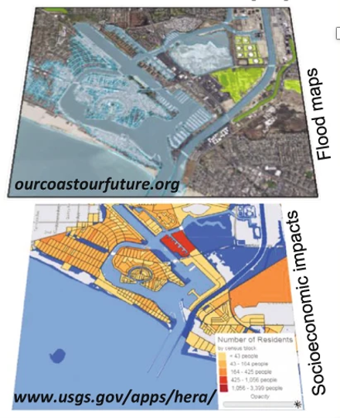
Projects around ‘exemplar’ use areas
will drive co-design, foster connections, produce answers
Observations
Models and Obs Assessment Tools
Integrated and Impactful Observing System, Models, and Products
Products and Services
User Needs and Requirements

Slide 17
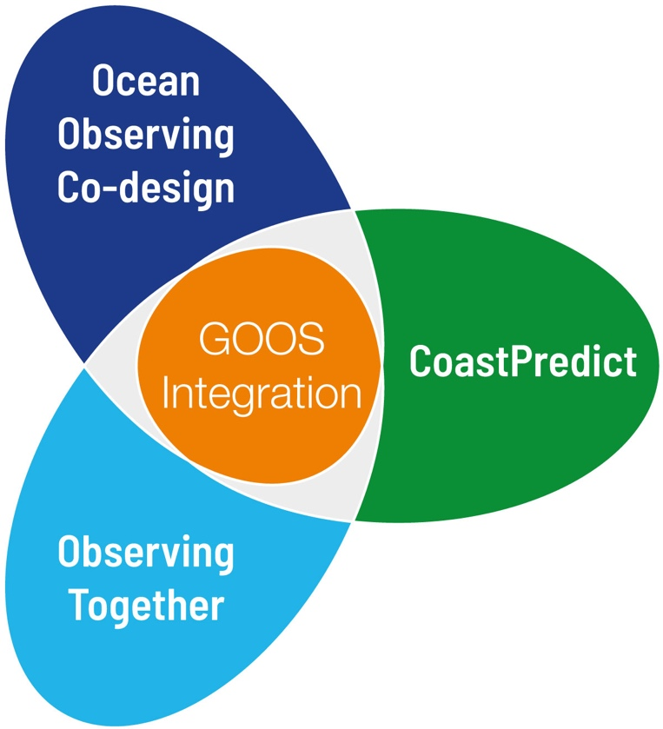
Working together: elevated level of collaboration for the Decade
MBON
SOCIB
Marine Life 2030
IODE
MOi
UNEP WCMC
IOOS
DITTO
Digital twin oceans
GCOS
COCAS
OASIS
Odyssey
Integrated ocean observing NW Atlantic
Bio-Eco Panel
OBON
OneArgo
AniBOS
GoShip Evolve
Ocean Practices (OBPS)
SMART cables
Recent behavior of cyclones and marine heatwaves [Bangladesh]
300 MERMAIDS
ForeSea / OceanPredict
Mercator
ICOS
WMO
IOCCP
Ocean monitoring & prediction: Gulf of Mexico / Caribbean
WCRP
Argo
IMOS
Coastal resilience programmes
ECMWF
IOC Marine Policy
OceanPredict
Copernicus Climate Change Service
Notes:
Here in red we’ve added the partners who were noted in the programme proposal

Slide 18
Exemplars and modelling participants:
Exemplar area | Modelling input identified / others?
The Ocean Carbon Cycle
Marine Heatwaves | Yosuke Fujii, Lia Santoleri, Simona Masina, Eric Boisseson, Magdalena Balmaseda
Boundary Currents | Tammy Morris, Andy Moore, Peter Oke
Forecasting tropical cyclones | Dr. Wada, Dr. Chun Chieh Wu , Zhan Zhang, Sue Chen, Matthieu Lehennaf, Kirstian Morgen, Santha Akella, Chris Harris
Marine Life 2030: Building global knowledge of marine life for local action | Stefano Ciavatto, Sheila Heymans [not available]
Coastal inundation | Pierre de Mey Frémaux

Slide 19
Workshop attendees
Partners
Endorsed Ocean Decade programmes
Allocated projects
National/international observing projects and programmes not under Ocean Decade
Funders / Supporters
Others???
Mid-March call for participation and expression of interest for workshop and exemplar breakout teams
Notes:
An overview of who will be invited to the workshop. Also keen to hear if you feel there are key participants who should be included? In mid-February we will publish a call for registration for the workshop and this will also allow interested projects to note an expression of interest in exemplar themes and breakout groups

Slide 20
Ocean Observing Co-Design PHASE 1: INITIAL EXEMPLARS
2022 | 2023 | 2024
CO-DESIGN WORKSHOP June
Define priorities & exemplar project outlines
Supporters’ Forum to present Exemplar project proposals e.g. to funders / organisations that may have related workplans
Paper highlighting current best-practices
Work on exemplar projects and co-design implementation with partners
Develop processes & initial tools.
Test & develop best practice development.

Slide 21
Workshop aims
1.
2.
3.
Evaluate lessons learned from previous observing system reviews, evaluations and experiences.
Describe actionable outcomes i.e. what will a successful co-design project look like for different stakeholders?
Identify capability [infrastructure, resources] required to support development of initial exemplars.
4.
5.
6.
Evaluate gaps and where further focus should be.
Select a set of initial priority exemplar areas, around which to focus projects.
Engage potential projects, participants and funders to develop the exemplars.
Notes:
For the workshop this is an outline of what we want to achieve. Starting with a look at lessons learnt from previous observing system reviews and then work to define exemplars: what a successful co-design project would look like for different stakeholders; what capability will be required to support the development of initial exemplars; evaluation of gaps and where further focus is needed; and as an outcome we want to select a set of priority exemplar areas around which to focus projects and engage the key players to work on these exemplar areas. We hope the selected exemplars will be attractive to, and provide a focus for a number of Ocean Decade projects

Slide 22
EXEMPLARS IN PROGRESS
Exemplar | Lead | Groups to connect into exemplars???
CARBON | ICOS | G7 FSOI, IOCCP
MARINE HEATWAVE | COCAS project / Mexican observing system | Mediterranean Sea (observations) - Lia Santoleri group // Joaquin Tintore group // Simona Masina Mediterranean Sea (predictions/reanalyses) // Magdalena Balmaseda at ECMWF for seasonal (and seamless) predictions / Regina Rodriguez in Brazil: WCRP contact for the Light House Activity on extremes. Working on MHWs and she is a representative of the Tropical Atlantic Observing System. IMOS has an event based sampling focussing on MHWs - Alistair Hobday from CSIRO has done a lot of work on this recently including predictions.
Hurricanes & trop storms | Hyun-Sook Kim Travis Miles Scott Glenn Dr Venkat I-I Lin Gustavo Goni | Bangladesh project - Bengal bay
Boundary currents | Tammy Morris Marjolaine Krug | OceanPredict (ForeSea, SynObs), regional groups / universities working on regional research Moninya Roughan UNSW / Andy Moore UCSC / Ken Ando - JAMSTEC [obs study of Kuroshio]
STORM SURGE | Giovanni Coppini CoastPredict - | Exemplar focus to be reviewed / cross-over with Marine Heatwaves and Hurricanes
Marine Life | Frank Muller-Karger /Jake Keritzer / Gabrielle Canonico

Slide 23
Structure and governance
Co-advisory board w / ForeSea & CoastPredict
Collaborative Centres
Programme Quarterly Assembly:
All programme partners / projects
+ GOOS panels, ETOOS, OBPS
Communities of Practice
Executive / Management Group
> Co-chairs
> GOOS representative
> ECOP
> Exemplar area representatives
Early Career
Ocean Professional Group
Oversight across exemplar areas: to develop infrastructure, tools, comms/output, capacity development, GOOS integration
Exemplar area I projects
Exemplar area II projects
Exemplar area III projects
Notes:
Do we want to indicate level of readiness/maturity of these groups is shown in colours - green / red / orange ...through our engagement with you we are working through the set-up of a co-advisory board, management group and at an implementation level we are working on the development of the exemplar areas with projects already allocated who will work under these exemplar areas. On the other hand we have not yet fully figured out ECOP engagement and we have not engaged at this stage with Communities of Practice or Decade Collaborative Centres. And furthermorea as the exemplar areas develop they will require executive oversight across them to guide the development of infrastructure, tools and other implementation.

