Slide 1
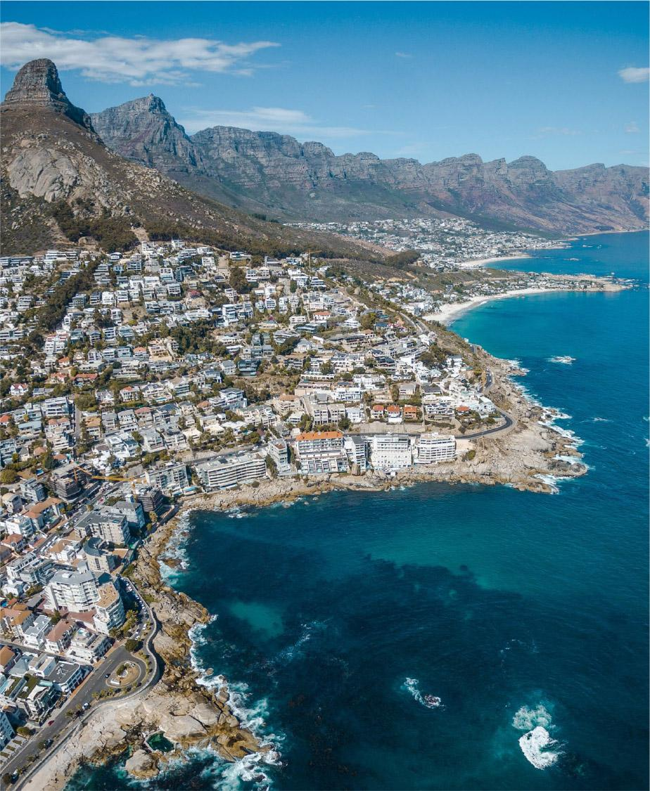
Revolutionising
Global Coastal
Ocean observing and forecasting
Nadia Pinardi, University of Bologna
Villy Kourafalou, University of Miami
Joaquín Tintoré, Balearic Islands Coastal Observing & Forecasting System
Emma Heslop, GOOS, IOC/UNESCO
This programme is endorsed by the UN Decade of Ocean Science
Notes:
This is a general overview of the progress of work by the CoastPredict Programme in the past 4 months.

Slide 2
Work in the past year:
Focus Areas: split the work on feasible blocks and projects
Decade Collaborative Centre on Coastal resilience in a changing climate
Preparing for more coastal networks coordination?
Notes:
First we have defined the CoastPredict Focus Areas that breakdown the work in 6 concentration areas. Second UNIBO has submitted in February 2022 a proposal for a Decade Collaborative Center on Coastal Resilience in a chaning climate. I conclude with requests for discussion to the GOOS SC

Slide 3
Reminder: CoastPredict high level objectives
A predicted global coastal ocean;
The upgrade to a fit-for-purpose oceanographic information infrastructure;
Co-design and implementation of an integrated coastal ocean observing and forecasting system adhering to best practices and standards, designed as a global framework and implemented locally.
Notes:
This is a quick reminder of the CoastPredcit high level objectives

Slide 4
CoastPredict focus areas & projects
Focus Area 1
Integrated observing and modelling for short term coastal forecasting and early warnings
Focus Area 4
Coastal ocean and human health
10 areas
where
CORE projects
will be developed
Focus Area 2
Earth system observing and modelling for coastal climate monitoring and downscaling
Focus Area 5
International open and free access to coastal information
Focus Area 3
Solutions for integrated coastal management
Focus Area 6
Equitable coastal ocean capacity
Three core projects reviewed and three projects under Focus Areas 1, 2 for endorsement, one project approved for Meerwissen funding under FA-3, one being prepared in collaboration with Co-design
Notes:
The six focus areas tries to breackdown the work in maneageable pieces for implementation. Each Focus Area is co-lead by three scientists and an expert team is being composed that will supervise the implementation of projects under each forcus area and the strategic thinking toward the wanted Decade outcomes. The Focus areas co-leads together with the ECOP co-leads compose an EXEC committee that meets every month.

Slide 5
Focus Areas
(each is advised by Expert Members incl. at least one ECOP representative and the CORE project leaders)
~10-15 people
Project proposals submitted for Decade endorsement in April 2022
Focus Area 1: core-PredictOnTime - will develop systems to observe and predict natural extreme events in the global coastal ocean in due time and with the appropriate accuracy so that impacts on natural and human resources and assets will be minimised
Focus Area 2: core-FLAME - Future Coastal Ocean Climates will generate innovative, high-resolution, downscaled projects of future coastal ocean climates and impacts.
Focus Area 5: core-CORE - Coastal Ocean Resource Environment will provide sustainable delivery of high-quality environmental data and information, products to research, industry and government for purposes such as ecosystem health, hazard response and resource management.
Projects – core
proposed for endorsement by UN Decade
Projects - affiliated
proposed for endorsement by UN Decade
Notes:
Focus-areas have each 1-2 CORE projects which then contain affilieated projects for implementation, three CORE project shave been submitted for endorsement

Slide 6
Project proposals submitted for Decade endorsement in April 2022
Focus Area 1: affiliated- Integrating Coastal Hazards Early Warning Systems in the Tropical Americas and Caribbean submitted by the Regional Office for the Americas and the Caribbean Sea
Focus Area 1: affiliated- Forecasting the Argentine Sea – The project is accelerating the capacity for operational forecasting in Argentina –FULLY FUNDED
Focus Area 2: affiliated- European Knowledge Hub on Sea Level Rise - Coastal Ocean Resource Environment will provide sustainable delivery of high-quality environmental data and information, products to research, industry and government for purposes such as ecosystem health, hazard response and resource management. PARTIALLY FUNDED
Focus Area 3: affiliated- Mangroves as Nature-based Solutions to Coastal Hazards in Eastern Ghana (MANCOGA) endorsed for funding by Meerwissen – FULLY FUNDED
In preparation: Collaborative project with Ocean Observing Co-Design:
Coastal inundation and storm surge exemplar project of the Ocean Observing Co-Design Programme will be a project affiliated to Focus Area 1 PredictOnTime core project.
Focus Areas
(each is advised by Expert Members incl. at least one ECOP representative and the CORE project leaders)
~10-15 people
Projects – core
proposed for endorsement by UN Decade
Projects - affiliated
proposed for endorsement by UN Decade
Notes:
3 affiliated projects have also been submitted for endorsement, one projects has received approval for funding and a new one is being built together with Co-design

Slide 7
DECADE COLLABORATIVE CENTRE
COASTAL RESILIENCE IN A CHANGING CLIMATE @University of Bologna
What are the functions?
A) Catalyst/strategic: be a place for strategic thinking and planning of the UN decade transformative science for sustainable development
B) Coordination: in consultation with the DCU at Unesco-IOC, and GOOS, coordinate Decade Programs in the Community of Practice
C) Communication: Make sure that adequate dissemination tools are developed
D) Monitoring and reporting: Develop reporting/regular reviews of all relevant Programs/Projects
E) Resource mobilization

Slide 8
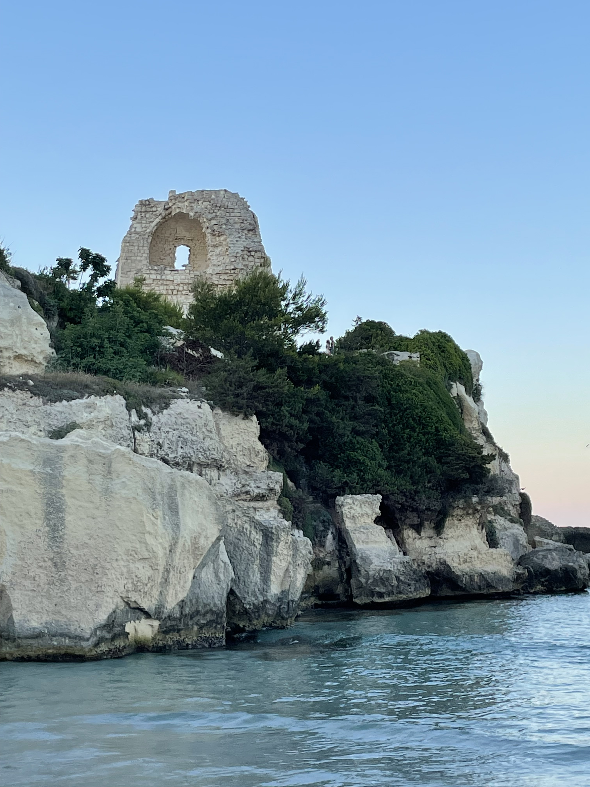

The DCC should work within The Community of Practice for coastal resilience (from UN Decade COP8)
Several keywords have been identified by members as core of the working group of the COP8. The keywords have been clustered as follow:
1. Engagement and Community: engagement to develop fit-for purpose science, Community engagement, proximity, support synergy, stakeholder engagement
2. Culture, Awareness and Territory: Cultural heritage, perception and interaction with coastal ocean, archeology, dissemination, history
3. Ocean, Ecosystems and Resilience: Ecosystem health, Ecosystem functioning, coastal ocean, climate change, estuaries, key habitats, wetland conservation link nature and resilience, land-sea connectivity, resilience, knowledge of coastal ocean, human and coastal health, clean ocean
4. Socioeconomic and Governance: Sustainable blue growth, usage of new science-based information products for the coasts, socioeconomics, circular and sustainable, marine spatial planning, social and build environment, best practices in coastal area, capacity building

Slide 9
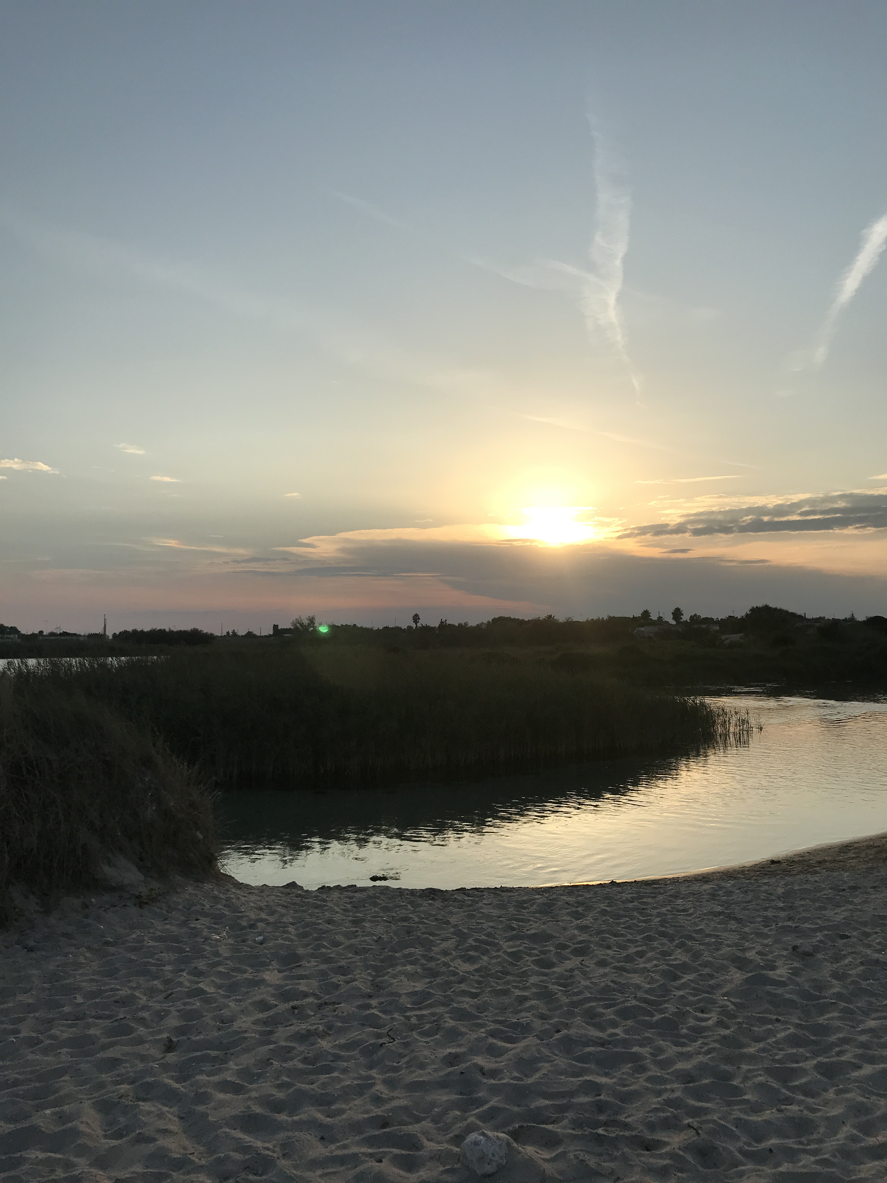
Preparing for more coastal networks coordination?
LARGE SCALE
SHELF/COASTAL SCALE
TIDE GAUGES
REPEATED MULTIPARAMETRIC VERTICAL SECTIONS
● COASTAL SATELLITE AND AERIAL SURVEYS
● COASTAL RADARS
● AUTONOMOUS UNDERWATER
VEHICLES
CABLED MULTIPARAMETRIC STATIONS
● RIVER RUNOFF AND LOADING
MONITORING
SEDIMENT/WQ MONITORING
CITIZEN SCIENCE MONITORING
● MOORED BUOY ARRAYS
● VOS EXPANDABLE AND ONDULATING INSTRUMENTS
SATELLITE MONITORING:
SEA LEVEL,
SEA SURFACE TEMPERATURE,
SEA SURFACE SALINITY,
COLOR, WINDS
● DRIFTING BUOYS
(SURFACE AND SUBSURFACE)
● GLIDERS
OBSERVING
MODEL PHYSICS
● PRIMITIVE EQUATIONS (> 1 KM)
● TURBULENCE CLOSURE SUBMODELS
MODEL PHYSICS
PRIMITIVE EQUATIONS (<1 KM)
● TURBULENCE AND LIGHT
SUBMODELS
DATA ASSIMILATION
OPTIMAL INTERPOLATION
3-DVAR, KALMAN FILTER
DATA ASSIMILATION
● KALMAN FILTERS
● ADJOINT MODELS
BIOCHEMICAL MODELS
● PELAGIC COMPARTMENT
● BENTHIC CLOSURE
BIOCHEMICAL MODELS
● PELAGIC COMPARTMENT
● BENTHIC-PELAGIC COUPLING
● SEDIMENT DYNAMICS
PREDICTING
ATMOSPHERIC FORCING
OPERATIONAL ANALYSES AND FORECASTS FROM GLOBAL SCALE MODELS
ATMOSPHERIC FORCING
OPERATIONAL ANALYSES AND FORECASTS FROM LIMITED AREA MODELS

Slide 10
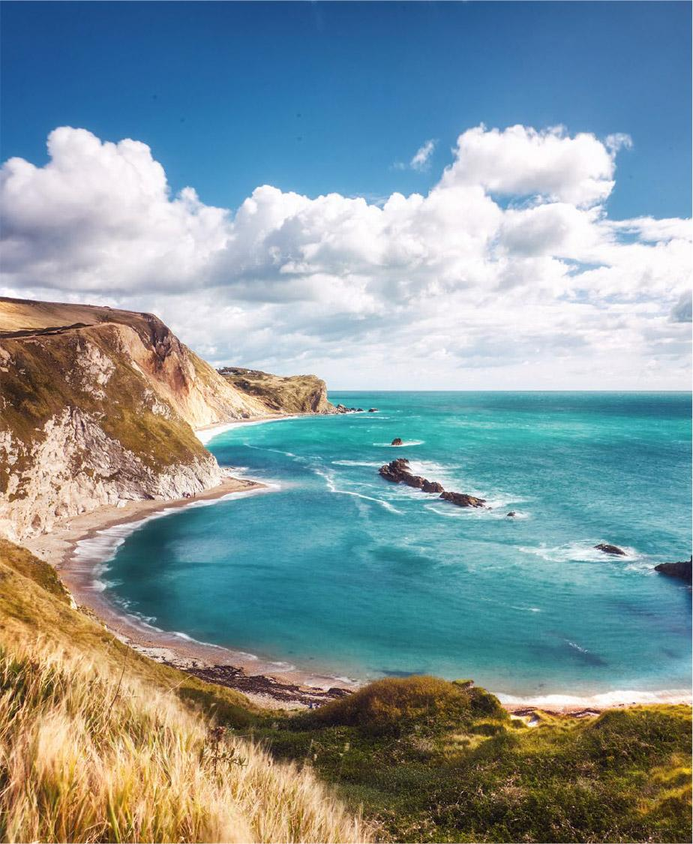
Thank you
© SOCIB
www.coastpredict.org
info@coastpredict.org

