Slide 1
Uncrewed Surface Vehicle Network for a remote, data-limited Global Ocean Observing System
Update on an emerging network for OCG
Ruth Patterson*^{,1}, Meghan Cronin², Adrienne Sutton², Eugene Burger², Jack Reeves Eyre*^{,3}, Dongxiao Zhang⁴, Jim Thomson⁵, Sebastiaan Swart⁶, Marcel du Plessis*^{,6}, Tom Farrar⁷, Luc Lenain⁸, Laurent Grare⁸, Iwao Ueki⁹, Samantha Wills*^{,4}, Chris Meinig², Jaime Palter¹⁰, Eric Lindstrom¹¹, Sarah Nicholson*^{,12}, Pedro Monteiro¹²
* Early Career Ocean Professional
1 Charles Darwin University, Darwin Australia
2 NOAA OAR Pacific Marine Environmental Laboratory, Seattle WA USA
3 NOAA NWS NCEP CPC, ERT, College Park, MD USA
4 UW CICOES, Seattle WA USA
5 U. Washington Applied Physics Lab, Seattle WA USA
6 Dept. of Marine Sciences, U. Gothenburg, Sweden
7 Woods Hole Oceanographic Inst., USA
8 SIO, UCSD USA
9 JAMSTEC, Japan
10 University of RI, GSO, Narragansett RI, USA
11 Viking Ocean Strategies (Eric@OceanStrategy.org)
12 SOCCO-CSIR, South Africa
OASIS
Observing Air Sea Interaction Strategy
https://airseaobs.org/
SCOR #162
13th Observations Coordination Group (OCG) Annual Meeting - 2 June 2022
Notes:
This presentation is delivered by OASIS which stands for the Observing Air-Sea Interaction Strategy, which is also SCOR working group and a program under the UN ocean decade. OASIS proposes an Uncrewed Surface Vehicles network for instrument-based data collection in the open ocean under the GOOS.
Our focus today is to describe the current global USV ecosystem that already exists, and how these individual platforms could translate into a global network under GOOS.

Slide 2
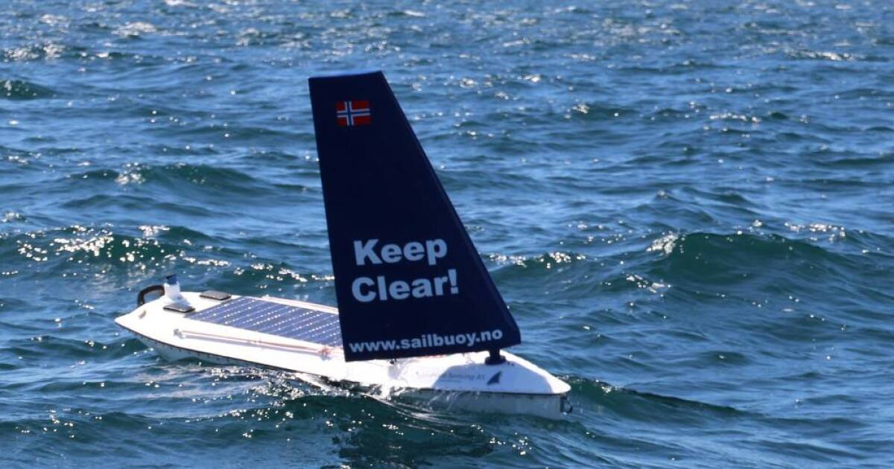
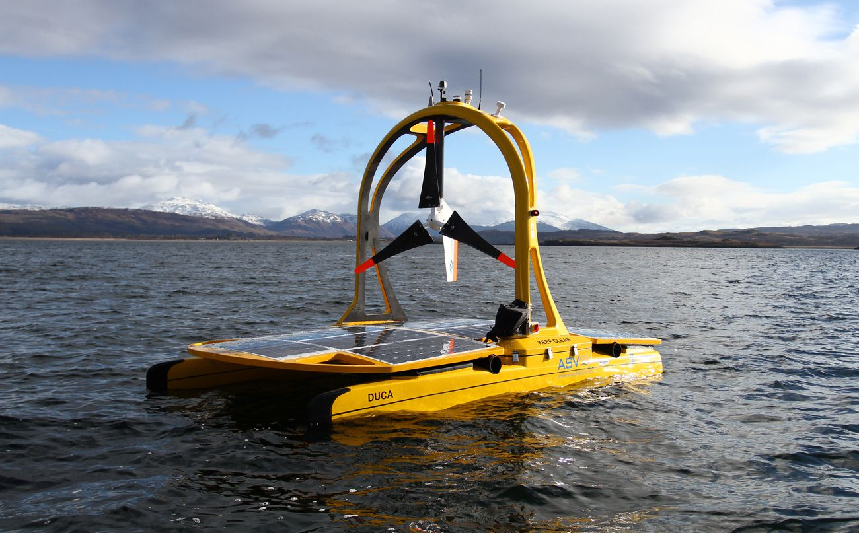
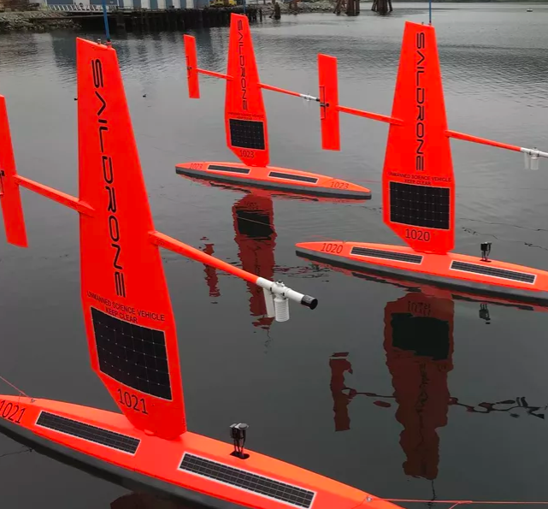
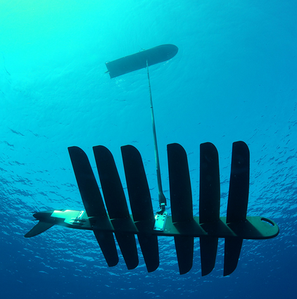
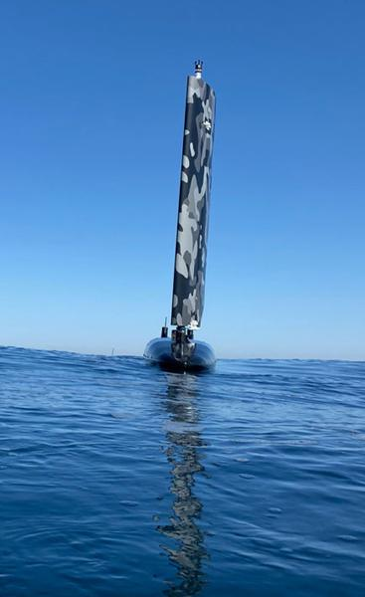
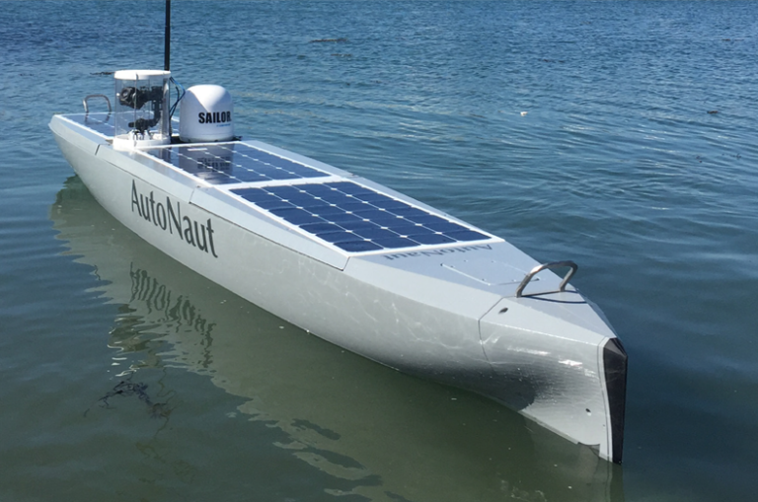
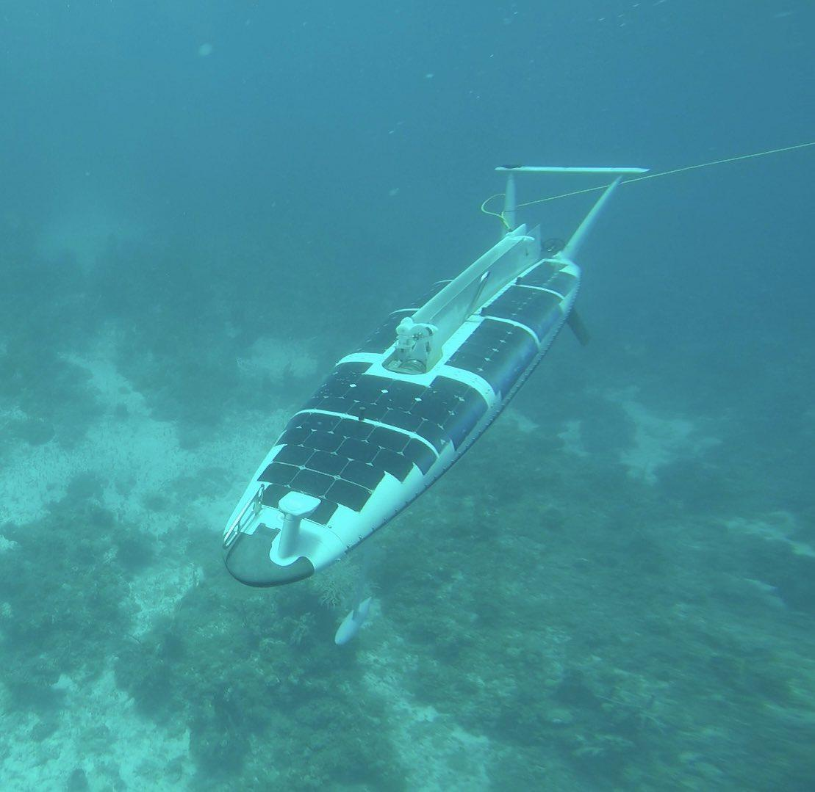
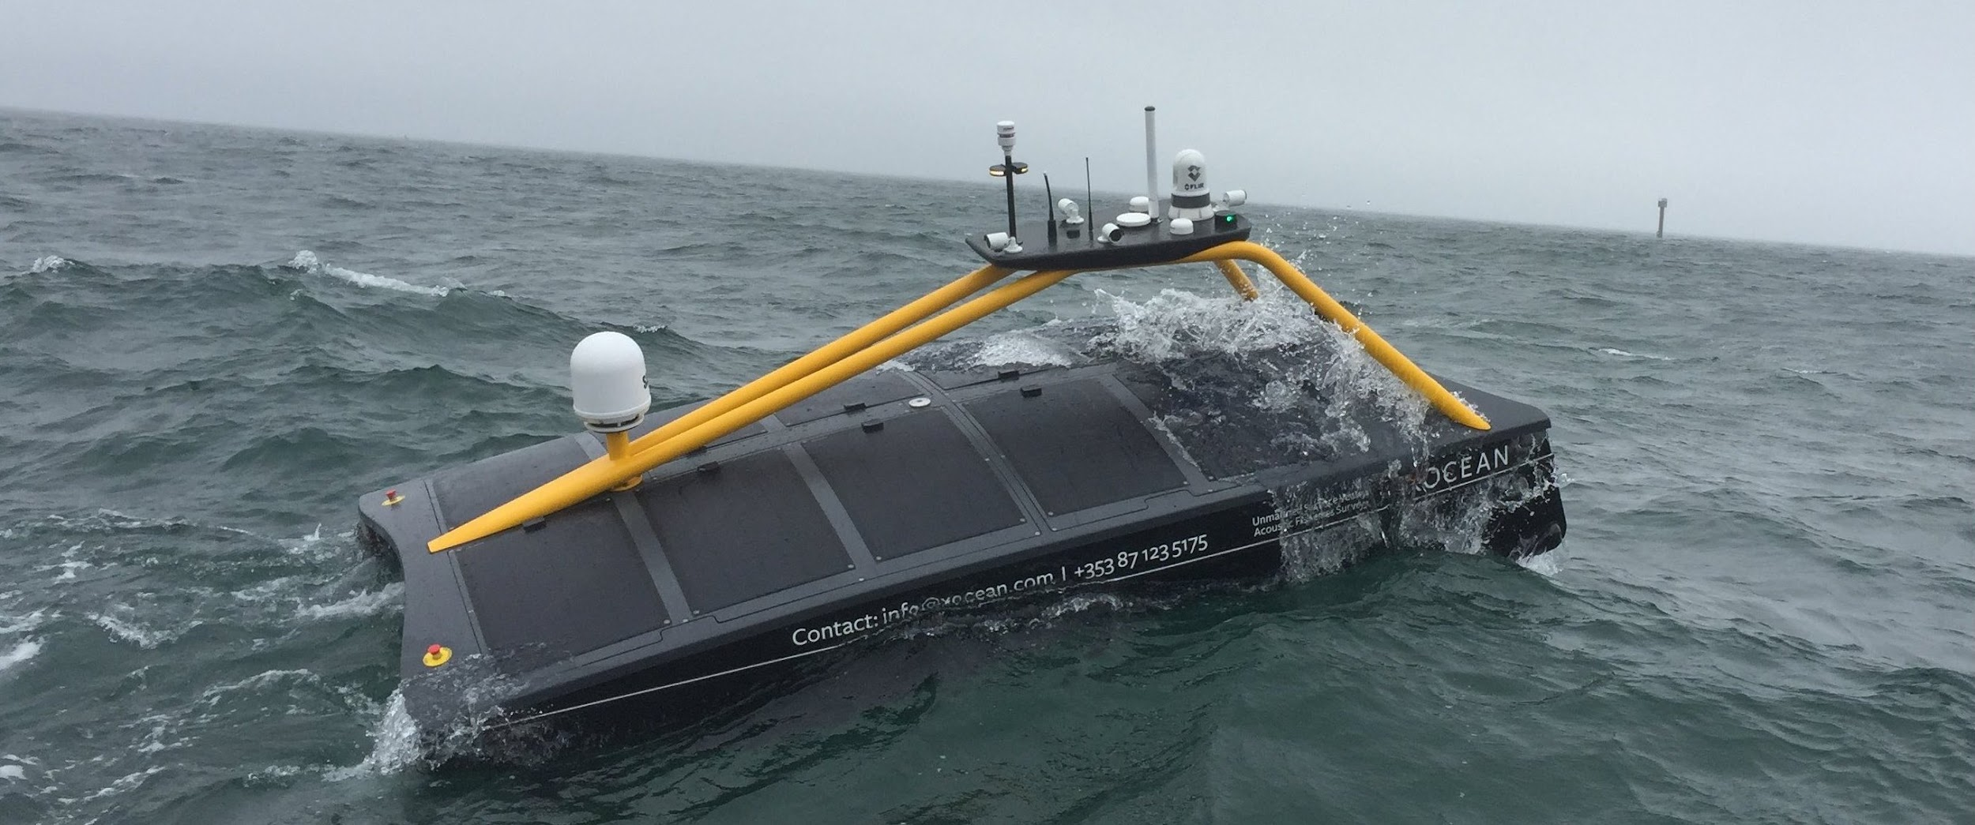
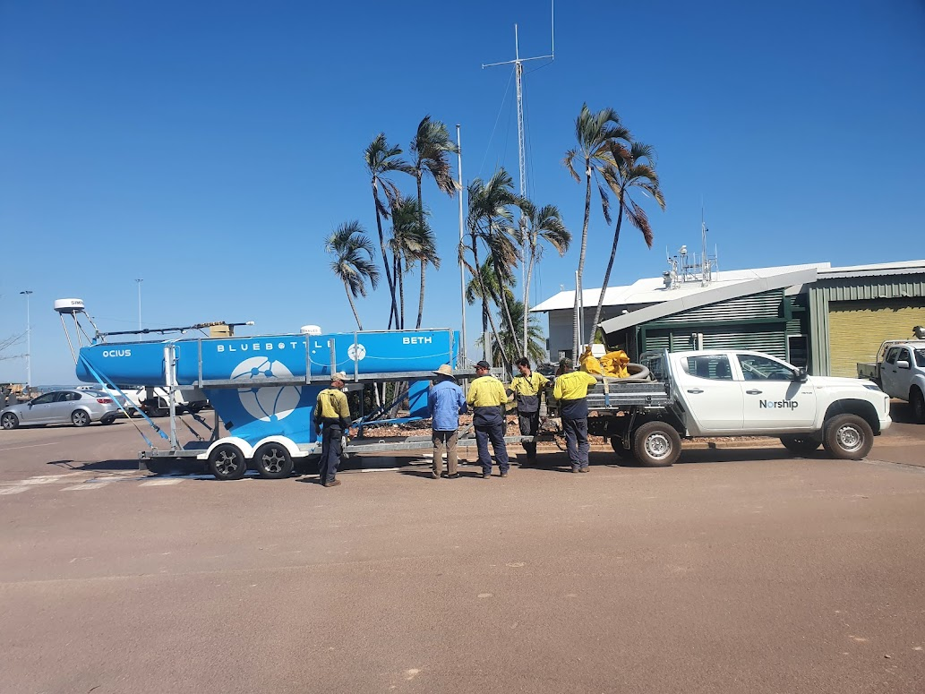
Readiness Levels
Uncrewed Surface Vehicles (USVs) are ready to join GOOS
Globally, at least a dozen USVs operate commercially in the open ocean at RL 7-8
OASIS ENVISAGES
A connected and diverse ecosystem of USV platforms operating globally under GOOS
RL9: Operational System (GOOS Network)
RL8: Finalized System
RL7: Prototype Demonstration in operational environment
RL6: Prototype Potential Demonstrated in relevant environment
RL5: Prototype Evaluation in relevant environment
RL4: Prototype Evaluation in experimental environment
RL3: Proof-of-concept
RL2: Applied Research
RL1: Basic Research
https://www.noaa.gov/organization/administration/nao-216-105b-policy-on-research-and-development-transitions
Notes:
We define USVs as a uncrewed surface vehicles, which are remotely operated, are about 2-12 m in length, and are capable of persisting in the open ocean for months to years.
There is already a global and diverse USV ecosystem at readiness levels 7 and above. Some glide, sail, motor, use surface waves or some combination of these propulsion mechanisms to move and have been developed in various locations around the world, that are intrinsically designed for different environments.
A GOOS network will sustain the drive for innovation for USVs globally and will bolster a rapidly growing and disruptive industry, who all have a vision to provide the world with enhanced ocean data.

Slide 3
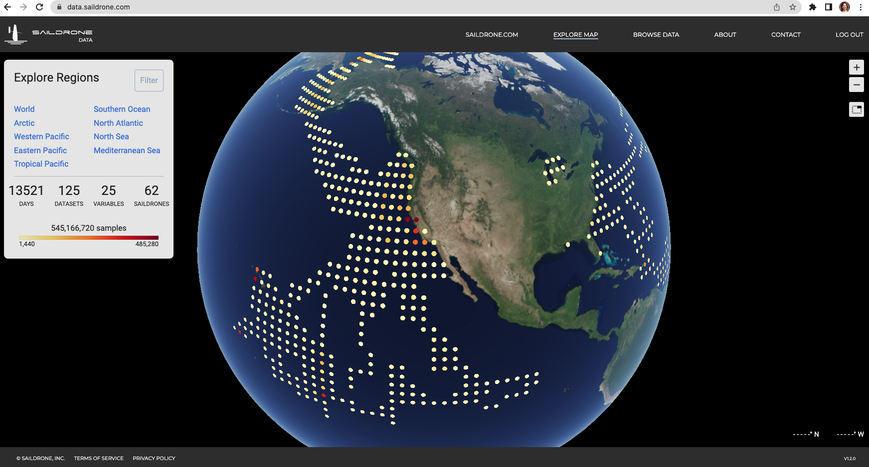
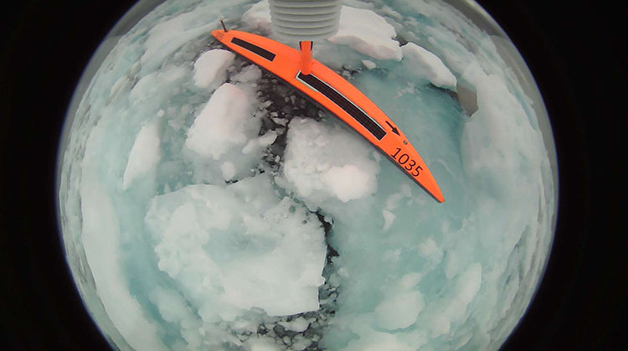
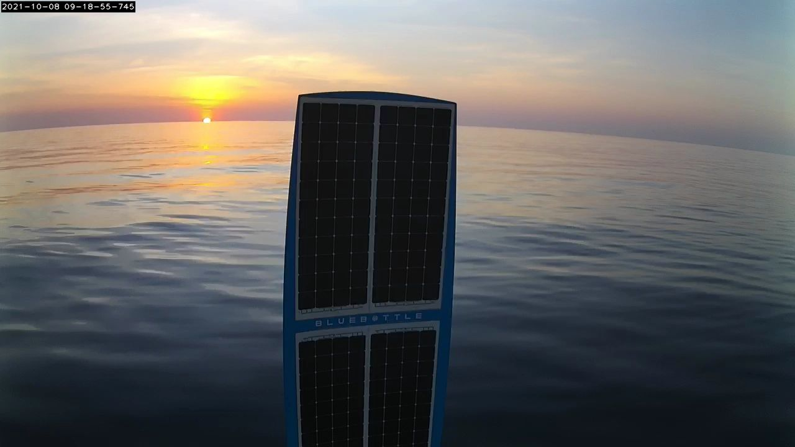
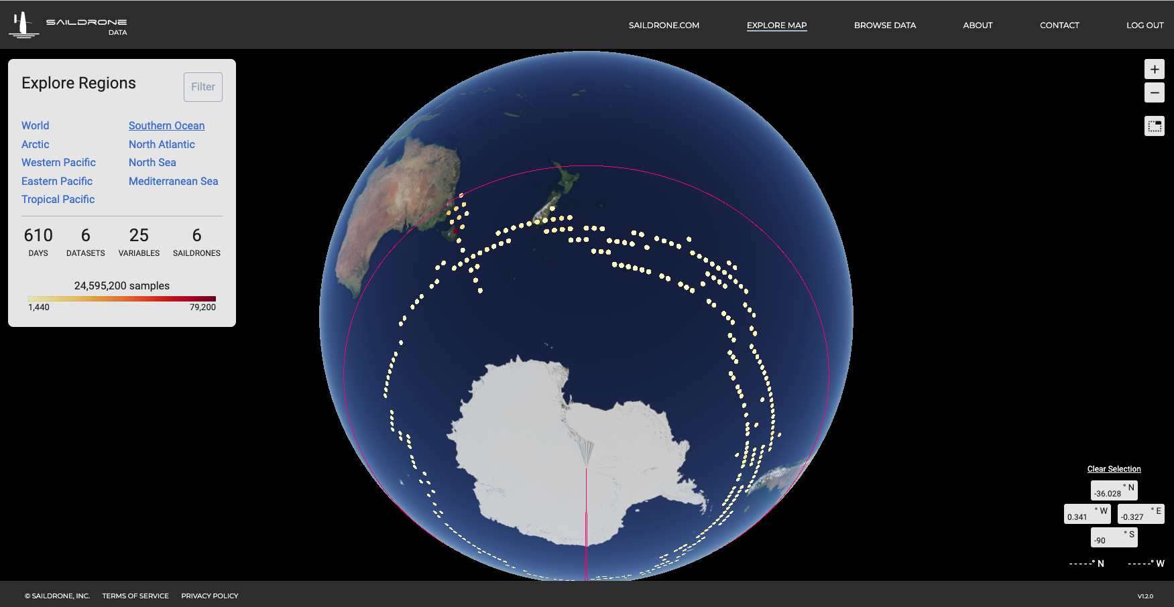
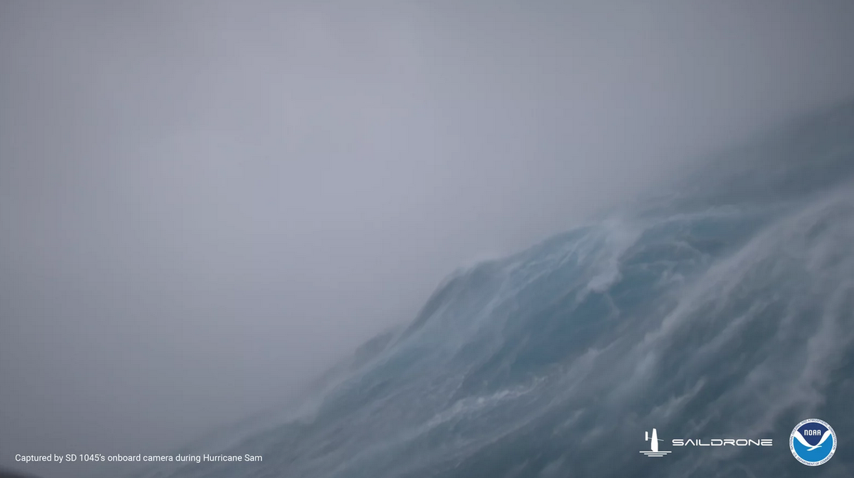
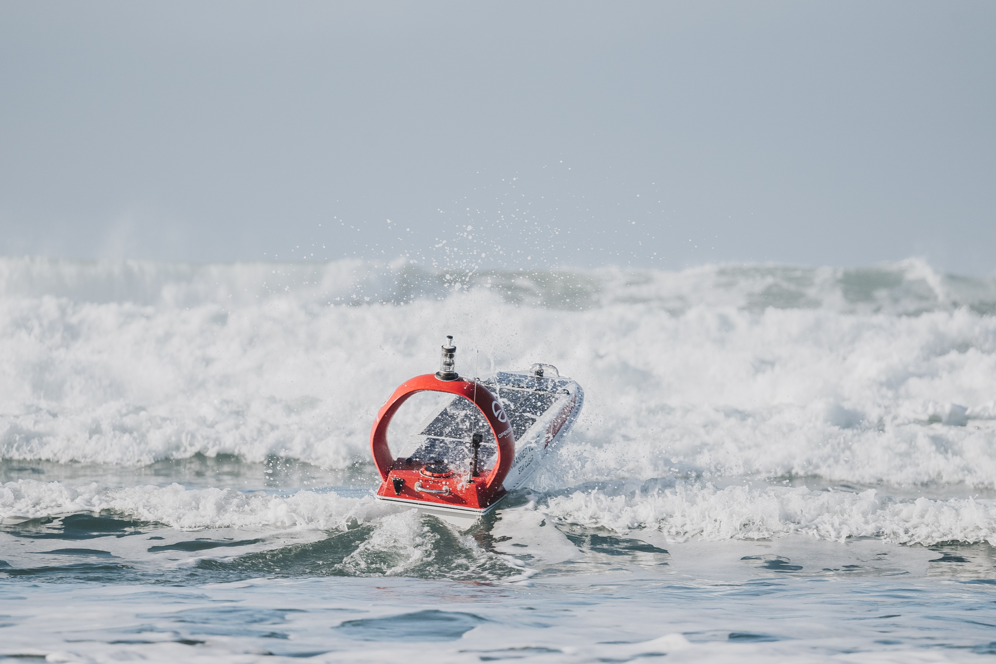
Persistent, scalable, diverse, manoeuvrable
USVs have been operated in:
Hurricane strength winds
Low winds, flat seas
High latitudes
Low latitudes
Ice edge
Strong currents
High waves
High productivity regions
Archipelagos
Reef networks
Semi-enclosed seas
https://www.saildrone.com/news/arctic-sea-ice-edge-mission
Ocius - Rowley Shoals
Saildrone hurricane Sam
https://data.saildrone.com/
https://openoceanrobotics.com/
Notes:
Many of the USVs that are operating all around the globe today have been designed with these difficult operating regimes in mind. From hurricanes, tropical cyclones, breaking waves and strong currents, to the doldrums, archipelagos, reef systems and semi-enclosed seas. USVs are spanning these difficult to access locations from high to low latitudes already.

Slide 4
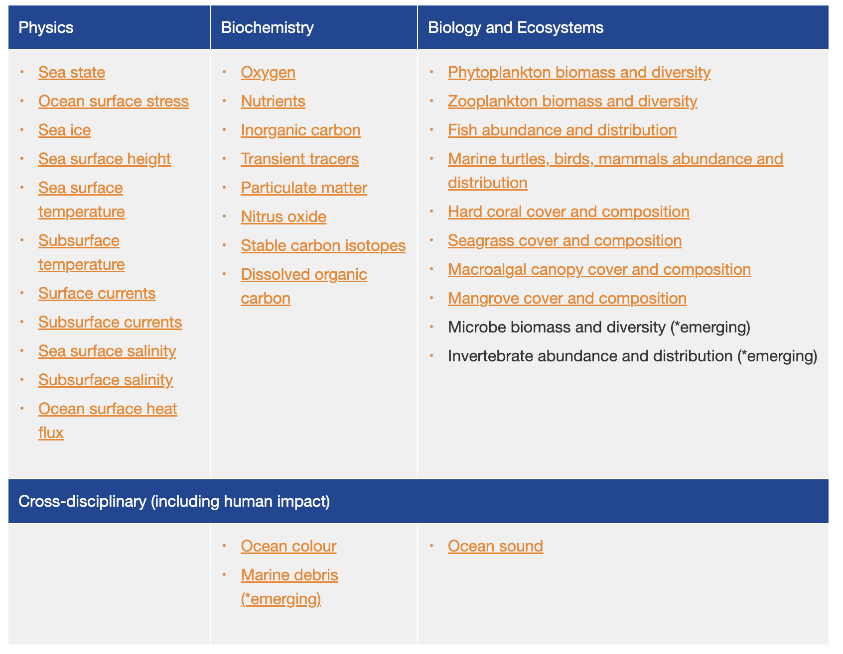
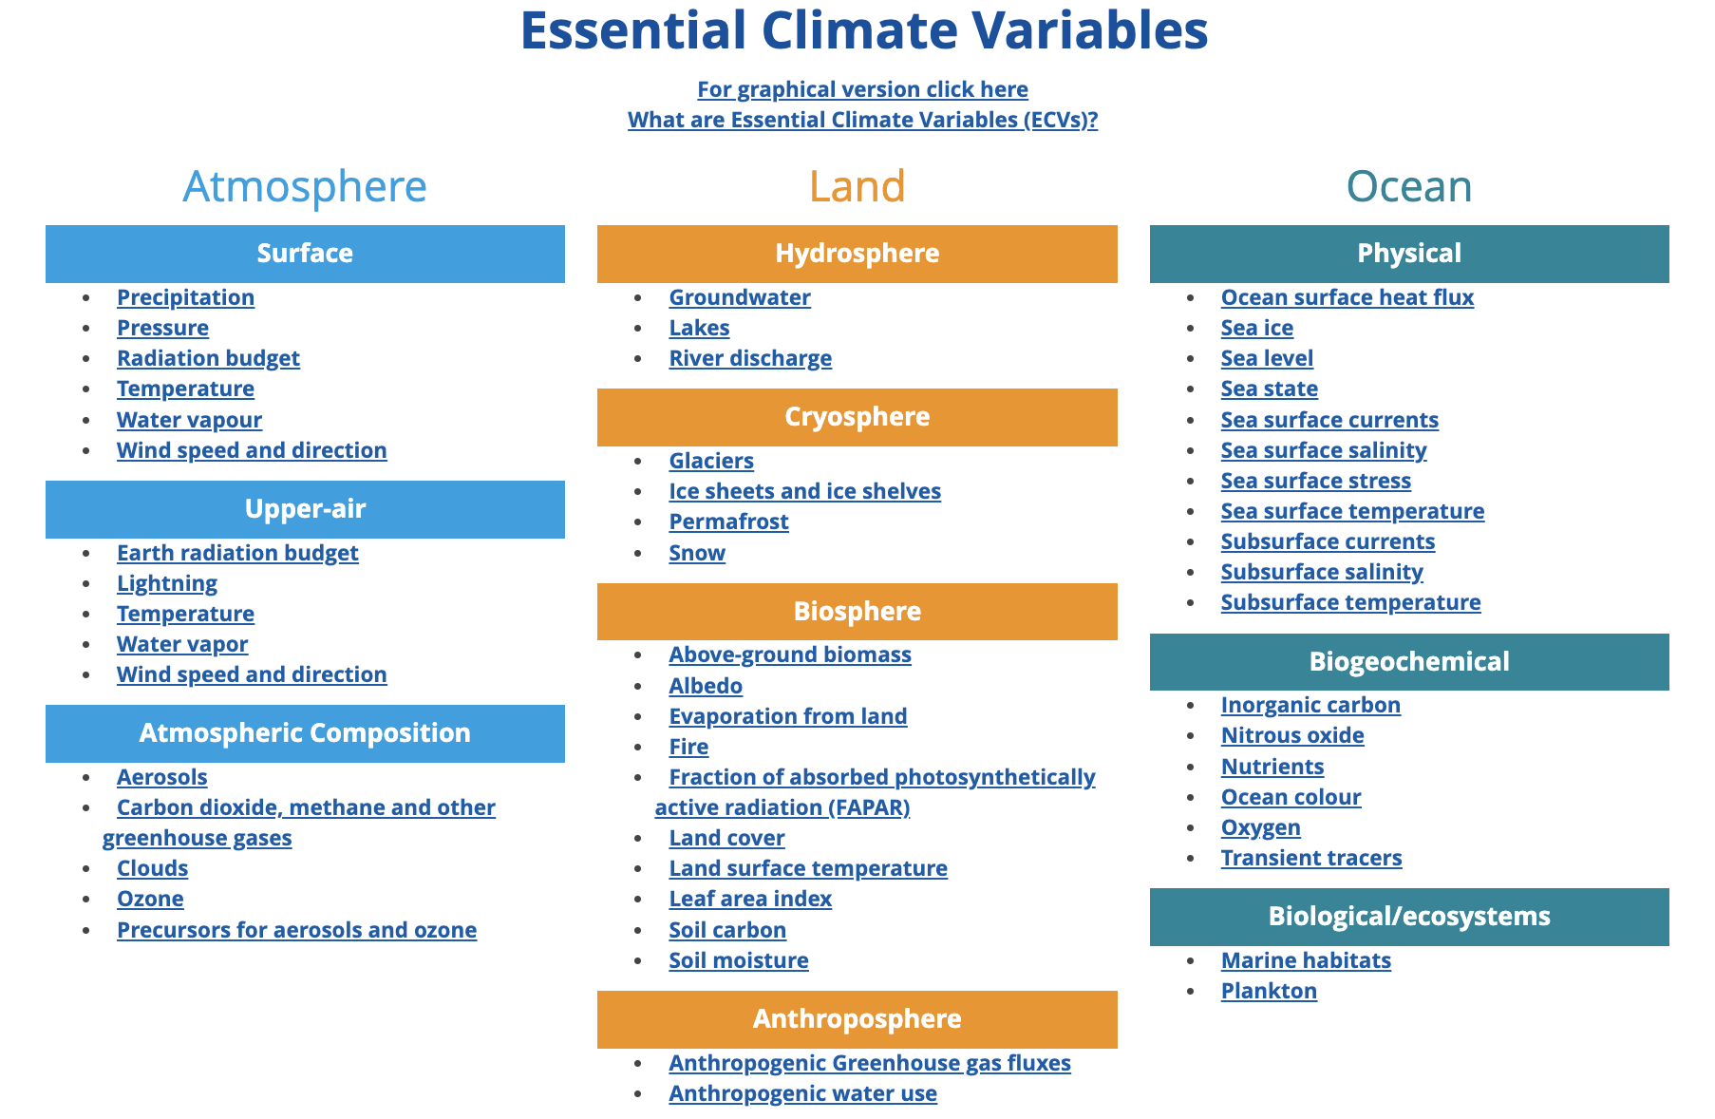
Multidisciplinary AIR and SEA instrument-based observations
https://gcos.wmo.int/en/essential-climate-variables/table
goosocean.org/eov
Notes:
USVs are highly interdisciplinary. We have provided the Essential Ocean Variables and Essential Climate Variables and have placed a green tick next to those variables that can be measured from a USV. This is by no means an exhaustive list of USV capability. Basically, any instrument-based measurement above or below the water can be undertaken from a USV. Commercial USV payloads can range from 20 - 150 kg. Which means, you can fit any instrument, and switch it on or off remotely as power, conditions and geography require.

Slide 5
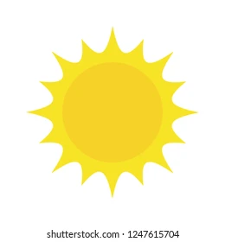
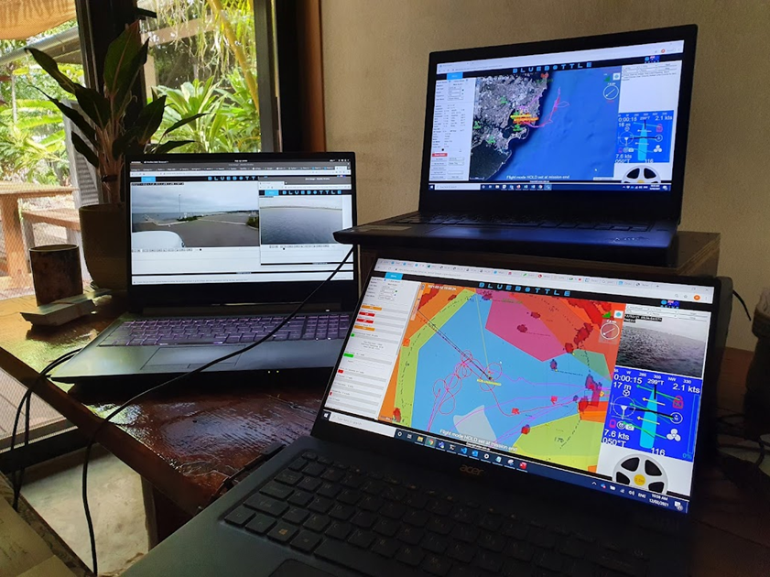
Intrinsically environmental
Power and propulsion
Renewable energy sources - Disruptive & future-proof
Solar power for operations and electric motors
Wind and wave propulsion
Batteries store power for darkness
Non-expendable - Can be ‘driven home’ when needs servicing
Flexible and resilient - adaptive sampling
Appropriate for very remote locations
Opportunities for affordable spatiotemporal coverage in very remote, data-limited locations
Technology transfer and skill development for servicing and operating in very remote locations (Patterson et al., 2022) https://www.frontiersin.org/articles/10.3389/fmars.2021.736984/full
USV operational setups are mobile, only requiring internet and a laptop
Notes:
The existing USVs appropriate for GOOS are inherently environmentally friendly. They must be propelled by wind, waves and solar powered electric motors to be able to persist for months on end. Instrument-based data collection are battery powered, which are charged using solar. and can be monitored in real-time, and if there’s a problem with the system, the USVs can self-retrieve across oceans.
Developing communities, especially those with high sea to land ratios, complex island groups, and few resources to collect in-situ data, will benefit immensely from a USV under GOOS network. Technology transfer, data transfer and capacity development all fall under the ‘frugal innovation’ band which was the core impetus of developing USVs in the first place. Essentially, USVs provide more bang for buck.
In addition, commercial USV operation is relatively simple, and can be controlled via a web-based browser on a laptop with internet connection from anywhere in the world

Slide 6
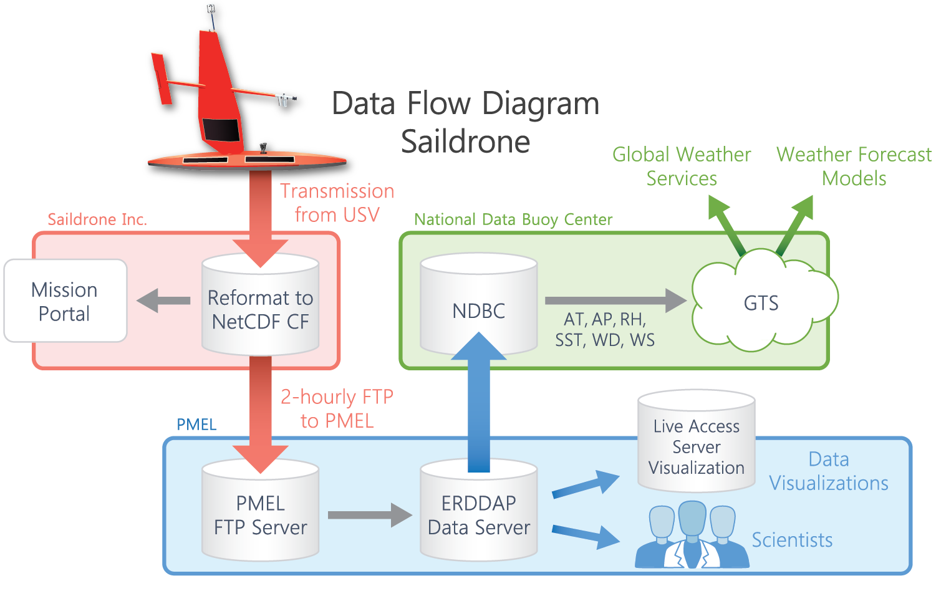
NOAA ERRDAP server could form the basis of a GDAC* for publicly available USV data
USVs transmit real-time data
Several EOVs from USV are already available through the Global Telecommunication System (GTS)
*GDAC: Global Data Assebly Center
Real-time data
Notes:
Currently, USV missions are project-based. Data formats and reporting differ between USV platforms, scientists, companies, interfaces and dashboards. However, we are not starting at ground-zero. For example, NOAA have invested significantly in guiding best practices for data quality, management and delivery with Saildrone, and has acquired deep understanding of USV data capabilities and challenges that will translate to other USV data platforms and providers.

Slide 7
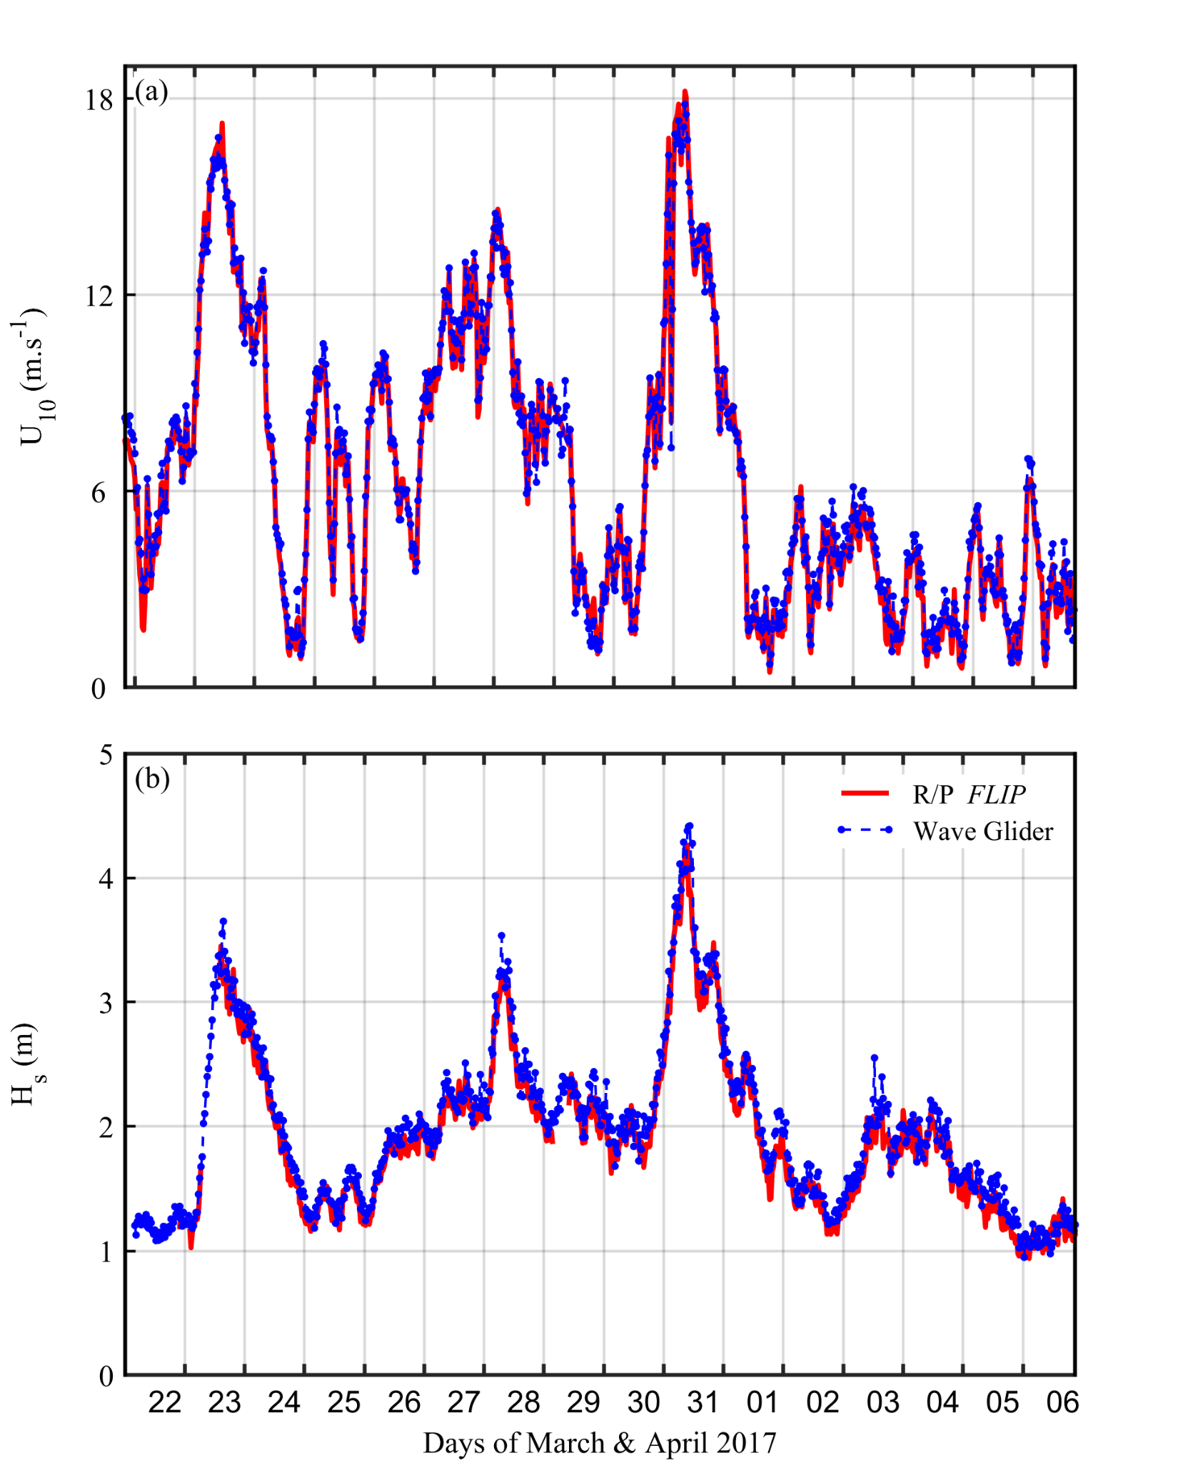
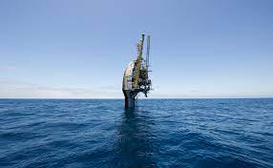
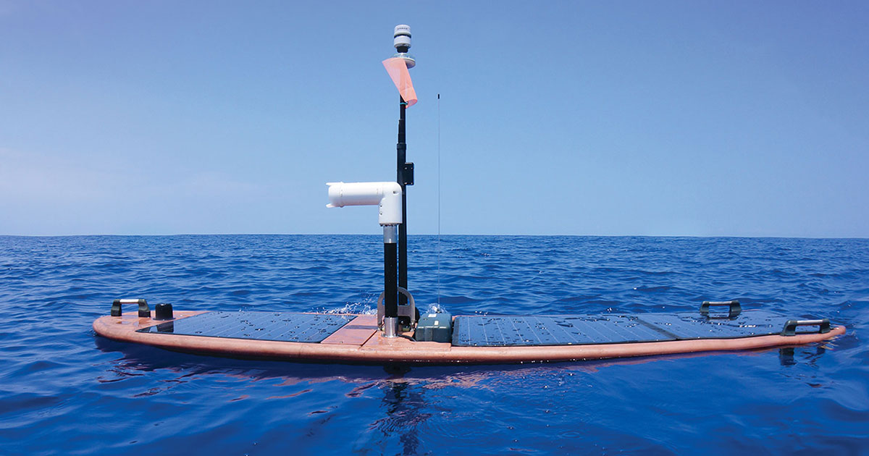
Best practices are being developed to ensure interoperability
Example of successful interoperability
The new network consists of multiple USV platform types
Here is an example of two different platform types, and a successful interoperability experiment.
10-m wind speed estimated using winds from R/P FLIP at 9 m and from motion-corrected Wave Glider at 1 m height
R/P FLIP at 9 m height
Significant wave height from the two platforms matches
Wave Glider at 1 m height
Grare et al., 2021
https://doi.org/10.3389/fmars.2021.664728
Notes:
Best practices are being developed to ensure interoperability. This emerging network will consist of multiple different USV platform types, so we will need to keep developing these best practices following scientific standards. This in an example of how USV data integrity from a waveglider has been tested against data from a FLIP. We’re developing standards for this type of data testing.

Slide 8
Moving from a patchwork of projects to a cohesive, open science network
Data from USVs available to customer user near real-time
The current expectation of open data is shared by USV end-users in government based agencies
All data in the network will be disseminated on the GTS/WIS2.0 in near real-time
“Patchwork of potentiality, and a network of promise”
Eric Lindstrom
Currently funded as single missions for research campaigns and pilot studies
Sustained funding is lacking, but…
Philanthropic and gov’t data buys could make data available through GTS and GDAC
NOAA has committed to Surface Ocean CO₂ Monitoring network. See COP26 Network
NOAA has created a draft Research to Operations Umbrella Plan
Missions duration ~ 6 months; Biofouling often the only limiting factor
Notes:
The growth of the network will be based on FAIR principles, and the data will be openly available. What we have currently is a patchwork of individual research projects, to an open data network. Existing infrastructure could be adopted, but we’re not limited to any particular architecture.
Our vision is to see sustained and persistent networks over multiple years. But currently, our missions are funded as single campaigns and pilot studies. We know that most persistent USVs are limited only by biofouling, and that USVs are successfully operating persistently across the world in commercial, government and defence capacity. New science and understanding are arising from all missions.
https://data.pmel.noaa.gov/dashboard/saildrone/
https://data.pmel.noaa.gov/dashboard/saildrone/?mission_id=wsm&drone=1045.0&drone=1031.0&trace_decimation=24&trace_variable=BARO_PRES_MEAN&plots_decimation=24&timeseries=BARO_PRES_MEAN&timeseries=TEMP_AIR_MEAN&start_date=2021-08-01&end_date=2021-11-16&columns=3&mode=both&plots_per=all
ERDDAP - Home Page

Slide 9
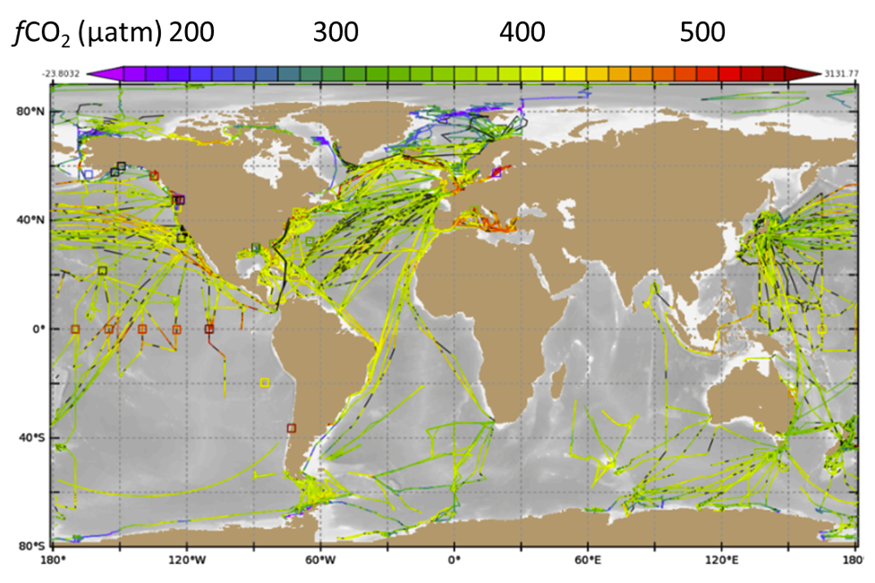
Will be developed by proposed Community of Practice
OASIS envisages a USV network for GOOS that will FILL GAPS in space, time, disciplines and complement existing GOOS infrastructure
SPACE AND TIME
Remote locations of global ocean not currently covered by GOOS infrastructure, including semi-enclosed seas, gulfs, archipelagos and reef networks
Under persistent cloud cover that can obscure some satellite observations
Clusters of USV that periodically come together to form “Mesonet”, then spread apart for greater coverage
Pairs of USV, in loose follow-the leader or side-by-side formation to observe EOV and spatial gradient
DISCIPLINARY
In severe weather and developing phenomena
In frontal regions, and near ice edge
In process studies
Air-Sea interface studies at sub meter scale
COMPLEMENTARY
Spatiotemporal coverage around fixed point moorings
Air-sea surface surveys at subsurface moorings or glider profiles
Acoustic gateway data transfers
All seawater pCO₂ observations made in 2015
Notes:
OASIS vision is to see a USV network that fills gaps in space and time, in disciplines, and to compliment the exiting GOOS network. This mission will be developed by our OASIS community of practice.

Slide 10
Will propose developing a Community of Practice as UN Decade Project linked to OASIS
PERSISTENT, MANOEUVRABLE, SCALABLE, AFFORDABLE, FLEXIBLE, SAFE, MULTIDISCIPLINARY
A USV network stands alone as an observing network, diversifying spatiotemporal coverage, filling gaps and complementing GOOS infrastructure.
A new project, “Uncrewed Surface Vehicle (USV) network for GOOS”, linked to OASIS, will be submitted for endorsement from the UN Ocean Decade
OASIS is currently undertaking a study that includes commercial USV manufacturers, operators and researchers, and will describe a USV Community of Practice. We welcome advice and participation.
Notes:
We are proposing developing a community of practice as a UN decade project. This means participating and collaborating with stakeholders in the USV industry as well as scientific and government end users. Bringing together commercial competitors under a common goal will be forward step for ocean observing.

