Slide 1
Presentation Profile
Key CTIC Activities 2021 - 2022
Update Re: ICG/CARIBE EWS XV Recommendations
Select UNESCO/IOC Tsunami Unit 2022 TIC Activities

Slide 2
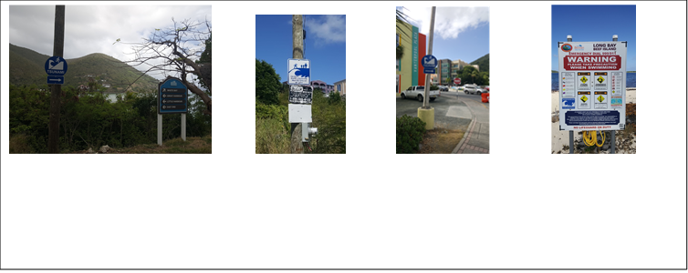
CTIC Activities 2021 – 2022
RENEWAL OF TSUNAMI READY COMMUNITIES:
British Virgin Islands (UNESCO/IOC-CTIC led): Deemed eligible for renewal through Regional Tsunami Ready Board meeting of 02 November 2021, following consideration of administrative changes BVI requested UNESCO/IOC to progress with TR tokens on 18 May 2022
St. Kitts and Nevis (ITIC/CAR led): Deemed eligible for renewal through Regional Tsunami Ready Board meeting of 03 March 2022. CTIC engaging on tokens and ceremony
Anguilla: Renewal pending

Slide 3
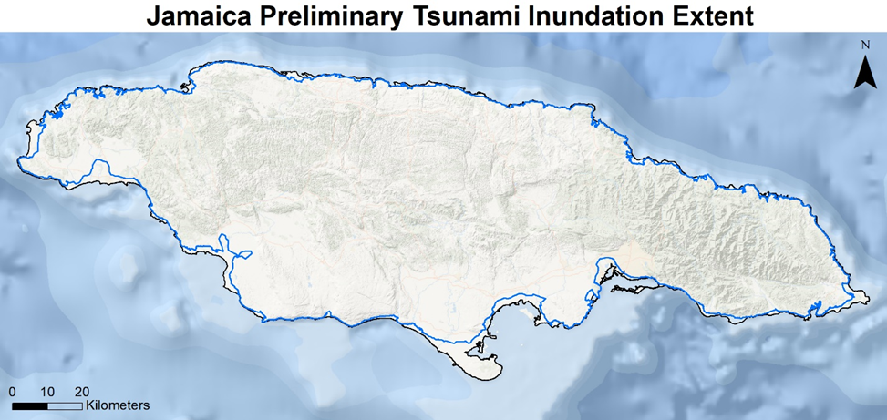
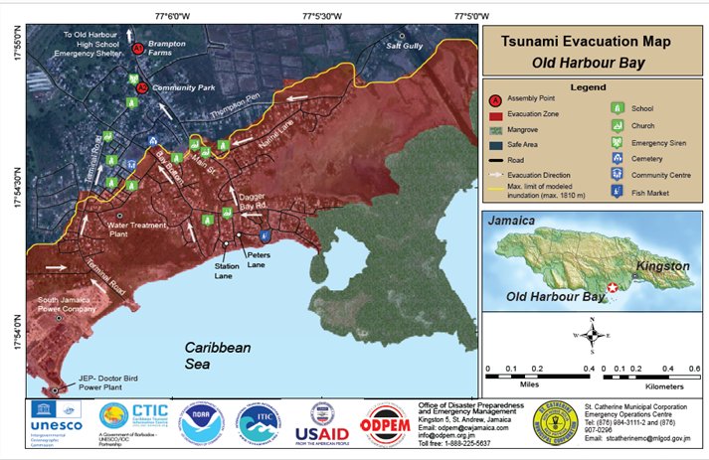
CTIC Activities 2021 – 2022
NEW TSUNAMI READY COMMUNITIES:
Old Harbour Bay, St. Catherine, Jamaica (ITIC/CAR led): IOC issued Tsunami Ready Certificate dated 24 January 2022, ceremony pending
Puerto Plata and Sabana Grande de Palenque, Dominican Republic: UNESCO/IOC-led, completion by September 2022
St. George, St. Vincent and the Grenadines: ITIC-CAR led, USAID/BHA funded, completion impacted by La Soufriere eruption response and recovery

Slide 4
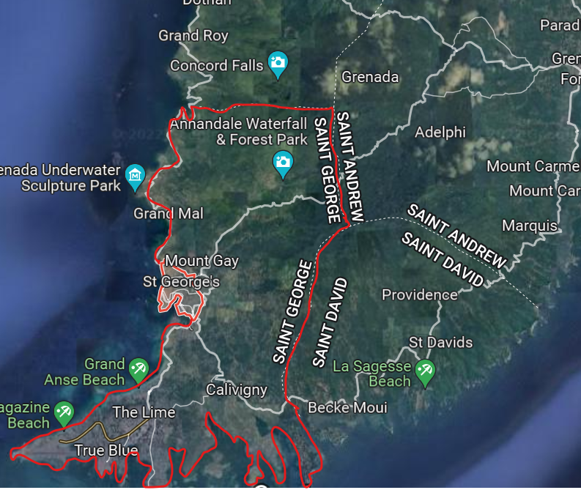
UNESCO/IOC CARIBE EWS Project, Grenada
Project Name: Strengthening Capacities for Tsunami Early Warning in Grenada
Donor: Government of Australia, Port of Spain Direct Aid Program & UNESCO/IOC
Funding: USD $57,000
Project Scope: Public Awareness and Education for Saint George Parish, Tsunami Ready nomination for select communities in St. George’s City
Completion by Dec 2023

Slide 5
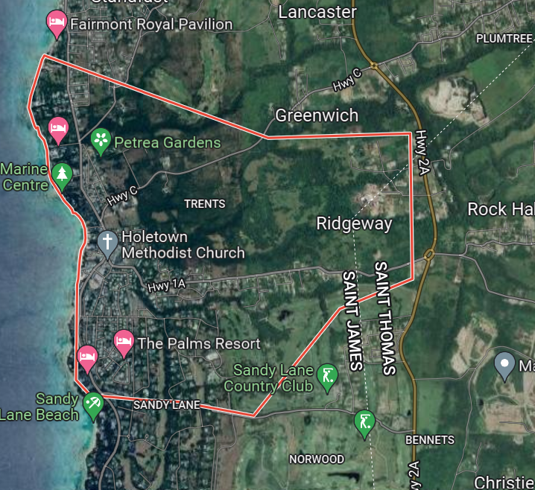
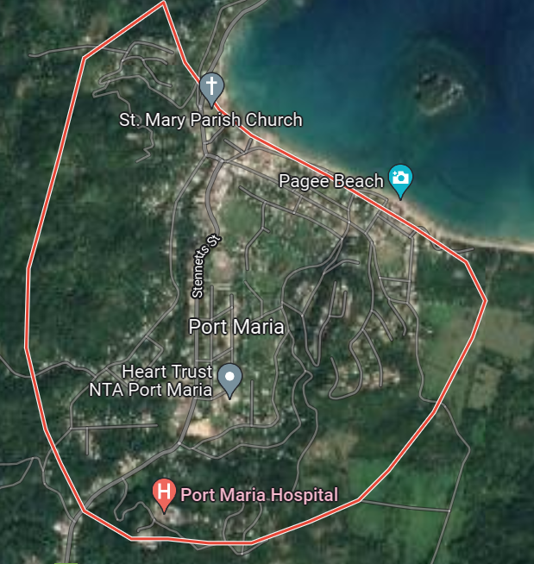
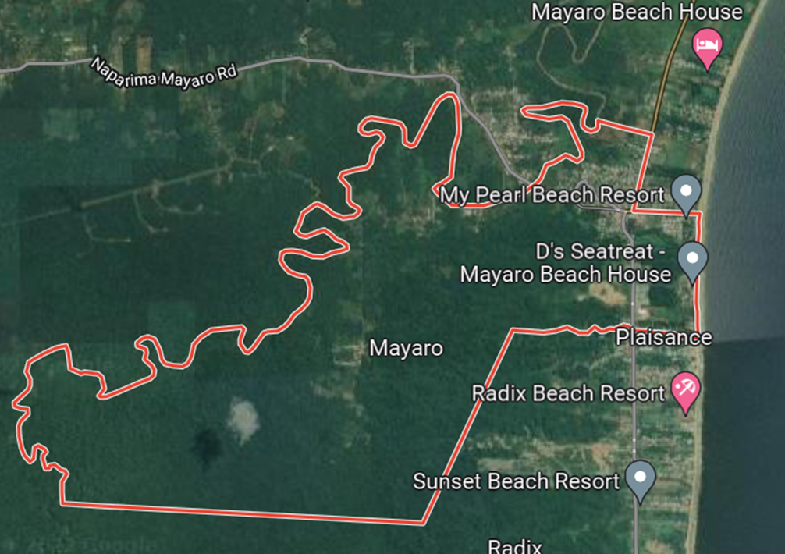
UNESCO/IOC CARIBE EWS NORAD Project Communities
Mayora Village, Mayaro–Rio Claro County, Trinidad and Tobago
Porters to Holders Hill, St. James, Barbados
Port Maria, St. Mary, Jamaica
Project Name: Towards a Safer Ocean in the Caribbean through Tsunami Ready Communities
Donor: Norwegian Agency for Development Cooperation (NORAD)
Funding: NORAD: 170,000, UNESCO: 30,000
Duration: January – September 2022
Capitalize on best practices and enhancing national capacity in Tsunami Ready Strategy e.g. National Consultants, UNESCO National Commissions, USAID/BHA, DIPECHO and Holetown projects (National protocol, EOP structure, modelling and mapping etc. available)

Slide 6
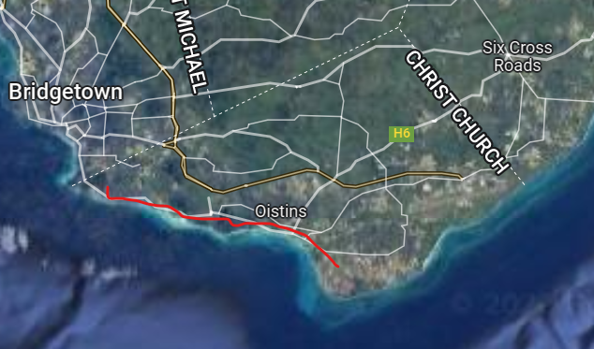
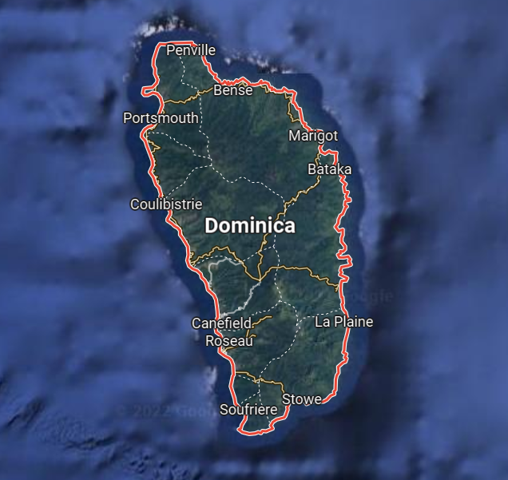
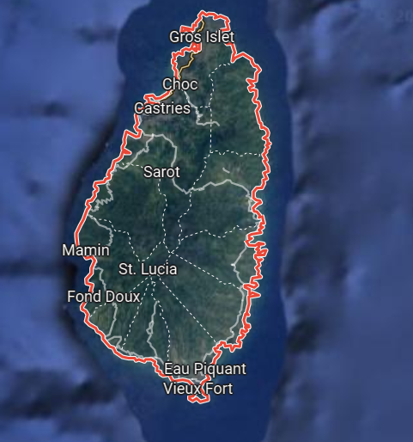
ITIC-CAR USAID/BHA Project Communities
St. Matthias to Rendevous, Christ Church, Barbados
Dominica
Saint Lucia
St. Matthias
Rendevous
Lead Implementing Agency: International Tsunami Information Center Caribbean Office, Mayaguez Puerto Rico

Slide 7
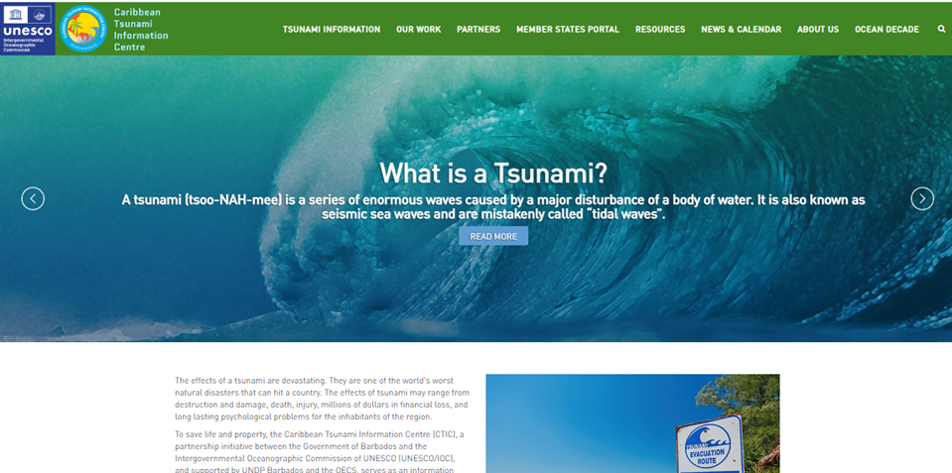
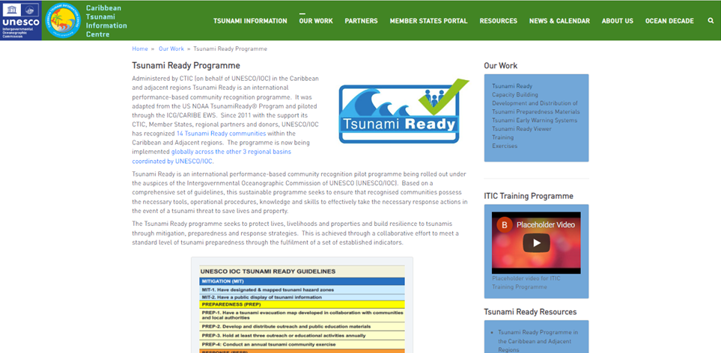
CTIC Activities 2021 – 2022 cont’d
*ICG/CARIBE EWS WG 4:
Meetings, review & development of documents and resources
CTIC WEBSITE:
Completion and transfer to IODE by 30 June 2022
*TSUNAMI READY TASK TEAM:
Meetings, review & development of documents and resources
Review, update and digitizing of Tsunami Ready evaluation survey for administration to Tsunami Ready communities recognized since 2019
*CARIBE WAVE 2022:
Exercise Handbook review, registration, promotion, webinars, exercise, evaluation
UN DECADE OF OCEAN SCIENCE:
Document review, meetings, presentations , project development
Safe Ocean Working Group meetings, Safe Ocean Laboratory 7 April
2022
“Integrating Coastal Hazards Early Warning Systems and Services in
Tropical Americas and Caribbean - iCHEWS” Project

Slide 8
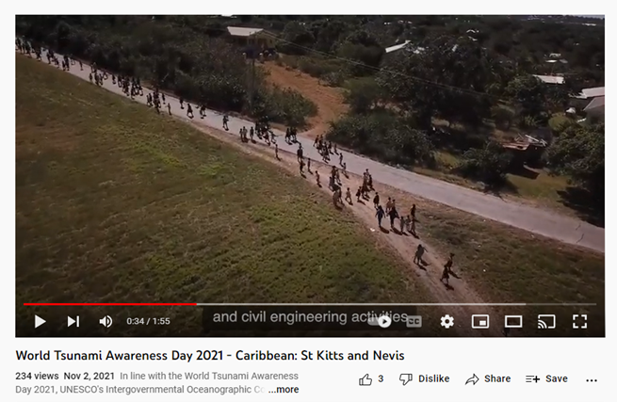
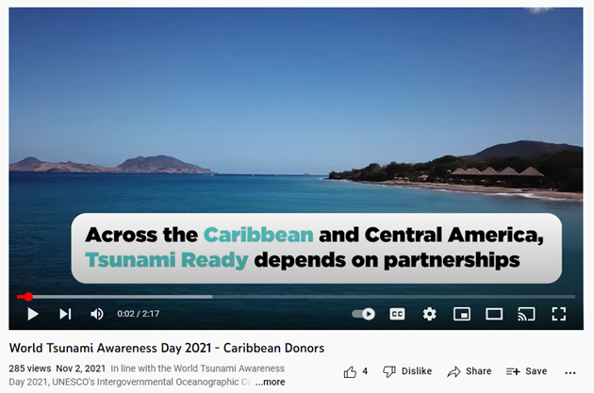
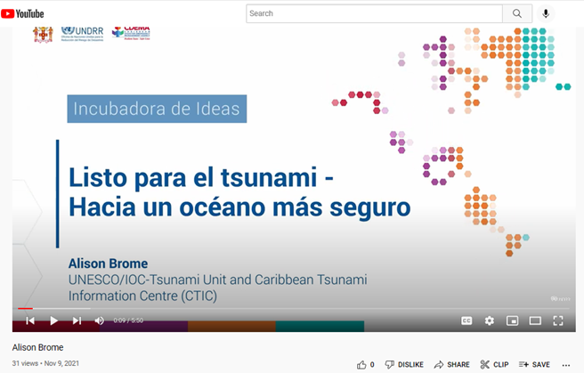
CTIC Activities 2021 – 2022 cont’d
*WTAD:
2021 - Supported UNDRR-led VII Regional Platform for DRR in Latin America and the Caribbean, development of 2 videos (Caribbean Partners & St. Kitts and Nevis)
2022 - Supported TOWS discussions for videos
OCEAN LITERACY:
Dissemination of PAE materials to Member States (including Request form, development of PAE resources and promotion
Support to development of Ocean Global Teacher Academy modules on Tsunami Awareness and Tsunami Ready

Slide 9
CTIC Activities 2021 – 2022 cont’d
CTIC BOARD MEETING:
Measured progress with follow-up actions
*MEMBER STATE REQUESTS AND PARTNER ENGAGEMENT:
Technical support, meeting participation, review of partnership agreements etc.
Facilitated deeper cooperation between ICG/CARIBE EWS and UNDRR Re: Regional Early Warning System Consortium (REWSC) to support Member State preparedness and resilience through ICG/CARIBE EWS Chair participation in Caribbean Regional Workshop on Measuring Effectiveness of Early Warning Systems - Trinidad and Tobago, May 10-12 2022
  *PARTNERSHIP AGREEMENTS AND TECHNICAL COLLABORATIONS:
Technical collaboration with ITIC-CAR, CDEMA, SRC, CEPREDENAC and other regional
partners ongoing
Review of draft framework agreements initiated with CDEMA
RESOURCE MOBILISATION AND STRATEGIC DEVELOPMENT:
Support UNESCO/IOC in project and strategic development e.g. JICA

Slide 10
Needed Action Re: ICG/CARIBE EWS XV Recommendations
Further requests CTIC in association with the Tsunami Ready Task Team and Member States determine the target number of communities in the CARIBE-EWS for Tsunami Ready recognition by 2030
Notes the recommendations of the CTIC Board, and as defined at 6.0 of the CTIC Board Terms of Reference, accepts the recommendation of the ICG/CARIBE-EWS Secretariat for the CTIC Board to develop a strategic plan to align the terms of reference for the CTIC, mobilize funding and in-kind support for the CTIC from ICG/CARIBE-EWS Member States, donors, universities and other technical institutions and report to ICG/CARIBE-EWS-XVI
Urges the IOC Secretariat and CTIC to work with the CARIBE-EWS officers to develop a strategic plan to mobilize funding and in-kind support for Tsunami Preparedness, Readiness and Resilience Activities
The ICG recommended the Task Team on Evacuation Maps with the support from Working Group 2, Working Group 4, and the Caribbean Tsunami Information Center (CTIC) to create a repository at the regional level to hold all national evacuation maps and “How to” manuals and supplemental manuals used for the creation of the tsunami inundation and evacuation maps
Instructs the CTIC to identify actions arising from Caribe Wave Exercise 2021 and coordinate with corresponding Working Groups and Task Teams follow up actions
Requests the Caribbean Tsunami Information Center (CTIC) to develop specific public awareness materials for local tsunami events

Slide 11
CTIC Considerations and Challenges
Financial and human resource constraints, implications for achievements – Project Assistant, NORAD (March – September, 2022)
Maximisation of opportunities for enhanced technical collaboration and resource mobilization
COVID-19 pandemic and other hazards impacts on priorities + human and financial resources of national Disaster Risk Management Organisations, donors, international and regional organisations to support CARIBE EWS
Need for sustained preparedness activities for tsunamis & deepening existing mechanisms and exploration of new opportunities to facilitate the integration of impacts and risks associated with other coastal hazards within CARIBE EWS
Limited avenues distribution of hard copy education and outreach materials

Slide 12


Select UNESCO/IOC-Tsunami Unit 2022 TIC Activities
Ocean Decade Laboratory (Online) - Ocean Decade Outcome “A Safe Ocean” 5 to 7 April 2022
Hosted by the German Federal Ministry of Education and Research in
partnership with the Intergovernmental Oceanographic Commission of UNESCO
100% of at-risk communities recognized Tsunami Ready - Satellite Activity | 7
April 2022 – 2 sessions (CARIBE EWS & PTWS Session =
maximum of 198 participants)
Establishing a Blue Line for Jamaica: Case Study for Jamaica Tsunami
Inundation Extent, Mayaguez, Puerto Rico
Importance of Multi-annual Tsunami Exercises for a Safe Ocean, Heredia, Costa
Rica
Sharing Experiences: Response to Volcanic Hazards, Bridgetown, Barbados
Sessions on Non-seismic tsunami sources

Slide 13
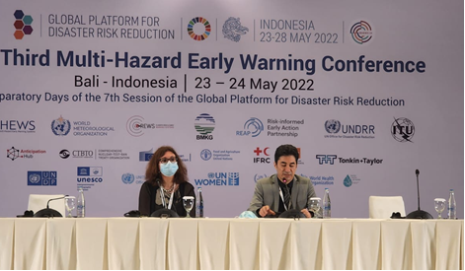
Select UNESCO/IOC-Tsunami Unit 2022 TIC Activities
Third Multi-Hazard Early Warning System (MHEWS-III) Conference 23-24 May 2022, Bali, Indonesia, Denis Chang Seng, Programme Specialist, TSU (NEAMTIC) partially Hybrid
Presentation on Tsunami Early Warning and Mitigation System: Progress, Gaps and Opportunities in the first key opening presentation on the State of Play on Early Warning Systems: Progress on Target G – Early Warning Access: Regional and Thematic Expert Perspective
Co-organize with WMO the session on 'Are our Early Warning Systems Effective?'
Session panelist on Innovation: The Next Generation of Forecasting and Warning Systems
Outputs & Outcomes:
Support publishing of Words into Action (WiA) Guide on
MHEWS for 13 October
Contribute to finalization the MHEWS-III Conference
Report
Co-author paper on Innovation: Next Generation of EWS
Prepare/publish news articles

Slide 14
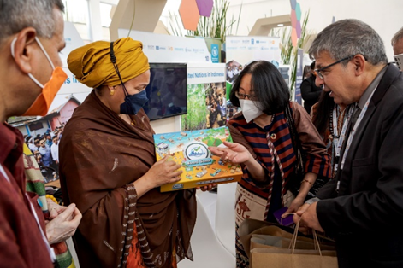
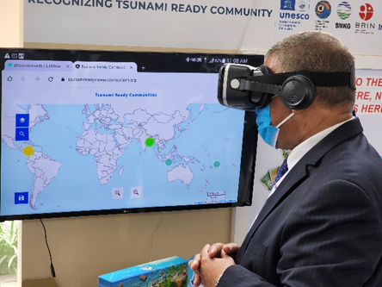
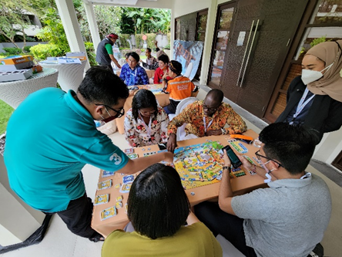
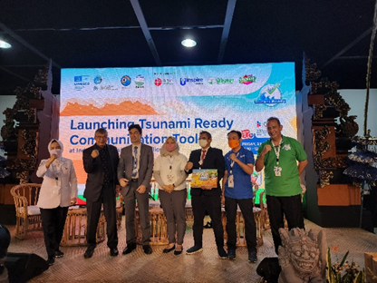
Select UNESCO/IOC-Tsunami Unit 2022 TIC Activities
Seventh Global Platform for Disaster Risk Reduction (GPDRR-7) 25-28 May 2022, Bali, Indonesia Denis Chang Seng, Programme Specialist, TSU (NEAMTIC), Ardito Kodijat, National Programme Officer, (IOTIC)
GP2022 took stock of Sendai Framework implementation, recommend actions for policy makers, highlight good practices and raise awareness
Outcomes to contribute to the inter-governmental midterm review of the Sendai Framework scheduled for 2023
Launched two UNESCO/IOC Tsunami Ready communication tools - Tsunami Ready Board Game and the 14 Animation Short Videos of Tsunami Ready Community.

Slide 15
Thank You
a.brome@unesco.org

