Slide 1
Tsunami Service Provider Report
Pacific Tsunami Warning Center
Charles McCreery, Director
NOAA Pacific Tsunami Warning Center
charles.mccreery@noaa.gov

Slide 2
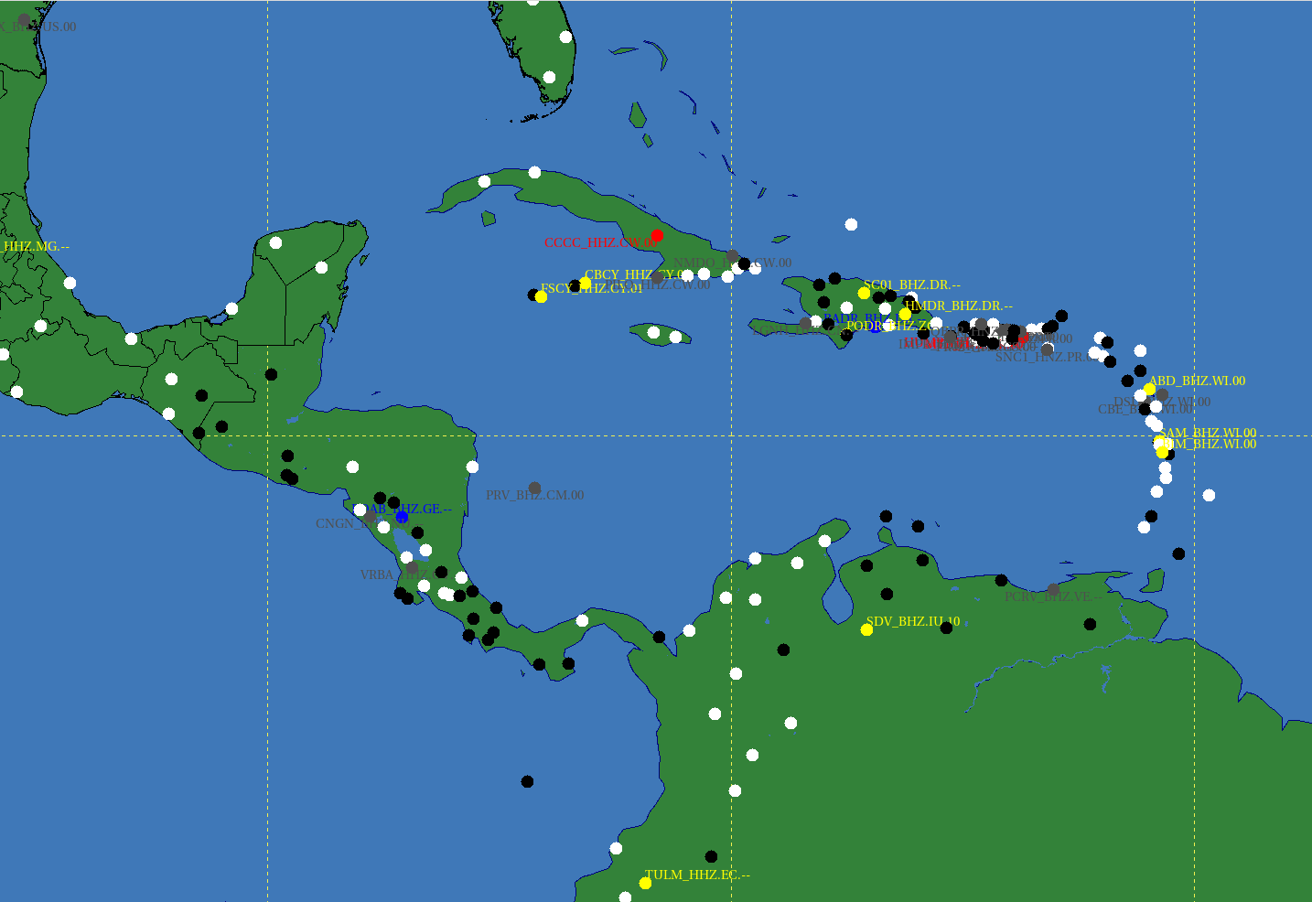
Sensing Network: Seismic
Snapshot on 6/5/22
White Dots are Active

Slide 3
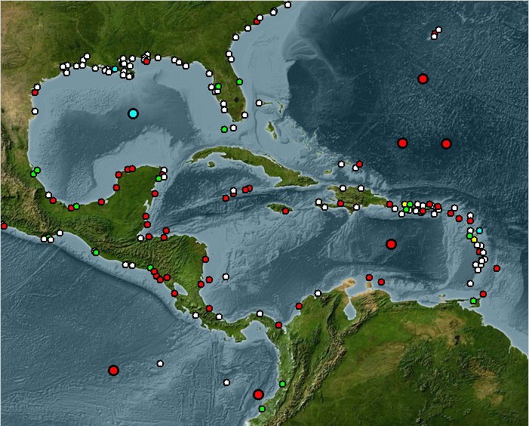
Sensing Network: Sea Level
Large Dots are DARTs
Snapshot on 6/5/22
White Dots are Active

Slide 4
7 Message Events: 04/25/2021 – 06/05/2022
PTWC EARTHQUAKE PARAMETERS |  |  |  | PTWC PRODUCTS
Origin Time (UTC) | Location | Mw | Depth (km) | Type | # | Elapsed Time
8/12/2021 18:32 | SOUTH_SANDWICH_ISLANDS_REGION | 7.6 | 78 | INFO | 1 | 00:13:27
8/12/2021 18:32 | SOUTH_SANDWICH_ISLANDS_REGION | 7.6 | 78 | INFO | 2 | 00:48:59
8/14/2021 12:29 | HAITI_REGION | 7 | 10 | INFO | 1 | 00:09:39
8/14/2021 12:29 | HAITI_REGION | 7.2 | 10 | THREAT | 2 | 00:49:52
8/14/2021 12:29 | HAITI_REGION | 7.2 | 10 | THREAT | 3 | 01:48:52
8/16/2021 11:10 | SOUTH_SANDWICH_ISLANDS_REGION | 7.1 | 33 | INFO | 1 | 00:09:58
8/22/2021 00:45 | SOUTH_SANDWICH_ISLANDS_REGION | 7.1 | 10 | INFO | 1 | 00:08:57
8/22/2021 21:33 | SOUTH_SANDWICH_ISLANDS_REGION | 7.2 | 10 | INFO | 1 | 00:11:03
1/15/2022 04:26 | TONGA | 0.1 | 0 | INFO | 1 | 14:52:40
1/15/2022 04:26 | TONGA | 0.1 | 0 | INFO | 2 | 15:08:47
3/22/2022 16:35 | NORTHERN_MID-ATLANTIC_RIDGE | 6.7 | 10 | INFO | 1 | 00:10:57

Slide 5
Message Events – Key Performance Indicators
PTWC EARTHQUAKE PARAMETERS |  |  |  | PTWC PRODUCTS |  |  | USGS PARAMETERS
Origin Time (UTC) | Location | Mw | Dep km | Type | # | Elapsed Time 10 min | ∆Mw 0.3 | ∆Dep (km) 30 | ∆Loc (km) 30
8/12/2021 18:32 | SOUTH_SANDWICH_ISLANDS_REGION | 7.6 | 78 | INFO | 1 | 00:13:27 | 0.1 | 31 | 23
8/12/2021 18:32 | SOUTH_SANDWICH_ISLANDS_REGION | 7.6 | 78 | INFO | 2 | 00:48:59 | -0.5 | 31 | 23
8/14/2021 12:29 | HAITI_REGION | 7.0 | 10 | INFO | 1 | 00:09:39 | -0.2 | 0 | 19
8/14/2021 12:29 | HAITI_REGION | 7.2 | 10 | THREAT | 2 | 00:49:52 | 0.0 | 0 | 19
8/14/2021 12:29 | HAITI_REGION | 7.2 | 10 | THREAT | 3 | 01:48:52 | 0.0 | 0 | 19
8/16/2021 11:10 | SOUTH_SANDWICH_ISLANDS_REGION | 7.1 | 33 | INFO | 1 | 00:09:58 | 0.2 | 16 | 17
8/22/2021 00:45 | SOUTH_SANDWICH_ISLANDS_REGION | 7.1 | 10 | INFO | 1 | 00:08:57 | 0.5 | 3 | 20
8/22/2021 21:33 | SOUTH_SANDWICH_ISLANDS_REGION | 7.2 | 10 | INFO | 1 | 00:11:03 | 0.1 | 4 | 7
1/15/2022 04:26 | TONGA | 0.1 | 0 | INFO | 1 | 14:52:40 | 0.0 | 0 | 0
1/15/2022 04:26 | TONGA | 0.1 | 0 | INFO | 2 | 15:08:47 | 0.0 | 0 | 0
3/22/2022 16:35 | NORTHERN_MID-ATLANTIC_RIDGE | 6.7 | 10 | INFO | 1 | 00:10:57 | 0.0 | 0 | 6

Slide 6
3 Noteable Events
1. 8/12/2021 South Sandwich Islands Earthquake and Tsunami
Multiple events – largest was an 8.1 – not quickly understood
Only one nearby sea level gauge – South Georgia Island (UK)
Amplitudes greater than 0.6m were recorded at South Georgia Island, in Argentina, and in South Africa
Tsunami was also widely recorded in the Pacific and Indian Oceans
No tsunami alerting system for southern Atlantic
ICG/PTWS has agreed to include this source region in its Seismic Source Zone
TOWS-WG recommends to explore expanding tsunami warning system coverage to southern Atlantic

Slide 7
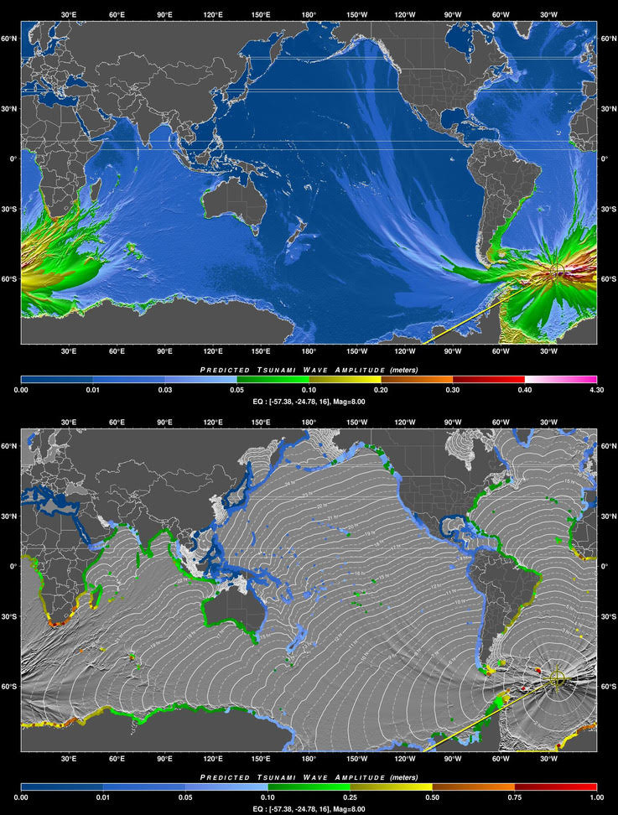
RIFT Simulation of 8/12/21 Tsunami
8/12/2021 South Sandwich Islands Earthquake and Tsunami
Multiple events – largest was an 8.1 – not quickly understood
Only one nearby sea level gauge – South Georgia Island (UK)
Tsunami was produced and recorded in Atlantic, Pacific and Indian Oceans
Amplitudes greater than 0.6m were recorded at South Georgia Island, in Argentina, and in South Africa
No tsunami alerting system for southern Atlantic
ICG/PTWS has agreed to

Slide 8
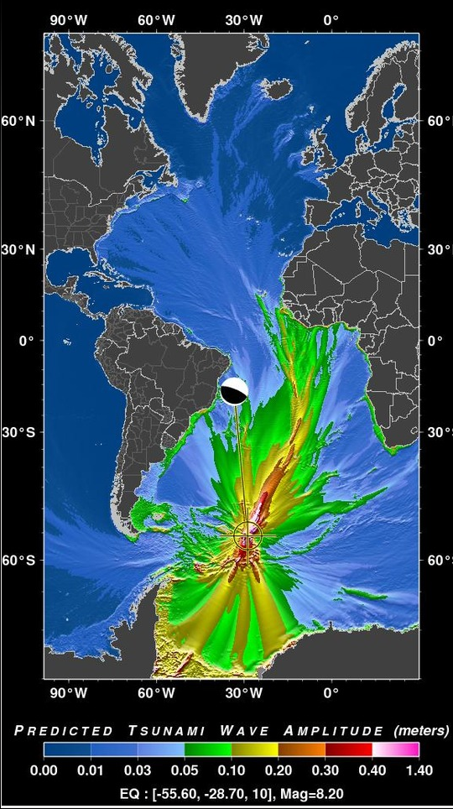
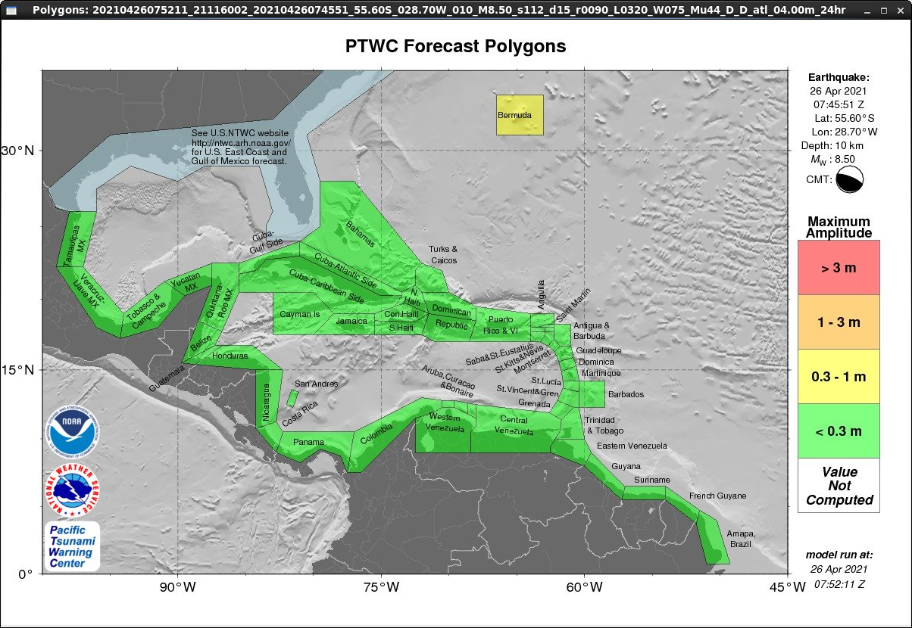
Continue Southern Atlantic Event Messages?
7 of 16 Message Events were for Southern Atlantic Earthquakes
An unlikely Mw 8.5 is only 0.3-1m in Bermuda with 14-hr travel time
Make Southern Atlantic part of PTWS – much closer to Chile
CARIBE-EWS still covered

Slide 9
3 Noteable Events
2. 8/14/2021 Haiti Earthquake and Tsunami
Initial Information Statement for Mw=7.0 was upgraded after 50 minutes to a Threat Message for upgraded Mw=7.2
Epicenter on the narrow Tiburon Peninsula – had to check for tsunami waves on both sides
Small tsunami waves, < 10 cm, recorded in Haiti and Mexico

Slide 10
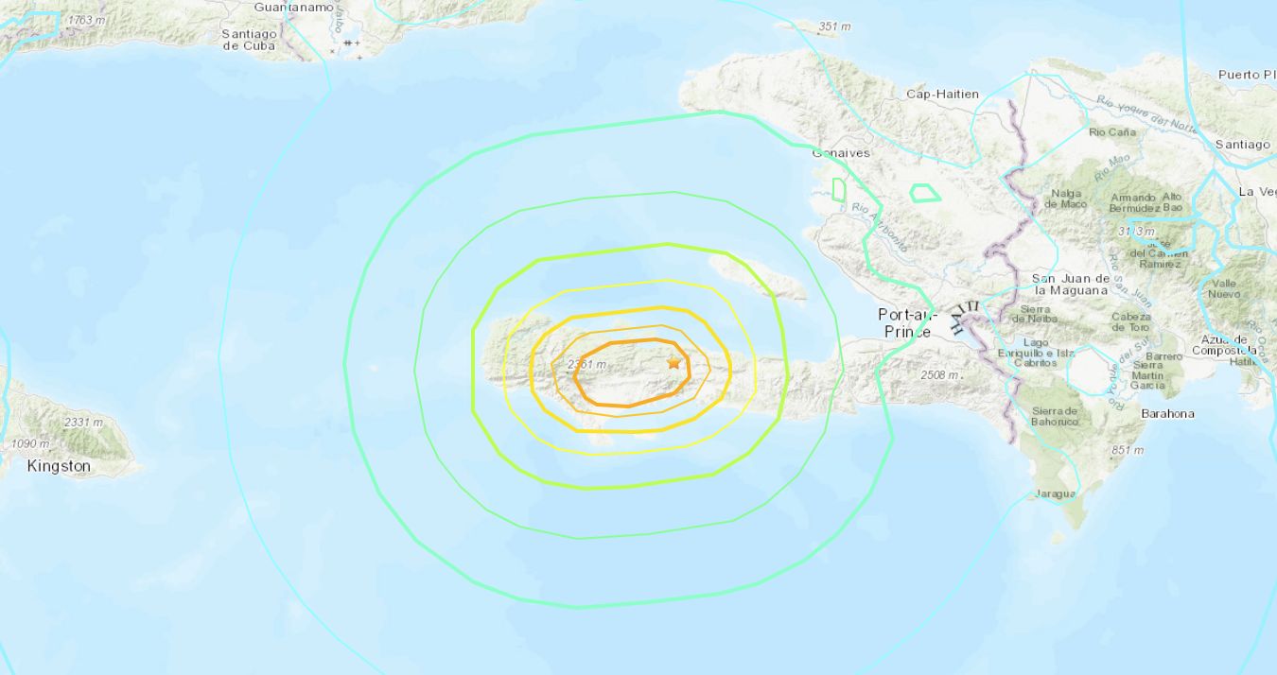
8/14/21 Mw 7.2 Haiti Earthquake
USGS
Modified Mercalli Intensity Contours – Maximum (orange) is 7.5

Slide 11
3 Noteable Events
3. 1/15/2022 Hunga Tonga Volcano eruption and tsunami
Explosive eruption of the Hunga Tonga – Hunga Ha`apai Volcano near Tonga
Tsunami runups > 10m in Tonga
Tsunami waves generated and observed in all the world’s ocean basins by the atmospheric disturbance
Equivalent to the 1883 explosive eruption of Krakatau?

Slide 12
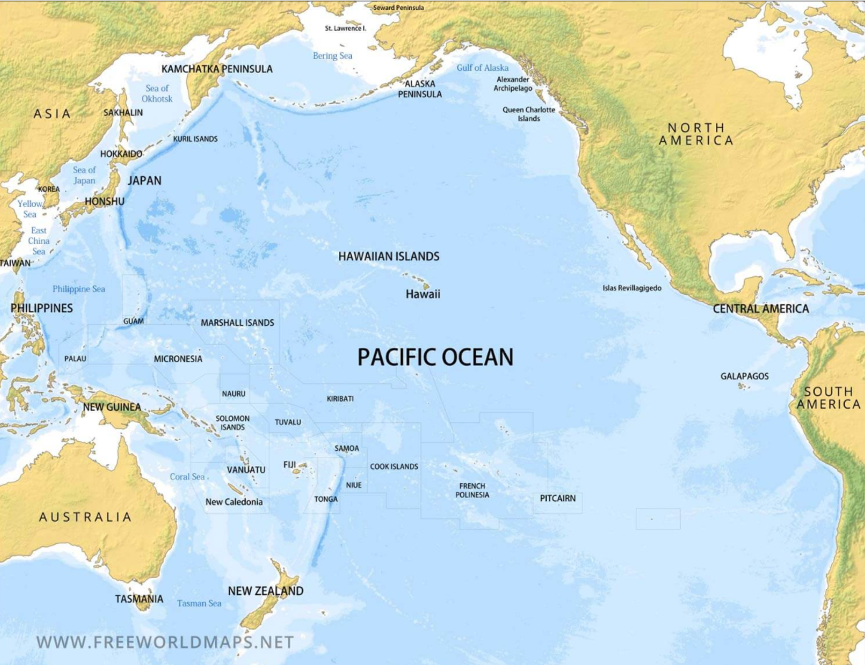
Geographic Awareness
Hunga Tonga – Hunga Ha`apai Volcano

Slide 13
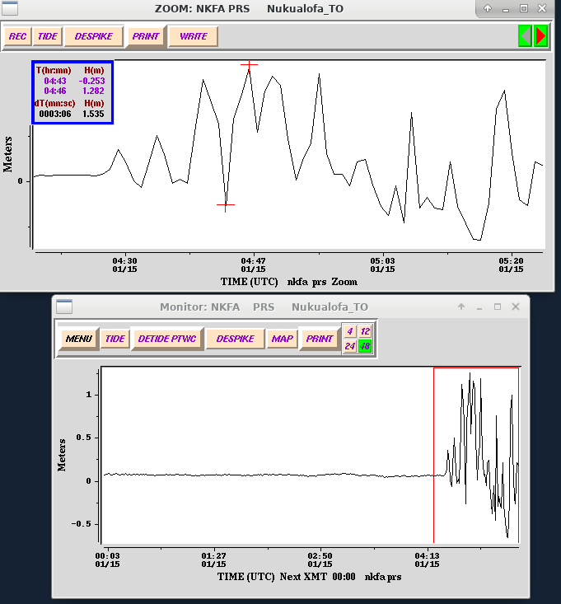
Tsunami arrival at Nuku`alofa
Tsunami signal at Nuku`alofa following the explosive eruption of Hunga Tonga

Slide 14
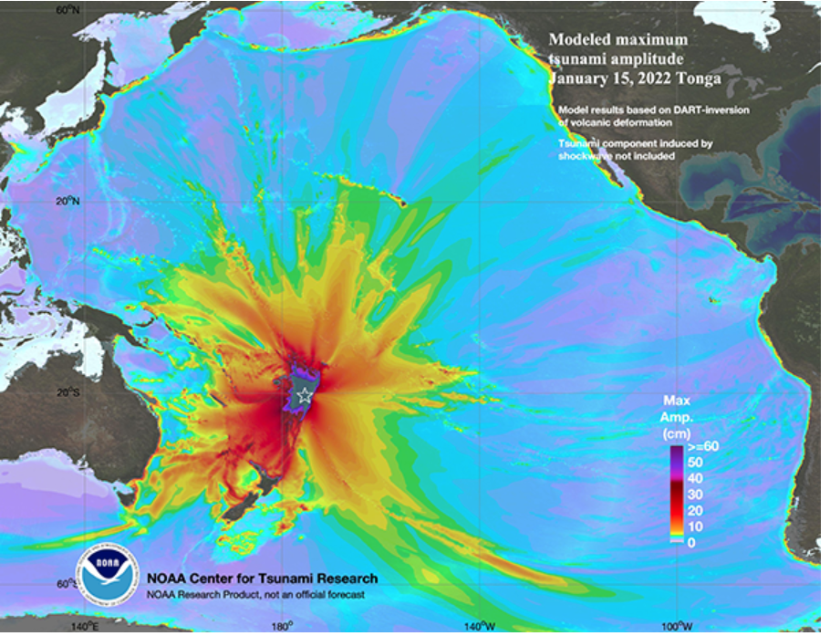
Modeled Tsunami Maximum Amplitude In the Pacific
Based on the Ocean Disturbance at the Volcano
Tonga Ridge

Slide 15
Sample Maximum Tsunami Amplitudes
Gauge | Amplitude
Nuku`alofa, Tonga | 0.82 m
Pago Pago, American Samoa | 0.62 m
Vanuatu | 1.41 m
Lifou, New Caledonia | 0.89 m
North Cape, New Zealand | 0.69 m
Kushimoto, Japan | 0.96 m
Rarotonga, Cook Islands | 0.90 m
Kahului, Hawaii | 0.83 m
Santa Cruz, Galapagos | 0.75 m
Coquimbo, Chile | 1.08 m
Arica, Chile | 1.22 m
Chanaral, Chile | 1.74 m
West of Tonga Ridge
East of Tonga Ridge

Slide 16
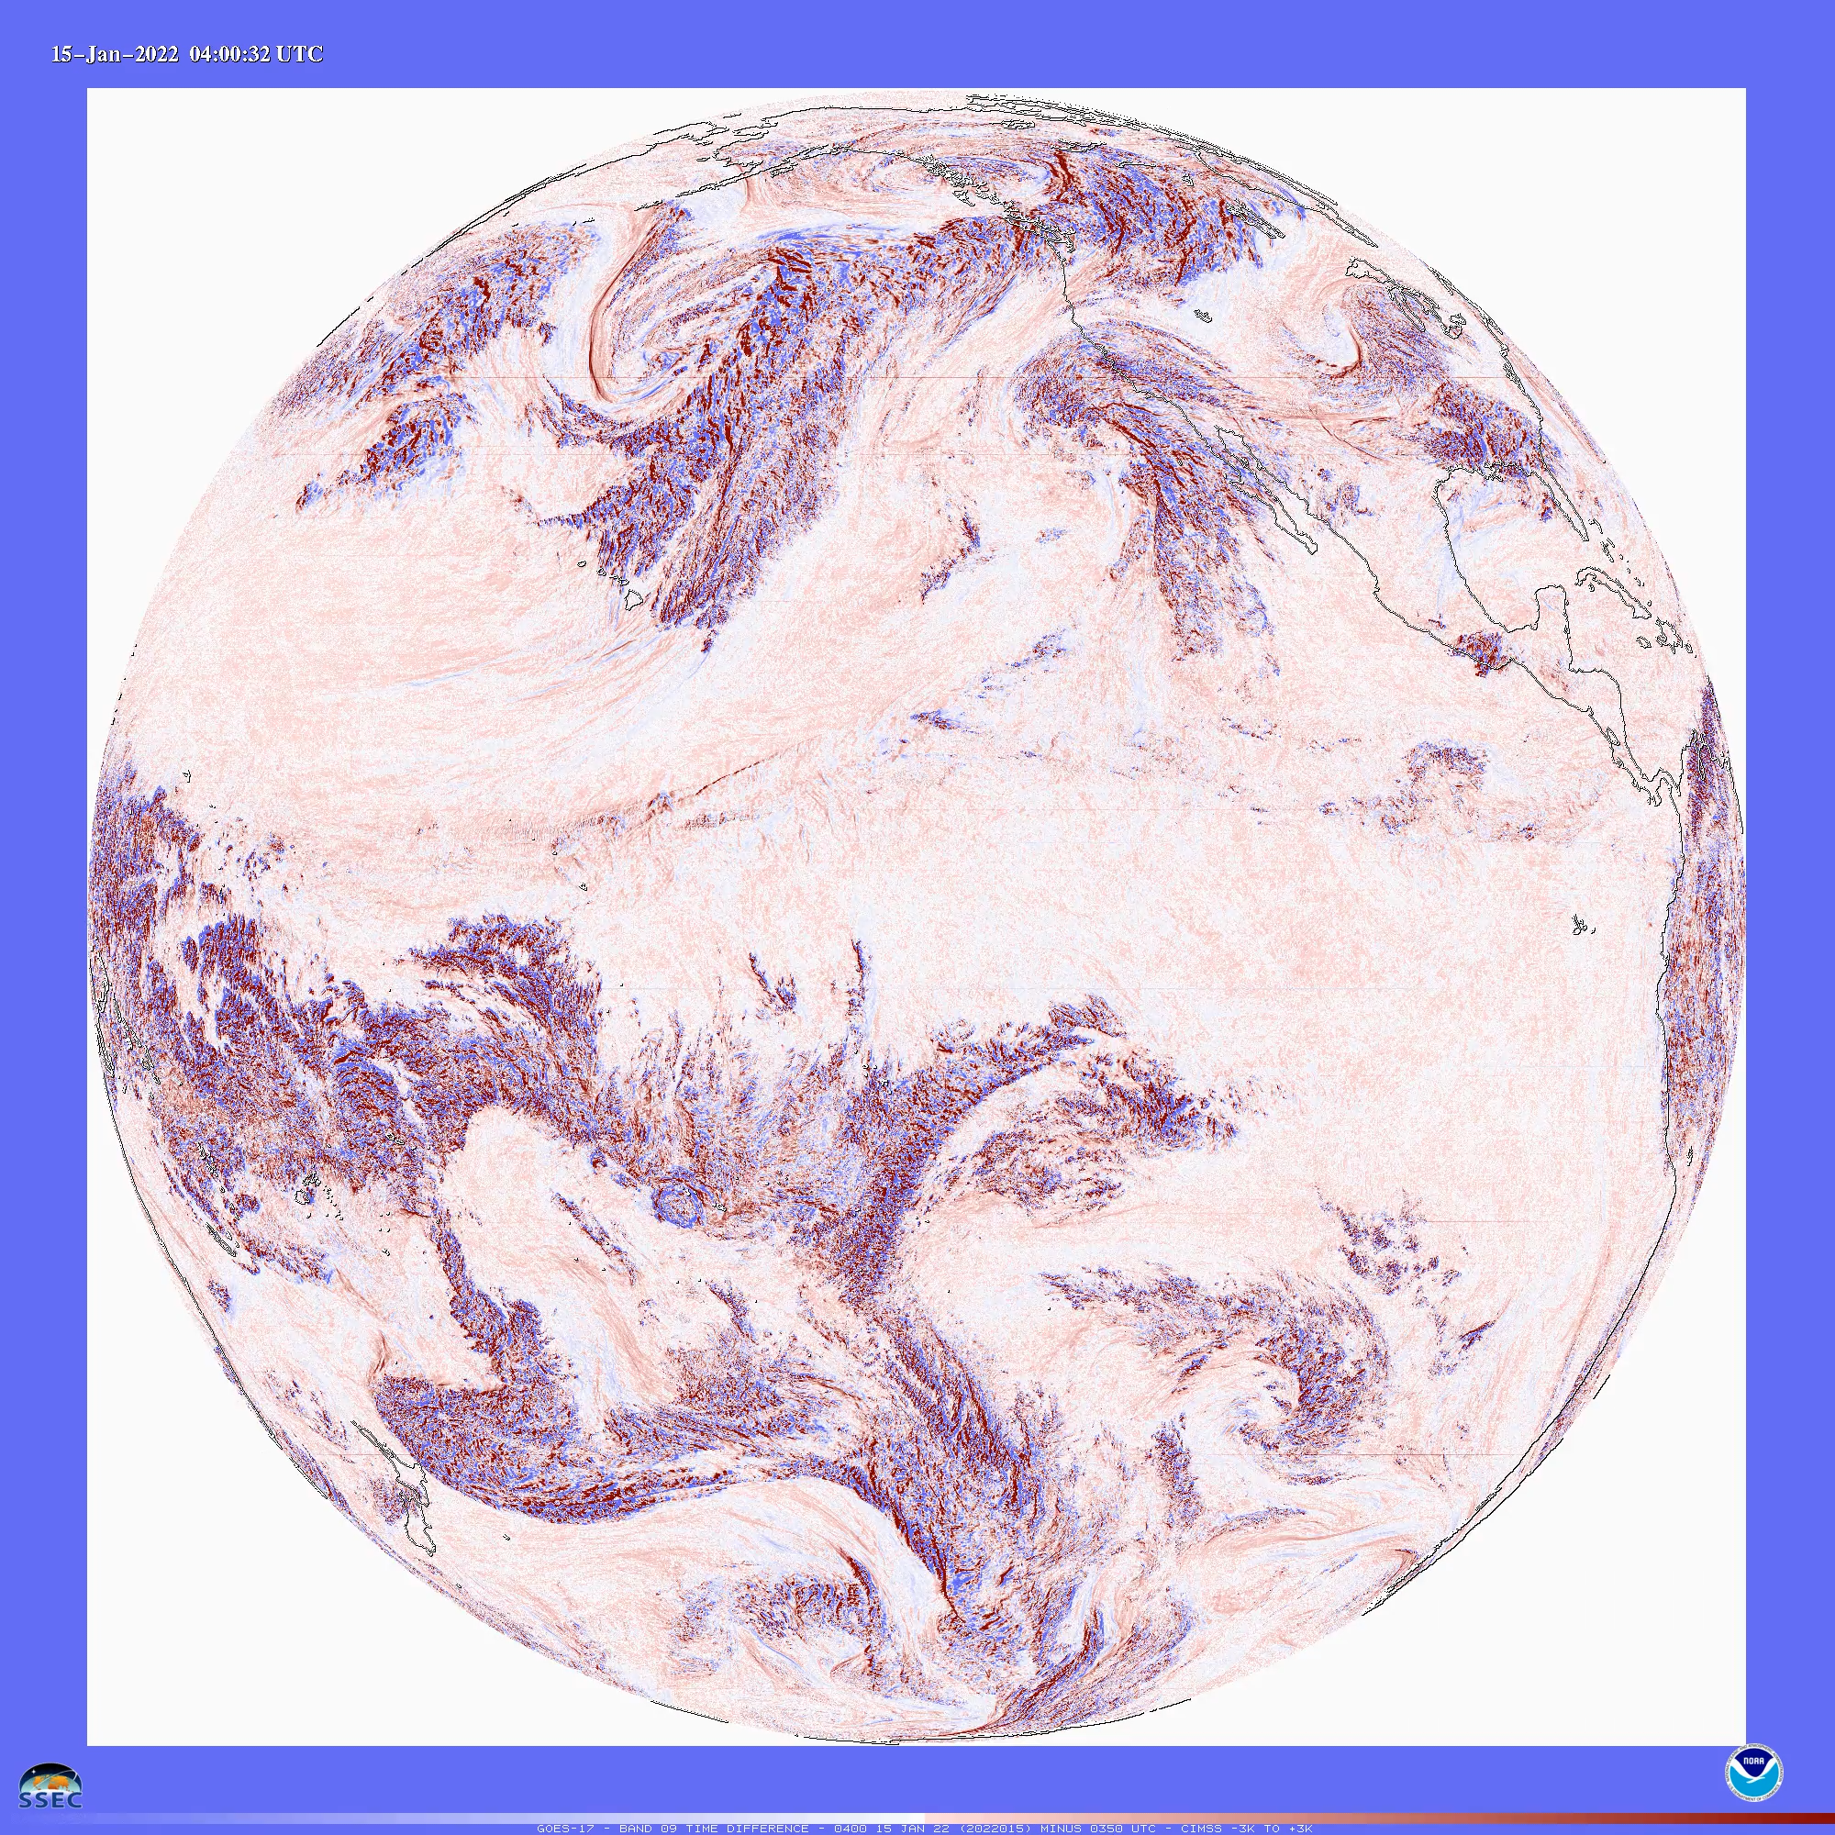
Atmospheric Pressure Wave Travels Around the World
Hunga Tonga Volcano
GOES-17 Mid-level Water Vapor (6.9 µm) Time Difference images (credit: Tim Schmit, NOAA/NESDIS/ASPB)
https://cimss.ssec.wisc.edu/satellite-blog/archives/44252

Slide 17
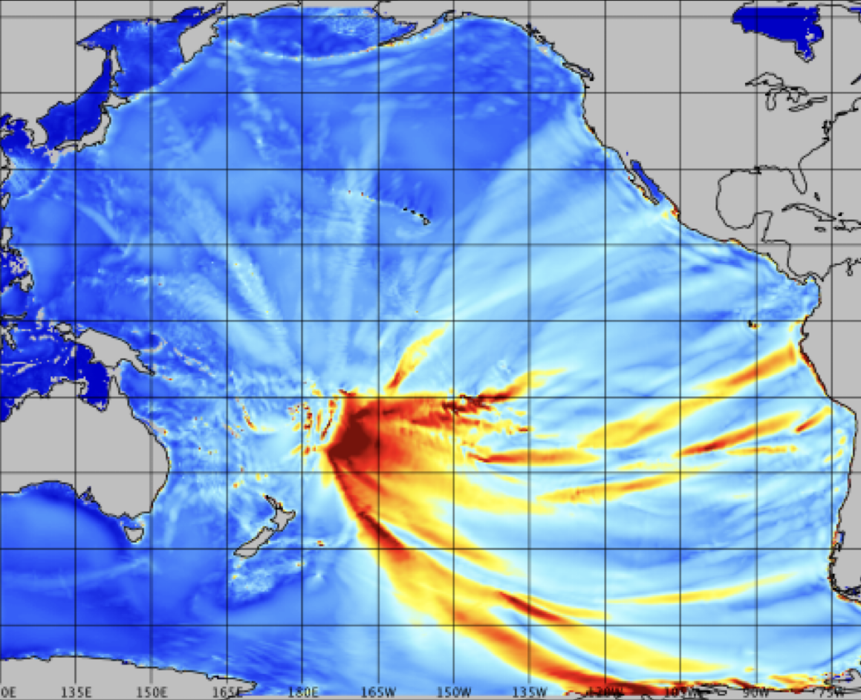

Modeled Tsunami Maximum Amplitude In the Pacific
Based on Atmospheric Pressure Wave Forcing
Tonga Ridge
Volcano

Slide 18
PTWC 1/15/21 Hunga Tonga Response
During Event
Tsunami detected quickly, but no automatic threat area or Pacific forecast since not an earthquake source and no earthquake parameters.
Could use fake earthquake parameters to generate PTWS text messages and threat areas and manually modify messages for the volcano source.
But dissemination problematic due to website expecting earthquake parameters. Ad hoc alternate dissemination methods had problems.
Information statements issued for the Caribbean when tsunami waves were observed there from atmospheric pressure wave
After Event
PTWS message code modified to handle any future Hunga Tonga tsunami
Forecast will be based on scaled 1/15/21 gauge amplitudes
Could this strategy be applied to any volcano using pre-run simulations and scaling to observations?

Slide 19
Noteable Operational Issues
COVID-19 Status
No infections of Duty Staff until past two months, but
No interruption of operations
Still limiting outside contact (no visitors) due to current high rate in Hawaii
No significant PTWC outages due to any other causes

Slide 20
Thank You
Charles McCreery, Chair
NOAA Pacific Tsunami Warning Center
charles.mccreery@noaa.gov

