Slide 1


CARIBE WAVE 2022
Summary Meeting
Dr. Elizabeth Vanacore
Seismologist, Puerto Rico Seismic Network
ICG CARIBE EWS CARIBE WAVE TT Chair
Christa G. von Hillebrandt-Andrade
Deputy Director, ITIC Caribbean Office
ICG CARIBE EWS WG IV Chair
Stephanie Soto Rios
Geologist
ITIC Caribbean Office
June, 2022

Slide 2
Objectives
Summary of CARIBE WAVE 22
Evaluation form results

Slide 3
CARIBE WAVE 22
CARIBE WAVE 22 was held successfully on March 10, 2022.
The forty-eight Member States and Territories participated, and a total of 413,285 people were directly engaged.
It was left up to the Member States and Territories to determine if any additional activity would be carried out and whether to use the simulated messages for one of the two scenarios: Western Muertos Trough and Northern Panama
CARIBE WAVE 21: PTWC (a) , Mexico (b)

Slide 4
CARIBE WAVE 22
Earthquake and Tsunami Scenarios
Western Muertos Trough
Northern Panama
Scenario | Origin Time | Mw | Epicenter
Western Muertos Trough | 14:00:00 UTC March 10, 2022 | 8.0 | 17.5⁰N, 69.5⁰W
Northern Panama |  | 8.3 | 9.3⁰N, 80.3⁰W

Slide 5
Timeline
ACTION | TIMELINE
Handbook Draft Circulated among ICG CARIBE EWS TNC/TWFP and TT CARIBE WAVE 22 | ✓ December 2021
Deadline for Comments | ✓ December 2021
Circular Letter Issued by IOC to MS | ✓ January 2022
Exercise Handbook Available Online | ✓ January 2022
1st Webinar CW (Overview, PTWC Products) | ✓18 January 2022 – English ✓19 January 2022 – Spanish ✓20 January 2022 - French
2nd Webinar CW (Update, Communication Methods, Registration, Questionnaire, Uploading Pictures/Videos ) | ✓15 February 2022 - English ✓16 February 2022 - Spanish ✓17 February 2022 - French
Countries Indicate Selected Scenario | ✓25 February 2022
Exercise | ✓10 March 2022
Exercise Evaluation Due | ✓31 March 2022
Final Draft Caribe Wave 22 Report ✓13 May 2022
Notes:
*Update timeline

Slide 6
Goals / Metrics
Goals | 2016 Results | 2017 Results | 2018 Results | 2019 Results | 2020 Results | 2021 Metrics | 2021 Results | 2022 Metrics | 2022 Results
TWFP receive the dummy message | 84% | 95% | 100% | 89% | 97% | 100% | 97% | 100% | 91%
Participation of Member States of ICG/CARIBE-EWS with designated focal warning point | 100% | 100% | 97% | 100% | 92% | 100% | 98% | 100% | 100%
Community involvement (including agencies beyond TWFP) | 73% | 82% | 77% | 66% | 38% | 95% | 56% | 95% | 43%
Number of participants* | 332,812 | 679,985 | 643,403 | 793,353 | 4,622 | +10% | 333,518 | +10% | 413,281
Countries who participate submit exercise questionnaire | 100% | 100% | 91% | 82% | 92% | 100% | 95% | 100% | 100%
Members State and territories are satisfied with exercise |  |  |  | 82% | 76% | 100% | 96% | 100% | 88%

Slide 7
Participation
*Number taken from TsunamiZone.org for cases where countries did not report number of participants in the survey.
Country | Participants according to Member States | Participants according to Tsunami Zone
Antigua and Barbuda | 5,454 | 0
Aruba | 11,960 | 11,960
Bahamas | 1 | 3
Barbados | 70 | 102
Belize | 1 | 0
Brazil | 10 | 9
Colombia | 49 | 39
Costa Rica | 45 | 62
Cuba | 350 | 0
Curacao | 50 | 3
Dominica | 100 | 5
Dominican Republic | 400 | 374
France (Martinique, Guadeloupe, Guyane, St. Barthelemy, St. Martin) | 196,400 | 196,393
Grenada | 2,000 | 6,464
Guatemala | 50 | 0
Guyana | 6 | 0
Haiti | 958* | 958
Honduras | 1 | 0
Jamaica | 253* | 253
Country |  | Participants according to Member States | Participants according to Tsunami Zone
Mexico |  | 6,000 | 357
Netherlands (Bonaire, Saba, Sint Eustatius) |  | 26 | 37
Nicaragua |  | 300 | 320
Panama |  | 7 | 838
Saint Kitts and Nevis |  | 5,000 | 5,000
Saint Lucia |  | 884* | 884
Sint Maarten |  | 5 | 2
Saint Vincent and the Grenadines |  | 45 | 101
Suriname |  | 1 | 0
Trinidad and Tobago |  | 50 | 265
United Kingdom | Anguilla | 1,250* | 1,250
 | Bermuda | 100 | 328
 | British Virgin Islands | 4,755 | 4,802
 | Cayman Islands | 1,000 | 3,250
 | Montserrat | 0* | 0
 | Turks and Caicos | 200 | 27
United States | Puerto Rico | 117,696 | 117,773
 | US Virgin Island | 12,351 | 12,351
Venezuela |  | 45,457 | 45,457
TOTAL |  | 413,285 | 409,667

Slide 8
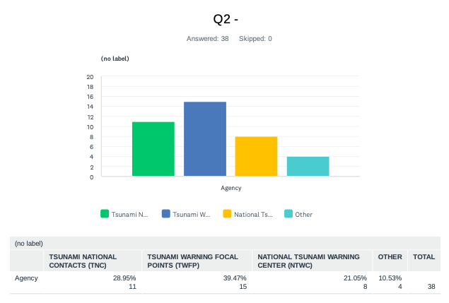
Evaluation Form
The questionnaire contained 35 questions for participating countries to provide feedback on the exercise.
Available from the day of the exercise, March 10 through March 31.
Responses from 100% of MS and territories. A total of 38 surveys were completed from the forty-eight Member States and Territories.

Slide 9
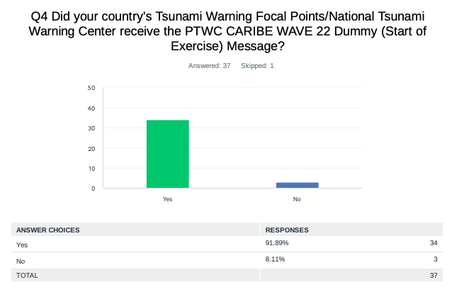
Evaluation Form – Dummy Message
The PTWC issued the “dummy” (start of exercise) message on March 10, 2022, at 1400 UTC and disseminated over all its standard broadcast channels.

Slide 10
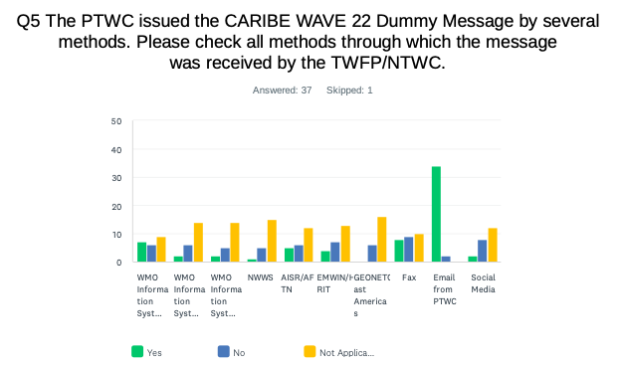
Evaluation Form – Dummy Message
As in past years, the most common methods to receive the Dummy message were the Email and Fax. WMO Information System (GTS) was also a method where several countries received the message.

Slide 12
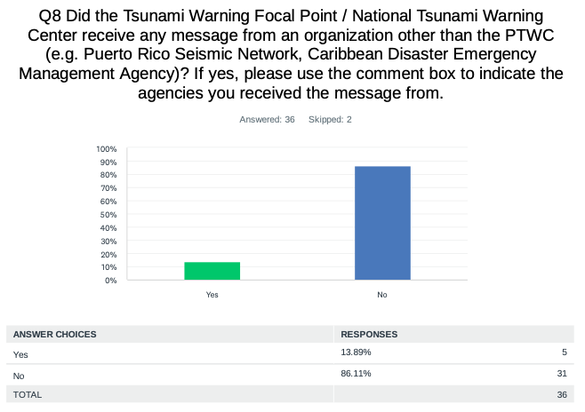
Evaluation Form - Dummy Message
Dominican Republic: Puerto Rico Seismic Network.
Panama: From CATAC.
UK - Anguilla: Puerto Rico Seismic Network.

Slide 13
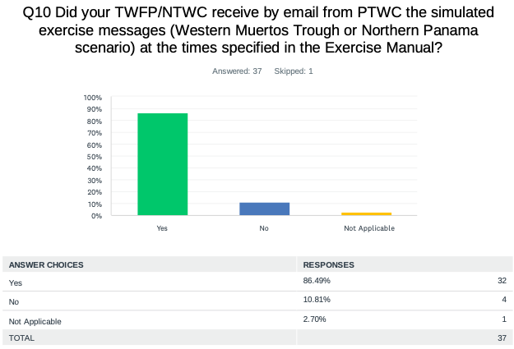
Evaluation Form - Threat Messages
Costa Rica: We received the Northern Panama scenario.
USA - Puerto Rico: WEA PR, EAS PR, and Interoperability (PREMB).
USA - US Virgin Islands: Agency also sent out IPAWS and Alert-VI messages, NOAA radio messages were not received though.

Slide 14
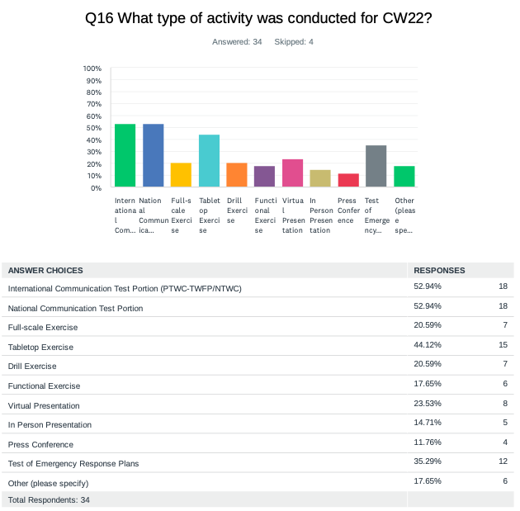
Evaluation Form – Type of Participation

Slide 15
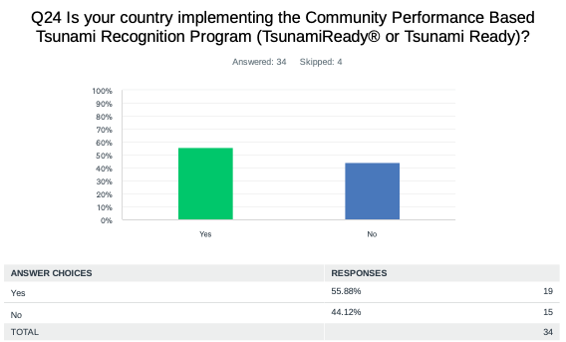
Evaluation Form – Tsunami Ready
According to Member States and Territories, there are about 87 communities recognized for TsunamiReady® or Tsunami Ready.

Slide 16
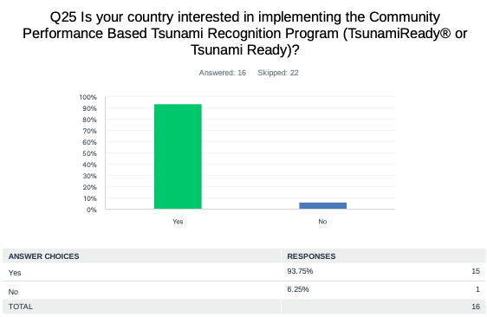
Evaluation Form – Tsunami Ready
The results indicated that 93% of the countries are interested in implementing Tsunami Ready, with 304 as total number of target communities to be recognized.
Countries Interested in Implementing TR
Aruba
Brazil
Colombia
Curacao
Dominica
Dominican Republic
Guatemala
Jamaica
Panama
Saint Lucia
Suriname
UK - Cayman Islands
UK – Turks and Caicos
Venezuela

Slide 17
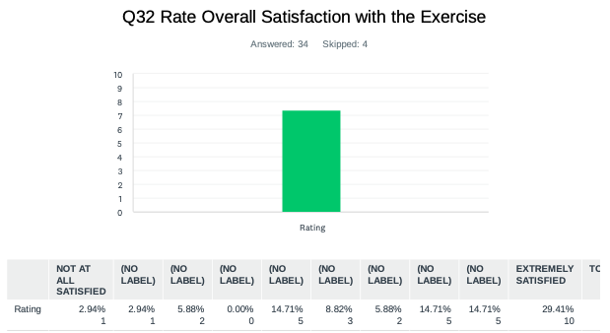
Evaluation Form – Exercise Satisfaction
Barbados: It went well from an exercise perspective highlighting possible areas for improvement.
France: A survey questionnaire was conducted with the main players of the exercise (33 responses): Without exception, they noted the importance of these exercises
Haiti: That is the first tsunami exercise in Jeremie. Very satisfied.
UK - Bermuda: CARIBE WAVE continues to bring tsunami awareness to the forefront annually.

Slide 18
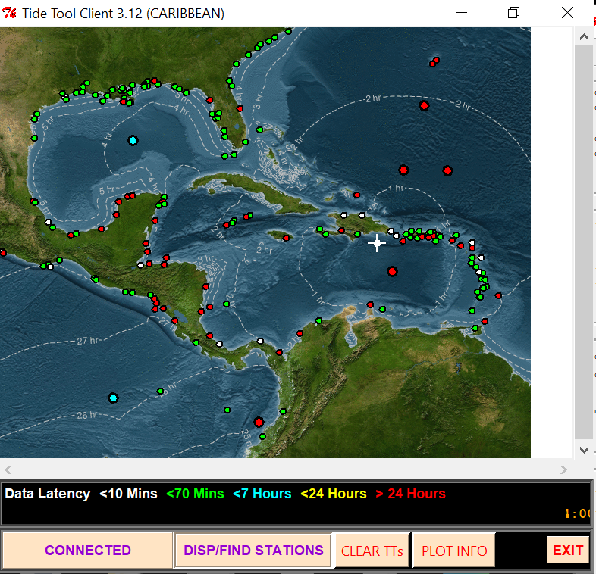
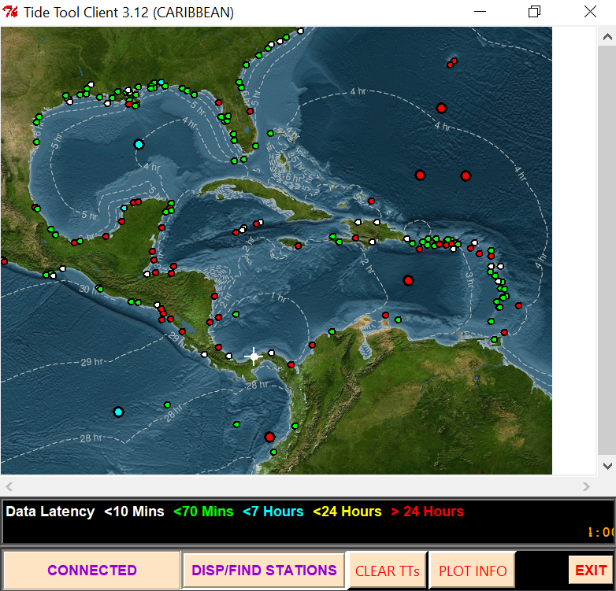
Status of Sea Level Stations during the exercise
Western Muertos Trough scenario
Northern Panama scenario
The PTWC provided simulated forecasted maximum wave heights for 64 CARIBE EWS stations in the simulated bulletins.
Only about 53% of these sea level stations were online on the IOC Sea Level facility during the exercise period.

Slide 19
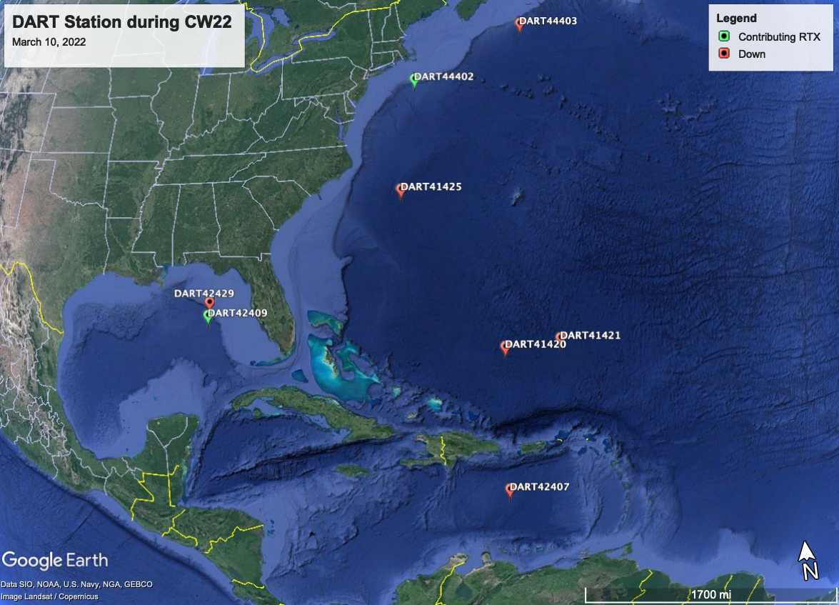
Status of DART’s
Only 2 of the 8 DART stations were not streaming data in the Caribbean/Gulf and Atlantic thru the National Buoy Center during the day of the exercise.

Slide 20
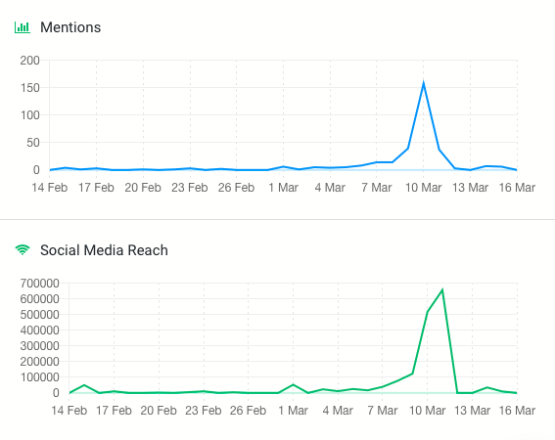
Media Arrangements
The hashtag tracker Brand24 was used to monitor #CaribeWave and #CaribeWave22 from February 14 to March 16.
Its data resulted in over 300 mentions on social media outlets and posts reaching over 1.7 million people worldwide.

Slide 21
CARIBE WAVE 22 Task Team

Slide 22
Hot-Wash
After the exercise, the CARIBE WAVE 22 Task Team organized a post-exercise ”hot-wash” webinar to permit Member States and Territories discuss and provide feedback on the exercise in an open forum on March 22, 2022.
Some feedback included the unique successes, lessons learned, strength from the exercise, and follow up actions.

Slide 23
Resources
NEW: Manual and Guides 86: Multi-Annual Community Tsunami Exercise Programme Guidelines for the Tsunami and Other Coastal Hazards Warning System for the Caribbean and Adjacent Regions.
https://www.weather.gov/itic-car/caribewave22
NEW: PTWC Enhanced Products and Staging for the Caribbean and Pacific, English
IOC Manuals “How to plan, conduct and evaluate tsunami exercises” and “Module on Tsunami Exercise” are useful resources.
CARIBE WAVE 2011 through 2022 Handbooks
CARIBE WAVE 2013 through 2021 Final and Media Report
PTWC Communications Plan for the Caribbean https://www.weather.gov/itic-car/caribewave22
Questions on the exercise can be addressed to the members of the CARIBE WAVE 22 Task Team.

Slide 24
Questions, Comments
Thank You!
elizabeth.vanacore@upr.edu
christa.vonh@noaa.gov

