Slide 1
Background on ICG CARIBE/EWS Service Model Agenda Item 6
Christa von Hillebrandt-Andrade
ICG CARIBE/EWS Officers Meeting
June 9, 2022

Slide 2
Service Model was developed in Dec. 2014 by the CARIBE EWS Tsunami Service Task Team and adopted by the ICG CARIBE EWS XI in 2015

Slide 3
TOWS WG VIII (2015). Adopted TSP definition:
Tsunami Service Provider: Centre that monitors seismic and sea level activity and issues timely tsunami threat information within an ICG framework to National Tsunami Warning Centres/Tsunami Warning Focal Points and other TSPs operating within an ocean basin.
ICG CARIBE EWS (2015)
Adopts Tsunami Service Model with TSP and subregional TSP.
The distinction between TSP and subregional TSP is that the TSP provides services to all member states and sub regional TSP’s send products only to Member States and Territories that have subscribed to their services.
Tsunami Service Task Team was charged with developing the TSP requirements which were to consider:
Tsunami Service Model (Dec. 2014)
Discussions at ICG-X, Sint Maarten 2015
Relevant recommendations from
TOWS-WG
Work and documentation provided for other Tsunami Warning Systems (PTWS, IOTWMS, NEAMTWS)
Accepts Nicaragua’s offer to host and develop the Central America Tsunami Advisory Center (CATAC) as a sub-regional Tsunami Service Provider (TSP) under the guidance of the PTWS Regional Working Group for Central America Pacific Coast and within the framework of ICG/PTWS, ICG/CARIBE-EWS and TOWS-WG;

Slide 4
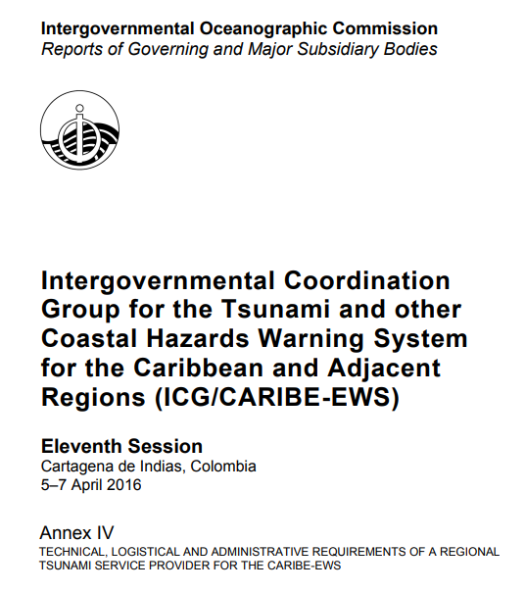
ICG CARIBE EWX XI (2016):
Approved the Technical, logistical and administrative requirements of a Regional Tsunami Service Provider for the CARIBE-EWS including the proposed key performance indicators and goals.
The ICG decided that the Pacific Tsunami Warning Center (PTWC) be henceforth referred to as a CARIBE-EWS Regional Tsunami Service Provider (RTSP), removing the term "Interim”.

