Slide 1
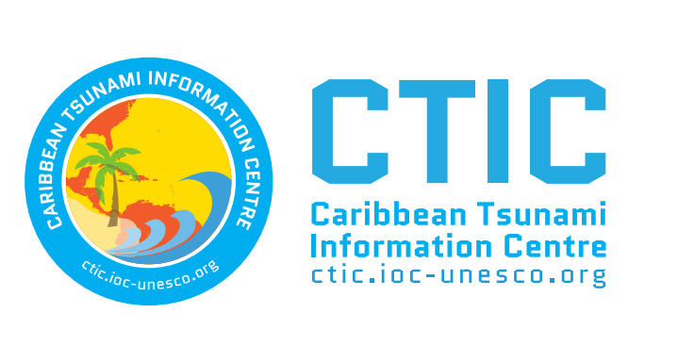
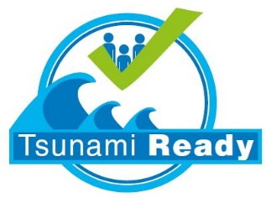
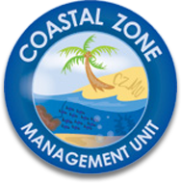
Regional Tsunami Evacuation Mapping Workshop
4.0 Key Stakeholders: Tsunami National Contacts (TNCs), Tsunami Service Provider (TSP), Tsunami Warning Focal Points (TWFPs), National Tsunami Warning Centers (NTWCs), Tsunami Information Centres (TICs)
Christa von Hillebrandt-Andrade
ITIC-CAR
Bridgetown, Barbados
August 8,2022

Slide 2
Reference Documents
UNESCO/IOC Tsunami Glossary
UNESCO/IOC Intergovernmental Coordination Group for Tsunamis and Other Coastal Hazards for the Caribbean and Adjacent Regions (CARIBE EWS) Organizational Structure and Governance
Available on Ocean Expert Workshop Page

Slide 3
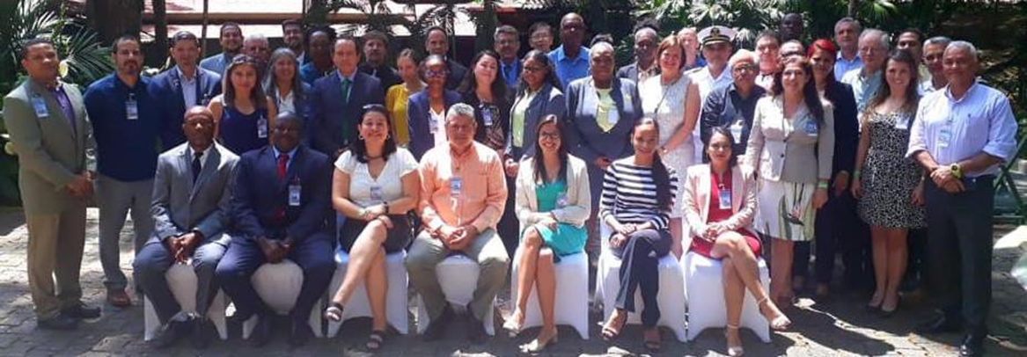
Tsunami National Contact (TNC)
The person designated by an ICG Member State government to represent his/her country in the coordination of international tsunami warning and mitigation activities. The person is part of the main stakeholders of the national tsunami warning and mitigation system program.

Slide 5
Tsunami Service Provider (TSP)
Centre that monitors seismic and sea level activity and issues timely tsunami threat information within an ICG framework to National Tsunami Warning Centres / Tsunami Warning Focal Points and other TSPs operating within an ocean basin.
The NTWCs / TWFPs may use these products to develop and issue tsunami warnings for their countries. TSPs may also issue Public messages for an ocean basin and act as National Tsunami Warning Centres providing tsunami warnings for their own countries.
PTWC

Slide 6
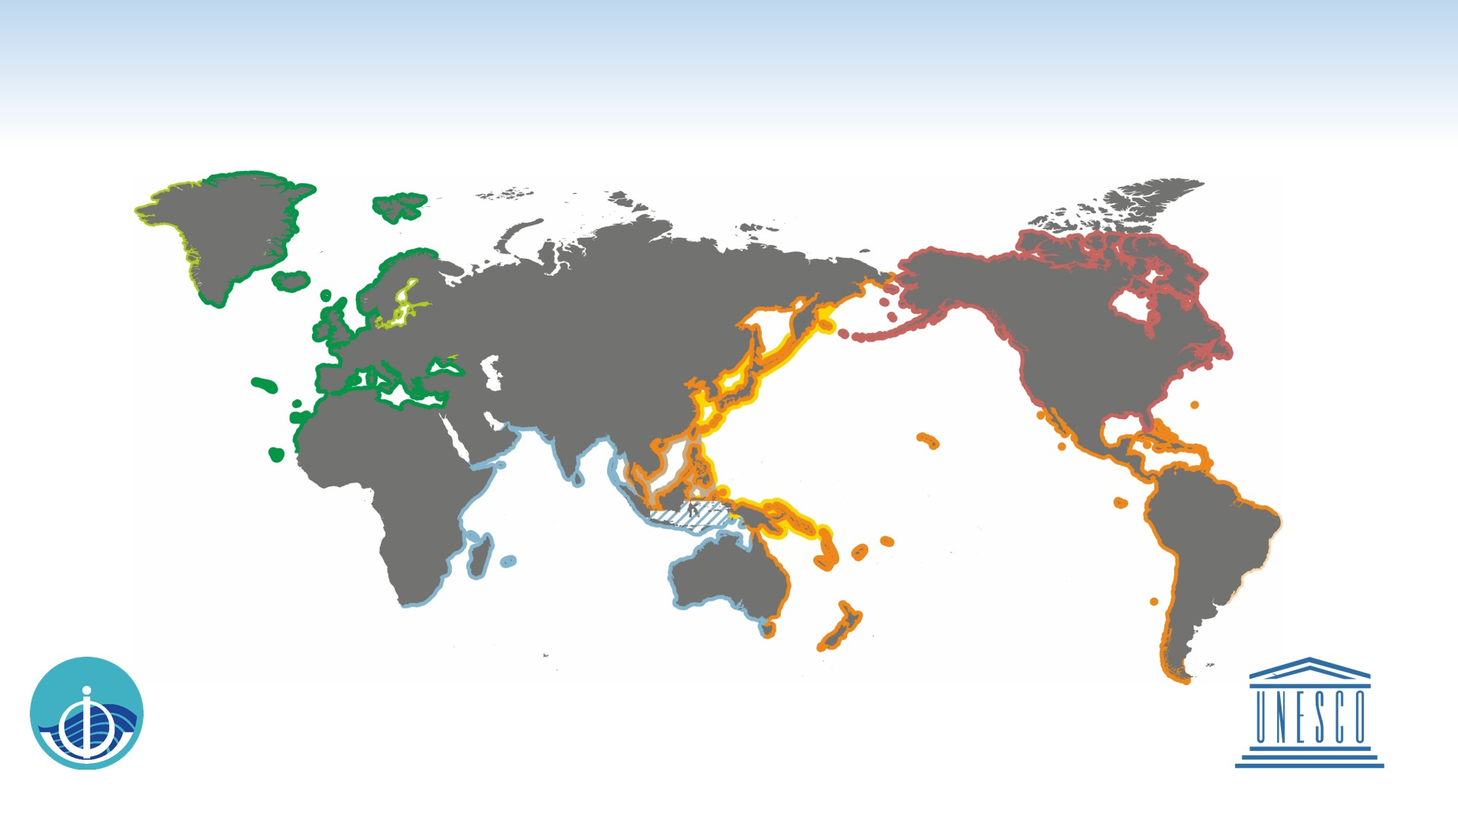
EXISTING SERVICES OF THE GLOBAL TSUNAMI WARNING SYSTEM
Intergovernmental Oceanographic Commission of UNESCO
2021 www.ioc-tsunami.org
The services provided by the
US National Tsunami Warning Center
are outside the framework of the IOC
coordinated tsunami warning systems
CARIBE-EWS
Tsunamis and Other Coastal Hazards Warning System for the Caribbean and Adjacent Regions
International Tsunami Information Centre, Caribbean Office (Hawaii, Puerto Rico, Chile, IOC
Service provided by
PTWC Pacific Tsunami Warning Center /
NWS/NOAA of USA
Planned
NEAMTWS
North Eastern Atlantic, Mediterranean
and connected seas Tsunami Warning and Mitigation System
Accredited TSPs:
CENALT Centre d'Alerte aux Tsunamis of France
IPMA Instituto Portugues do Mar e da Atmosfera
of Portugal
INGV Istituto Nazionale di Geofisica e Vulcanologia of Italy
KOERI Kandilli Observatory and Earthquake Research Institute of Turkey
NOA National Observatory of Athens of Greece
Planned
Caribbean Tsunami Information
Centre (Barbados, IOC)
NEAM Tsunami
Information Centre (IOC)
PTWS
Pacific Tsunami Warning and Mitigation System
NWPTAC/JMA
Northwest Pacific Tsunami Advisory Center /
Japan Meteorological Agency
PTWC
Pacific Tsunami Warning Center /
NWS/NOAA of USA
SCSTAC/NMEFC
South China Sea Tsunami Advisory Center /
National Marine Environmental Forecasting Center of P. R. China
International Tsunami
Information Centre (USA, Chile, IOC)
IOTWMS
Indian Ocean Tsunami Warning and Mitigation System
InaRTSP
Indonesian Regional Tsunami Service Provider
ITEWC
Indian Tsunami Early Warning Centre
JATWC
Joint Australian Tsunami Warning Centre
Indian Ocean Tsunami
Information Centre (Indonesia, IOC)
Service is provided by the
InaTEWS
Indonesian Tsunami Early Warning System at the BMKG, outside the framework of the IOC-coordinated tsunami warning systems

Slide 7
Global Tsunami Warning System

Slide 8
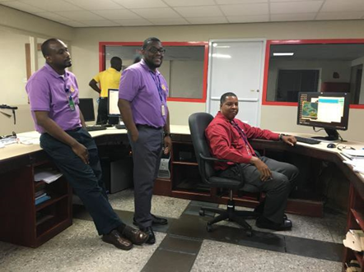
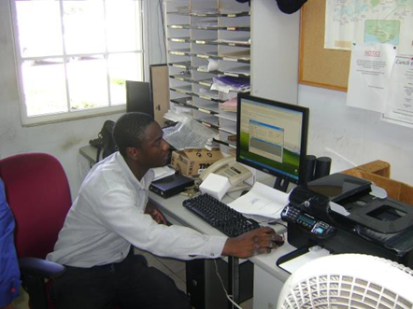
Tsunami Warning Focal Point (TWFP)
A 24 x 7 point of contact (office, operational unit or position, not a person) officially designated by the NTWC or the government to receive and disseminate tsunami information from an ICG Tsunami Service Provider according to established National Standard Operation Procedures. The TWFP may or not be the NTWC (National Tsunami Warning Center)
Grenada
Anguilla

Slide 9
Functions of a TWFP
BASIC
Monitor Communication Systems from the TSP (eg. Email, FAX, Internet, EMWIN, GEONET CAST Americas, AFTN)
Monitor Communication Systems to the NTWC and other corresponding authorities (eg. Telephone, Radio, Fax, WhatsApp)
UPON RECEIPT MESSAGE TSP
Inform NTWC and corresponding authorities
Log communications between TSP, NTWC
DURING NON-CRISIS
Review and Exercise Tsunami Protocol
Participate in CARIBE WAVE Exercise

Slide 10
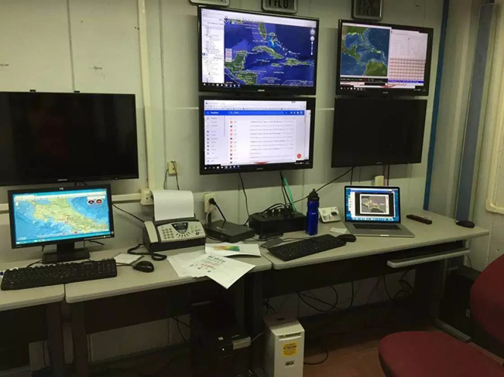
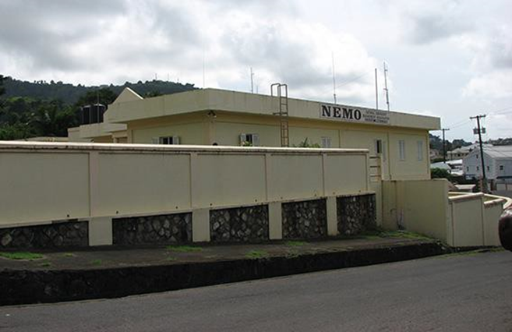
National Tsunami Warning Centre (NTWC)
Centre officially designated by the government to monitor and issue tsunami warnings and other related statements within their country according to established national Standard Operating Procedures.
Costa Rica Saint Vincent and the Grenadines

Slide 11
Functions of an NTWC
BASIC
Monitor and Locate Earthquakes
Monitor and Detect Tsunami Waves
Assess the Tsunami Threat
Create and Disseminate Alerts
Monitor Tsunami Impacts
UPON RECEIPT MESSAGE TSP/TWFP
Consult with NDMO During Events
Brief the Media – Your Partner
DURING NON-CRISIS
Outreach
Research/Tsunami Modeling/Scenarios
Review and Exercise Tsunami Protocol
Participate in CARIBE WAVE Exercise

Slide 12
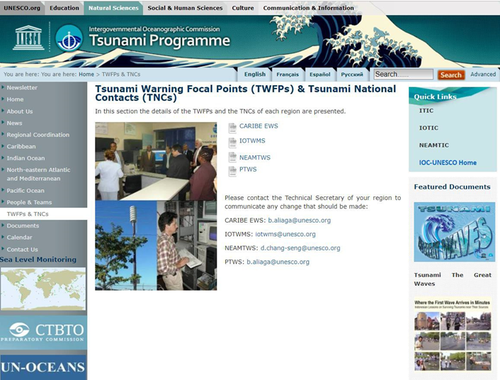
Official Contact Information Updates
Member States should update TWFP/NTWC/TNC
data to IOC (B.Aliaga@unesco.org) and in case of NTWC/TWFP also ptwc@ptwc.noaa.gov)

Slide 13
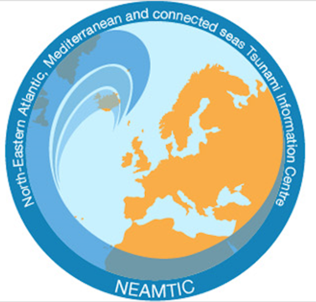
IOC Tsunami Information Centres
PTWS
USA NOAA – IOC Partnership
1965
Caribbean Office (part of ITIC since 2017, since 2010 as CTWP)
NEAMTWS
IOC Tsunami Programme
NEAMTWS Secretariat
ITIC Caribbean Office (since 2017, since 2010 as CTWP)
IOTWS
Indonesia – IOC Partnership 2012 (formerly JTIC since 2006)
CARIBE-EWS
Barbados– IOC Partnership
2015 (established 2015)

Slide 14
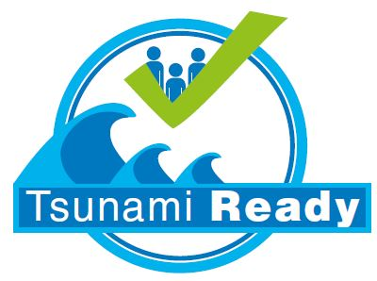
Thank you
Any questions or comments?
Christa.vonhh@noaa.gov

