Slide 1
38th Session of the Data Buoy Cooperation Panel (DBCP-38)- Geneva, Switzerland 1 - 4 November 2022
Kuwait’s National Report on Current and Planned Buoy Programs
Faiza Al-Yamani
Kuwait Institute for Scientifc Research

Slide 2
Kuwait An integrated system for monitoring of meteorological, oceanographic and water quality data in near-shore and offshore regions of Kuwait
Shatt Al-Arab River
Kuwait
ROPME’s Inner Gulf
Oman Sea

Slide 3
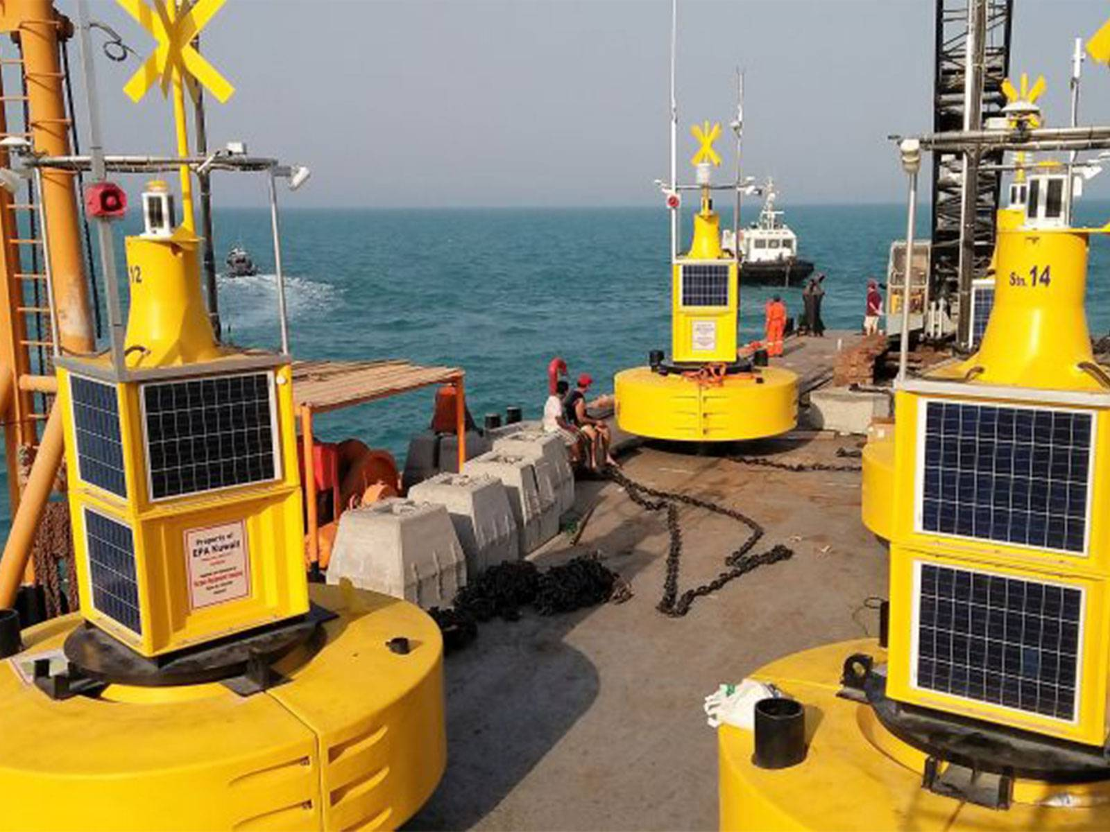
Integrated Met-Ocean Monitoring Systems for Kuwait-1
Shatt Al-Arab River
Kuwait
Buoys Monitoring Locations
Source: https://www.burganequipment.com/major-achievements/

Slide 4
Integrated Met-Ocean Monitoring Systems for Kuwait-2
Purpose: Monitoring/early warning of meteorological, oceanographic, and water quality variables in near-shore and offshore waters of Kuwait (spatial and temporal coverage)
Number of Data Buoys (Kuwait: Environment Public Authority): 15
Stations in Kuwait waters: 15
Monitoring Variables:
Sensors in the upper part of the buoy system: meteorological parameters like wind speed and direction, air temperature, humidity, barometric pressure, solar radiation
Sensors under water: covers oceanographic parameters like tide, current profiles, waves including directional energy spectrum; water quality parameters like conductivity, temperature, salinity, turbidity, dissolved oxygen, ph. The water quality parameters include also chlorophyll (algal biomass).

Slide 5
Integrated Met-Ocean Monitoring Systems for Kuwait-2
Unfortunately, EPA decided to retrieve the 15 environmental buoys, due to high maintenance costs, lack of manpower, and unavailability of the necessary budget to keep them operational.

Slide 6
Meteorological Department-Civil Aviation
Weather Forecast
Marine Forecast (One Weather/Marine Station in Salmiyah)
Warnings and Weathers Watches

Slide 7
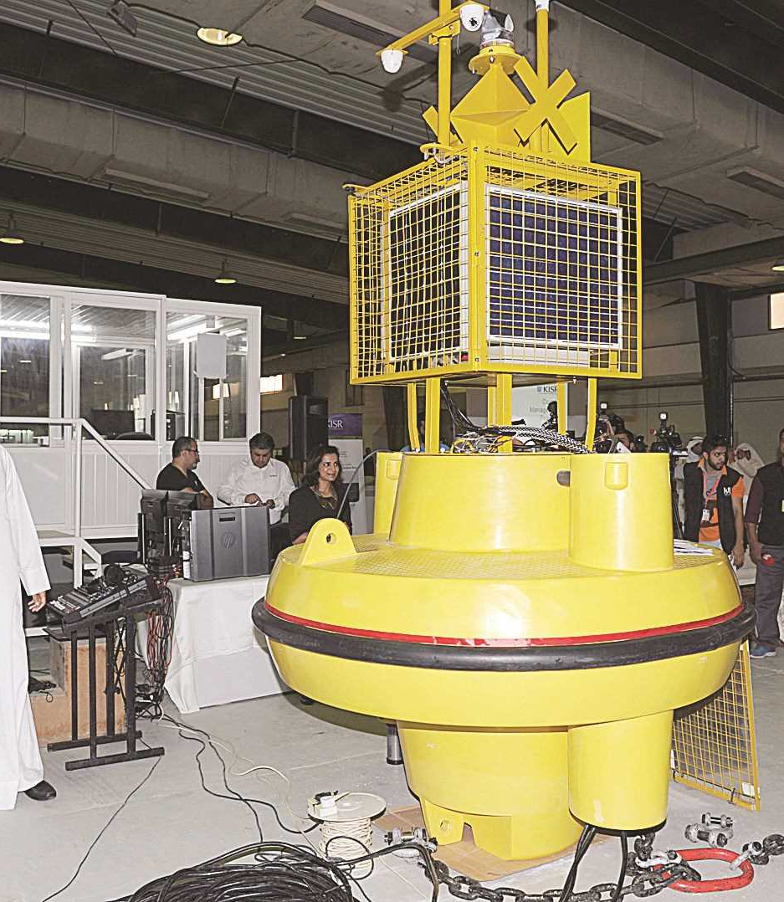
Kuwait Institute for Scientific Research
Smart marine buoy device: monitoring of various marine environmental parameters (Kuwait Bay)
Wave-Buoy (Fintas)

Slide 8
Future/Planned Buoy Program Kuwait Institute for Scientific Research (KISR)
In early 2023, KISR is planning to install a station to monitor sea level rise.
The system will be integrated with the Global Sea Level Observing System (GLOSS).
The main aim of the station is to support long-term climate change studies worldwide and provide necessary data in this aspect.

Slide 9
Future/Planned Buoy Program The Public Authority of Agriculture and Fisheries Resources (PAAFR)
A data monitoring buoy will be installed at Al-Khiran close to Fish Cages to monitor key environmental and weather data.

Slide 10
Main issues - Kuwait
Warnings:
Sarayat (March-May): a sudden change in the weather due to the passage of an atmospheric depression and high at high speed. Mixture of sandstorms and rainstorms, sometimes with hail. Sarayat period often causes material losses to businesses, shepherds of sheep and camels, and the suspension or cancellation of flights, and the suspension of schools is often done during this period due to danger and safety issues.
Dust Storms, Thunder Storms
Red Tides
Monitoring the increase in salinity due to Shatt Al-Arab reduced flow to the northern Gulf

Slide 11
Main Problems with Data Buoys
Buoy vandalism
Marine biofouling, affects quality of generated data; cleaning is needed every 7-10 days for Kuwait’s waters
Calibration issues
The maintenance budget, is not always available
Lack of needed manpower
Thank You

