Slide 1
CHILE
National Report
DBCP– 38, Hybrid meeting, Geneva, Switzerland, 1-4 November 2022
Juan Pablo Jorquera García
Hydrographic and Oceanographic Service of the Chilean Navy
56-32-2266684
jjorquera@shoa.cl

Slide 2
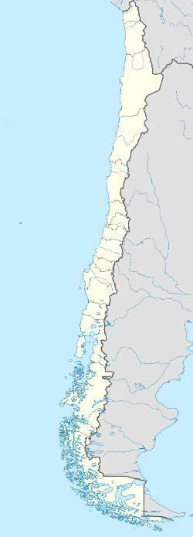
Network Buoy
Oceanographic and Meteorological Wave Program
TRIAXYS: 06 nautical miles SW of Iquique, Chile
WATCHKEEPER: 8 nautical miles N of Valparaíso, Chile
WATCHKEEPER: 10 nautical miles W of Talcahuano, Chile
TRIAXYS: 06 nautical miles E of Punta Arenas, Chile
WATCHKEEPER: 25 nautical miles NW of Chaitén, Chile
National Tsunami Warning System – DART buoy
DART II: 180 nautical miles W of Iquique, Chile
DART 4G: 93 nautical miles W of Antofagasta, Chile
DART II: 160 nautical miles W of Caldera, Chile
DART 4G: 121 nautical miles NW of Valparaíso, Chile
DART 4G: 120 nautical miles NW of Talcahuano, Chile

Slide 3
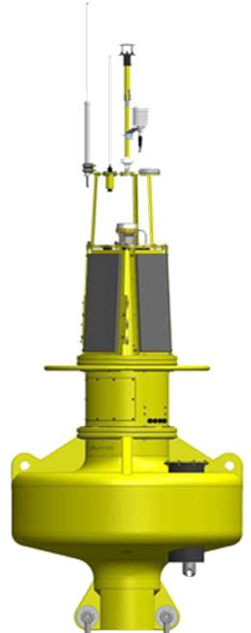
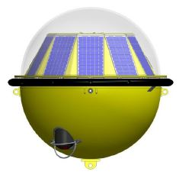
Oceanographic and Meteorological Wave Program
TRIAXYS
WatchKeeper
TRIAXYS Buoy: Wave and Water Surface Temperature.
WatchKeeper Buoy: Meteorological, Waves, Currents, Temperature, Conductivity, pH and Oxygen.

Slide 4
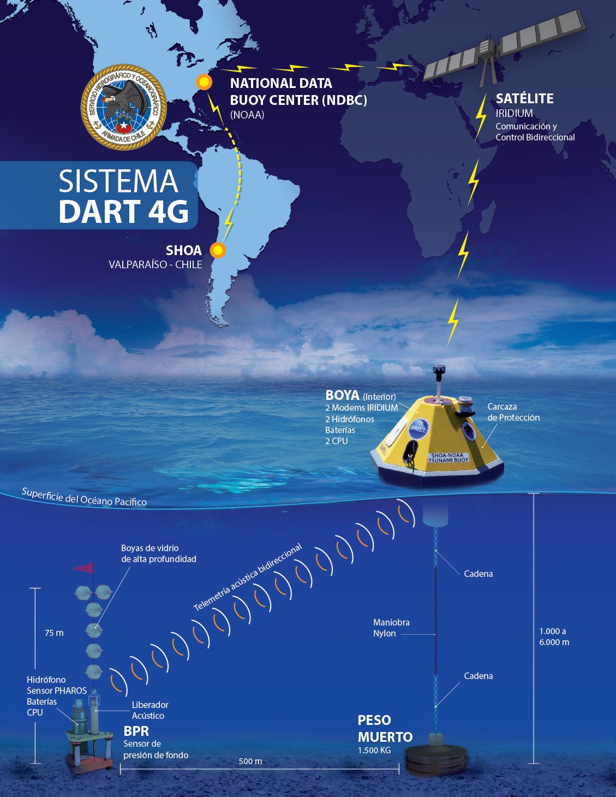
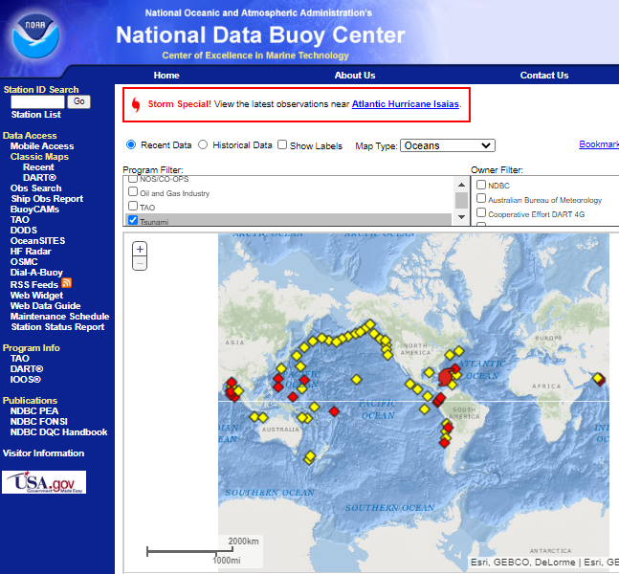
National Tsunami Warning System – DART buoy

Slide 5
Issues
Covid-19 Impacts:
Spare elements are reduced during 2022 for DART systems.
Reduction of data broadcasted by satellite telemetry for wave buoys.
New alternatives of rope:
Chilean local company was appointed for manufacturing mooring lines, reducing costs and shipping time. Actually a wave and tsunami buoy system is using it.

Slide 6
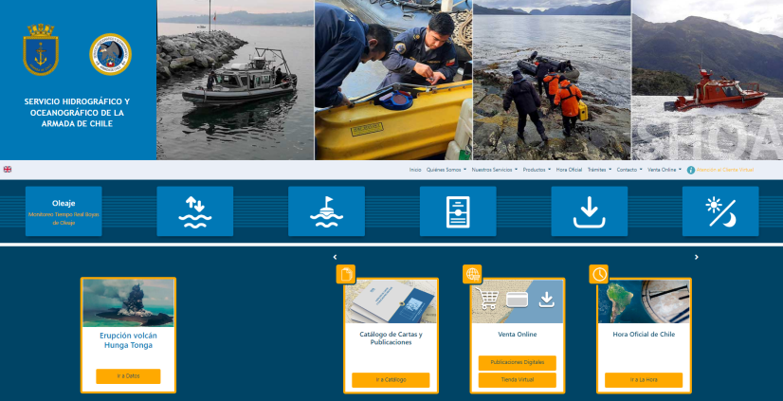
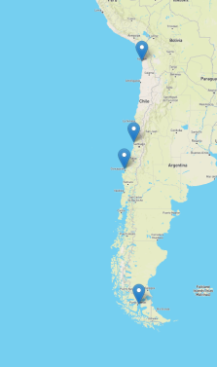
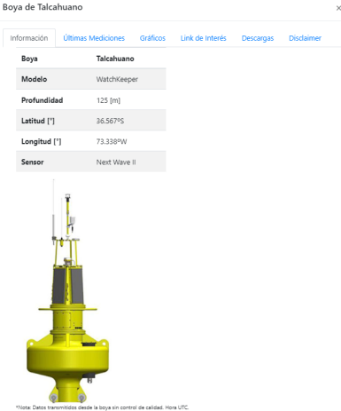
Social Benefits
• Public information of all our buoy (real time data):

Slide 7
Thank you!

