Slide 1
Barbados’ National Report on Planned Buoy(AutoNaut) Program
DBCP– 38, Hybrid meeting, Geneva, Switzerland, 1-4 November 2022
Mr. Jonathan Alleyne, Meteorologist
Barbados Meteorological Services
Jonathan.alleyne@barbados.gov.bb

Slide 2
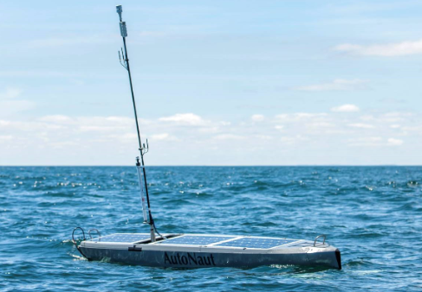
BMS AutoNaut Monitoring Area
AutoNauts will be deployed offshore just east of Barbados in the Atlantic Ocean
AutoNaut Monitoring Area

Slide 3
Implementation
Purpose: Advance BMS early warning systems and collect meteorological and oceanographic data for both climatological research and forecasting purposes.
Aim: By the beginning of the 2023 hurricane season BMS intends to have 4 AutoNauts monitoring conditions within the area bounded by latitude 10-14N, longitude 50-59W.
Monitoring Variables: Wind speed and direction, air temperature, humidity, barometric pressure, swell height and direction.

Slide 4
Highlights
Vessels are powered by renewable energy
Vessels are remotely controlled
BMS will progressively add to its fleet to improve data density across the monitoring area.

Slide 5
Highlights
BMS aims to work directly with Regional Specialized Meteorological Centres to place these vessels specifically within areas of interest dictated by the threat of hazardous circumstances or forecast conditions.

Slide 6
Key Issues and Risks
Vandalism
Theft
Fouling
Vessels max speed: 5 knots

Slide 7
Impacts/Benefits
Monitoring environmental conditions especially during hazardous weather with no risk to human life
Improved density of in-situ data over open water
Improved early warning systems
Forecast/model verification based on collected data
Collection of data for research and climatological purposes.

Slide 8
Needed Assistance / Advice
External funding would be a tremendous asset to the yearly maintenance and overall longevity of the project.
Guidance on the best strategies to sustain the project as well as provide an impactful product

Slide 9
Thank you!
Mr. Jonathan Alleyne
Barbados Meteorological Services

