Slide 1
PICT Regional exercise (on 9th November 2022 )
Following the recommendation of ICG/PTWS Steering Committee Meeting, a joint task team from WG-PICT officials and Task Team PacWave22 with the collaboration of PTWC and ITIC officers organized a Pacific islands Regional PacWave22 Exercise with the following objectives :
Test the Hunga Tonga Hunga Ha'apai (HTHH) PTWC Interim Procedures and PTWS Products (IOC Circular Letter 2902),
Test a trial regional communication and cooperation between PICT Member States, and the value of information sharing in facilitating national tsunami alert decision-making.
The PacWave22-PICT will consist of a 2 hours real-time table top exercise starting at 2300 UTC on 9 November 2022.
The exercise scenario will replay the HTHH tsunami sequence that occured on 15th January 2022 with PTWC-simulated products. During the exercise, PICT national stakeholders (National Tsunami Warning Centres and National Disaster Management Offices) will share event information through multiple informal communications modes, including by WhatsApp, mailing list, and/or HF Radio.
No live communication will be perform, pre-computed PTWC bulletin will be shared before the exercise with the guidelines.

Slide 2
PICT Regional exercise ( save the dates )
23rd September 2022 | Register form deadline
2nd November 2022, 23:00 UTC | PacWave22 PICT Regional Exercise informational webinar – Exercise Briefing
9th November 2022, 23:00 UTC | Start of the table-top real-time regional Exercise
16th November 2022, 23:00 UTC | Cold Wash / PICT Regional Exercise Debrief Session
21st December 2022 | Deadline: Member States to complete and submit Post-Exercise evaluation form
The online register form link will be share through the PICTs PacWave22 regional exercise circular letter , and it will be also available through its dedicated web-page reachable from http://www.pacwave.info website.

Slide 3
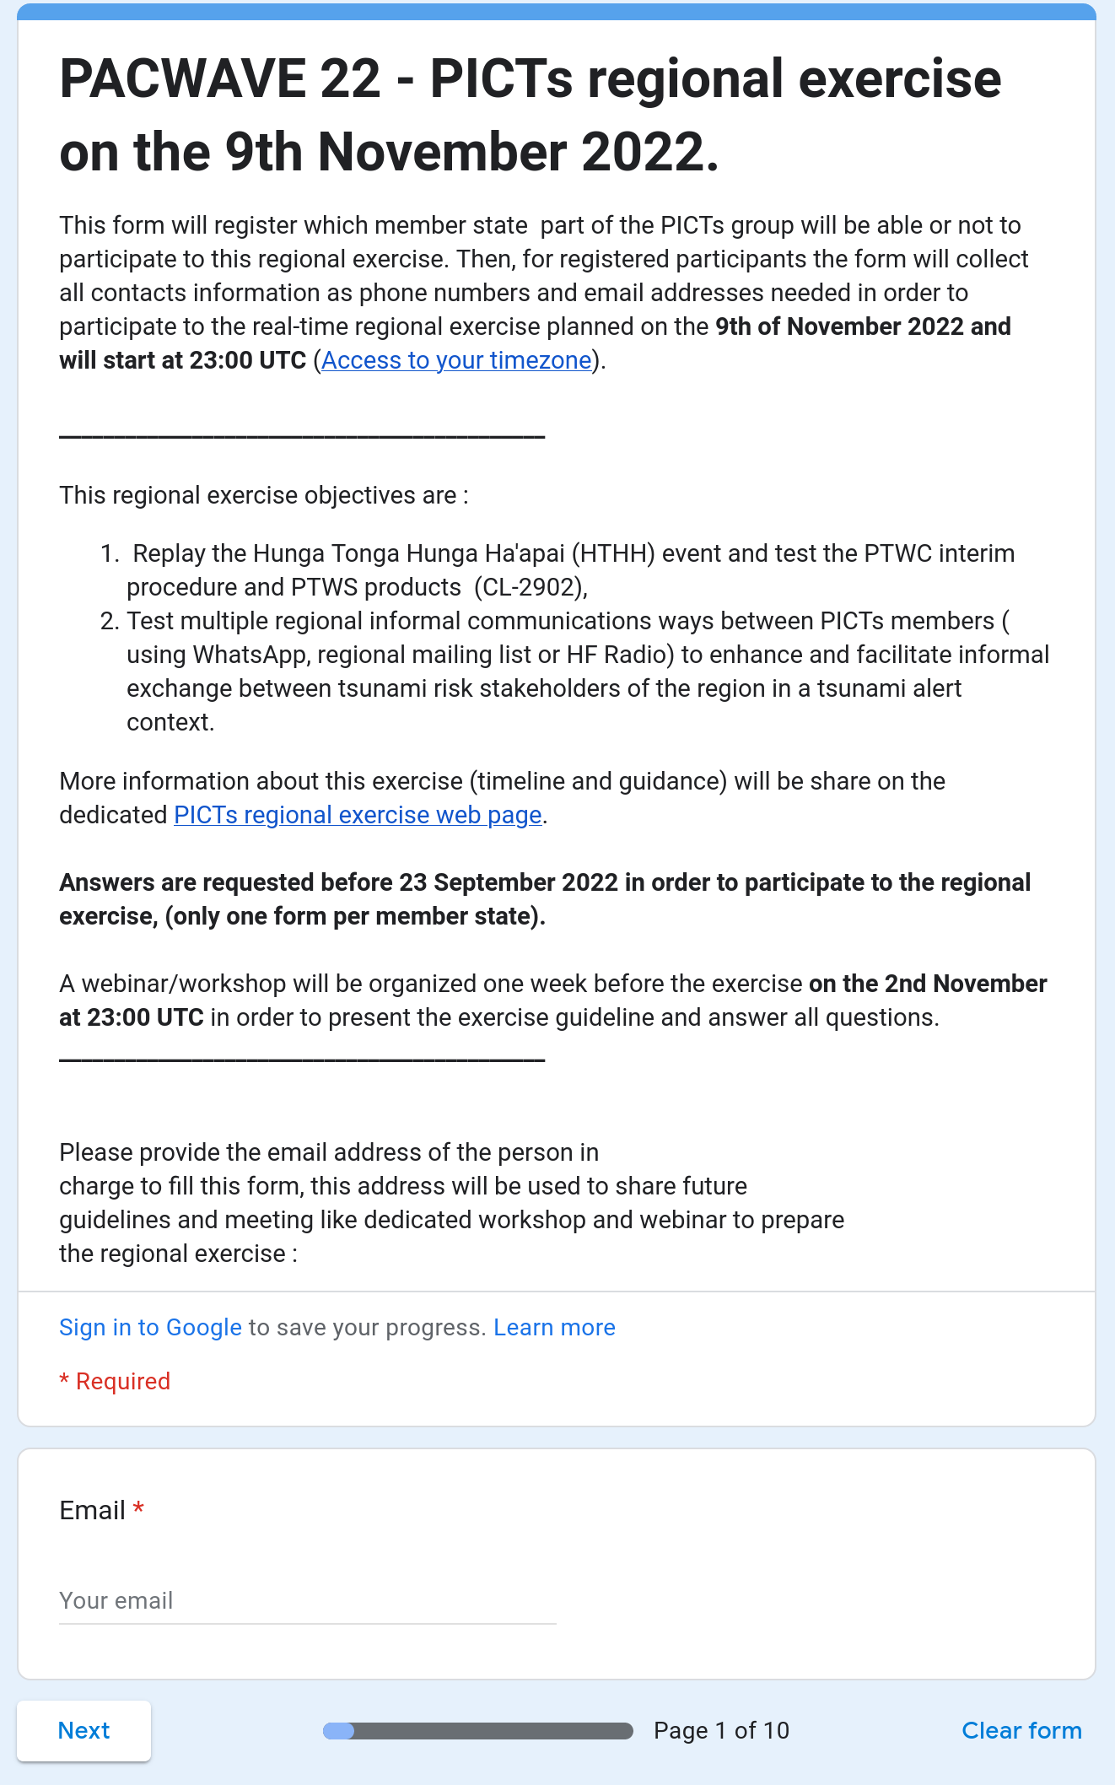
PICT Regional exercise ( online register form)
Note: Only ONE (1) on-line evaluation form is to be completed per member state.
It is recommended that the PacWave22 National Contact, Tsunami National Contact (TNC) and Tsunami Warning Focal Point (TWFP) should compile responses before submitting one common registration form.

Slide 4
PICT Regional exercise ( online register form)
Note: Only ONE (1) on-line evaluation form is to be completed per member state.
It is recommended that the PacWave22 National Contact, Tsunami National Contact (TNC) and Tsunami Warning Focal Point (TWFP) should compile responses before submitting one common registration form.
Optional : will use your gmail account if your are login to save during filling up the form. Just disconnect your from your gmail account into your navigator to avoid this. This address won’t be collected.

Slide 5
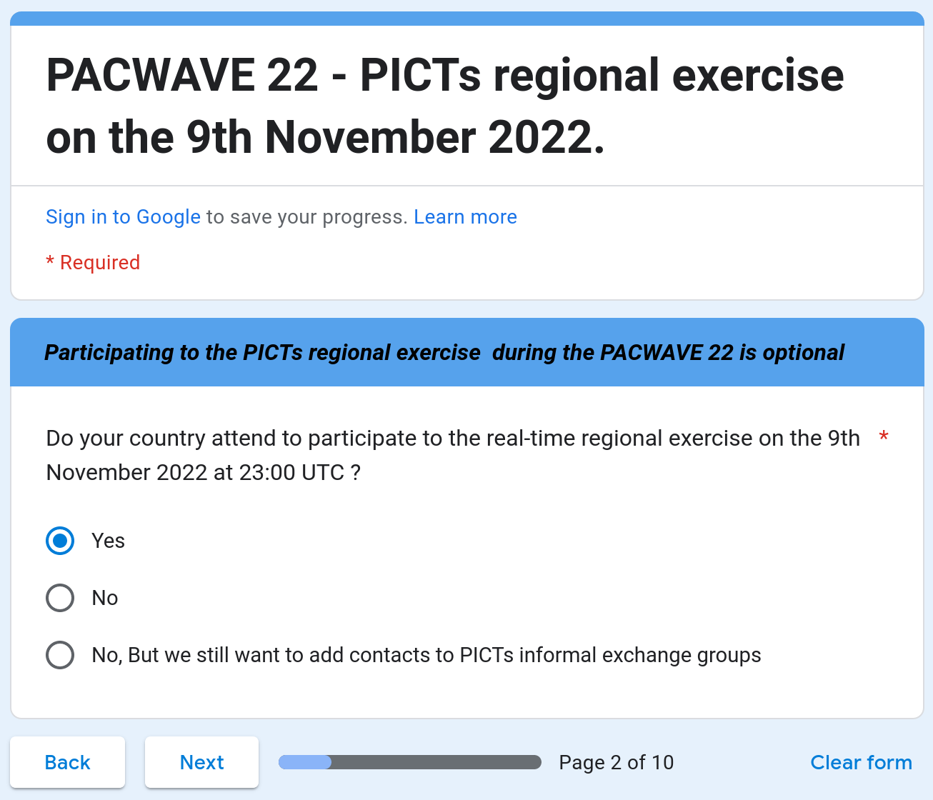
PICT Regional exercise ( online register form)
Participation ?
Yes = Active participation during the 2 hours dedicated to the exercise
No = end of the form
No, But … = cannot be fully available but would to be an observer

Slide 6
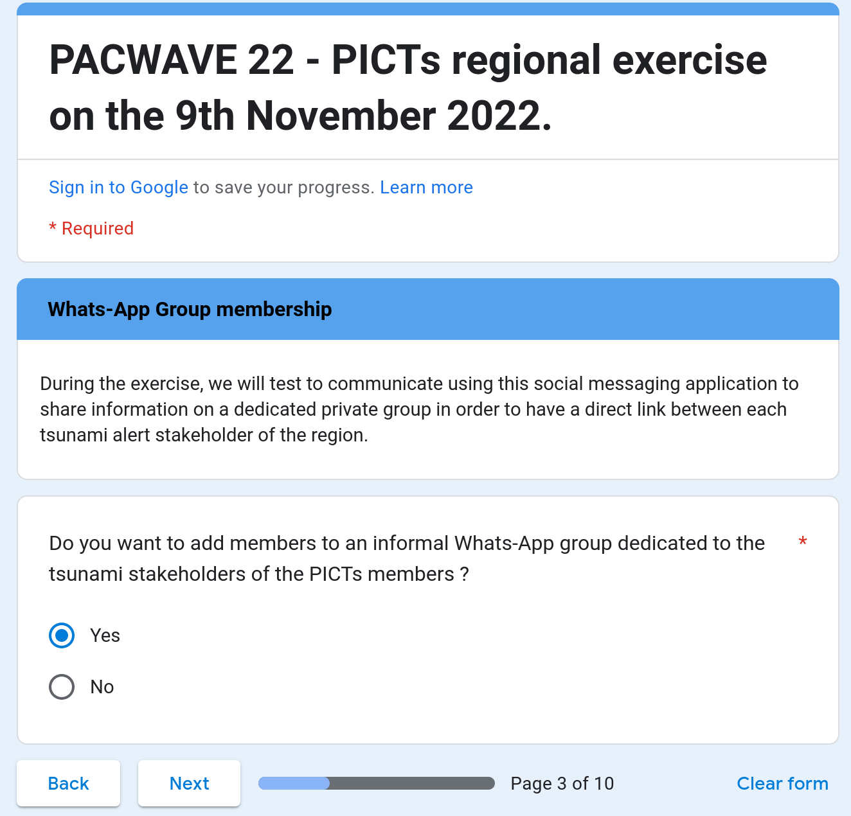
PICT Regional exercise ( online register form)
Be part of the WhastApp Group ?
Yes = next section
No = end of the form

Slide 7
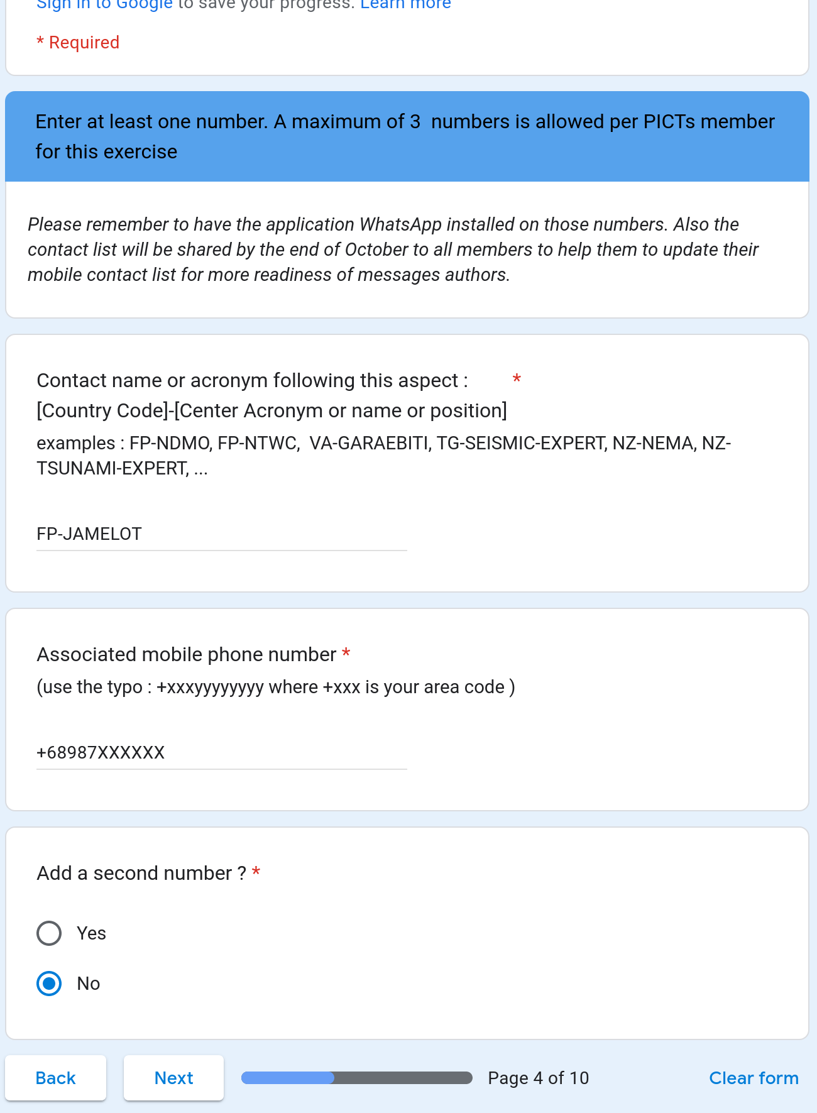
PICT Regional exercise ( online register form)
Be part of the WhatsApp Group ?
We allow only 3 mobile numbers per member
Please try to use duty mobile phone than personal if possible.

Slide 8
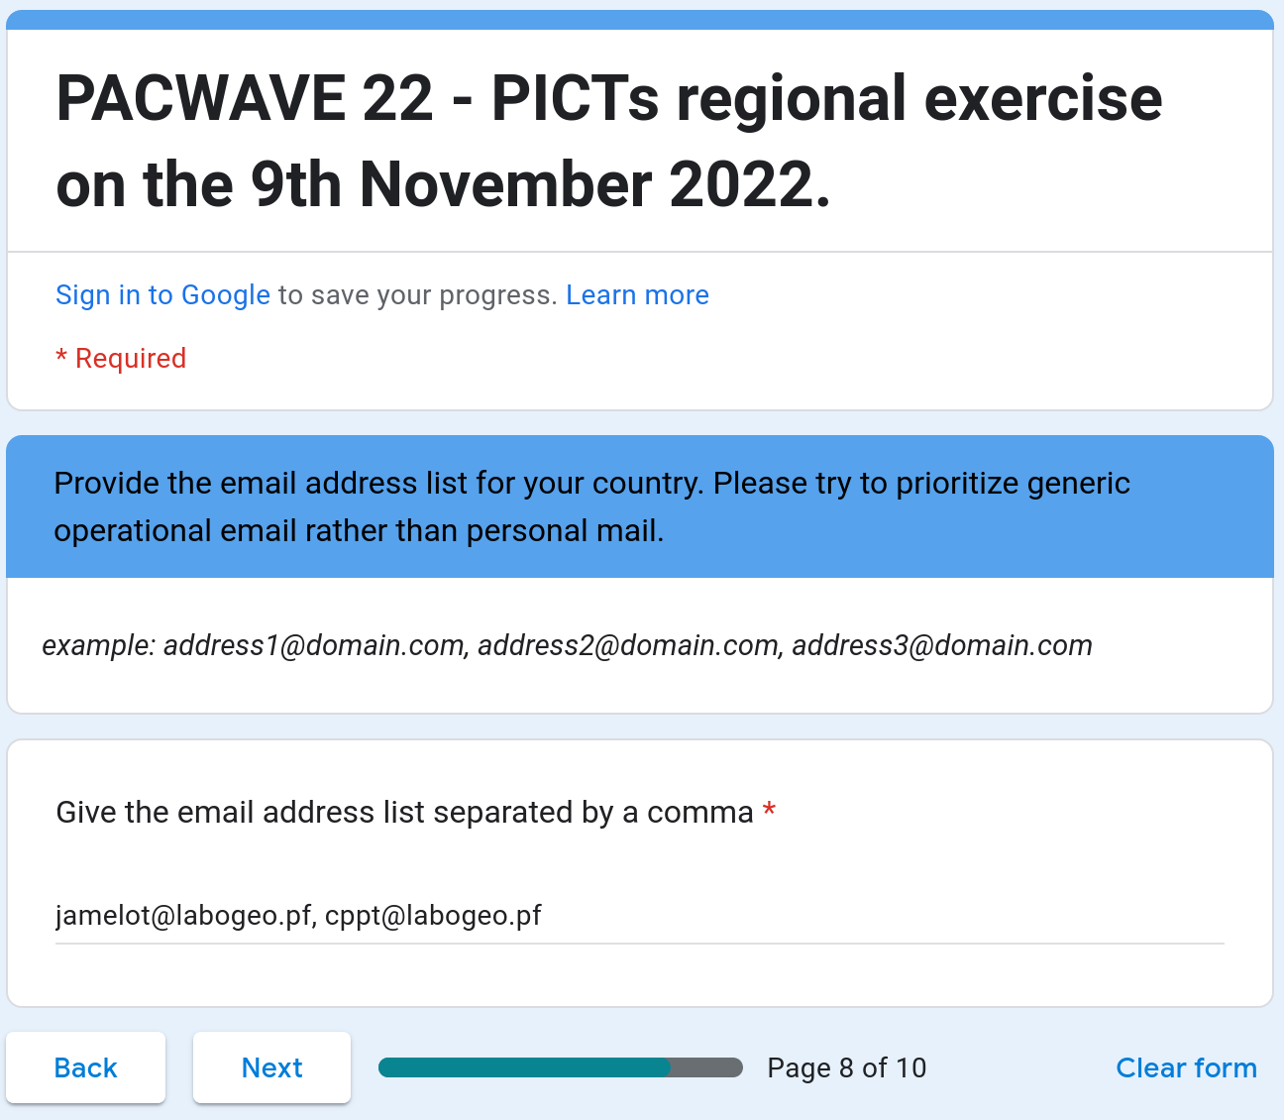
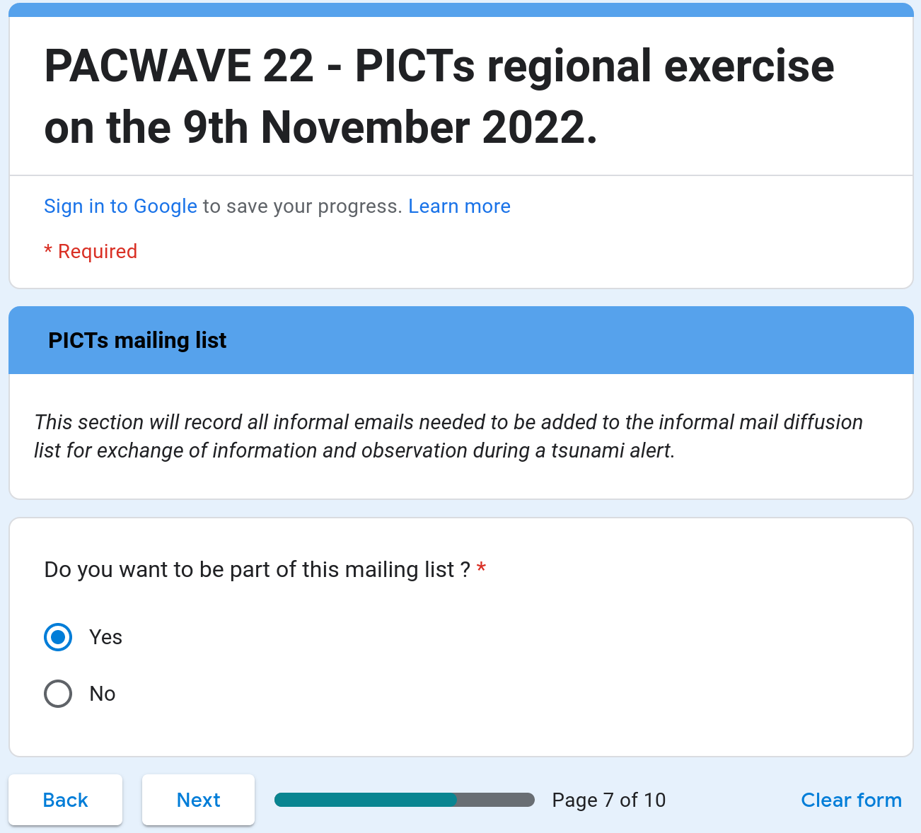
PICT Regional exercise ( online register form)
Be part of the dedicated mailing list ? that will be provide by ITIC.
No limitation

Slide 9
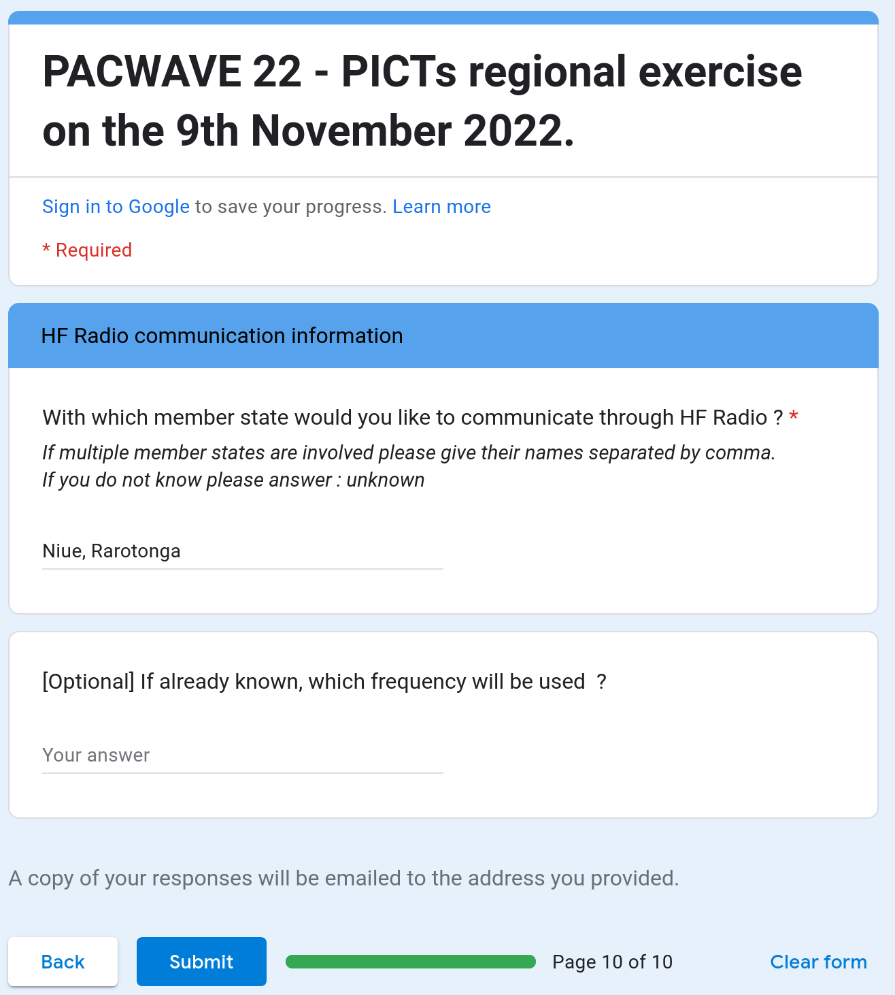
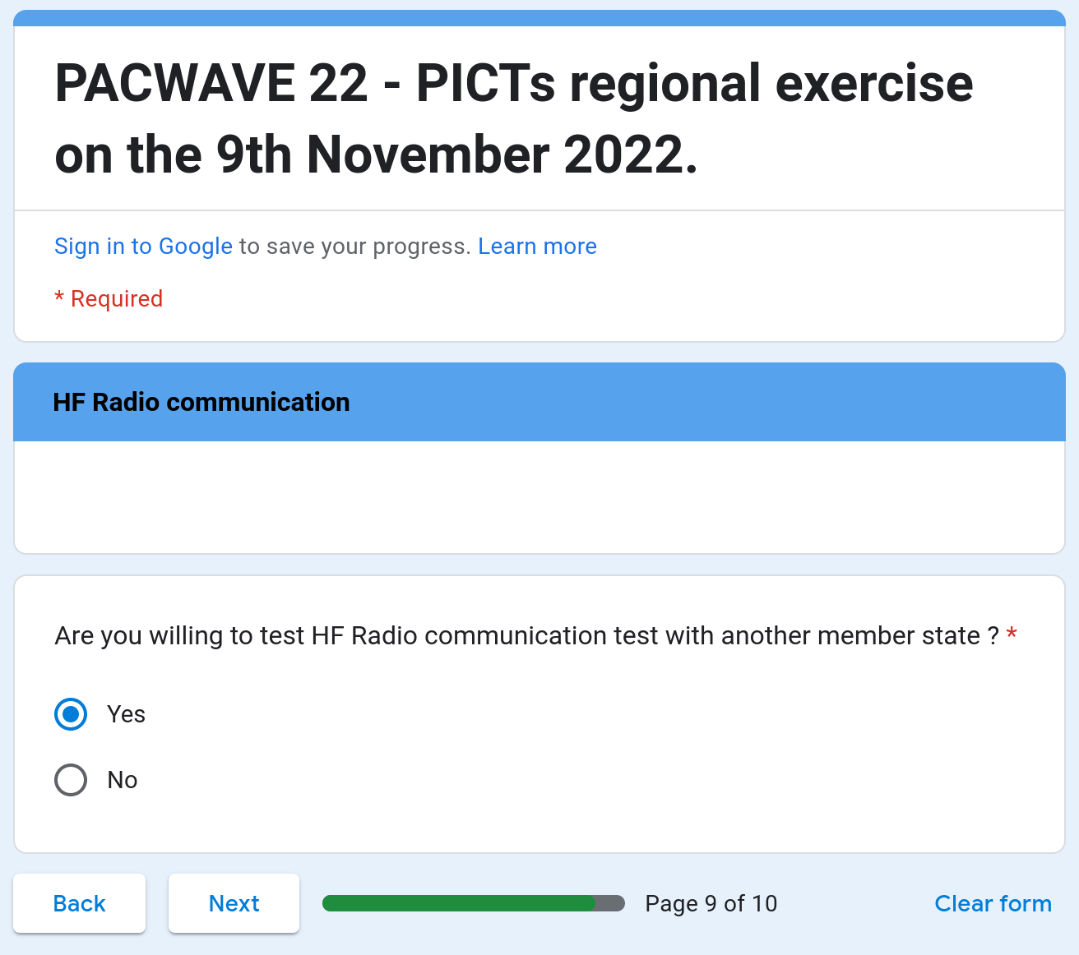
PICT Regional exercise ( online register form)

Slide 10
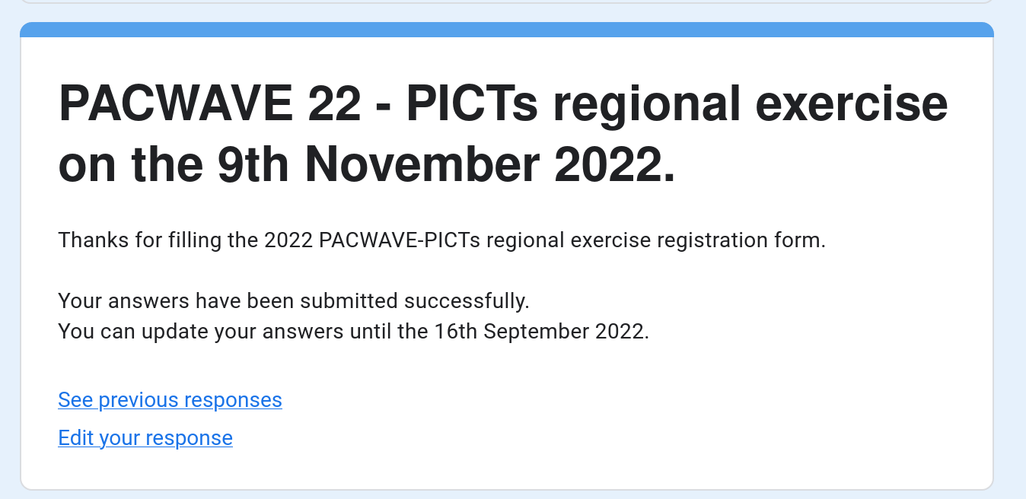
PICT Regional exercise ( online register form)
23

Slide 11
PICT Regional exercise ( save the dates )
23rd September 2022 | Register form Deadline
2nd November 2022, 23:00 UTC | PacWave22 PICT Regional Exercise informational webinar – Exercise Briefing
9th November 2022, 23:00 UTC | Start of the table-top real-time regional Exercise
16th November 2022, 23:00 UTC | Cold Wash / PICT Regional Exercise Debrief Session
21st December 2022 | Deadline: Member States to complete and submit Post-Exercise evaluation form
The online register form link will be share through the PacWave22-PICT regional exercise circular letter , and it will be also available through its dedicated web-page reachable from http://www.pacwave.info website.

