Slide 1
Solomon Islands National Report
DBCP– 38, Hybrid meeting, Geneva, Switzerland, 1-4 November 2022
Presenter: Max Norman Sitai
Principal Climate Officer(Climate Section)
Solomon Islands Meteorological Service
PO Box 21, Honiara, Solomon Islands

Slide 2
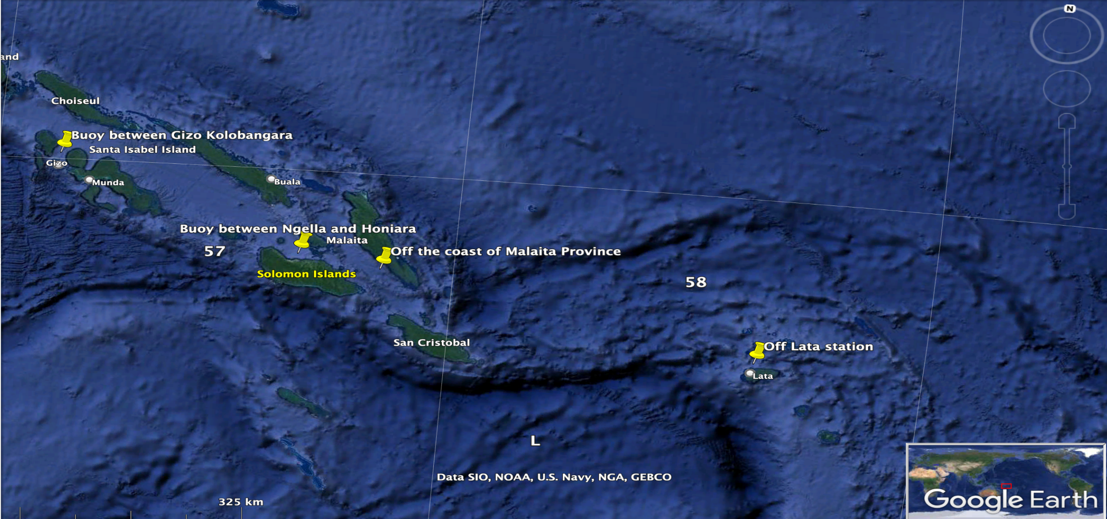
Ocean observation network
At present – 3 tide gauges installed
Glider deployed around western province waters
Proposed Buoy deployment positions

Slide 3
Ocean observation network
Purpose of program:
Observation
Operations
Forecasting
Research

Slide 4
Key successes / highlights
Highlights:
New Funding – Accepted proposal for buoy deployment.
Deployment – Coordinated by SI Met Service with support from DBCP and SPC

Slide 5
Key issues and Risks
Key issues:
Logistics – might take sometime before deployment.
Training – Need to be trained to look after the instruments
Awareness – Inform public to look after and respect the instrument.
Risks:
Avoid vandalism

Slide 6
Social Benefits
Improve ocean weather forecasting
Helps in Scientific research
Data Storage and dissemination
Contribute to ocean observation network

Slide 7
DBCP assistance / advice
Request ocean experts from DBCP to assist with deployment of Buoy.
Provide training and technical advice from DBCP
Help with ocean network capabilities and data storage
Continues support for future developments

Slide 8
Thank you!

