Slide 1

India National Report
DBCP– 38, Hybrid meeting, Geneva, Switzerland, 1-4 November 2022
Dr TATA SUDHAKAR
Scientist G & Head OOS
NIOT - India

Slide 2
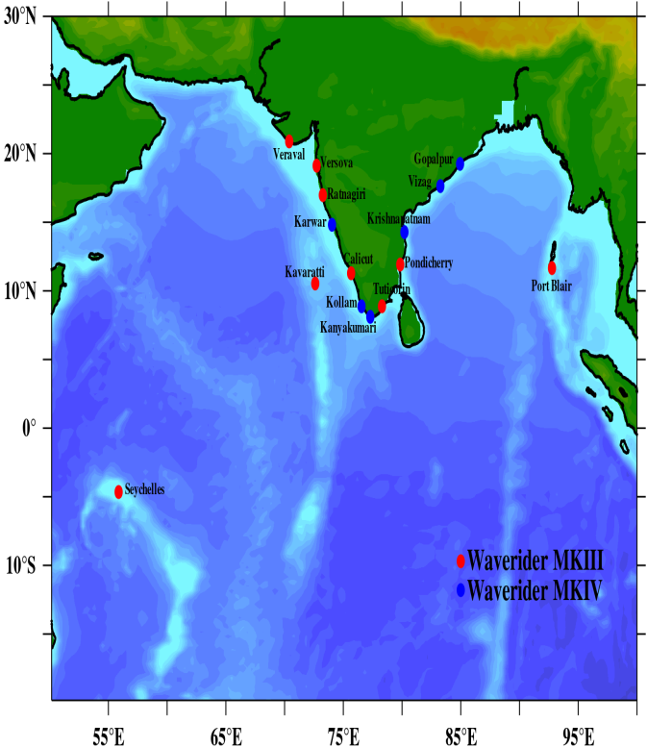
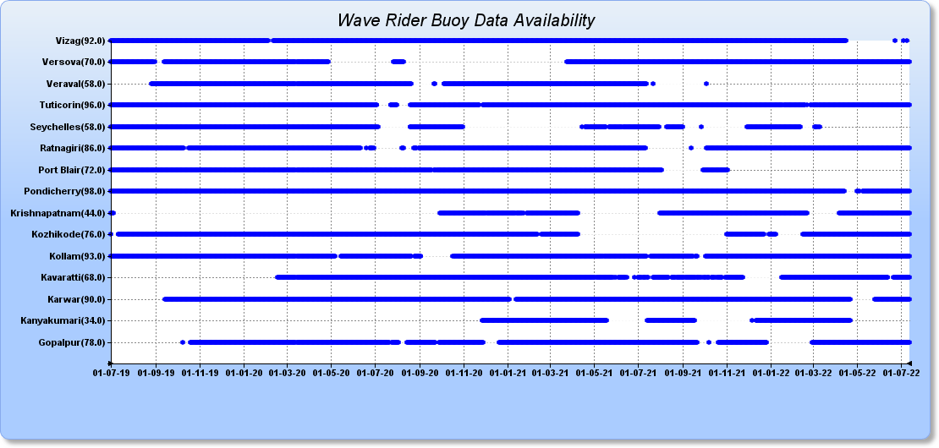
Wave Rider Buoy Network
The network of 16 wave rider buoys (WRB) was maintained in collaboration with various research and academic institutes
New collaborators were identified for continuation of the project and project sanctions were released
Upgradation of old WRBs with solar panel is in progress
Transportation and logistics arrangement for maintenance of WRB got suffered–Major impact of Covid
The wave rider buoy off Gopalpur was stolen by fishermen and successfully retrieved on 05.12.2021
Commissioned | 16
Operational | 11
Drifted | 08
Under repair | 15
Redeployment | 07
Vandalism (01.12.2021) | 01

Slide 3
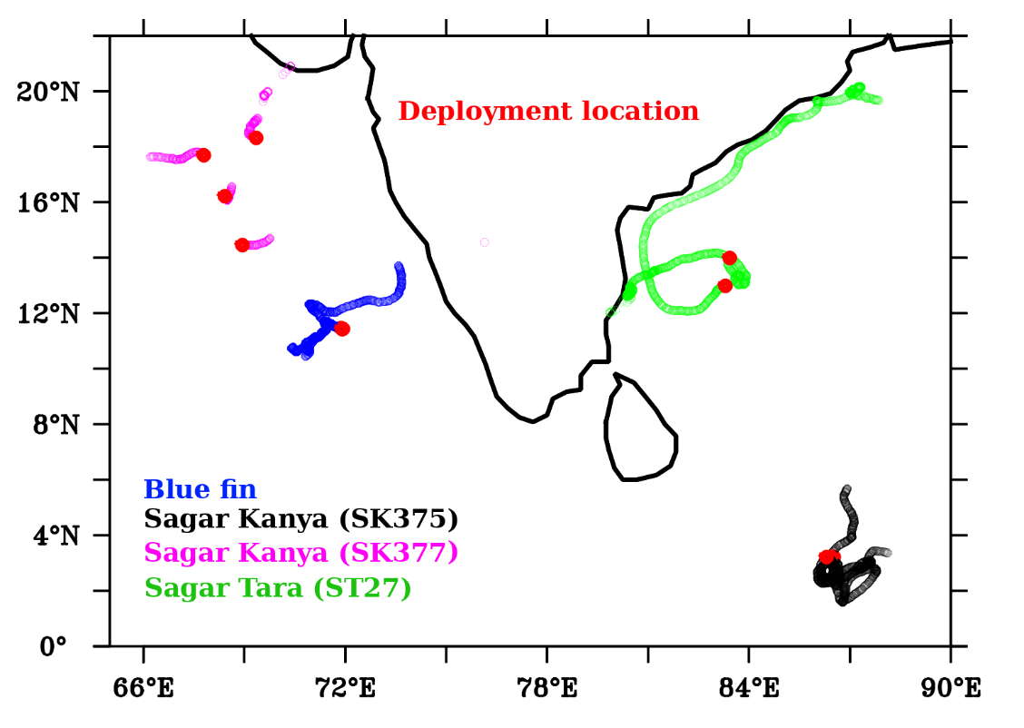
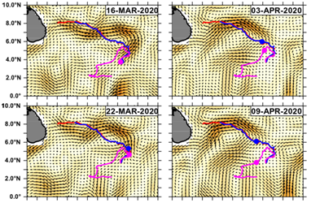
Satellite Tracked Surface Drifters (SVP)
Vessel | Period | Deployed | Area
ORV Sagar Kanya | 17 Jan-17 Feb, 2022 | 3 | Southern BoB
ORV Sagar Kanya | 5 Mar 2022 onwards | 6 | NEAS
CRV Sagar Tara | 4-15 Feb 2022 | 3 | SW BoB
MV Blue Fin | 14-15 Feb, 2022 | 3 | EAS
Procured 30 Nos of drifters from in 2021-22.
Deployed 15 drifters in North Indian Ocean.
Evaluated data from indigenous satellite-tracked (INSAT) drifter.
It is planned to procure 20 drifters during 2022-23 period

Slide 4
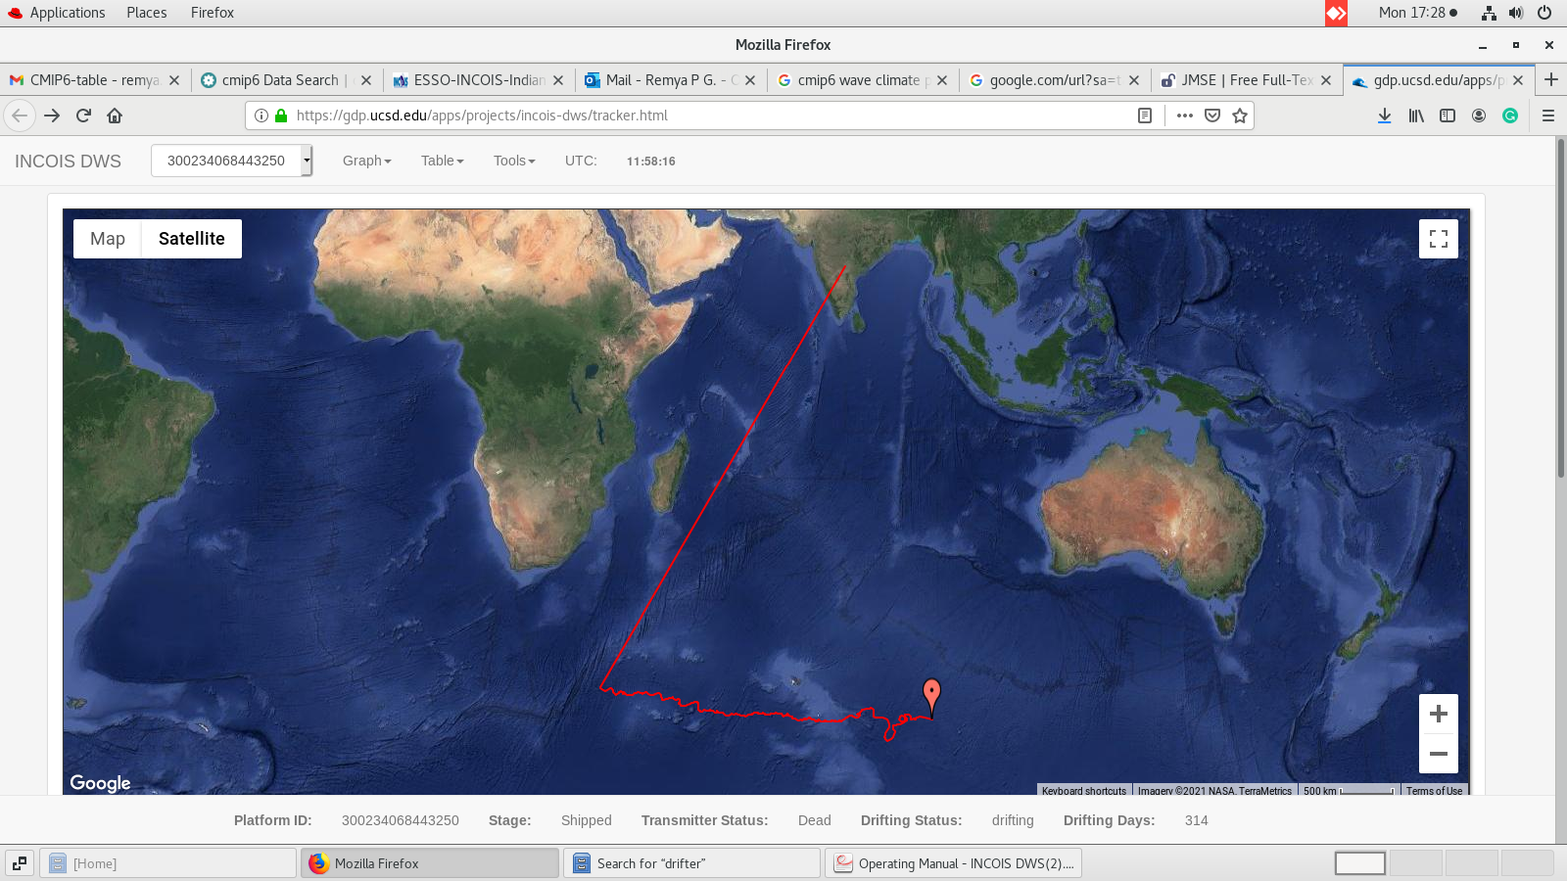
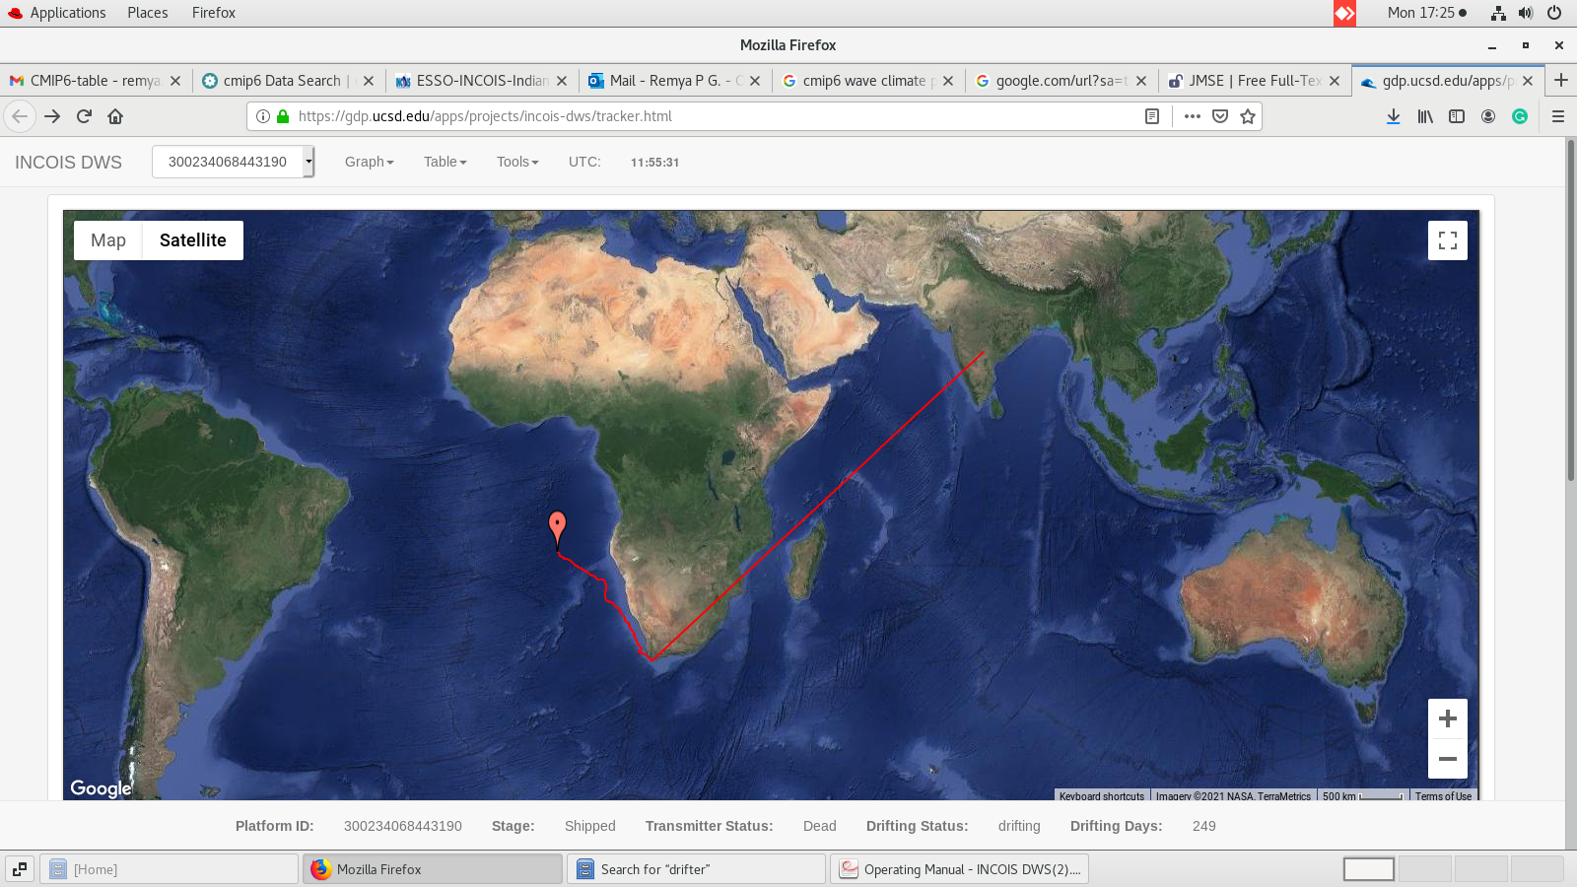
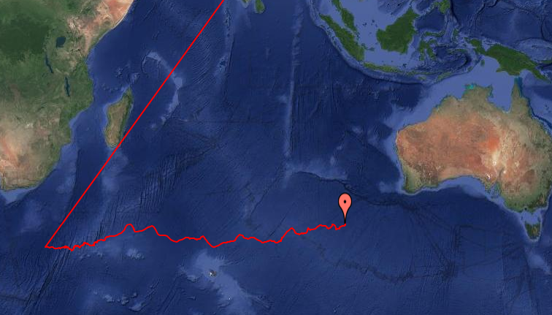


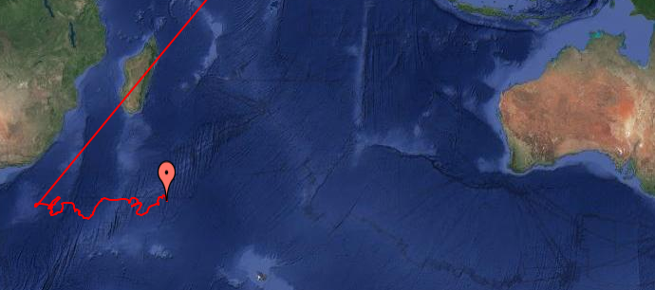

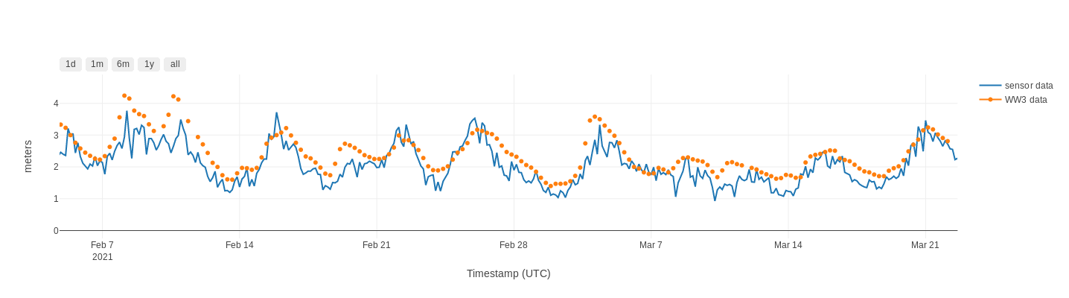
Satellite Tracked Wave Drifters
Four wave drifters were deployed in the Indian Ocean sector of Southern Ocean in 2021 and three of them were in the major swell generation areas of IO
Procurement of 30 wave drifters for 2022-23 period is underway
There is a lack of in situ wave observations in the Southern Ocean for wave parameter validation
Deployment locations
Wave parameters from the drifters were used extensively to validate the simulated data from operational WaveWatch III set up for the Indian Ocean

Slide 5
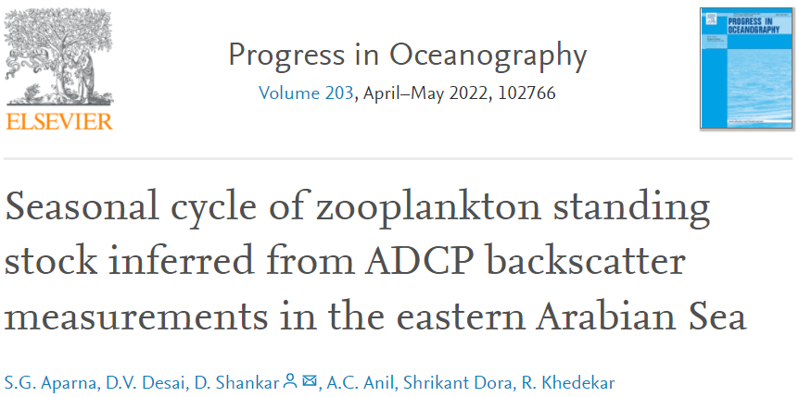
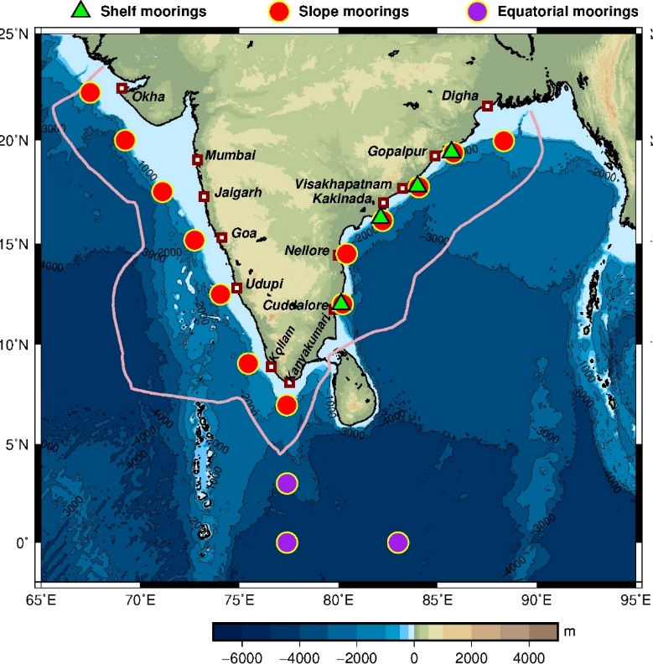
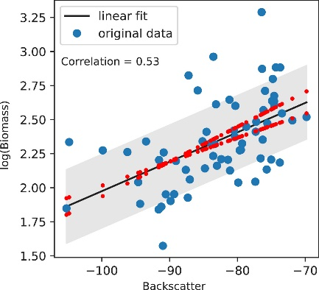
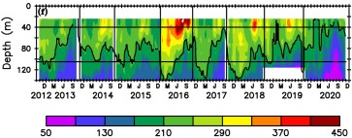
Equatorial and coastal current meter array
Network is maintained in collaboration with NIO
Time series of zooplankton biomass (mg m⁻³) during October 2012 to December 2020
Biomass decreases with depth till thermocline, but this trend is weaker in the SEAS.
Standing stock in NEAS and CEAS is maximum during winter and minimum during summer monsoon.
The seasonal variation of standing stock is weaker in the southeastern Arabian Sea.
This variation of standing stock is in contrast to that of satellite-derived chl-a.
17 coastal ADCP and 3 equatorial current meter is active.
One cruise was carried out to service moorings in the west coast and one cruise to service three moorings in the EIO.

Slide 6

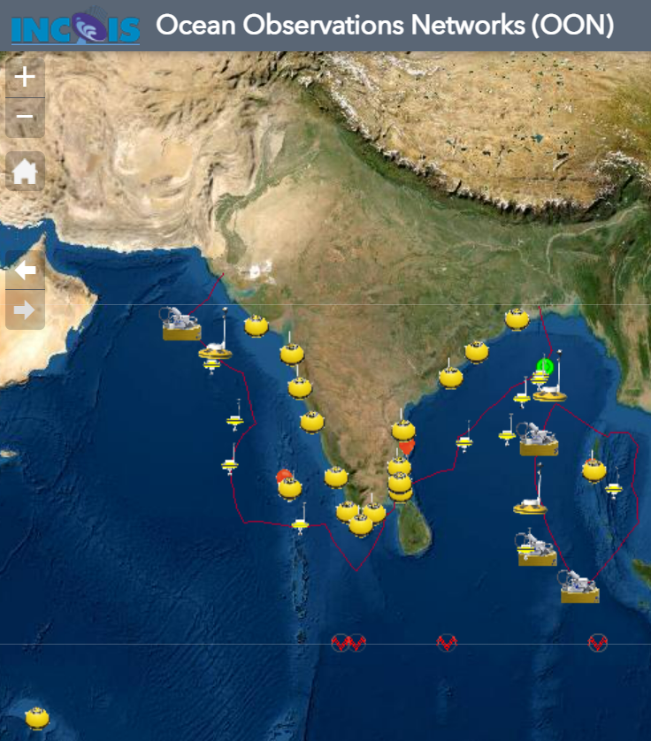
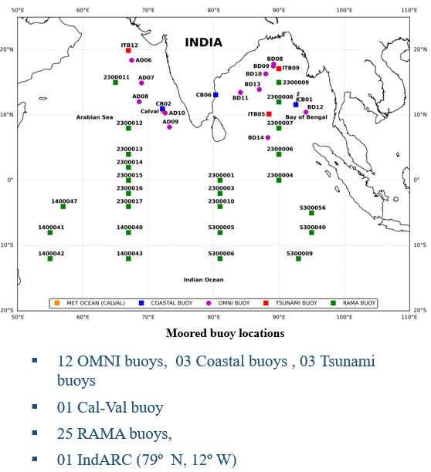
Buoy network in NIOT
NIOT supporting to NOAA –PMEL for sustain the RAMA buoy network

Slide 7
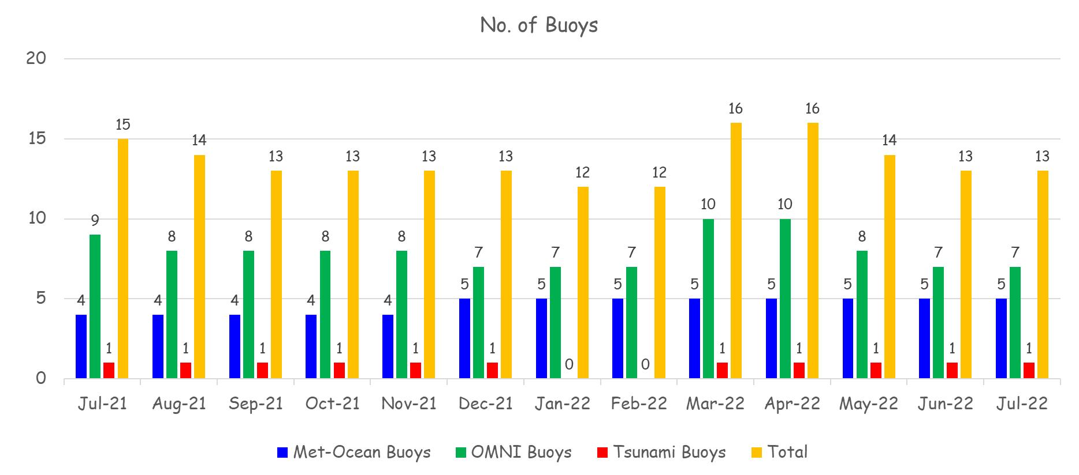
Moored Buoy
Metadata updated on OCEANOPS
BUFR format for Moored buoy tested
Indigenously developed Indian Bottom Pressure Recorder deployed at depth of 1000 m
Joint OMNI-RAMA Indian Ocean Data Portal was launched https://incois.gov.in/portal/datainfo/buoys.jsp
3 Tsunami buoy and one OMNI buoy serviced during Sep 2022
Subsurface Tsunami buoy is being tested
Two OMNI vandalized and retrieved successfully with help of Indian Coast Guard.

Slide 8
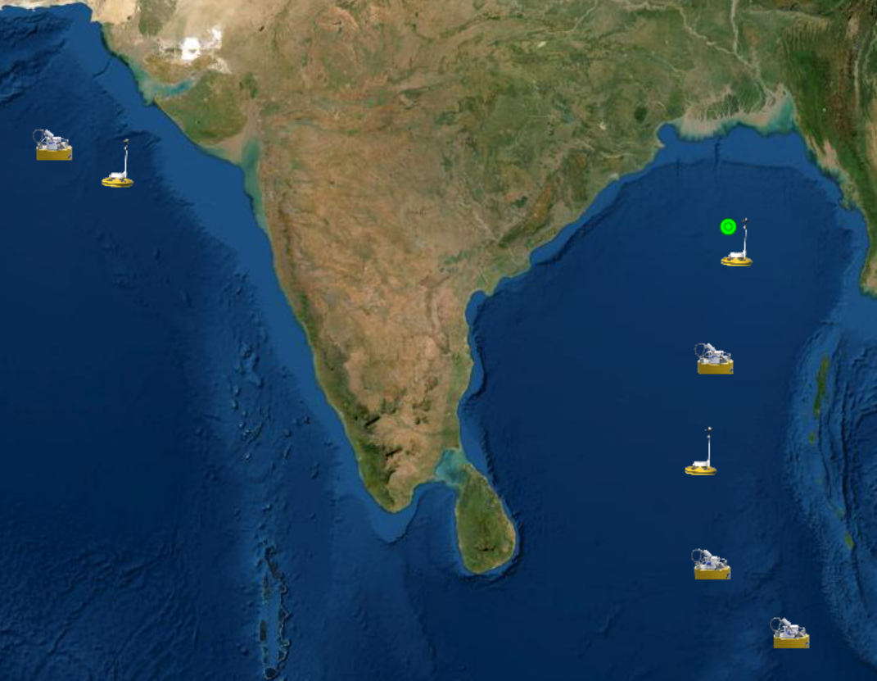
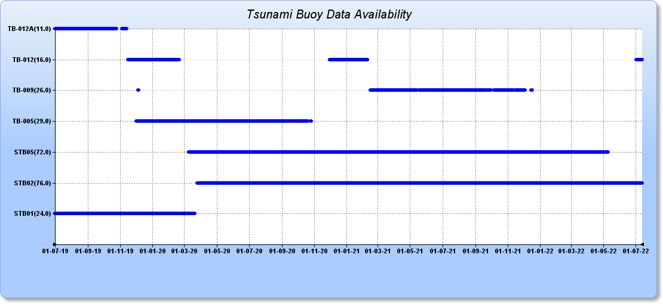
Tsunami buoys with BPR
Real-time Network of 7 tsunami buoys in the Indian Ocean
Out of the total 7 stations, 4 occupied (STB01, STB02, STB03 & STB05) by SAIC Tsunami Buoys (STBs) by INCOIS and the remaining 3 stations (ITB05, ITB09 & ITB12) by NIOT Buoys
Shares data from 7 Indian stations to NDBC-NOAA
Due to the COVID-19 pandemic situation and other administrative grounds, the planned Tsunami Buoys were unable to be serviced during reporting period.
The commercial purchase agreement was signed between INCOIS & SAIC for the scheduled maintenance service of STB01 & STB05 (Bay of Bengal) and STB02 (Arabian Sea) in March/April 2023.
Attempt made to deploy ITBs in the Bay of Bengal/Arabian Sea
STB02
ITB12
ITB09
STB05
ITB05
STB01
STB03

Slide 9
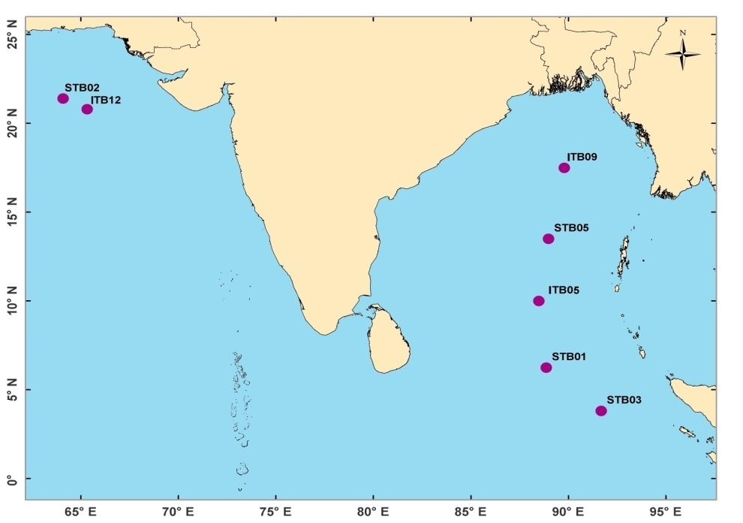
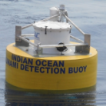
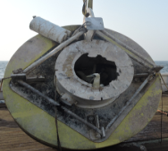
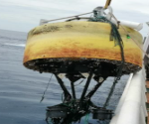

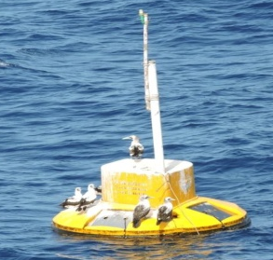
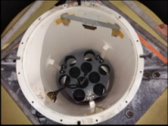
Tsunami buoys Vandalism issues
STB03 system vandalized two times (Aug 2016 it was lost full Surface buoy and May 2019 lost surface’s buoy payload and electronic items)
STB01 vandalized in Mar 2020 (small damage)
STB04 vandalized in Oct 2018 and recovered by Indian Navy
STB02 system vandalized three times (During 2013 & 2018 communication cables were cut and in 2016 lost surface buoy payload and electronic items.
ITB12 system deployed during December 2011 in AS, since the surface buoy was vandalized 8 times, out of buoy lost 3 times, i.e. Dec 2017, Jun 2018 and Jan 2019
Northern Arabian Sea buoys are facing frequent Vandalism and it is difficult to sustain the buoy network in this region.
STB02 Surface buoy damaged in 2016 and Communication cables were cut in 2013 & 2018
STB04 surface buoy was drifted and recovered by Indian Navy in 2018
STB01 surface buoy vandalism in 2020
1. Surface Buoy was lost in 2016
2. All electronics items were lost in Surface Buoy in 2019
ITB12 vandalized 8 times and buoy lost 3 times

Slide 10
Thank you!

