Slide 1
Colombian Oceanographic and Marine Meteorological Network
RedMpomm Red de Medición de Parámetros Oceanográficos y de Meteorología Marina REDMPOMM

Slide 2
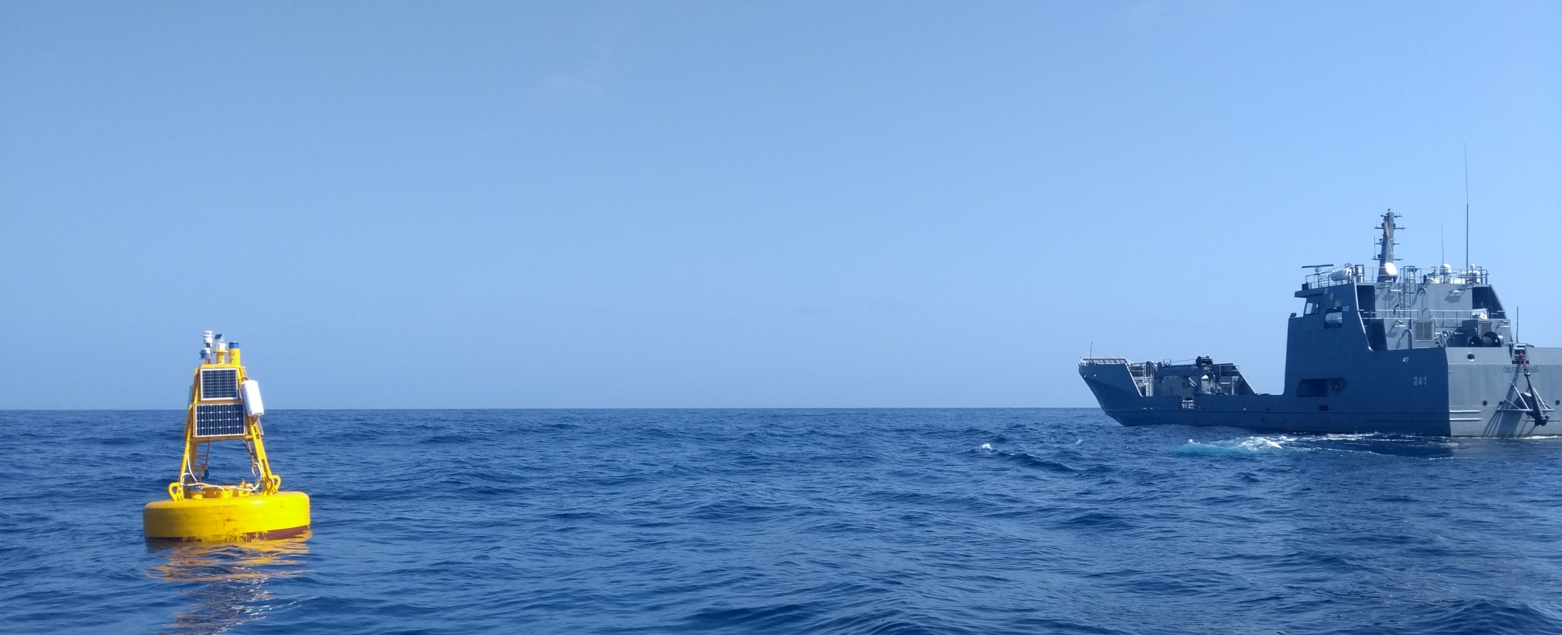
Red de Medición de parámetros Oceanográficos y de meteorología marina RedMpomm
Is a network that allows for real-time meteo-marine data from the Colombian Caribbean and Pacific Seas.
This monitoring network allows the observation of real-time data related to oceanic and atmospheric conditions of the "Colombian maritime territory", in order to provide information necessary to guarantee and safeguard human life in the various maritime and coastal activities carried out in the country.
It is interconnected with weather stations, directional wave buoys and Metereo-oceanic buoys located in different national maritime points near major ports and coastal cities,
Which record data such as speed and direction of wind, temperature, relative humidity, atmospheric pressure, Sun radiation and sea state: direction and speed of currents up to 50 meters; period, height and wave direction, sea surface temperature, surface salinity
DIMAR - RedMpomm is a network created for safety and maritime security, monitoring tsunami and Marine Meteorological events
General Maritime Directorate - Dimar is responsible for operating and maintaining the Sea Level data

Slide 3
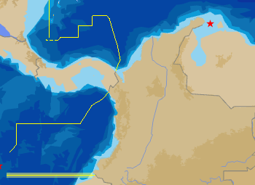
Ubication And Data Transmission Station tide Gauge
Providencia
P. Bolívar
P. Estrella
Data Transmission
Systems
Principal: GPRS / Movil
Secondary: Satelital GOES, BGAN Inmarsat
Protocol
HTTP - Remote management
FTP
remote areas- does not have good mobile coverage
San Andres
P. Espada
Ballenas
Barranquilla
P. Brisa
Santa Marta
Cartagena
I. Naval
Coveñas
Sapzurro
I. Fuerte
Turbo
B. Solano
Malpelo
Juanchaco
B. Málaga
Buenaventura
Tumaco
Candelilla

Slide 4
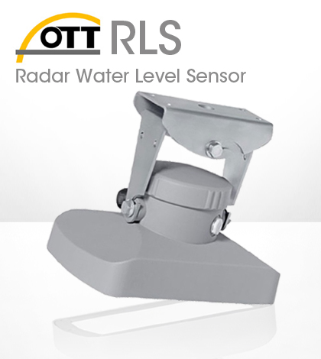
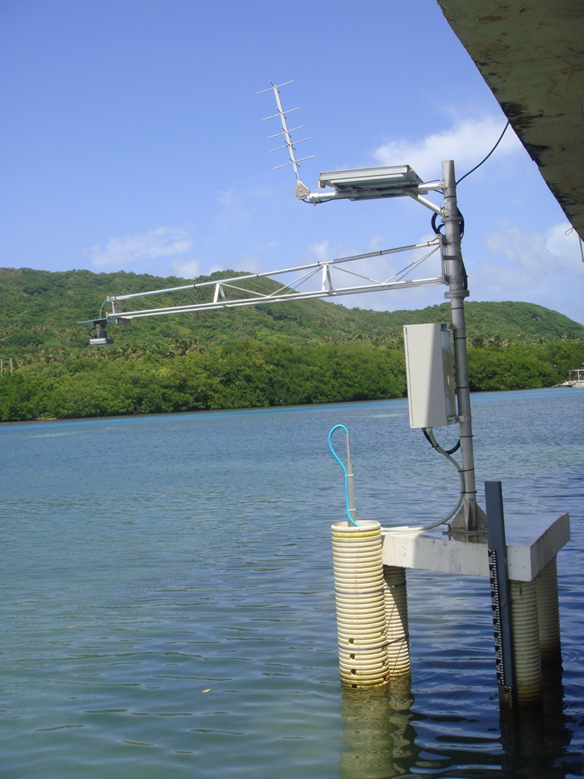
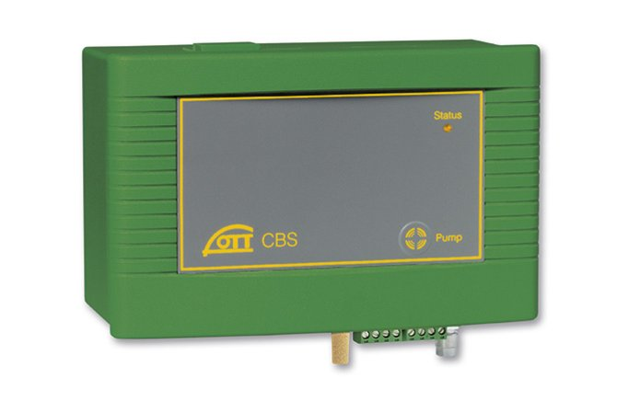
Configuration a sensors
Sensors
Datalogger: OTT NetDL1000
Principal sensor
Radar level sensor (RLS -OTT Hydromet)
Secondary Sensor
bubbler sensor for surface water level monitoring (CBS-OTT Hydromet)
Measurement unit: Meters
Transmission Format: OTT Binary, *.mis
Antenna GOES/GPRS/BGAN
Solar panel
Radar sensor
Datalogger
Batt
Bubbler
Sensor
*Pressure sensors not conditioned for local area

Slide 5
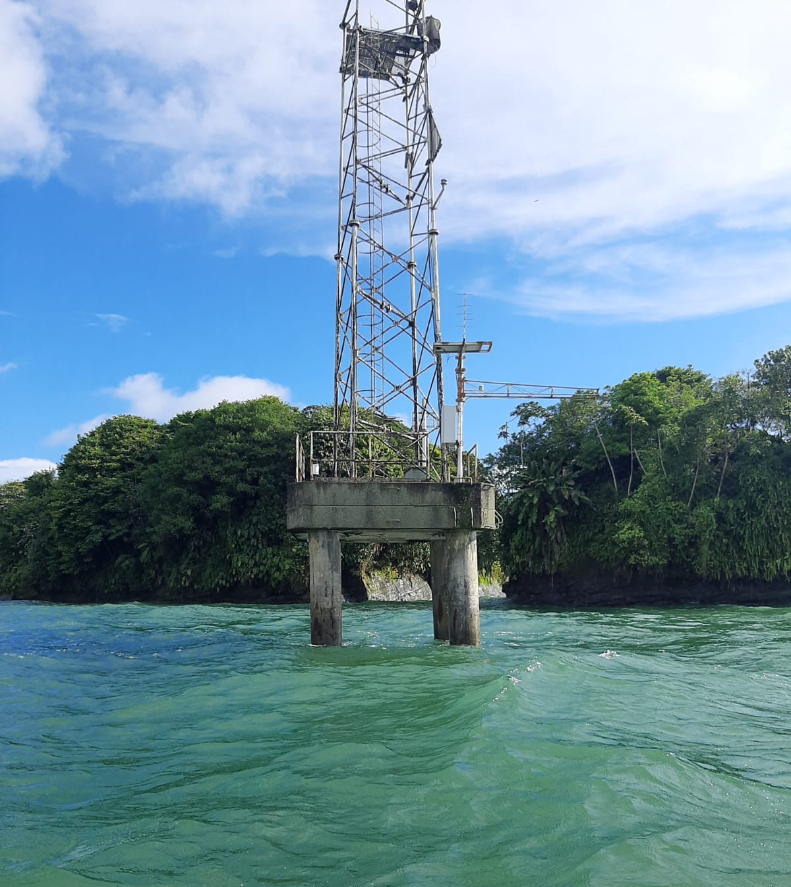
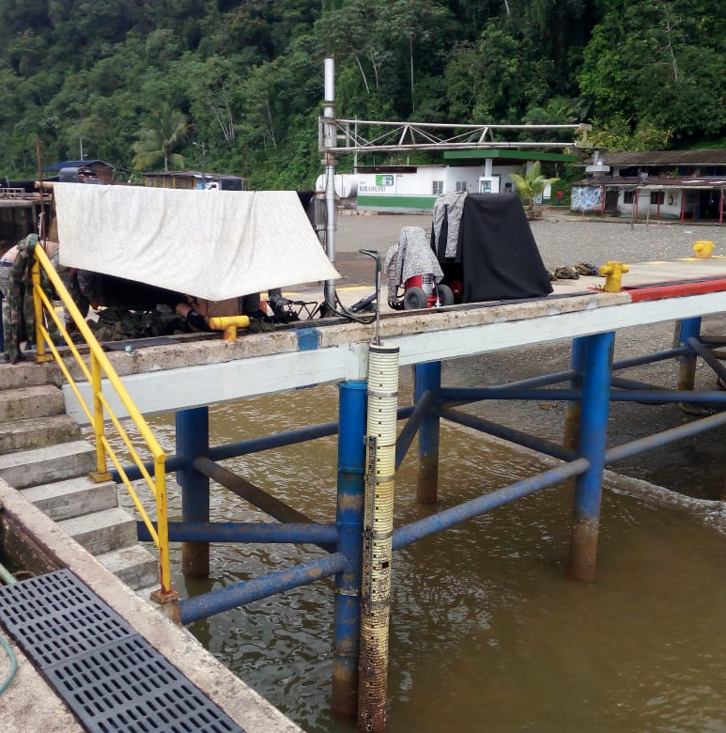
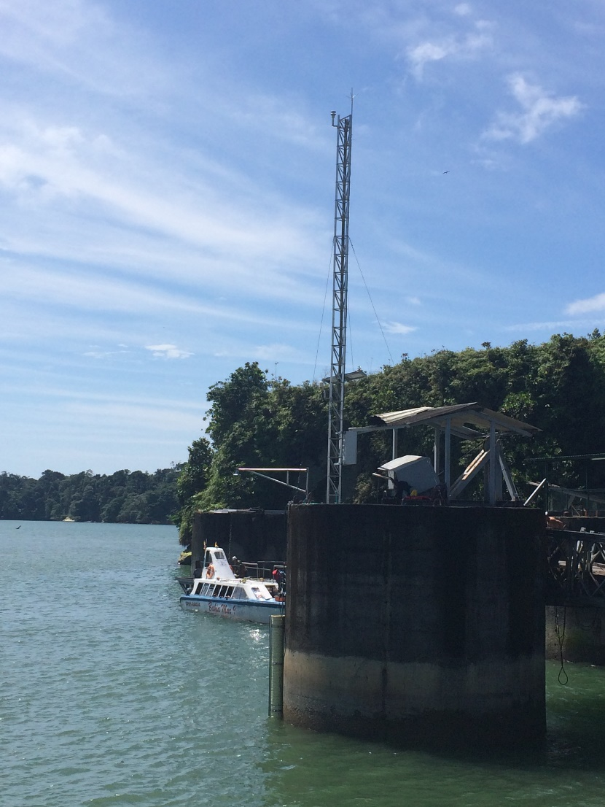
Configuration a sensors
Juanchaco
Bahía Solano
Bahía Málaga

Slide 6
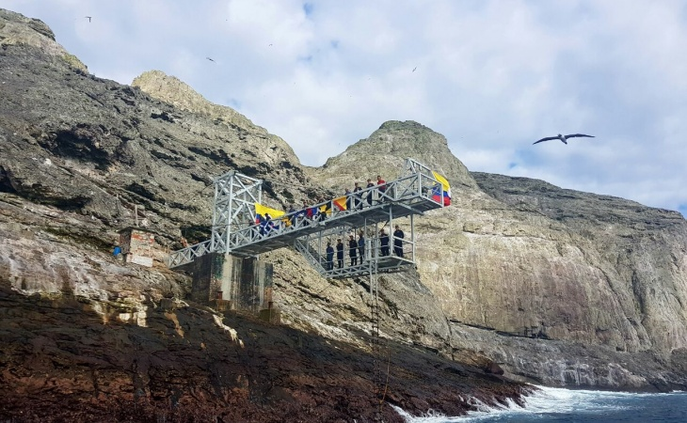
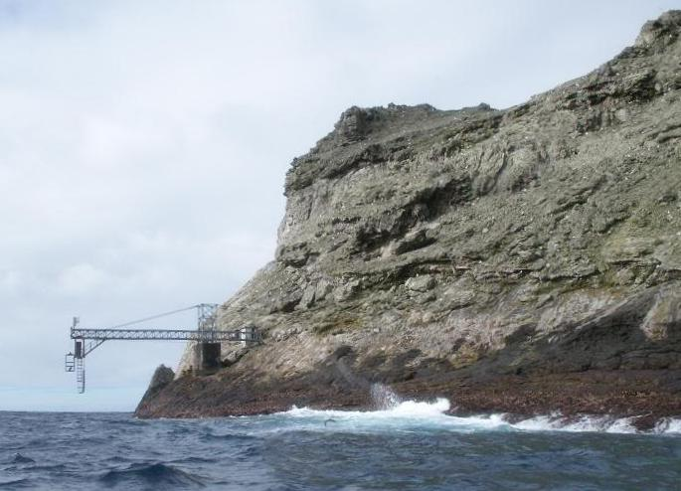
Configuration a sensors
Malpelo

Slide 7
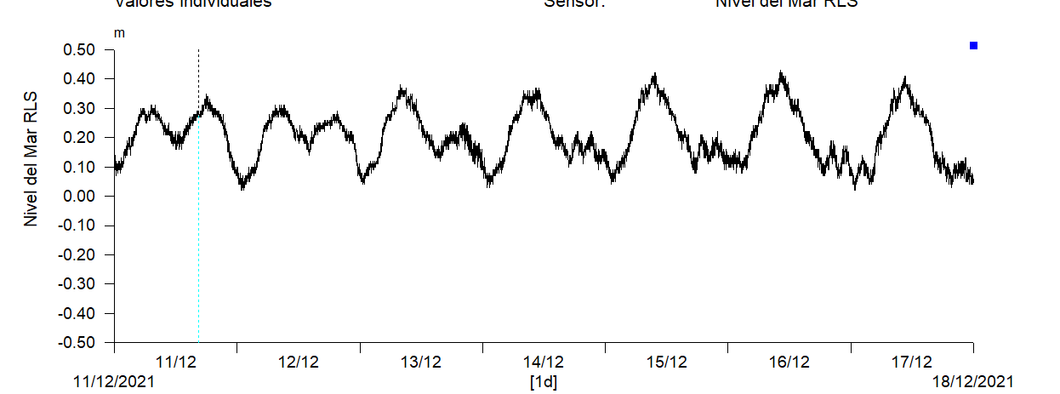
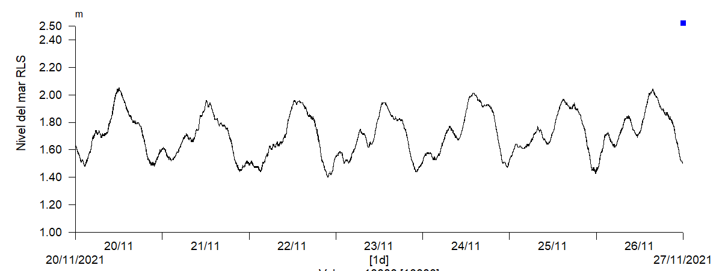
Configuration a sensors
Coveñas

Slide 8
Data management
standardized
Quality control Handbook for Tide Gauge
Data standardization – IODE – The Colombian Oceanographic Data Center (Cecoldo)
Data Update: 6-12 months
DATA BASES
Hydras Ftp/Goes
Hydras HTTP
SQL primary
Sql standardized

Slide 9
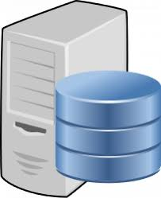
Data management
Hydras Ftp/Goes
Hydras HTTP
SQL SERVER Primary
Cecoldo
Update 6 month
Real Time data
Update 2/5 min
Update 12 month
SQL SERVER
standardized

Slide 10
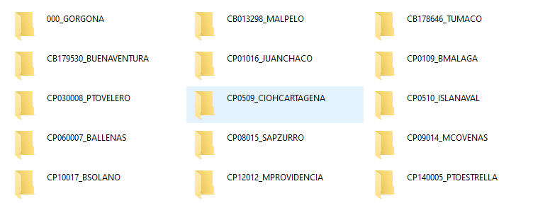
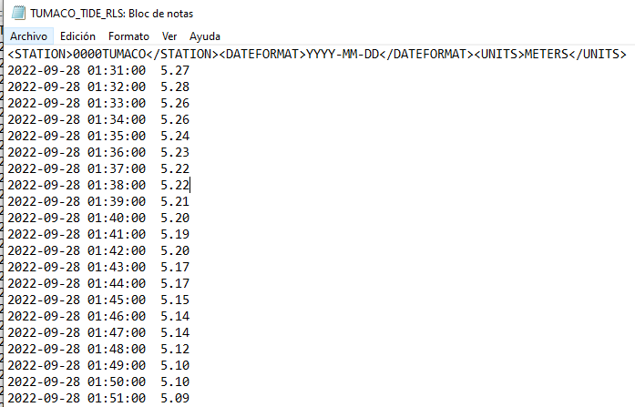
IOC data sharing Status
FTP 30 min

Slide 11
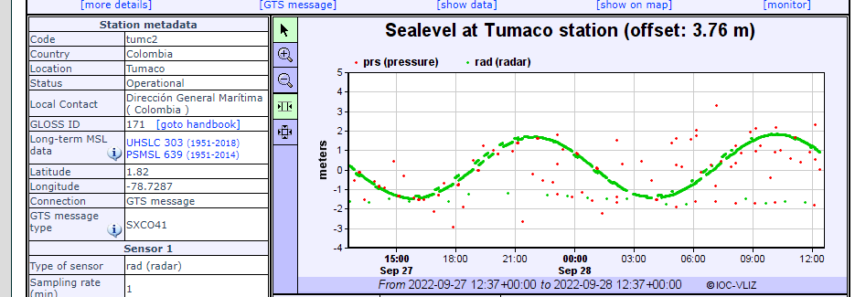
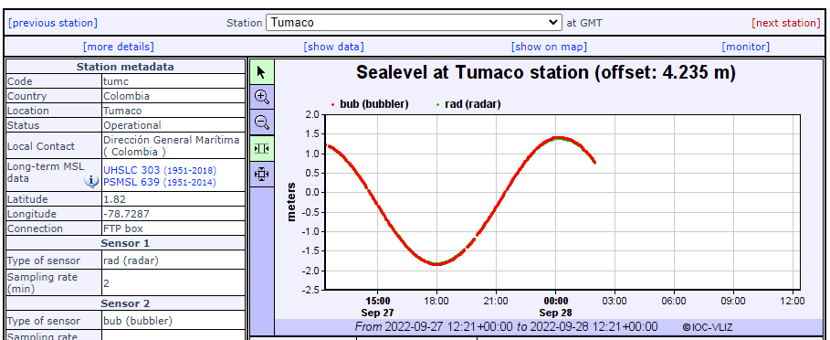
IOC data sharing Status
Coveñas

Slide 12
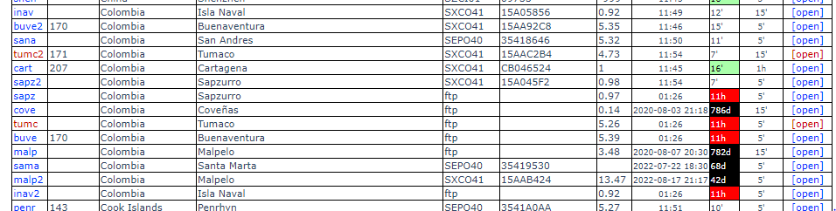
IOC data sharing Status

Slide 13
IOC data sharing Status
Thank you for your attention
walvarez@dimar.mil.co

