Slide 1
Taller
“Tsunami Analysis Tools Tonga Event”.
27 al 30 de septiembre
Valparaíso - Chile

Slide 2
My Presentation Will Have Three Sections:
A brief recap of what happened at Hunga Tonga-Hunga Ha`api.
Tools Available
Tsunami Observations &
Wave Height vs. Amplitude

Slide 3
Recap of Hunga Tonga-Hunga Ha`api Explosion

Slide 4
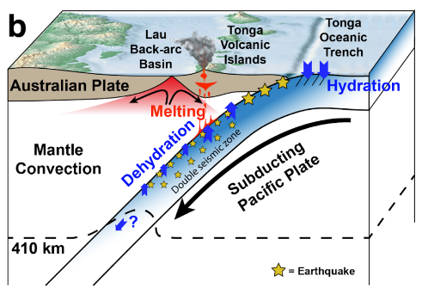
Tectonic background
Cross Section of Kermadec-Tonga Trench
Kermadec-Tonga Trench is a “Subduction Zone”
Subduction Zones Pose a Triple Threat:
Great Earthquakes*
Volcanic Eruptions
Tsunamis!*
Convergence rate
~24cm/yr
Yuen et al., “Planetary-Scale Waves, Volcanic Lightning, and Gaseous Clouds Caused by Submarine
Volcanic Eruption at Tonga Trench: An Exceptional Research Opportunity”

Slide 5
Hunga-Tonga Activity
Geologic record suggest events like this occur
every ~1000 years in this region.
7 year eruption hiatus ended on Dec. 20, 2021
Eruption on Jan. 13, 2022 generated small tsunami
Great Eruption commenced ~4:15 UTC Jan. 15
and lasted ~12hours
Complex, destructive tsunami generated
The Volcanic Eruption started ~200m beneath the Sea Surface.
Hot magma (especially if its gas enriched) with the right amount
of water creates an Explosion.
Too deep => The water can suppress the power of the blast
Too shallow => not enough water to fuel the explosion

Slide 6
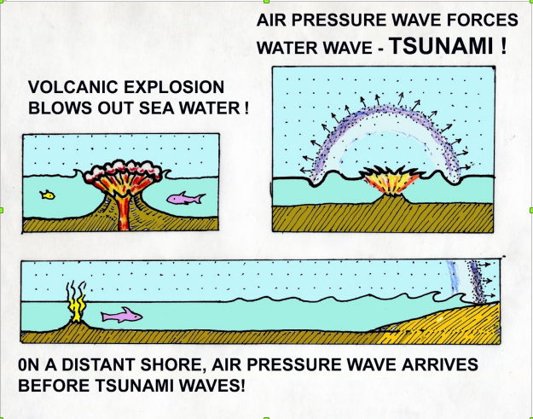
Tsunami Generation
Three Tsunami Generation
Mechanisms:
Caldera/Flank collapse
=> Near field
( This is what we thought was
happening at first )
Sonic Boom, Air pressure
waves (Lamb Waves), V ~300m/s
=> World wide ( Atmosphere is
vibrating )
3. Volcanic explosion/Pressure
Change deforming sea-surface
=> Classic Tsunami Waves
Tsunamis generated by non-seismic source!

Slide 7
2. What’s New/Current
How big was the explosion ? NASA first estimate was 10-18MTNs. Then folks began to wonder if it was on par with
Pinatubo or Tsar Bomba? Answer is, bigger!
100-200MTNs on par with Krakatau (1883)
2. The HTHH activity started at 4:02, Main explosion
~04:15 USGS
3. Plume height 57-58km (originally thought to be 35-45km)
4. VEI index. Initially estimates ranged from 5-6. The
consensus now is 6. Same as Krakatau
Back in March, it was thought HTHH was “ash poor”.
➔ Today, not so much..

Slide 8
2. What’s New/Current
5. Largest event recorded by IMS infrasound
6. Ionospheric disturbances due to Lamb Waves and
classical Tsunami waves detected
=> These can be used for tsunami modelling/forecasting
Air-Pressure wave generated tsunami could be hazardous

Slide 9
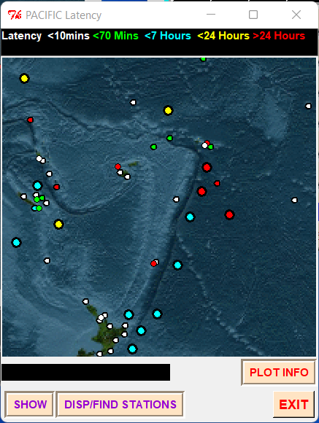
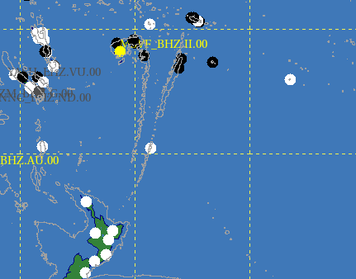
Tsunami Warning Challenges
Tsunami not generated by a seismic source
Few resources near the Tonga-Kermadec Trench
Seismic Stations
Sea-Level Stations
nkfa
2600 km
dnzg
Raoul Is.

Slide 10
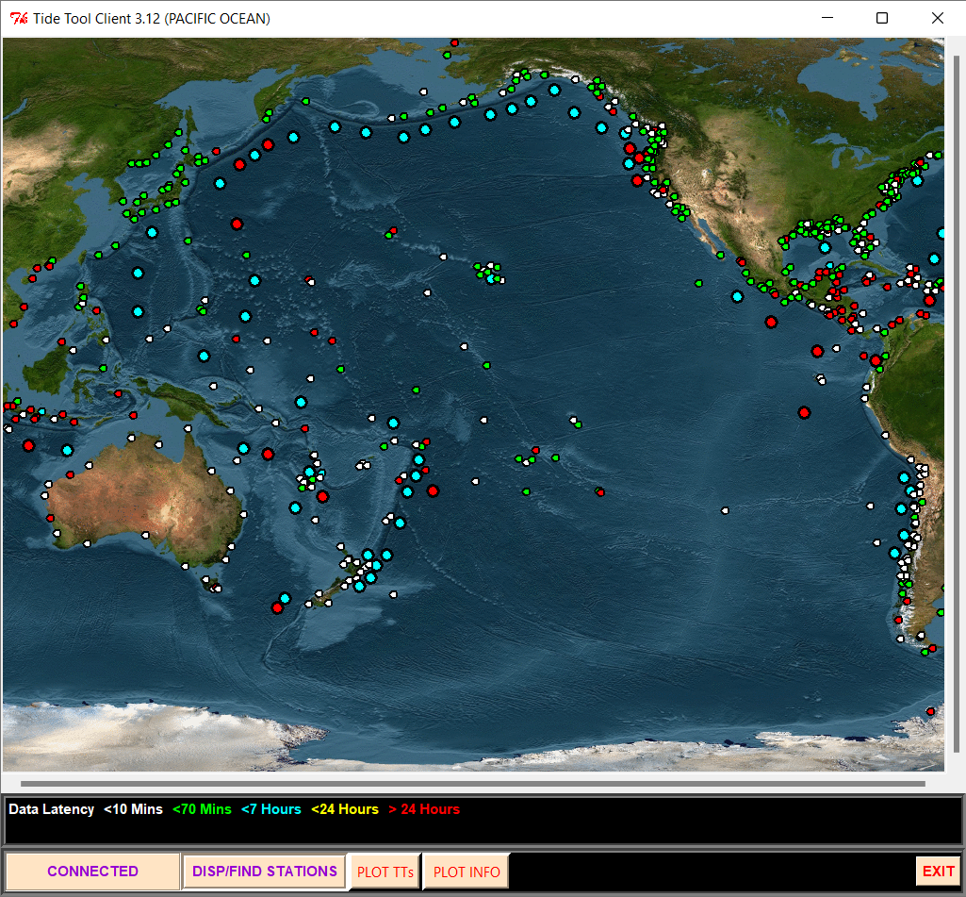
2. Tools Available
TideTool

Slide 11
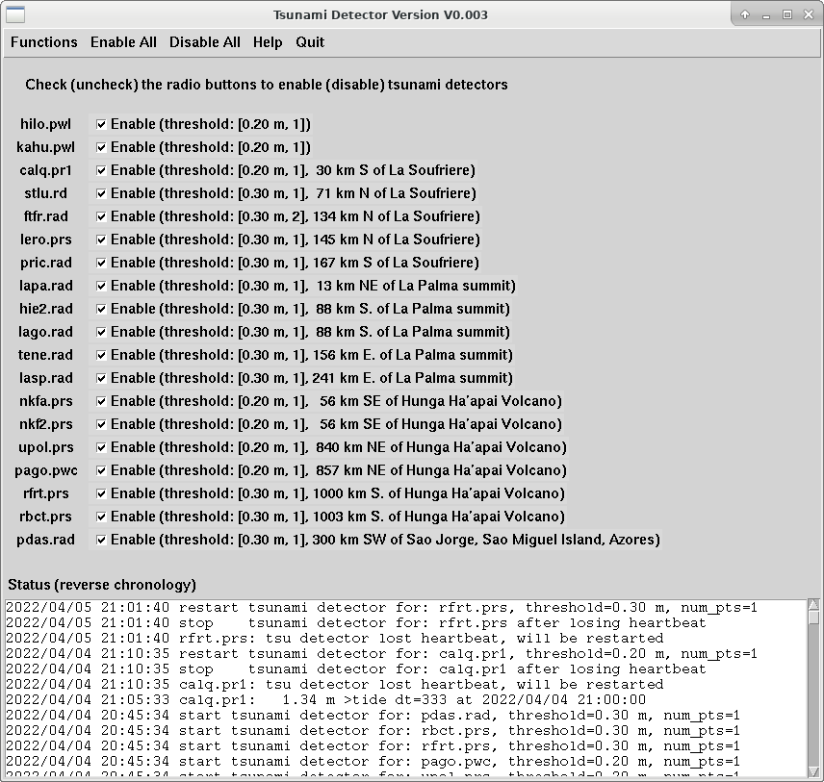
2. Tools Available
2. Tsunami Detector
➔ Very useful for Tsunamis not generated by
Earthquakes. Uses data gathered by Tide Tool
PTWC added the Nukuʻalofa gauge to the tsunami
detector after it recorded the tsunami generated by
the Jan. 13 Eruption
At 4:29 UTC Jan. 15, the detector alerted PTWC
duty scientists after the arrival of the tsunami at
Nukuʻalofa. We didn’t have to guess where the
tsunami originated
Developed by Dailin Wang in the aftermath of
eruptions at St. Vincent and concerns about
Kick’em Jenny
Alarm threshold based on de-tided sea-level. If a
deviation exceeds a threshold (20cm for Nukuʻalofa)
Duty Scientists are paged.
Active area of research at both US TWCs

Slide 12
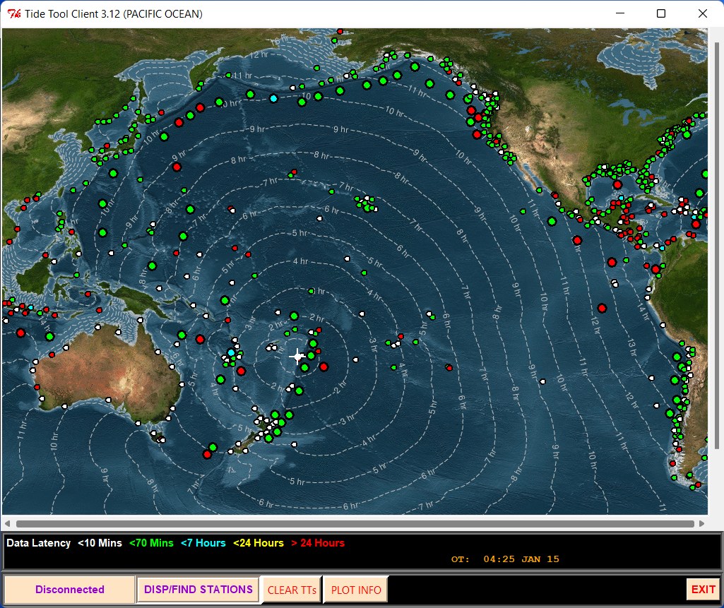
2. Tools Available
Tsunami Travel-Time Calculator
But only for classical tsunami waves (gh)^{1/2}
Calcuation for Air-pressure wave generated tsunamis
is simple and is being added

Slide 13
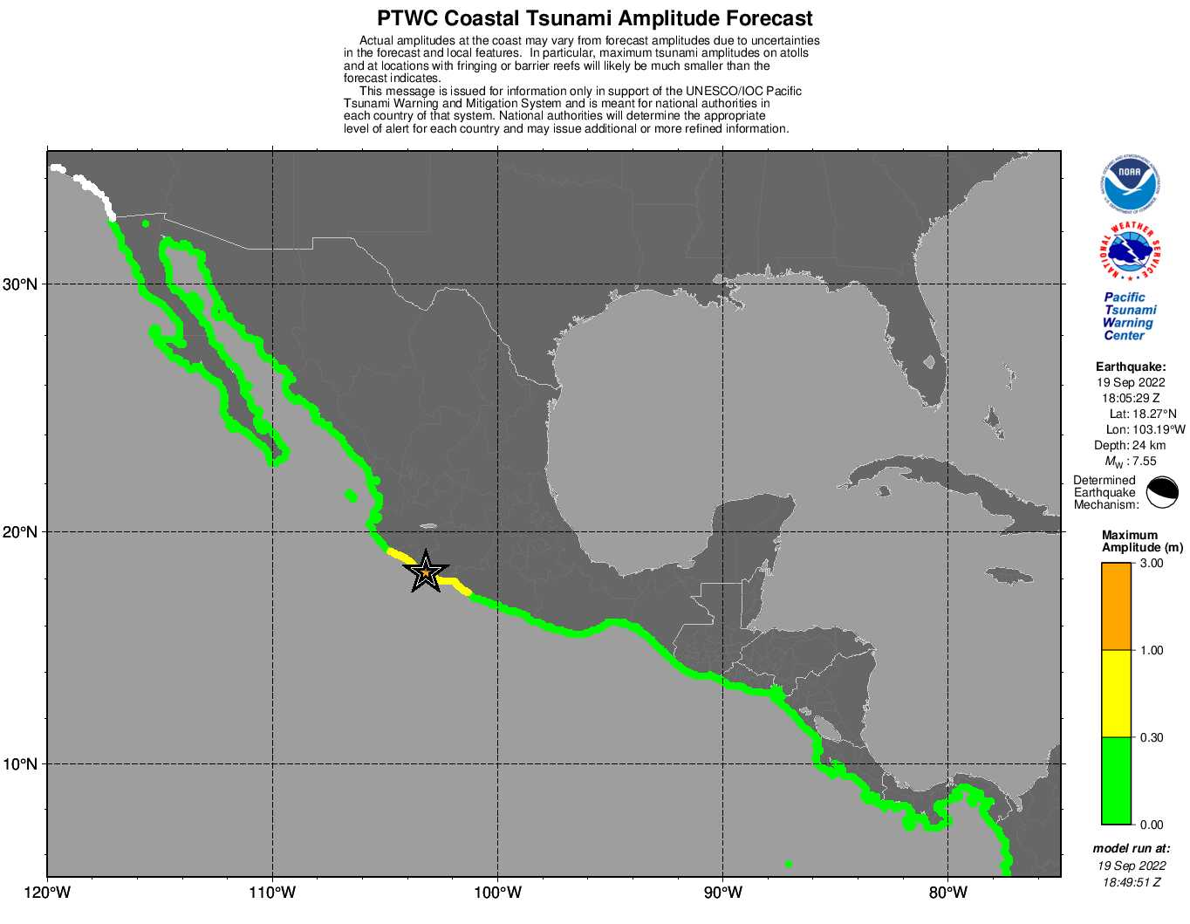
2. Tools Available
Forecast Tools for Seismic Sources only!
No forecast tools for volcanic explosions!

Slide 14
3. Tsunami Observations
Nuku’alofa
Dark Blue Line
Forecasted Arrival Time
Of Pressure Wave Generated
Tsunami
Magenta Line
Forecasted Arrival Time of
Explosion Generated Tsunami
Max T-2-P (Wave Height) ~1.9m
Red: Actual Marigram
Black: De-tided

Slide 15
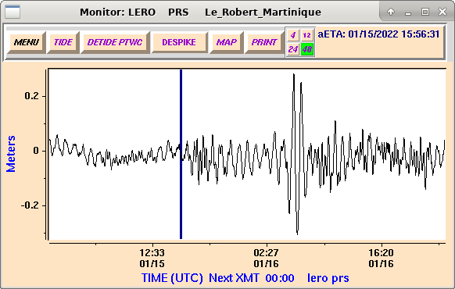
3. Tsunami Observations
Wave Height: Trough to Peak

Slide 16
3. Tsunami Observations
Amplitude:
Zero to Peak ( Z-2-P )
or
Zero to Trough ( Z-2-T )

Slide 17
* THE FOLLOWING ARE TSUNAMI WAVE OBSERVATIONS FROM COASTAL
AND/OR DEEP-OCEAN SEA LEVEL GAUGES AT THE INDICATED
LOCATIONS. THE MAXIMUM TSUNAMI HEIGHT IS MEASURED WITH
RESPECT TO THE NORMAL TIDE LEVEL.
GAUGE TIME OF MAXIMUM WAVE
COORDINATES MEASURE TSUNAMI PERIOD
GAUGE LOCATION LAT LON (UTC) HEIGHT (MIN)
-------------------------------------------------------------
LAZARO CARDENAS MX 17.9N 102.2W 2147 0.32M/ 1.0FT 14
ZIHUATANEJO MX 17.6N 101.6W 2121 0.53M/ 1.7FT 16
PUERTO VALLARTA MX 20.7N 105.2W 1820 0.21M/ 0.7FT 06
MANZANILLO MX 19.1N 104.3W 1924 0.79M/ 2.6FT 32
ACAPULCO MX 16.8N 99.9W 1907 0.13M/ 0.4FT 34
In our products, what we call “TSUNAMI MAXIMUM HEIGHT”
=> Is actually the Wave Height divided by 2
➔ PTWS should probably have discussion on that

Slide 18
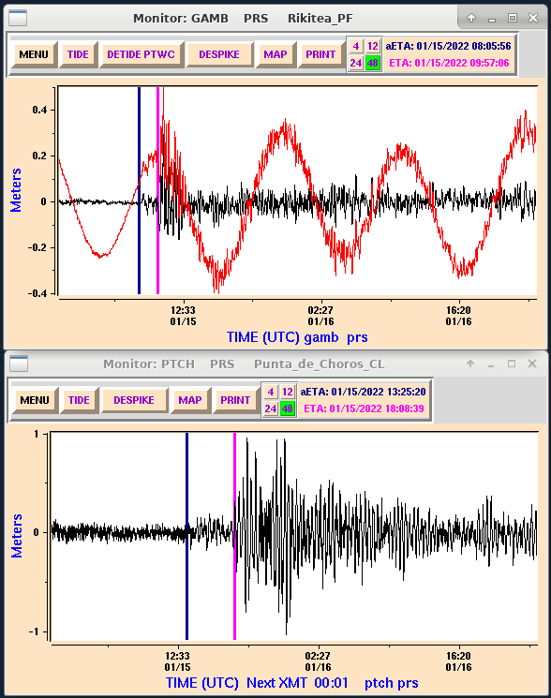
Cook Islamd
2hrs separates Pressure Generated
Tsunami from Classical Tsunami
Long Duration
Acoustic
Tsunami
Punta de Choros, Chile
4.5hrs separates Pressure Generated
Tsunami from Classical Tsunami
South America was hardest hit
Classical
Tsunami

Slide 19
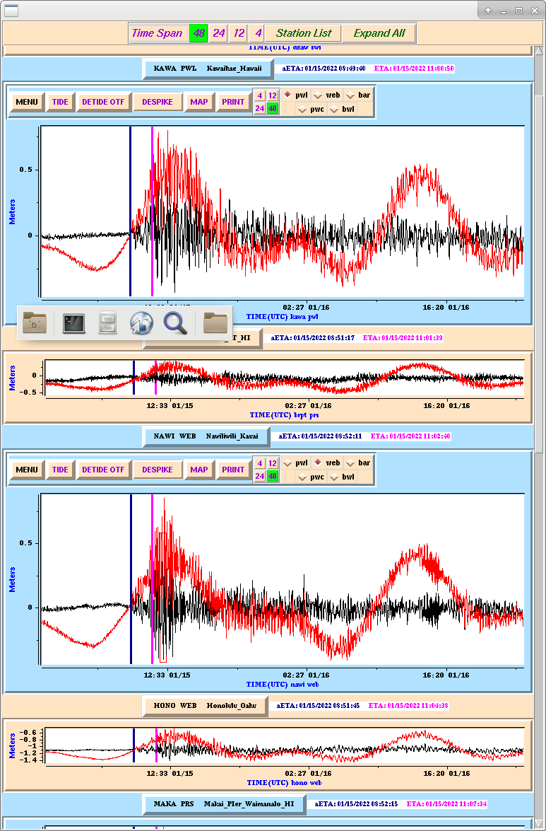
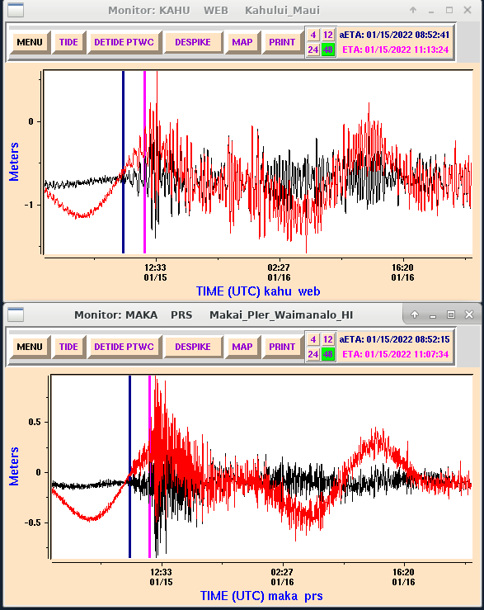
Tsunami Observations From Hawaii
Kahului 1.7m T-2-P
At 12:20 UTC
Kawaihae
Waimanalo 1.5m T-2-P
At 11:50 UTC
Nawiliwili
2.5 hrs

Slide 20
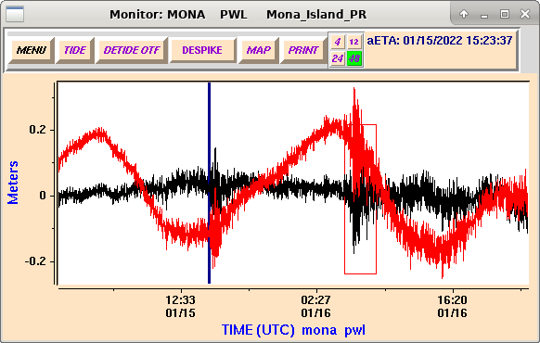
Tsunami Observations
One thing I noticed is that the Air-Pressure wave traveling
the short route doesn’t always generate a bigger tsunami
than the Air-Pressure wave traveling the long way…
East Propagating
24cm T-2-P
Mona Island
West Propagating
35cm T-2-P

Slide 21
Tsunami Observations
One thing I noticed is that the Air-Pressure wave traveling
the short route doesn’t always generate a bigger tsunami
than the Air-Pressure wave traveling the long way…
East Propagating
24cm T-2-P
Mona Island
West Propagating
35cm T-2-P

Slide 22
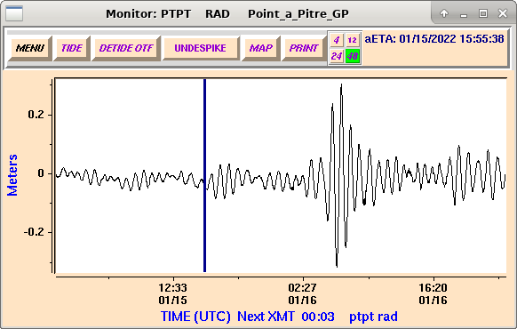
Tsunami Observations
One of the conclusions I came too back in March was that
the Air-Pressure wave generated tsunami was not hazardous..
Is that strictly true? Not exactly..
Amp. 29cm
East Propagating
Amp. 32cm
East Propagating
West Propagating
West Propagating

Slide 23
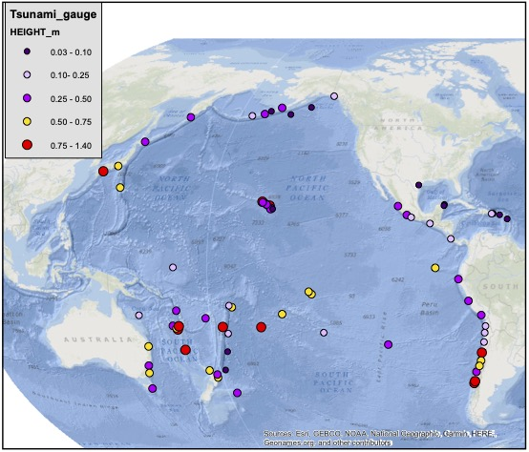
Modified Procedures
What happens if HTHH blows up again?
Pacific Sea-Level Observations
We can use these data
as the basis for a forecast.
For example, if HTHH
explodes again, and we
observe a tsunami with an
amplitude of 2m at
Nuku’alofa, we would
simply multiply these
observations by 2 and use
that as the basis for a
forecast.
In which case we’d be
thinking about putting
Hawaii in a warning.
This is the best we can do
for now

Slide 24
Gracias!
stuart.weinstein@noaa.gov

Slide 25
Actions Being Taken/Under Consideration
Develop a seismic network along the Tonga-Kermadec Trench
=> Broadband seismometers, “Raspberry Pi” seismometers
=> USGS helping with that
New Zealand, added another SL station at Nuku’Alofa and two more
in Tonga. Stations on Raoul Island repaired. ABM to fix SL station
at Niue.
TWC’s considering processing infrasound data
Forecasting Tools being developed by PMEL/NCTR
Establish comms with other organizations like NASA,
Volcanic Ash Advisory Centers (VAAC)
➔ VAAC products available over the GTS
Careful study of tsunami travel-times of both classical and
Air pressure wave generated tsunami
Further investigation into Air Pressure wave generated tsunami
amplitudes

Slide 26
Tsunami Modeling
Current DART inversion
inverts for the displacement
on pre-determined fault
planes at subduction zones
Here the inversion computes
the initial displacement of
the sea-surface. That
displacement causes the
“Classic” tsunami.

