Slide 1
Taller
“Acceso compartido a datos de Nivel del Mar:
Herramienta para una respuesta Regional
efectiva ante Emergencias de Tsunami”.
27 al 30 de septiembre
Valparaíso - Chile

Slide 2
Data transfer redundancy

Slide 3
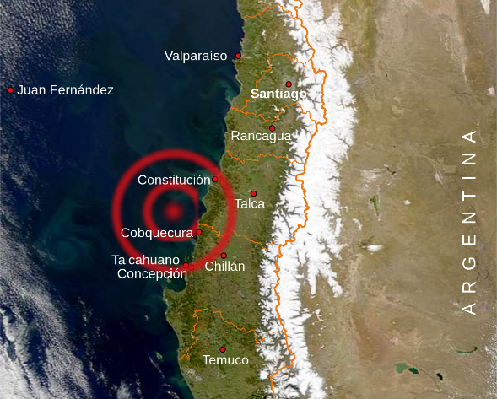
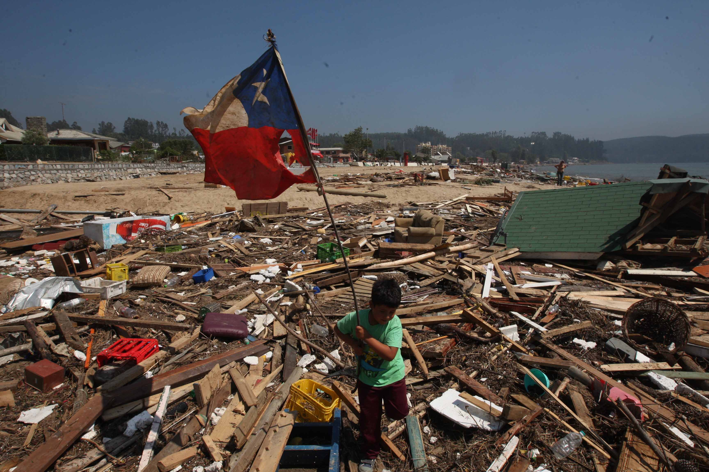
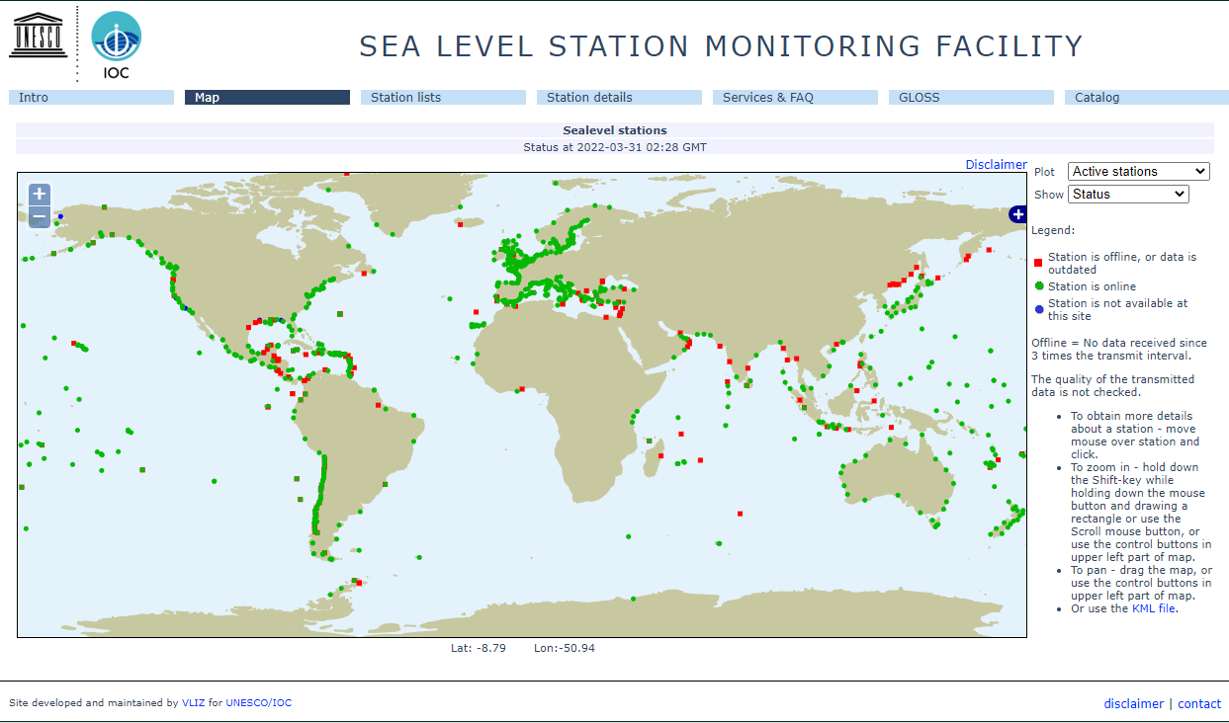
2010 Earthquake and Tsunami: The turning point
Data Transmission :
GOES (NOAA)
GPRS
BGAN
P A T R I O T I S M O
HONOR
LEALTAD
VALENTÍA
INTEGRIDAD
DEBER

Slide 4
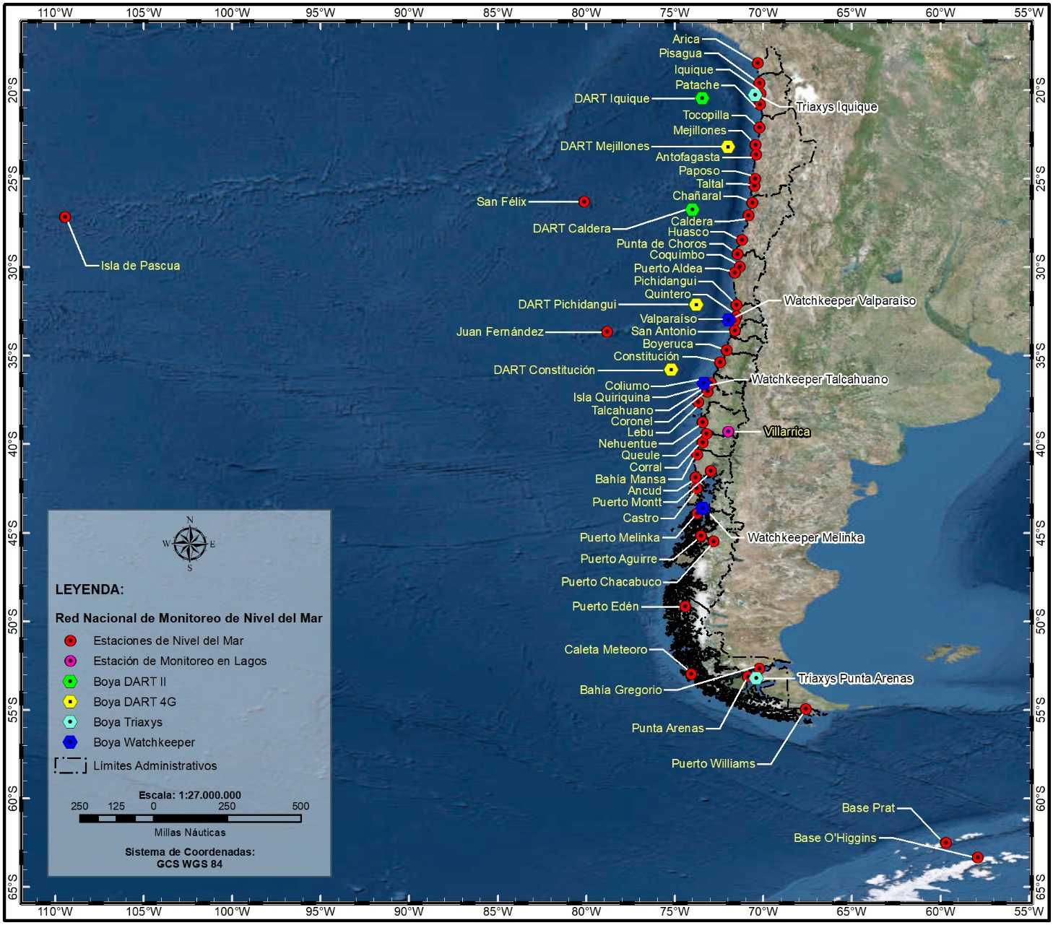
Sea Level Stations Network 2010 - 2022
P A T R I O T I S M O
HONOR
LEALTAD
VALENTÍA
INTEGRIDAD
DEBER

Slide 5
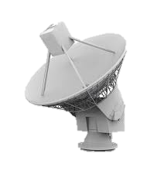
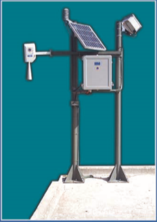
Coordinated work with VLIZ
Through VLIZ, SHOA is able to:
Share its sea level gauges information.
Receive sea level gauges information from around the world.
NOAA
Data Transmission :
GOES Direct Readout Ground Station (DRGS)
GPRS
BGAN
P A T R I O T I S M O
HONOR
LEALTAD
VALENTÍA
INTEGRIDAD
DEBER

Slide 6
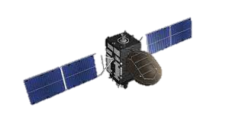
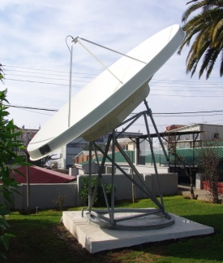
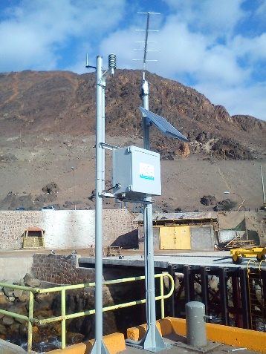
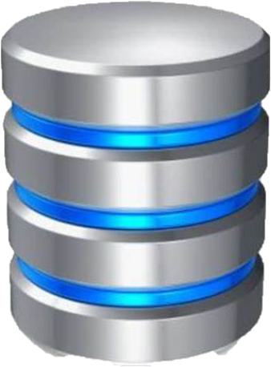
Data Sharing Options: GOES
SHOA
NOAA
LAN
GTS
Datacenter 01
Datacenter 02
Push
Pull
P A T R I O T I S M O
HONOR
LEALTAD
VALENTÍA
INTEGRIDAD
DEBER

Slide 7
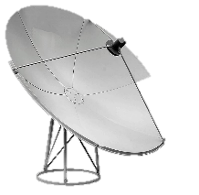
Data Sharing Options: BGAN and GPRS
GPRS
BGAN
Land based Internet
LAN
Pull
DataC 01
DataC 02
P A T R I O T I S M O
HONOR
LEALTAD
VALENTÍA
INTEGRIDAD
DEBER

Slide 8
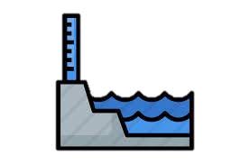
Data Sharing Options: Third Party Stations
VLIZ / SHOA cooperation enabled monitoring of far field Tsunamis (Tonga 2022) in real time.
VSAT Internet
SHOA
Pull
Land based Internet
P A T R I O T I S M O
HONOR
LEALTAD
VALENTÍA
INTEGRIDAD
DEBER

Slide 9
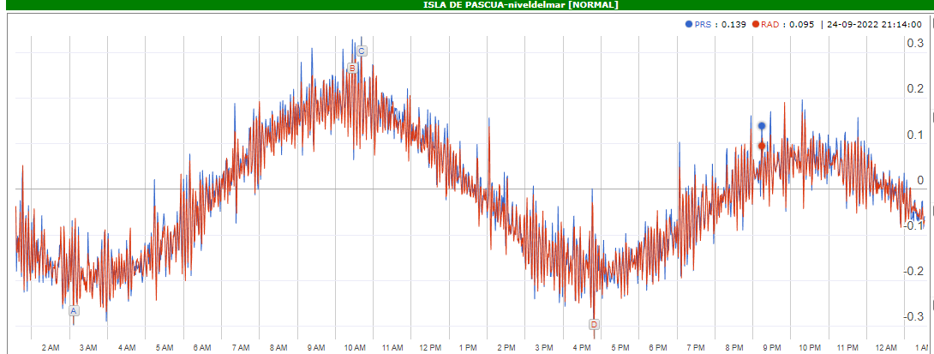
Data Redundancy: Visualization
Data Redundancy originally intended for Station Data Robustness.
Two Tide sensors
P A T R I O T I S M O
HONOR
LEALTAD
VALENTÍA
INTEGRIDAD
DEBER

Slide 10
Data Redundancy: Data Transfer
Data Redundancy originally intended for Station Data Robustness.
Redundant Telemetry
P A T R I O T I S M O
HONOR
LEALTAD
VALENTÍA
INTEGRIDAD
DEBER

Slide 11
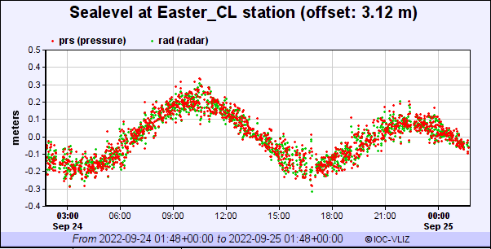
Data Redundancy: Data Management
Data Redundancy originally intended for Station Data Robustness.
Redundant Data Servers
Easter Island
Savtec Servers
Gap filling script
IOC Servers
Independent Telemetry visualization
P A T R I O T I S M O
HONOR
LEALTAD
VALENTÍA
INTEGRIDAD
DEBER

Slide 12
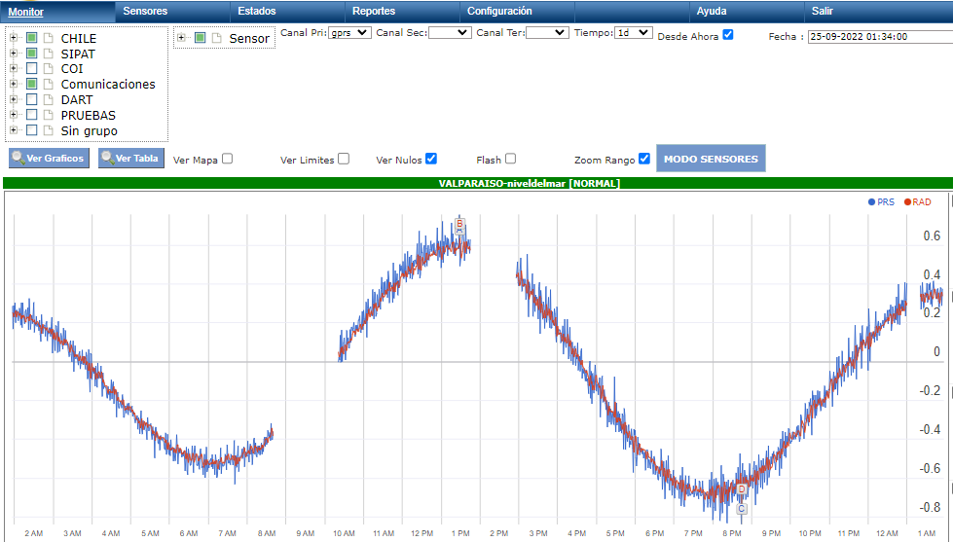
Data Redundancy: Data Management
Valparaíso
Primary Telemetry: GPRS
Savtec Servers: GPRS GAPS
P A T R I O T I S M O
HONOR
LEALTAD
VALENTÍA
INTEGRIDAD
DEBER

Slide 13
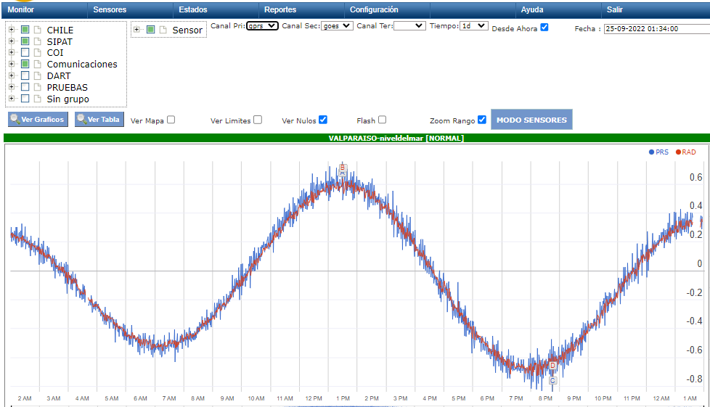
Data Redundancy: Data Management
Valparaíso
Secondary Telemetry: GOES
GPRS GAPS: Filled with GOES
P A T R I O T I S M O
HONOR
LEALTAD
VALENTÍA
INTEGRIDAD
DEBER

Slide 14
Data Sharing Options: GOES
SHOA
NOAA
LAN
GTS
Datacenter 01
Datacenter 02
Push
Pull
P A T R I O T I S M O
HONOR
LEALTAD
VALENTÍA
INTEGRIDAD
DEBER

Slide 15
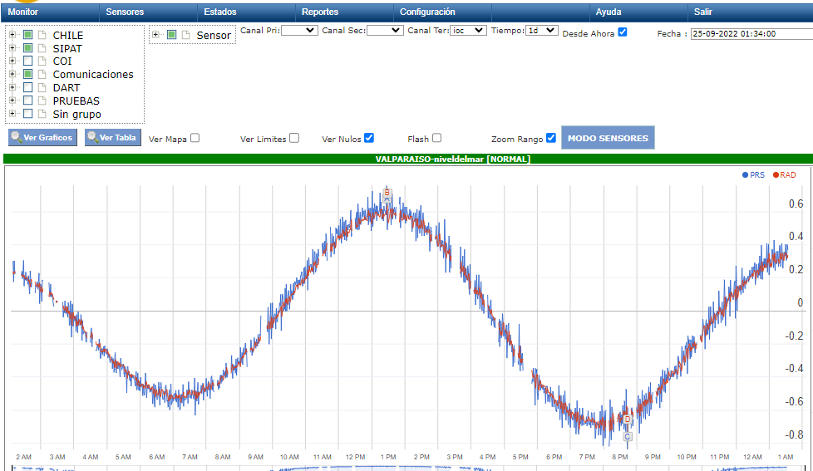
Data Redundancy: Data Management
Valparaíso
Tertiary Telemetry: IOC
GPRS or GOESGAPS: Filled with IOC
P A T R I O T I S M O
HONOR
LEALTAD
VALENTÍA
INTEGRIDAD
DEBER

Slide 16
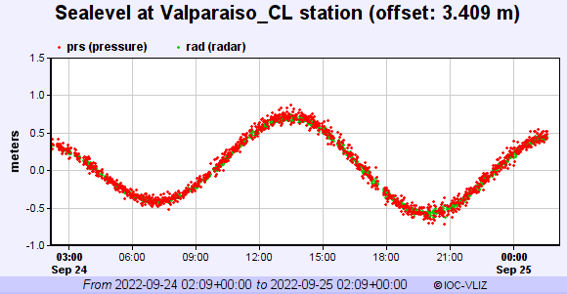
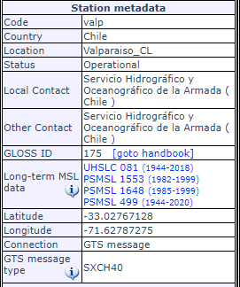
Data Redundancy: Data Management
Valparaíso
Valp Code: GTS Network – WMO Header SXCH40
P A T R I O T I S M O
HONOR
LEALTAD
VALENTÍA
INTEGRIDAD
DEBER

Slide 17
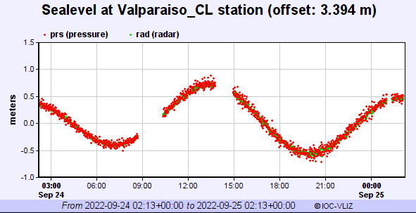
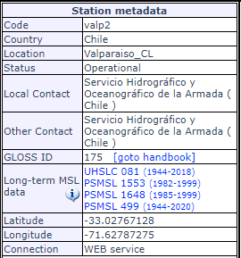
Data Redundancy: Data Management
Valparaíso
Valp2 Code: Internet – Webservice connection to Amazon Web Services
P A T R I O T I S M O
HONOR
LEALTAD
VALENTÍA
INTEGRIDAD
DEBER

Slide 18
Summary
Since 2010, the enhancement of SHOA’s operational Capabilities is based upon 7 main axes.
Extended Coverage of monitoring stations
Increased transmission frecuencies
Redundant Telemetry options
Redundant sea level sensors
Real time data reception and processing
Redundant data management strategies
Integration with IOC external servers
P A T R I O T I S M O
HONOR
LEALTAD
VALENTÍA
INTEGRIDAD
DEBER

Slide 19
Thank you for your attention

Slide 20
P A T R I O T I S M O
HONOR
LEALTAD
VALENTÍA
INTEGRIDAD
DEBER

