Slide 1
Taller
“Acceso compartido a datos de Nivel del Mar:
Herramienta para una respuesta Regional
efectiva ante Emergencias de Tsunami”.
27 al 30 de septiembre
Valparaíso - Chile

Slide 2
Sensor integration and data format design

Slide 3
Sensor Integration and Data Format Design
P A T R I O T I S M O
HONOR
LEALTAD
VALENTÍA
INTEGRIDAD
DEBER

Slide 4
Preliminary Overview
Sensor Integration
Hardware Connections
Installation Site operational requirements
DCP software programming
Telemetry Options available
Data format constraints
P A T R I O T I S M O
HONOR
LEALTAD
VALENTÍA
INTEGRIDAD
DEBER

Slide 5
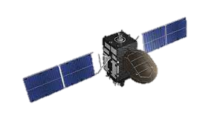
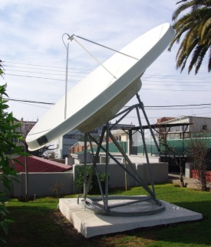
GOES format Constraints
SHOA
GOES DATA FORMAT
ADC0D05612139180751G43+0NN217EXE00104
2263 2251 2143 2339 2101
4100 4183 4024 4229 4019
21.2
068
17.9
1012.8
14.3
428
382
LAN
DCP ID
Year (20xx)
Julian Day
HHMMSS
Antenna Power
GOES Channel
Pressure sensor data (mm)
Radar Sensor Data (mm)
Datacenter 01
Datacenter 02
P A T R I O T I S M O
HONOR
LEALTAD
VALENTÍA
INTEGRIDAD
DEBER

Slide 6
GOES format Constraints
GOES DATA FORMAT
ADC0D05612139180751G43+0NN217EXE00104
2263 2251 2143 2339 2101
4100 4183 4024 4229 4019
21.2
068
17.9
1012.8
14.3
428
382
DCP ID
Year (20xx)
Julian Day
HHMMSS
Antenna Power
GOES Channel
Pressure sensor data (mm)
Radar Sensor Data (mm)
Formatting script before Data Transmission
(S:ARI_GOES;D:180512;T:180751;WL-K:2101;WL-V:4019;TA:21.2;RH:068;TW:17.9;BP:1012.8;BAT:14.3)
(S:ARI_GOES;D:180512;T:180651;WL-K:2339;WL-V:4229;TA:21.2;RH:068;TW:17.9;BP:1012.8;BAT:14.3)
(S:ARI_GOES;D:180512;T:180551;WL-K:2143;WL-V:4024;TA:21.2;RH:068;TW:17.9;BP:1012.8;BAT:14.3)
(S:ARI_GOES;D:180512;T:180451;WL-K:2251;WL-V:4183;TA:21.2;RH:068;TW:17.9;BP:1012.8;BAT:14.3)
(S:ARI_GOES;D:180512;T:180351;WL-K:2263;WL-V:4100;TA:21.2;RH:068;TW:17.9;BP:1012.8;BAT:14.3)
P A T R I O T I S M O
HONOR
LEALTAD
VALENTÍA
INTEGRIDAD
DEBER

Slide 7
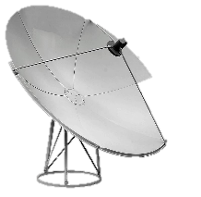
BGAN and GPRS Format Constraints
GPRS
BGAN
Land based Internet
LAN
Pull
DataC 01
DataC 02
P A T R I O T I S M O
HONOR
LEALTAD
VALENTÍA
INTEGRIDAD
DEBER

Slide 8
BGAN and GPRS Format Constraints
Format operation takes place at DCP
Optimize Sensors data format (Avoid decimals to sabe spaces)
Avoids complex hardware for data receivers
Destination can be set as IP Adress or domain name
Simplifies Data Base structure by using same format for all Telemetry Options
S (Station code): XXX_GOES/BGAN/GPRS
(S:ARI_GPRS;D:180512;T:180751;WL-K:2101;WL-V:4019;TA:21.2;RH:068;TW:17.9;BP:1012.8;BAT:14.3)
(S:ARI_GPRS;D:180512;T:180651;WL-K:2339;WL-V:4229;TA:21.2;RH:068;TW:17.9;BP:1012.8;BAT:14.3)
(S:ARI_GPRS;D:180512;T:180551;WL-K:2143;WL-V:4024;TA:21.2;RH:068;TW:17.9;BP:1012.8;BAT:14.3)
(S:ARI_GPRS;D:180512;T:180451;WL-K:2251;WL-V:4183;TA:21.2;RH:068;TW:17.9;BP:1012.8;BAT:14.3)
(S:ARI_GPRS;D:180512;T:180351;WL-K:2263;WL-V:4100;TA:21.2;RH:068;TW:17.9;BP:1012.8;BAT:14.3)
P A T R I O T I S M O
HONOR
LEALTAD
VALENTÍA
INTEGRIDAD
DEBER

Slide 9
Thank you for your attention

Slide 10
P A T R I O T I S M O
HONOR
LEALTAD
VALENTÍA
INTEGRIDAD
DEBER

