Slide 1
SEA LEVEL STATION MONITORING FACILITY
Getting data into the IOC-SLSMF
Bart Vanhoorne, Francisco Hernandez
Flanders Marine Institute (VLIZ)
Belgium
www.ioc-sealevelmonitoring.org

Slide 2
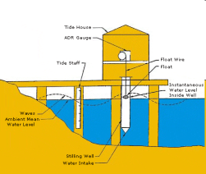
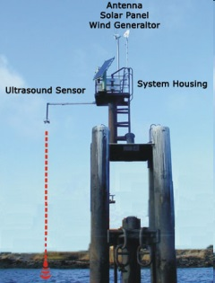
From tide gauge to the facility by GTS, HTTP push, FTP, webservice, email, socket
Belgian
MetOffice
GTS
6 methods
HTTP push
FTP / webservice / email / socket
Database

Slide 3
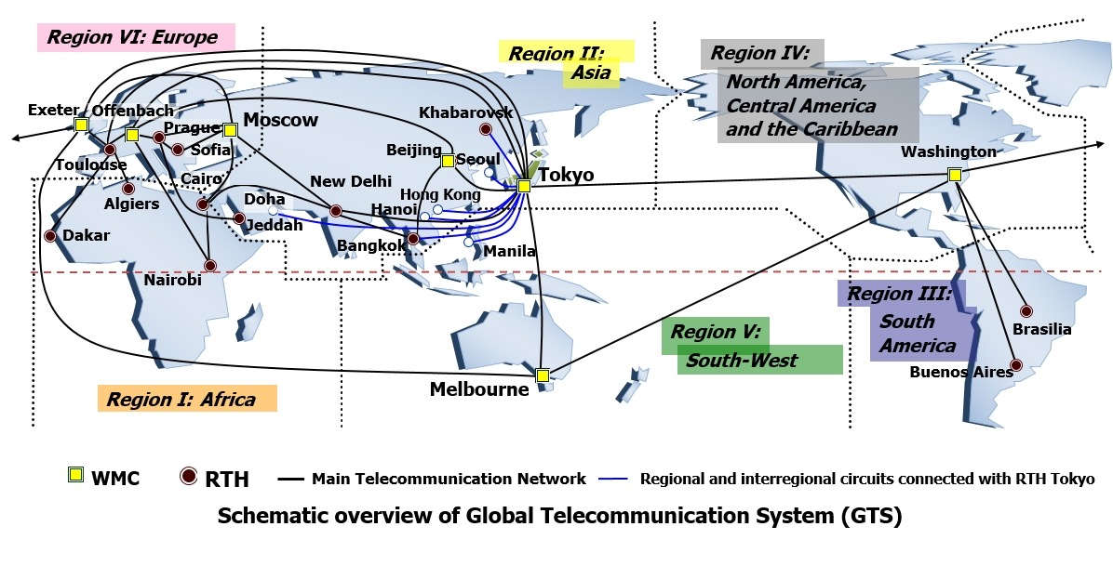
Method 1 – GTS
Global Telecommunication System
Managed by WMO
Weather data/earth observations between nodes
Combination of satellite, land lines, internet, ...

Slide 4
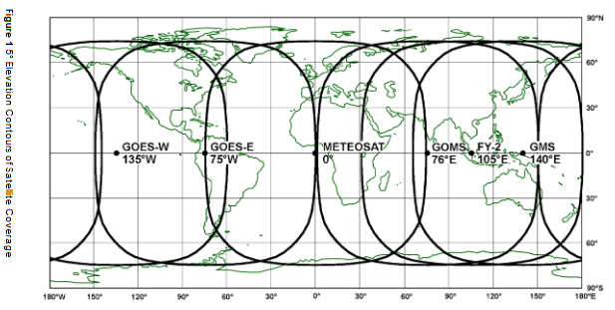
Method 1 – GTS How is data transferred?
Measurements generated by sensor
Grouped into a message by logger, at station
Logger sends message to satellite via modem, incl. unique Data Collection Platform (DCP) address, DCP_ID
Messages collected by satellite operators (METEOSAT, GOES, ...)
Message put and routed on the GTS network to configured destinations

Slide 5
Method 1 – GTS Message arrival & parsing at VLIZ
GTS -> Royal Meteorological Institute of Belgium (RMI) -> VLIZ FTP subset of all GTS: filtered by WMO header
100+ messages from last minute from all stations uploaded in one file.
PHP script:
downloads files 1x/min (pull)
each station: metadata entry with DCP_ID (see later)
loop through all GTS stations, when DCP_ID match: use parsing parameters (sensor, start, end, unit)
insert into database: (sensor, timestamp, sealevel measurement) – value “AS IS”
Multiple message formats ASCII, CREXX, pseudo binary, ...

Slide 6
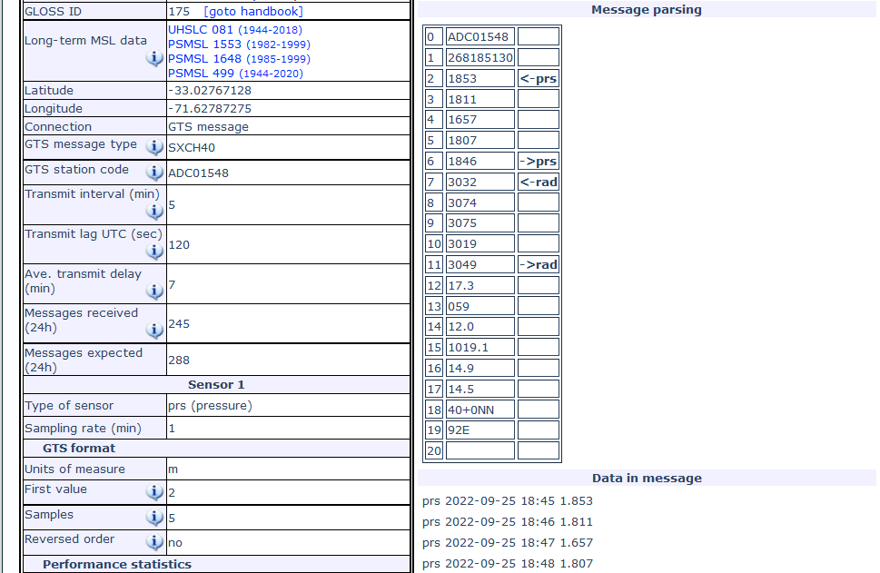
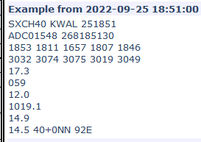
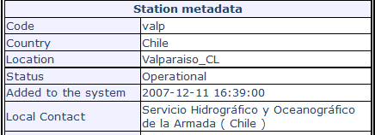
Method 1 – GTS Message parsing example: ASCII

Slide 7
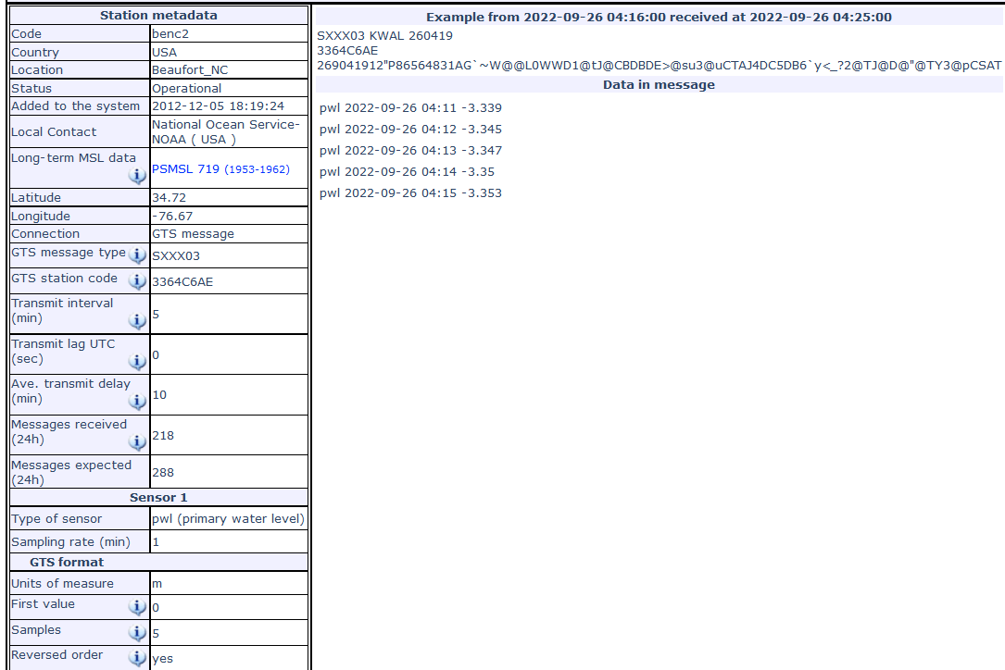
Method 1 – GTS Message parsing example: binary/GOES

Slide 8
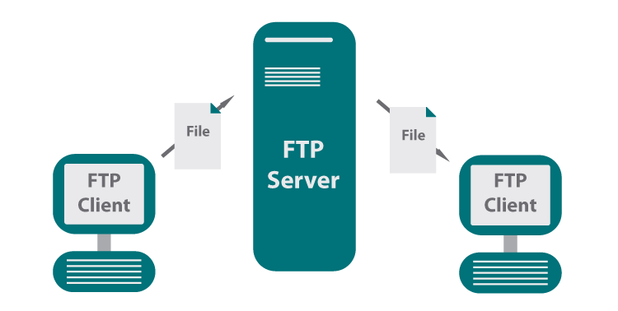
Method 2 – FTP How is data transferred?
Measurements generated by sensor
Script on logger or server groups & transforms it to format similar as <timestamp><separator><value>
File uploaded to own server or VLIZ FTP
Files named consistently, but organized in many different ways: by station name, sensor, date, ...
Two methods: same file constantly updated <-> new file for each (batch of) measurements

Slide 9
Method 2 – FTP Script processing at VLIZ
Config in in PHP script: server & path, format, station code
Downloads files 1x/5min/each FTP (pull)
Each provider != format & file/folder structure => custom parsing function per provider
Metadata (code, sensor) retrieved from DB, based on config
Specific parser for provider generates: <station><sensor><timestamp><measurement>
Insert into database “AS-IS”

Slide 10
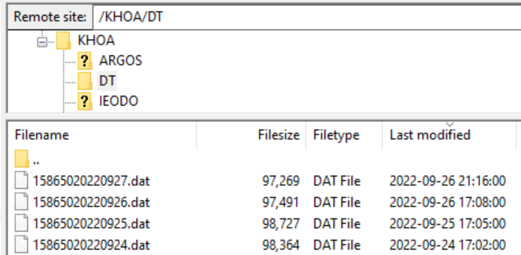
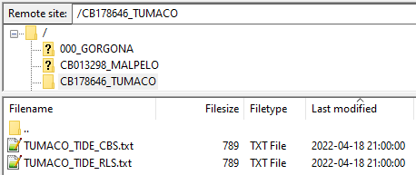
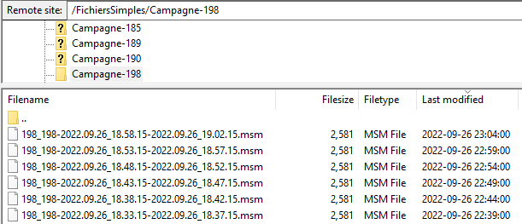
Method 2 – FTP File organisation example
1 file per day, updated 1x/5min (i.e. Korea)
1 file forever (i.e. Colombia)
New file each 5min (i.e. SHOM)

Slide 11
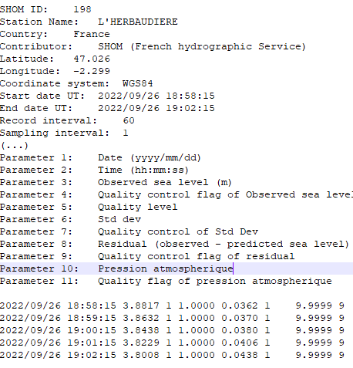
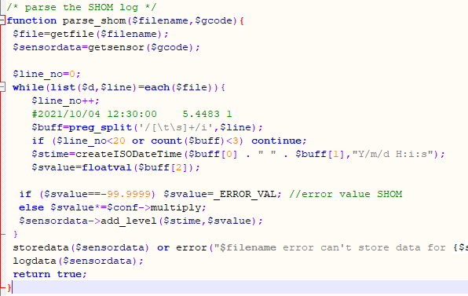
Method 2 – FTP File parsing example
Data file
Custom parsing function (i.e. SHOM)
PHP config: server, login, pass, path

Slide 12
Method 3 – Email Processing script at VLIZ
Providers sends (scripted) email that contains sensor measurements
PHP script reads emails from mailbox gauges@vliz.be, 1x/3min (pull)
Config in script: subject, sender, station code
Rest of the processing => same as FTP
Not used any longer

Slide 13
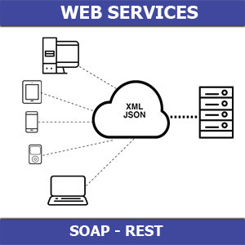
Method 4 – webservice (or “HTTP pull”)
Providers sets up webservice that returns sensor measurements when sending a HTTP request (~browser)
Examples http://tidesandcurrents.noaa.gov, SHOA, ...
Script reads 1x/3min/each webservice URL (pull)
Configuration in in PHP script: URL, format, station code
Rest of the processing => same as FTP

Slide 14
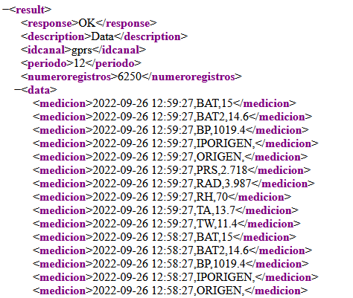
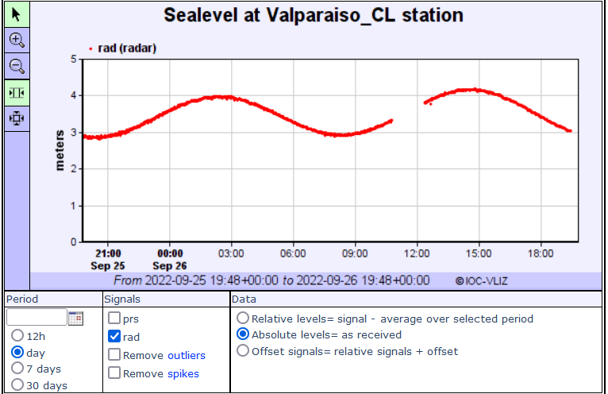
Method 4 – webservice Parsing example
Webservice URL https://niveldelmar.snam.cl/apps/src/ws/wsgateway.php ?wsname=getData &idcanal=gprs &period=12 &date=2022-09-26T13:00:00 &idestacion=valp

Slide 15
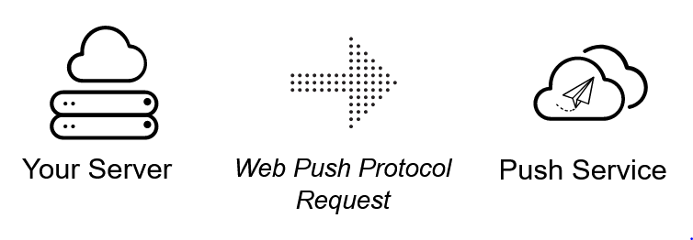
Method 5 – HTTP push (or referred to as “BGAN”)
Station is connected to the public internet via 4G, GPRS, satellite, ...
Script on logger sends HTTP POST request to the SLSMF webserver, containing measurements from sensor
Webserver processes posted messages via same method & data format as GTS
Measurements immediately added to the database: 0 delay (push)
Whitelist of IP addresses that can push

Slide 16
Method 5 – HTTP push Example
Manual http://www.ioc-sealevelmonitoring.org/bgan/
Message parsing => identical as GTS

Slide 17
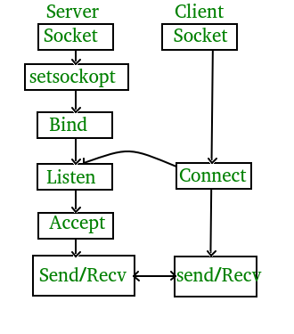
Method 6 – TCP Socket
Station is connected to the public internet via 4G, GPRS, satellite, ...
Logger (or server at provider) opens TCP port that streams measurements from sensor in real time (i.e. 1/sec)
Config in in PHP script: TCP address, format & station code
PHP script connects to TCP port, reads measurements & immediately added to the database = 0 delay (~push)

Slide 18
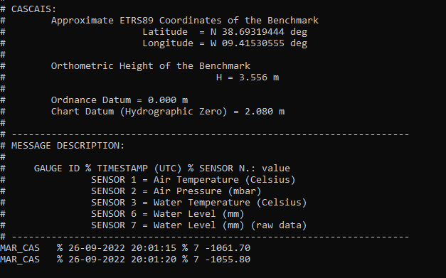
Method 6 – TCP Socket Example
Config in PHP script
Measurements streamed at the bottom
measurements
Message parsing => identical as FTP/webservice: custom function

Slide 19
Method comparison
 | GTS | FTP | Email | HTTP push | Webservice | Socket
Transmit interval (min) | 5 ..15 | 1 .. 60 | 1 .. 60 | 1 .. 15 | 1 .. 6 | 0.01 .. 1
# stations | 556 | 216 | 0 | 60 | 334 | 5
Typical delay (min) | 2 .. 15 | 3 .. 60 | 3 .. 60 | 0 ..15 | 1 .. 6 | 0 .. 1
Ratio expected/ arrived (%) | ~100% | < 90% | < 90% | ~100% | < 95% | < 100%
Data format standard | some | none | good | good | good | good
Mechanism for VLIZ | pull | pull | pull | push | pull | push
Access | Restricted (WMO) | Easy | Easy | Transmission expensive | Set up server & API | Set up server
Issues | Format decoding sometimes hard | Many formats, many file structures. Quite some communication errors | No longer used | Many station non-functional. | Many formats. Quite some communication errors | Not much used. Some communication errors

Slide 20
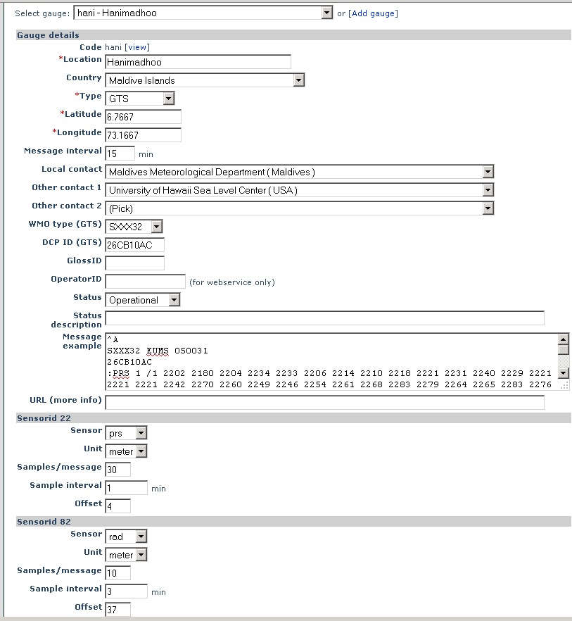
Edit metadata
Edit most station metadata
Add/edit sensors
Add/edit GTS parsing parameters
< method

Slide 21
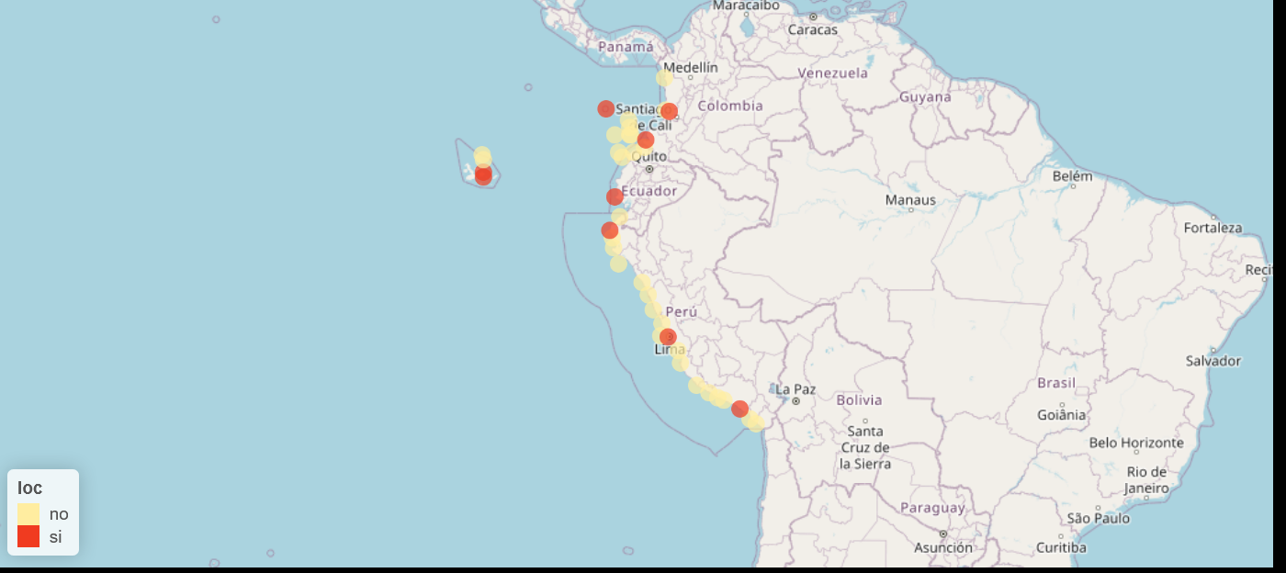
Survey results summary
 | Ecuador | Peru | Colombia
Stations in SLMF | 3 GTS | 3 GTS | 8 GTS 6 FTP
Operational | 3 GTS | 2 GTS | 6 GTS
Additional stations | 11 | 17 | 2
Telemetry | webservice | GPRS/INMARSAT | GOES/BGAN

Slide 22
Stations provided by Instituto Oceanográfico de la Armada (Ecuador) Status at 2022-09-25: 3 stations listed
Code | Country | Location | Connection | DCP ID | Delay | Transmit Interval
balt | Ecuador | Baltra,Galapagos | SEEQ40 | 932040EE | 8' | 5'
lali | Ecuador | La Libertad | SEPO40 | 3540B126 | 7' | 5'
sant | Ecuador | SantaCruz,Galapagos | SEEQ40 | 932085F0 | 9' | 5'

Slide 23
Stations provided by Dirección de Hidrografía y Navegación (Perú) Status at 2022-09-25: 3 stations listed
Code | Country | Location | Connection | DCP ID | Delay | Transmit Interval
atic | Perú | Atico | SEPR40 | 9323727A | 2415d | 1h
call | Perú | Callao,La-Punta | SEPO40 | 354165B4 | 8' | 5'
tala | Perú | Talara | SEPO40 | 35414358 | 8' | 5'

Slide 24
Stations provided by Dirección General Marítima (Colombia) Status at 2022-09-25: 14 stations listed
Code | Country | Location | Connection | DCP ID | Delay | Transmit Interval
cove | Colombia | Coveñas | ftp |  | 783d | 15'
malp | Colombia | Malpelo | ftp |  | 779d | 15'
sapz | Colombia | Sapzurro | ftp |  | 160d | 5'
buve | Colombia | Buenaventura | ftp |  | 160d | 5'
inav2 | Colombia | Isla Naval | ftp |  | 160d | 5'
tumc | Colombia | Tumaco | ftp |  | 160d | 5'
sama | Colombia | Santa Marta | SEPO40 | 35419530 | 65d | 5'
malp2 | Colombia | Malpelo | SXCO41 | 15AAB424 | 39d | 5'
tumc2 | Colombia | Tumaco | SXCO41 | 15AAC2B4 | 19' | 15'
cart | Colombia | Cartagena | SXCO41 | CB046524 | 13' | 1h
buve2 | Colombia | Buenaventura | SXCO41 | 15AA92C8 | 12' | 5'
inav | Colombia | Isla Naval | SXCO41 | 15A05856 | 9' | 15'
sapz2 | Colombia | Sapzurro | SXCO41 | 15A045F2 | 9' | 5'
sana | Colombia | San Andres | SEPO40 | 35418646 | 8' | 5'

Slide 25
Questions?
Thanks.
www.ioc-sealevelmonitoring.org
info@ioc-sealevelmonitoring.org

