Slide 1




Taller
“Acceso compartido a datos de Nivel del Mar:
Herramienta para una respuesta Regional
efectiva ante Emergencias de Tsunami”.
27 al 30 de septiembre
Valparaíso - Chile

Slide 2

SEA LEVEL STATION MONITORING FACILITY
Francisco Hernandez (tjess@vliz.be)
Bart Vanhoorne
info@ioc-sealvelmonitoring.org
Flanders Marine Institute (VLIZ)
Belgium
www.ioc-sealevelmonitoring.org

Slide 3
Content
Sea level station monitoring facility summary
History
Data flow
Operational Interface
Station metadata management
Webservices & API
Sea Level Station Catalogue
Plans & projects

Slide 4
Summary
The sea level station monitoring facility (http://www.ioc-sealevelmonitoring.org/) collects and processes in real time data from 1028 sea level measuring stations operated by 164 institutes (station operators) world wide.
The objective of this service is
  to provide information about the operational status of global and regional networks of real time sea level stations
  to provide a display service for quick inspection of the raw data stream from individual stations.
The system was build and is operated by Flanders Marine Institute (VLIZ) for UNESCO as part of the GLOSS program of IOC.

Slide 5
Summary
The station operators push the raw data to the SLMF using different data protocols : the WMO GTS, FTP push, HTTP and even Email. The data is parsed in real-time and stored in the database. The SLMF redistributes the parsed real time data through a series of interfaces ( webpages, a rest API, or the GTS) to the different users, including the Tsunami warning centers, the station operators and the scientific community.
The SLMF database contains the sealevel data, but also metadata, contact information and configuration data about the different stations and their sensors. The team at VLIZ, the station operators and the Tsunami warning centers, maintain the configuration data.

Slide 6

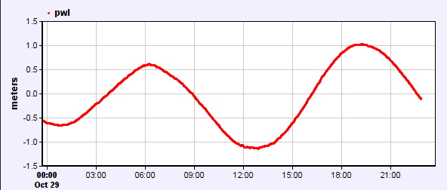


History
Monitoring status of gauges: working yes/no (2006)
  Collect data in realtime
Inspect raw data (2007-2008)
  Display graph
  Download data
  => tsunami evaluation
Performance (2011-2012)
  Expected vs. Arrived
  => Feedback operators
Archive data (2013)
  Accessible via webservice
  redundancy

Slide 7

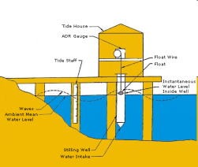
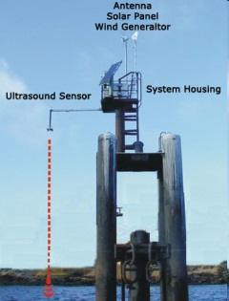


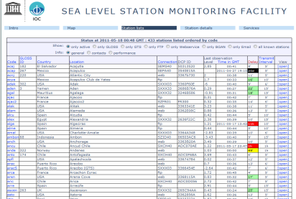

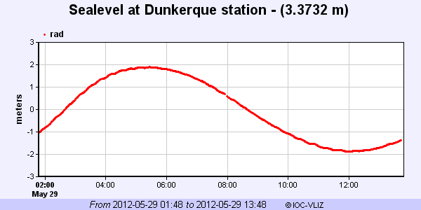
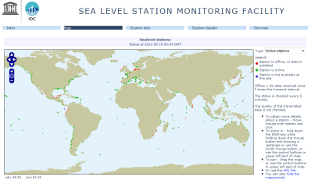
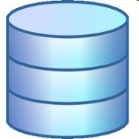

Data flow
GTS
Belgian
MetOffice
BGAN
FTP upload
VLIZ server (1x/min)
FTP/HTTP/Email
Push/pull to VLIZ
server (5min-1h)
Website
±730 stations: parse & insert into database
Tsunami centers
Station operators
Webservice / REST API
Database
Script(s)

Slide 8
Data ingestion
 | GTS | FTP | HTTP API | Webservice
Transmit interval (min) | 5 ..15 | 1 .. 60 | 1..60 | 5
Total station | 541 | 225 | 325 | 58
Typical delay (min) | 2 .. 15 | 2..12 | 1..15 | 1-5
Ratio expected/arrived (%) | ~100% | << 80% | ~100% | ~100%
Mechanism | Push to GTS of WMO | Push to FTP server at VLIZ or pull from station operator FTP | Pull from web api | Push to HTTP server at VLIZ
Notes | Many formats , some standards CREXX, OTT, GOES, | Mostly 1 new file per day per station, updated constantly | Many formats | Almost no delay

Slide 9
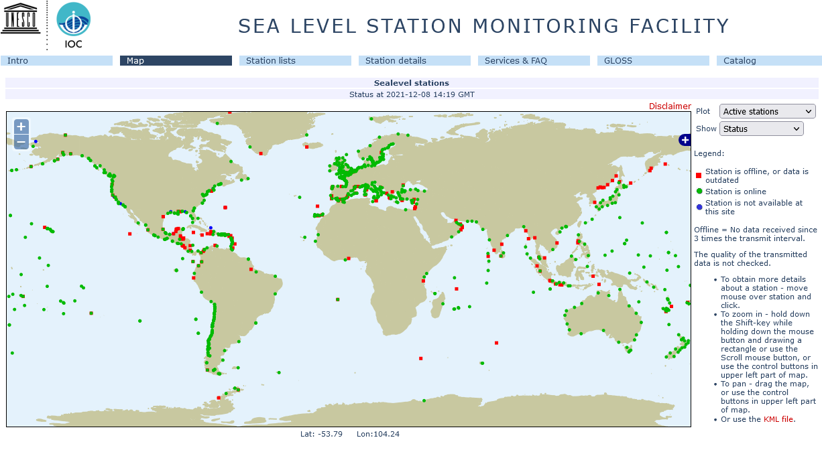
What stations are operational or offline.
For which data flow GTS / FTP / HTTP /.. ?

Slide 10
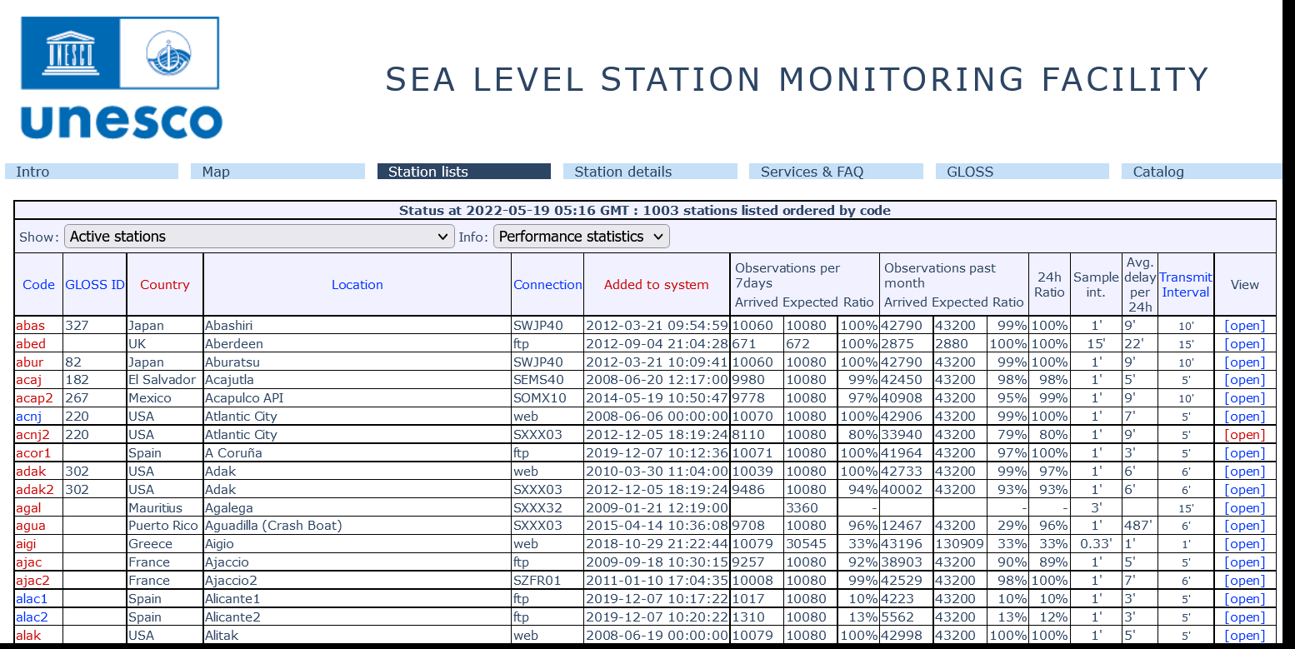
List of stations

Slide 11
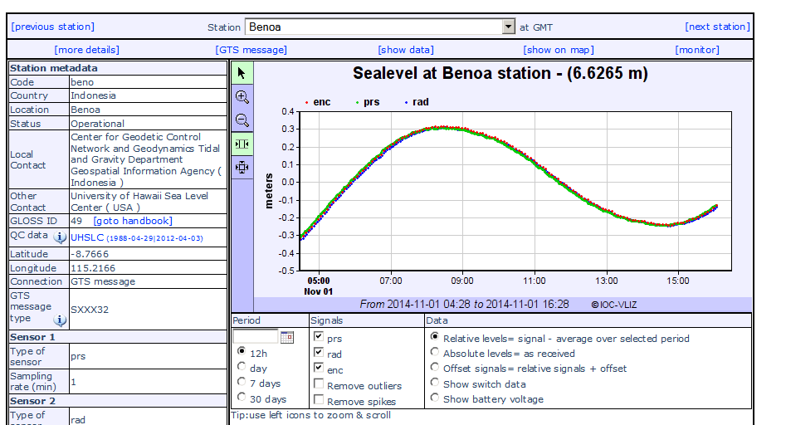
Station details

Slide 12
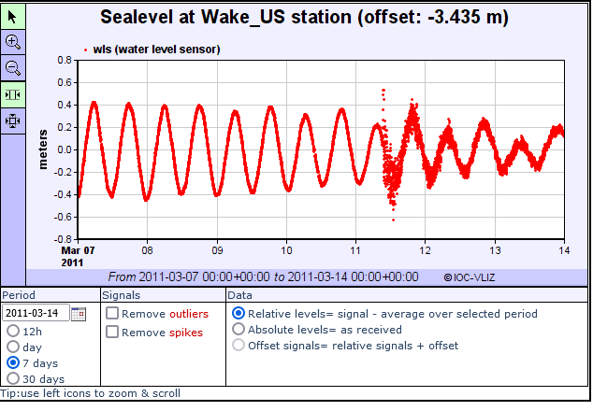
Tsunami signals

Slide 13
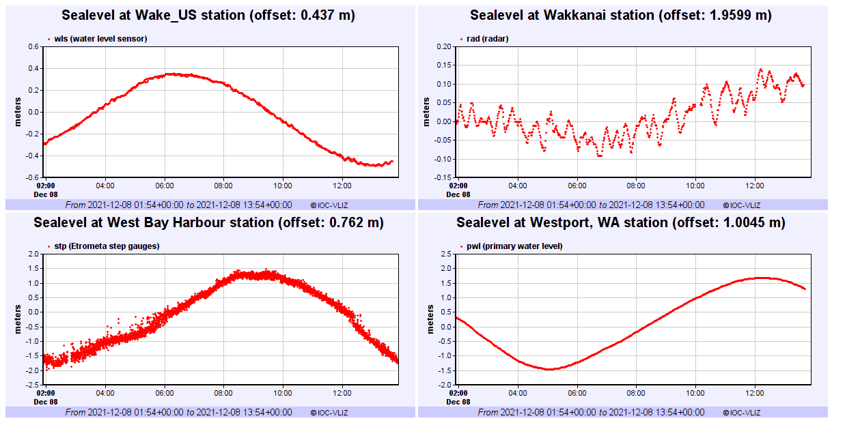
Real Time monitoring multiple stations

Slide 14
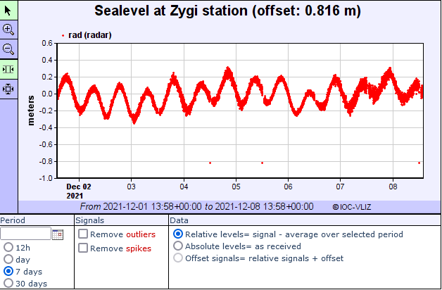
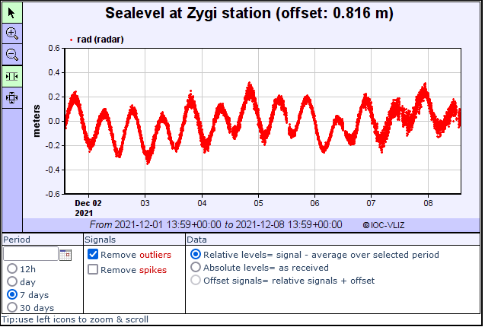
Optional quality control

Slide 15
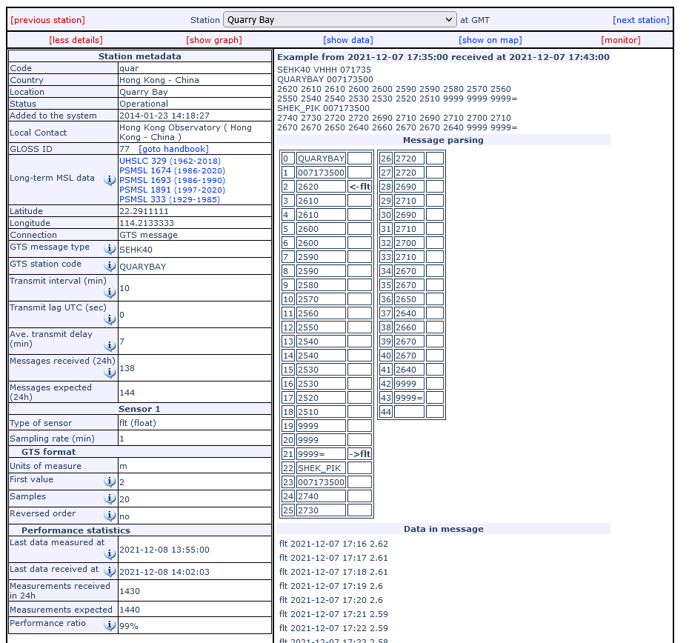
Parsing GTS messages

Slide 16
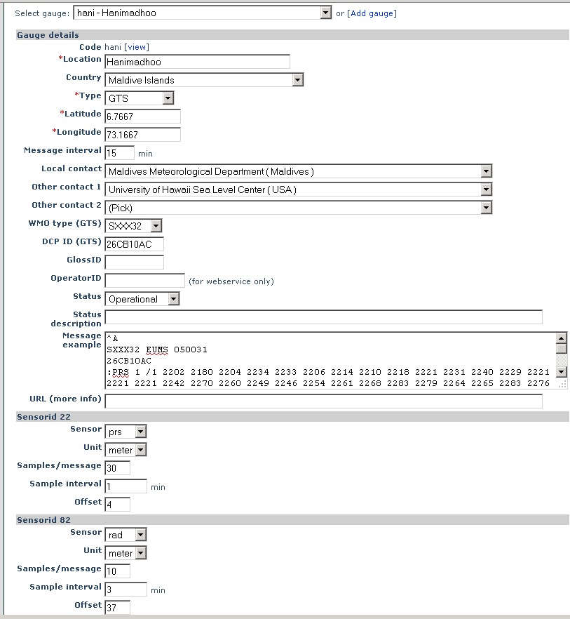
Edit metadata
Edit most station metadata
Add/edit sensors
Add/edit GTS parsing parameters

Slide 17
Webservice API users
“Official”/registered users:
Centre national d'alerte aux tsunamis (CENALT), France
EU Joint Research Centre (JRC), Europe
GEMPA, Germany
Indian National Centre for Ocean Information Services (INCOIS), India
Instituto de Meteorologia, Departamento de Sismologia e Geofísica, Portugal
Marinel-Eareth Science and Technology (JAMSTEC), Jampan
NOAA Center for Tsunami Research, US
NOAA, NGDC, US
Pacific Islands Ocean Observing System (PacIOOS)
Permanent Service for Mean Sea Level (PSMSL), UK
Service Hydrographique et Océanographique de la Marine (SHOM), France
University of Tasmania
=> users@ioc-sealevelmonitoring.org

Slide 18
Webservice API
Machine to machine
REST
Standard format: JSON/XML/ASCII
Registration
Simple: 4 data types:
  data
  stationlist
  Sensorlist
  Station

Slide 19
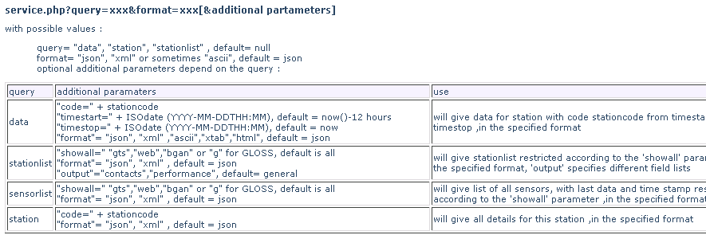
Query parameters

Slide 20
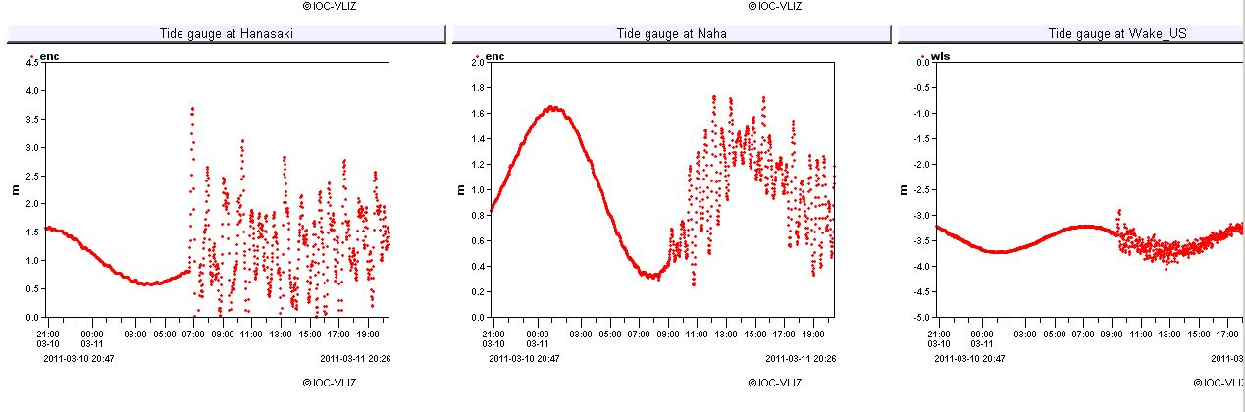
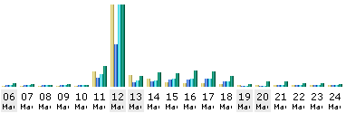
Japan Tsunami 2011-03-11 impact on performance
2,901,945
44,150

Slide 21
Sealevel Station Catalog (SSC) http://www.ioc-sealevelmonitoring.org/ssc
Goal
Central point for station metadata Updated by datacenters and/or gauge operators
By
Linking station identifiers of #datacenters (UHSLC, PSMSL, SONEL, ...) and any other identifier (GLOSS, PTWC, …)

Slide 22
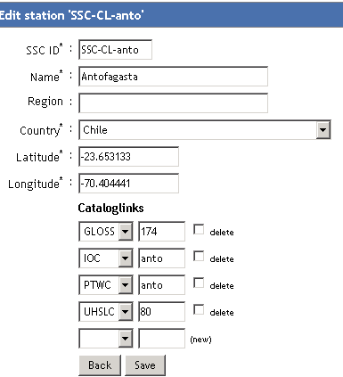
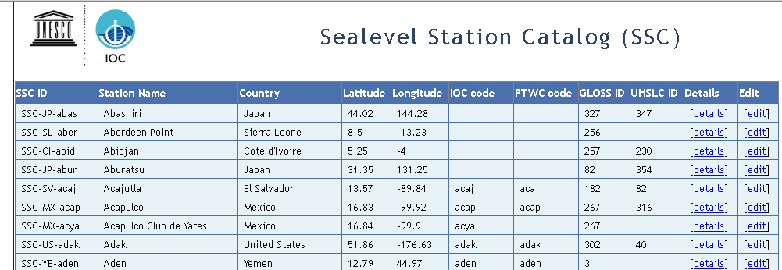
SSC Core fields
Very limited fields
(4-5) stored in SSC
Unique Identifier
Station name
Country
Region (optional)
Lat/lon
Identifiers (1-n)

Slide 23
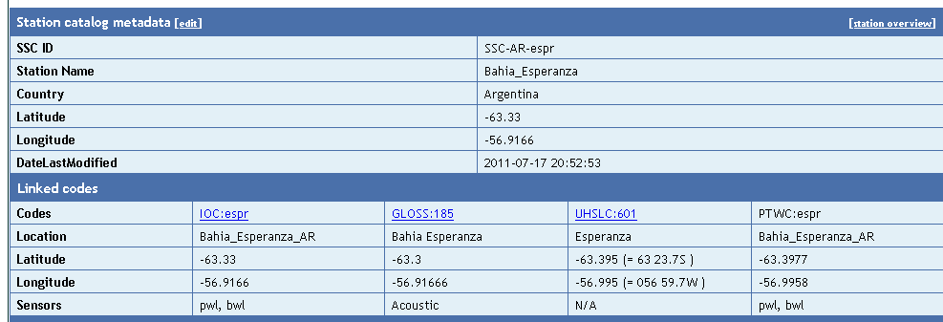
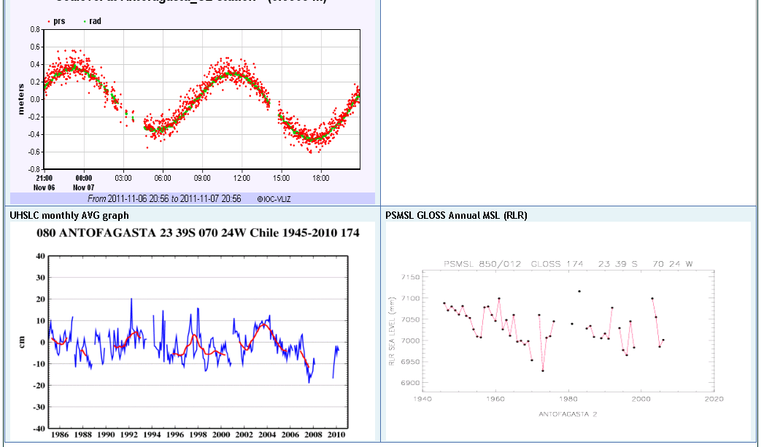
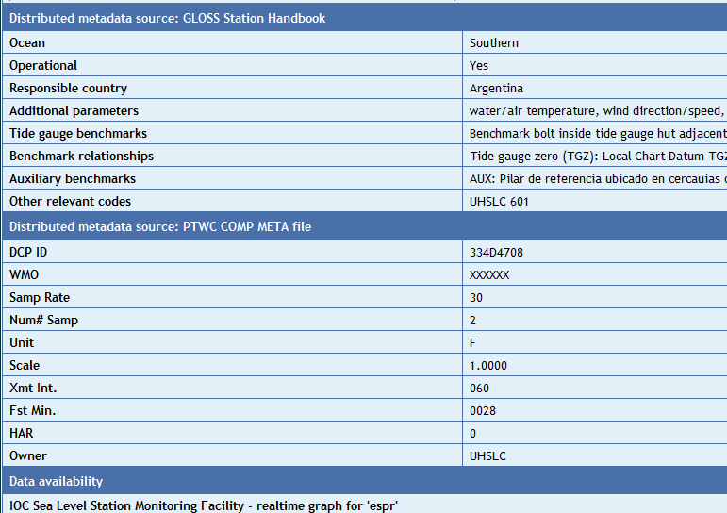
SSC Station detail
Stored
in SSC
Compare
metadata
Linked
via
Web-service

Slide 24
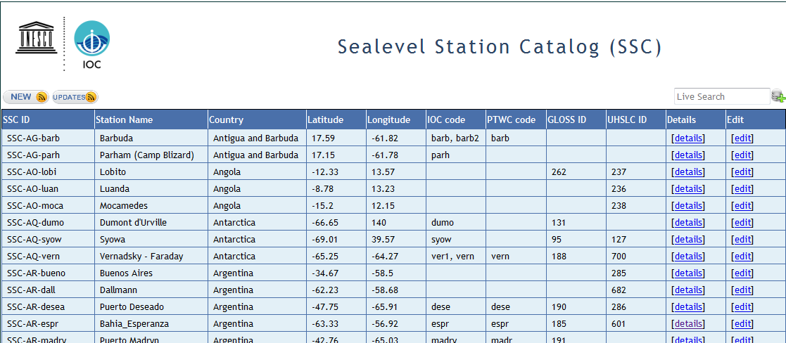
SSC functionalities
Live search
RSS feeds
Anyone can go in and edit
Cache linked data (performance)

Slide 25
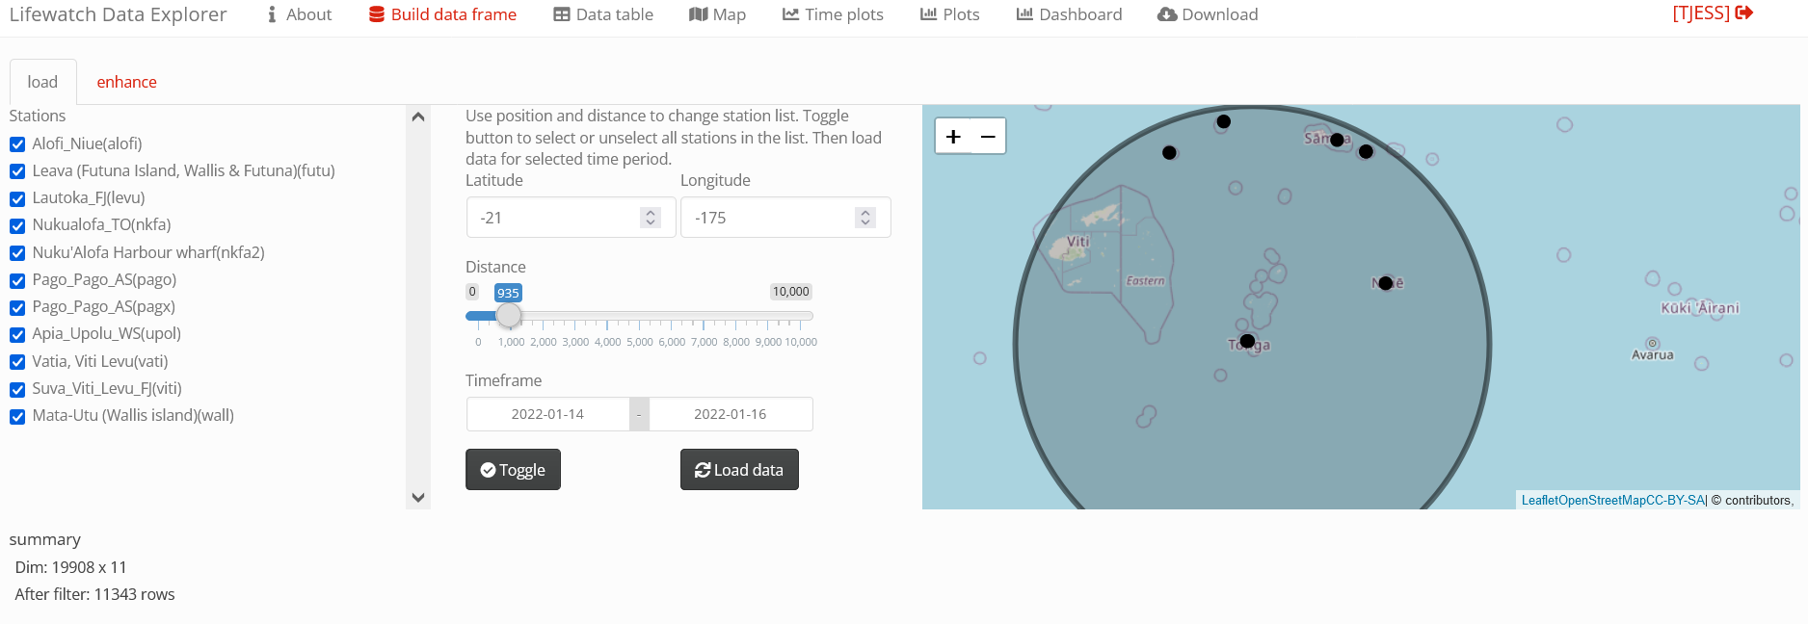
http://rstudio.vsc.vliz.be:52038/tjess/lifewatch-dataexplorerOnVSC/?_state_id_=c52ceb269cc3366c

Slide 26
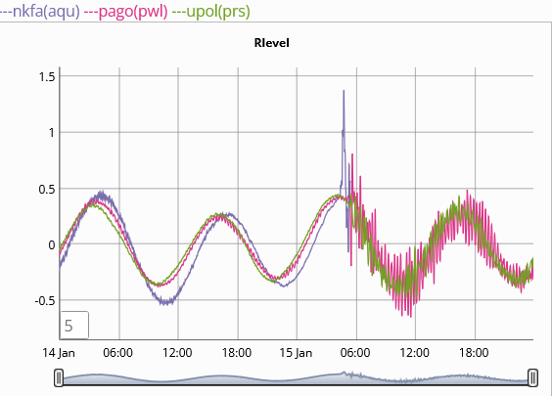
Tonga

Slide 27
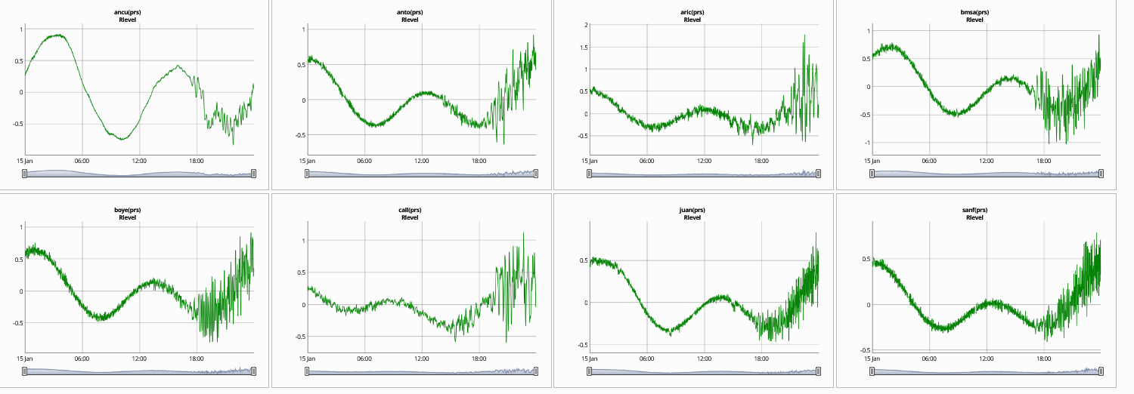
Tonga waves Chile

Slide 28
Plans
Budget & projects :
  EPOS Tsunami CTS
  Geo Inquire : + 1 FTE/3y
  Geophysical extremes Digital Twin : + 1 FTE/1y
  VLIZ : + 1 FTE + hardware
Operationality :
  Mirrors :
    2 data hubs
    2 websites
    # timezones
  Split research data

Slide 29
Plans
Research tools:
  API 30day limit
  Online QC & detiding
  Cloud (Rstudio/Rshiny) & HPC
  Archive data via file download
Filling gaps :
  Africa 50k€, IDSL
  S-America SHOA : Chile, Peru, Ecuador
  DART
  Baltic ?
  Denser network ?
Feedback : info@ioc-sealevelmonitoring.org

Slide 30
Thank you
www.ioc-sealevelmonitoring.org
info@ioc-sealevelmonitoring.org

