Slide 1
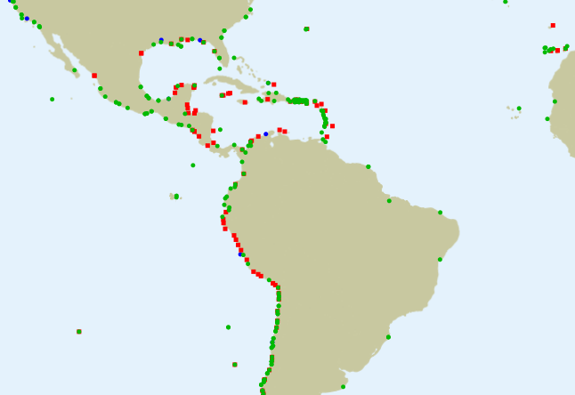
New station status 2022-09-29

Slide 2
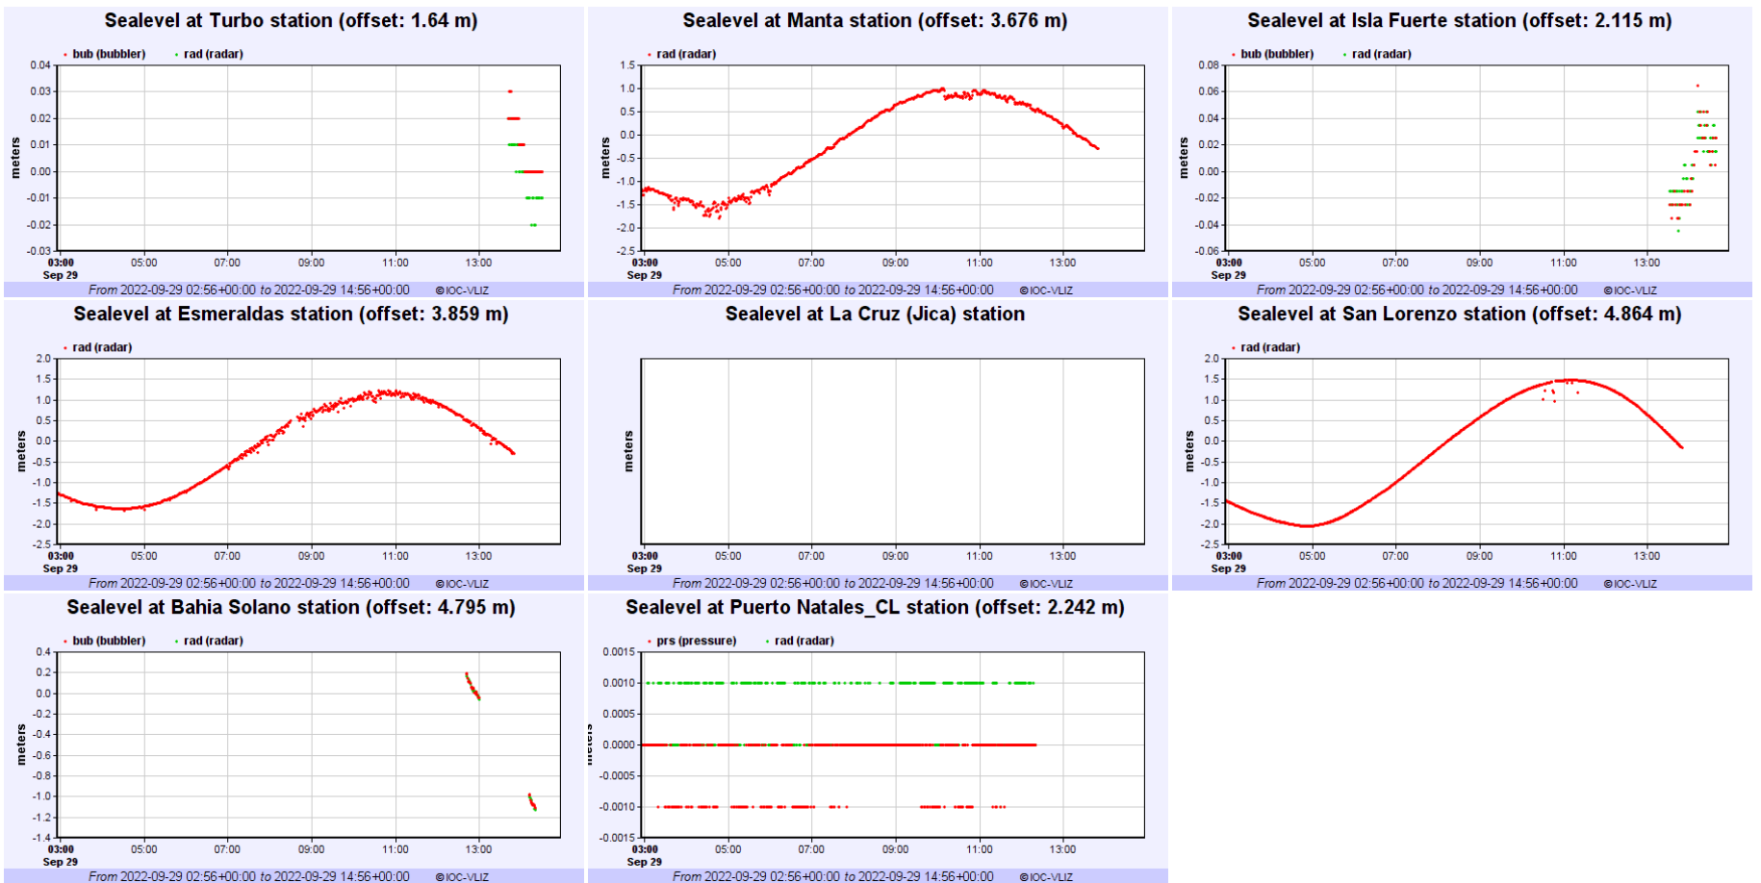

Slide 3
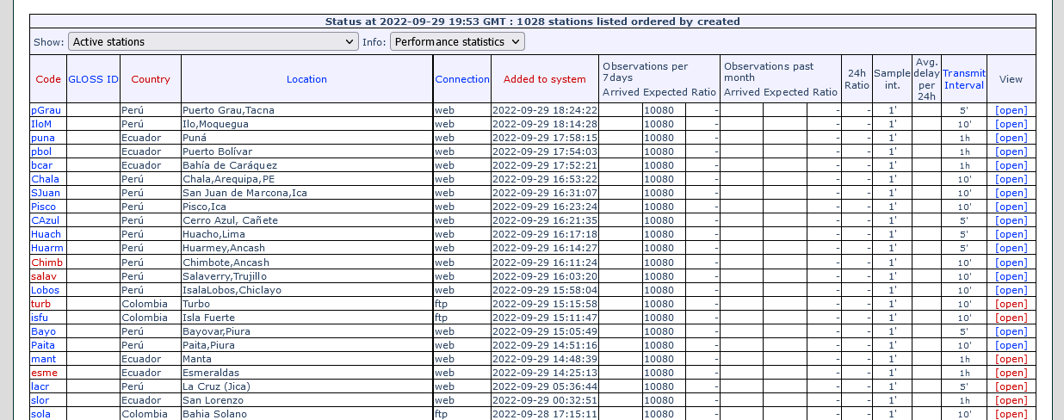
23 new stations

Slide 4
The plan
During workshop
  Colombia
    Start 3 Shared stations in the Pacific + 5 in the Caribean
    Added 2 for the Pacific and 3 in the Caribean
    From 13: 6 (GTS) Still to fix coding problems. Ott binary issue will be tackled by VLIZ.
    Still pending adding one station in Buenaventura
    Add station metadata for Colombia
    ftp connection to VLIZ is done every 10 minutes
    Transfer redundancy pending
    Solve OTT binary problem for GOES connection
    High staff rotation and low budhet issues for keeping a steady advance

Slide 5
The plan
During workshop
  Ecuador
    Add station metadata for Ecuador (done).
    Learned new strategies and optimizing already existing tools (GRASP website).
    Start 3 stations (GTS)
    Added 4 new Stations (3 GTS)
    Comitted to correct format errors
    Sampling from 60 min to 5 minutes from INOCAR servers to GRASP website, still pending.
    Importance of Institucional will to progress, and keep in contact with VLIZ.
    Updating Tide tools in Tsunami Warning Centers.
    BID project will add 3 new stations in the future.
    Transfer from grasp pulled from VLIZ
    Add webservice connection to INOCAR : https://coos.inocar.mil.ec/visores/red_mareografica/

Slide 6
The plan
During workshop
  Peru
    Started 3 stations (GTS) already in VLIZ
    19 Sttaions operationals nut 16 missing from VLIZ
    Aquired knowledge to transfer existing stations
    Added 15 stations (8 require manual update of the data, the rest is automatic)
    Missing 1 stations that has DCP ID issue
    Solved timezones differences by VLIZ script, in the future
    Add station metadata for Peru, VLIZ Pulls data from DHN servers
    Add webservice connection to Peru website
    Add GOES connection for Hormigas de Afuera
    Improve redundancy in data management in the future.

Slide 7
The plan
During workshop
  Chile
  Improve delay problemas in GTS
  Work on implementing low cost stations in isolated SIPAT blocks.
  Improve redundancy in inmarsat stations
  Share local observers training.
  Share knowledge in GOES uses

Slide 8
The plan
During workshop
  PTWC
    Finding common solutions and achieving progress.
    Filling information GAP from sea level data is truly importance.
    Importance of keeping in contact and work on maintainability not only in hardware but also in staff

Slide 9
The plan
Short term after the workshop
  Peru : 1 GOES -> GTS
  Columbia : Binary OTT
  Ecuador : 5min script
  Chile : solve delay problems, work on web push
In 2023
  IDSL : 4 stations in test ?
  Project to fund IDSL or GOES transmitters (IOC?)
  Antarctica ?

