Slide 1
UK National Report
DBCP– 38, Hybrid meeting, Geneva, Switzerland, 1-4 November 2022
fraser.cunningham@metoffice.gov.uk

Slide 2
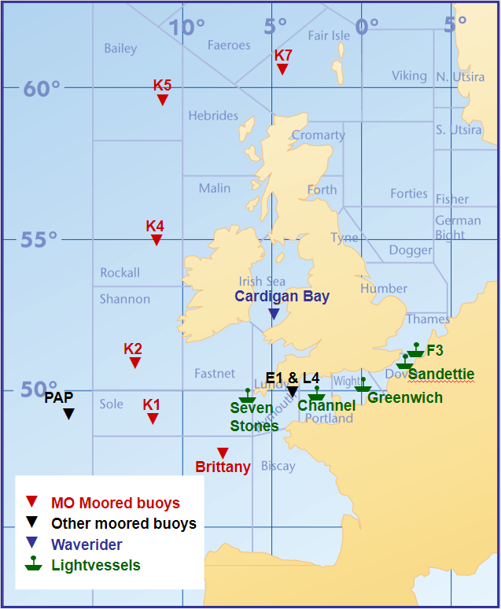
Moored Buoys
K1 to K7, Brittany and Cardigan Bay/Channel waverider operated by Met Office
PAP (OceanSITES) operated jointly with National Oceanography Centre
E1, L4 operated jointly with Plymouth Marine Laboratory (not deployed at present)
Light vessels operated by Trinity House with Met Office systems installed
Primary use of moored buoy data by Met Office is for forecasting and early warning of severe weather conditions, forecast verification, validation of wave model forecasts
Data also used in marine climate datasets and studies
Notes:
List parameters

Slide 3
Successes
Marine Systems Engineering team visited every buoy in the network, restoring network to full operation for first time in a number of years
New MoA agreed with MeteoFrance. Met Office has taken responsibility for Brittany Buoy, while MeteoFrance has taken responsibility for Gascogne

Slide 4
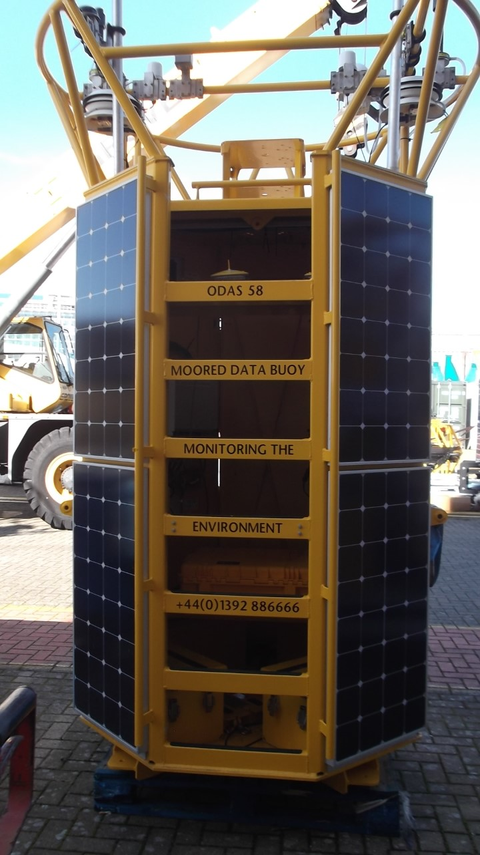
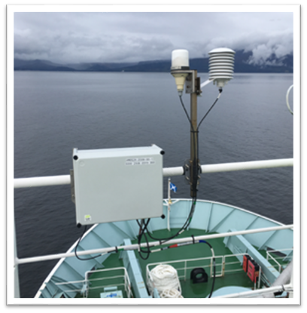
Technology/Developments
New generation of buoys rolled out across network: AMOS2X (CR1000X loggers/Iridium comms) on Mobilis/Hyrdosphere hulls. One type of system deployed across automated networks
Wind speed, direction, max gust, air temp, relative humidity, SST, spectral wave parameters (visibility on light vessels)
Legacy Mk2b CR10x/PC42 based systems on Balmoral hulls have been retired
Data processing/monitoring to be migrated to common SurfaceNet architecture - flexible/easy to maintain - Delayed
Moored buoy BUFR template generation delayed
Wave data processing problems

Slide 5
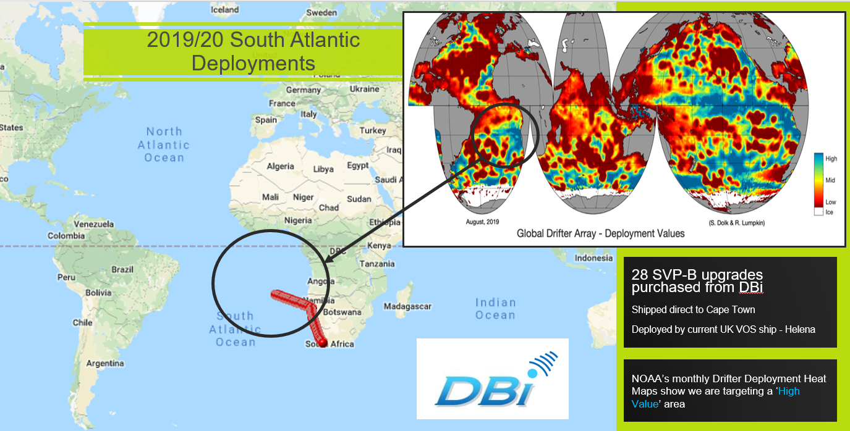
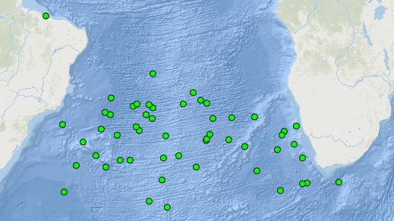
Drifting Buoys
South Atlantic Deployments
SVP-B Deployments
FY21/22
20 DBi
2 Pacific Gyre
FY22/23 so far
6 Scrips
5 Pacific Gyre
Assimilation into NWP models
Use in Hadley Centre climate datasets

Slide 6
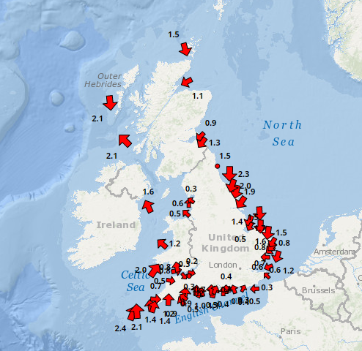
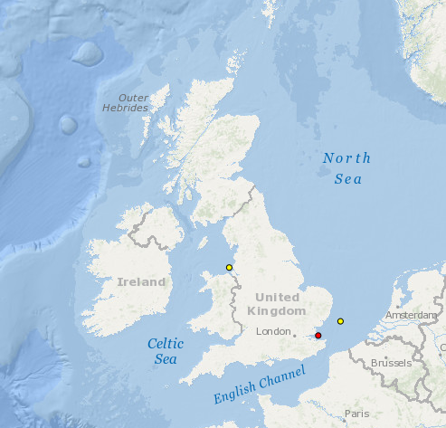
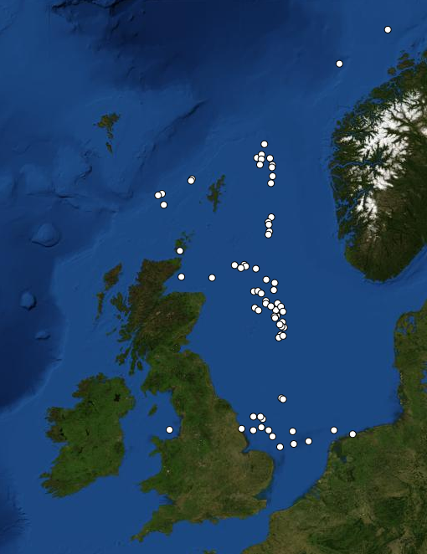
Other UK networks
Cefas WaveNet - real-time wave data from a network of wave buoys located in areas at risk from flooding
Cefas SmartBuoys - multi-parameter platforms to collect marine environmental data for eutrophication, environmental variability and change, ecosystem function monitoring
RigNet MetReach – real-time metocean data from around 50 offshore oil and gas platforms (data exchanged on the GTS)

Slide 7
Thank you!
fraser.Cunningham@metoffice.gov.uk

