Slide 1
USA National Report
DBCP–38, 1—4 Nov 2022
Rick Lumpkin, Rick.Lumpkin@noaa.gov
Input from Tara Clemente, Karen Grissom, Robert Jensen, Ignatius Rigor, and Rory Toon

Slide 2
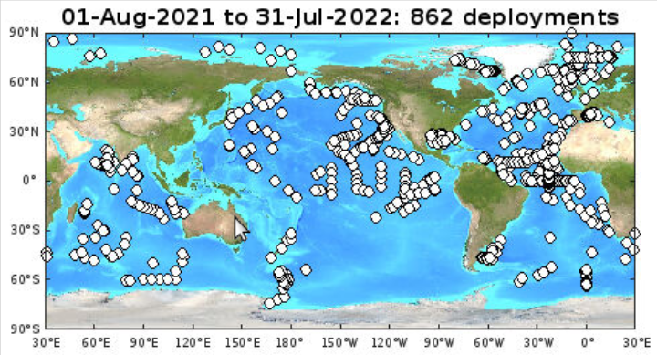
Global Drifter Program

Slide 3
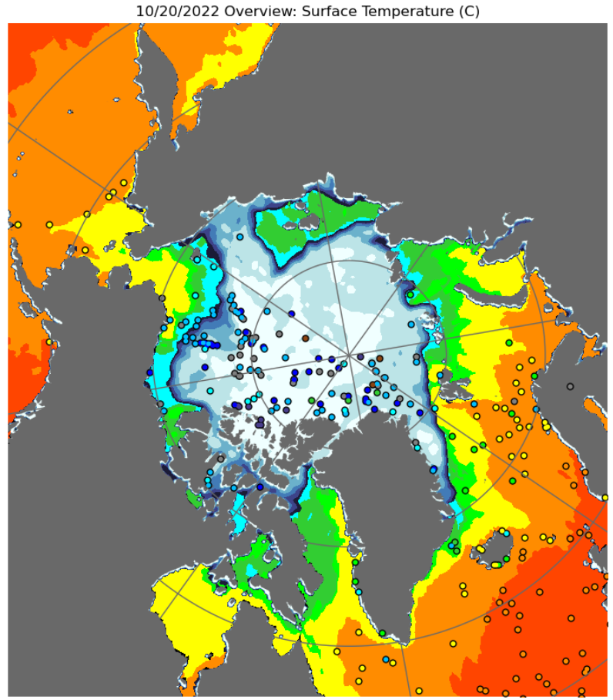
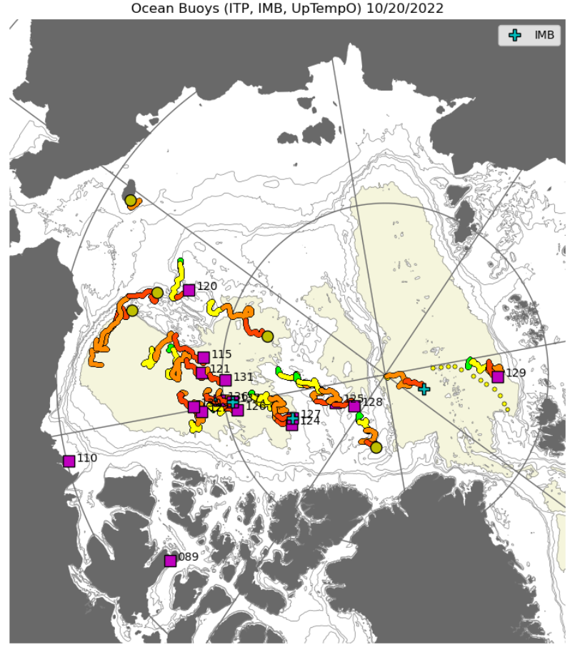
US Interagency Arctic Buoy Program (USIABP)

Slide 4
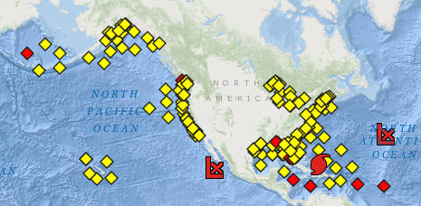
NDBC Coastal Weather Buoys
NDBC Moored Buoys (MET/OCEAN), showing stations reporting in the last 8h (yellow) or not (red). Figure from http://www.ndbc.noaa.gov/obs.shtml. This image is for 20 September 2022.

Slide 5
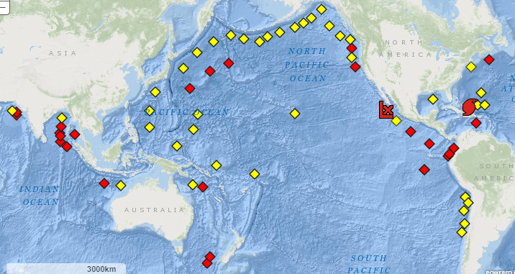
NDBC Tsunameters
: International Tsunami Network status, showing stations reporting in the last 24h (yellow) or not (red). Figure from http://www.ndbc.noaa.gov/obs.shtml. This image is for 20 September 2022.

Slide 6
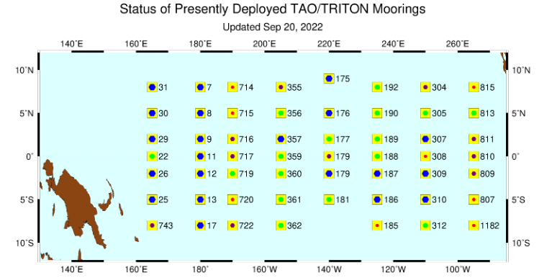
Tropical Atmosphere Ocean (TAO)
NDBC Tropical Atmosphere Ocean (TAO) Array and TRITON Array status. The numbers indicate how many days have passed since last servicing (ideally <365). Figure from http://www.pmel.noaa.gov/tao/global/status/.

Slide 7
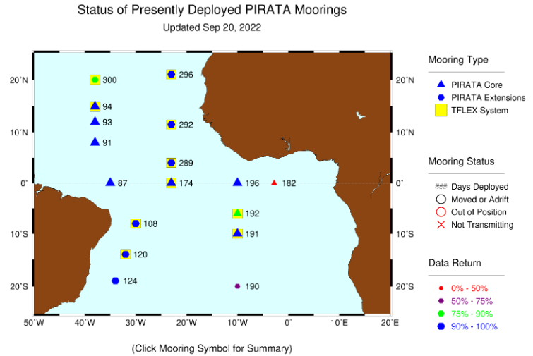
Prediction and Research moored Array in the Tropical Atlantic (PIRATA)
PIRATA Array including PMEL/AOML Northeast Extension status. The numbers indicate how many days have passed since last servicing (ideally <365). ). Figure from http://www.pmel.noaa.gov/tao/global/status/.

Slide 8
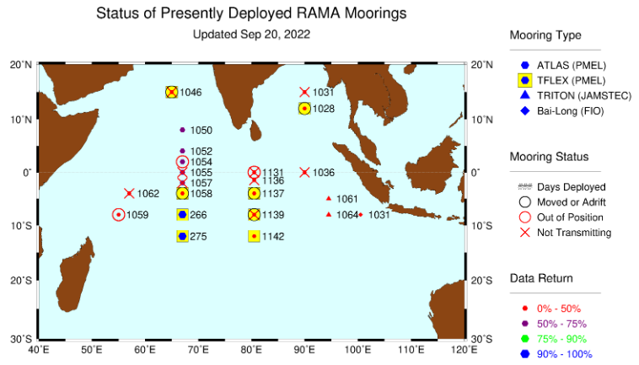
Research Moored Array for African-Asian-Australian Monsoon Analysis and prediction (RAMA)
International RAMA Array status. The numbers indicate how many days have passed since last servicing (ideally <365). Figure from http://www.pmel.noaa.gov/tao/global/status/.

Slide 9
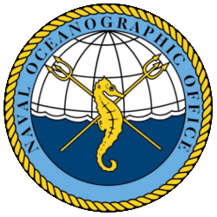
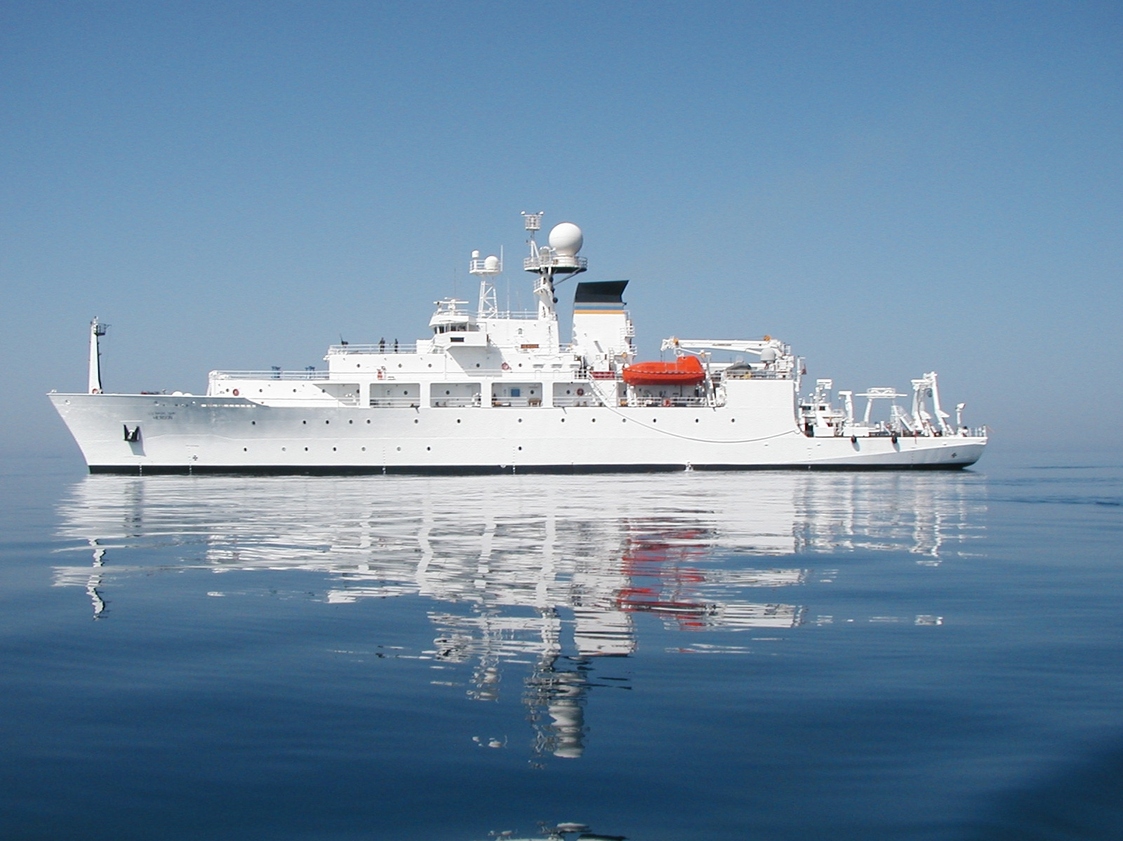
Naval Oceanographic Office (NAVOCEANO)

Slide 10
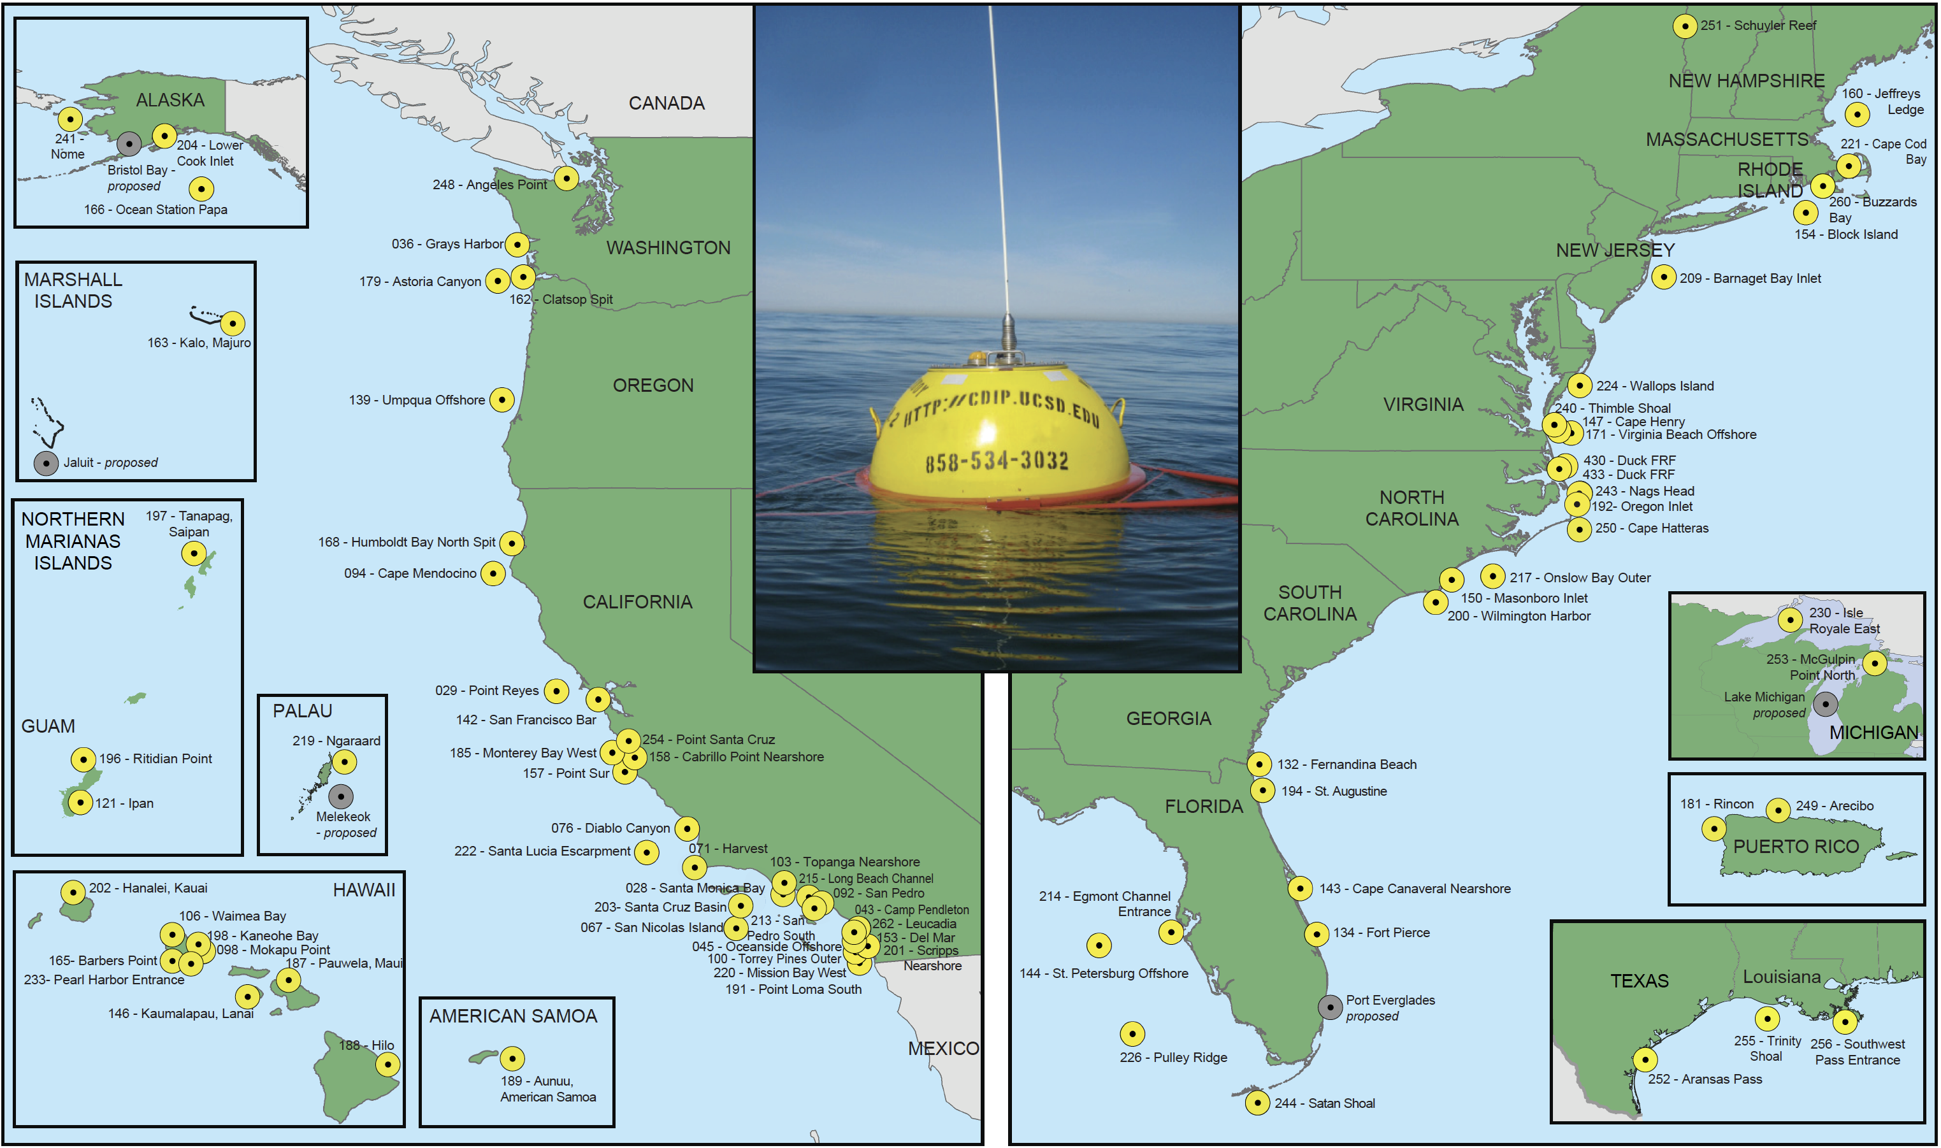
Coastal Data Information Program (CDIP)

Slide 11
Key Successes/Highlights
A new generation of mooring data acquisition system, named TELOS, is currently being tested. These systems will offer increased flexibility for incorporating additional instrumentation and higher resolution real-time data transmissions.
The Bay of Bengal Large Marine Ecosystem Project (BoBLME) supports a PMEL-designed system for CO₂ and ocean acidification observations at one RAMA site. Ancillary observations are provided by Oregon State University, GEOMAR, LOCEAN, and Dalhousie University.
The next generation of the TAO buoy is currently being tested in the TAO array. To date there have been three successful field tests of the new technology. Each deployment is more complex than the previous. The new TAO Recap buoys will offer value additional mixed-layer observations and air-sea flux instruments along with higher resolution real-time data transmissions.

Slide 12
Data usage
Data used for weather prediction, ocean state estimation, and monitoring climate change globally.
Over 100 peer-reviewed research papers published in the intersessional period that rely on data from these buoy programmes (see USA national report).

