Slide 1
Australian National Report
DBCP– 38, Hybrid meeting, Geneva, Switzerland, 1-4 November 2022
Joel Cabrie
Manager Marine Networks
Bureau of Meteorology

Slide 2
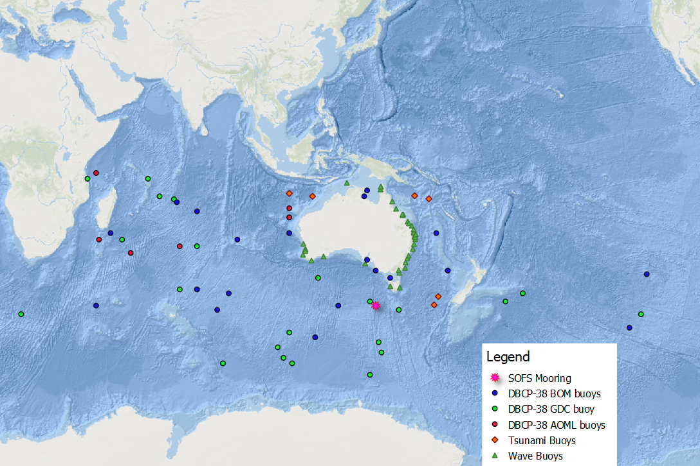
Current Status
27 x Bureau-owned drifting buoys
6 x Barometer upgrade drifting buoys
22 x GDC drifting buoys
2 x Bureau-owned wave buoys (Triaxys)
2 x IMOS-funded wave buoys (Triaxys)
37 x 3rd party wave buoys
6 x Tsunameters
1 x Southern Ocean Flux Station buoy

Slide 3
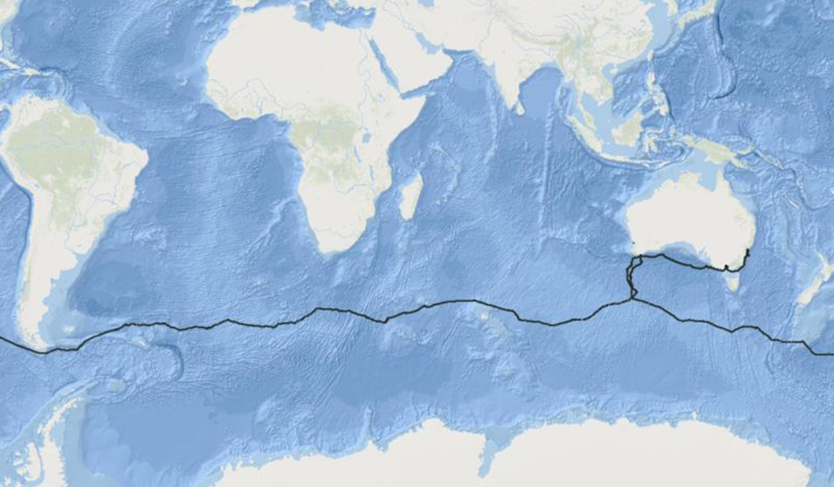
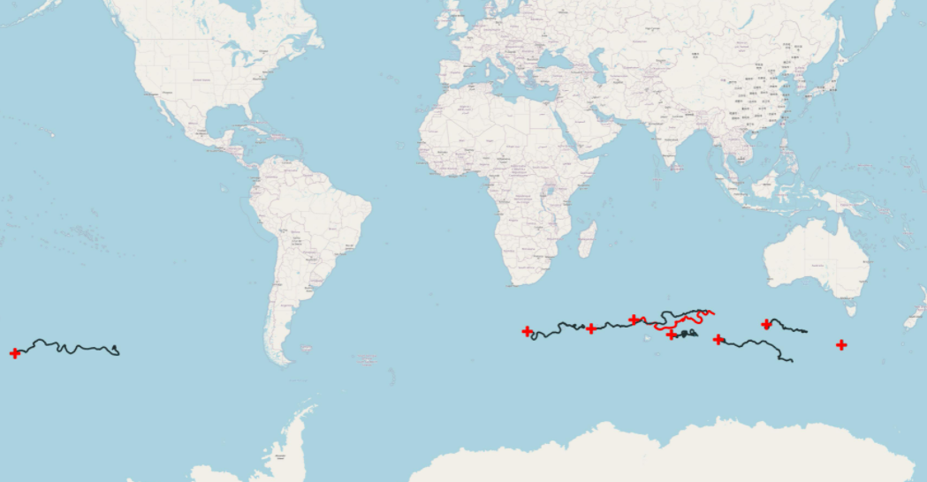
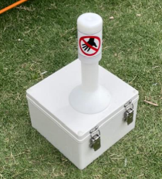
Highlights
Deck Drifter deployed on Climate Action Now reporting hourly pressure observations during Antarctic circumnavigation
8 x Drifting Buoys deployed by Lisa Blair during this voyage.

Slide 4
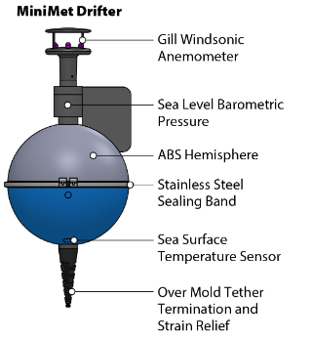
Highlights
National infrastructure for in-situ wave observations project well underway
Standard operating procedures
Standardised data format (simplified to encourage participation from 3rd party providers)
Standardised Quality Control procedures based on QARTOD manual
Scripps Minimet moored buoy ready for deployment in the Gulf of Carpentaria
To report in BUFR 315008
To be deployed by fishing trawler in June 2023

Slide 5
Issues & Risks
PMO Fremantle responsible for drifting buoy deployment planning and logistics will be retiring in November. Vacant position currently being advertised
BUFR migration for wave buoy networks delayed until National infrastructure for in-situ wave observations project is completed
All data supplied to the Bureau in a standard data format can then be easily translated into BUFR 315008 for posting to the GTS

Slide 6
Publications & User Impact
Data from the national wave buoy network (41 buoys) now being used for forecast verification.
All wave and SOFS mooring data made available on the Australian Ocean Data Network (AODN) database for research purposes.

Slide 7
Thank you!
Joel Cabrie
Joel.cabrie@bom.gov.au

