Slide 1
Global Drifter Program
Rick Lumpkin and Luca Centurioni
DBCP-38, 1-4 November 2022

Slide 2
1. Statistics
  How many meetings did you have this year ? Many (biweekly GDP telecons; GOMO Extreme Events and Ocean Observations (EEOO) telecons)
  How many actions do you have ? None
  How many actions have been completed N/A
  How many actions will be completed next year ? N/A
  How many actions have not progressed ? N/A
  How many new actions have been added? None

Slide 3
2. Alignment to DBCP strategy
1. Which are the top three key Strategic Pillars for your TT?
1 (Impact and value), 2 (Scientific and operational excellence), 3 (Technology innovation) and 5 (International cooperation and partnerships)
2. Which are the top three Strategic Actions for your TT?
1.3: Promote the use of data from ocean buoys
1.6: Derive and report on metrics and key performance indicators
3.1: Encourage research and development activities
5. What are success measures of these strategic actions? Number of publications; improvements to marine forecasts; drifter array coverage.

Slide 4
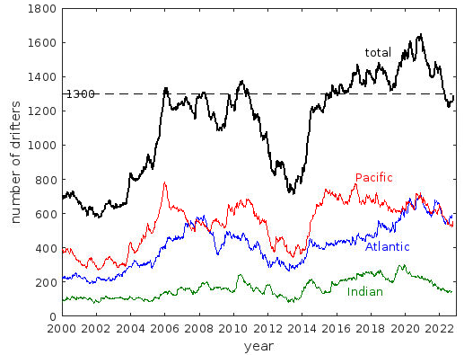
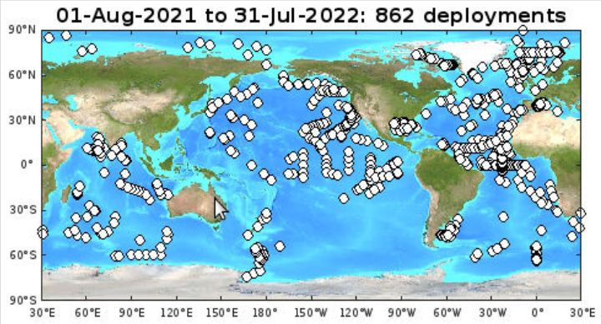
3. Key highlights this year
Certification and deployment of A-sized drifters from NOAA P-3 research aircraft
Global array maintained via 862 deployments in the intersessional period
Number of GDP publications has exceeded 1180

Slide 5
4. Key focus areas for next year
Seek barometer upgrade partners to increase fraction of array with barometers for improved marine weather forecasts
Grow array of directional wave spectrum drifters alongside array of drogued drifters measuring ocean currents
Strengthen connections with operational agencies such as NOAA/National Weather Service/Ocean Prediction Center

Slide 6
5. Key take-home messages
While Global Drifter Array coverage was impacted by increased Iridium transmission costs and the pandemic, deployments are now increasing in high-need regions
Continued DBCP assistance in advertising the Barometer Upgrade Program is welcome

