Slide 1
China National Report
DBCP– 38, Hybrid meeting, Geneva, Switzerland, 1-4 November 2022
YUE Xinyang
yue_xin_yang@outlook.com

Slide 2
Current Programme
AGENCY: Ministry of Natural Resources(SOA), China Meteorological Administration, Chinese Academy of Sciences
1. Deployed during August 2021—July 2022: 25
2. Operational as of 31 July:
56 Moored buoys
58 Argo floats
3 Other type of buoys
3. Reporting on GTS as of 31 July: 60
4. Main deployment areas:
China Seas and adjacent waters, Tropical Western Pacific，
Tropical Indian Ocean, the Arctic Ocean
5. Vandalism incidents: 8
6. Purpose of the programme:
research, operations, forecasting and etc.

Slide 3
Planned Programme(s)
Number and type of buoys planned for deployment in next 12 months | Deploy location
6 moored buoys | China Seas and adjacent waters, Indian Ocean, the Arctic Ocean
AGENCY:
Ministry of Natural Resources(SOA)
Purpose of the programme:
research, operations, forecasting and etc.

Slide 4
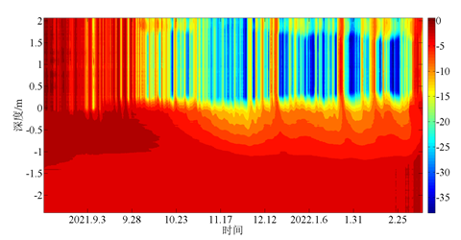
Technical Developments
The sensors on Ice stations are able to meet the requirement of the low temperature environment, and the data quality is good and reliable. The wave sensors have been tested in practice for decades, and their reliability has been steadily improved and the data quality is good. The buoys in China has been continuously improved and the solar power supply system operates steadily and reliably.
Ice buoy observation

Slide 5
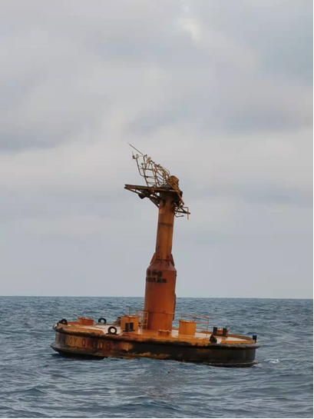
Key issues and risks
(1) Buoy observation equipment is difficult to maintain
Buoy deployment is difficult and dangerous, which means the deployment method need to be improved, and there should be more protection methods. In addition, the marine forecast should be more accuracy to make sure the offshore operation is safe.
(2) More professionals are needed
The professionals for buoy maintenance are not enough, the personnel structure need to be improved to meet the requirement of high strength offshore operation.

Slide 6
Publications & User Impact
Publications
Ref | Title | Type
1 | Solution of Bailong buoy data sharing through GTS. | Technical developments
2 | A configurable data receiving controller for ocean buoys and its configuration method. | Technical developments
Other issue
At present, the COVID-19 outbreak is under control in China, and the buoy observation network is less affected by the pandemic. Various tasks are progressing steadily, and offshore buoys are operating normally.
The international cooperation is stagnated due to COVID-19, and the maintenance of oversea buoys is difficult
.

Slide 7
Thank you!
谢谢
YUE Xinyang
yue_xin_yang@outlook.com

