Slide 1
Financial Report
38th Session of Data Buoy Cooperation Panel
WMO, Geneva, Switzerland
01-04 November 2022

Slide 2
DBCP Funding Sources
WHOI Trust Funds at WMO(support cost 7%)
Primarily for OceanOPS staff salaries (fraction for OceanOPS activities)
Managed by WMO following the instructions from the donor
DBCP Trust Fund at WMO (support cost 3%)
Evolved to a multi-user trust fund
Benifits from lower support cost
Managed by WMO with authorization from respective panels
DBCP Trust Fund at IOC (support cost 7%)
Primarily for DBCP Capacity Building activities (MNR, China contribution)
Managed by IOC with authorization from DBCP following the instructions from the donor
Notes:
Funds related to DBCP activities come from different accounts managed by WMO, and IOC. WMO manage two trust funds related to DBCP activities; JCOMM Trust Fund(JCOMM-TF), and DBCP Trust Fund (DBCP-TF). IOC also manage a trust fund for DBCP activities

Slide 3
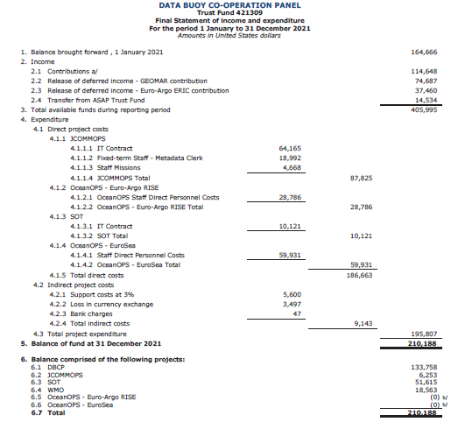
DBCP TF Governance
DBCP-TF Item description
OceanOPS (OCG with Panel Chairs)
OceanOPS Logistical Support (i.e. IT hosting)
DBCP-TC Travel
SOT-TC Travel
Other OceanOPS expenses
DBCP (DBCP EXB)
DBCP chair and other travel
DBCP Capacity Building
Other DBCP expenses
SOT (SOT EXB)
SOT chair and other travel
Other SOT expenses
WMO (Secretariat)
WMO activities
3% program support cost

Slide 4
DBCP TF Regular Contributions
Country | Currency | Amount
Australia | EURO | 11,700
Canada* | CAD$ | 35,000
E-SURFMAR | EURO | 55,000
Germany | EURO | 3,600
India | US$ | 5,000
New Zealand | EURO | 1,800
South Africa | EURO | 4,000
* contributions for 2022 and the amount increases by CAD$ 1,000 each year until the end of agreement in 2023
Contributors | OceanOPS | SOT | DBCP
All except E-SURFMAR | 61% | 08% | 31%
E-SURFMAR | 70% | 15% | 15%

Slide 5
Regular contributions for DBCP
 | Annual contribution | OceanOPS | DBCP | SOT
E-SURFMAR | € 55,000 | 70% | 15% | 15%
Meteorological Services of New Zealand | € 1,800 | 61% | 31% | 8%
Environment and Climate Change Canada | CAD$ 33,000 | 61% | 31% | 8%
Bureau of Meteorology, Australia | € 11,700 | 61% | 31% | 8%
National Institute of Ocean Technology, India | US$5,000 | 61% | 31% | 8%
South African Weather Service (SAWS) | € 4,000 | 61% | 31% | 8%
BSH, Germany | € 3,600 | 61% | 31% | 8%
United States (Contribution to for DBCP) | ~US$520,000 | ~64% * | ~20% | ~20%
Ministry of natural Resources, China (received at IOC) | US$ 20,000 |  | 100%
* includes 20% DBCP and 20% SOT
Notes:
Around 45K in total per year for purely DBCP activities with current distribution of funds.

Slide 6
Contributions to Panels in 2022
 | In Currency of Payment | In US$ (exchange rate of 02/07/2021) | WMO/DBCP TF (Estimates) |  |  | IOC TF Estimates
 |  |  | OceanOPS | DBCP | SOT | DBCP
E-SURFMAR (DBCP/SOT) | € 55,000 | $62,745 | $43,950 | $9,418 | $9,418
Meteorological Services of New Zealand | € 1,800 | $2,027 | $1,236 | $628 | $162
Environment and Climate Change Canada** | CAD$ 34,000 | $27,698 | $16,896 | $8,586 | $2,216
Bureau of Meteorology, Australia** | € 11,700 | $13,176 | $8,037 | $4,085 | $1,054
National Institute of Ocean Technology, India** | US$ 5,000 | $5,000 | $3,050 | $1,550 | $400
South African Weather Service (SAWS)* | € 4,000 | $4,730 | $2,885 | $1,466 | $378
BSH, Germany (SOT) | € 3,600 | $4,110 | $2,548 | $1,274 | $329
MNR-China | US$ 10,000 |  |  |  |  | $10,000
Total |  | $119,526 | $78,603 | $27,007 | $13,975 | $10,000
* Contribution may not be possible, ** contributions not yet received

Slide 7
Financial Statement - 2022
ITEM | DBCP TF (US$) | IOC TF (US$)
Balance Brought Forward from previous year | $133,758 | $53,354
National Contributions | $27,007 | $10,000
Funds Available | $160,765 | $63,354
Expenses (travel support for DBCP participants) | ($20,000) | ($2,042*)
Expenses (Chair travel) | ($4,100)
Wave drifter pilot | ($20,500)
Expenses (Direct & Indirect costs) | ($1,338**) | ($154***)
Balance at 31 December 2022 | $114,827 | $61,158
*These expenses are already committed but not yet spent (see Annex 4)
** 3% Support cost *** 7% support cost

Slide 8
Estimated Budget for 2023
ITEM | DBCP TF (US$) | IOC TF (US$)
Balance Brought Forward from previous year 2022 | $114,827 | $61,158
National Contributions* | ~$28,000 | $10,000
Funds Available for 2023 year | $142,827 | $71,158
* With the assumption that all regular contributions will arrive

Slide 9
Planned maximum expenditure for 2023
DBCP – Draft Spend Plan - 2023 | WMO/DBCP TF | IOC/DBCP TF
Travel of DBCP Chairperson and other Exec Board or Panel members | $15,000
DBCP Capacity Building | $10,000 | $30,000
TT and other DBCP activities | $20,000
Communications | $5,000
Total | $50,000 | $30,000
Action: Request this Panel to review and approve proposed expenditures for 2023.

Slide 10
Estimated Balance by the end of 2023
ITEM | DBCP TF (US$) | IOC TF (US$)
Funds Available for 2023 Year* | $142,827 | $71,158
Approved maximum expenditures for 2023 (as approved at DBCP-38) | ($50,000) | ($30,000)
Support cost | **($1,500) | ***($2,100)
Estimated carry forward to 2024 | $91,327 | $39,058
*With the assumption that all regular contributions will arrive
** 3% support cost , *** 7% support cost

Slide 11
Thank you
Merci

