Slide 1
ECUADOR National Report
DBCP-38, 1-4 Nov 2022
Sonia Recalde*
INSTITUTO OCEANOGRÁFICO Y ANTÁRTICO DE LA ARMADA
sonia.recalde@inocar.mil.ec
Input from: Miriam Lucero*, Susy Marin*, Inti Keith**
*INOCAR
**FCD

Slide 2
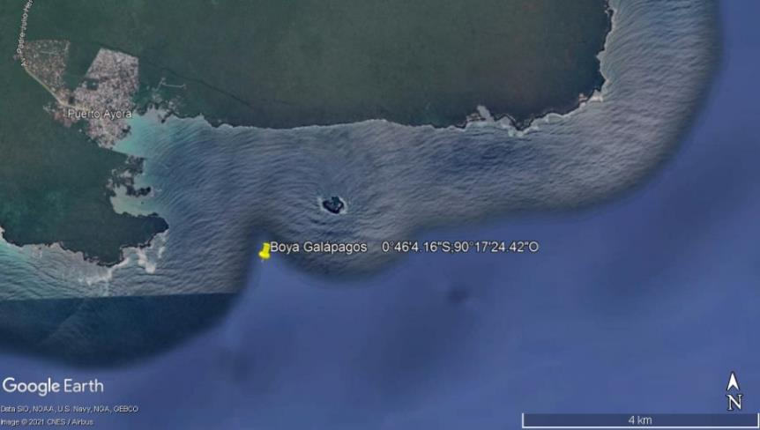
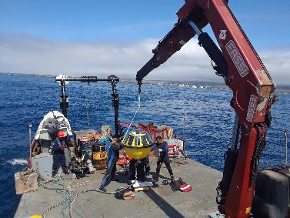
NETWORK MONITORING OCEANOGRAPHIC BUOY
TRIAXYS BUOY
WAVES: Significant Wave Height, Peak Period, Peak Direction, Mean Period, Mean Direction,
CURRENTS: Velocity, Direction
SST: Sea Surface Temperature (°C)
Buoy | Latitude | Longitude
Santa Cruz Island-Puerto Ayora | 0° 46’ 4.16’’S | 90° 17’ 24.42’’W
DATE INSTALATED: October 2021
DEEP: 40 m.
TRANSMISSION: Inmarsat

Slide 3
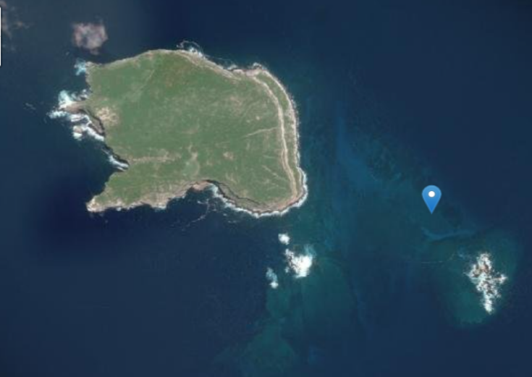
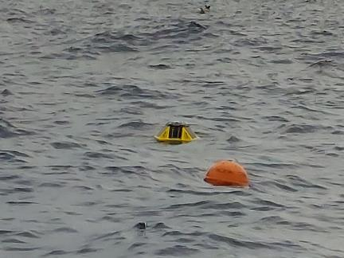
NETWORK MONITORING OCEANOGRAPHIC BUOY
SOFAR SPOTTER BUOY
WAVES: Significant Wave Height, Period, Direction
SEA TEMPERATURE: 1 and 18 m depth.
WIND SPEED
Buoy | Latitude | Longitude
Darwin Island-Wellington reef | 1.674° N | 91.993° W
DATE INSTALATED: March-2022
DEEP: 20 m.
TRANSMISSION: Iridium SBD (satellite) connectivity

Slide 4
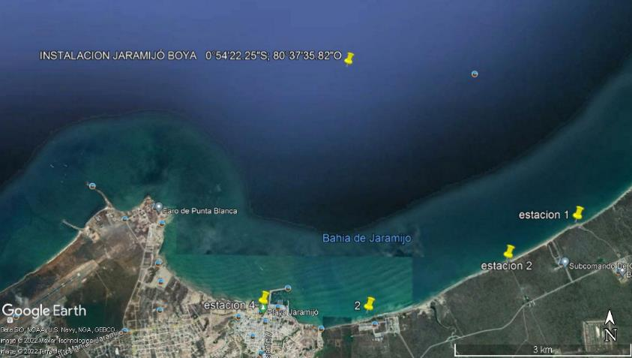
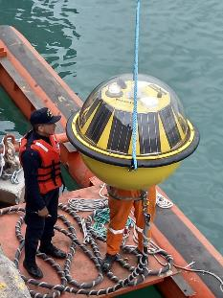
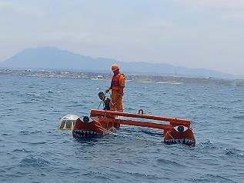
NETWORK MONITORING OCEANOGRAPHIC BUOY
TRIAXYS BUOY
WAVES: Significant Wave Height, Period, Direction,
CURRENTS: Velocity, Direction
SST: Sea Surface Temperature
Buoy | Latitude | Longitude
Manabí-Bahía de Jaramijó | 0° 54’ 22.25’’ S | 80° 37’ 35.82’’ W
DATE INSTALATED: October 2022
DEEP: 20 m.
TRANSMISSION: Inmarsat

Slide 5
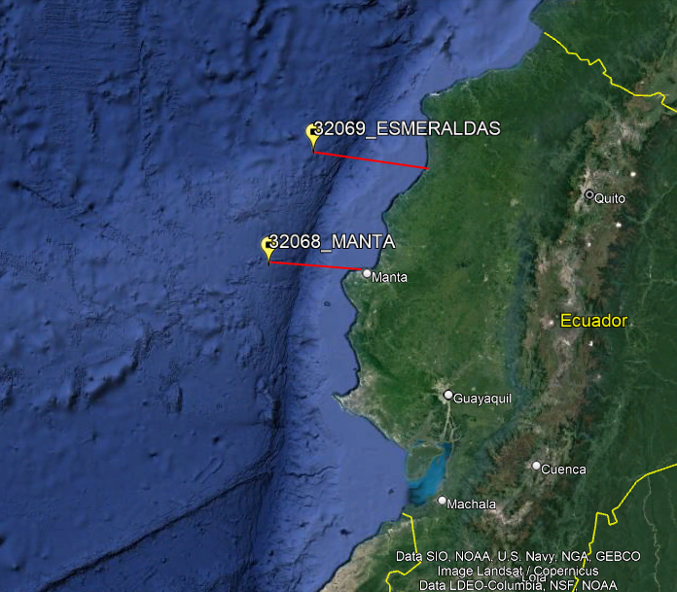
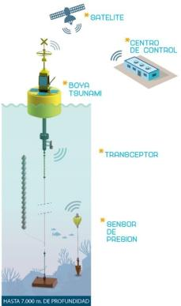
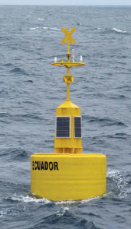
NATIONAL TSUNAMI WARNING SYSTEM
TSUNAMI BUOY EBM24-TS
PRESSURE SENSOR: sea surface variations
TRANSMISSION: Iridium satellite communications
Buoy | Latitude | Longitude
Manta 32068 | 0° 53’ 17’’ S | 81° 39’ 50’’ W
Esmeraldas 32069 | 0°15‘18"S | 81°12‘40“O

Slide 6
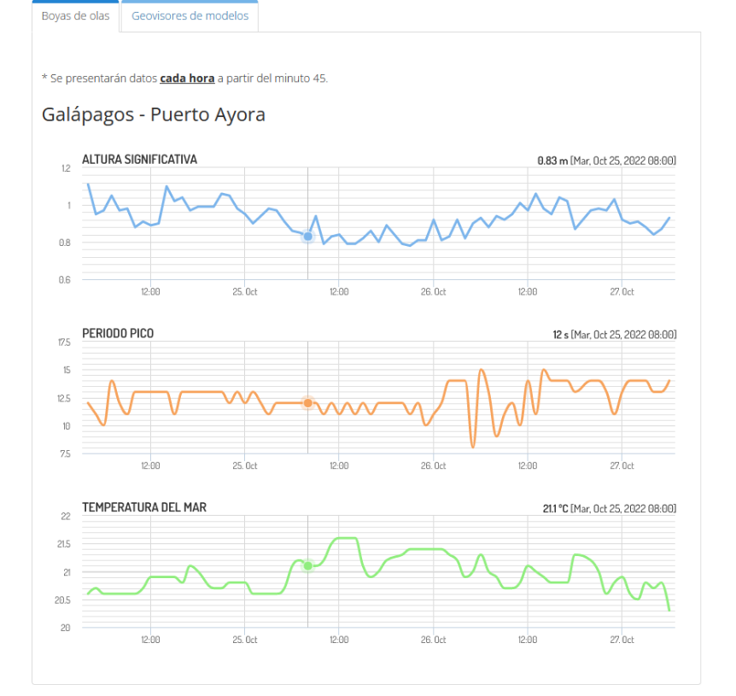
PUBLIC INFORMATION
TIAXYS BUOY
Santa Cruz Island
https://www.inocar.mil.ec/web/index.php/productos/monitoreo-oceanico

Slide 7
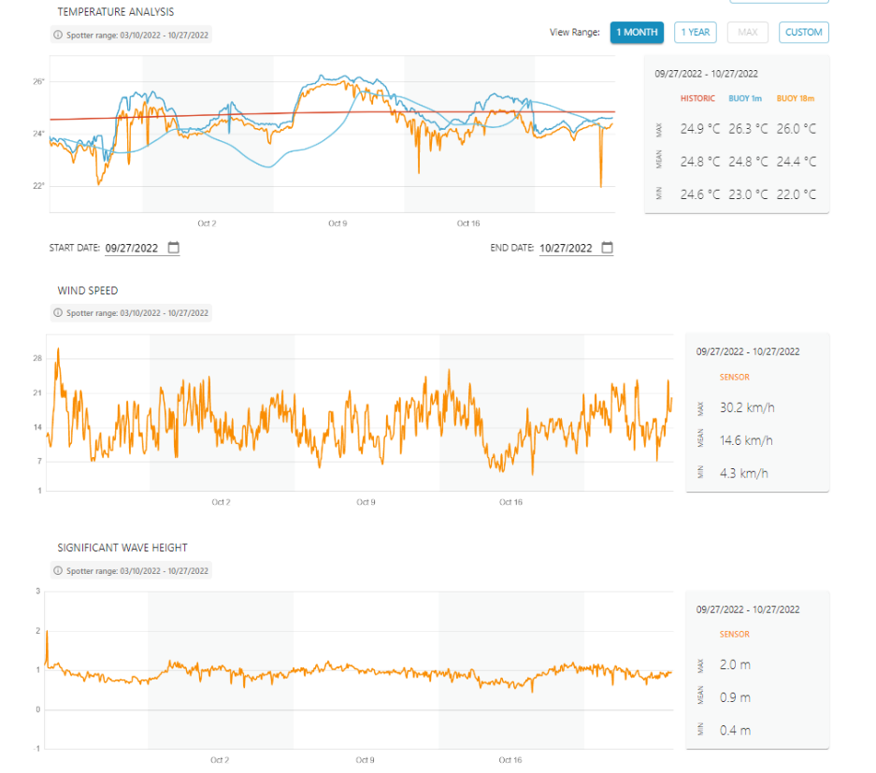
PUBLIC INFORMATION
SOFAR SPOTTER BUOY
Darwin Island
https://aqualink.org/sites/944

Slide 8
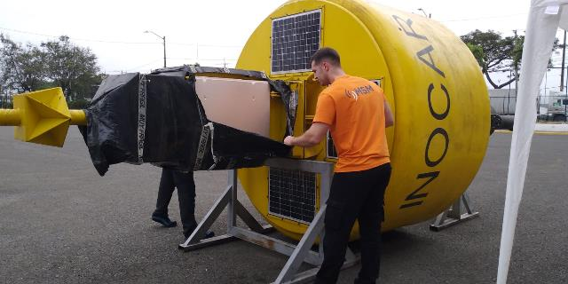
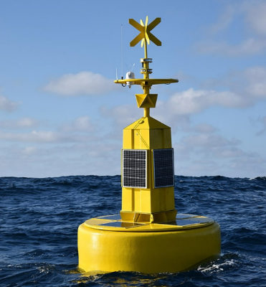
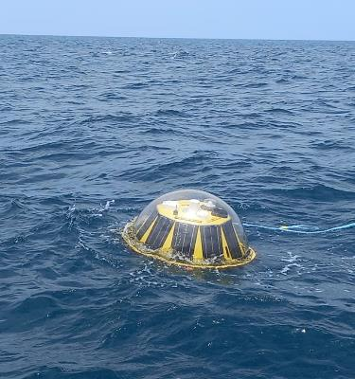
PLANNED PROGRAMMES
01 TSUNAMI MSM BUOY
Deployed: Galápagos
October 2022
05 OCEANOGRAPHIC BUOY
2023
03 Oceanographic MSM Buoy
02 Triaxys Buoy

Slide 9
DATA USAGE
Data used for weather prediction.
Waves, currents prediction
Ocean state estimation
Navigation aids newsletters
Newsletters for seaside community in general

Slide 10
Thank you!
INSTITUTO OCEANOGRÁFICO Y ANTÁRTICO DE LA ARMADA
Dirección de Oceanografía y Meteorología Marina
Av. 25 de Julio vía Pto. Marítimo. Base Naval Sur Tel.: + (593-4) 3813440 Ext.38233
Código Postal: 090205 - Guayaquil-Ecuador
Mail: inocar@inocar.mil.ec Website: www.inocar.mil.ec

