Slide 1
Peru National Report
DBCP– 38, Hybrid meeting, Geneva, Switzerland, 1-4 November 2022
Myriam Tamayo Infantes
mtamayo@dhn.mil.pe
Gibson Marquez Hernandez
gmarquez@dhn.mil.pe

Slide 2
Network Buoy, Purpose of the program
Niño Anual y Las Anomalias Medidas en el Pacifico (Naylamp II – Program)
Oceanographic Buoy 1: 240 nautical miles W Paita, Piura - Peru
Oceanographic Buoy 2: 320 nautical miles W Salaverry, Trujillo – Peru
Oceanographic and meteorological observation in real time
2. South Eastern Pacific Circulation From A argo FLATS (SEPICAF I – Program)
Argo floats : 9 buoy – different part of peruvian sea
Oceanographic and meteorological observation at the moment

Slide 3
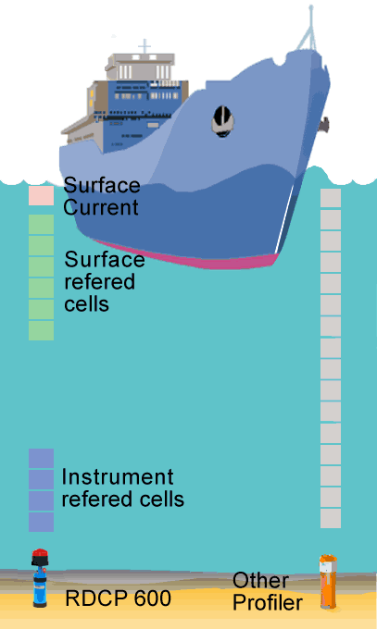
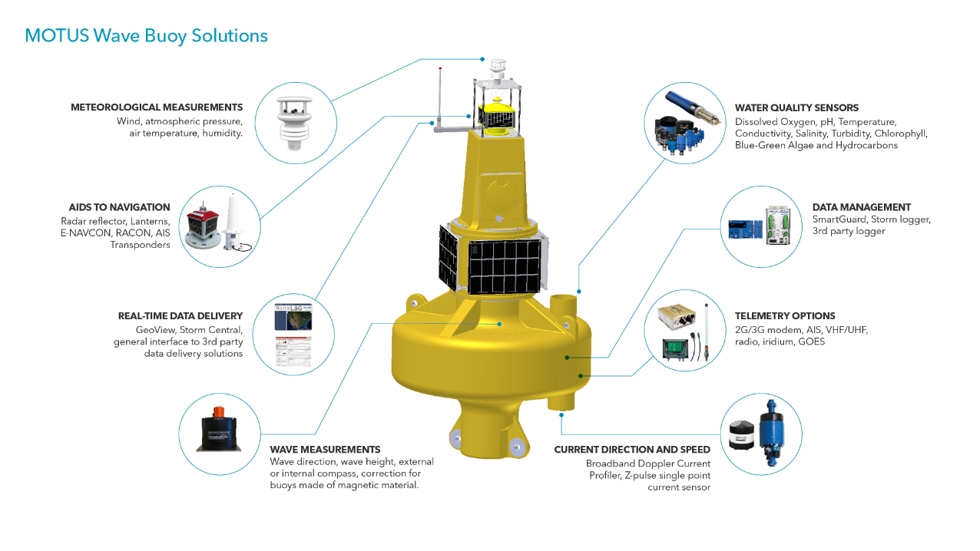
Key successes/highlights
In project (I + D):
Deployment of a new oceanographic and meteorological observation network using buoys over main ports in Peruvians litoral.

Slide 4
Key issues and risks
Our program have had bigger Impacts operational, logistical and economic, during and after COVID – 19
NAYLAMP-2
Maintenance of the Buoys was delayed.
SEPICAF 1
In 2021, COVID-19 delayed the ARGO float deployment for one year and a half.

Slide 5
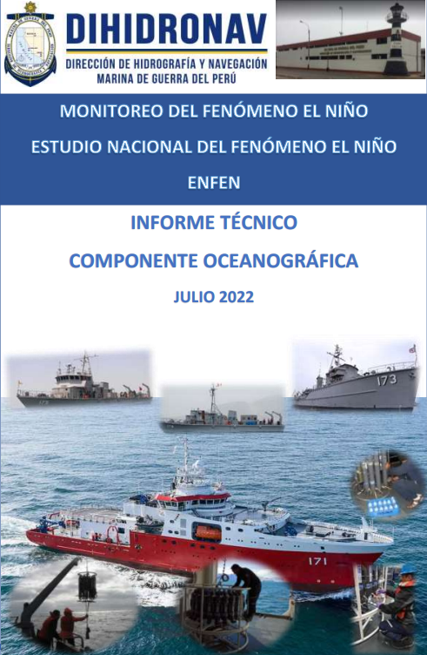
How your buoy ocean observing network?
The two programs that are currently being developed are basically for climate monitoring in the Peruvian sea, especially for monitoring El Niño/La Niña events.
Another purpose is the monitoring of high seas waves that have a great impact on the Peruvian coast, called irregular waves, which mainly cause problems in Peruvian artisanal fishing, water sports and sighting tourism.

Slide 6
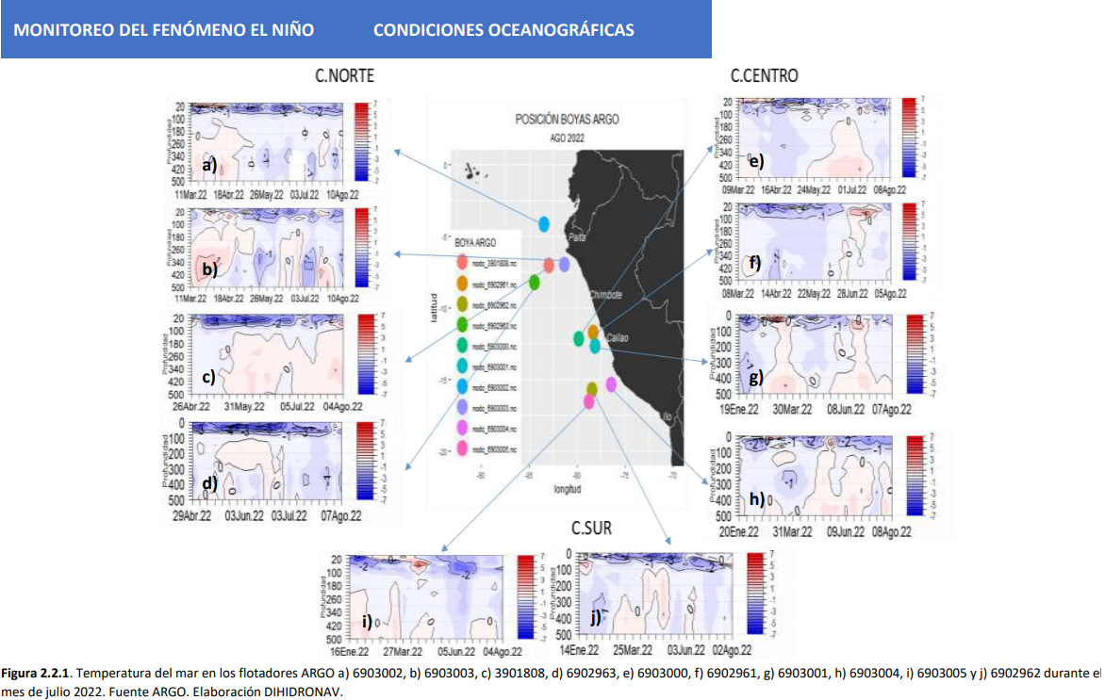
How your buoy ocean observing network?
Temperatura del mar medida por los flotadores ARGO: a) 6903002, b) 6903003, c) 3901808, d) 69002963, e) 6902961, g) 6903001, h) 6903004, i) 6903005 y j) 5902962 durante julio 2022. Fuente ARGO, elaboración DIHIDRONAV-Perú.

Slide 7
Key issues and risks
What assistance or advice would you like from the DBCP?
A training program in maintenance of buoys, sensors, etc is required.
Updating of programs to improve the anti-vandalism system.
What suggestions do you have for the DBCP?
Improve communication with the members of the Buoy Panel.

Slide 8
Thank you!

