Slide 1
Canadian National Report
DBCP– 38, Hybrid meeting, Geneva, Switzerland, 1-4 November 2022
Alexander Zucconi
Marine Networks Manager
Meteorological Service of Canada

Slide 2
OVERVIEW
MSC Buoy Networks Overview/Status
Future Plans/Challenges
Vandalism Example

Slide 3
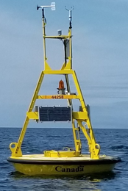
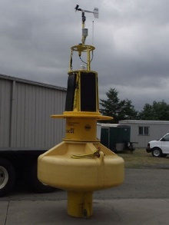
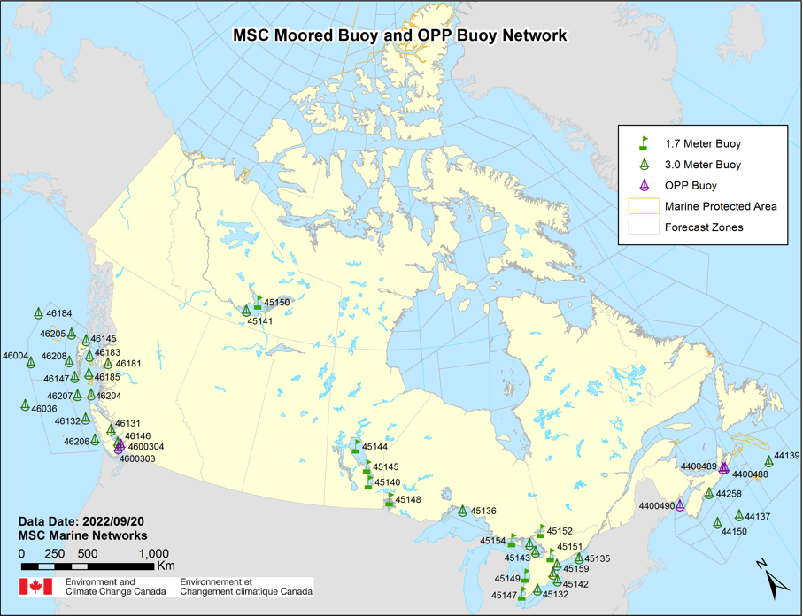
Moored Buoy Network
Purpose: To support marine warning/forecasting, modelling, research applications and general marine safety
Status:
43 Moored Buoys across Canada (39 CORE + 4 OPP):
18 Pacific (16xCORE + 2xOPP)
19 In-land Lakes (Seasonal)
6 Atlantic (4xCORE, 2xOPP)
Mix of 3m (33) & 1.7m (10)
Measure/transmit: Pressure, Wind Speed/Direction, Air Temperature, SST, Waves
CORE -> hourly; OPP -> /10 mins
Data available in Near Real-Time via GTS, now is BUFR format

Slide 4
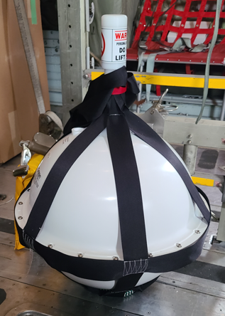
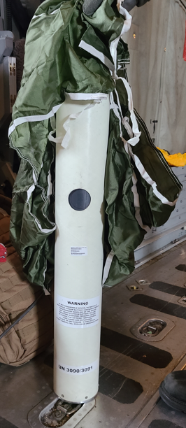
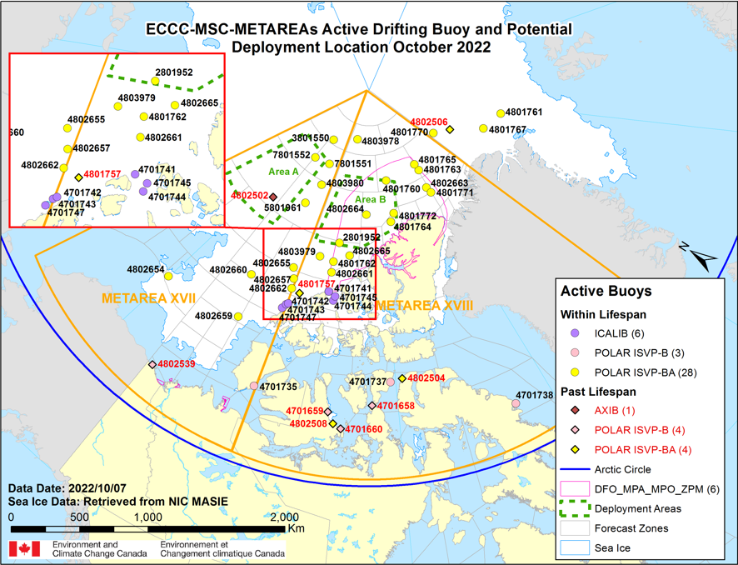
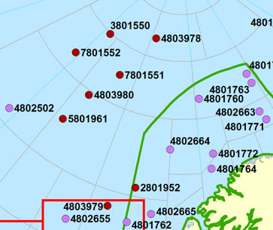
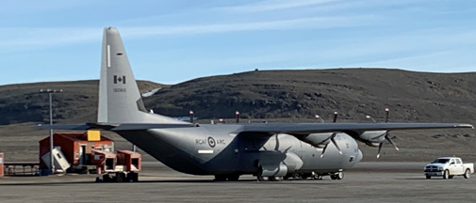
Drifting Buoy Network
Purpose:
Work towards fulfilling METAREA obligations (XVII & XVIII)
Support growing need of marine transportation in Arctic Environments
Work collaboratively with DND-DRDC and ICE-PPR, IABP for strategies & deployments
Status:
~37 “active” drifting buoys that measure and transmit – SST, Air Temp, Pressure, Lat/Long on a hourly basis via Iridium Satellite Communication
Aim to re-seed annually 10-15 drifting buoys every summer to maintain array of active buoys in Arctic Ocean & Beaufort Sea
Data available in Near Real-Time via GTS

Slide 5
Plans & Challenges
Plans
Integrating new WM500 Payload Technology & TriAxys Wave Sensors
TriAxys G3 Wave Senors -> Spectral Wave Data (in non real-time)
Challenges
Reliable public sector ship-time capacity/availability to service our moored buoys
Significant issue in Atlantic Canada (FY22/23 no ship-time in Atlantic for CORE buoys)
Sustainable funding to support continued long-term operations

Slide 6
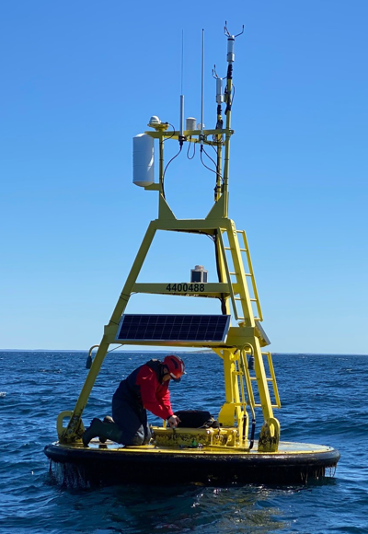
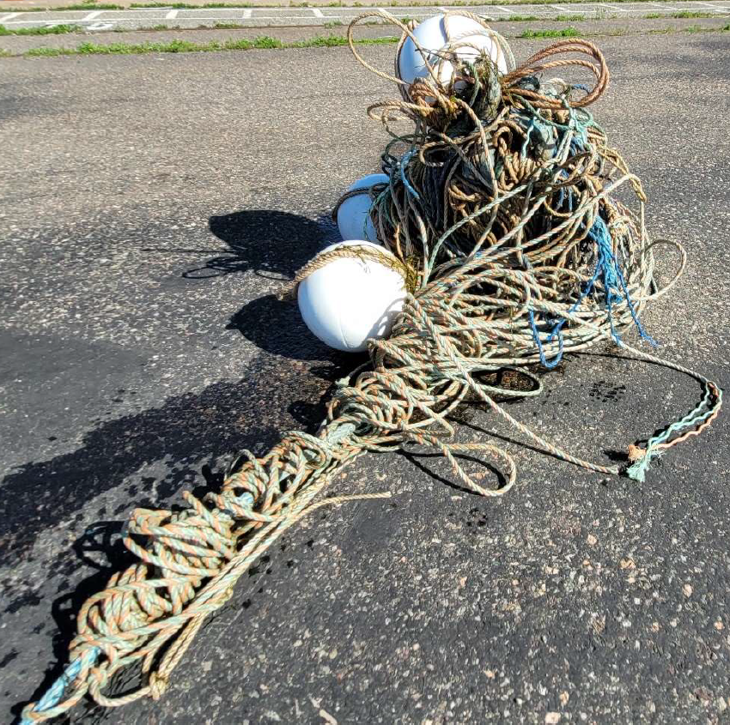
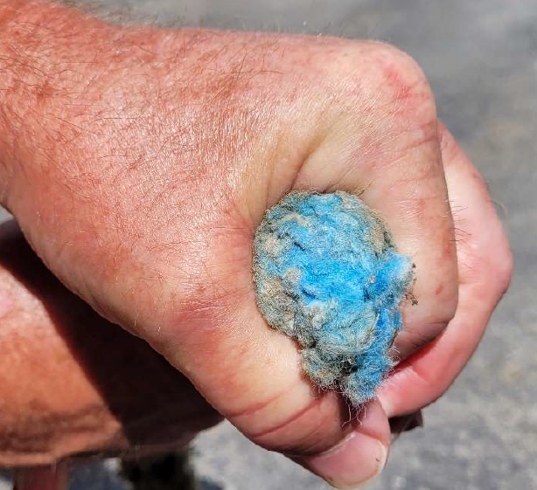
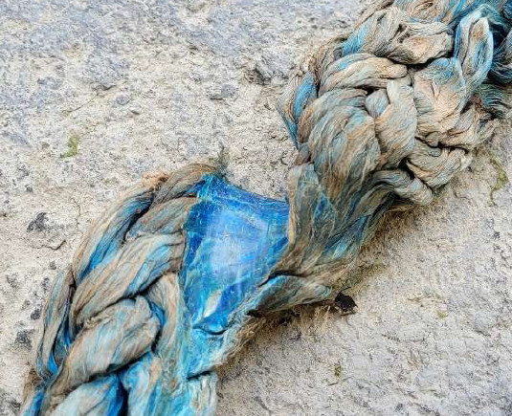
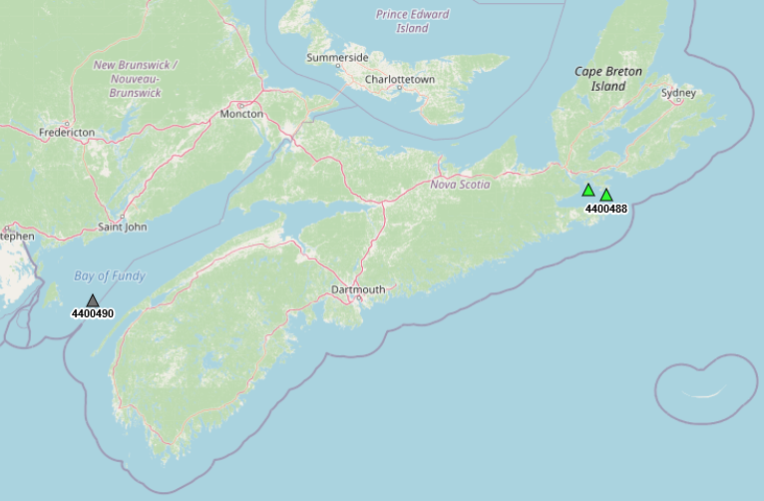
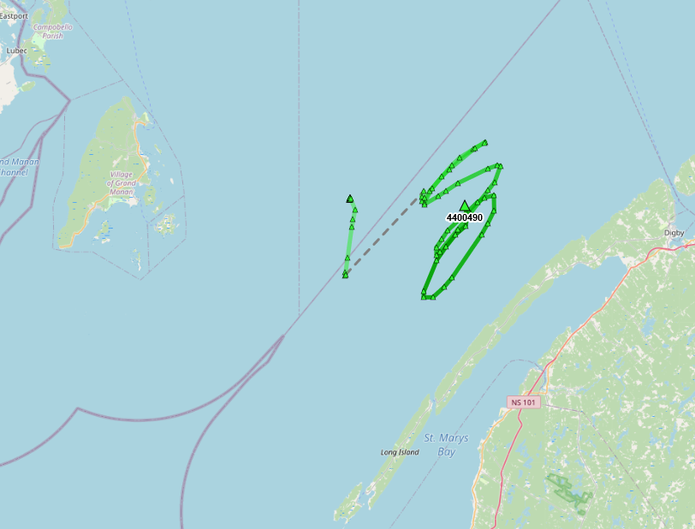
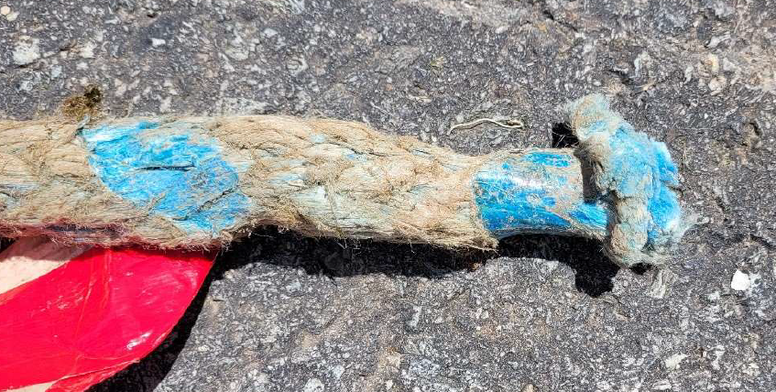
Vandalism – Example Buoy: West Bay of Fundy(4400490)
Buoy originally deployed Nov/2019 and hadn’t been serviced since
June 19, 2022: Drift Alarm Triggered
Potential Cause: Mooring intentionally severed to free entangled fishing gear
Loss of mooring (~$20k-$25k), and expensive retrieval costs (~$30k)
Loss of data – redeployment uncertain?

Slide 7
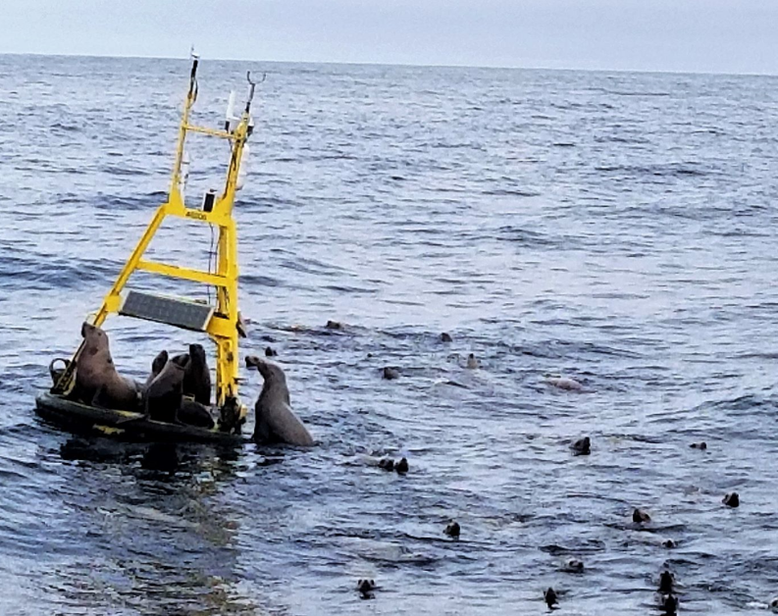
Thanks!
Alexander Zucconi Marine Networks Manager
Meteorological Service of Canada
Alexander.Zucconi@ec.gc.ca

