Slide 1
Outcomes of the EOI on Deploying Wave drifter
DBCP– 38, Hybrid meeting, Geneva, Switzerland, 1-4 November 2022
Presenter: Max Norman Sitai
Principal Climate Officer(Climate Section)
Solomon Islands Meteorological Service
PO Box 21, Honiara, Solomon Islands

Slide 2
TOPICS:
Background Information
Proposed Drifter Buoy Deployment Location/Site
Scientific, Technical, and Operational Advantages to the identified locations.
Impacts and Values of Deployment of Wave drifters to Solomon Islands
Regular Maintenance and Awareness
SI Met Service Support after first year of operation

Slide 3
BACKGROUND INFORMATION
Call for application of wave drifter deployment was announced in May 2021. Discussions were made within out Met Service and with the approval of Solomon Islands Meteorological Service Director Mr. David Hiriasia our ocean service officer Mr. Danny Shadrach submitted Solomon Islands application in July 2021.
Application was assessed and further information was submitted upon request by DBCP assessment team in August 2021.
DBCP Executive board made a positive decision to the application. Internal processes took place within WMO with consultation with implementing partners UCSD/SIO.
Mr. Boris notified Danny in June 2022 of the application approval and further collaboration took place there on.
DSIMS and Danny requested SPC to support shipping from SIO to Solomon Islands and approval was granted to assist with shipping cost and custom facilitation.

Slide 4
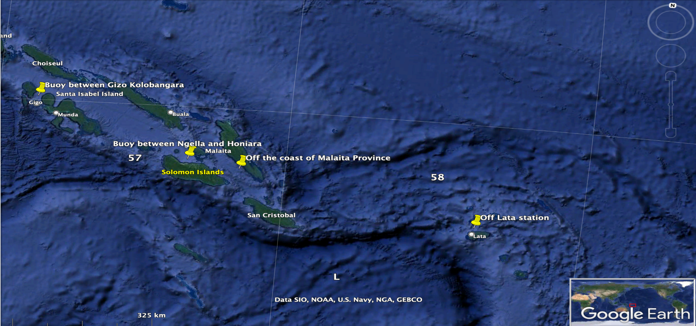
Proposed Drifter Buoy Deployment Location/Site

Slide 5
Proposed Drifter Buoy Deployment Location/Site
This will be in the seas within the Solomon Islands. The proposed idea was to deploy these buoys between islands where people regularly uses to commute from urban centres to their home village. One is between Choiseul Island and the Western Province, second is between Honiara (Capital City), Guadalcanal Island and the Central Province and the others will be between Guadalcanal and Malaita Provinces, and between the islands of Temotu Province. That will account for 4 areas identified for this project.

Slide 6
Scientific/Technical/Operational Advantages to the identified locations
Provide real-time information on waves, currents, swell heights and so forth that are needed by boat travellers commuting back and forth along those areas of the sea. Sea travellers have been victimized by the treacherous seas that have taken of lives.
Provide ocean data to SI Met Service to issue warnings on rough seas with confidence. Also, to verify the satellite data that are being used for the products issued to the public on marine weather.
Provide venue for Scientific Research with the involvement of our ocean unit.

Slide 7
Impacts and Value of Deployment of Wave drifters to Solomon Islands
This deployment will bring in major improvement to the Solomon Island Met Service in relation to ocean services. The public will be better informed on marine weather warnings and advisories in real time or near real time.
More understanding of the coastal current behaviours resulting in coastal dwellers making safe decisions when travelling between the islands.
From ocean information gathered people living along the coast will be able to protect themselves from swells, waves and coastal inundations.

Slide 8
Regular Maintenance and Awareness
The proposed plan is to undertake maintenance of these buoys every 3 months. This requires training from DBCP for our local Met technicians who would be assign to do 3-month regular checks on the buoy.
Also training for Met officers living close to buoy locations to do the regular checks and maintenance. This will reduce travelling costs.
Public awareness on the importance of the drifter buoys to avoid stealing and vandalism.

Slide 9
SI Met Service Support after first year of operation
Increase budget for Ocean Services to support equipment repairs, replacement, training and recruitment of more technical officers to maintain and ensure smooth running of the drifter buoys.
Support the expansion of Drifter buoy network
Provide ocean data storage in the in the CLIDE database or local server, etc.

Slide 10
Thank you!

