Slide 1
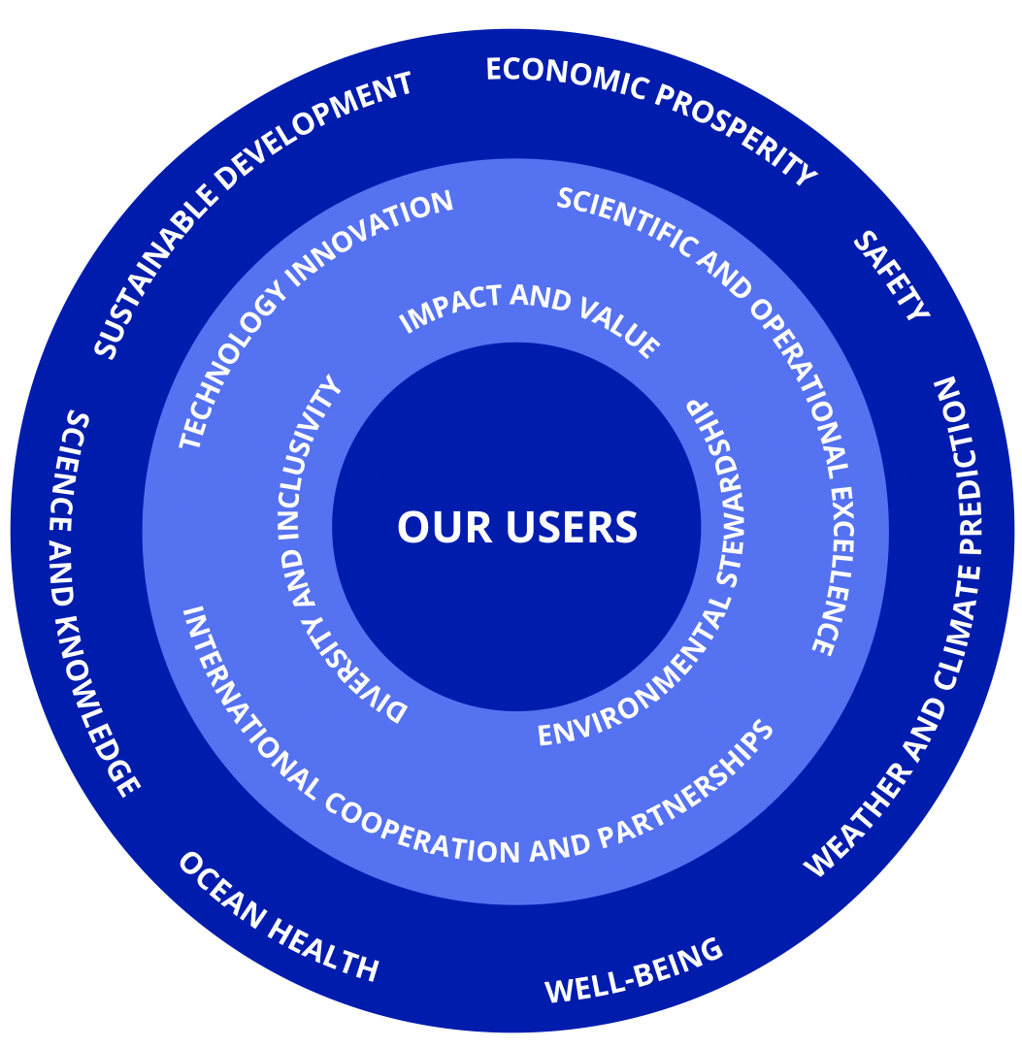
DBCP 38
Data Buoy Cooperation Panel 38th Annual Session
1-4 November 2022, Geneva, Switzerland
Getting to know
the DBCP
4 Decades

Slide 2
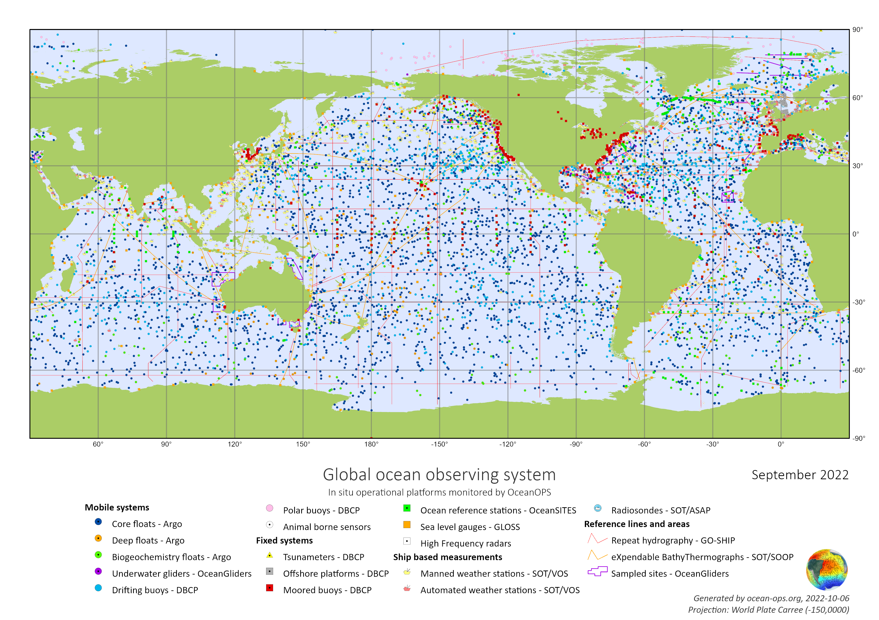
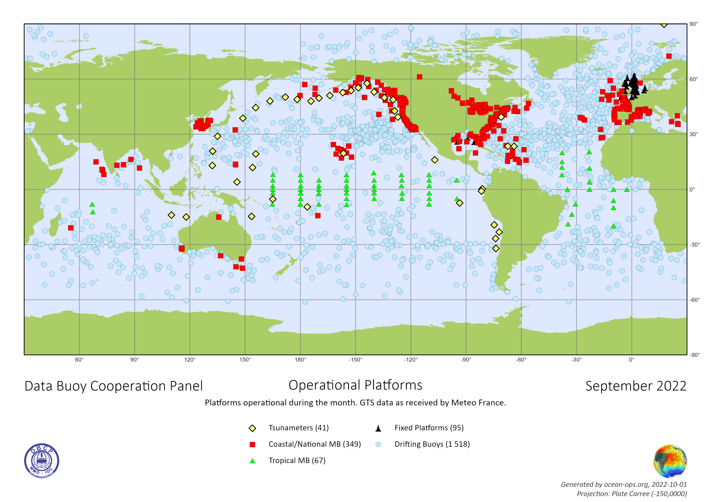
The global ocean observing networks
DBCP Challenges
Notes:
So here you see this wonderful image showing the remarkable achievement of the in situ global Ocean observing community. The DBCP is one of a number of ocean observing partners who together work so tirelessly and with great effect to deliver a spectrum of observations to capture the behaviour of this four dimensional vital organ of the Earth system-our oceans.

Slide 3
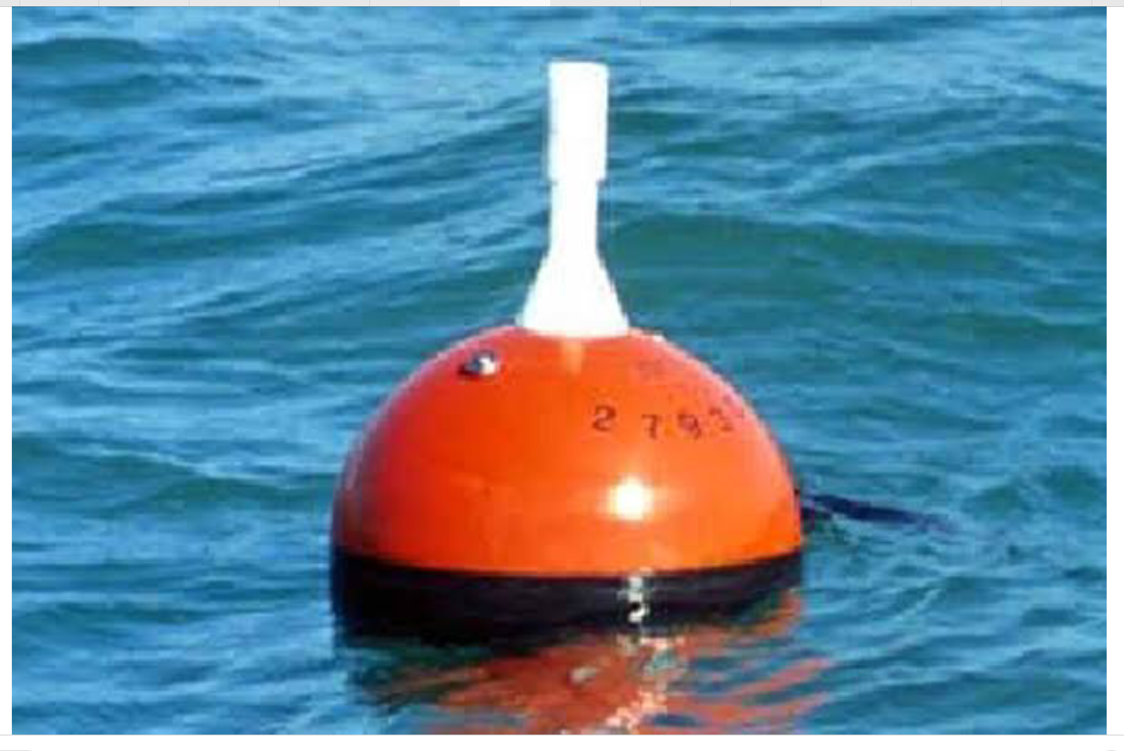
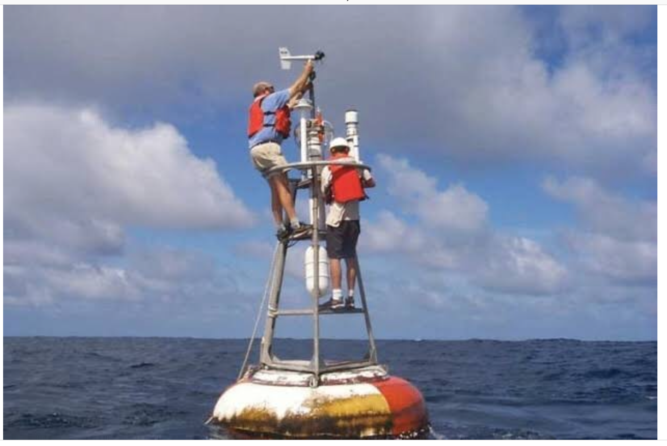
The DBCP component
Above, at and just below the ocean surface
DBCP Challenges
Essential weather and climate observations
Temperature
Pressure
Wind
Waves
Currents
Met-Ocean buoys
Drifting buoys
Wave buoys
Tsunami buoys
Notes:
And here is the contribution from the DBCP. Our contribution focuses on observations above, at and just below the ocean surface using a combination of drifting buoys, met-ocean buoys, tsunami buoys and wave buoys. And our primary observations are physics-based-temperature, pressure, salinity, currents, wind and waves. This I should say is that the current state, noting importantly that we will evolve with the growing needs of our existing and emerging users.

Slide 4
Why we exist and what we do
VISION
A flagship surface ocean observing panel of global standing recognized for its significant contributions from drifting and fixed moored buoys to ocean and climate science, weather, ocean and earth system prediction, sustainable development, safety, well-being and prosperity.
MISSION
To facilitate the collection of essential and trusted observations from data buoys at the air-sea interface and the upper ocean as part of an integrated, resilient and sustainable global observing system that serves the current and emerging needs of society - all day, every day.

Slide 5
How we operate
Executive Board
Chair
Environmental Stewardship
Scientific Excellence
Technology Innovation
International cooperation partnerships
Diversity and Inclusivity
Operational excellence
Impact and value

Slide 6
How we operate
GOOS Observations Coordination Group
Executive Board
WMO & IOC
Secretariats
Technical
coordinator
Task Teams
Action Groups
e.g. ENVIRONMENTAL
STEWARDSHIP
Pilot Projects
e.g. INDIAN OCEAN
DEPLOYMENTS
e.g. HIGH RESOLUTION
SST BUOYS

Slide 7
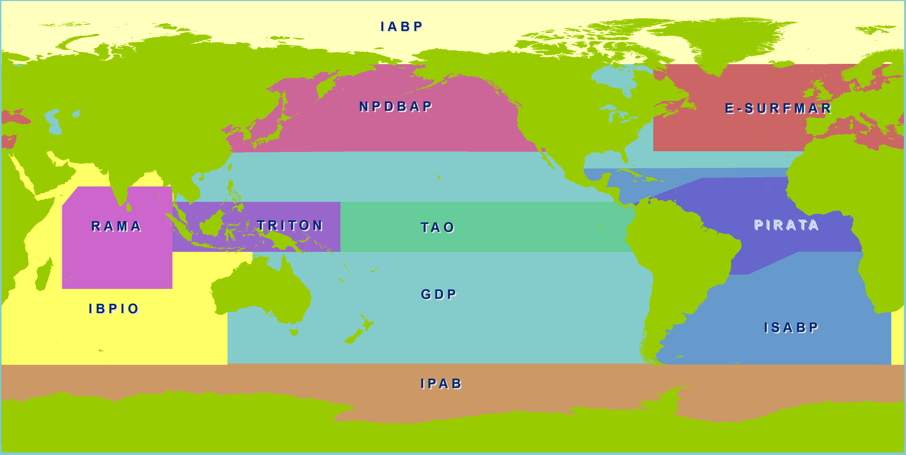
The Engine Room – Action Groups
They coordinate and implement buoy deployments
Each AG has co-chairs from each region
See Session 8 today
For more info : https://www.ocean-ops.org/dbcp/overview/actiongroups.html

Slide 8
The Engine Room – Task Teams
They address specific areas of focus
Data Management (Lance Braasch, Shaun Dolk)
Drifter Best Practices and Technology Development (Rick Lumpkin)
Moored Buoys (Ken Connell)
Capacity Building (Rachel Qiu)
Wave Measurement (Val Swail and Bob Jensen)
Environmental Stewardship (Karen Grissom)
Impact and Value (Users) (?)
See Session 9 tomorrow
For more info: https://www.ocean-ops.org/dbcp/overview/taskteams.html

Slide 9
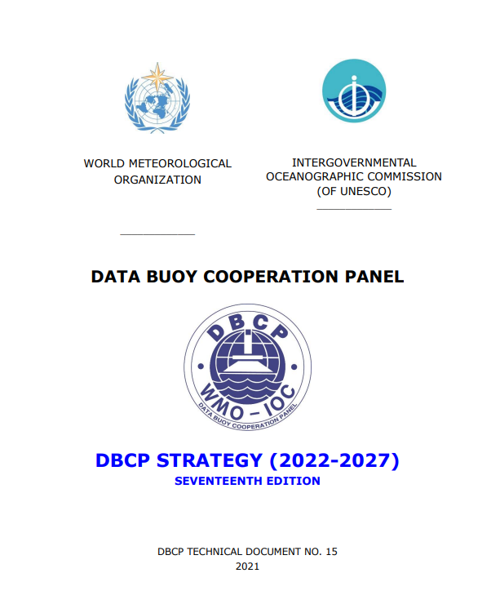
Come on board and play an active role!
Contact
Long Jiang (Ljiang@wmo.int)
Or
Boris Kelly-Gerreyn (Boris.Kelly-Gerreyn@bom.gov.au)
for any of the information presented here or
to find out more such as how to join a task team
or action group
https://www.ocean-ops.org/dbcp/doc/DBCP%20Strategy/DBCP%20Strategy%202022-2027.pdf

Slide 10
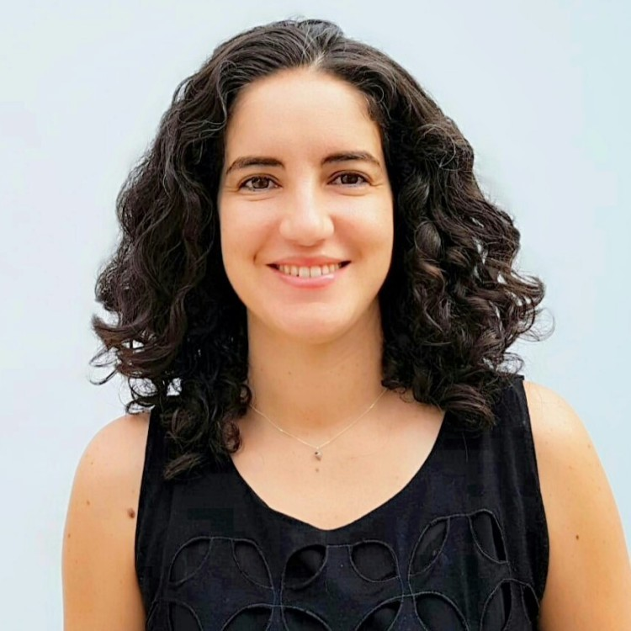
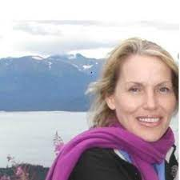
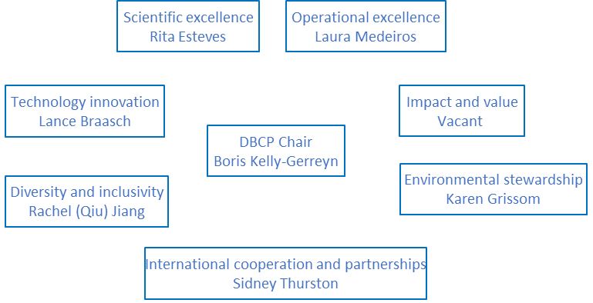
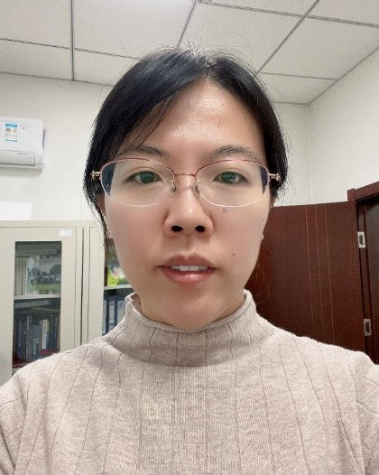
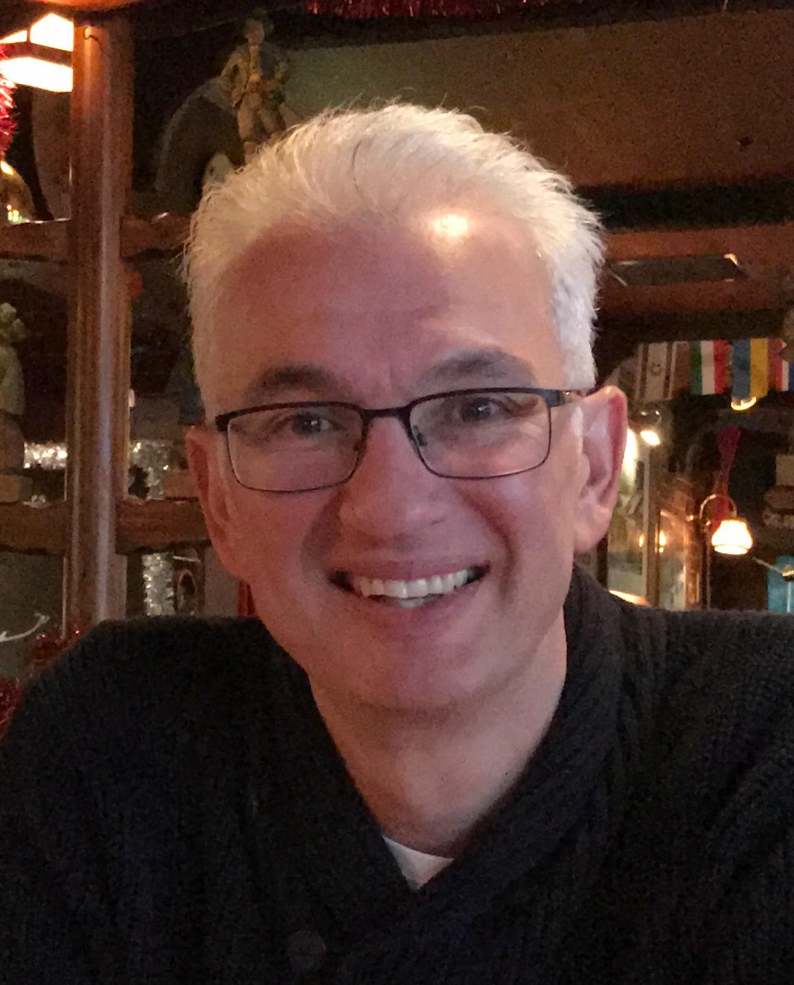
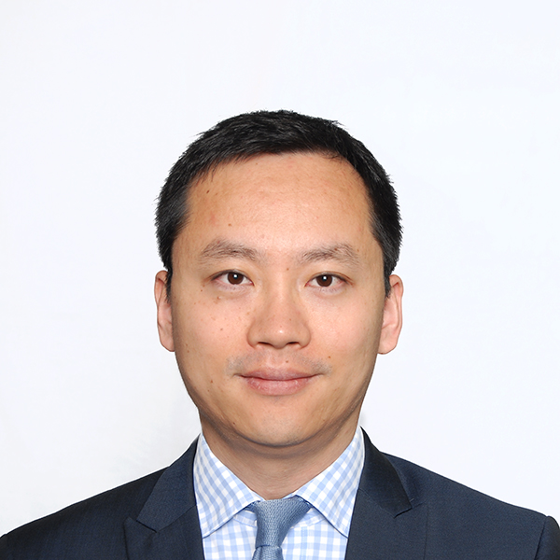
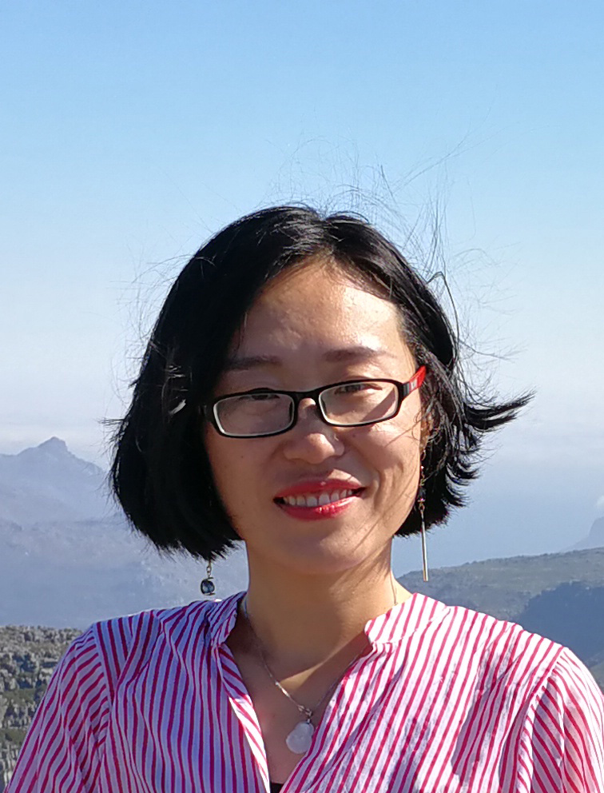
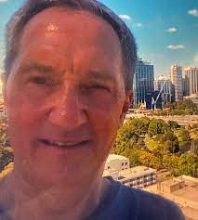
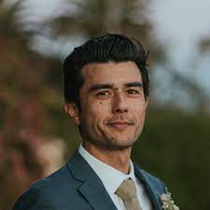
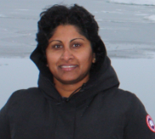
Who's who in the Executive Board
Technical coordinator
Long Jiang
WMO Secretariat
Champika Gallage
IOC Secretariat
Julia Yu

