Slide 1
Forum for Dialogue with Industry How can Industry, Science, and Government TOGETHER advance Ocean Observing for 2030
Zdenka Willis
President
Marine Technology Society
1 November, 2022

Slide 2
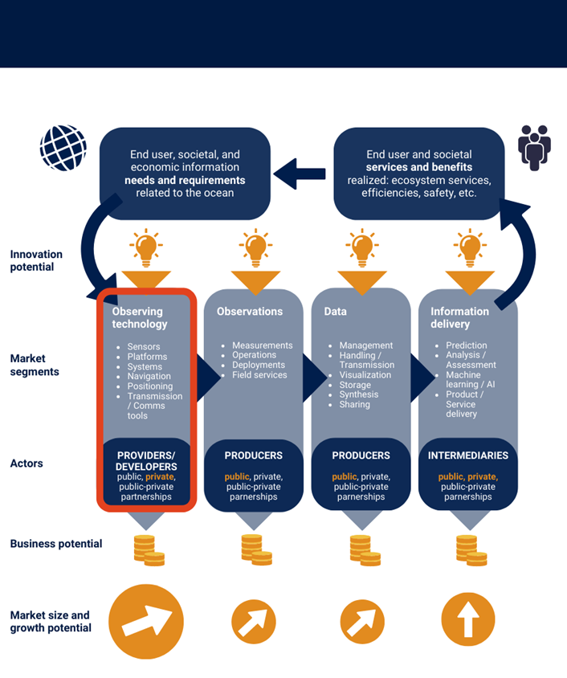
Notes:
Optional depending on if Zdenka wants to speak or speak to slides…

Slide 3
Dialogue 1: 14 September, 2022
Instrument Provision: Supply & Development of Sensors/ Platforms
Dialogue 2: 13 October, 2022
Multi-Sectoral Ocean Architecture: Integrating New Observing Networks and Business Models
Dialogue 3: 7 December, 2022
User Driven Ocean Information Services
Dialogue 4: 10 January, 2023
Looking Ahead: New Technology for the Ocean Decade

Slide 4
Key Take Aways Dialogue 1
Governments and intergovernmental organizations (e.g., GOOS) have a key role in developing frameworks, setting standards and information about requirements
Understanding and articulating the market size drives investment
Early engagement with commercial partners is critical for transitioning innovation from the public and academic sectors
Private companies have to make trade-offs between easy to use, affordable and high quality/precision in product development
Easy to use instruments cost more to develop
High potential for efficiency and cost savings in instrument and platform acquisition
Building and retaining the workforce is a major challenge
Opportunity for a new paradigm of data as a service and missions as a service
Appetite for sustained engagement
Notes:
Optional depending on if Zdenka wants to speak or speak to slides…

Slide 5
Key Take Aways Dialogue 2 - Preliminary
Investment in “blue” business hampered by lack of ocean data
Market size and maturity hampers investments in technology
Standards are important (hardware and data)
Different models for private networks have different barriers, and thus need different solutions
Licenses, models, and buying data from industry
How society views ocean data is of relevance for investment and licenses
Major opportunities in hybrid public/private observation network but there is risk
Aggregating demand – a roadmap for a hybrid system?
Create structures to facilitate dialogue
Notes:
Optional depending on if Zdenka wants to speak or speak to slides…

