Slide 1

Institut de Recherches Halieutiques et
Océanologiques du Bénin (IRHOB)
Benin National Report
DBCP– 38. Hybrid meeting. Geneva. Switzerland. 1-4 November 2022
Contact Details
Zacharie SOHOU, National DBCP Focal Point Benin
Biologist Oceanographer

Slide 2
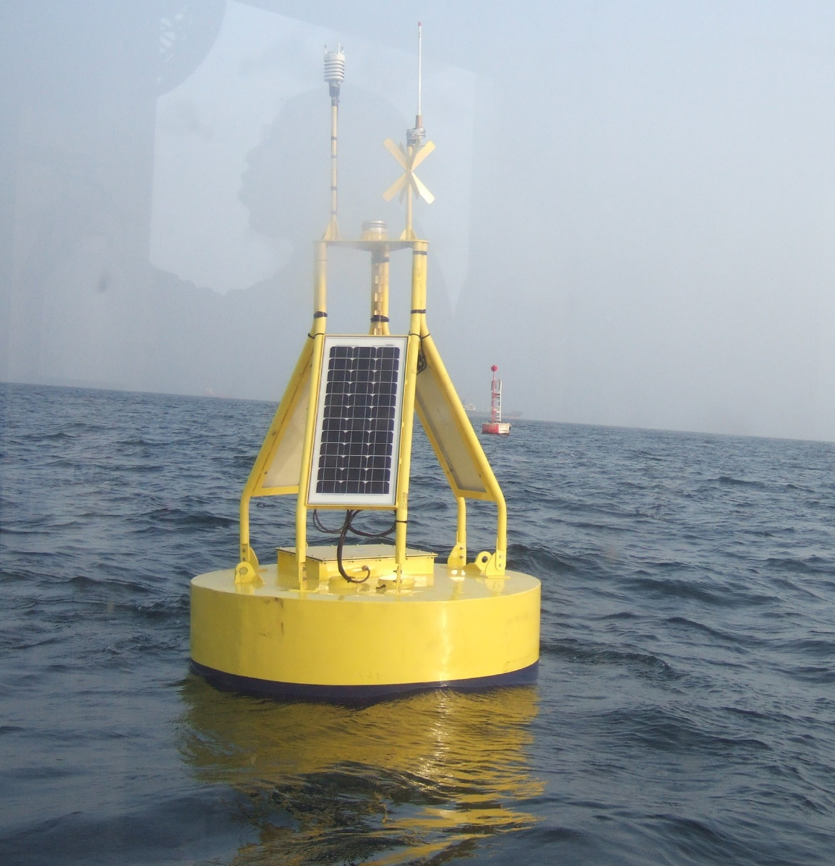
First oceanographic Data buoy in Benin
Contexte: The Early Warning System project, funded by the UNDP (SAP-Benin) Project Oceanographic Buoy
Buoy : ALIZE form Nortek Med
Oceanographic and Meteorologigical
stations
Powered by a solar panel

Slide 3
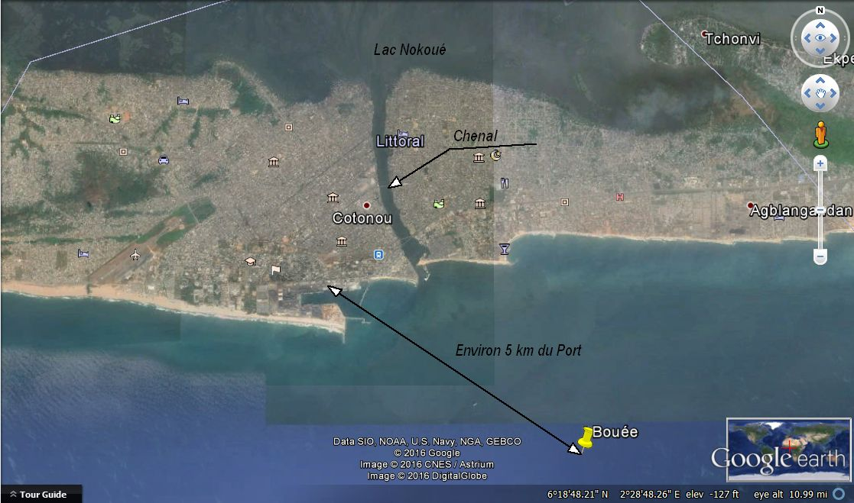
Buoy position
6°18.488’N, 2°28.46’E

Slide 4
Components of oceanographic buoy
Anchorage: about 6.3 km from the Cotonou Port Authority;
Coordinates : 6°18.488’N, 2°28.46’E
Start of recording: December 15. 2015
3 types of measurements (i.e. 3 stations):
1- Meteo data: interval: 10 min
Wind (Direction. Average Speed)
Humidity
Precipitation
2- Current meter: interval: 10 min
Surface temperature (1.5 m depth)
Turbidity
Current (Direction and Speed)
3- Central altitude: interval: 30 min
Swells (Significant Height. Direction and Peak Period)

Slide 5
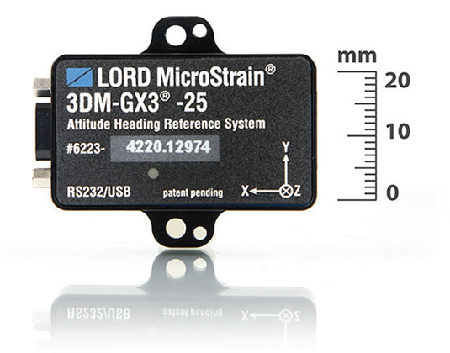
Wave sensor
3DM-GX3 -25
Miniature Attitude Heading Reference System

Slide 6
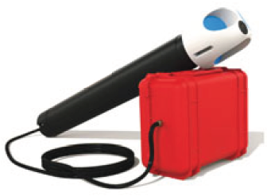
Profiler
The Nortek Aquadopp® Profiler is designed with flexibility in mind. It is small. easy to use. and works equally well in ocean. coastal. or river environments. From its introduction in 2000. the Aquadopp® Profiler has represented a completely new generation of current profilers.

Slide 7
Turbidity sensors
OBS-3+ et BS300 OB S-3A
The OBS-3+ and OBS300 use OBS® technology to measure suspended solids and turbidity up to 4000 NTU. Those are submersible sensors.

Slide 8
Meteorological Station at the top of the buoy
Vaisala Weather Transmitter WXT520
Access to real-time weather data

Slide 9
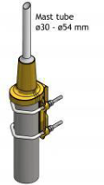
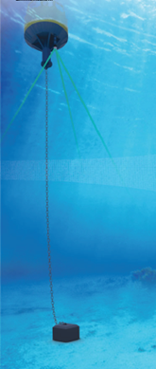
System at the sea. under water
Under the Buoy. the sensors
Antenna
Chain
Heavy body to keep the buoy at the bottom

Slide 10
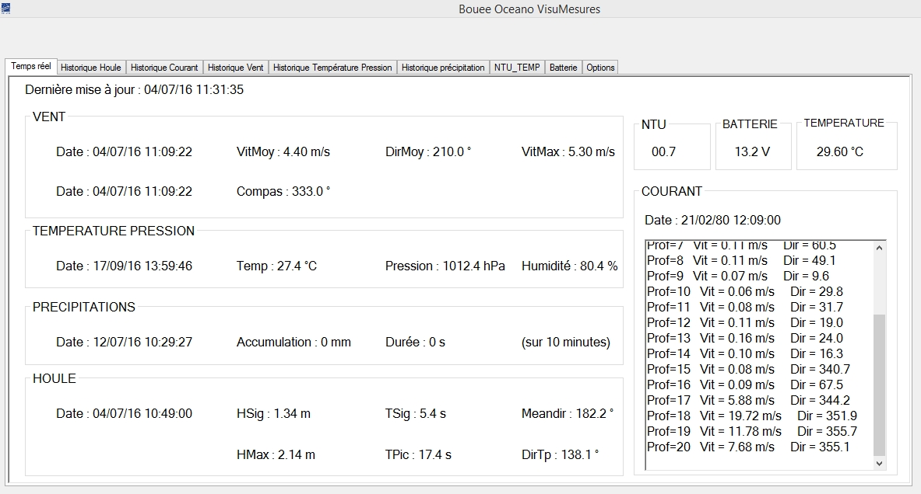
Output of Data on the interface receiver

Slide 11
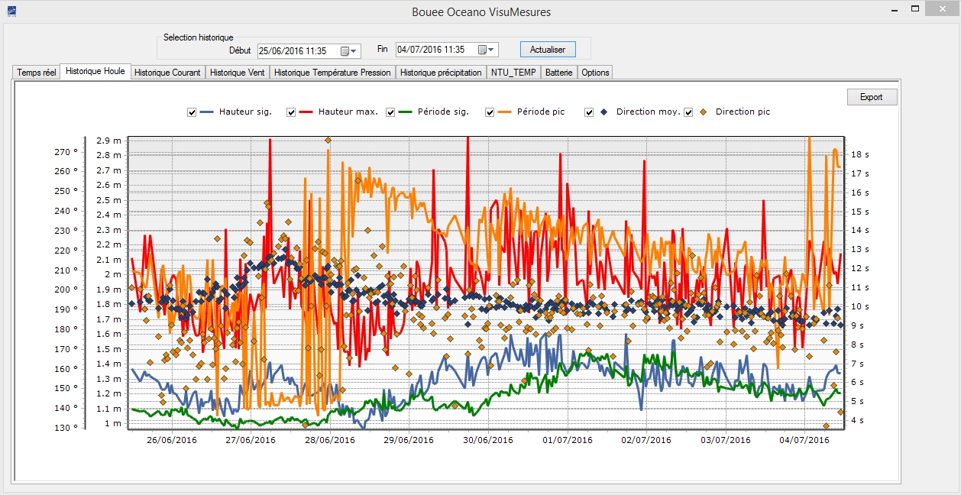
Output of Data on the interface receiver

Slide 12
The Swell (Significant Height Peak Period and Peak Direction)

Slide 13
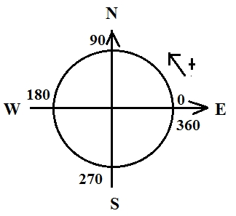
Evolution of Speed and Direction over time the wind
Min = 0.4
Moy = 4.2
Max = 9.6
Sector wind SW
(Dir Aver: 209 deg)

Slide 14
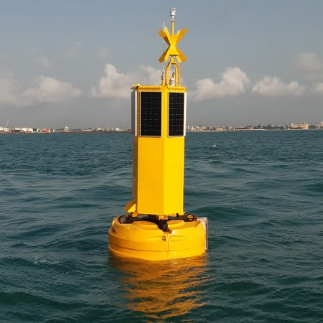
Buoy of Cotonou Port authority 2021
Buoy from Nobilis company
28/09/2020
Sensors available at the beginning:
- Temperature
- Current
Meteo station at the top
- Wind speed, direction,
- Humidity
- Pressure
Today Profiler was stolen

Slide 15
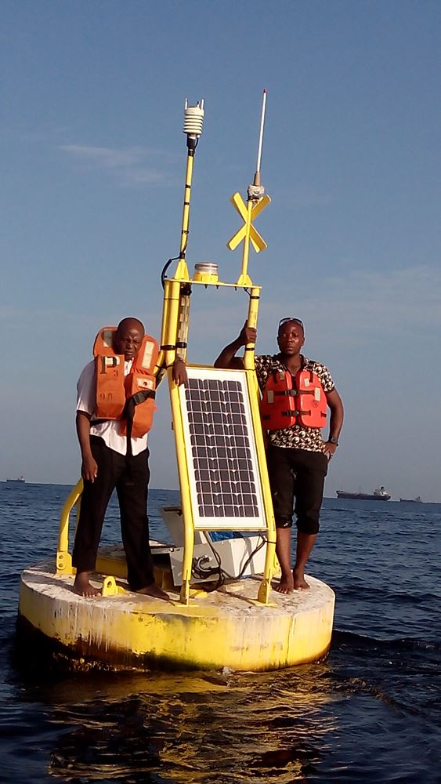
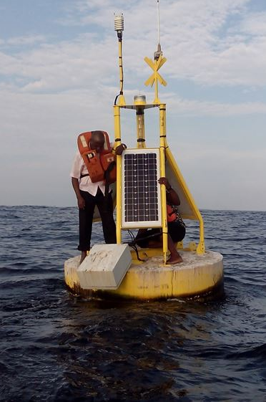
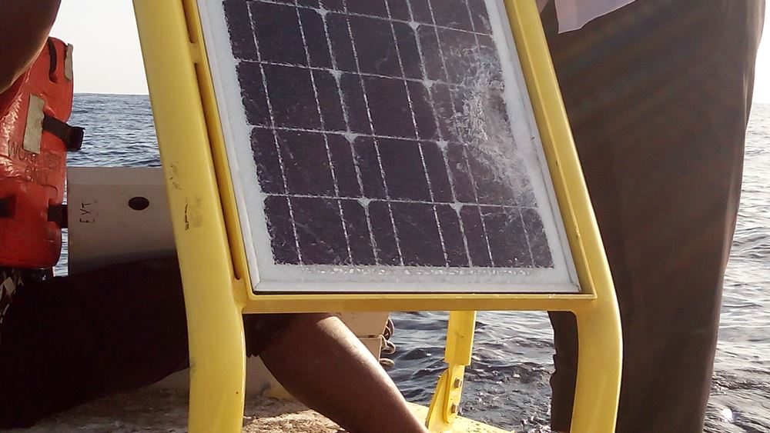
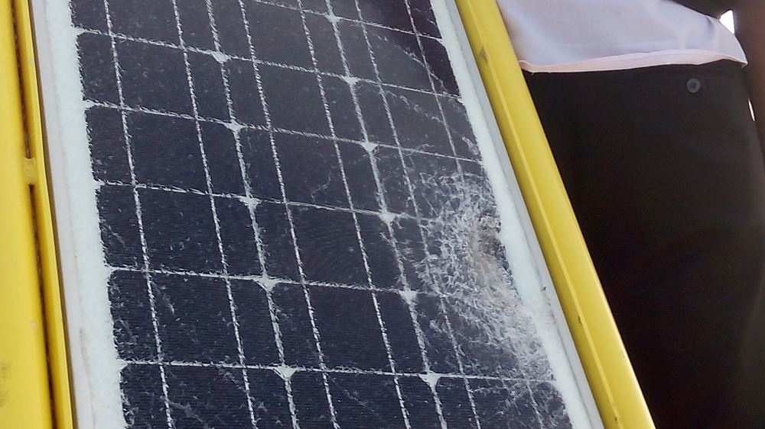
Challenges
Fishermen activities impacts

Slide 16
Importance of the buoy data
With the data collected we valided the model of forecasting;
Data used is used by masters and Ph.D. students in their reports and dissertations (hydrology/hydrography and oceanography)
Data was use by GMES & Africa project coordination at the University of Ghana to validate weather forecasting

Slide 17
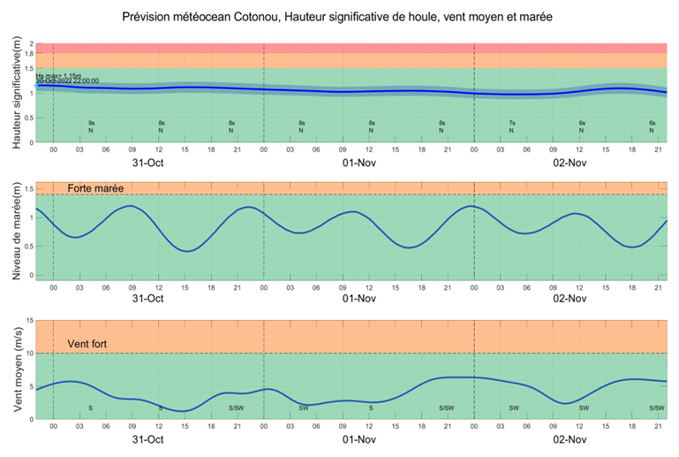
Importance of the buoy data
TOMAWAC model (EDF). The forcing of this model is provided by PREVIMER GLOBAL data.

Slide 18
Communities involvment: advantage
Information given to National Civil Protection Agency who in charge in national level share the information with local population and everbody in the country.
Fishermen should take care upon receive information on ocean state when going to the sea or they are not going at all.

Slide 19
Challenge
Equipements needs (sensors and new buoy); maitenance?
Capacity Development for Marine Science and Technology and Ocean Literacy
Continuous Professional Development (Focused workshops, Regional Training Centres, Fellowships,
Develop essential capacities and skills in Africa related to ocean science with a focus on scientific and technical skills of Early Career Ocean Professionals;
Implementation of Regional and International collaboration on joint project
Lak or Insufficient of funds for project implementation
Data sharing
Covid negatively impacts our activities.

Slide 20
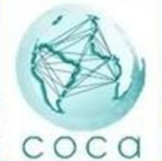
Some initiatives on the buoy network
Coastal Observatory for Climate, CO2 and Acidification in the Atalnto-Pacific: COCAS
The COCA project is based on a core of seven existing buoy-stations and their laboratories (France. Canary Islands. Morocco. Senegal. Benin. Brazil. Argentina) and two others planned (Colombia. Peru). In the future. COCA shall extend to more less-equipped coastal productivity hot spots (e.g.. Namibia).

Slide 21
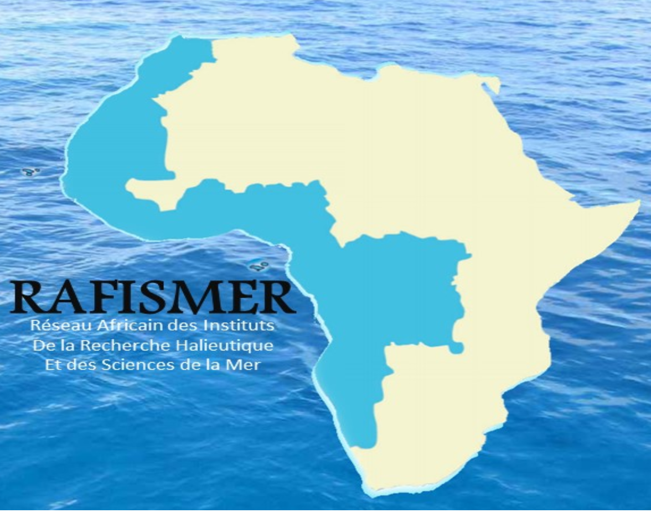
Some initiatives on the buoy network
African Network of Fisheries Research and Marine Science Institutes (RAFISMER), leaded by Maroc
Objectives: permanent organization for reflection, consultation and cooperation in fisheries research and marine sciences, which has the following Specific objectives:
promote scientific research in collaboration with similar sub-regional, regional and international organizations;
strengthen cooperation between African research institutions;
strengthen skills in the fields of scientific and technological research in the field of fisheries and marine sciences;
disseminate research results to different users in the most appropriate form;
improve the training of researchers from members countries.

Slide 22
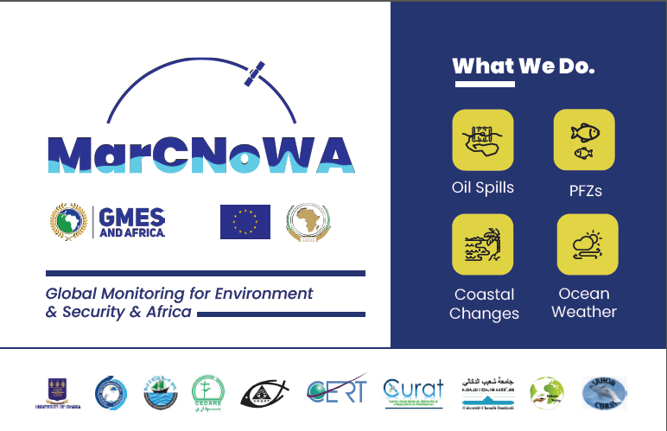
Marine & Coastal Areas Management in North and West Africa (MarCNoWa)

Slide 23
UG-GMES External Communication
Stakeholders
All activities within the project
Results and outcomes of activities
Target groups
How the various partners are benefiting from the project
The role of EO in sustainable management of marine and coastal areas
Final Beneficiaries
Services impacting on social, economical and environmental life
Towards Sustainable Development Goals

Slide 24
Address to DBCP
Capacity building for the youth formal or/and License, Master and Ph. D degree
Implementation of regional project using low cost equipment
Involvement in the existing project
And/or
What suggestions do you have for the DBCP?:
  To allow individual person to become member, if possible

Slide 25
Thank you!

