Slide 1
Task Team Environmental Stewardship
Chair: Karen Grissom
DBCP-38, 1-4 November 2022

Slide 2
1. Statistics
How many meetings did you have this year ? – 2 with team and 2 with others
How many actions do you have ? 3 (membership, connections, baseline)
How many actions have been completed? All 3 are progressing, 1 will be complete this spring and 2 will be ongoing
How many will be completed next year ? 1 (baseline)
How many actions have not progressed ? 0
How many new actions have been added? 1 (best practices)

Slide 3
2. Alignment to DBCP strategy*
Pillar: Environmental Stewardship, Technology Innovations, Scientific and Operational Excellence
Actions: Work with our ocean observing network partners to baseline and continuously review our environmental impact.; Encourage research and development activities which are prioritized to meet defined user needs; Adopt, define, and promote best practice in the lifecycle
3. Success: Baseline complete; new green tech, best practices available
* refer to the DBCP Strtegy

Slide 4
3. Key highlights this year*
Met with materials researcher about developing bio-degradable sensors (XBT, etc)
Publicity through poster at Sea Tech Week
Baseline survey near complete and ready to be released

Slide 5
4. Key focus areas for next year
Complete baseline
Build membership & awareness
Best practices

Slide 6
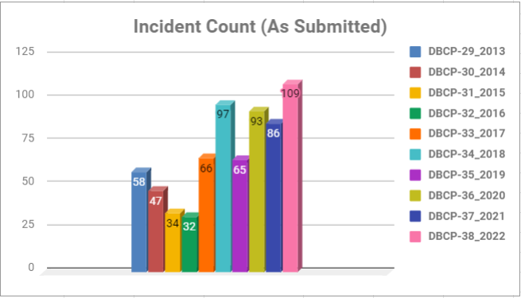
Overall Incident Count
Reporting Period:
1 August – 31 July
*Note: Variability in Incident Count is largely attributable to available resources and enhanced detection and documentation capabilities in recent years

Slide 7
5. Key take-home messages*
Contribute to growing awareness and momentum within community
DBCP can include ES in discussions, meeting, need people to start thinking about it as a SOP

Slide 8
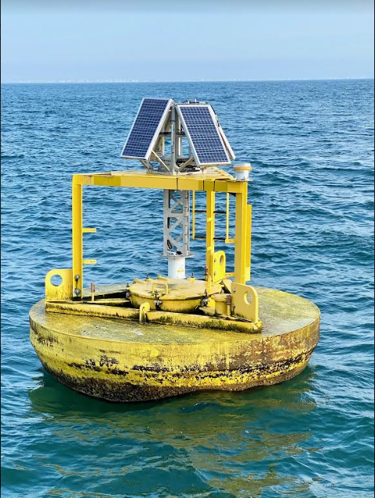
Working Group Vandalism
Chair: Karen Grissom
DBCP-38, 1-4 November 2022
Vandalism Cartoon 11 versions

Slide 9
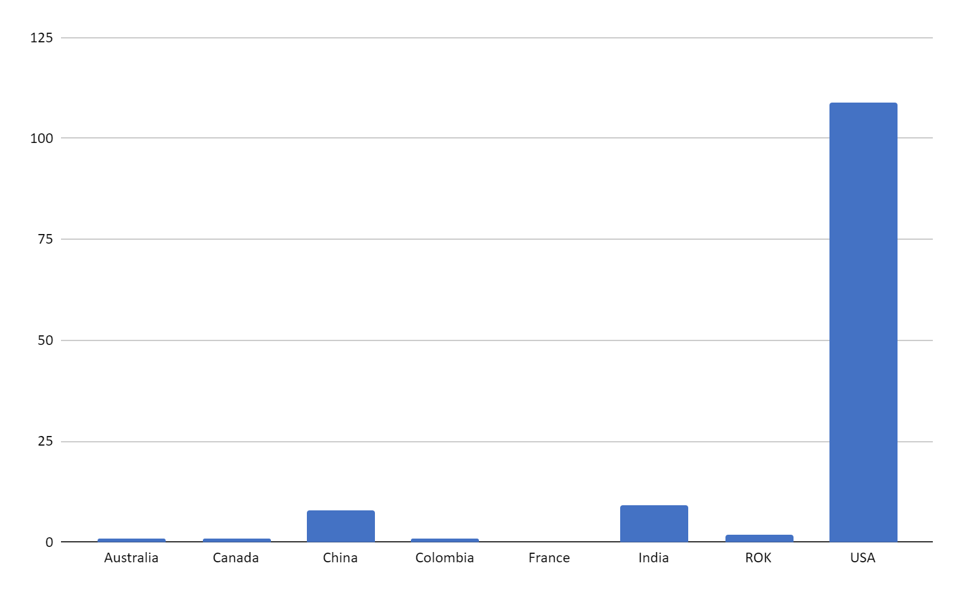
3. Key highlights this year*
Met with materials researcher about developing bio-degradable sensors (XBT, etc)
Publicity through poster at Sea Tech Week
Baseline survey near complete and ready to be released

Slide 10
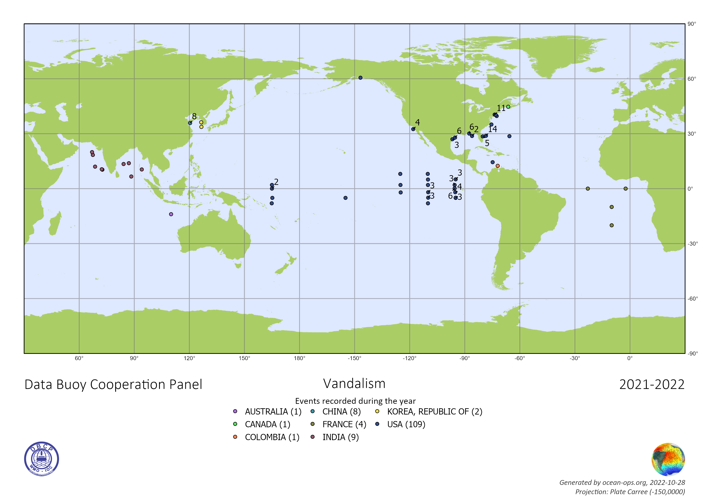
3. Key highlights this year*

Slide 11
US Overall Incidents Count

Slide 12
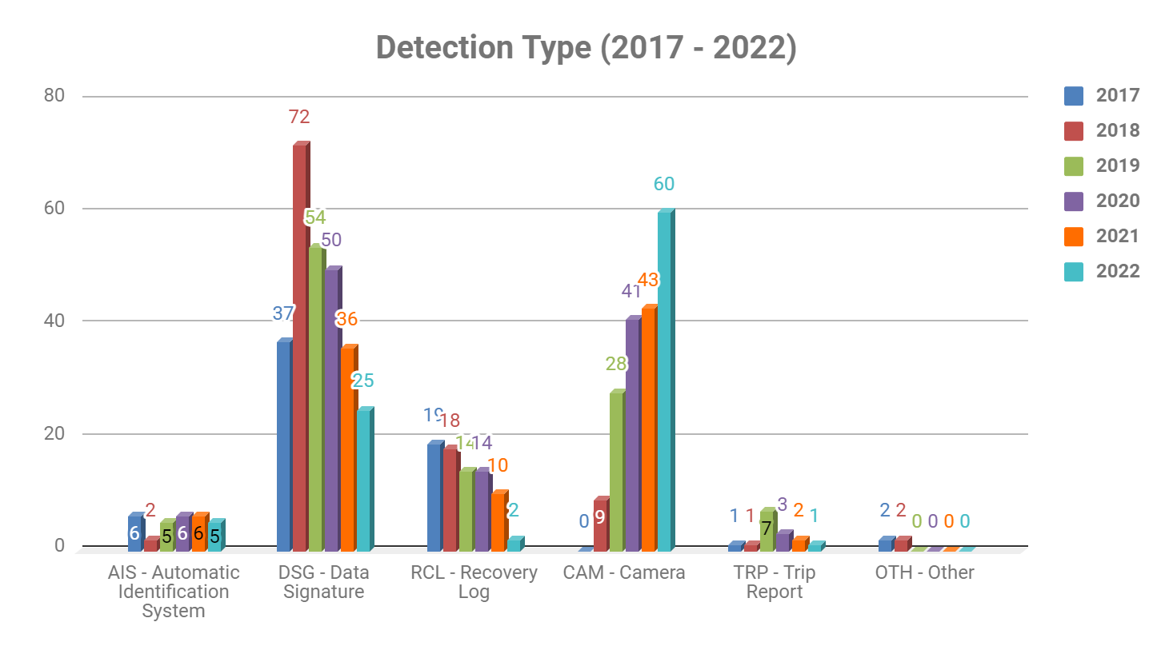
Incidents by Detection Type

